Slide 1


Slide 2
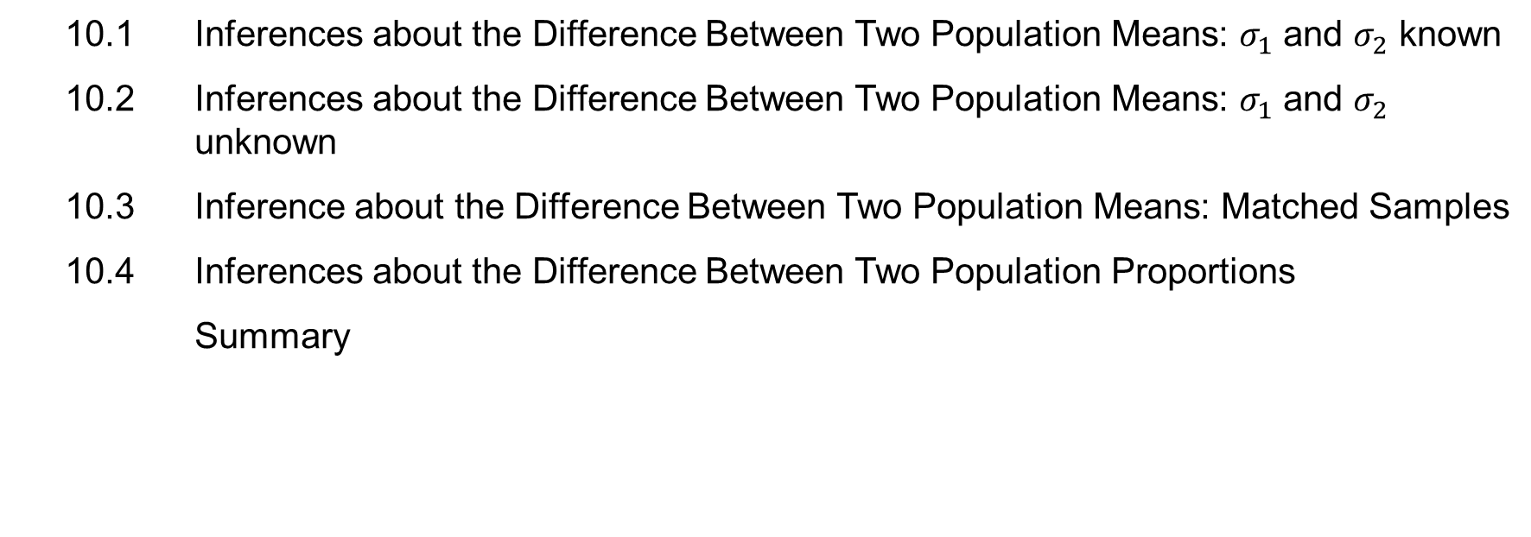
Chapter Contents
10.1 Inferences about the Difference Between Two Population Means: $σ_{1}$ and $σ_{2}$ known
10.2 Inferences about the Difference Between Two Population Means: $σ_{1}$ and $σ_{2}$ unknown
10.3 Inference about the Difference Between Two Population Means: Matched Samples
10.4 Inferences about the Difference Between Two Population Proportions
Summary

Slide 3
Chapter Objectives (1 of 2)
After completing this chapter, you will be able to:
LO 10-1 Describe and explain the distribution form and parameters of the sampling distribution of the difference between the sample means of two different populations.
LO 10-2 Calculate and interpret the interval estimate at a given level of confidence for a difference between two population means when the standard deviations of the two populations are known.
LO 10-3 Conduct a hypothesis test about the difference between two population means when the standard deviations of the two populations are known.
LO 10-4 Calculate and interpret the interval estimate at a given level of confidence for a difference between two population means when the standard deviations of the two populations are unknown.
LO 10-5 Conduct a hypothesis test about the difference between two population means when the standard deviations of the two populations are unknown.

Slide 4
Chapter Objectives (2 of 2)
LO 10-6 Conduct a hypothesis test about the difference between two population means when using a matched sample design.
LO 10-7 Calculate and interpret the interval estimate at a given level of confidence for a difference between two population means when using a matched sample design.
LO 10-8 Describe and explain the distribution form and parameters of the sampling distribution of the difference between the sample proportions of two different populations.
LO 10-9 Calculate and interpret the interval estimate at a given level of confidence for a difference between two population proportions.
LO 10-10 Conduct a hypothesis test about the difference between two population proportions.

Slide 5
Introduction
In this chapter, we extend the discussion of statistical inference by developing interval estimates and conducting hypothesis tests for situations involving the difference between two population means or two population proportions.
For example, we may want to
Develop an interval estimate of the difference in mean starting salary between a population of males and a population of females.
Conduct a hypothesis test to determine whether there is a difference in the proportion of defective parts between the populations of parts produced by two suppliers.
We begin our discussion of inference about the difference between two population means by first considering the case of population standard deviations assumed known, and then repeating the process for the case of population standard deviations assumed unknown.
Finally, we consider the inference of the difference between two population means when using a matched sample design and the difference between two population proportions.

Slide 6
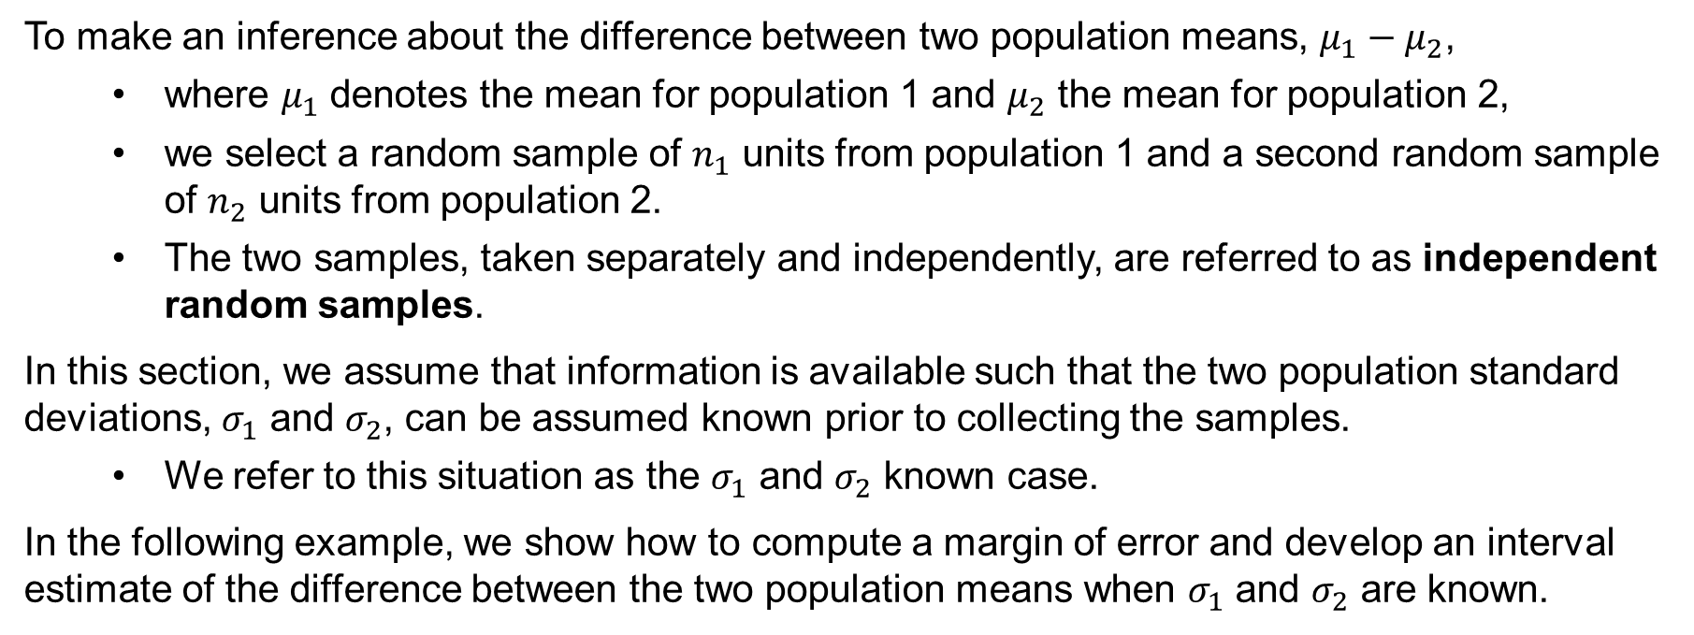

10.1 Inferences about the Difference Between Two Population Means: $σ_{1}$ and $σ_{2}$ Known
To make an inference about the difference between two population means, $μ_{1}−μ_{2}$,
where $μ_{1}$ denotes the mean for population 1 and $μ_{2}$ the mean for population 2,
we select a random sample of $n_{1}$ units from population 1 and a second random sample of $n_{2}$ units from population 2.
The two samples, taken separately and independently, are referred to as independent random samples.
In this section, we assume that information is available such that the two population standard deviations, $σ_{1}$ and $σ_{2}$, can be assumed known prior to collecting the samples.
We refer to this situation as the $σ_{1}$ and $σ_{2}$ known case.
In the following example, we show how to compute a margin of error and develop an interval estimate of the difference between the two population means when $σ_{1}$ and $σ_{2}$ are known.

Slide 7
10.1 Interval Estimation of $μ_{1}−μ_{2}$: $σ_{1}$ and $σ_{2}$ Known
The interval estimate of the difference between two population means ($μ_{1}−μ_{2}$), when $σ_{1}$ and $σ_{2}$ are known, can be written as follows.
$${\overline{x}}_{1}−{\overline{x}}_{2}±z_{α/2}σ_{{\overline{x}}_{1}−{\overline{x}}_{2}}$$
Where
$${\overline{x}}_{1}−{\overline{x}}_{2} \text{is} \text{the} \text{point} \text{estimator} \text{of} μ_{1}−μ_{2}$$
$1−α \text{is} \text{the} \text{confidence} \text{coefficient}$
$z_{α/2} \text{is} \text{the} \text{critical} \text{value} \text{such} \text{that} P\left(z≥z_{α/2}\right)=1−α/2$
$$σ_{{\overline{x}}_{1}−{\overline{x}}_{2}}=\sqrt{\frac{σ_{1}^{2}}{n_{1}}+\frac{σ_{2}^{2}}{n_{2}}} \text{is} \text{the} \text{standard} \text{error} \text{of} {\overline{x}}_{1}−{\overline{x}}_{2}\text{ (∗}\text{see} \text{notes}\text{)}$$
$$z_{α/2}σ_{{\overline{x}}_{1}−{\overline{x}}_{2}} \text{is} \text{the} \text{margin} \text{of} \text{error}$$
Notes:
*Note: If both populations have a normal distribution, or if the sample sizes are large enough that the central limit theorem enables us to conclude that the sampling distributions of ${\overline{x}}_{1}$ and ${\overline{x}}_{2}$ can be approximated by a normal distribution, the sampling distribution of ${\overline{x}}_{1}−{\overline{x}}_{2}$ will have a normal distribution with mean given by $μ_{1}−μ_{2}$.

Slide 8
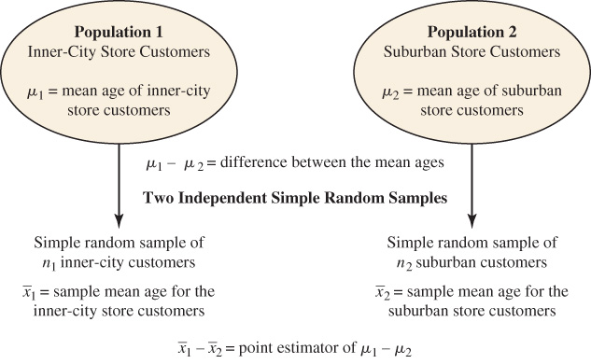
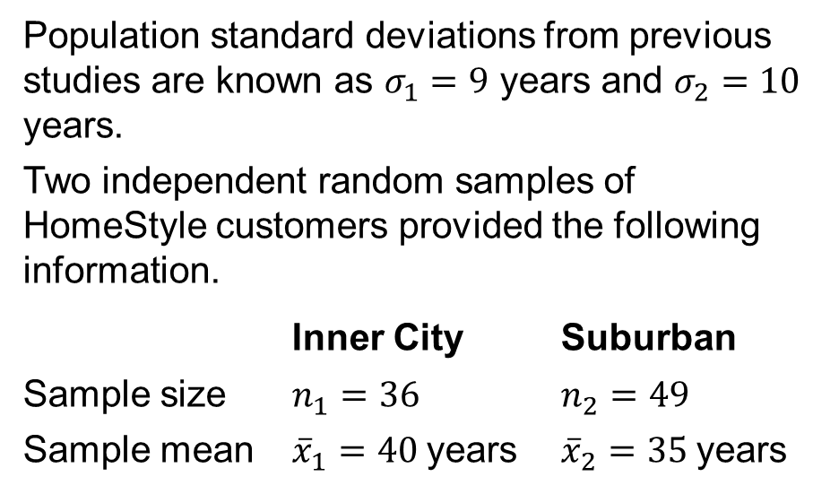
10.1 The HomeStyle Furniture Stores Example
DATAfile: homestyle_mod
The regional manager at HomeStyle furniture stores wants to investigate the difference between the mean ages of the customers who shop at two of their stores, one in the inner-city (index 1) and one in a suburban area (index 2.)
Population standard deviations from previous studies are known as $σ_{1}=9$ years and $σ_{2}=10$ years.
Two independent random samples of HomeStyle customers provided the following information.
Inner City Suburban
Sample size $n_{1}=36$ $n_{2}=49$
Sample mean ${\overline{x}}_{1}=40 \text{years}$ ${\overline{x}}_{2}=35 \text{years}$

Slide 9
10.1 Interval Estimate of the Difference Between the Mean Ages at HomeStyle Furniture Stores
The point estimate of the difference between the two population mean ages is
$${\overline{x}}_{1}−{\overline{x}}_{2}=40−35=5 \text{years}$$
The standard error of ${\overline{x}}_{1}−{\overline{x}}_{2}$ is
$$σ_{{\overline{x}}_{1}−{\overline{x}}_{2}}=\sqrt{\frac{σ_{1}^{2}}{n_{1}}+\frac{σ_{2}^{2}}{n_{2}}}=\sqrt{\frac{9^{2}}{36}+\frac{{10}^{2}}{49}}=2.07 \text{years}$$
Using 95% confidence and $z_{α/2}=z_{.025}=1.96$, we have
$${\overline{x}}_{1}−{\overline{x}}_{2}±z_{α/2}σ_{{\overline{x}}_{1}−{\overline{x}}_{2}}=5±1.96\left(2.07\right)=5±4.06 \text{years}$$
Thus, the margin of error is 4.06 years, and the 95% confidence interval estimate of the difference between the two population means is $5−4.06=0.94 \text{years}$ to $5+4.06=9.06 \text{years}$.

Slide 10
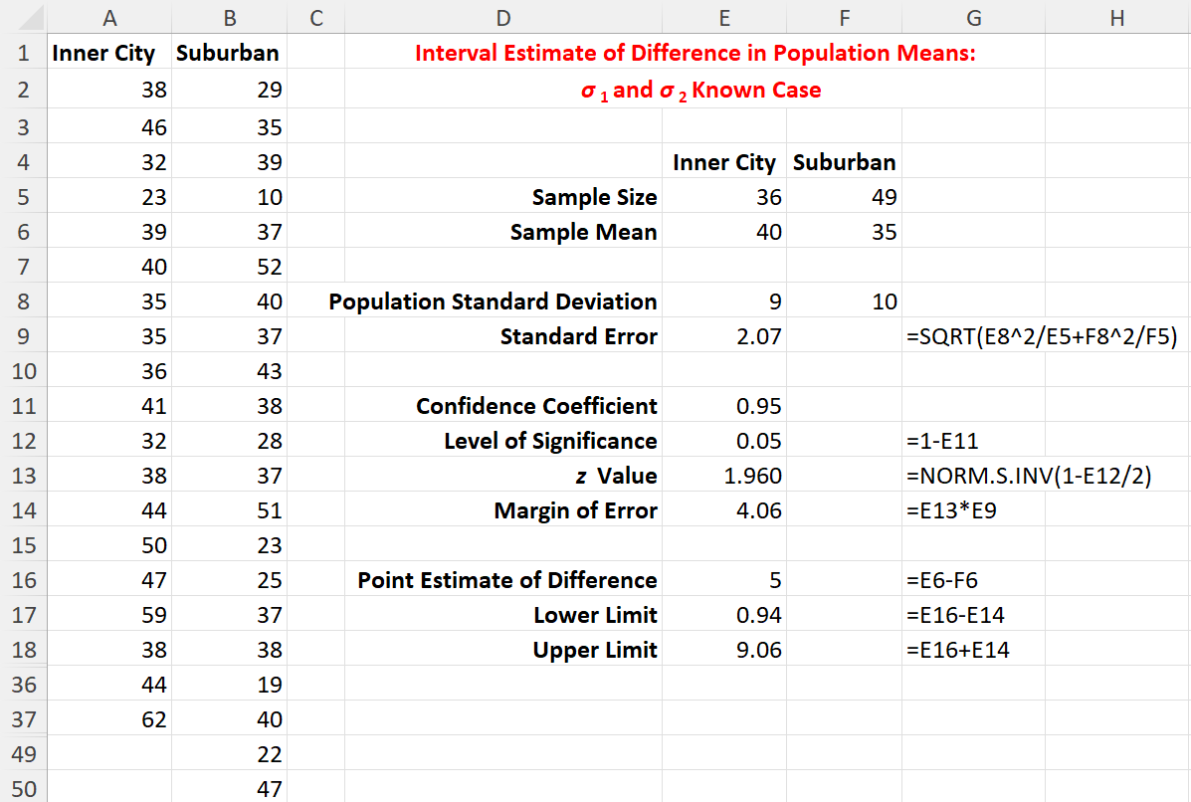
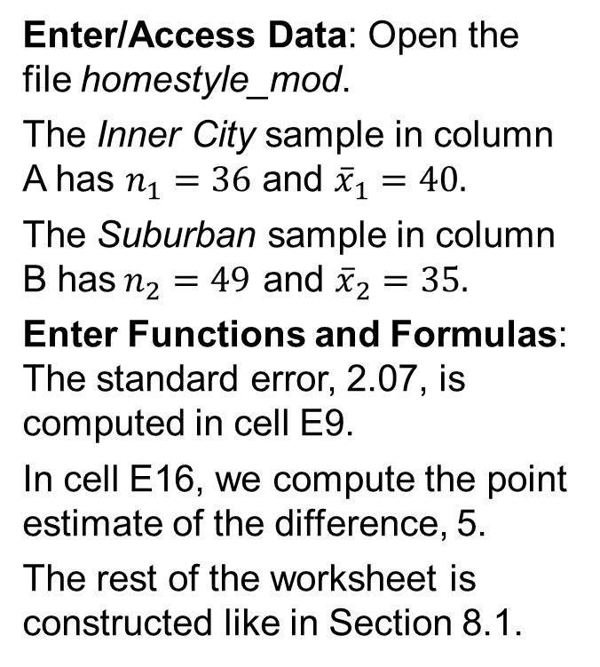
10.1 Excel: Construct a 95% Confidence Interval
Enter/Access Data: Open the file homestyle_mod.
The Inner City sample in column A has $n_{1}=36$ and ${\overline{x}}_{1}=40.$
The Suburban sample in column B has$n_{2}=49$ and ${\overline{x}}_{2}=35.$
Enter Functions and Formulas: The standard error, 2.07, is computed in cell E9.
In cell E16, we compute the point estimate of the difference, 5.
The rest of the worksheet is constructed like in Section 8.1.

Slide 11
10.1 Hypothesis Tests About $μ_{1}−μ_{2}$
In general, a hypothesis test about the difference between two population means ($μ_{1}−μ_{2}$) must take one of the following three forms.
Where $D_{0}$ denotes the hypothesized difference between $μ_{1}$ and $μ_{2}$.
Using the two-tailed test as an example, when $D_{0}=0$, as it is in most cases, the null hypothesis is $H_{0}:μ_{1}−μ_{2}=0$. In this case, the null hypothesis is that $μ_{1}$ and $μ_{2}$ are equal.
The rejection of $H_{0}$ leads to the conclusion that $H_{a}:μ_{1}−μ_{2}≠0$ is true; that is, $μ_{1}$ and $μ_{2}$are not equal.
One-tailed (Lower-tail) | One-tailed (Upper-tail) | Two-tailed
$$H_{0}:μ_{1}−μ_{2}≥D_{0}$$ | $$H_{0}:μ_{1}−μ_{2}≤D_{0}$$ | $$H_{0}:μ_{1}−μ_{2}=D_{0}$$
$$H_{a}:μ_{1}−μ_{2}<D_{0}$$ | $$H_{a}:μ_{1}−μ_{2}>D_{0}$$ | $$H_{a}:μ_{1}−μ_{2}≠D_{0}$$

Slide 12
10.1 Test Statistic for Hypothesis Tests About $μ_{1}−μ_{2}$: $σ_{1}$ and $σ_{2}$ Known
When the sample sizes are large enough, the distribution of ${\overline{x}}_{1}−{\overline{x}}_{2}$ can be described by a normal distribution (*see notes.)
In this case, the test statistic for the difference between two population means ($μ_{1}−μ_{2}$), when $σ_{1}$ and $σ_{2}$ are known, can be written as
$$z=\frac{\left({\overline{x}}_{1}−{\overline{x}}_{2}\right)−D_{0}}{σ_{{\overline{x}}_{1}−{\overline{x}}_{2}}}$$
Where
$${\overline{x}}_{1}−{\overline{x}}_{2} \text{is} \text{the} \text{point} \text{estimator} \text{of} μ_{1}−μ_{2}$$
$D_{0}$ is the hypothesized difference between $μ_{1}$ and $μ_{2}$
$$σ_{{\overline{x}}_{1}−{\overline{x}}_{2}}=\sqrt{\frac{σ_{1}^{2}}{n_{1}}+\frac{σ_{2}^{2}}{n_{2}}} \text{is} \text{the} \text{standard} \text{error} \text{of} {\overline{x}}_{1}−{\overline{x}}_{2}$$
Notes:
*Note: In most applications of the interval estimation and hypothesis testing procedures presented in this section, random samples with n₁≥30 and n₂≥30 are adequate. In cases where either or both sample sizes are less than 30, the distributions of the populations become important considerations. In general, with smaller sample sizes, it is more important for the analyst to be satisfied that it is reasonable to assume that the distributions of the two populations are at least approximately normal.

Slide 13
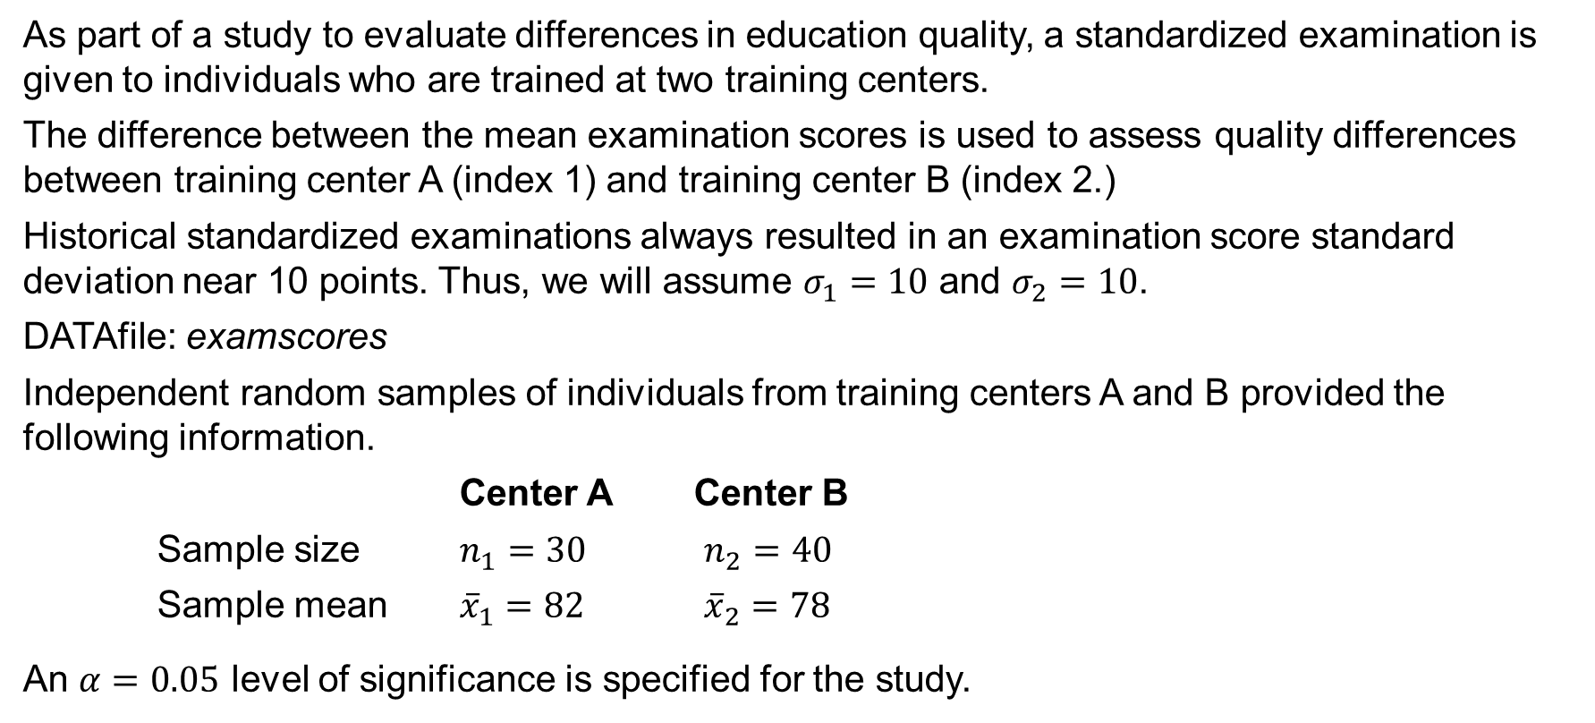
10.1 A Quality Assessment of Two Training Centers
As part of a study to evaluate differences in education quality, a standardized examination is given to individuals who are trained at two training centers.
The difference between the mean examination scores is used to assess quality differences between training center A (index 1) and training center B (index 2.)
Historical standardized examinations always resulted in an examination score standard deviation near 10 points. Thus, we will assume $σ_{1}=10$ and $σ_{2}=10$.
DATAfile: examscores
Independent random samples of individuals from training centers A and B provided the following information.
Center A Center B
Sample size $n_{1}=30$ $n_{2}=40$
Sample mean ${\overline{x}}_{1}=82$ ${\overline{x}}_{2}=78$
An $α=0.05$ level of significance is specified for the study.

Slide 14
10.1 A Two-Tailed Test About $μ_{1}−μ_{2}$: $σ_{1}$ and $σ_{2}$ Known
We begin with the tentative assumption that no difference exists between the training quality provided at the two centers. Hence, the null hypothesis is that $μ_{1}−μ_{2}=0$, and its rejection leads to the conclusion that a quality differential exists between center A and center B.
$$H_{0}:μ_{1}−μ_{2}=0$$
$H_{a}:μ_{1}−μ_{2}≠0$
Calculations of the test statistic follow.
$$z=\frac{\left({\overline{x}}_{1}−{\overline{x}}_{2}\right)−D_{0}}{σ_{{\overline{x}}_{1}−{\overline{x}}_{2}}}=\frac{\left(82−78\right)−0}{\sqrt{{{10}^{2}}/{30}+{{10}^{2}}/{40}}}=1.66$$
The p-value for a two-tailed test is: $p\text{−}\text{value}=2P\left(z≥1.66\right)=2[1−P\left(z<1.66\right)]=0.0970$
Thus, because $p\text{−}\text{value}>α$, we cannot reject $H_{0}$. The sample results do not provide sufficient evidence to conclude that the training centers differ in quality.

Slide 15
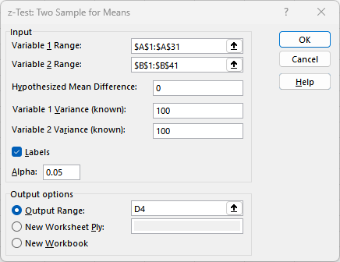
10.1 Excel: Dialog Box for z-Test: Two Sample for Means Tool
Enter/Access Data: Open the file examscores.
Apply Tools: Follow these steps in the z-Test: Two Sample for Means dialog box.
Step 1. Click the Data tab on the Ribbon
Step 2. In the Analyze group, click Data Analysis
Step 3. Choose z-Test: Two Sample for Means from the list of Analysis Tools
Step 4. In the dialog box:
Enter A1:A31 in the Variable 1 Range: box
Enter B1:B41 in the Variable 2 Range: box
Enter 0 in the Hypothesized Mean Diff.: box
Enter 100 in the Variable 1 Variance (known): and Variable 2 Variance (known): boxes
Select the check box for Labels
Select Output Range: and enter D4 in the box
Click OK

Slide 16
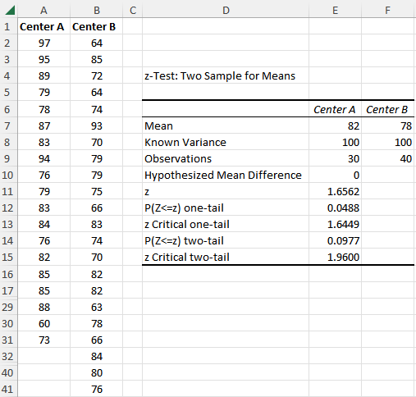
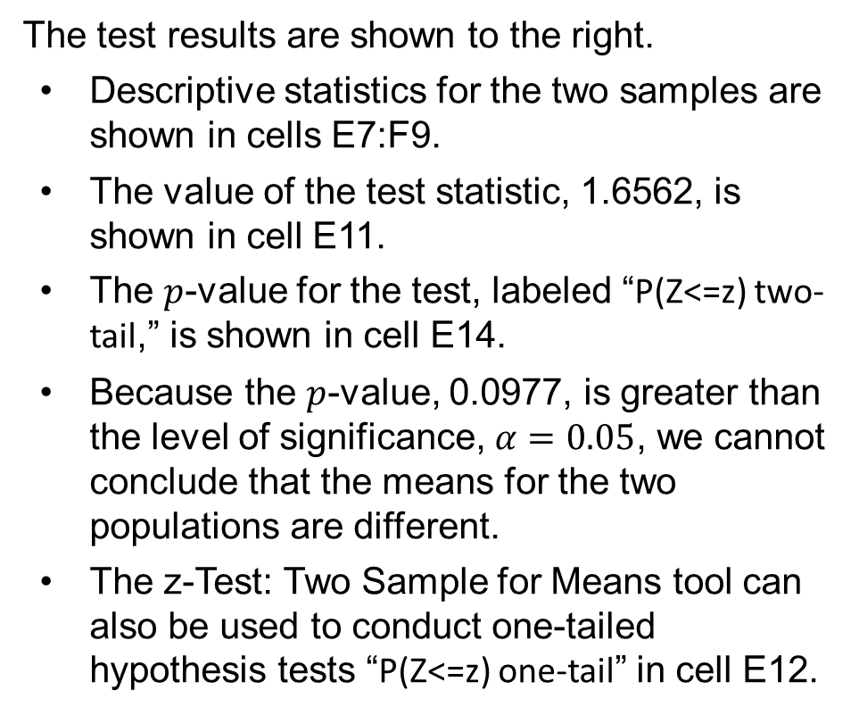
10.1 Excel: Conduct a Hypothesis Test
The test results are shown to the right.
Descriptive statistics for the two samples are shown in cells E7:F9.
The value of the test statistic, 1.6562, is shown in cell E11.
The $p$-value for the test, labeled “P(Z<=z) two-tail,” is shown in cell E14.
Because the $p$-value, 0.0977, is greater than the level of significance, $α=0.05$, we cannot conclude that the means for the two populations are different.
The z-Test: Two Sample for Means tool can also be used to conduct one-tailed hypothesis tests “P(Z<=z) one-tail” in cell E12.

Slide 17
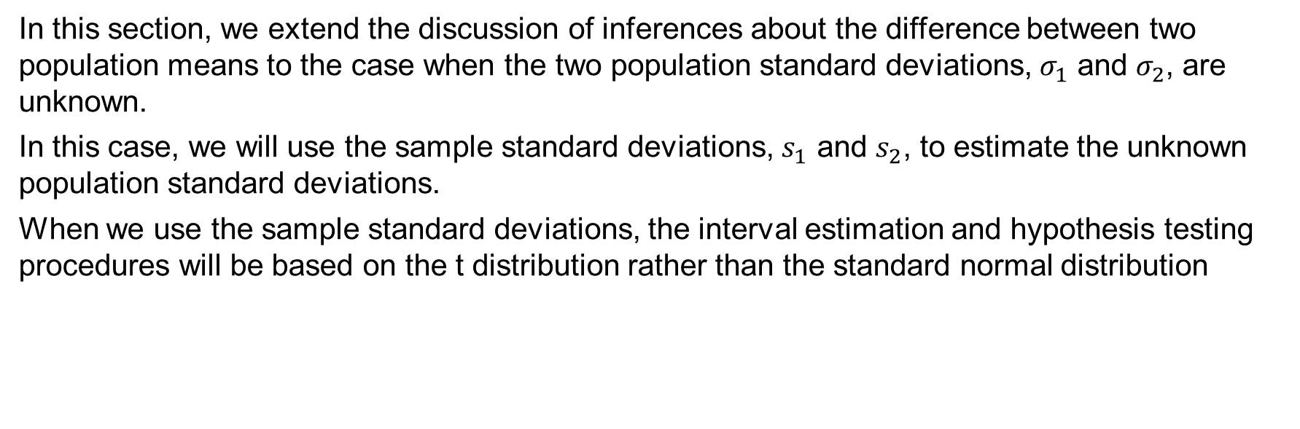

10.2 Inferences about the Difference Between Two Population Means: $σ_{1}$ and $σ_{2}$ Unknown
In this section, we extend the discussion of inferences about the difference between two population means to the case when the two population standard deviations, $σ_{1}$ and $σ_{2}$, are unknown.
In this case, we will use the sample standard deviations, $s_{1}$ and $s_{2}$, to estimate the unknown population standard deviations.
When we use the sample standard deviations, the interval estimation and hypothesis testing procedures will be based on the t distribution rather than the standard normal distribution

Slide 18
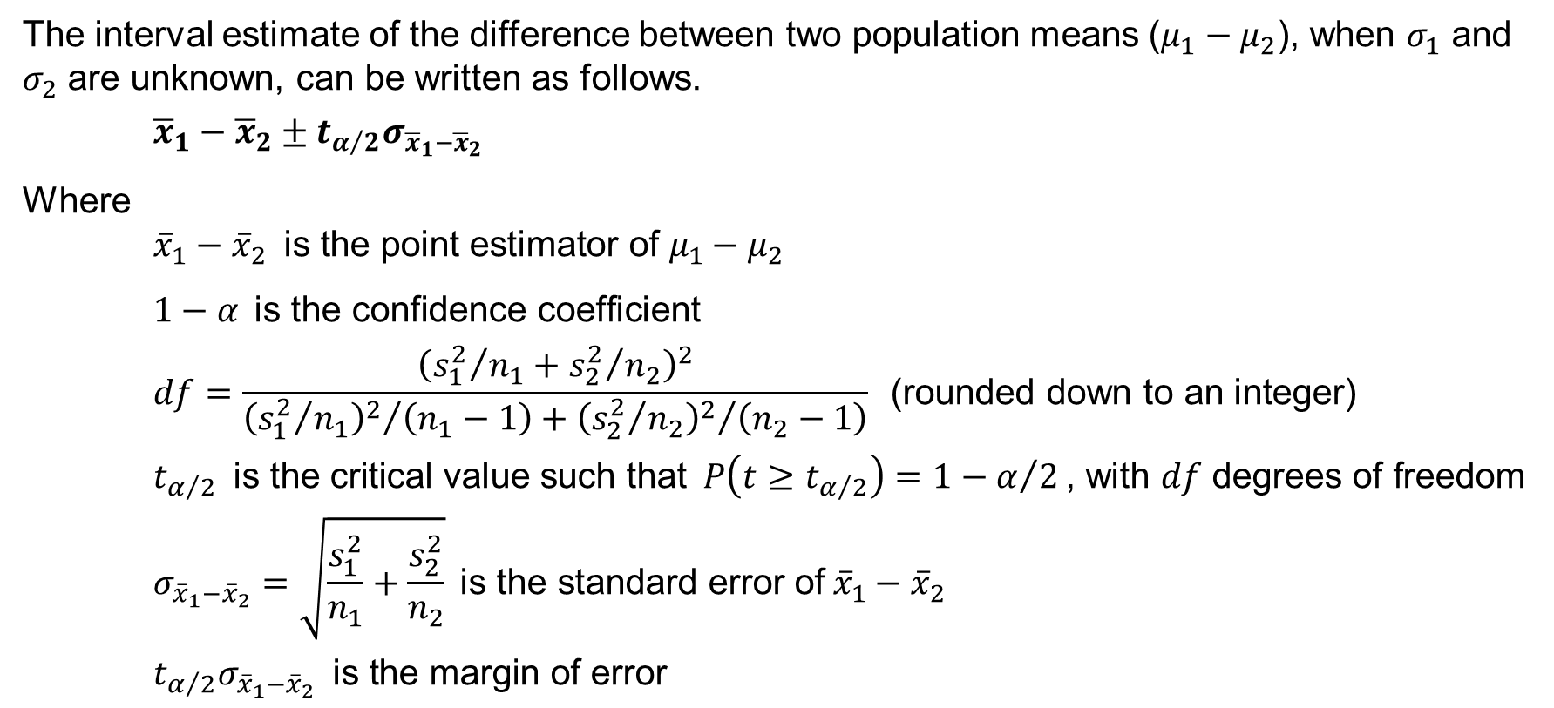
10.2 Interval Estimation of $μ_{1}−μ_{2}$: $σ_{1}$ and $σ_{2}$ Unknown
The interval estimate of the difference between two population means ($μ_{1}−μ_{2}$), when $σ_{1}$ and $σ_{2}$ are unknown, can be written as follows.
$${\overline{x}}_{1}−{\overline{x}}_{2}±t_{α/2}σ_{{\overline{x}}_{1}−{\overline{x}}_{2}}$$
Where
$${\overline{x}}_{1}−{\overline{x}}_{2} \text{is} \text{the} \text{point} \text{estimator} \text{of} μ_{1}−μ_{2}$$
$1−α \text{is} \text{the} \text{confidence} \text{coefficient}$
$$df=\frac{{\left({s_{1}^{2}}/{n_{1}}+{s_{2}^{2}}/{n_{2}}\right)}^{2}}{{{\left({s_{1}^{2}}/{n_{1}}\right)}^{2}}/{\left(n_{1}−1\right)}+{{\left({s_{2}^{2}}/{n_{2}}\right)}^{2}}/{\left(n_{2}−1\right)}} \text{(}\text{rounded} \text{down} \text{to} \text{an} \text{integer}\text{)}$$
$$t_{α/2} \text{is} \text{the} \text{critical} \text{value} \text{such} \text{that} P\left(t≥t_{α/2}\right)=1−α/2\text{, }\text{with} df \text{degrees} \text{of} \text{freedom}$$
$$σ_{{\overline{x}}_{1}−{\overline{x}}_{2}}=\sqrt{\frac{s_{1}^{2}}{n_{1}}+\frac{s_{2}^{2}}{n_{2}}} \text{is} \text{the} \text{standard} \text{error} \text{of} {\overline{x}}_{1}−{\overline{x}}_{2}$$
$$t_{α/2}σ_{{\overline{x}}_{1}−{\overline{x}}_{2}} \text{is} \text{the} \text{margin} \text{of} \text{error}$$

Slide 19
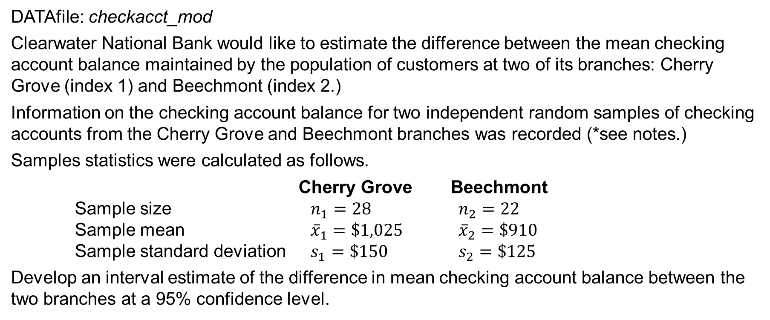
10.2 A Checking Account Balance Study at Clearwater National Bank
DATAfile: checkacct_mod
Clearwater National Bank would like to estimate the difference between the mean checking account balance maintained by the population of customers at two of its branches: Cherry Grove (index 1) and Beechmont (index 2.)
Information on the checking account balance for two independent random samples of checking accounts from the Cherry Grove and Beechmont branches was recorded (*see notes.)
Samples statistics were calculated as follows.
Cherry Grove Beechmont
Sample size $n_{1}=28$ $n_{2}=22$
Sample mean ${\overline{x}}_{1}=\$1,025$ ${\overline{x}}_{2}=\$910$
Sample standard deviation $s_{1}=\$150$ $s_{2}=\$125$
Develop an interval estimate of the difference in mean checking account balance between the two branches at a 95% confidence level.
Notes:
*Note: The interval estimation and hypothesis testing procedures presented in this section are robust and can be used with relatively small sample sizes. In most applications, equal or nearly equal sample sizes such that the total sample size n₁+n₂ is at least 20 can be expected to provide very good results even if the populations are not normal. Larger sample sizes are recommended if the distributions of the populations are highly skewed or contain outliers. Smaller sample sizes should only be used if the analyst is satisfied that the distributions of the populations are at least approximately normal.

Slide 20
10.2 Interval Estimate of the Mean Checking Account Balance Difference at Clearwater National Bank
The standard error of ${\overline{x}}_{1}−{\overline{x}}_{2}$ is
$$σ_{{\overline{x}}_{1}−{\overline{x}}_{2}}=\sqrt{\frac{s_{1}^{2}}{n_{1}}+\frac{s_{2}^{2}}{n_{2}}}=\sqrt{\frac{{150}^{2}}{28}+\frac{{125}^{2}}{22}}=38.9$$
The degrees of freedom (*see notes) for $t_{α/2}$ are
$$df=\frac{{\left({s_{1}^{2}}/{n_{1}}+{s_{2}^{2}}/{n_{2}}\right)}^{2}}{{{\left({s_{1}^{2}}/{n_{1}}\right)}^{2}}/{\left(n_{1}−1\right)}+{{\left({s_{2}^{2}}/{n_{2}}\right)}^{2}}/{\left(n_{2}−1\right)}}=\frac{{\left({{150}^{2}}/{28}+{{125}^{2}}/{22}\right)}^{2}}{{{\left({{150}^{2}}/{28}\right)}^{2}}/{27}+{{\left({{125}^{2}}/{22}\right)}^{2}}/{21}}=47.8$$
Using 95% confidence and $df=47$, it follows that $t_{α/2}=t_{.025}=2.012$, and we have
$${\overline{x}}_{1}−{\overline{x}}_{2}±t_{α/2}σ_{{\overline{x}}_{1}−{\overline{x}}_{2}}=(1025−910)±2.012\left(38.9\right)=115±78$$
Thus, the margin of error is $78, and the 95% confidence interval estimate of the difference between the two population means is $115−78=\$37$ to $115+78=\$193$.
Notes:
*Note: Statistical software packages compute the appropriate degrees of freedom automatically.

Slide 21
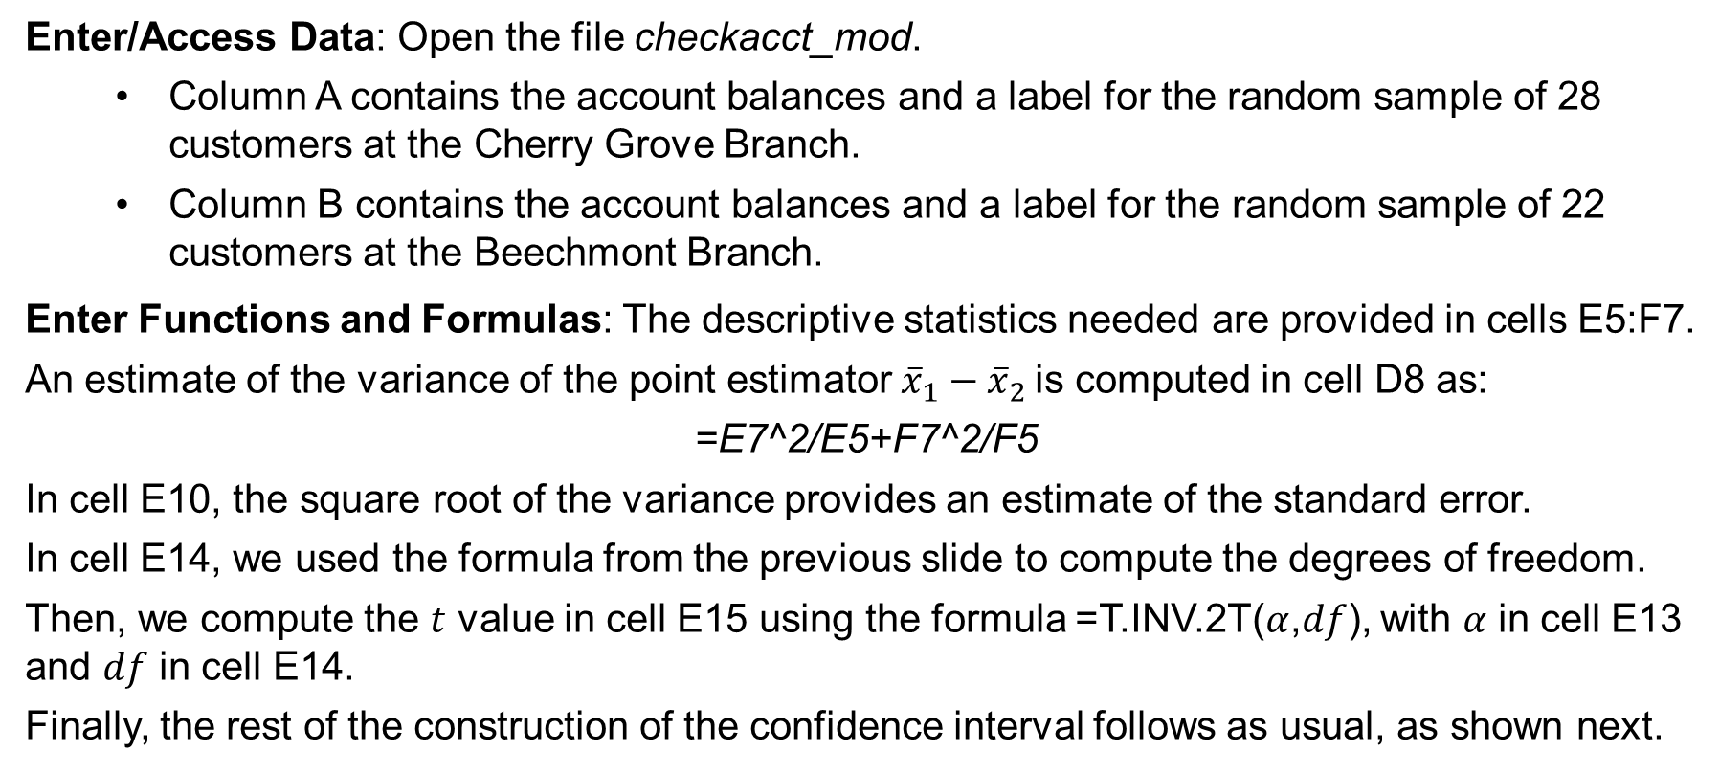
10.2 Excel: Construct a 95% Confidence Interval
Enter/Access Data: Open the file checkacct_mod.
Column A contains the account balances and a label for the random sample of 28 customers at the Cherry Grove Branch.
Column B contains the account balances and a label for the random sample of 22 customers at the Beechmont Branch.
Enter Functions and Formulas: The descriptive statistics needed are provided in cells E5:F7.
An estimate of the variance of the point estimator ${\overline{x}}_{1}−{\overline{x}}_{2}$is computed in cell D8 as:
=E7^2/E5+F7^2/F5
In cell E10, the square root of the variance provides an estimate of the standard error.
In cell E14, we used the formula from the previous slide to compute the degrees of freedom.
Then, we compute the $t$ value in cell E15 using the formula =T.INV.2T($α$,$df$), with $α$ in cell E13 and $df$ in cell E14.
Finally, the rest of the construction of the confidence interval follows as usual, as shown next.

Slide 22
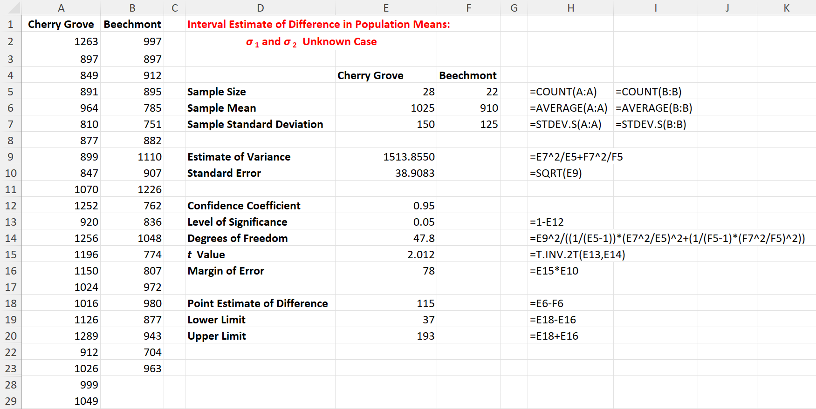
10.2 Excel: Confidence Interval for Clearwater National Bank

Slide 23
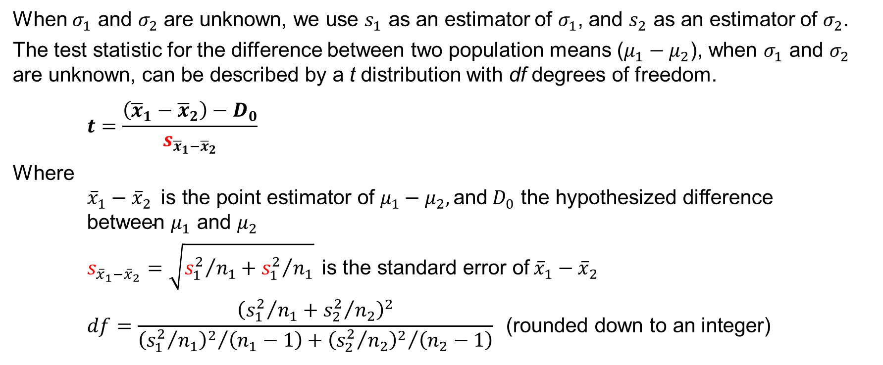
10.2 Test Statistic for Hypothesis Tests About $μ_{1}−μ_{2}$: $σ_{1}$ and $σ_{2}$ Unknown
When $σ_{1}$ and $σ_{2}$ are unknown, we use $s_{1}$ as an estimator of $σ_{1}$, and $s_{2}$ as an estimator of $σ_{2}$.
The test statistic for the difference between two population means ($μ_{1}−μ_{2}$), when $σ_{1}$ and $σ_{2}$ are unknown, can be described by a t distribution with df degrees of freedom.
$$t=\frac{\left({\overline{x}}_{1}−{\overline{x}}_{2}\right)−D_{0}}{s_{{\overline{x}}_{1}−{\overline{x}}_{2}}}$$
Where
$${\overline{x}}_{1}−{\overline{x}}_{2} \text{is} \text{the} \text{point} \text{estimator} \text{of} μ_{1}−μ_{2}, \text{and} D_{0} \text{the} \text{hypothesized} \text{difference} \text{between} μ_{1} \text{and} μ_{2}$$
$$s_{{\overline{x}}_{1}−{\overline{x}}_{2}}=\sqrt{{s_{1}^{2}}/{n_{1}}+{s_{1}^{2}}/{n_{1}}} \text{is} \text{the} \text{standard} \text{error} \text{of} {\overline{x}}_{1}−{\overline{x}}_{2}$$
$$df=\frac{{\left({s_{1}^{2}}/{n_{1}}+{s_{2}^{2}}/{n_{2}}\right)}^{2}}{{{\left({s_{1}^{2}}/{n_{1}}\right)}^{2}}/{\left(n_{1}−1\right)}+{{\left({s_{2}^{2}}/{n_{2}}\right)}^{2}}/{\left(n_{2}−1\right)}} \text{(}\text{rounded} \text{down} \text{to} \text{an} \text{integer}\text{)}$$

Slide 24
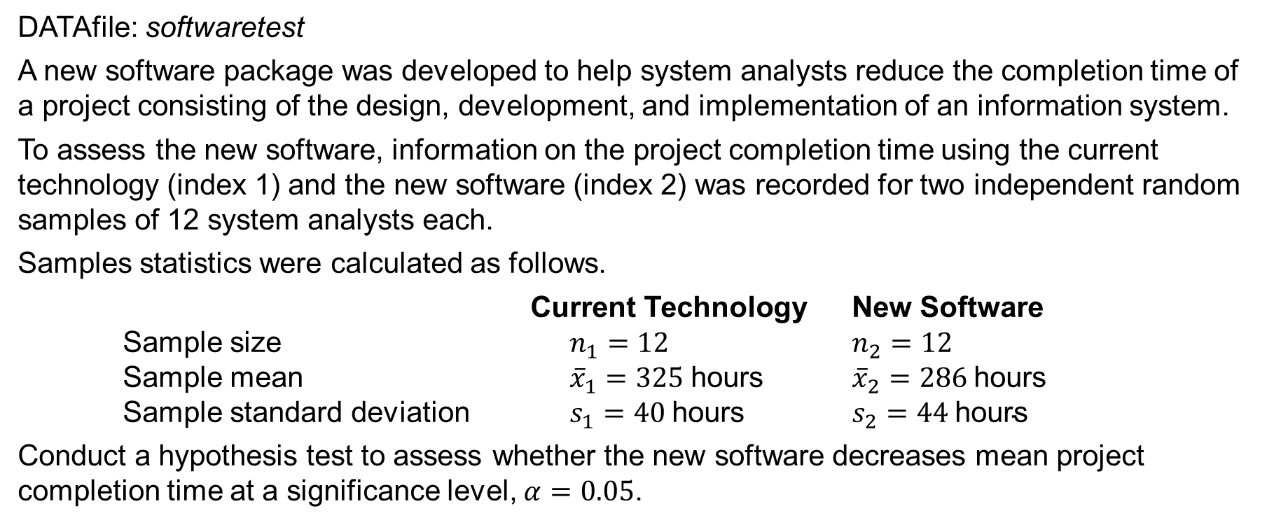
10.2 A New Software Project Completion Time Study
DATAfile: softwaretest
A new software package was developed to help system analysts reduce the completion time of a project consisting of the design, development, and implementation of an information system.
To assess the new software, information on the project completion time using the current technology (index 1) and the new software (index 2) was recorded for two independent random samples of 12 system analysts each.
Samples statistics were calculated as follows.
Current Technology New Software
Sample size $n_{1}=12$ $n_{2}=12$
Sample mean ${\overline{x}}_{1}=325 \text{hours}$ ${\overline{x}}_{2}=286 \text{hours}$
Sample standard deviation $s_{1}=40 \text{hours}$ $s_{2}=44 \text{hours}$
Conduct a hypothesis test to assess whether the new software decreases mean project completion time at a significance level, $α=0.05$.
Notes:
*Note: The interval estimation and hypothesis testing procedures presented in this section are robust and can be used with relatively small sample sizes. In most applications, equal or nearly equal sample sizes such that the total sample size n₁+n₂ is at least 20 can be expected to provide very good results even if the populations are not normal. Larger sample sizes are recommended if the distributions of the populations are highly skewed or contain outliers. Smaller sample sizes should only be used if the analyst is satisfied that the distributions of the populations are at least approximately normal.

Slide 25
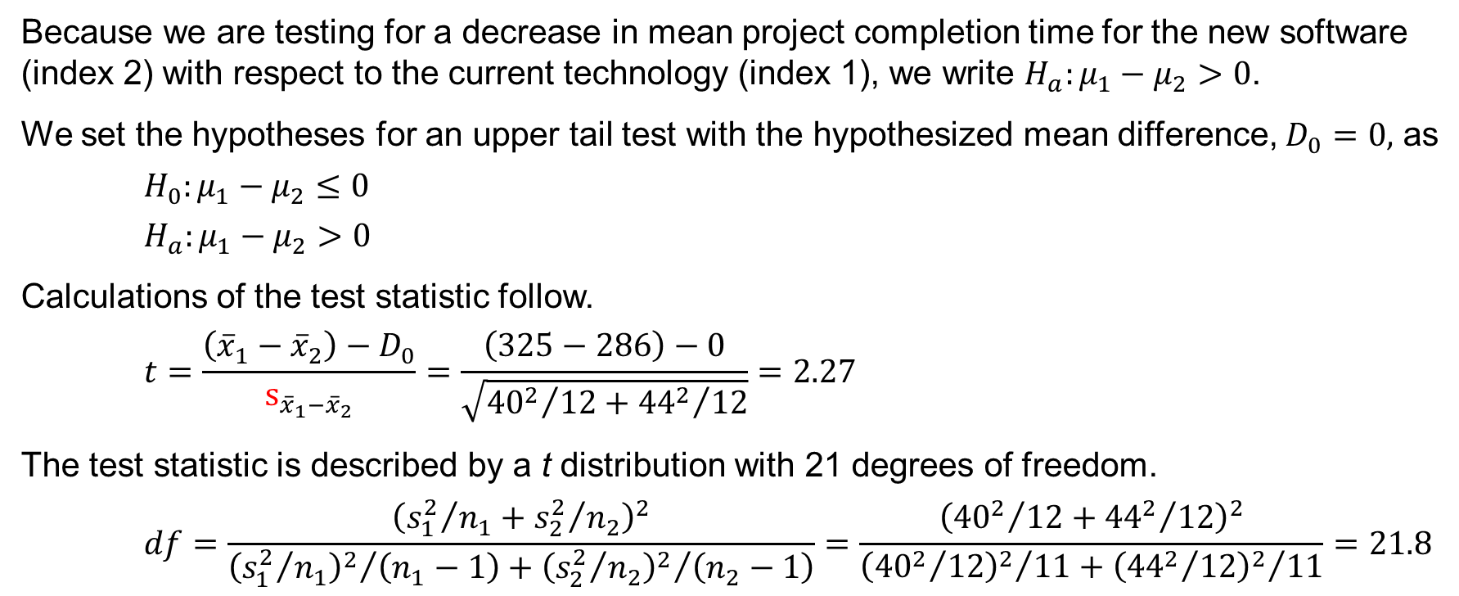
10.2 An Upper Tail Test About $μ_{1}−μ_{2}$: $σ_{1}$ and $σ_{2}$ Unknown
Because we are testing for a decrease in mean project completion time for the new software (index 2) with respect to the current technology (index 1), we write ${H_{a}:μ}_{1}−μ_{2}>0$.
We set the hypotheses for an upper tail test with the hypothesized mean difference, $D_{0}=0,$ as
$$H_{0}:μ_{1}−μ_{2}≤0$$
$H_{a}:μ_{1}−μ_{2}>0$
Calculations of the test statistic follow.
$$t=\frac{\left({\overline{x}}_{1}−{\overline{x}}_{2}\right)−D_{0}}{s_{{\overline{x}}_{1}−{\overline{x}}_{2}}}=\frac{\left(325−286\right)−0}{\sqrt{{{40}^{2}}/{12}+{{44}^{2}}/{12}}}=2.27$$
The test statistic is described by a t distribution with 21 degrees of freedom.
$$df=\frac{{\left({s_{1}^{2}}/{n_{1}}+{s_{2}^{2}}/{n_{2}}\right)}^{2}}{{{\left({s_{1}^{2}}/{n_{1}}\right)}^{2}}/{\left(n_{1}−1\right)}+{{\left({s_{2}^{2}}/{n_{2}}\right)}^{2}}/{\left(n_{2}−1\right)}}=\frac{{\left({{40}^{2}}/{12}+{{44}^{2}}/{12}\right)}^{2}}{{{\left({{40}^{2}}/{12}\right)}^{2}}/{11}+{{\left({{44}^{2}}/{12}\right)}^{2}}/{11}}=21.8$$
Notes:
*Note:

Slide 26
10.2 p-Value Approach to a One-Tailed Test About $μ_{1}−μ_{2}$: $σ_{1}$ and $σ_{2}$ Unknown
The p-value is the upper tail of a t distribution with 21 degrees of freedom.
$$p\text{−}\text{value}=P(t≥2.27)$$
Using Table 2 in Appendix B, the t distribution with 21 degrees of freedom provides the following information.
Area in upper tail | 0.20 | 0.10 | 0.05 | 0.025 | 0.01 | 0.005
t Value ($df=21$) | 0.859 | 1.323 | 1.721 | 2.080 | 2.518 | 2.831
Because $t=2.27$ is between 2.080 and 2.518, the values in the “Area in Upper Tail” row show that the p-value range must be: $0.01≤p\text{−}\text{value}≤ 0.025$.
We can also use Excel to compute the exact p-value as: $\text{=}\text{T}\text{.}\text{DIST}\text{.}\text{RT}\text{(2.27,21)}=0.0169$
Because $p\text{−}\text{value}≤α$, we can reject the null hypothesis and conclude that the new software decreases mean project completion time.

Slide 27
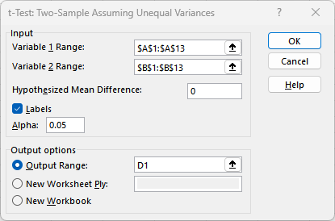
10.2 Excel: Dialog Box for t-Test: Two-Sample Assuming Unequal Variances Tool
Enter/Access Data: Open the file softwaretest.
Apply Tools: In the t-Test: Two Sample Assuming Unequal Variances dialog box, enter
Step 1. Click the Data tab on the Ribbon
Step 2. In the Analyze group, click Data Analysis
Step 3. Choose t-Test: Two-Sample Assuming Unequal Variances from the list of Analysis Tools
Step 4. When the dialog box appears:
Enter A1:A13 in the Variable 1 Range: box
Enter B1:B13 in the Variable 2 Range: box
Enter 0 in the Hypothesized Mean Diff.: box
Select the check box for Labels
Select Output Range: and enter D1 in the box
Click OK

Slide 28
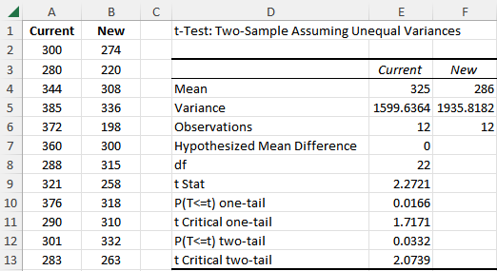
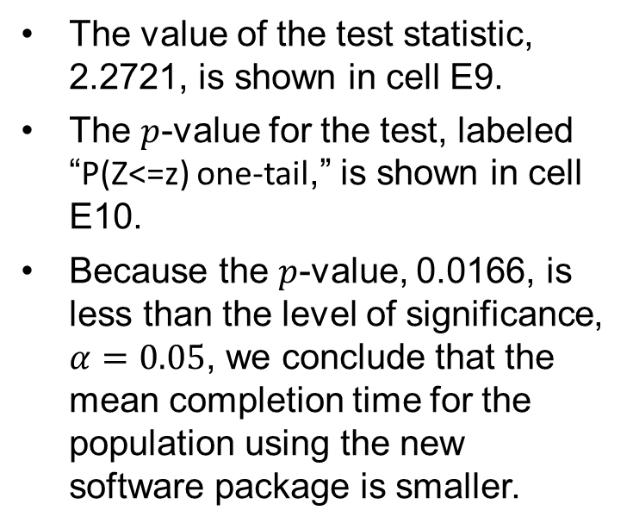
10.2 Excel: Conduct a Hypothesis Test
The test results are shown below.
Descriptive statistics for the two samples are shown in cells E4:F6.
The value of the test statistic, 2.2721, is shown in cell E9.
The $p$-value for the test, labeled “P(Z<=z) one-tail,” is shown in cell E10.
Because the $p$-value, 0.0166, is less than the level of significance, $α=0.05$, we conclude that the mean completion time for the population using the new software package is smaller.

Slide 29
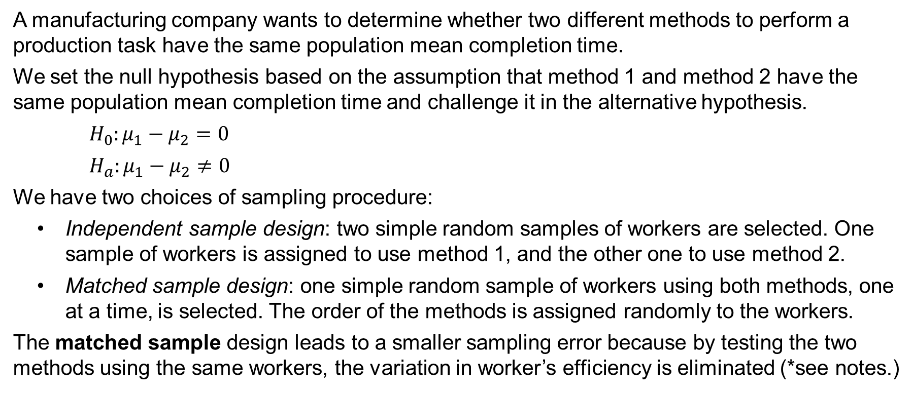
10.3 Inferences about the Difference Between Two Population Means: Matched Samples
A manufacturing company wants to determine whether two different methods to perform a production task have the same population mean completion time.
We set the null hypothesis based on the assumption that method 1 and method 2 have the same population mean completion time and challenge it in the alternative hypothesis.
$H_{0}:μ_{1}−μ_{2}=0$
$H_{a}:μ_{1}−μ_{2}≠0$
We have two choices of sampling procedure:
Independent sample design: two simple random samples of workers are selected. One sample of workers is assigned to use method 1, and the other one to use method 2.
Matched sample design: one simple random sample of workers using both methods, one at a time, is selected. The order of the methods is assigned randomly to the workers.
The matched sample design leads to a smaller sampling error because by testing the two methods using the same workers, the variation in worker’s efficiency is eliminated (*see notes.)
Notes:
*Note: a matched sample procedure for inferences about two population means generally provides better precision than the independent sample approach; therefore, it is the recommended design. However, in some applications, the matching cannot be achieved, or perhaps the time and cost associated with matching are excessive. In such cases, the independent sample design should be used.

Slide 30
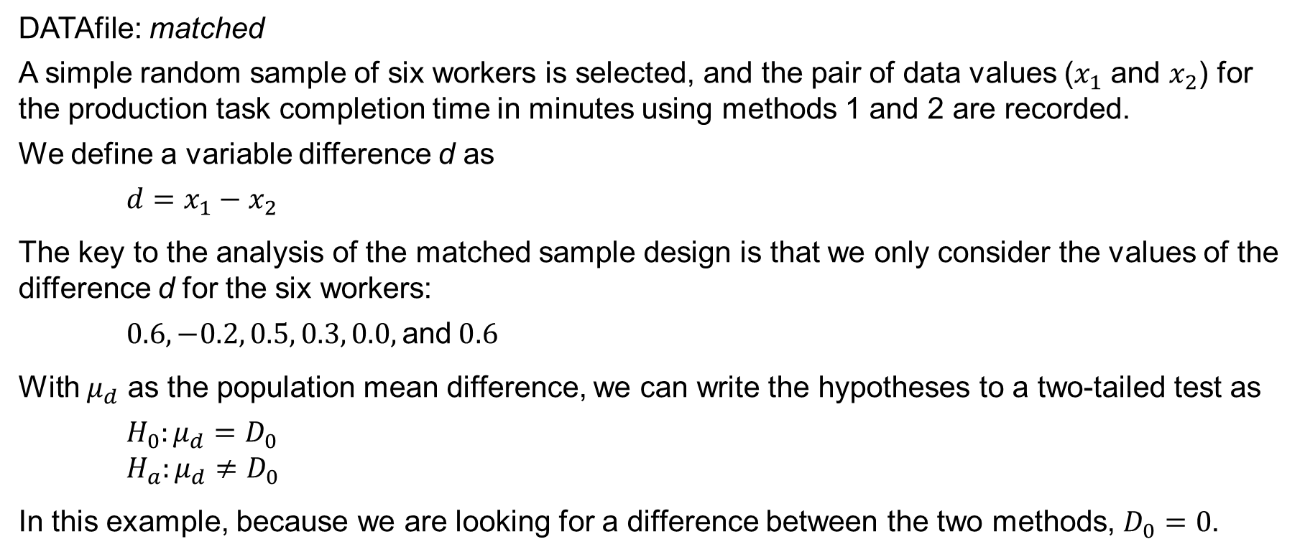
10.3 Hypothesis Tests Involving Matched Samples
DATAfile: matched
A simple random sample of six workers is selected, and the pair of data values ($x_{1}$ and $x_{2}$) for the production task completion time in minutes using methods 1 and 2 are recorded.
We define a variable difference d as
$${d=x}_{1}−x_{2}$$
The key to the analysis of the matched sample design is that we only consider the values of the difference d for the six workers:
$$0.6, −0.2, 0.5, 0.3, 0.0, \text{and} 0.6$$
With $μ_{d}$ as the population mean difference, we can write the hypotheses to a two-tailed test as
$H_{0}:μ_{d}=D_{0}$
$$H_{a}:μ_{d}≠D_{0}$$
In this example, because we are looking for a difference between the two methods, $D_{0}=0$.
Notes:
*Note:

Slide 31
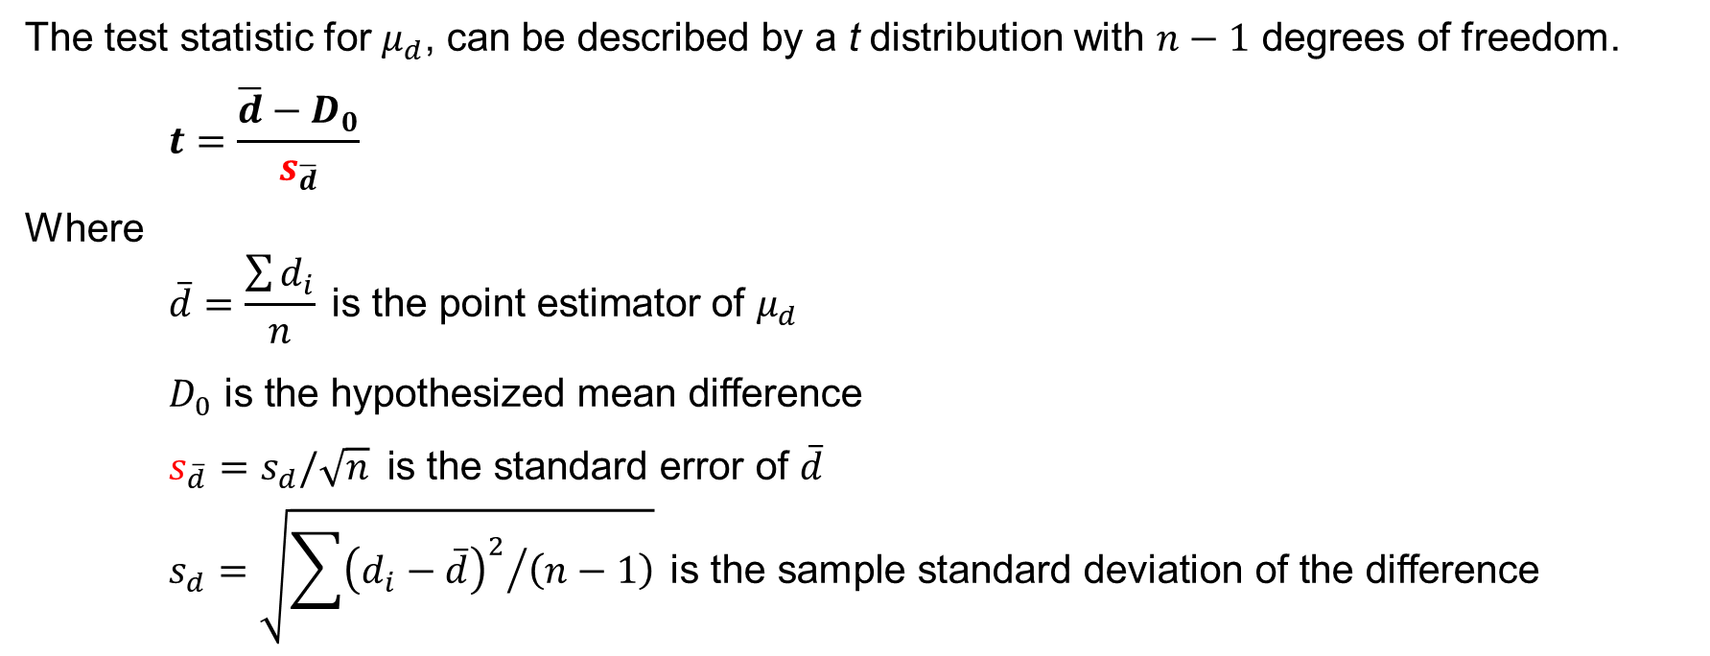
10.3 Test Statistic for Hypothesis Tests Involving Matched Samples
The test statistic for $μ_{d}$, can be described by a t distribution with $n−1$ degrees of freedom.
$$t=\frac{\overline{d}−D_{0}}{s_{\overline{d}}}$$
Where
$$\overline{d}=\frac{\sum{d_{i}}}{n} \text{is} \text{the} \text{point} \text{estimator} \text{of} μ_{d}$$
$D_{0} \text{is} \text{the} \text{hypothesized} \text{mean} \text{difference}$
$s_{\overline{d}}=s_{d}/\sqrt{n} \text{is} \text{the} \text{standard} \text{error} \text{of} \overline{d}$
$$s_{d}=\sqrt{{\sum{{\left(d_{i}−\overline{d}\right)}^{2}}}/{\left(n−1\right)}} \text{is} \text{the} \text{sample} \text{standard} \text{deviation} \text{of} \text{the} \text{difference}$$

Slide 32
10.3 p-Value Approach to a Test About Matched Samples
Calculations lead to $n=6$, $\overline{d}=0.30$, and $s_{d}=0.335$. Thus, the test statistic is
$$t=\frac{\overline{d}−D_{0}}{σ_{\overline{d}}}=\frac{\overline{d}−D_{0}}{s_{d}/\sqrt{n}}=\frac{0.30−0}{0.335/\sqrt{6}}=2.20$$
The p-value for this two-tailed test is twice the upper tail of a t distribution with 5 degrees of freedom (*see notes.) Using Table 2 in Appendix B, we have
Area in upper tail | 0.20 | 0.10 | 0.05 | 0.025 | 0.01 | 0.005
t Value ($df=5$) | 0.920 | 1.476 | 2.015 | 2.571 | 3.365 | 4.032
For a two-tailed test, the p-value is twice the 0.025 to 0.05 range identified in the “Area in Upper Tail” row for $t=2.20$. Thus, we have: $0.05≤p\text{−}\text{value}≤ 0.10$.
We can also use Excel to compute the exact p-value as: $\text{=}\text{T}\text{.}\text{DIST}\text{.2}\text{T}\text{(2.20,5)}=0.0791$
Because $p\text{−}\text{value}>α$, we do not reject the null hypothesis and cannot conclude that the two production methods have a different mean completion time.
Notes:
*Note: it is not necessary to make the assumption that the population has a normal distribution if the sample size is large, but with the small sample of $n=6$ workers, we need to make the assumption that the population of differences has a normal distribution. This assumption is necessary so that we may use the t distribution for hypothesis testing and interval estimation procedures.

Slide 33
10.3 Interval Estimation Involving Matched Samples
We can obtain an interval estimate of the population mean completion time difference between the two methods using the single population methodology from Chapter 8.
$$\overline{d}±t_{α/2}s_{d}/\sqrt{n}$$
With 95% confidence and $n−1=5$ degrees of freedom, Table 2 in Appendix B can be used to obtain $t_{.025}=2.571$.
Area in upper tail | 0.20 | 0.10 | 0.05 | 0.025 | 0.01 | 0.005
t Value ($df=5$) | 0.920 | 1.476 | 2.015 | 2.571 | 3.365 | 4.032
Alternatively, the Excel equation =T.INV(1−0.025,5) will also generate the value 2.571.
We compute an interval estimate of the population mean completion time difference as
$$\overline{d}±t_{.025}s_{d}/\sqrt{n}=0.3±2.571\left({0.335}/{\sqrt{6}}\right)=0.3±0.35$$
We are 95% confident that the population mean completion time difference between the two production methods is between $0.3−0.35=−0.05$ minutes and $0.3+0.35=0.65$ minutes.
Notes:
*Note: it is not necessary to make the assumption that the population has a normal distribution if the sample size is large, but with the small sample of $n=6$ workers, we need to make the assumption that the population of differences has a normal distribution. This assumption is necessary so that we may use the t distribution for hypothesis testing and interval estimation procedures.

Slide 34
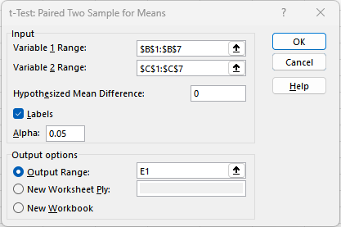
10.3 Excel: Dialog Box for t-Test: Paired Two Sample For Means Tool
Enter/Access Data: Open the file matched.
Apply Tools: In the t-Test: Paired Two Sample For Means dialog box, enter the following:
Step 1. Click the Data tab on the Ribbon
Step 2. In the Analyze group, click Data Analysis
Step 3. Choose t-Test: Paired Two-Sample For Means from the list of Analysis Tools
Step 4. When the dialog box appears:
Enter B1:B7 in the Variable 1 Range: box
Enter C1:C7 in the Variable 2 Range: box
Enter 0 in the Hypothesized Mean Diff.: box
Select the check box for Labels
Select Output Range: and enter E1 in the box
Click OK

Slide 35
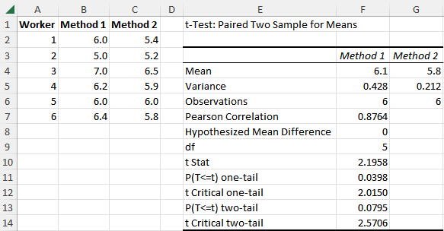
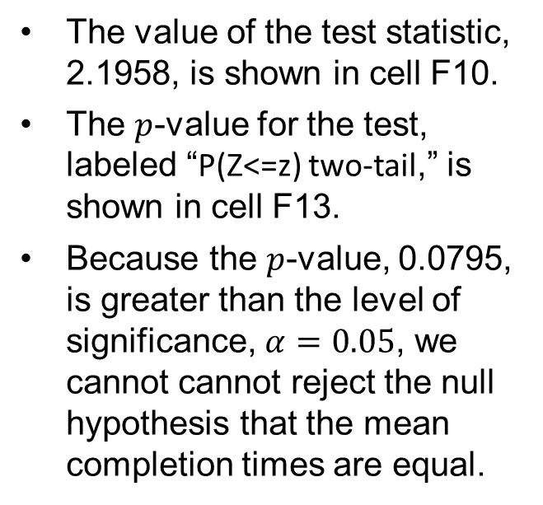
10.3 Excel: Conduct a Hypothesis Test
The test results are shown below.
Descriptive statistics for the two samples are shown in cells F4:G6.
The value of the test statistic, 2.1958, is shown in cell F10.
The $p$-value for the test, labeled “P(Z<=z) two-tail,” is shown in cell F13.
Because the $p$-value, 0.0795, is greater than the level of significance, $α=0.05$, we cannot cannot reject the null hypothesis that the mean completion times are equal.

Slide 36

10.4 Inferences about the Difference Between Two Population Proportions
Letting $p_{1}$ denote the proportion for population 1 and $p_{2}$ the proportion for population 2, we next consider inferences about the difference between the two population proportions: $p_{1}−p_{2}$.
To make an inference about the difference between the two population proportions: $p_{1}−p_{2}$,
we will select two independent random samples consisting of $n_{1}$ units from population 1 and $n_{2}$ units from population 2.

Slide 37
10.4 Interval Estimation of $p_{1}−p_{2}$
The interval estimate of the difference between two population proportions ($p_{1}−p_{2}$), is based on the sampling distribution of ${\overline{p}}_{1}−{\overline{p}}_{2}$, which can be approximated by a normal distribution so long as $n_{1}p_{1}$, $n_{1}{(1−p}_{1})$, $n_{2}p_{2}$, and $n_{2}{(1−p}_{2})$ are all greater than or equal to 5.
In such case, the confidence interval of $p_{1}−p_{2}$ can be written as follows.
$${\overline{p}}_{1}−{\overline{p}}_{2}±z_{α/2}σ_{{\overline{p}}_{1}−{\overline{p}}_{2}}$$
Where
$${\overline{p}}_{1}−{\overline{p}}_{2} \text{is} \text{the} \text{point} \text{estimator} \text{of} p_{1}−p_{2}$$
$z_{α/2} \text{is} \text{the} \text{critical} \text{value} \text{such} \text{that} P\left(z≥z_{α/2}\right)=1−α/2$
$$σ_{{\overline{p}}_{1}−{\overline{p}}_{2}}=\sqrt{\frac{{\overline{p}}_{1}{(1−\overline{p}}_{1})}{n_{1}}+\frac{{\overline{p}}_{2}{(1−\overline{p}}_{2})}{n_{2}}} \text{is} \text{the} \text{standard} \text{error} \text{of} {\overline{p}}_{1}−{\overline{p}}_{2}$$
$$z_{α/2}σ_{{\overline{p}}_{1}−{\overline{p}}_{2}} \text{is} \text{the} \text{margin} \text{of} \text{error}$$

Slide 38
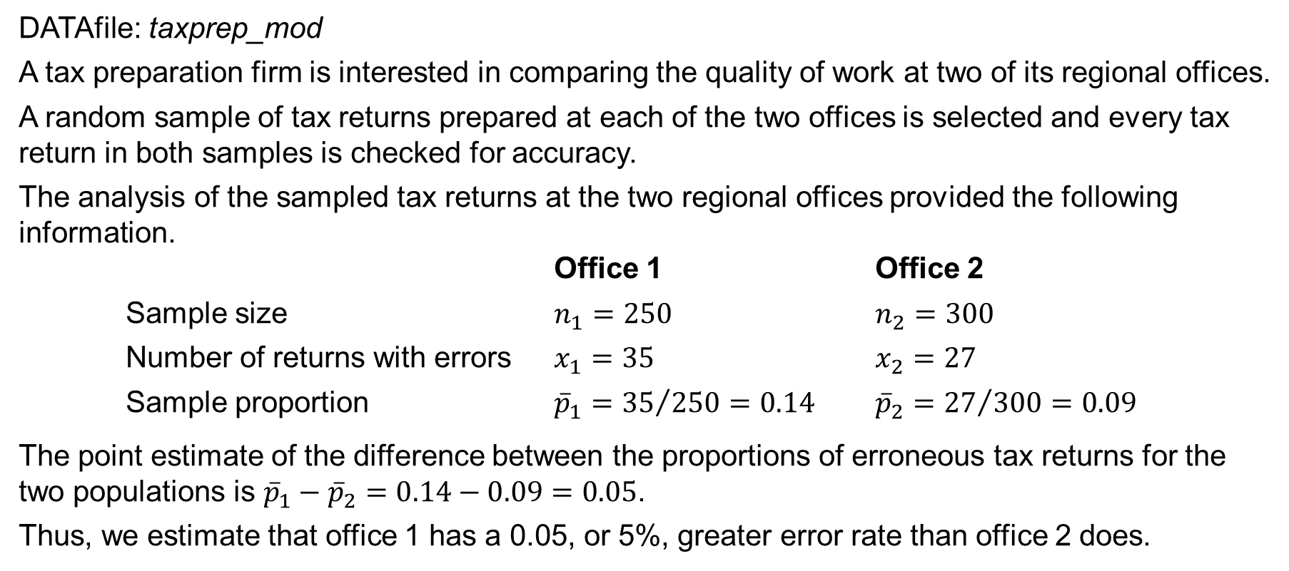
10.4 A Tax Preparation Example
DATAfile: taxprep_mod
A tax preparation firm is interested in comparing the quality of work at two of its regional offices.
A random sample of tax returns prepared at each of the two offices is selected and every tax return in both samples is checked for accuracy.
The analysis of the sampled tax returns at the two regional offices provided the following information.
Office 1 Office 2
Sample size $n_{1}=250$ $n_{2}=300$
Number of returns with errors $x_{1}=35$ $x_{2}=27$
Sample proportion ${\overline{p}}_{1}={35}/{250}=0.14$ ${\overline{p}}_{2}={27}/{300}=0.09$
The point estimate of the difference between the proportions of erroneous tax returns for the two populations is ${\overline{p}}_{1}−{\overline{p}}_{2}=0.14−0.09=0.05$.
Thus, we estimate that office 1 has a 0.05, or 5%, greater error rate than office 2 does.

Slide 39
10.4 Estimation of the Difference Between the Proportions of Tax Return Errors
The standard error of ${\overline{p}}_{1}−{\overline{p}}_{2}$ is
$$σ_{{\overline{p}}_{1}−{\overline{p}}_{2}}=\sqrt{\frac{{\overline{p}}_{1}{(1−\overline{p}}_{1})}{n_{1}}+\frac{{\overline{p}}_{2}{(1−\overline{p}}_{2})}{n_{2}}}=\sqrt{\frac{0.14(1−0.14)}{250}+\frac{0.09(1−0.09)}{300}}=0.0275$$
Using 90% confidence and $z_{α/2}=z_{.05}=1.645$, we have
$${\overline{p}}_{1}−{\overline{p}}_{2}±z_{α/2}σ_{{\overline{p}}_{1}−{\overline{p}}_{2}}=0.05±1.645\left(0.0275\right)=0.05±0.045$$
Thus, the margin of error is 0.045, and the 90% confidence interval estimate of the difference between the two population proportions is $0.05−0.045=0.005$ to $0.05+0.045=0.095$.
We are 90% confident that the difference in error rates between office 1 and office 2 is between 0.5% and 9.5%.

Slide 40
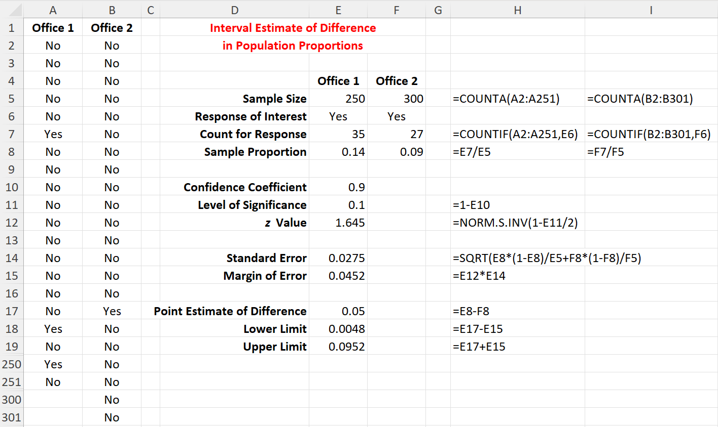
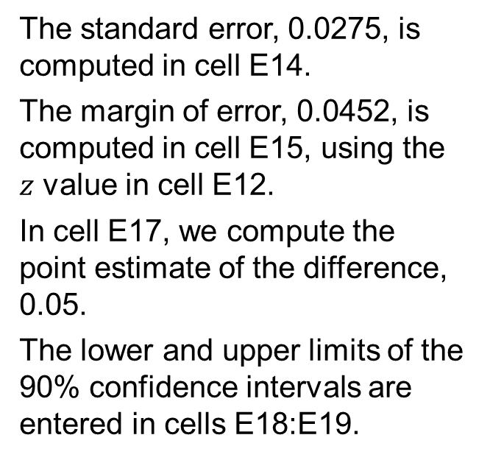
10.4 Excel: Construct a 90% Confidence Interval
Enter/Access Data: Open the file taxprep_mod. Columns A and B contain data and labels.
Enter Functions and Formulas: The descriptive statistics needed are provided in cells D4:E4 and D6:E7.
The standard error, 0.0275, is computed in cell E14.
The margin of error, 0.0452, is computed in cell E15, using the $z$ value in cell E12.
In cell E17, we compute the point estimate of the difference, 0.05.
The lower and upper limits of the 90% confidence intervals are entered in cells E18:E19.

Slide 41
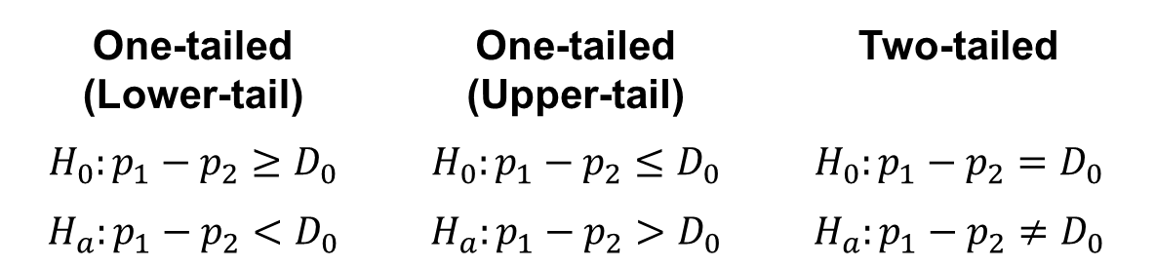
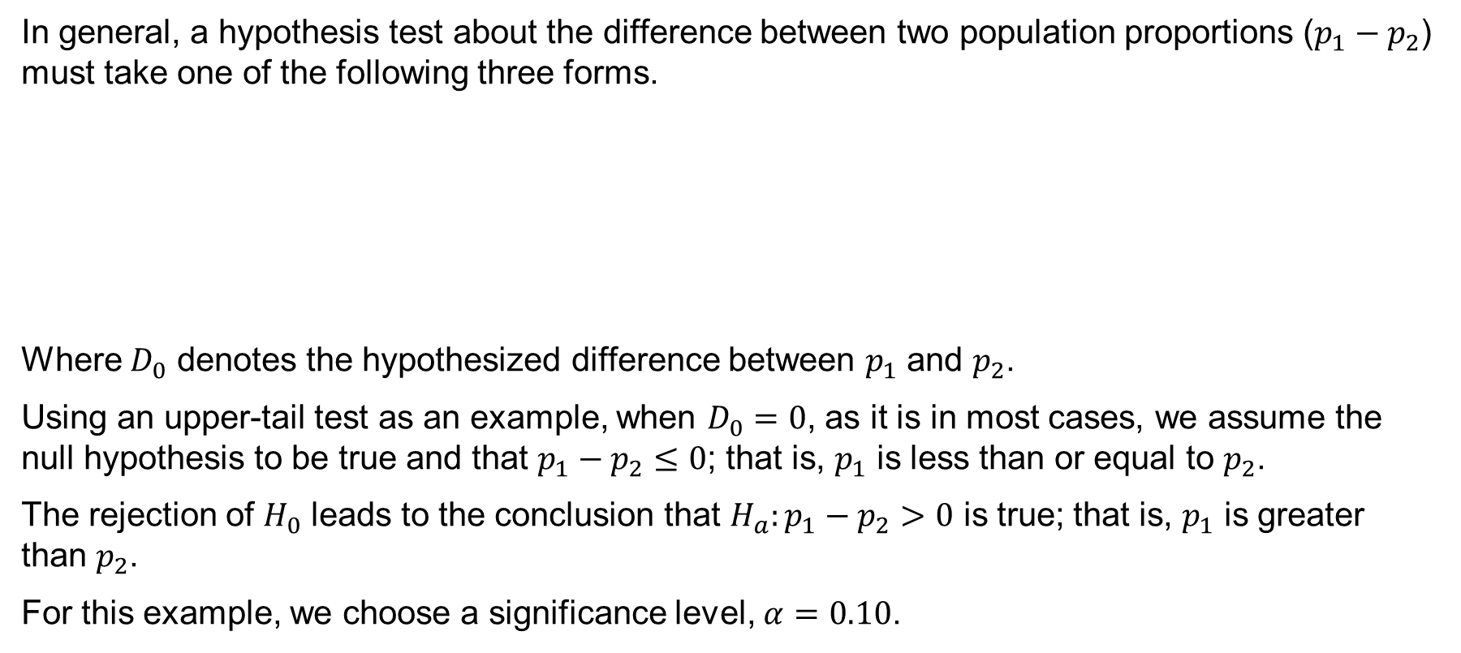
10.4 Hypothesis Tests About $p_{1}−p_{2}$
In general, a hypothesis test about the difference between two population proportions ($p_{1}−p_{2}$) must take one of the following three forms.
Where $D_{0}$ denotes the hypothesized difference between $p_{1}$ and $p_{2}$.
Using an upper-tail test as an example, when $D_{0}=0$, as it is in most cases, we assume the null hypothesis to be true and that $p_{1}−p_{2}≤0$; that is, $p_{1}$ is less than or equal to $p_{2}$.
The rejection of $H_{0}$ leads to the conclusion that $H_{a}:p_{1}−p_{2}>0$ is true; that is, $p_{1}$ is greater than $p_{2}$.
For this example, we choose a significance level, $α=0.10$.
One-tailed (Lower-tail) | One-tailed (Upper-tail) | Two-tailed
$$H_{0}:p_{1}−p_{2}≥D_{0}$$ | $$H_{0}:p_{1}−p_{2}≤D_{0}$$ | $$H_{0}:p_{1}−p_{2}=D_{0}$$
$$H_{a}:p_{1}−p_{2}<D_{0}$$ | $$H_{a}:p_{1}−p_{2}>D_{0}$$ | $$H_{a}:p_{1}−p_{2}≠D_{0}$$

Slide 42
10.4 Test Statistic for Hypothesis Tests About $p_{1}−p_{2}$
The test statistic of the difference between $p_{1}$ and $p_{2}$, is based on the sampling distribution of ${\overline{p}}_{1}−{\overline{p}}_{2}$, which can be approximated by a normal distribution so long as $n_{1}p_{1}$, $n_{1}{(1−p}_{1})$, $n_{2}p_{2}$, and $n_{2}{(1−p}_{2})$ are all greater than or equal to 5.
In such case, the test statistic for $p_{1}−p_{2}$ can be written as
$$z=\frac{\left({\overline{p}}_{1}−{\overline{p}}_{2}\right)−D_{0}}{σ_{{\overline{p}}_{1}−{\overline{p}}_{2}}}$$
Where
$D_{0}$ is the hypothesized difference between $p_{1}$ and $p_{2}$
$$σ_{{\overline{p}}_{1}−{\overline{p}}_{2}}=\sqrt{\overline{p}\left(1−\overline{p}\right)\left(\frac{1}{n_{1}}+\frac{1}{n_{2}}\right)} \text{is} \text{the} \text{standard} \text{error} \text{of} {\overline{p}}_{1}−{\overline{p}}_{2}\text{ (∗}\text{see} \text{notes}\text{.)}$$
$$\overline{p}=\frac{n_{1}{\overline{p}}_{1}+n_{2}{\overline{p}}_{2}}{n_{1}+n_{2}} \text{is} \text{the} \text{pooled} \text{estimator} \text{of} p, \text{a} \text{weighted} \text{average} \text{of} {\overline{p}}_{1} \text{and} {\overline{p}}_{2}$$
Notes:
*Note: Under the assumption H₀ is true as an equality, the population proportions are equal and $p_{1}=p_{2}=p$. That is why we can use a weighted average of ${\overline{p}}_{1} \text{and} {\overline{p}}_{2}$ as $\overline{p}$, the pooled estimator of p.

Slide 43
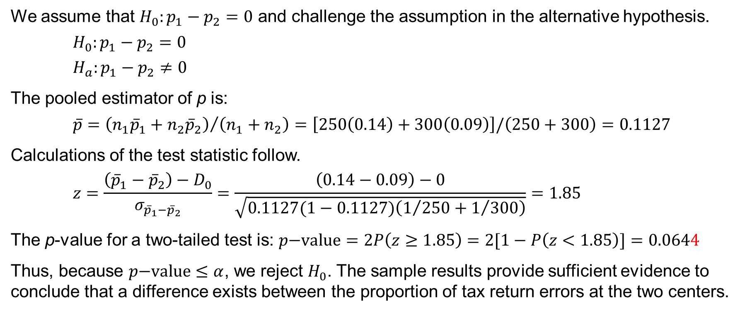
10.4 A Two-Tailed Test About $p_{1}−p_{2}$
We assume that ${H_{0}:p}_{1}−p_{2}=0$ and challenge the assumption in the alternative hypothesis.
$$H_{0}:p_{1}−p_{2}=0$$
$H_{a}:p_{1}−p_{2}≠0$
The pooled estimator of p is:
$$\overline{p}={\left(n_{1}{\overline{p}}_{1}+n_{2}{\overline{p}}_{2}\right)}/{\left(n_{1}+n_{2}\right)}=\left[250\left(0.14\right)+300\left(0.09\right)\right]/\left(250+300\right)=0.1127$$
Calculations of the test statistic follow.
$$z=\frac{\left({\overline{p}}_{1}−{\overline{p}}_{2}\right)−D_{0}}{σ_{{\overline{p}}_{1}−{\overline{p}}_{2}}}=\frac{\left(0.14−0.09\right)−0}{\sqrt{0.1127(1−0.1127)\left(1/{250}+1/{300}\right)}}=1.85$$
The p-value for a two-tailed test is: $p\text{−}\text{value}=2P\left(z≥1.85\right)=2[1−P\left(z<1.85\right)]=0.0644$
Thus, because $p\text{−}\text{value}≤α$, we reject $H_{0}$. The sample results provide sufficient evidence to conclude that a difference exists between the proportion of tax return errors at the two centers.

Slide 44
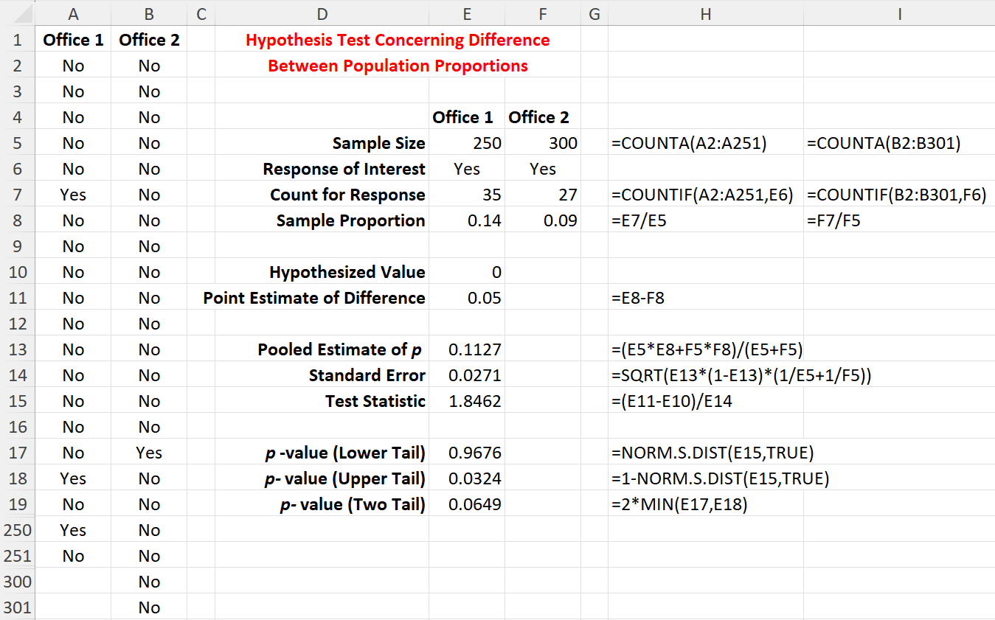
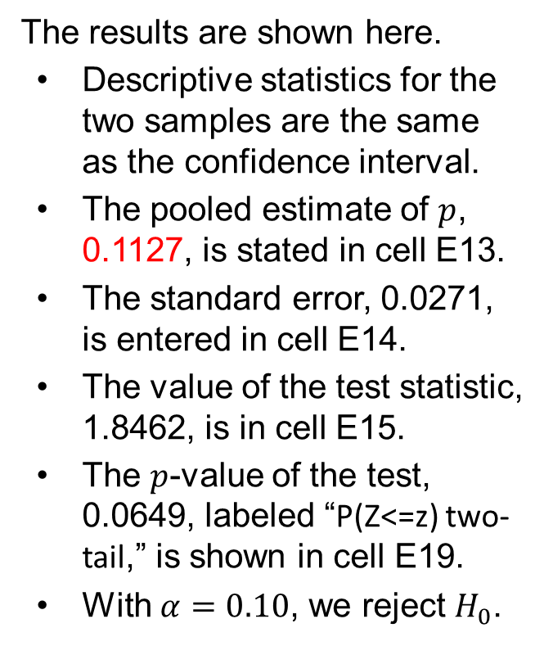
10.4 Excel: Conduct a Hypothesis Test
The results are shown here.
Descriptive statistics for the two samples are the same as the confidence interval.
The pooled estimate of $p$, 0.1127, is stated in cell E13.
The standard error, 0.0271, is entered in cell E14.
The value of the test statistic, 1.8462, is in cell E15.
The $p$-value of the test, 0.0649, labeled “P(Z<=z) two-tail,” is shown in cell E19.
With $α=0.10$, we reject $H_{0}$.

Slide 45
Summary
In this chapter, we discussed procedures for developing interval estimates and conducting hypothesis tests involving two populations.
First, we showed how to make inferences about the difference between two population means when independent simple random samples are selected.
When the population standard deviations, σ₁ and σ₂, can be assumed known, the standard normal distribution z is used to make inferences.
When the population standard deviations, σ₁ and σ₂, are unknown and estimated by the sample standard deviations, s₁ and s₂, the t distribution is used instead.
We then discussed inferences about the difference between two population means for the matched sample design, in which the difference between the paired data values is used.
Finally, we presented how to make inferences about the difference between two population proportions using the standard normal distribution z.

