Slide 1


Slide 2
Chapter Contents
11.1 Inferences about a Population Variance
11.2 Inferences about Two Populations Variances
Summary

Slide 3
Chapter Objectives
After completing this chapter, you will be able to:
LO 11-1 Describe the distribution form and parameters of the sampling distribution of the sample variance and report values from this distribution.
LO 11-2 Calculate and interpret the interval estimate at a given level of confidence for a population variance and a population standard deviation.
LO 11-3 Conduct a hypothesis test about the population variance using either the p-value approach or the critical value approach.
LO 11-4 Describe the distribution form and parameters of the sampling distribution of the ratio of the sample variances of two different populations and report values from this distribution.
LO 11-5 Conduct a hypothesis test about the ratio between two population variances using either the p-value approach or the critical value approach.

Slide 4
Introduction
In this chapter, we examine methods of statistical inference involving population variances.
A variance can provide important decision-making information, such as in the case of the production process of filling containers with a liquid detergent product:
The mean filling weight is important, but also so is the variance of the filling weights.
By selecting a sample of containers, we can compute a sample variance for the amount of detergent placed in a container.
If the sample variance is excessive, overfilling and underfilling may be occurring even though the mean is correct.
In the first section, we consider inferences about the variance of a single population.
Subsequently, we will discuss procedures that can be used to make inferences about the variances of two populations.

Slide 5
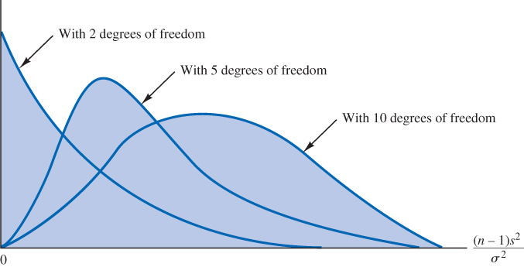
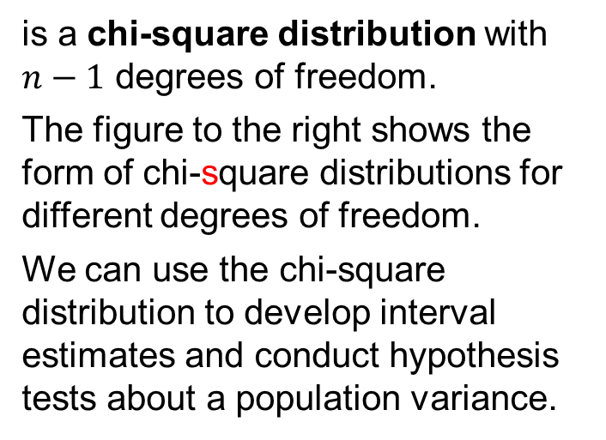
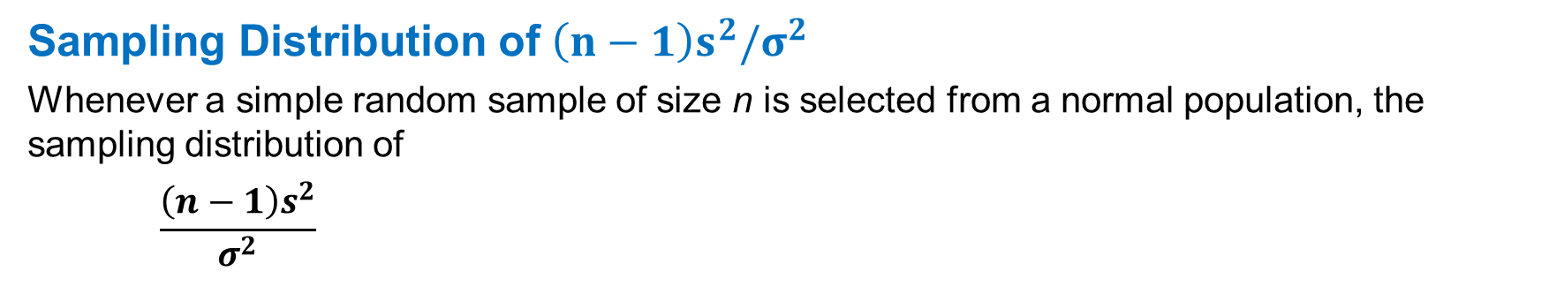
11.1 Inferences About a Population Variance
Sampling Distribution of $\left(n−1\right)s^{2}/σ^{2}$
Whenever a simple random sample of size n is selected from a normal population, the sampling distribution of
$$\frac{\left(n−1\right)s^{2}}{σ^{2}}$$
is a chi-square distribution with $n−1$ degrees of freedom.
The figure to the right shows the form of chi-square distributions for different degrees of freedom.
We can use the chi-square distribution to develop interval estimates and conduct hypothesis tests about a population variance.

Slide 6
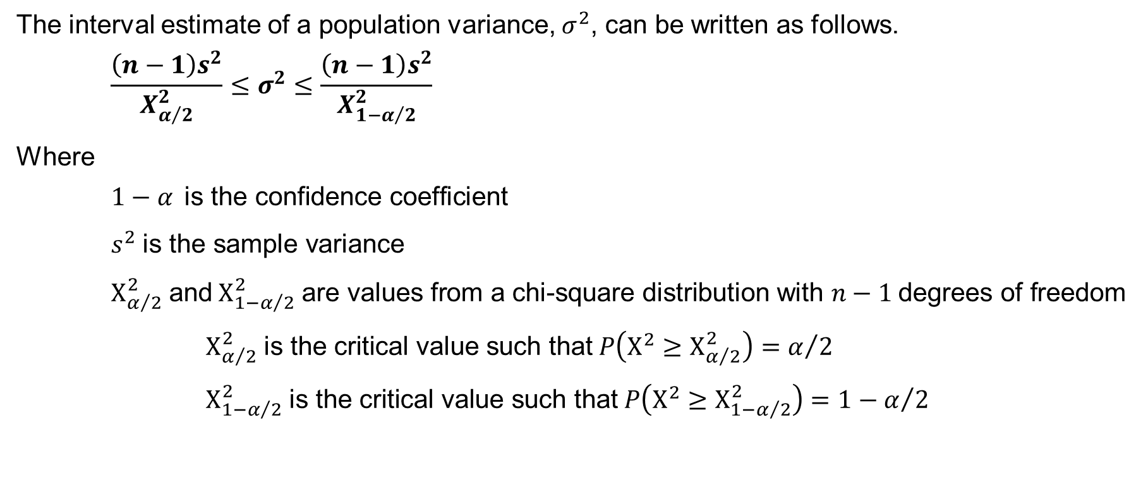
11.1 Interval Estimation of a Population Variance
The interval estimate of a population variance, $σ^{2}$, can be written as follows.
$$\frac{\left(n−1\right)s^{2}}{Χ_{α/2}^{2}}≤σ^{2}≤\frac{\left(n−1\right)s^{2}}{Χ_{{1−α}/2}^{2}}$$
Where
$1−α \text{is} \text{the} \text{confidence} \text{coefficient}$
$s^{2} \text{is} \text{the} \text{sample} \text{variance}$
$Χ_{α/2}^{2} \text{and} Χ_{{1−α}/2}^{2} \text{are} \text{values} \text{from} \text{a} \text{chi}\text{−}\text{square} \text{distribution} \text{with} n−1 \text{degrees} \text{of} \text{freedom}$
$Χ_{α/2}^{2} \text{is} \text{the} \text{critical} \text{value} \text{such} \text{that} P\left(Χ^{2}≥Χ_{α/2}^{2}\right)=α/2$
$Χ_{{1−α}/2}^{2} \text{is} \text{the} \text{critical} \text{value} \text{such} \text{that} P\left(Χ^{2}≥Χ_{1−α/2}^{2}\right)={1−α}/2$
Notes:
*Note: If both populations have a normal distribution, or if the sample sizes are large enough that the central limit theorem enables us to conclude that the sampling distributions of ${\overline{x}}_{1}$ and ${\overline{x}}_{2}$ can be approximated by a normal distribution, the sampling distribution of ${\overline{x}}_{1}−{\overline{x}}_{2}$ will have a normal distribution with mean given by $μ_{1}−μ_{2}$.

Slide 7
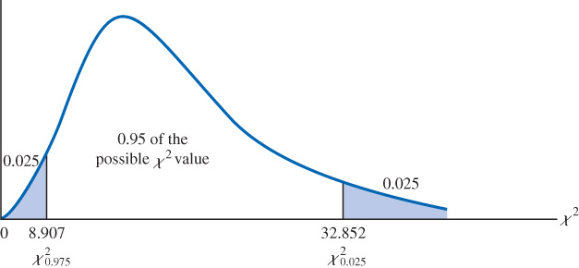
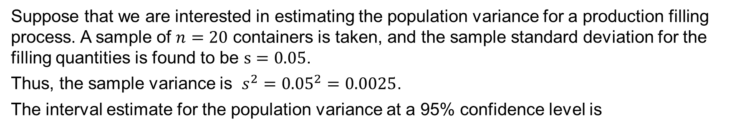
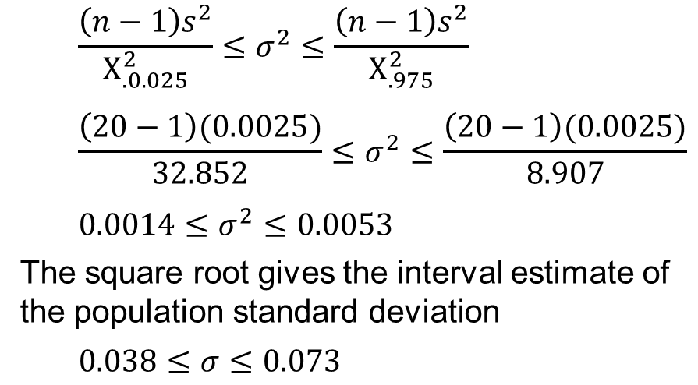
11.1 An Interval Estimate of a Production Filling Process
Suppose that we are interested in estimating the population variance for a production filling process. A sample of $n=20$ containers is taken, and the sample standard deviation for the filling quantities is found to be $s=0.05$.
Thus, the sample variance is $s^{2}={0.05}^{2}=0.0025$.
The interval estimate for the population variance at a 95% confidence level is
$$\frac{\left(n−1\right)s^{2}}{Χ_{.0.025}^{2}}≤σ^{2}≤\frac{\left(n−1\right)s^{2}}{Χ_{.975}^{2}}$$
$$\frac{\left(20−1\right)(0.0025)}{32.852}≤σ^{2}≤\frac{\left(20−1\right)(0.0025)}{8.907}$$
$0.0014≤σ^{2}≤0.0053$
The square root gives the interval estimate of the population standard deviation
$0.038≤σ≤0.073$

Slide 8

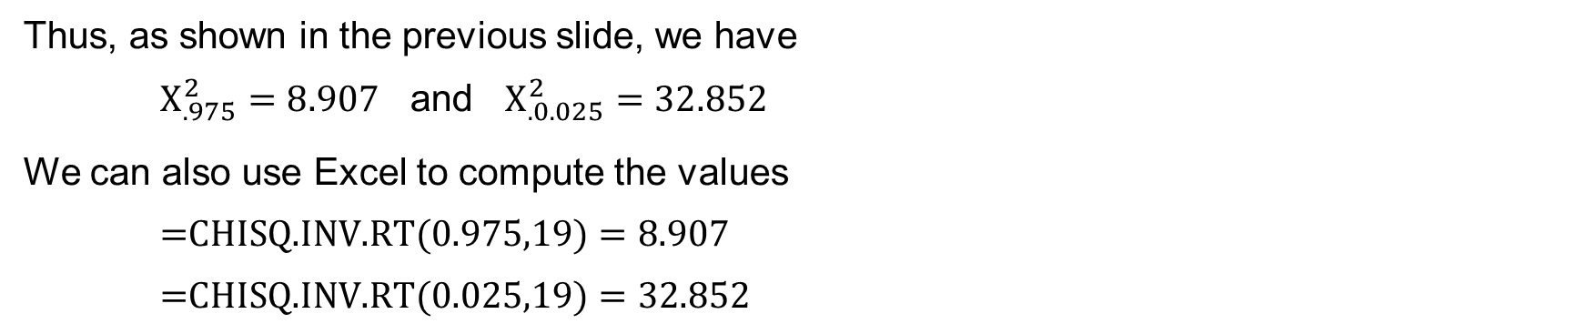
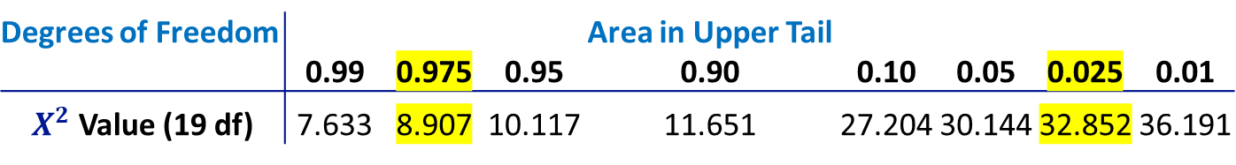
11.1 Determination of Chi-Square Values
Table 3 in Appendix B provides the values of a chi-square distribution with different degrees of freedom such that $P(Χ^{2}≥Χ_{α}^{2})$.
The line on the table for 19 degrees of freedom provides the following information.
Degrees of Freedom |  |  |  | Area in Upper Tail
 | 0.99 | 0.975 | 0.95 | 0.90 | 0.10 | 0.05 | 0.025 | 0.01
$Χ^{2}$ Value (19 df) | 7.633 | 8.907 | 10.117 | 11.651 | 27.204 | 30.144 | 32.852 | 36.191
Thus, as shown in the previous slide, we have
$Χ_{.975}^{2}=8.907$ and $Χ_{.0.025}^{2}=32.852$
We can also use Excel to compute the values
$\text{=}\text{CHISQ}\text{.}\text{INV}\text{.}\text{RT}\text{(0.975,19)}=8.907$
$\text{=}\text{CHISQ}\text{.}\text{INV}\text{.}\text{RT}\text{(0.025,19)}=32.852$

Slide 9
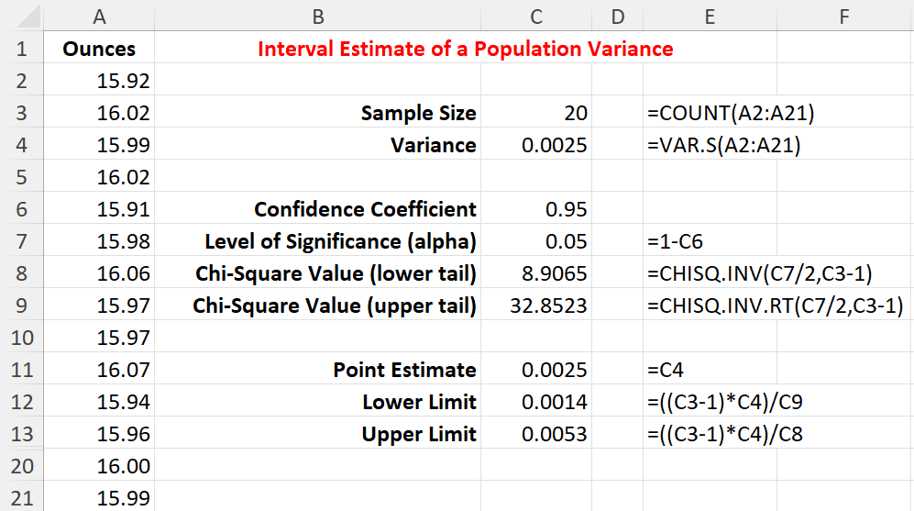
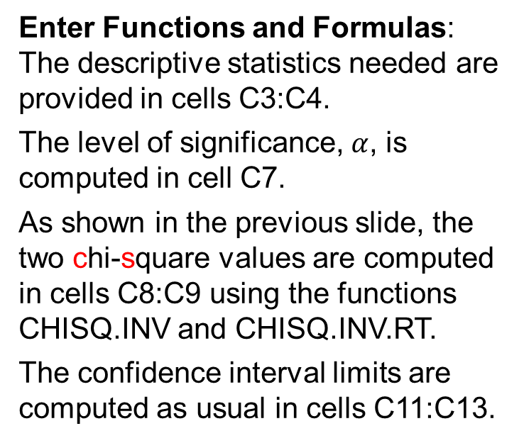
11.1 Excel: Construct a 95% Confidence Interval
We use Excel to construct a 95% confidence interval of the population variance for the example involving filling containers with a liquid detergent product.
Enter/Access Data: Open the file detergent_mod. The data are in cells A2:A21.
Enter Functions and Formulas: The descriptive statistics needed are provided in cells C3:C4.
The level of significance, $α$, is computed in cell C7.
As shown in the previous slide, the two chi-square values are computed in cells C8:C9 using the functions CHISQ.INV and CHISQ.INV.RT.
The confidence interval limits are computed as usual in cells C11:C13.

Slide 10
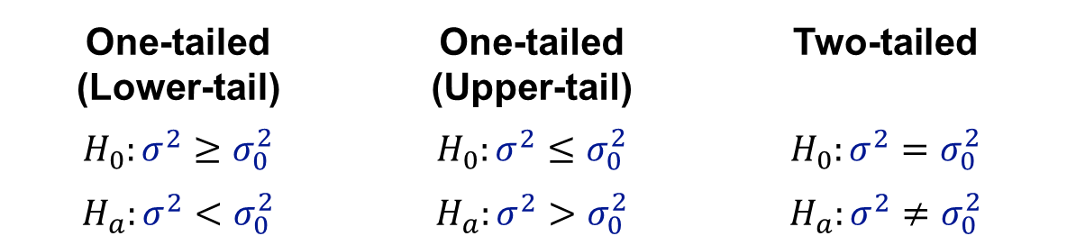
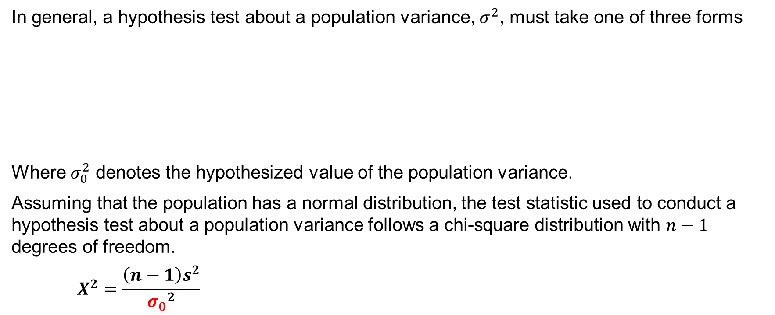
11.1 Hypothesis Tests About a Population Variance
In general, a hypothesis test about a population variance, $σ^{2}$, must take one of three forms
Where $σ_{0}^{2}$ denotes the hypothesized value of the population variance.
Assuming that the population has a normal distribution, the test statistic used to conduct a hypothesis test about a population variance follows a chi-square distribution with $n−1$ degrees of freedom.
$$Χ^{2}=\frac{\left(n−1\right)s^{2}}{{σ_{0}}^{2}}$$
One-tailed (Lower-tail) | One-tailed (Upper-tail) | Two-tailed
$$H_{0}:σ^{2}≥σ_{0}^{2}$$ | $$H_{0}:σ^{2}≤σ_{0}^{2}$$ | $$H_{0}:σ^{2}=σ_{0}^{2}$$
$$H_{a}:σ^{2}<σ_{0}^{2}$$ | $$H_{a}:σ^{2}>σ_{0}^{2}$$ | $$H_{a}:σ^{2}≠σ_{0}^{2}$$

Slide 11
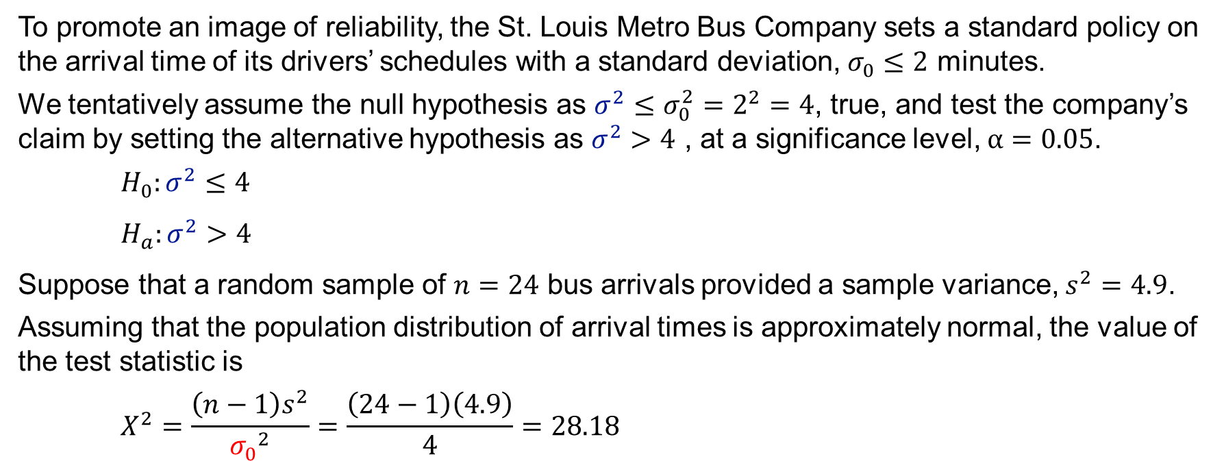
11.1 A One-Tailed Test Hypothesis Test About a Population Variance
To promote an image of reliability, the St. Louis Metro Bus Company sets a standard policy on the arrival time of its drivers’ schedules with a standard deviation, $σ_{0}≤2$ minutes.
We tentatively assume the null hypothesis as $σ^{2}≤σ_{0}^{2}=2^{2}=4$, true, and test the company’s claim by setting the alternative hypothesis as $σ^{2}>4$ , at a significance level, $α=0.05$.
$$H_{0}:σ^{2}≤4$$
$H_{a}:σ^{2}>4$
Suppose that a random sample of $n=24$ bus arrivals provided a sample variance, $s^{2}=4.9$.
Assuming that the population distribution of arrival times is approximately normal, the value of the test statistic is
$$Χ^{2}=\frac{\left(n−1\right)s^{2}}{{σ_{0}}^{2}}=\frac{\left(24−1\right)\left(4.9\right)}{4}=28.18$$

Slide 12
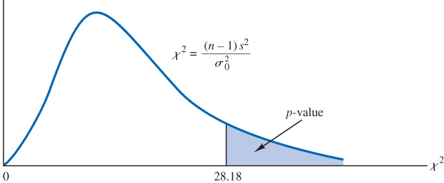

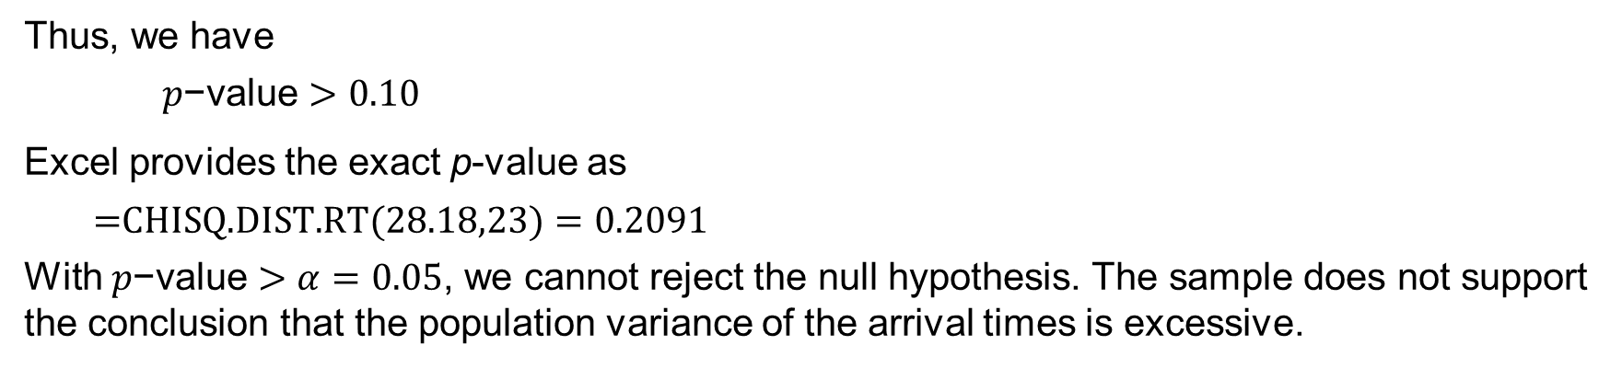
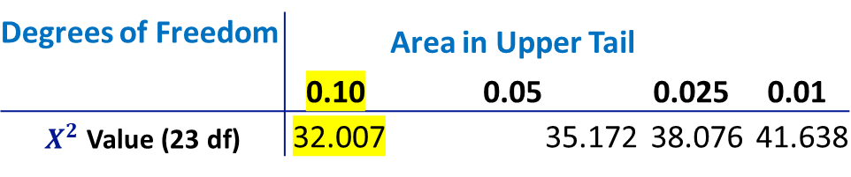
11.1 p-Value Approach to a One-Tailed Test About a Population Variance
The chi-square distribution with $n−1=24−1=23$ degrees of freedom is shown in the figure below. Because this is an upper-tail test, we have $p\text{−}\text{value}=P(Χ^{2}≥28.18)$.
Like the t distribution, the chi-square distribution only allows us to obtain a range of p-values.
Degrees of Freedom |  | Area in Upper Tail
 | 0.10 | 0.05 | 0.025 | 0.01
$Χ^{2}$ Value (23 df) | 32.007 | 35.172 | 38.076 | 41.638
Thus, we have
$$p\text{−}\text{value}>0.10$$
Excel provides the exact p-value as
$$\text{=}\text{CHISQ}\text{.}\text{DIST}\text{.}\text{RT}\text{(28.18,23)}=0.2091$$
With $p\text{−}\text{value}>α=0.05$, we cannot reject the null hypothesis. The sample does not support the conclusion that the population variance of the arrival times is excessive.

Slide 13
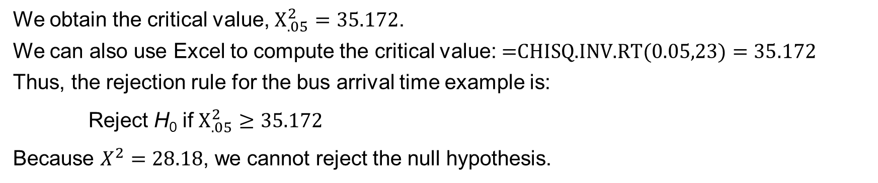
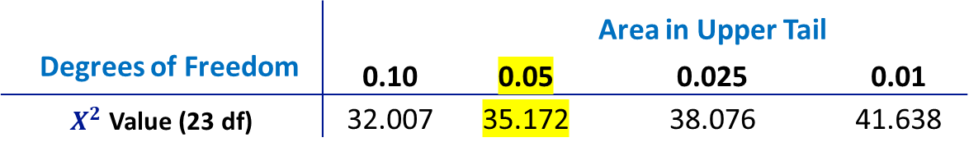
11.1 Critical Value approach to a One-Tailed Test About a Population Variance
With $α=0.05$, $Χ_{.05}^{2}$ provides the value for the upper tail hypothesis test. Using Table 3 in Appendix B, with $n−1=23$ degrees of freedom
 |  |  | Area in Upper Tail
Degrees of Freedom | 0.10 | 0.05 | 0.025 | 0.01
$Χ^{2}$ Value (23 df) | 32.007 | 35.172 | 38.076 | 41.638
We obtain the critical value, $Χ_{.05}^{2}=35.172$.
We can also use Excel to compute the critical value: $\text{=}\text{CHISQ}\text{.}\text{INV}\text{.}\text{RT}\text{(0.05,23)}=35.172$
Thus, the rejection rule for the bus arrival time example is:
Reject H₀ if $Χ_{.05}^{2}≥35.172$
Because $Χ^{2}=28.18$, we cannot reject the null hypothesis.

Slide 14
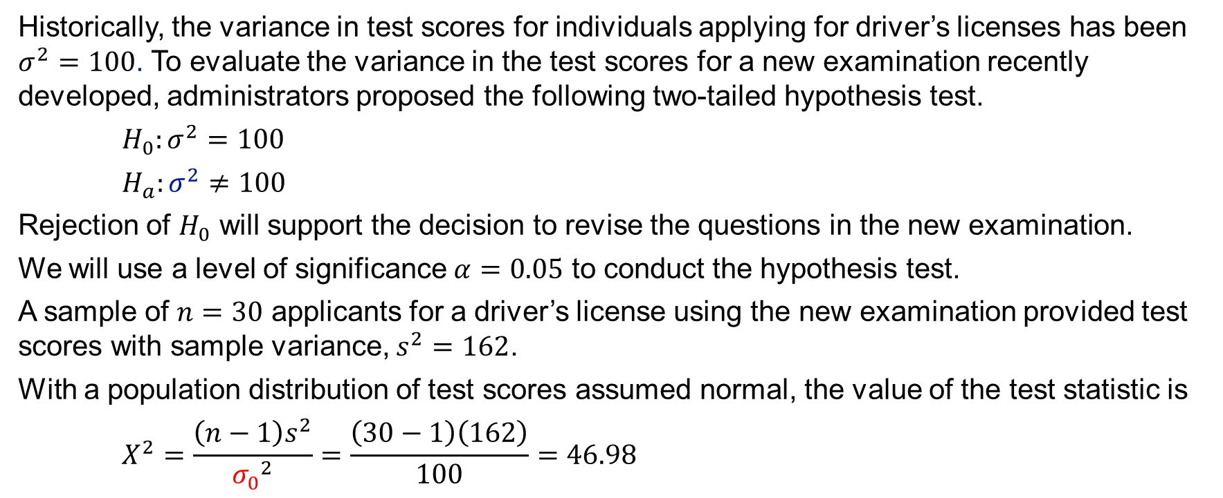
11.1 A Two-Tailed Hypothesis Test About a Population Variance
Historically, the variance in test scores for individuals applying for driver’s licenses has been $σ^{2}=100$. To evaluate the variance in the test scores for a new examination recently developed, administrators proposed the following two-tailed hypothesis test.
$$H_{0}:σ^{2}=100$$
$H_{a}:σ^{2}≠100$
Rejection of $H_{0}$ will support the decision to revise the questions in the new examination.
We will use a level of significance $α=0.05$ to conduct the hypothesis test.
A sample of $n=30$ applicants for a driver’s license using the new examination provided test scores with sample variance, $s^{2}=162$.
With a population distribution of test scores assumed normal, the value of the test statistic is
$$Χ^{2}=\frac{\left(n−1\right)s^{2}}{{σ_{0}}^{2}}=\frac{\left(30−1\right)\left(162\right)}{100}=46.98$$

Slide 15
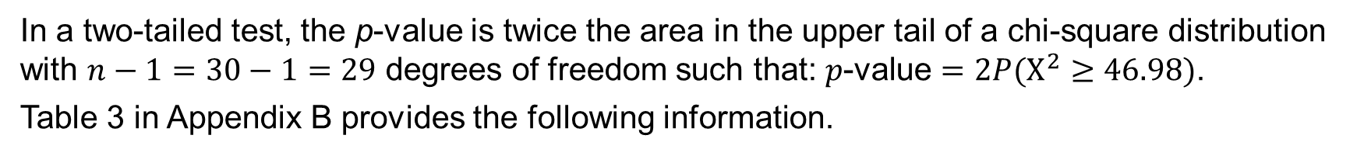
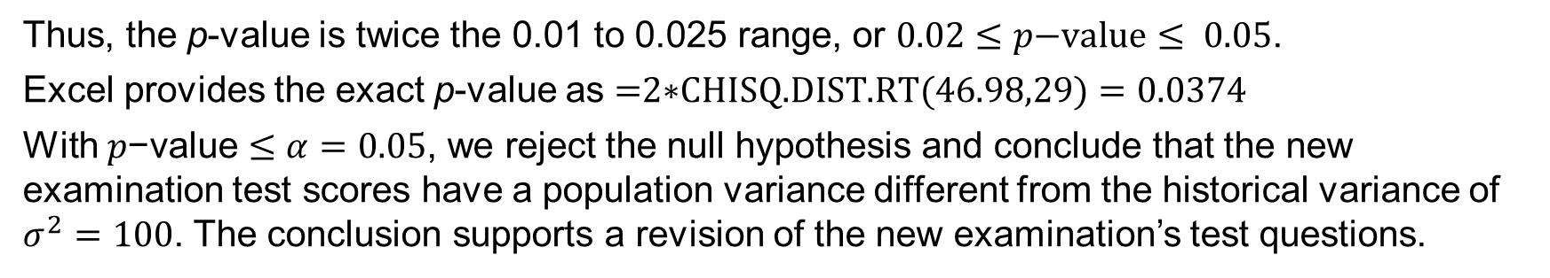
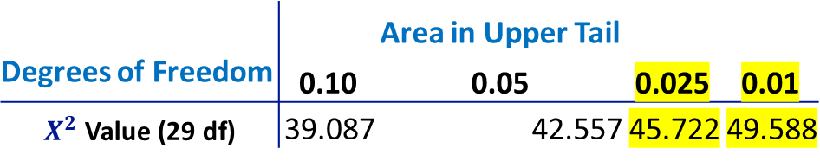
11.1 p-Value Approach to a Two-Tailed Test About a Population Variance
In a two-tailed test, the p-value is twice the area in the upper tail of a chi-square distribution with $n−1=30−1=29$ degrees of freedom such that: $p\text{−}\text{value}=2P(Χ^{2}≥46.98)$.
Table 3 in Appendix B provides the following information.
 |  | Area in Upper Tail
Degrees of Freedom | 0.10 | 0.05 | 0.025 | 0.01
$Χ^{2}$ Value (29 df) | 39.087 | 42.557 | 45.722 | 49.588
Thus, the p-value is twice the 0.01 to 0.025 range, or $0.02≤p\text{−}\text{value}≤ 0.05$.
Excel provides the exact p-value as $\text{=}\text{2}\text{∗}\text{CHISQ}\text{.}\text{DIST}\text{.}\text{RT}\text{(46.98,29)}=0.0374$
With $p\text{−}\text{value}≤α=0.05$, we reject the null hypothesis and conclude that the new examination test scores have a population variance different from the historical variance of $σ^{2}=100$. The conclusion supports a revision of the new examination’s test questions.

Slide 16
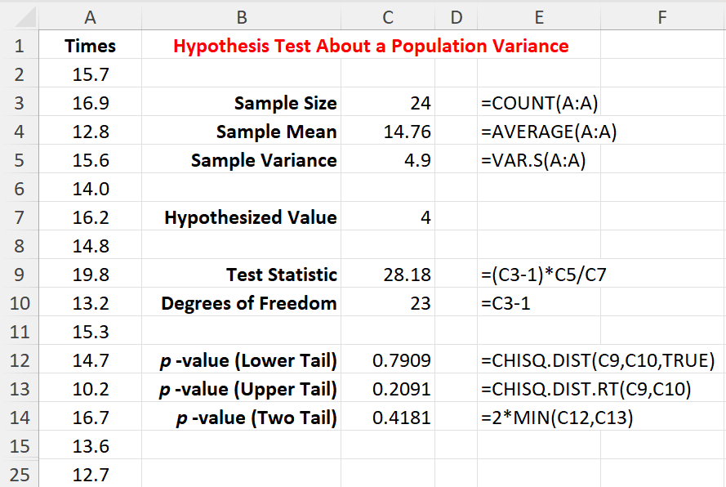
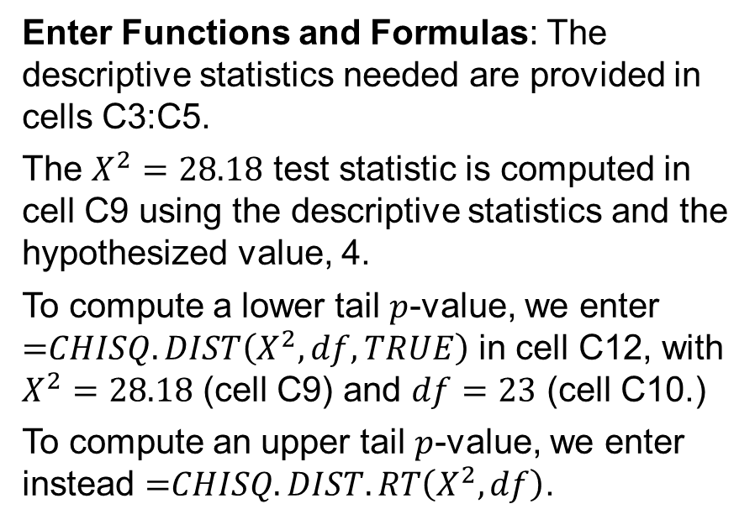
11.1 Excel: Conduct a Hypothesis Test
We now adapt the hypothesis test approach described in the previous chapters and use Excel to conduct a hypothesis test of the population variance for the St. Louis Metro Bus example.
Enter/Access Data: Open the file bustimes_mod. The 24 arrival times are in cells A2:A25.
Enter Functions and Formulas: The descriptive statistics needed are provided in cells C3:C5.
The $Χ^{2}=28.18$ test statistic is computed in cell C9 using the descriptive statistics and the hypothesized value, 4.
To compute a lower tail $p$-value, we enter $\text{=}CHISQ.DIST\left(Χ^{2},df,TRUE\right)$ in cell C12, with $Χ^{2}=28.18$ (cell C9) and $df=23$ (cell C10.)
To compute an upper tail $p$-value, we enter instead $\text{=}CHISQ.DIST.RT\left(Χ^{2},df\right)$.

Slide 17
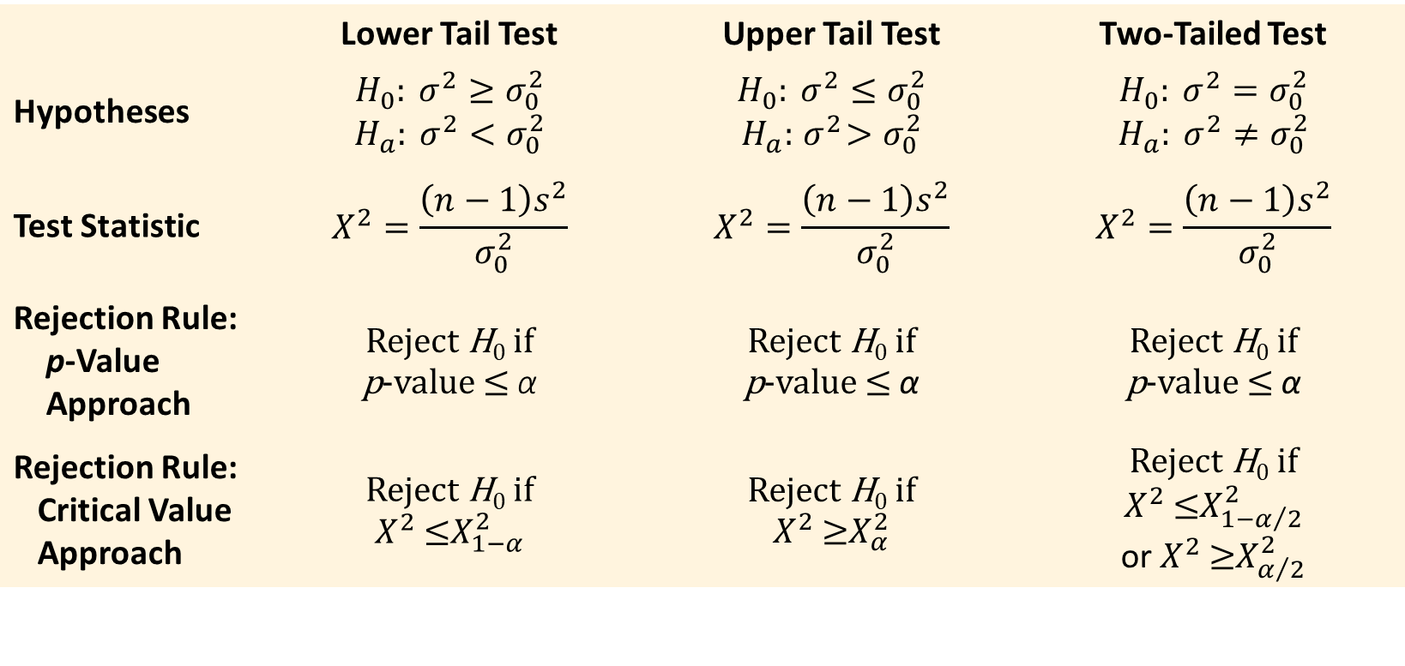
11.1 Summary of Hypothesis Tests About a Population Variance
 | Lower Tail Test | Upper Tail Test | Two-Tailed Test
Hypotheses | $$H_{0}: σ^{2}≥σ_{0}^{2}$$ $$H_{a}: σ^{2}<σ_{0}^{2}$$ | $$H_{0}: σ^{2}≤σ_{0}^{2}$$ $$H_{a}:{ σ}^{2}>σ_{0}^{2}$$ | $$H_{0}: σ^{2}=σ_{0}^{2}$$ $$H_{a}: σ^{2}≠σ_{0}^{2}$$
Test Statistic | $$Χ^{2}=\frac{\left(n−1\right)s^{2}}{σ_{0}^{2}}$$ | $$Χ^{2}=\frac{\left(n−1\right)s^{2}}{σ_{0}^{2}}$$ | $$Χ^{2}=\frac{\left(n−1\right)s^{2}}{σ_{0}^{2}}$$
Rejection Rule: p-Value Approach | Reject H₀ if p-value ≤ α | Reject H₀ if p-value ≤ α | Reject H₀ if p-value ≤ α
Rejection Rule: Critical Value Approach | Reject H₀ if $Χ^{2}$ ≤$Χ_{1−α}^{2}$ | Reject H₀ if $Χ^{2}$ ≥$Χ_{α}^{2}$ | Reject H₀ if $Χ^{2}$ ≤$Χ_{1−α/2}^{2}$ or $Χ^{2}$ ≥$Χ_{α/2}^{2}$

Slide 18
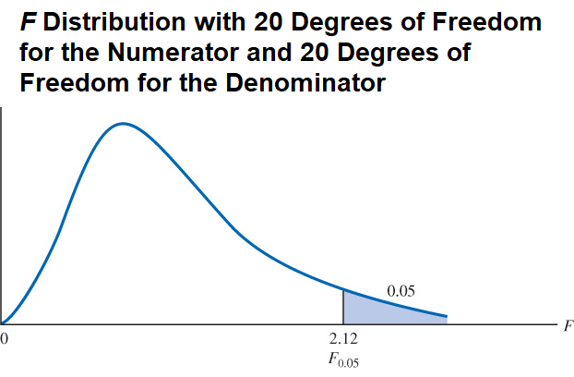
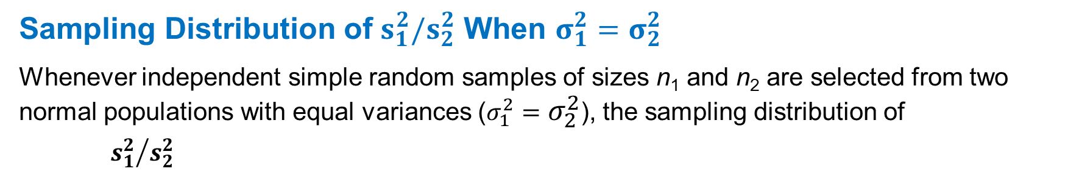
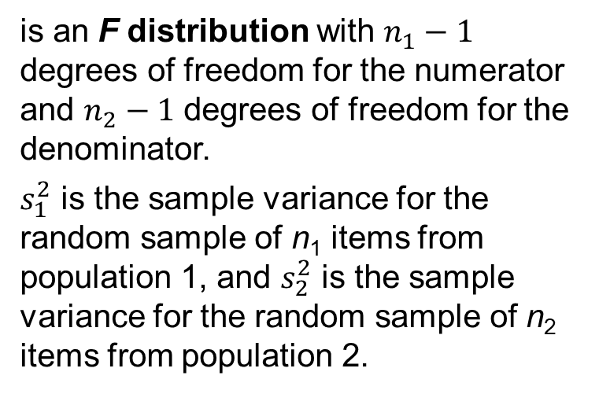
11.2 Inferences About Two Population Variances
Sampling Distribution of $s_{1}^{2}/s_{2}^{2}$ When $σ_{1}^{2}=σ_{2}^{2}$
Whenever independent simple random samples of sizes n₁ and n₂ are selected from two normal populations with equal variances ($σ_{1}^{2}=σ_{2}^{2}$), the sampling distribution of
$${s_{1}^{2}}/{s_{2}^{2}}$$
is an F distribution with $n_{1}−1$ degrees of freedom for the numerator and $n_{2}−1$ degrees of freedom for the denominator.
$s_{1}^{2}$ is the sample variance for the random sample of n₁ items from population 1, and $s_{2}^{2}$ is the sample variance for the random sample of n₂ items from population 2.

Slide 19
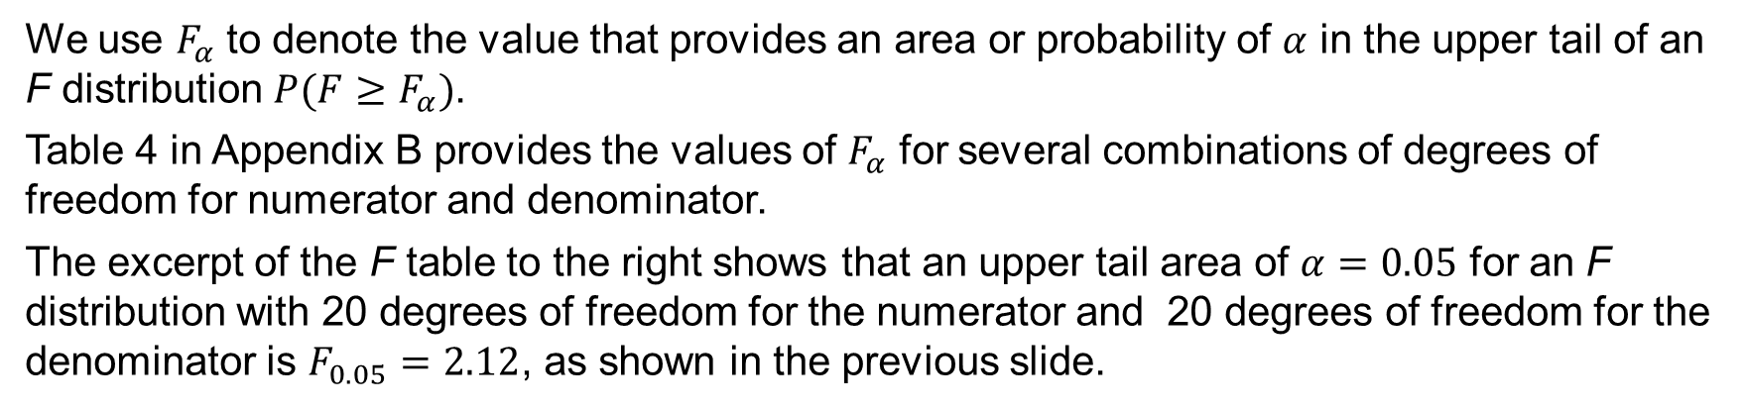
11.2 Extracting Values for the F Distribution
We use $F_{α}$ to denote the value that provides an area or probability of $α$ in the upper tail of an F distribution $P(F≥F_{α})$.
Table 4 in Appendix B provides the values of $F_{α}$ for several combinations of degrees of freedom for numerator and denominator.
The excerpt of the F table to the right shows that an upper tail area of $α=0.05$ for an F distribution with 20 degrees of freedom for the numerator and 20 degrees of freedom for the denominator is $F_{0.05}=2.12$, as shown in the previous slide.
Denominator Degrees of Freedom | Area in Upper Tail |  |  | Numerator Degrees of Freedom
 |  | 10 | 15 | 20 | 25 | 30
20 | 0.10 | 1.94 | 1.84 | 1.79 | 1.76 | 1.74
 | 0.05 | 2.35 | 2.20 | 2.12 | 2.07 | 2.04
 | 0.025 | 2.77 | 2.57 | 2.46 | 2.40 | 2.35
 | 0.01 | 3.37 | 3.09 | 2.94 | 2.84 | 2.78
We can also use Excel to compute $F_{α}$ as $\text{=}\text{F}\text{.}\text{INV}\text{.}\text{RT}\text{(0.05,20,20)}=2.12$

Slide 20
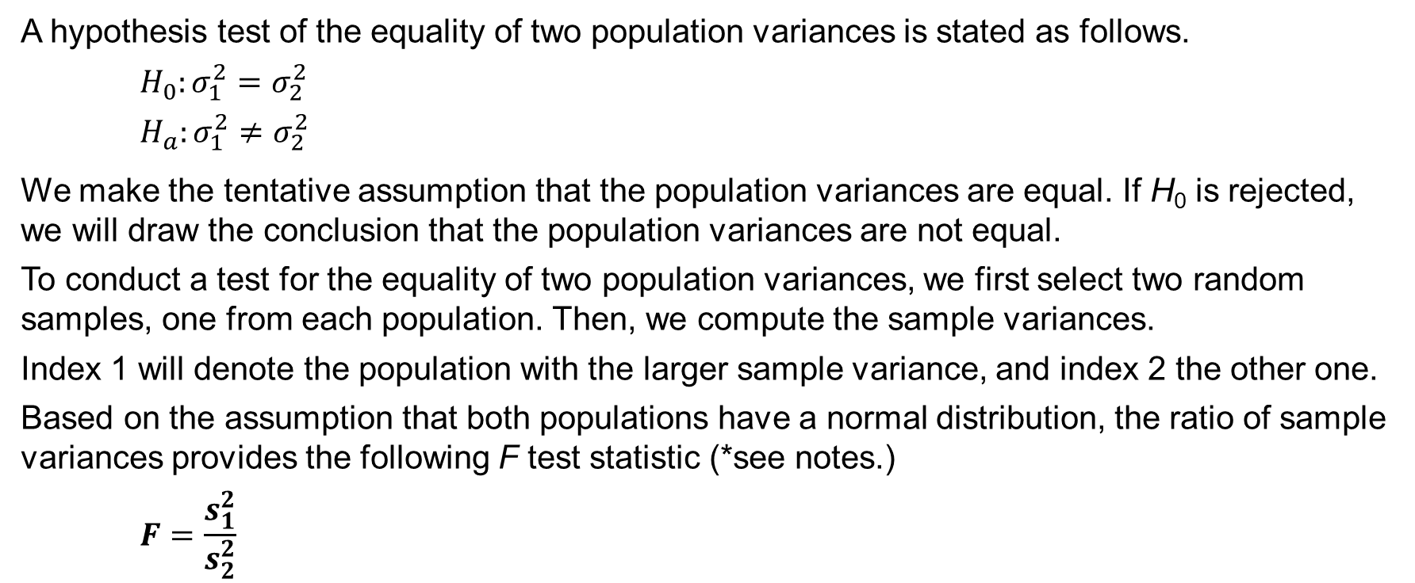
11.2 Hypothesis Test For the Equality of Two Population Variances
A hypothesis test of the equality of two population variances is stated as follows.
$$H_{0}:σ_{1}^{2}=σ_{2}^{2}$$
$$H_{a}:σ_{1}^{2}≠σ_{2}^{2}$$
We make the tentative assumption that the population variances are equal. If H₀ is rejected, we will draw the conclusion that the population variances are not equal.
To conduct a test for the equality of two population variances, we first select two random samples, one from each population. Then, we compute the sample variances.
Index 1 will denote the population with the larger sample variance, and index 2 the other one.
Based on the assumption that both populations have a normal distribution, the ratio of sample variances provides the following F test statistic (*see notes.)
$$F=\frac{s_{1}^{2}}{s_{2}^{2}}$$
Notes:
*Note: Because the F test statistic is constructed with the larger sample variance $s_{1}^{2}$ in the numerator, the value of the test statistic will be in the upper tail of the F distribution. Therefore, the F distribution table as shown in Table 4 in Appendix B need only provide upper tail areas or probabilities. If we did not construct the test statistic in this manner, lower tail areas or probabilities would be needed. In this case, additional calculations or more extensive F distribution tables would be required.

Slide 21
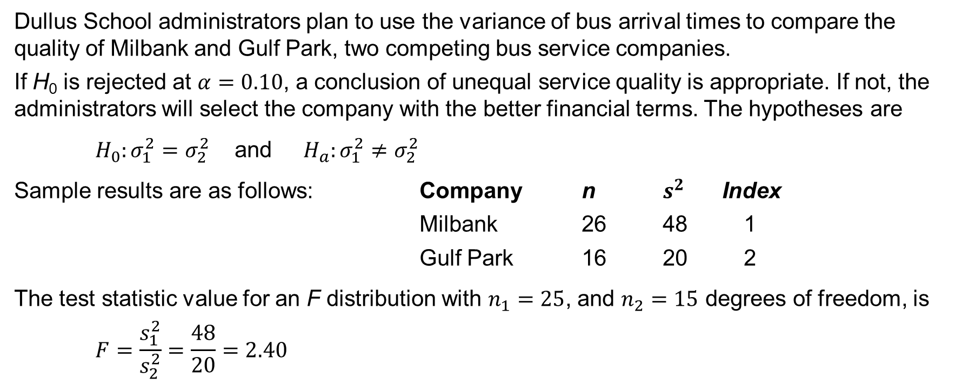
11.2 A Two-Tailed Test About the Equality of Two Population Variances
Dullus School administrators plan to use the variance of bus arrival times to compare the quality of Milbank and Gulf Park, two competing bus service companies.
If H₀ is rejected at $α=0.10$, a conclusion of unequal service quality is appropriate. If not, the administrators will select the company with the better financial terms. The hypotheses are
$H_{0}:σ_{1}^{2}=σ_{2}^{2}$ and $H_{a}:σ_{1}^{2}≠σ_{2}^{2}$
Sample results are as follows: Company n $s^{2}$ Index
Milbank 26 48 1
Gulf Park 16 20 2
The test statistic value for an F distribution with $n_{1}=25$, and $n_{2}=15$ degrees of freedom, is
$$F=\frac{s_{1}^{2}}{s_{2}^{2}}=\frac{48}{20}=2.40$$

Slide 22

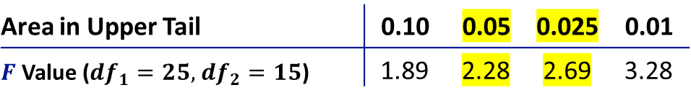
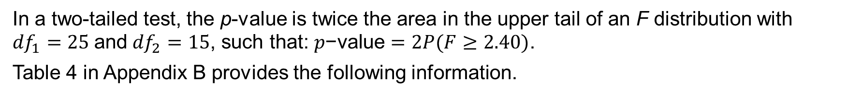
11.2 p-Value Approach to a Two-Tailed Test About Two Population Variances
In a two-tailed test, the p-value is twice the area in the upper tail of an F distribution with ${df}_{1}=25$ and ${df}_{2}=15$, such that: $p\text{−}\text{value}=2P(F≥2.40)$.
Table 4 in Appendix B provides the following information.
Area in Upper Tail | 0.10 | 0.05 | 0.025 | 0.01
$F$ Value (${df}_{1}=25,$ ${df}_{2}=15$) | 1.89 | 2.28 | 2.69 | 3.28
Thus, the p-value is twice the 0.025 to 0.05 range, or $0.05≤p\text{−}\text{value}≤ 0.10$.
Excel provides the exact p-value as $\text{=}\text{2}\text{∗}\text{F}\text{.}\text{DIST}\text{.}\text{RT}\text{(2.40,25,15)}=0.0812$
With $p\text{−}\text{value}≤α=0.10$, we reject the null hypothesis and conclude that the Dullus County School administrators give special consideration to the better (lower) variance service offered by the Gulf Park Company.

Slide 23
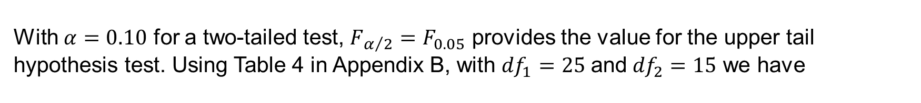
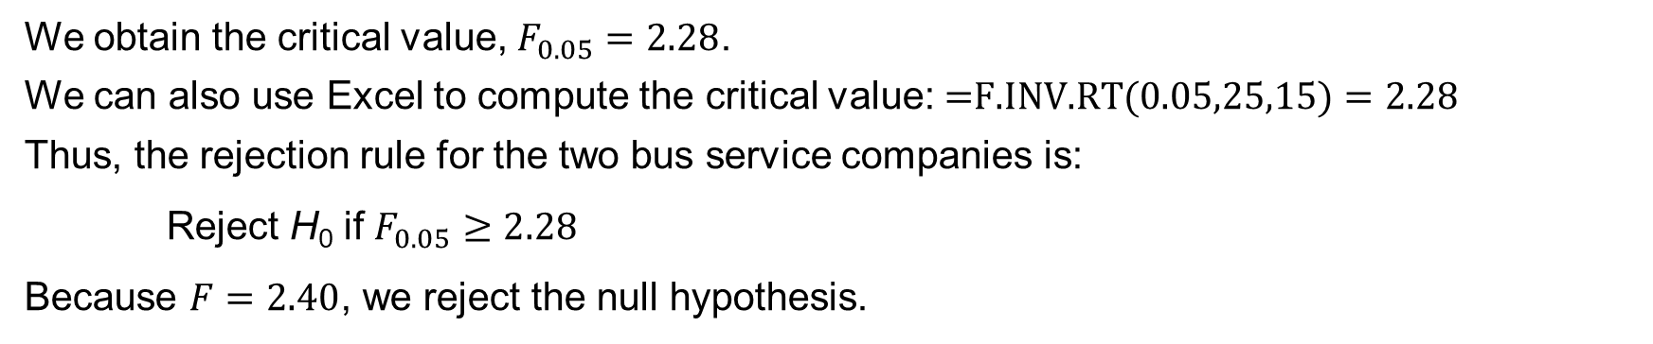
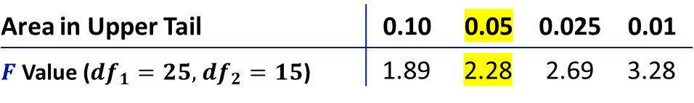
11.2 Critical Value Approach to a Two-Tailed Test About Two Population Variances
With $α=0.10$ for a two-tailed test, ${F_{α/2}=F}_{0.05}$ provides the value for the upper tail hypothesis test. Using Table 4 in Appendix B, with ${df}_{1}=25$ and ${df}_{2}=15$ we have
Area in Upper Tail | 0.10 | 0.05 | 0.025 | 0.01
$F$ Value (${df}_{1}=25,$ ${df}_{2}=15$) | 1.89 | 2.28 | 2.69 | 3.28
We obtain the critical value, $F_{0.05}=2.28$.
We can also use Excel to compute the critical value: $\text{=}\text{F}\text{.}\text{INV}\text{.}\text{RT}\text{(0.05,25,15)}=2.28$
Thus, the rejection rule for the two bus service companies is:
Reject H₀ if $F_{0.05}≥2.28$
Because $F=2.40$, we reject the null hypothesis.

Slide 24
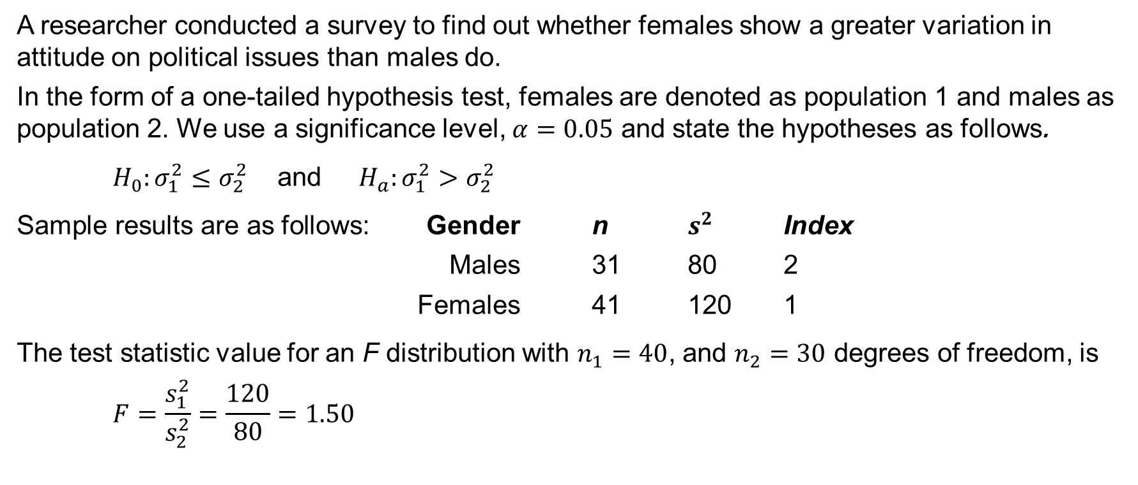
11.2 A One-Tailed Test About Two Population Variances
A researcher conducted a survey to find out whether females show a greater variation in attitude on political issues than males do.
In the form of a one-tailed hypothesis test, females are denoted as population 1 and males as population 2. We use a significance level, $α=0.05$ and state the hypotheses as follows.
$H_{0}:σ_{1}^{2}≤σ_{2}^{2}$ and $H_{a}:σ_{1}^{2}>σ_{2}^{2}$
Sample results are as follows: Gender n $s^{2}$ Index
Males 31 80 2
Females 41 120 1
The test statistic value for an F distribution with $n_{1}=40$, and $n_{2}=30$ degrees of freedom, is
$$F=\frac{s_{1}^{2}}{s_{2}^{2}}=\frac{120}{80}=1.50$$

Slide 25
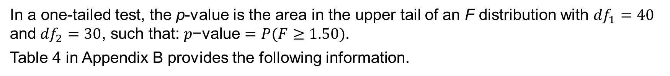
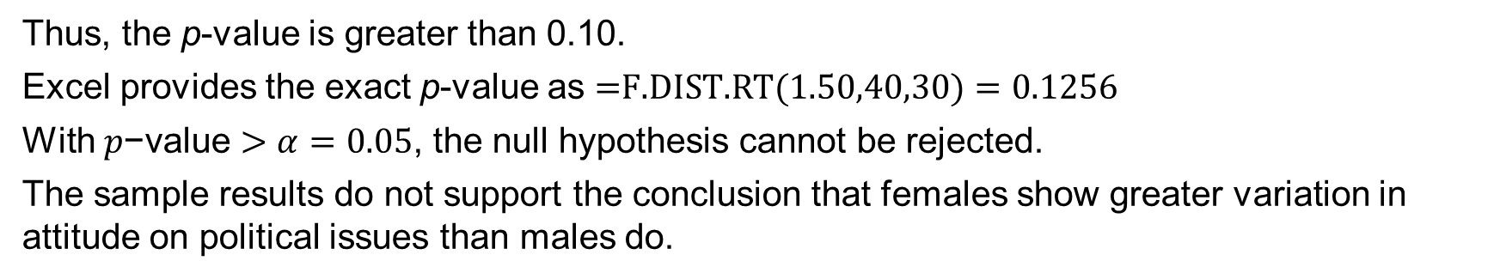
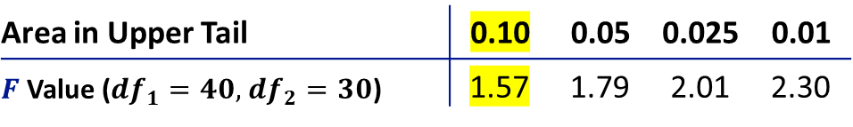
11.2 p-Value Approach to a One-Tailed Test About Two Population Variances
In a one-tailed test, the p-value is the area in the upper tail of an F distribution with ${df}_{1}=40$ and ${df}_{2}=30$, such that: $p\text{−}\text{value}=P(F≥1.50)$.
Table 4 in Appendix B provides the following information.
Area in Upper Tail | 0.10 | 0.05 | 0.025 | 0.01
$F$ Value (${df}_{1}=40,$ ${df}_{2}=30$) | 1.57 | 1.79 | 2.01 | 2.30
Thus, the p-value is greater than 0.10.
Excel provides the exact p-value as $\text{=}\text{F}\text{.}\text{DIST}\text{.}\text{RT}\text{(1.50,40,30)}=0.1256$
With $p\text{−}\text{value}>α=0.05$, the null hypothesis cannot be rejected.
The sample results do not support the conclusion that females show greater variation in attitude on political issues than males do.

Slide 26
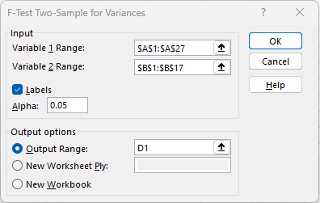
11.2 Excel: Dialog Box for F-Test: Two Sample for Variances Tool
Enter/Access Data: Open the file schoolbus, containing arrival times for the two companies.
Apply Tools: Follow these steps in the F-Test: Two Sample for Variances dialog box.
Step 1. Click the Data tab on the Ribbon
Step 2. In the Analyze group, click Data Analysis
Step 3. Choose F-Test: Two Sample for Variances from the list of Analysis Tools
Step 4. In the dialog box:
Enter A1:A27 in the Variable 1 Range: box
Enter B1:B17 in the Variable 2 Range: box
Select the check box for Labels
Enter 0.05 in the Alpha: box (note: this Excel procedure applies alpha to the upper tail)
Select Output Range: and enter D1 in the box
Click OK

Slide 27
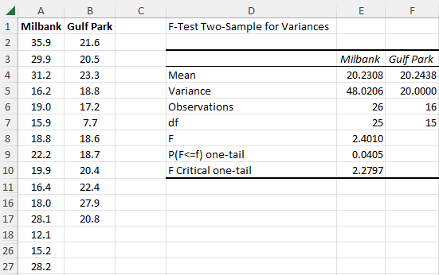
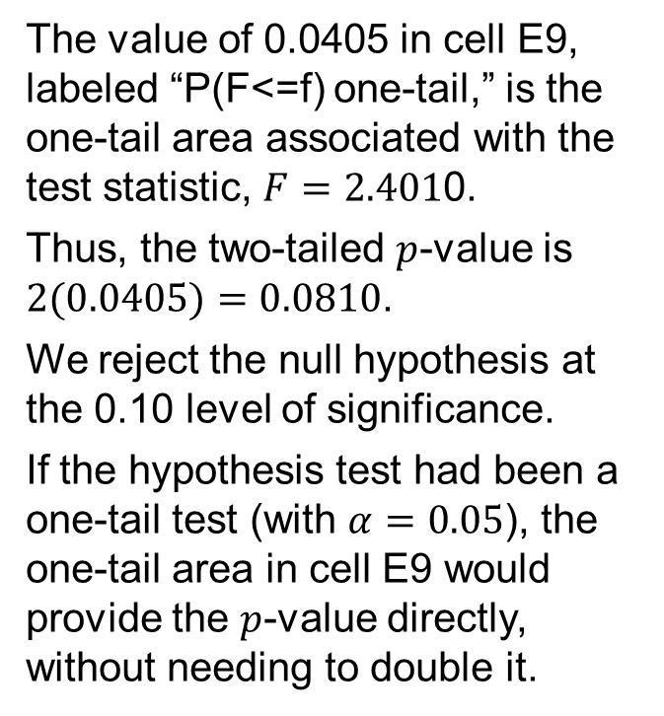
11.2 Excel: Conduct a Hypothesis Test
The descriptive statistics needed are provided in cells E4:F6.
The test statistic, $F=2.4010$, is located in cell E8.
The value of 0.0405 in cell E9, labeled “P(F<=f) one-tail,” is the one-tail area associated with the test statistic, $F=2.401$0.
Thus, the two-tailed $p$-value is $2(0.0405)=0.0810$.
We reject the null hypothesis at the 0.10 level of significance.
If the hypothesis test had been a one-tail test (with $α=0.05$), the one-tail area in cell E9 would provide the $p$-value directly, without needing to double it.

Slide 28
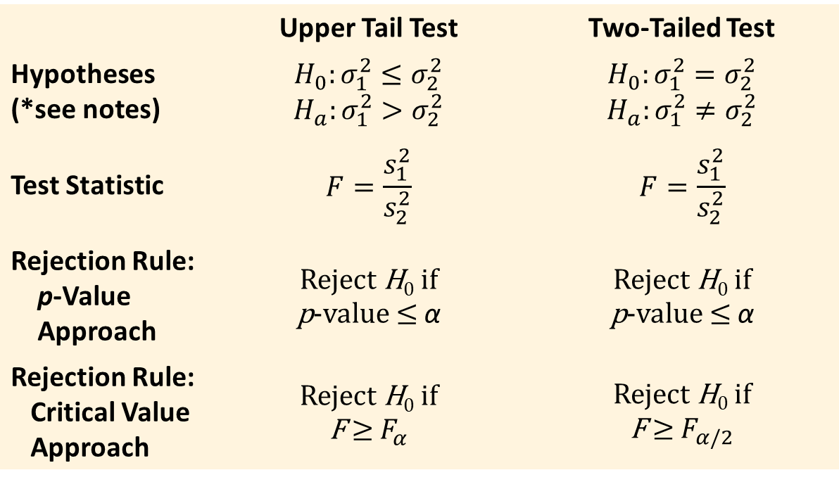
11.2 Summary of Hypothesis Tests About Two Population Variances
 | Upper Tail Test | Two-Tailed Test
Hypotheses (*see notes) | $$H_{0}:σ_{1}^{2}≤σ_{2}^{2}$$ $$H_{a}:σ_{1}^{2}>σ_{2}^{2}$$ | $$H_{0}:σ_{1}^{2}=σ_{2}^{2}$$ $$H_{a}:σ_{1}^{2}≠σ_{2}^{2}$$
Test Statistic | $$F=\frac{s_{1}^{2}}{s_{2}^{2}}$$ | $$F=\frac{s_{1}^{2}}{s_{2}^{2}}$$
Rejection Rule: p-Value Approach | Reject H₀ if p-value ≤ α | Reject H₀ if p-value ≤ α
Rejection Rule: Critical Value Approach | Reject H₀ if F ≥ $F_{α}$ | Reject H₀ if F ≥ $F_{α/2}$
Notes:
*Notes: population 1 has the larger variance.

Slide 29
Summary
In this chapter, we presented statistical procedures that can be used to make inferences about population variances.
In the process, we introduced two new probability distributions:
The chi-square distribution can be used as the basis for interval estimation and hypothesis tests about the variance of a normal population.
The F distribution can be used in hypothesis tests about the variances of two normal populations.

