Slide 1


Slide 2
Chapter Contents
13.1 An Introduction to Experimental Design and Analysis of Variance
13.2 Analysis of Variance and the Completely Randomized Design
13.3 Multiple Comparison Procedures
13.4 Randomized Block Design
13.5 Factorial Experiment
Summary

Slide 3
Chapter Objectives (1 of 2)
After completing this chapter, you will be able to:
LO 13-1 Compute the various components of an analysis of variance (ANOVA) table needed for testing of population means from a completely randomized design.
LO 13-2 Identify appropriate hypotheses to be tested with ANOVA.
LO 13-3 Test if the means of multiple populations are equal using ANOVA in a completely randomized design.
LO 13-4 Employ Fisher’s least significant difference (LSD) procedure to conduct statistical comparisons between pairs of population means.
LO 13-5 Use Fisher’s LSD procedure to estimate a confidence interval of the difference between means.

Slide 4
Chapter Objectives (2 of 2)
LO 13-6 Compute the various components of an ANOVA table needed for testing of population means from a randomized block design.
LO 13-7 Test if the means of multiple populations are equal using ANOVA in a randomized block design.
LO 13-8 Compute the various components of an ANOVA table needed for testing of population means from a factorial experiment.
LO 13-9 Test if the means of multiple populations are equal using ANOVA in a factorial experiment.

Slide 5
Introduction
Statistical studies can be classified as either experimental or observational.
In an experimental study, a variable of interest is identified, one or more other variables are identified and controlled, and data are collected about how those variables influence the variable of interest.
In an observational study, data are usually obtained through sample surveys that use good design principles, but the lack of rigorous controls associated with an experimental study prevents to establish cause-and-effect relationships.
In this chapter, we introduce three types of experimental designs:
a completely ran­domized design
a randomized block design
a factorial experiment.
For each design we show how analysis of variance (ANOVA) can be used to analyze the data available. ANOVA can also be used to analyze data obtained through observational studies.

Slide 6
13.1 An Introduction to Experimental Design and Analysis of Variance
Managers at Chemitech, Inc. want to implement an experimental study to determine which of three assembly methods can produce the greatest number of filtration systems per week.
In this example, the assembly method is an independent categorical variable, called the factor of the study, and it consists of three outcomes: method A, method B, and method C.
Each outcome is called a treatment. Each treatment defines one of the three populations of interest in the experimental study.
The Chemitech problem is an example of a single-factor experiment, as it involves one categorical factor (method of assembly.) More complex problems consisting of multiple factors are possible.
The dependent or response variable is the number of filtra­tion systems assembled per week.
The primary statistical objective of the experiment is to determine whether the mean number of units produced per week is the same for all three populations (methods).

Slide 7
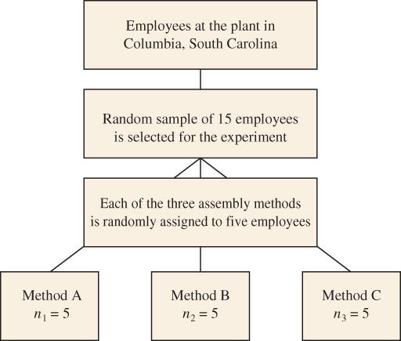
13.1 Data Collection
A random sample of 15 workers is selected from all assembly workers at the Chemitech production facility and each of the three assembly methods is randomly assigned to five employees.
In experimental design terminology, the 15 randomly selected workers are the experimental units, and the experimental design used is called a completely randomized design.
Because each method of assembly is assigned to five workers, we say that five replicates have been obtained.
The process of replication is another important principle of experimental design.

Slide 8
13.1 Hypothesis Test for a Completely Randomized Design
In the Chemitech case, each worker assembles for one week the new filtration systems using the assigned method after being trained, and the number of units assembled is recorded.
DATAFile: chemitech
The table to the right shows the sample mean, sample variance, and sample standard deviation for the three methods.
The objective is to determine whether the differences between the sample means are large enough to make a conclusion about differences existing between the underlying population means.
Method | A | B | C
 | 58 | 58 | 48
 | 64 | 69 | 57
 | 55 | 71 | 59
 | 66 | 64 | 47
 | 67 | 68 | 49
$\overline{x}$ | 62 | 66 | 52
$s^{2}$ | 27.5 | 26.5 | 31.0
$s$ | 5.244 | 5.148 | 5.568
In statistical terms, we write the hypotheses as follows, with index 1 corresponding to method A, index 2 to method B, and index 3 to method C.
$H_{o}: μ_{1}=μ_{2}=$ $μ_{3}$
$H_{a}:$ Not all population means are equal

Slide 9
13.1 Assumptions for Analysis of Variance
Analysis of variance (ANOVA) is the statistical procedure used to determine whether the observed differences in the three sample means are large enough to reject the null hypothesis.
Three assumptions are required to conduct an analysis of variance.
For each population, the response variable is normally distributed.
Implication: In the Chemitech experiment, the number of units produced per week (response variable) must be normally distributed for each assembly method.
The variance of the response variable, $σ^{2}$, is the same for all of the populations.
Implication: In the Chemitech experiment, the variance of the number of units produced per week must be the same for each assembly method.
The observations must be independent.
Implication: In the Chemitech experi­ment, the number of units produced per week for each worker must be independ­ent of the number of units produced per week for any other worker.

Slide 10
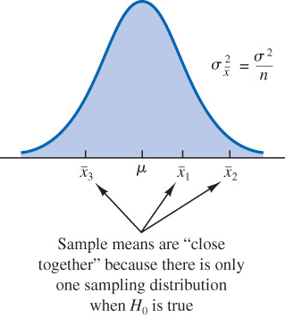
13.1 Analysis of Variance: a Conceptual Overview of the Sampling Distribution of $\overline{x}$ when H₀ Is True
if we assume the null hypothesis true, we can think of each of the three sample means, ${\overline{x}}_{1}=62$, ${\overline{x}}_{2}=66$, and${\overline{x}}_{3}=52$ as values drawn at random from the same sampling distribution of $\overline{x}$.
In this case, we can use the three sample means to estimate mean and variance of the sampling distribution of $\overline{x}$ as follows.
The overall sample mean: $\overset{̿}{x}={\left(62+66+52\right)}/3=60$
Variance of the sample means:
$s_{\overline{x}}^{2}={\left[{\left(62−60\right)}^{2}+{\left(66−60\right)}^{2}+{\left(52−60\right)}^{2}\right]}/{(3−1)}=52$
Because $σ_{\overline{x}}^{2}={σ^{2}}/n$, solving for $σ^{2}$ gives
$\text{Estimate} \text{of} σ^{2}=n(\text{Estimate} \text{of} σ_{\overline{x}}^{2})=ns_{\overline{x}}^{2}=5(52)=260$
$ns_{\overline{x}}^{2}$ is referred to as the between-treatments estimate of $σ^{2}$.

Slide 11
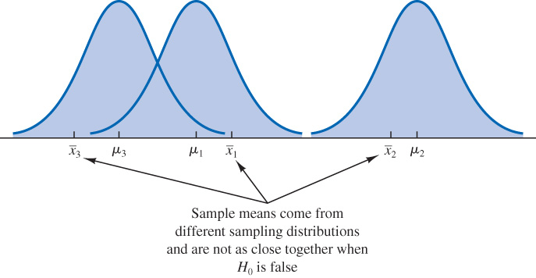
13.1 Analysis of Variance: a Conceptual Overview of the Sampling Distribution of $\overline{x}$ when H₀ Is False
If we assume the null hypothesis false, and suppose that the three population means all differ, then the three sample means must be drawn from distinct sampling distributions.
In this case, we provide an unbiased estimate of $σ^{2}$ by pooling the three sample variances, $s_{1}^{2}$, $s_{2}^{2}$, and $s_{3}^{2}$, into one overall estimate.
$\text{Estimate} \text{of} σ^{2}$:
$$={\left(27.5+26.5+31.0\right)}/3=28.33$$
This estimate of $σ^{2}$ is called the pooled or within-treatments estimate of $σ^{2}$.
In general, when the population means are not equal, the between­-treatments estimate seen in the previous slide will overestimate the population variance $σ^{2}$.

Slide 12
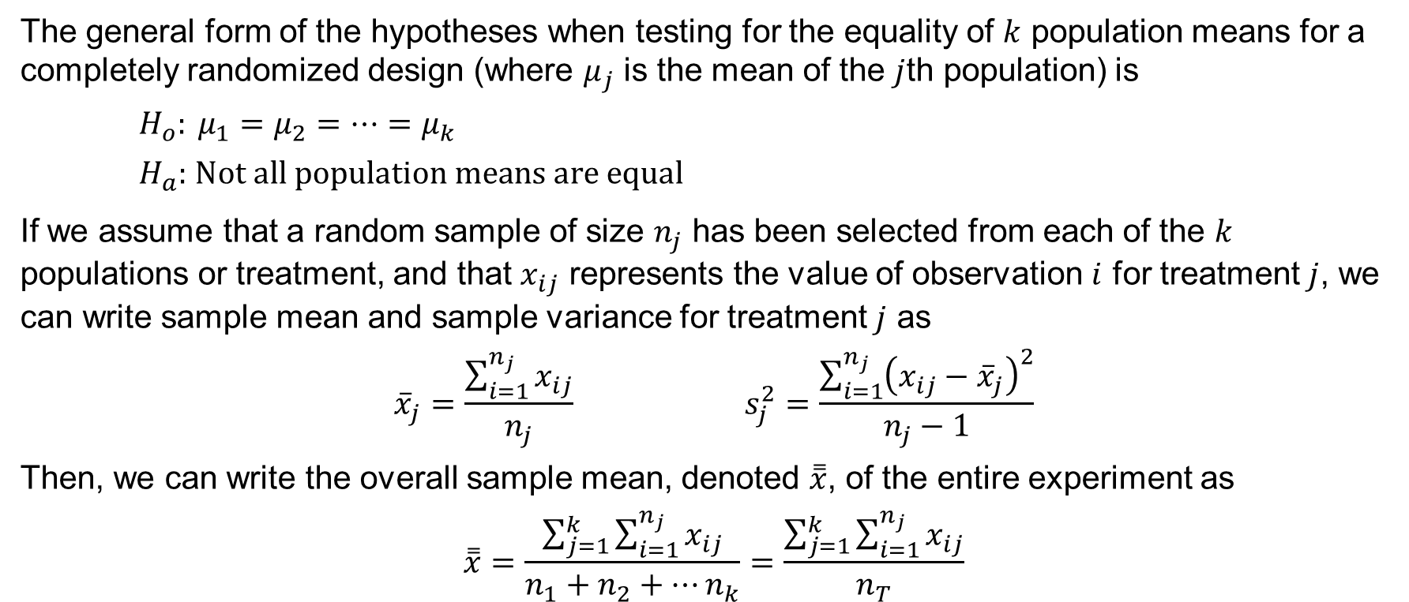
13.2 Analysis of Variance and the Completely Randomized Design
The general form of the hypotheses when testing for the equality of $k$ population means for a completely randomized design (where $μ_{j}$ is the mean of the $j$th population) is
$H_{o}: μ_{1}=μ_{2}=…{=μ}_{k}$
$H_{a}:$ $\text{Not} \text{all} \text{population} \text{means} \text{are} \text{equal}$
If we assume that a random sample of size $n_{j}$ has been selected from each of the $k$ populations or treatment, and that $x_{ij}$ represents the value of observation $i$ for treatment $j$, we can write sample mean and sample variance for treatment $j$ as
$${\overline{x}}_{j}=\frac{\sum_{i=1}^{n_{j}}{x_{ij}}}{n_{j}} s_{j}^{2}=\frac{\sum_{i=1}^{n_{j}}{{\left(x_{ij}−{\overline{x}}_{j}\right)}^{2}}}{n_{j}−1}$$
Then, we can write the overall sample mean, denoted $\overset{̿}{x}$, of the entire experiment as
$$\overset{̿}{x}=\frac{\sum_{j=1}^{k}{\sum_{i=1}^{n_{j}}{x_{ij}}}}{n_{1}+n_{2}+…n_{k}}=\frac{\sum_{j=1}^{k}{\sum_{i=1}^{n_{j}}{x_{ij}}}}{n_{T}}$$

Slide 13
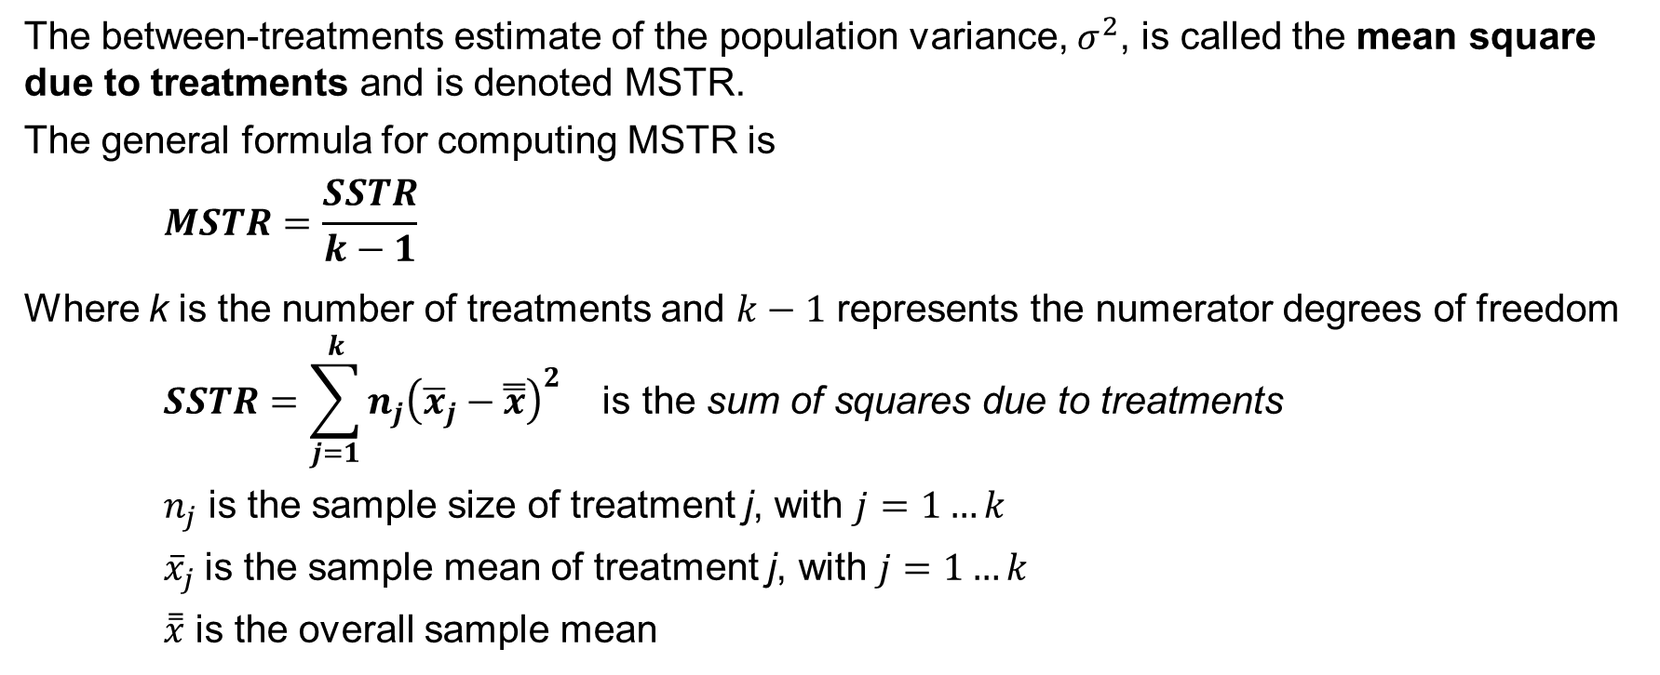
13.2 Between-Treatments Estimate of Population Variance
The between-treatments estimate of the population variance, $σ^{2}$, is called the mean square due to treatments and is denoted MSTR.
The general formula for computing MSTR is
$$MSTR=\frac{SSTR}{k−1}$$
Where k is the number of treatments and $k−1$ represents the numerator degrees of freedom
$$SSTR=\sum_{j=1}^{k}{n_{j}{\left({\overline{x}}_{j}−\overset{̿}{x}\right)}^{2}} \text{is} \text{the} \text{sum} \text{of} \text{squares} \text{due} \text{to} \text{treatments}$$
$n_{j}$ is the sample size of treatment j, with $j=1…k$
${\overline{x}}_{j}$is the sample mean of treatment j, with $j=1…k$
$\overset{̿}{x}$ is the overall sample mean

Slide 14
13.2 Within-Treatments Estimate of Population Variance
The within-treatments estimate of the population variance, $σ^{2}$, is called the mean square due to error and is denoted MSE.
Because MSE is based on the variation within each of the treatments, and it is not influenced by whether the null hypothesis is true, MSE always provides an unbiased estimate of $σ^{2}$.
The general formula for computing MSE is
$$MSE=\frac{SSE}{n_{T}−k}$$
Where $n_{T} \text{is} \text{the} \text{total} \text{number} \text{of} \text{observations}$ and $n_{T}−k$ the denominator degrees of freedom.
$$SSE=\sum_{j=1}^{k}{\left(n_{j}−1\right)s_{j}^{2}} \text{is} \text{the} \text{sum} \text{of} \text{squares} \text{due} \text{to} \text{error}$$
Where $s_{j}^{2}$ is the sample variance of treatment j, with $j=1…k$

Slide 15
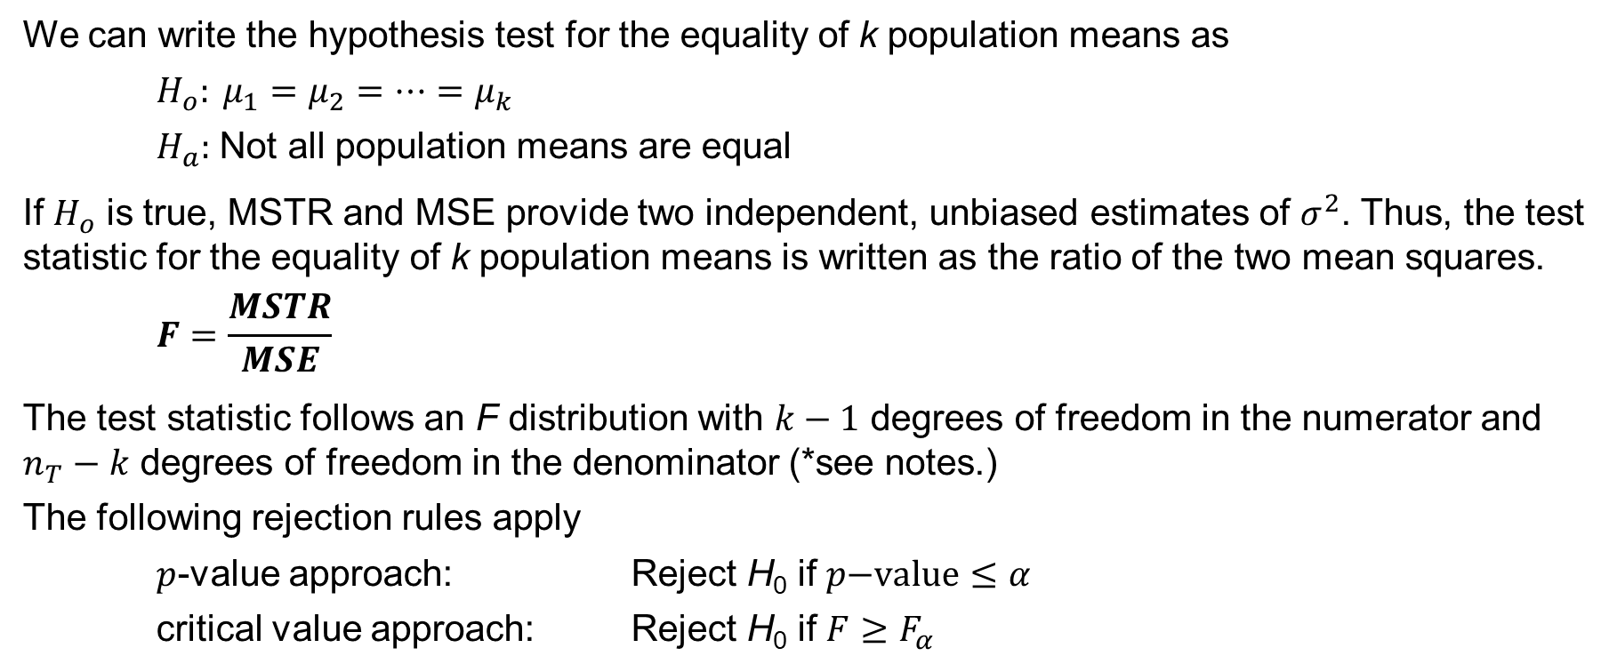
13.2 Comparing the Variance Estimates: The F Test
We can write the hypothesis test for the equality of k population means as
$H_{o}: μ_{1}=μ_{2}=…{=μ}_{k}$
$H_{a}:$ Not all population means are equal
If $H_{o}$ is true, MSTR and MSE provide two independent, unbiased estimates of $σ^{2}$. Thus, the test statistic for the equality of k population means is written as the ratio of the two mean squares.
$$F=\frac{MSTR}{MSE}$$
The test statistic follows an F distribution with $k−1$ degrees of freedom in the numerator and $n_{T}−k$ degrees of freedom in the denominator (*see notes.)
The following rejection rules apply
$p$-value approach: Reject H₀ if $p\text{−}\text{value}≤α$
critical value approach: Reject H₀ if $F≥F_{α}$
Notes:
*Note: we know from Chapter 11 that, for normal populations, the sampling distribution of the ratio of two independent estimates of $σ^{2}$ follows an F distribution.

Slide 16
13.2 Test Statistic for the Chemitech Completely Randomized Design
The calculations of the F statistic for the results of the Chemitech experiment are as follows.
$$SSTR=\sum_{j=1}^{3}{n_{j}{\left({\overline{x}}_{j}−\overset{̿}{x}\right)}^{2}}={5\left(62−60\right)}^{2}+{5\left(66−60\right)}^{2}+{5\left(52−60\right)}^{2}=520$$
$$MSTR={SSTR}/{\left(k−1\right)=}{520}/{(3−1)}=260$$
$$SSE=\sum_{j=1}^{3}{\left(n_{j}−1\right)s_{j}^{2}}=\left(5−1\right)27.5+\left(5−1\right)26.5+\left(5−1\right)31.0=340$$
$$MSE={SSE}/{\left(n_{T}−k\right)=}{340}/{(15−3)}=28.33$$
The test statistic for the equality of the population means for the three assembly methods is
$F={MSTR}/{MSE}={260}/{28.33}=9.18$

Slide 17
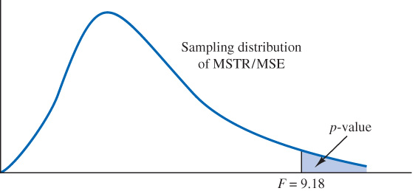
13.2 p-Value Approach to an F Test
In the Chemitech example, the p-value is the upper tail of an $F$ distribution with $k−1=3−1=2$ and $n_{T}−k=15−3=12$degrees of freedom.
Using Table 4 in Appendix B, the $F$ distribution with 2 and 12 degrees of freedom provides the following.
Area in upper tail | 0.10 | 0.05 | 0.025 | 0.01
$F$ Value (${df}_{1}=2,{df}_{2}=12$) | 2.81 | 3.89 | 5.10 | 6.93
Because $F=9.18$ is greater than 6.93, the values in the “Area in Upper Tail” row show that the p-value range must be: $p\text{−}\text{value}≤ 0.01$ (*see notes.)
Because $p\text{−}\text{value}≤α=0.05$, we reject the null hypothesis and conclude that the population mean number of units produced per week for the three assembly methods are not equal.
Notes:
*Note: using Excel, we have the exact p-value: $\text{=}\text{F}\text{.}\text{DIST}\text{.}\text{RT}\text{(9.18,2,12)}=0.004$

Slide 18
13.2 Critical Value Approach to an F Test
With $α=0.05$, $F_{α}=F_{0.05}$ provides the critical value for the upper tail F test. Using Table 4 in Appendix B, with 2 degrees of freedom at the numerator, and 12 degrees of freedom at the denominator, we obtain the critical value, $F_{0.05}=3.89$.
Area in upper tail | 0.10 | 0.05 | 0.025 | 0.01
$F$ Value (${df}_{1}=2,{df}_{2}=12$) | 2.81 | 3.89 | 5.10 | 6.93
We can also use Excel to compute the critical value, $F_{0.05} \text{=}\text{F}\text{.}\text{INV}\text{.}\text{RT}\text{(0.05,2,12)}=3.89$
Thus, the rejection rule for the F test is:
Reject H₀ if$F≥F_{0.05}=3.89$
Because $F=9.18$, we reject the null hypothesis and conclude that the population mean number of units produced per week for the three assembly methods are not equal.

Slide 19
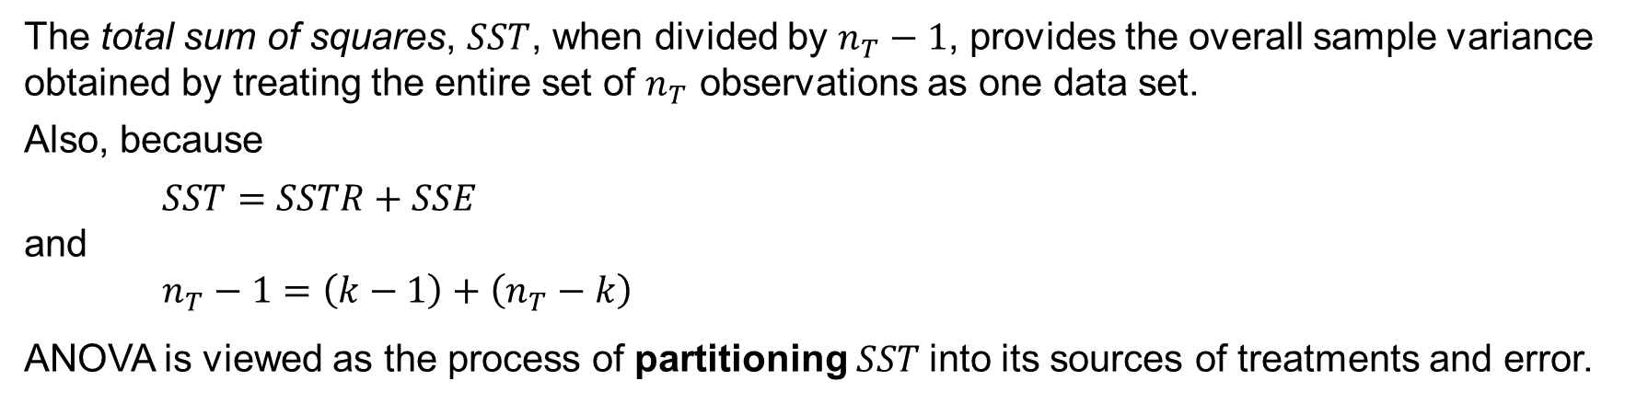
13.2 ANOVA Table for a Completely Randomized Design
The ANOVA table for a completely randomized design is formatted as follows
Source of Variation | Sum of Squares | Degrees of Freedom | Mean Squares | F | p-value
Treatments | SSTR | k − 1 | MSTR = SSTR / (k − 1) | MSTR / MSE | P(F ≥ MSTR / MSE)
Error | SSE | n_{T} − k | MSE = SSE / (n_{T} − k)
Total | SST | n_{T} − 1
The total sum of squares, $SST$, when divided by $n_{T}−1$, provides the overall sample variance obtained by treating the entire set of $n_{T}$ observations as one data set.
Also, because
$SST=SSTR+SSE$
and
$$n_{T}−1=\left(k−1\right)+\left(n_{T}−k\right)$$
ANOVA is viewed as the process of partitioning $SST$into its sources of treatments and error.

Slide 20
13.2 ANOVA Table for the Chemitech Experiment
In the ANOVA table for the Chemitech experiment, we have
Source of Variation | Sum of Squares | Degrees of Freedom | Mean Squares | F | p-value
Treatments | 520 | 2 | 260 | 9.18 | 0.004
Error | 340 | 12 | 28.33
Total | 860 | 14
Where
$SST=SSTR+SSE=520+340=860$
$n_{T}−1=\left(k−1\right)+\left(n_{T}−k\right)=\left(3−1\right)+\left(15−3\right)=2+12=14$
$MSTR={SSTR}/{\left(k−1\right)}={520}/2=260$
$MSE={SSE}/{\left(n_{T}−k\right)}={340}/{12}=28.33$
$F={MSTR}/{MSE={260}/{28.33}=9.18}$

Slide 21
13.2 Interval Estimate of the Population Means
The square root of MSE provides the best estimate of the population standard deviation σ.
$s=\sqrt{MSE}=\sqrt{28.33}=5.323$
This estimate of σ is a pooled standard deviation because it is derived from MSE.
From our study of interval estimation in Chapter 8, we know that we can write the interval estimate of the population mean for method A of the Chemitech example as
$${\overline{x}}_{1}±t_{α/2}\frac{s}{\sqrt{n_{1}}}$$
The degrees of freedom for $t_{α/2}$ is $n_{T}−k=12$. Using $1−α=0.95$, we have
$${\overline{x}}_{1}±t_{.025}\frac{s}{\sqrt{n_{1}}}=62±2.179\frac{5.323}{\sqrt{5}}=62±5.19$$
The 95% confidence interval for method A goes from $62−5.19=56.81$ to $62+5.19=67.19$.
Similar calculations for methods B and C lead to $(60.81, 71.19)$ and $(46.81, 57.19)$.

Slide 22
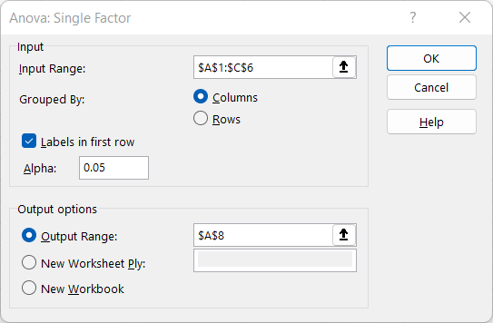
13.2 Excel: Dialog Box for the ANOVA: Single Factor Tool
Excel’s Anova: Single Factor tool can be used to conduct a hypothesis test about the difference between the population means for the Chemitech experiment.
Enter/Access Data: Open the file chemitech. The data are in cells A1:C6.
Apply Tools: Follow these steps in the ANOVA: Single Factor dialog box.
Step 1. Click the Data tab on the Ribbon
Step 2. In the Analyze group, click Data Analysis
Step 3. Choose ANOVA: Single Factor from the list of Analysis Tools
Step 4. In the dialog box:
Enter A1:C6 in the Input Range: box
Select Columns in the Grouped By: area
Select the check box for Labels in First Row
In the Output options area, select Output Range: and enter A8.
Click OK

Slide 23
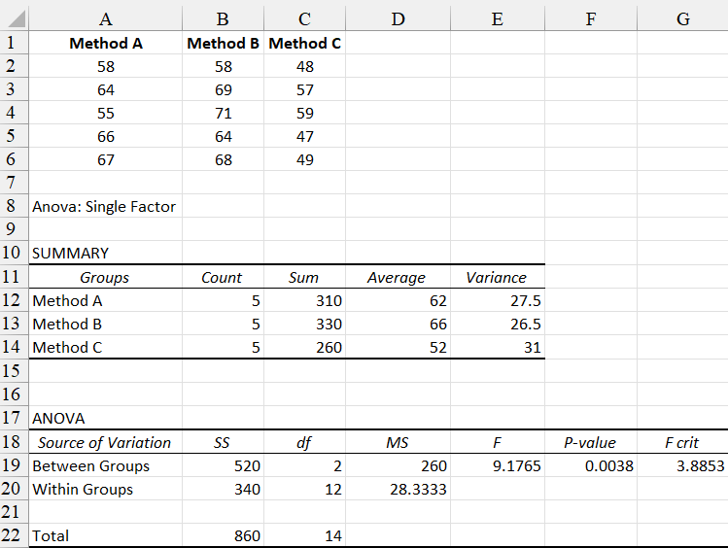
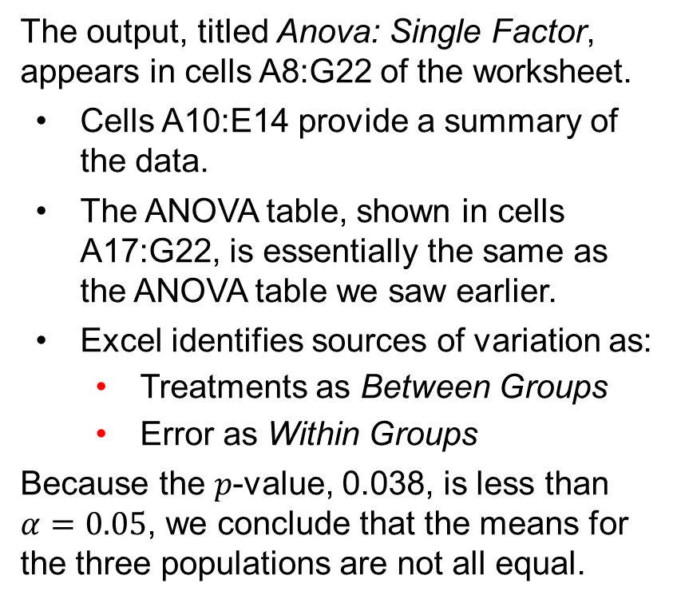
13.2 Excel: Conduct ANOVA for a Completely Randomized Design
The output, titled Anova: Single Factor, appears in cells A8:G22 of the worksheet.
Cells A10:E14 provide a summary of the data.
The ANOVA table, shown in cells A17:G22, is essentially the same as the ANOVA table we saw earlier.
Excel identifies sources of variation as:
Treatments as Between Groups
Error as Within Groups
Because the 𝑝-value, 0.038, is less than $α=0.05$, we conclude that the means for the three populations are not all equal.

Slide 24
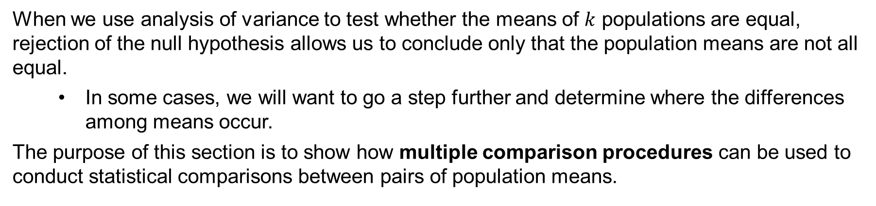
13.3 Multiple Comparison Procedures
When we use analysis of variance to test whether the means of $k$ populations are equal, rejection of the null hypothesis allows us to conclude only that the population means are not all equal.
In some cases, we will want to go a step further and determine where the differences among means occur.
The purpose of this section is to show how multiple comparison procedures can be used to conduct statistical comparisons between pairs of population means.

Slide 25
13.3 Fisher’s LSD Procedure
A multiple comparison procedure such as Fisher’s Least Significant Difference (LSD) can be used to conduct statistical comparisons between pairs of population means.
The Fisher’s LSD procedure for the comparisons of $μ_{i}$ and $μ_{j}$, can be summarized as follows.
$H_{o}: μ_{i}=μ_{j}$
$H_{a}:$ $μ_{i}≠μ_{j}$
Test statistic:
$$t=\frac{{\overline{x}}_{i}−{\overline{x}}_{j}}{\sqrt{MSE\left(\frac{1}{n_{i}}+\frac{1}{n_{j}}\right)}}$$
The following rejection rules apply p-value approach: Reject H₀ if $\text{p}\text{−}\text{value}≤α$
critical value approach: Reject H₀ if $t≤{−t}_{α/2}$ or $t≥t_{α/2}$

Slide 26
13.3 Fisher’s LSD Procedure Based on the Test Statistic ${\overline{x}}_{i}−{\overline{x}}_{j}$
Many practitioners find easier to determine how large the difference between the sample means must be to reject H₀. Thus, this version of the Fisher’s LSD procedure is preferred.
$H_{o}: μ_{i}=μ_{j}$
$H_{a}:$ $μ_{i}≠μ_{j}$
Rejection rule at a level of significance, α
Reject H₀ if $\left|{\overline{x}}_{i}−{\overline{x}}_{j}\right|≥LSD$
Where
${\overline{x}}_{i}−{\overline{x}}_{j}=$ test statistic
$$LSD=t_{α/2}\sqrt{MSE\left(\frac{1}{n_{i}}+\frac{1}{n_{j}}\right)}$$

Slide 27
13.3 Application of the Fisher’s LSD Procedure
Let us apply the Fisher’s LSD procedure to determine whether the population means of method A and method C are different, at a significance level, $α=0.05$.
The test statistic is ${\overline{x}}_{1}−{\overline{x}}_{3}=62−52=10$
For a two-tail test, Table 2 in Appendix B provides $t_{0.025}=2.179$ with 12 degrees of freedom.
Area in upper tail | 0.20 | 0.10 | 0.05 | 0.025 | 0.01 | 0.005
$t$ Value ($df=12$) | 0.873 | 1.356 | 1.782 | 2.179 | 2.681 | 3.055
Thus, we have
$$LSD=t_{α/2}\sqrt{MSE\left(\frac{1}{n_{1}}+\frac{1}{n_{3}}\right)}=2.179\sqrt{28.33\left(\frac{1}{5}+\frac{1}{5}\right)}=7.34$$
Because $\left|{\overline{x}}_{1}−{\overline{x}}_{3}\right|=10≥7.34$, we reject H₀ and conclude that the population means for method A and method C differ.

Slide 28
13.3 Fisher’s LSD Procedure for the Complete Chemitech Example
Because the sample sizes for the three treatments in the Chemitech example are equal, $n_{1}=n_{2}=n_{3}=5$, it follows that only one value for LSD needs to be computed.
The computations for the remaining pairwise test statistics are
method A vs. method B: ${\overline{x}}_{1}−{\overline{x}}_{2}=62−66=−4$
method B vs. method C: ${\overline{x}}_{2}−{\overline{x}}_{3}=66−52=14$
Using $LSD=7.34$ calculated for the method A vs. method C comparison in the previous slide, we have the following rejection rules for the remaining pairwise comparisons.
method A vs. method B: $\left|{\overline{x}}_{1}−{\overline{x}}_{2}\right|=4<7.34$ Do not reject H₀
method B vs. method C: $\left|{\overline{x}}_{2}−{\overline{x}}_{3}\right|=14≥7.34$ Reject H₀
Thus, we conclude that the population means for method A and method B both differ from the population mean for method C.

Slide 29
13.3 Confidence Interval Estimate of $μ_{1}−μ_{2}$ Using Fisher’s LSD Procedure
The general procedure to develop a confidence interval estimate of $μ_{1}−μ_{2}$ is
${\overline{x}}_{i}−{\overline{x}}_{j}±LSD$
Where $t_{α/2}$ is based on a t distribution with $n_{T}−k$ degrees of freedom.
For the Chemitech experiment, we found $LSD=7.34$.
The 95% confidence interval estimates for the difference between each pairs of population means in the Chemitech example follow.
method A vs. method B: ${\overline{x}}_{1}−{\overline{x}}_{2}±LSD=−4±7.34=(−11.34, 3.34)$
method A vs. method C: ${\overline{x}}_{1}−{\overline{x}}_{3}±LSD=10±7.34=(2.66, 17.34)$
method B vs. method C: ${\overline{x}}_{2}−{\overline{x}}_{3}±LSD=14±7.34=(6.66, 21.34)$
Because the interval estimate for $μ_{1}−μ_{2}$ includes zero, we cannot reject H₀ for the method A vs method B pair of treatment means.

Slide 30
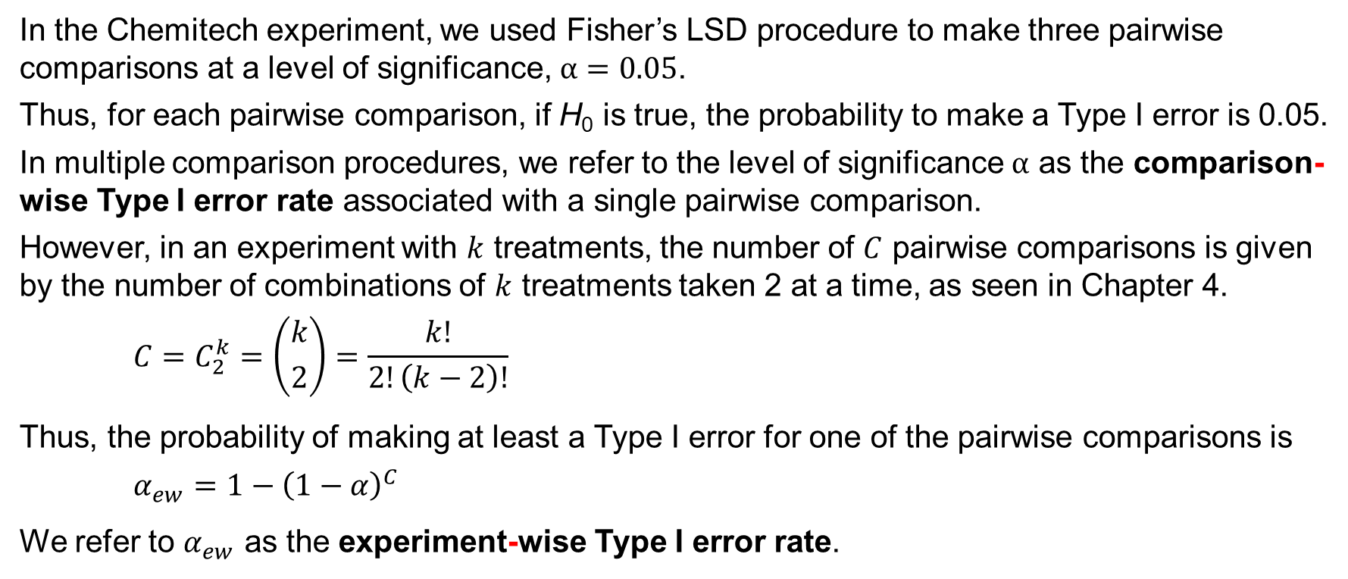
13.3 Type I Error Rates
In the Chemitech experiment, we used Fisher’s LSD procedure to make three pairwise comparisons at a level of significance, $α=0.05$.
Thus, for each pairwise comparison, if H₀ is true, the probability to make a Type I error is 0.05.
In multiple comparison procedures, we refer to the level of significance $α$ as the comparison-wise Type I error rate associated with a single pairwise comparison.
However, in an experiment with $k$ treatments, the number of $C$ pairwise comparisons is given by the number of combinations of $k$ treatments taken 2 at a time, as seen in Chapter 4.
$$C=C_{2}^{k}=\left({k \atop 2}\right)=\frac{k!}{2!\left(k−2\right)!}$$
Thus, the probability of making at least a Type I error for one of the pairwise comparisons is
$$α_{ew}=1−{\left(1−α\right)}^{C}$$
We refer to $α_{ew}$ as the experiment-wise Type I error rate.

Slide 31
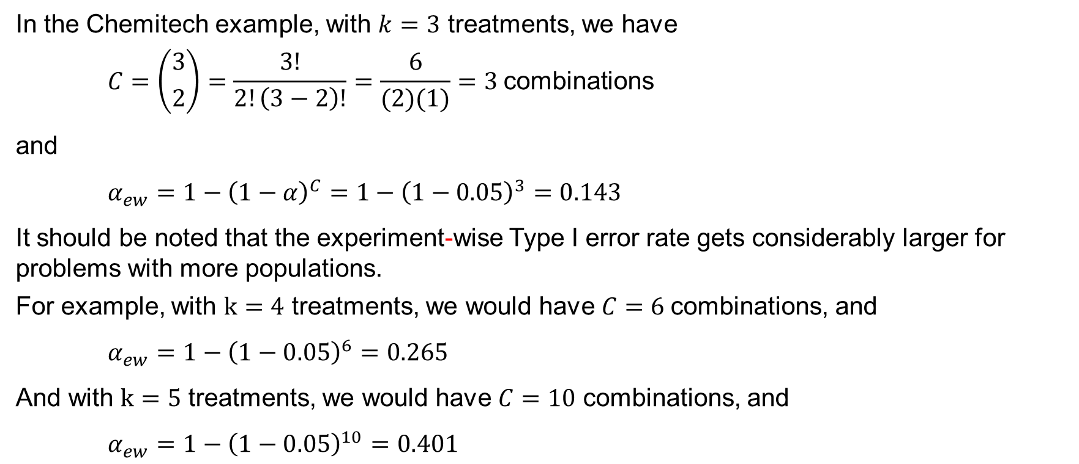
13.3 Type I Error Rates for the Chemitech Experiment
In the Chemitech example, with $k=3$ treatments, we have
$$C=\left({3 \atop 2}\right)=\frac{3!}{2!\left(3−2\right)!}=\frac{6}{(2)(1)}=3 \text{combinations}$$
and
$α_{ew}=1−{\left(1−α\right)}^{C}=1−{\left(1−0.05\right)}^{3}=0.143$
It should be noted that the experiment-wise Type I error rate gets considerably larger for problems with more populations.
For example, with $k=4$ treatments, we would have $C=6$combinations, and
$α_{ew}=1−{\left(1−0.05\right)}^{6}=0.265$
And with $k=5$ treatments, we would have $C=10$ combinations, and
$α_{ew}=1−{\left(1−0.05\right)}^{10}=0.401$

Slide 32
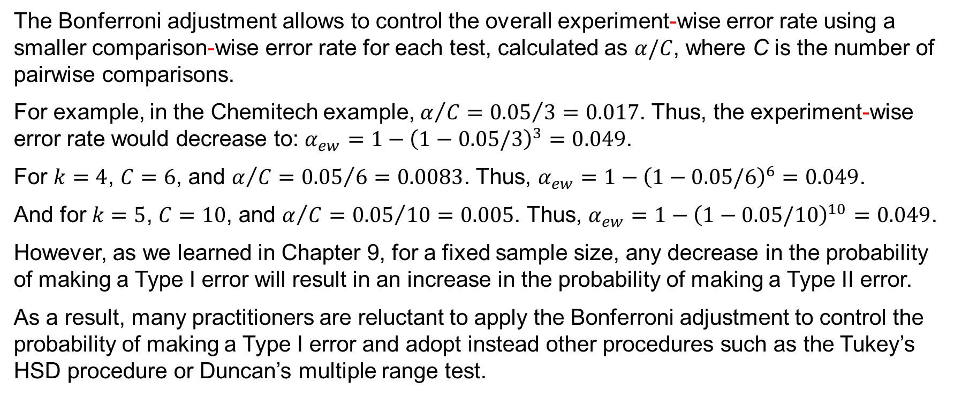
13.3 Bonferroni Adjustment
The Bonferroni adjustment allows to control the overall experiment-wise error rate using a smaller comparison-wise error rate for each test, calculated as $α/C$, where C is the number of pairwise comparisons.
For example, in the Chemitech example, $α/C={0.05}/3=0.017$. Thus, the experiment-wise error rate would decrease to: $α_{ew}=1−{\left(1−0.05/3\right)}^{3}=0.049$.
For $k=4$, $C=6$, and $α/C={0.05}/6=0.0083$. Thus, $α_{ew}=1−{\left(1−0.05/6\right)}^{6}=0.049$.
And for $k=5$, $C=10$, and $α/C={0.05}/{10}=0.005$. Thus, $α_{ew}=1−{\left(1−0.05/10\right)}^{10}=0.049$.
However, as we learned in Chapter 9, for a fixed sample size, any decrease in the probability of making a Type I error will result in an increase in the probability of making a Type II error.
As a result, many practitioners are reluctant to apply the Bonferroni adjustment to control the probability of making a Type I error and adopt instead other procedures such as the Tukey’s HSD procedure or Duncan’s multiple range test.

Slide 33
13.4 Randomized Block Design
Recollect how in the completely randomized design, the treatments are randomly assigned to the experimental units.
A problem can arise whenever differences due to extraneous factors (ones not con­sidered in the experiment) cause the experimental units to be heterogeneous.
When that happens, the MSE term becomes large, making the F statistic smaller, and signaling no difference among treatment means when in fact such a difference exists.
A randomized block design controls some of the extraneous sources of variation by blocking the experimental units into homogenous group, thus removing the sources of variation from the MSE term.
A randomized block design provides a better estimate of the true error variance and leads to a more powerful hypothesis test in terms of its ability to detect differences among treatment means.

Slide 34
13.4 ANOVA Table for a Randomized Block Design
The ANOVA procedure for the randomized block design partitions the total sum of squares (SST) into three groups: sum of squares due to treatments (SSTR), sum of squares due to blocks (SSBL), and sum of squares due to error (SSE).
$SST=SSTR+SSBL+SSE$
The total degrees of freedom, $n_{T}−1$, are partitioned so that
$n_{T}−1=\left(k−1\right)+\left(b−1\right)+\left(k−1\right)\left(b−1\right)$
Where k is the number of treatments, b the number of blocks, and $n_{T}=kb$ the total number of observations.
Source of Variation | Sum of Squares | Degrees of Freedom | Mean Squares | F | p-value
Treatments | SSTR | k − 1 | MSTR = SSTR / (k − 1) | MSTR / MSE | P(F ≥ MSTR / MSE)
Blocks | SSBL | b − 1 | MSBL = SSBL / (b − 1)
Error | SSE | (k − 1)(b − 1) | MSE = SSE / [(k − 1)(b − 1)]
Total | SST | n_{T} − 1

Slide 35
13.4 Air Traffic Controller Stress Test
DATAfile: airtraffic
Three workstation alternatives (system A, system B, and system C) have been selected as having the best potential for reducing fatigue and stress of air traffic controllers.
To account for the within-­group source of variation (MSE) due to individual controller differences, a randomized block design was selected.
In experimental design terminology:
the workstation is the factor of interest
the three workstation alternatives (systems A, B, and C) are the three treatments
the sample of six controllers assigned to each treatment are the blocks
The randomized aspect of the randomized block design is the random order in which the treatments (systems) are assigned to the controllers.
The response variable is the stress level on each system measured for each participating controller during a follow-up interview and medical examination.

Slide 36
13.4 Summary of Stress Data for the Air Traffic Controller Stress Test
 |  |  | Treatments
 |  | System A | System B | System C | Row or Block Totals | Block Means
Blocks | Controller 1 Controller 2 Controller 3 Controller 4 Controller 5 Controller 6 | 15 14 10 13 16 13 | 15 14 11 12 13 13 | 18 14 15 17 16 13 | 48 42 36 42 45 39 | $${\overline{x}}_{1∙}={48}/3=16.0$$ $${\overline{x}}_{2∙}={42}/3=14.0$$ $${\overline{x}}_{3∙}={36}/3=12.0$$ $${\overline{x}}_{4∙}={42}/3=14.0$$ $${\overline{x}}_{5∙}={45}/3=15.0$$ $${\overline{x}}_{6∙}={39}/3=13.0$$
Column or Treatment Totals |  | 81 | 78 | 93 | 252 | $$\overset{̿}{x}=\frac{252}{18}=14.0$$
Treatment Means |  | $${\overline{x}}_{∙1}=\frac{81}{6}$$ $=13.5$ | $${\overline{x}}_{∙2}=\frac{78}{6}$$ $=13.0$ | $${\overline{x}}_{∙3}=\frac{93}{6}$$ $=15.5$

Slide 37
13.4 Computations for the Air Traffic Controller Stress Test
Step 1. Compute the total sum of squares (SST)
$$SST=\sum_{i=1}^{b}{\sum_{j=1}^{k}{{\left(x_{ij}−\overset{̿}{x}\right)}^{2}}}={(15−14)}^{2}+{(15−14)}^{2}+{(18−14)}^{2}+\text{…}+{(13−14)}^{2}=70$$
Step 2. Compute the sum of squares due to treatments (SSTR)
$$SSTR=b\sum_{j=1}^{k}{{\left({\overline{x}}_{∙j}−\overset{̿}{x}\right)}^{2}}=6\left[{(13.5−14)}^{2}+{(13.0−14)}^{2}+{(15.5−14)}^{2}\right]=21$$
Step 3. Compute the sum of squares due to blocks (SSBL)
$$SSBL=k\sum_{i=1}^{b}{{\left({\overline{x}}_{i∙}−\overset{̿}{x}\right)}^{2}}=3\left[{(16.0−14)}^{2}+{(14.0−14)}^{2}+{(12.0−14)}^{2}+\text{…}+{(13.0−14)}^{2}\right]=30$$
Step 4. Compute the sum of squares due to error (SSE)
$SSE=SST−SSTR−SSBL=70−21−30=19$

Slide 38
13.4 ANOVA Table for the Air Traffic Controller Stress Test
The sums of squares computed in the four steps and divided by their degrees of freedom, provide the corresponding mean square values shown in the ANOVA table below.
The ratio of MSRT and MSE produces the test statistic: $F={MSRT}/{MSE={10.5}/{1.9}=5.53}$
Table 4 in Appendix B, with degrees of freedom $k−1=2$ for the numerator, and $(k−1)(b−1)=10$ for the denominator, indicates that $F=5.53$ is between $F_{.025}=5.46$ and $F_{.01}=7.56$.
Area in Upper Tail | 0.10 | 0.05 | 0.025 | 0.01
$F$ Value (${df}_{1}=2,$ ${df}_{2}=10$) | 2.92 | 4.10 | 5.46 | 7.56
The p-value is the area in the upper tail: $0.01≤p\text{−}\text{value}≤ 0.025$.
Thus, we reject H₀ and conclude that at least one population mean stress level differs.
Source of Variation | Sum of Squares | Degrees of Freedom | Mean Squares | F | p-value
Treatments | 21 | 2 | 10.5 | 10.5 / 1.9 = 5.53 | 0.024
Blocks | 30 | 5 | 6.0
Error | 19 | 10 | 1.9
Total | 70 | 17

Slide 39
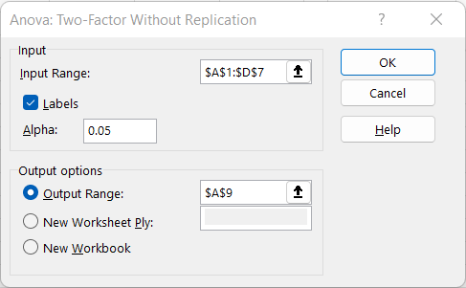
13.4 Excel: Dialog Box for the ANOVA: Two-Factor Without Replication Tool
Excel’s Anova: Two-Factor Without Replication tool is used for a randomized block design.
Enter/Access Data: Open the file airtraffic. The data and labels are in cells A1:D7.
Apply Tools: Follow these steps in the ANOVA: Two-Factor Without Replication dialog box.
Step 1. Click the Data tab on the Ribbon
Step 2. In the Analyze group, click Data Analysis
Step 3. Choose ANOVA: Two-Factor Without Replication from the list of Analysis Tools
Step 4. In the dialog box:
Enter A1:D7 in the Input Range: box
Select the check box for Labels in First Row
In the Output options area, select Output Range: and enter A9.
Click OK

Slide 40
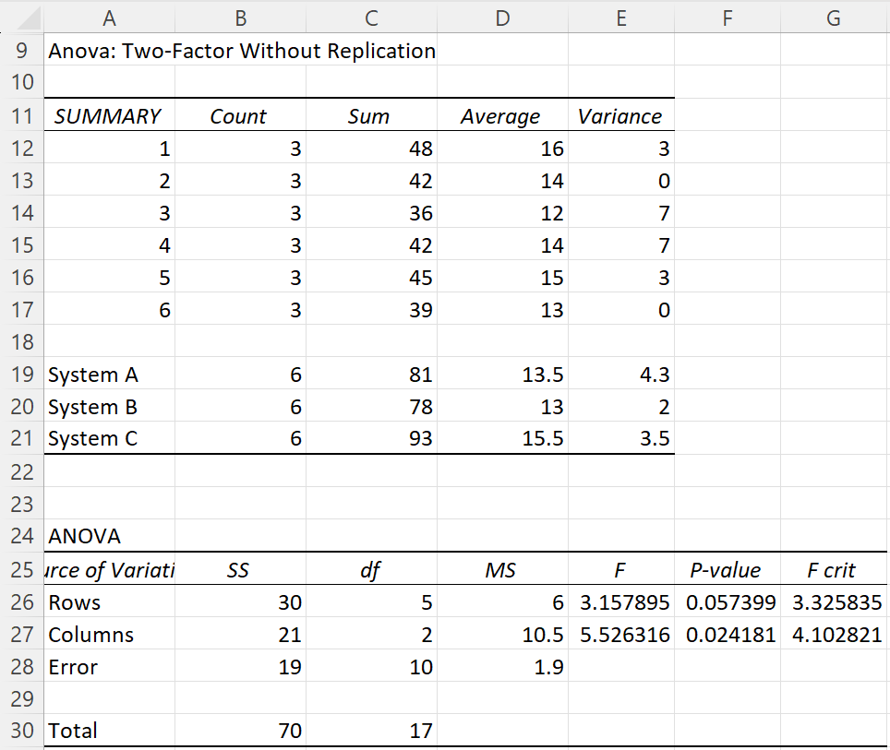
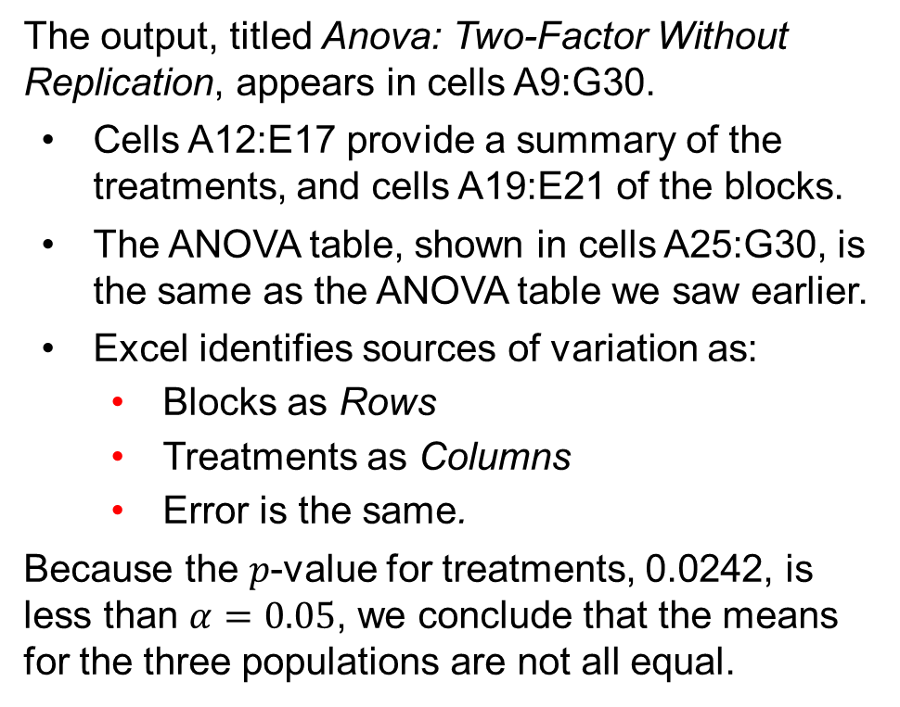
13.4 Excel: Conduct ANOVA for a Randomized Block Design
The output, titled Anova: Two-Factor Without Replication, appears in cells A9:G30.
Cells A12:E17 provide a summary of the treatments, and cells A19:E21 of the blocks.
The ANOVA table, shown in cells A25:G30, is the same as the ANOVA table we saw earlier.
Excel identifies sources of variation as:
Blocks as Rows
Treatments as Columns
Error is the same.
Because the 𝑝-value for treatments, 0.0242, is less than $α=0.05$, we conclude that the means for the three populations are not all equal.

Slide 41
13.5 Factorial Experiment
The completely randomized design and the randomized block design we have considered so far enable us to draw statistical conclusions about one factor.
A factorial experiment allows simultan­eous conclusions about two or more factors.
In this section, we will show the analysis for a two­-factor experiment. The basic approach can be extended to experiments involving more than two factors.
The term factorial is used because the experimental conditions include all possible combinations of the factors.
For example, for $a$ levels of factor A and b levels of factor B, the experiment will involve collecting data on ab treatment combinations.
In experimental design terminology, the sample size for each treatment combination indicates the number of replications $r$, so that the total number of observations for a two-factor factorial experiment is $abr$.

Slide 42
13.5 ANOVA Table for a Two-Factor Experiment
The ANOVA procedure for a two-factor experiment partitions the total sum of squares (SST) into four groups: sum of squares for factor A (SSA), sum of squares for factor B (SSB), sum of squares for interaction (SSAB), and sum of squares due to error (SSE).
$SST=SSA+SSB+SSAB+SSE$
The total degrees of freedom, $n_{T}−1$, are partitioned so that
$n_{T}−1=\left(a−1\right)+\left(b−1\right)+\left(a−1\right)\left(b−1\right)+ab(r−1)$
Where $a$ is the number of levels for factor A, $b$ the number of levels for factor B, $r$ the number of replications, and $n_{T}=abr$ the total number of observations.
Source of Variation | Sum of Squares | Degrees of Freedom | Mean Squares | F | p-value
Factor A | SSA | a − 1 | MSA = SSA / (a − 1) | MSA / MSE | P(F ≥ MSA / MSE)
Factor B | SSB | b − 1 | MSB = SSB / (b − 1) | MSB / MSE | P(F ≥ MSB / MSE)
Interaction | SSAB | (a − 1)(b − 1) | MSAB = SSAB / [(a − 1)(b − 1)] | MSAB / MSE | P(F ≥ MSAB / MSE)
Error | SSE | ab(r – 1) | MSE = SSE/[ab(r - 1)]
Total | SST | n_{T} − 1

Slide 43
13.5 The Two-Factor GMAT Experiment
DATAfile: gmatstudy
To improve students’ performance on the Graduate Management Admissions Test (GMAT), a Texas university is considering offering the following three GMAT preparation programs: (1) a three-hour review session, (2) a one-day program, or (3) an intensive 10-week course.
The second factor of interest is whether a student’s undergraduate college affects the GMAT score. Three colleges are being considered: Business, Engineering, and Arts and Sciences.
Assume that a sample of two students from each college will be randomly assigned to each of the programs, for a total of 3 x 3 = 9 treatment combinations and 18 observations.
The table to the right shows the GMAT scores for the 18 students, the response variable for this two-factor experiment.
 |  | Factor B: College
Factor A: Preparation Program | Business | Engineering | Arts and Sciences
Three-hour review | 500 580 | 540 460 | 480 400
One-day program | 460 540 | 560 620 | 420 480
10-week course | 560 600 | 600 580 | 480 410

Slide 44
13.5 The Interaction Effect in a Two-Factor Experiment
The analysis of variance computations with the data will provide answers to the following questions.
Main effect (factor A): do the preparation programs differ in terms of effect on GMAT scores?
Main effect (factor B): do the undergraduate colleges differ in terms of effect on GMAT scores?
Interaction effect (factors A and B): does a student’s under­graduate college affects the impact of the different types of preparation program?
The interaction refers to a new effect that we can study because we use a factorial experiment that considers all the treatment combinations.
If the interaction effect has a significant impact on the GMAT scores, we can conclude that the effect of the type of preparation program depends on the student’s under­graduate college.

Slide 45
13.5 Summary of the Two-Factor GMAT Experiment
 | Factor B: College | Business | Engineering | Arts and Science | Row Totals | Factor A means
Factor A: Preparation Program | Three-hour review | 500 | 540 | 480 |  | $${\overline{x}}_{1∙}=\frac{2960}{6}$$ $=493.33$
 | Three-hour review | 580 1080 | 460 1000 | 400 880 | 2960 | $${\overline{x}}_{1∙}=\frac{2960}{6}=493.33$$
 |  | $${\overline{x}}_{11}=\frac{1080}{2}=540$$ | $${\overline{x}}_{12}=\frac{1000}{2}=500$$ | $${\overline{x}}_{13}=\frac{ 880}{2}=440$$
 | One-day program | 460 | 560 | 420 |  | $${\overline{x}}_{2∙}=\frac{3080}{6}$$ $=513.33$
 | One-day program | 540 1000 | 620 1180 | 480 900 | 3080
 |  | $${\overline{x}}_{21}=\frac{1000}{2}=500$$ | $${\overline{x}}_{22}=\frac{1180}{2}=590$$ | $${\overline{x}}_{23}=\frac{ 900}{2}=450$$
 | 10-week course | 560 | 600 | 480 |  | $${\overline{x}}_{3∙}=\frac{3230}{6}$$ $=528.33$
 | 10-week course | 600 1160 | 580 1180 | 410 890 | 3230
 |  | $${\overline{x}}_{31}=\frac{1160}{2}=580$$ | $${\overline{x}}_{32}=\frac{1180}{2}=590$$ | $${\overline{x}}_{33}=\frac{ 890}{2}=445$$
 | Column Totals | 3240 | 3360 | 2670 | 9270
 | Factor B Means | $${\overline{x}}_{∙1}=\frac{3240}{6}=540$$ | $${\overline{x}}_{∙2}=\frac{3360}{6}=560$$ | $${\overline{x}}_{∙1}=\frac{2670}{6}=445$$ | $$\overset{̿}{x}=\frac{9270}{18}=515$$

Slide 46
13.5 Computations for the Two-Factor GMAT Experiment
Step 1. Compute the total sum of squares (SST)
$$SST=\sum_{i=1}^{a}{\sum_{j=1}^{b}{\sum_{k=1}^{r}{{\left(x_{ijk}−\overset{̿}{x}\right)}^{2}}}}={(500−515)}^{2}+{(580−515)}^{2}+{(540−515)}^{2}+ \text{…}+{(410−515)}^{2}=82,450$$
Step 2. Compute the sum of squares due to factor A (SSA)
$$SSA=br\sum_{i=1}^{a}{{\left({\overline{x}}_{i∙}−\overset{̿}{x}\right)}^{2}}=(3)(2)\left[{\left(493.33−515\right)}^{2}+{\left(513.33−515\right)}^{2}+{\left(538.33−515\right)}^{2}\right]=6,100$$
Step 3. Compute the sum of squares due to factor B (SSB)
$$SSB=ar\sum_{j=1}^{b}{{\left({\overline{x}}_{∙j}−\overset{̿}{x}\right)}^{2}}=(3)(2)\left[{\left(540−515\right)}^{2}+{\left(560−515\right)}^{2}+{\left(445−515\right)}^{2}\right]=45,300$$
Step 4. Compute the sum of squares for interaction (SSAB)
$$SSAB=r\sum_{i=1}^{a}{\sum_{j=1}^{b}{{\left({\overline{x}}_{ij}−{\overline{x}}_{i∙}−{\overline{x}}_{∙j}+\overset{̿}{x}\right)}^{2}}}=2[{\left(540−493.33−540+515\right)}^{2}+\text{…}=11,200$$

Slide 47
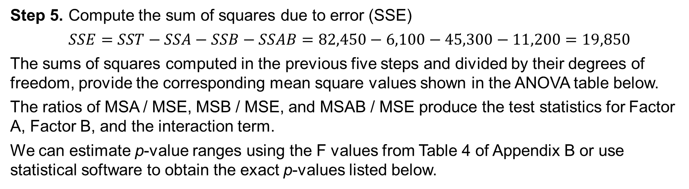
13.5 ANOVA Table for the Two-Factor GMAT Experiment
Step 5. Compute the sum of squares due to error (SSE)
$SSE=SST−SSA−SSB−SSAB=82,450−6,100−45,300−11,200=19,850$
The sums of squares computed in the previous five steps and divided by their degrees of freedom, provide the corresponding mean square values shown in the ANOVA table below.
The ratios of MSA / MSE, MSB / MSE, and MSAB / MSE produce the test statistics for Factor A, Factor B, and the interaction term.
We can estimate p-value ranges using the F values from Table 4 of Appendix B or use statistical software to obtain the exact p-values listed below.
Source of Variation | Sum of Squares | Degrees of Freedom | Mean Squares | F | p-value
Factor A | 6,100 | 2 | 3,050 | 1.3829 | 0.2994
Factor B | 45,300 | 2 | 22,650 | 10.2695 | 0.0048
Interaction | 11,200 | 4 | 2,800 | 1.2695 | 0.3503
Error | 19,850 | 9 | 2,206
Total | 82,450 | 17

Slide 48
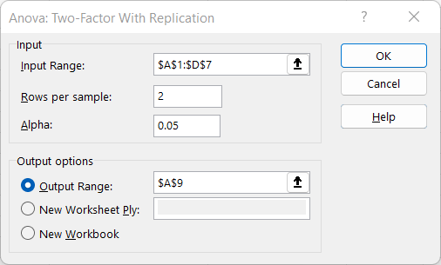
13.5 Excel: Dialog Box for the ANOVA: Two-Factor With Replication Tool
Excel’s Anova: Two-Factor With Replication tool is used for a two-factor design.
Enter/Access Data: Open the file gmatstudy. The data and labels are in cells A1:D7.
Apply Tools: Follow these steps in the ANOVA: Two-Factor With Replication dialog box.
Step 1. Click the Data tab on the Ribbon
Step 2. In the Analyze group, click Data Analysis
Step 3. Choose ANOVA: Two-Factor With Replication from the list of Analysis Tools
Step 4. In the dialog box:
Enter A1:D7 in the Input Range: box
Enter 2 in the Rows per sample: box
Select the check box for Labels in First Row
In the Output options area, select Output Range: and enter A9.
Click OK

Slide 49
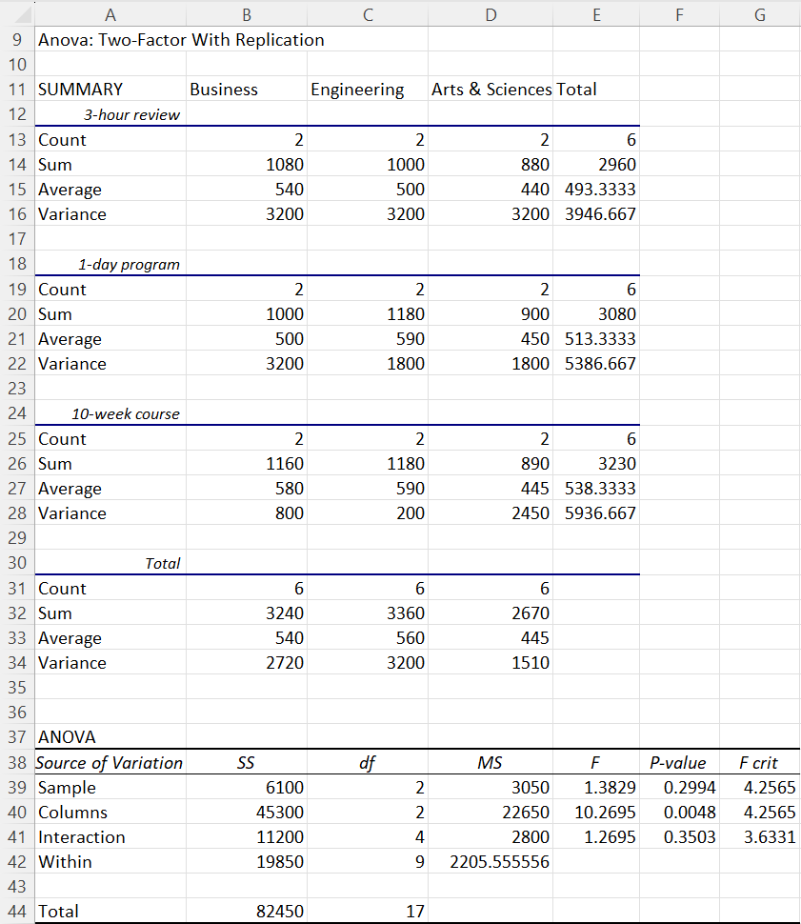
13.5 Excel: Conduct ANOVA for a Two-Factor Design
The output, titled Anova: Two-Factor With Replication, appears in cells A9:G44.
Excel identifies sources of variation as:
Factor A as Sample
Factor B as Columns
Interaction is the same
Error as Within.
Cells E13:E28 provide a column summary of Factor A (Sample). Cells B31:D34 provide a row summary of Factor B (Columns). Cells B13:D28 provide a table summary of the interaction term.
The ANOVA table, shown in cells A38:G44, is the same as the ANOVA table we saw earlier.
The conclusions are summarized next.

Slide 50
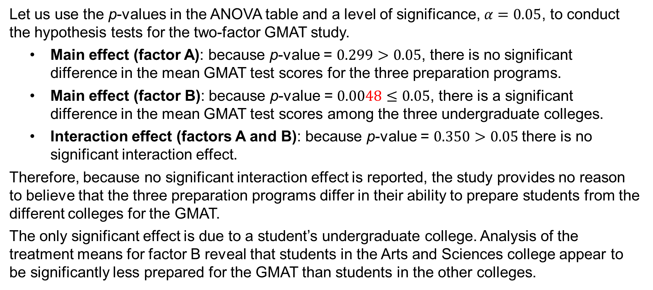
13.5 Conclusions of the GMAT Two-Factor Experiment
Let us use the p-values in the ANOVA table and a level of significance, $α=0.05$, to conduct the hypothesis tests for the two­-factor GMAT study.
Main effect (factor A): because p-­value = $0.299>0.05$, there is no significant difference in the mean GMAT test scores for the three preparation programs.
Main effect (factor B): because p-­value = $0.0048≤0.05$, there is a significant difference in the mean GMAT test scores among the three undergraduate colleges.
Interaction effect (factors A and B): because p-­value = $0.350>0.05$there is no significant interaction effect.
Therefore, because no significant interaction effect is reported, the study provides no reason to believe that the three preparation programs differ in their ability to prepare students from the different colleges for the GMAT.
The only significant effect is due to a student’s undergraduate college. Analysis of the treatment means for factor B reveal that students in the Arts and Sciences college appear to be significantly less prepared for the GMAT than students in the other colleges.

Slide 51
Summary
In this chapter, we showed how analysis of variance can be used to test for differences among means of several populations or treatments.
We introduced the completely randomized design, the randomized block design, and the two­-factor factorial experiment.
The completely randomized design and the randomized block design are used to draw conclusions about dif­ferences in the means of a single factor.
The primary purpose of blocking in the randomized block design is to remove extraneous sources of variation from the error term, providing a better estimate of the true error variance and a better test to determine whether the treatment means differ significantly.
In all the experimental designs considered, the analysis of variance is performed by first partitioning the sum of squares and degrees of freedom into their various sources.
We also showed how Fisher’s LSD procedure and the Bonferroni ad­justment can be used to perform pairwise comparisons to determine which means are different.

