Slide 1
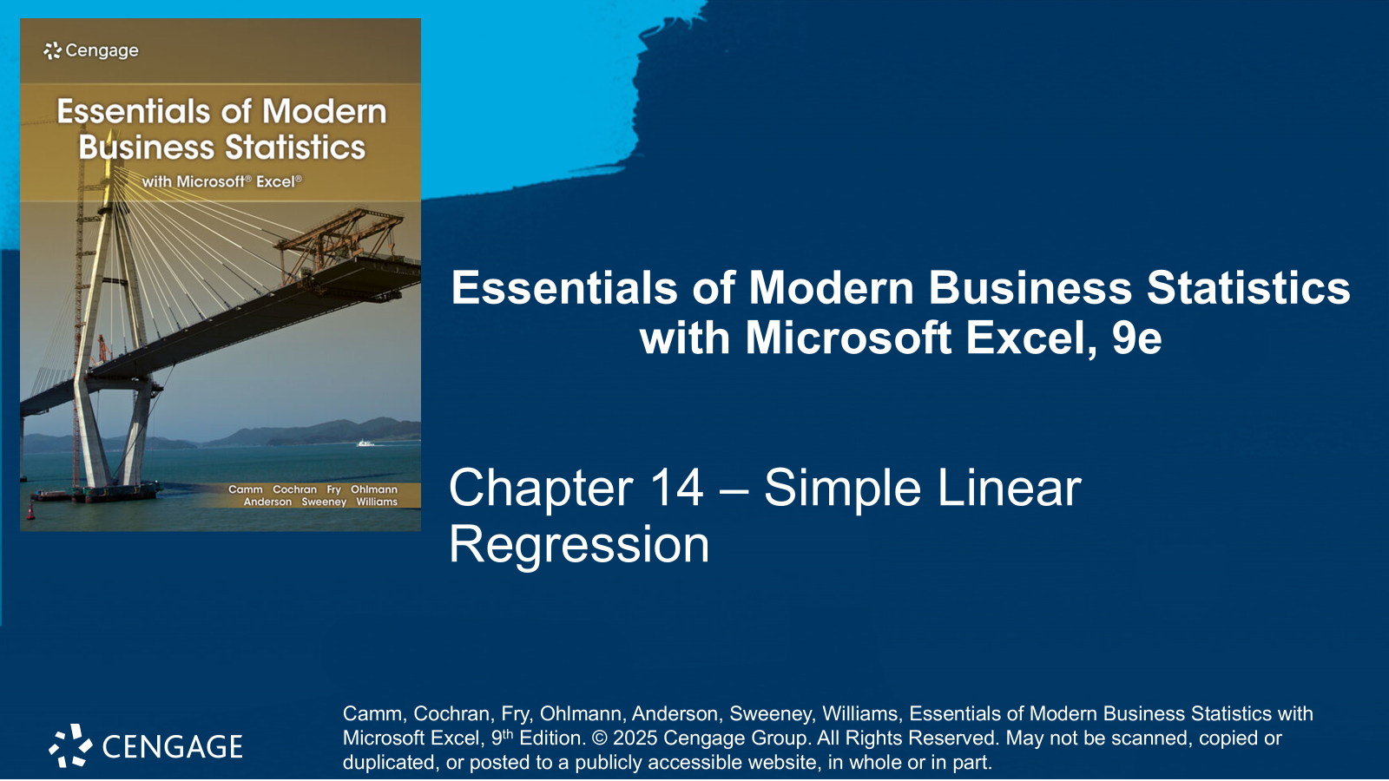

Slide 2
Chapter Contents
14.1 Simple Linear Regression Model
14.2 Least Squares Method
14.3 Coefficient of Determination
14.4 Model Assumptions
14.5 Testing for Significance
14.6 Using the Estimated Regression Equation for Estimation and Prediction
14.7 Excel’s Regression Tool
14.8 Residual Analysis: Validating Model Assumptions
14.9 Outliers and Influential Observations
14.10 Practical Advice: Big Data and Hypothesis Testing in Simple Linear Regression
Summary

Slide 3
Chapter Objectives (1 of 2)
After completing this chapter, you will be able to:
LO 14-1 Develop an equation that estimates how two variables are related based on sample data.
LO 14-2 Use a simple linear regression equation to predict the value of the dependent variable for a given value of the independent variable.
LO 14-3 Provide an interpretation of the intercept and slope of an estimated simple linear regression equation.
LO 14-4 Compute and interpret the coefficient of determination.
LO 14-5 Compute and interpret the sample correlation coefficient.
LO 14-6 Use the t test to assess the significance in a simple linear regression.

Slide 4
Chapter Objectives (2 of 2)
LO 14-7 Calculate the ANOVA table and use the F test to assess the significance in a simple linear regression.
LO 14-8 Develop a confidence interval for the mean value of the dependent variable 𝑦 given a specific value of 𝑥.
LO 14-9 Develop a prediction interval for an individual value of the dependent variable 𝑦 given a specific value of 𝑥.
LO 14-10 Use a residual plot to assess whether the assumptions of simple linear regression are valid.
LO 14-11 Use residual analysis to identify outliers and influential observations.

Slide 5
Introduction
Managerial decisions often are based on the relationship between two or more variables.
A statistical procedure called regression analysis can be used to develop an equation showing how the variables are related.
The variable being predicted is called the dependent variable and is denoted by 𝑦.
The variables being used to predict the value of the dependent variable are called the independent variables and are denoted by 𝑥.
In this chapter we consider simple linear regression, the simplest type of regression:
it involves one independent variable and one dependent variable.
the relationship between the two variables is approximated by a straight line.
Regression analysis involving two or more independent variables is called multiple regression, and it will be the subject of the next two chapters.

Slide 6
14.1 Simple Linear Regression Model
The regression model is the equation that describes how the dependent variable 𝑦 is related to the independent variables 𝑥 and an error term $ε$.
The simple linear regression model is described by the following equation.
$$y=β_{0}+β_{1}x+ε$$
Where
𝑦 is the dependent variable.
𝑥 is the independent variable.
$β_{0}$ and $β_{1}$ are referred to as the parameters of the model.
$ε$ is the error term. It accounts for the variability in 𝑦 that cannot be explained by the linear relationship between 𝑥 and 𝑦.

Slide 7
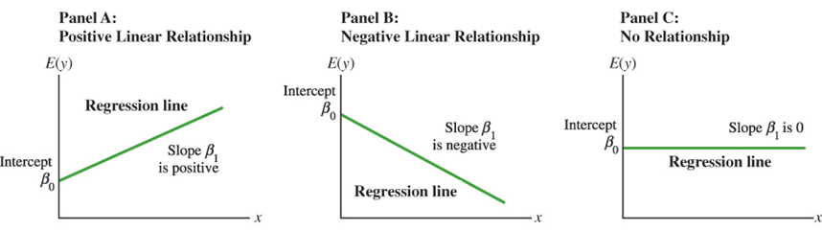
14.1 Simple Linear Regression Equation
The simple linear regression equation is described as follows.
$E\left(y\right)=β_{0}+β_{1}x$
Where
$E\left(y\right)$ is the expected value of a distribution of 𝑦 values for a given 𝑥 value.
$β_{0}$ is the 𝑦-intercept of the regression line.
$β_{1}$ is the slope of the regression line. Its sign dictates the type of linear relationship.

Slide 8
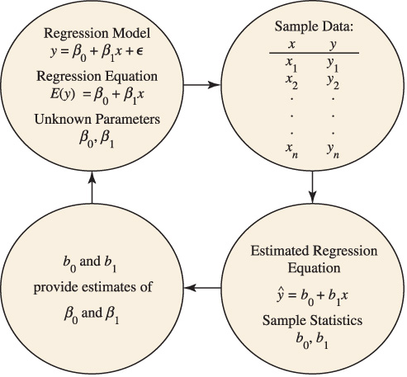
14.1 The Estimation Process in Simple Linear Regression
The estimated simple linear regression equation is
$$\hat{y}=b_{0}+b_{1}x$$
The graph of the estimated simple linear regression equation is called the estimated regression line, where:
$\hat{y}$ is a point estimate of $E\left(y\right)$ for a given 𝑥.
$b_{0}$ is the 𝑦-intercept of the regression.
$b_{1}$ is the slope of the regression.
The flow chart to the right provides a summary of the estimation process for simple linear regression.

Slide 9
14.2 Least Squares Method
The least squares method uses the sample data to provide the values of $b_{0}$ and $b_{1}$ that minimize the sum of the squares of the deviations between the observed values of the dependent variable $y_{i}$ and the predicted values of the dependent variable ${\hat{y}}_{i}$.
Least Squares Criterion
$$\min{\sum{{\left(y_{i}−\hat{y}\right)}^{2}}}$$
Slope and 𝑦-Intercept for the Estimated Regression Equation
$$b_{1}=\frac{\sum{\left(x_{i}−\overline{x}\right)\left(y_{i}−\overline{y}\right)}}{\sum{{\left(x_{i}−\overline{x}\right)}^{2}}} b_{0}=\overline{y}−b_{1}\overline{x}$$
Where: $x_{i}$and $y_{i}$ are the values of independent and dependent variables for the 𝑖th observation.
$\overline{x}$ and $\overline{y}$ are the mean values for the independent and dependent variables.
$n$ is the total number of observations.

Slide 10
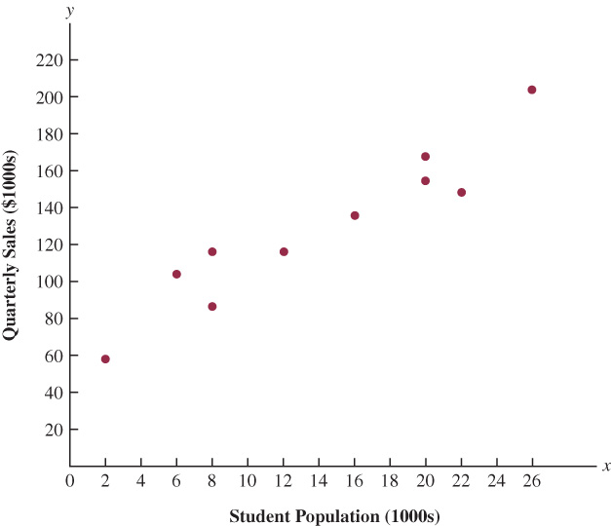
14.2 The Armand’s Pizza Parlors Example
The managers at Armand's Pizza Parlors, a chain of Italian-food restaurants located near college campuses, believe that restaurants’ quarterly sales (denoted by 𝑦) are positively related to the size of the student population (denoted by 𝑥.)
In this example, the chain of the Armand’s restaurants constitutes the population of interest.
DATAfile: armands
We use a sample of 10 randomly selected restaurants to build a scatter diagram depicting the relationship between quarterly sales and the student population.
Because the scatter diagram shows a positive linear relationship, we choose the simple linear regression model to represent the relationship between Armand’s quarterly sales (𝑦) and student population (𝑥.)

Slide 11
14.2 Estimated Regression Equation for Armand’s Pizza
The calculations necessary to develop the least squares estimated regression equation for the sample of $n=10$ Armand’s Pizza Parlors restaurants are shown in the table below.
We first calculate $\sum{x_{i}}=140$ and $\sum{y_{i}}=1,300$. Dividing them by $n=10$, we obtain $\overline{x}=14$ and $\overline{y}=130$, which we then use to compute $\sum{\left(x_{i}−\overline{x}\right)\left(y_{i}−\overline{y}\right)=2840}$ and $\sum{{\left(x_{i}−\overline{x}\right)}^{2}}=568$.
The calculations of $b_{1}$ and $b_{0}$ are :
$$b_{1}=\frac{\sum{\left(x_{i}−\overline{x}\right)\left(y_{i}−\overline{y}\right)}}{\sum{{\left(x_{i}−\overline{x}\right)}^{2}}}=\frac{2,840}{568}=5$$
$$b_{0}=\overline{y}−b_{1}\overline{x}=130−5\left(14\right)=60$$
Thus, the estimated regression equation for the Armand’s Pizza Parlors sample of 10 restaurants is
$$\hat{y}=60+5x$$
Restaurant i | $x_{i}$ | $y_{i}$ | $$x_{i}−\overline{x}$$ | $$y_{i}−\overline{y}$$ | $$\left(x_{i}−\overline{x}\right)\left(y_{i}−\overline{y} \right)$$ | $${\left(x_{i}−\overline{x}\right)}^{2}$$
1 | 2 | 58 | -12 | -72 | 864 | 144
2 | 6 | 105 | -8 | -25 | 200 | 64
3 | 8 | 88 | -6 | -42 | 252 | 36
4 | 8 | 118 | -6 | -12 | 72 | 36
5 | 12 | 117 | -2 | -13 | 26 | 4
6 | 16 | 137 | 2 | 7 | 14 | 4
7 | 20 | 157 | 6 | 27 | 162 | 36
8 | 20 | 169 | 6 | 39 | 234 | 36
9 | 22 | 149 | 8 | 19 | 152 | 64
10 | 26 | 202 | 12 | 72 | 864 | 144
 | 140 | 1300 |  |  | 2840 | 568
 | $\sum{x_{i}}$ | $\sum{y_{i}}$ |  |  | $\sum{\left(x_{i}−\overline{x}\right)\left(y_{i}−\overline{y} \right)}$ | $\sum{{\left(x_{i}−\overline{x}\right)}^{2}}$

Slide 12
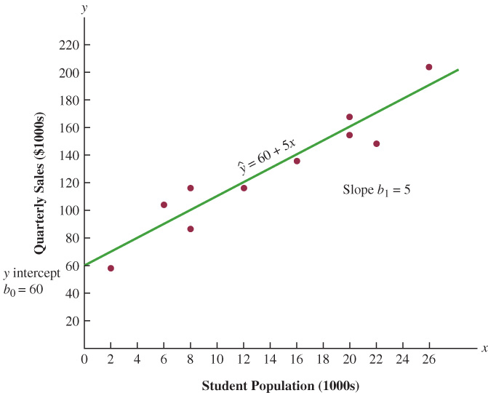
14.2 Interpretation of the Estimated Regression Equation
The slope of the estimated regression equation ($b_{1}=5$) is positive, implying that as the student population increases, sales also increase.
We can conclude that quarterly sales are expected to increase by
$$b_{1}=5 \left[\frac{\$1,000}{1,000 \text{students}}\right]=\$5 \text{per} \text{student}$$
We can also use the estimated regression equation to predict the value of 𝑦 for a given value of 𝑥. For a restaurant located near a 16,000 students’ campus
$$\hat{y}=60+5x=60+5\left(16\right)=140 [\$1,000]$$
Hence, we predict quarterly sales of $140,000 for this restaurant (* see notes.)
Notes:
*Note: One should be cautious about making predictions based on regression for values of the independent variable outside the range of values in the data used to estimate the regression equation. We cannot be sure that the relationship is valid outside the experimental region of the data.

Slide 13
14.2 Excel: Construct and Edit a Scatter Diagram
We can use Excel to construct a scatter diagram, display the estimated regression line, and display the estimated regression equation for the Armand's Pizza Parlors data.
Refer to the figure in the next slide as we describe the tasks involved.
Enter/Access Data: Open the file armands. Data and labels are in cells A1:C11.
Apply Tools: The following steps describe how to construct a scatter diagram.
Step 1. Select cells B2:C11.
Step 2. Click the Insert tab on the Ribbon
Step 3. In the Charts group, click Insert Scatter (X,Y) or Bubble Chart
Step 4. When the list of scatter diagram subtypes appears, click Scatter.
Editing Options: You can edit the scatter diagram to add a chart title and axis titles.
Step 1. Click the Chart Title and replace it with Armand’s Pizza Parlors
Step 2. Click the Chart Elements button (located next to the top-right corner of the chart)
Step 3. Click the horizontal Axis Title and replace it with Student Population (1,000s)
Step 4. Click the Vertical (Value) Axis Title and replace it with Quarterly Sales ($1,000s

Slide 14
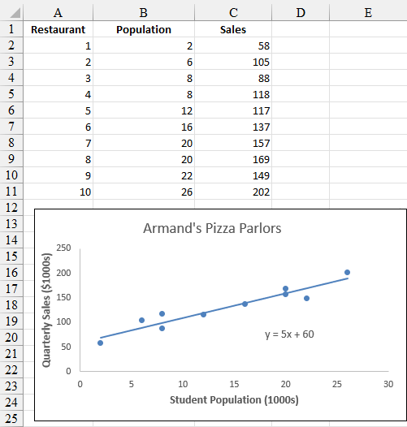
14.2 Excel: Display the Estimated Regression Line and Equation on a Scatter Diagram
Editing Options (cont.): We can use Excel to display the estimated regression line and equation.
Step 5. Click the Chart Elements button again.
Step 6. Click Gridlines (to deselect the Gridlines option)
Step 7. Click Trendline
Step 8. To change the trendline from a dashed line to a solid line, right-click on the trendline and select the Format Trendline option
Step 9. When the Format Trendline dialog box appears:
Scroll down and select Display Equation on chart
Click the Fill & Line button
In the Dash type box, select Solid
Close the Format Trendline dialog box

Slide 15
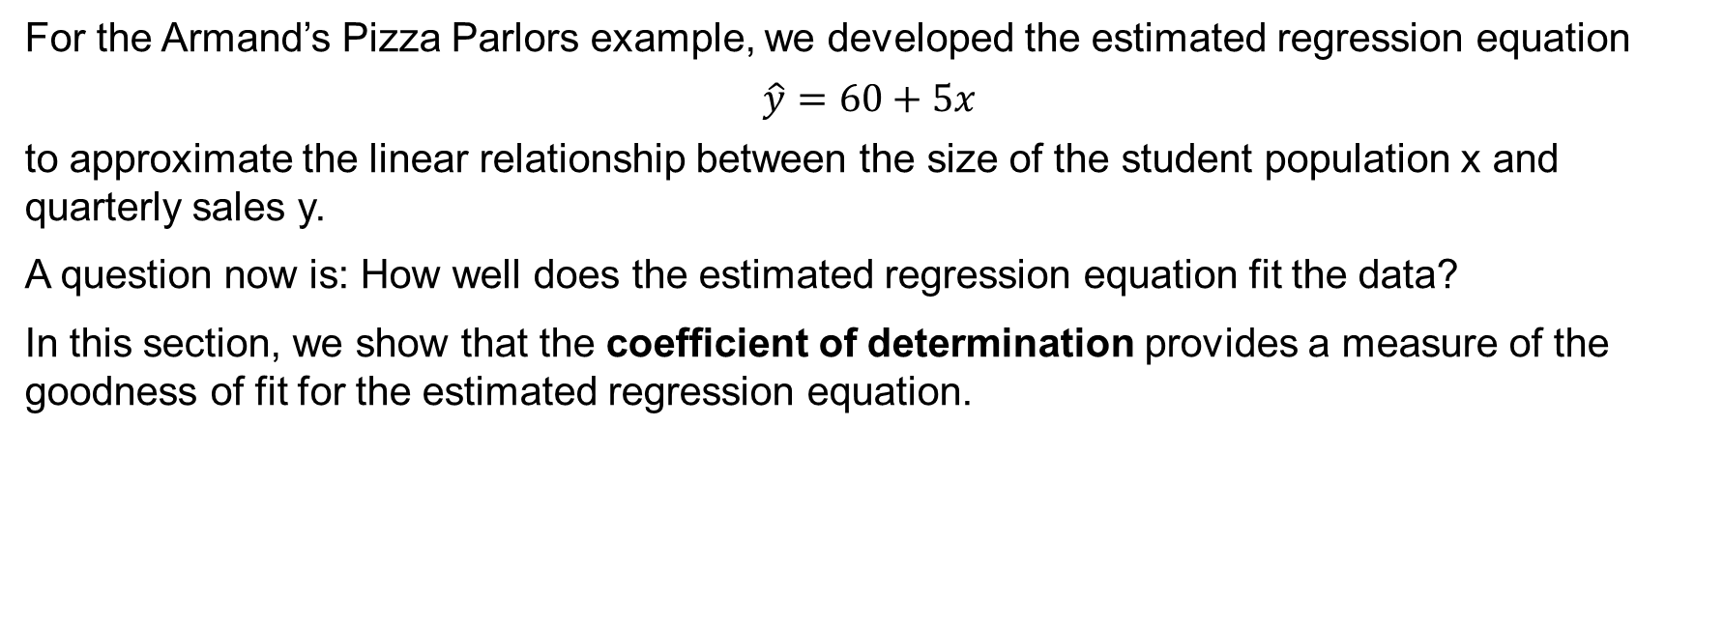
14.3 Coefficient of Determination
For the Armand’s Pizza Parlors example, we developed the estimated regression equation
$$\hat{y}=60+5x$$
to approximate the linear relationship between the size of the student population x and quarterly sales y.
A question now is: How well does the estimated regression equation fit the data?
In this section, we show that the coefficient of determination provides a measure of the goodness of fit for the estimated regression equation.

Slide 16
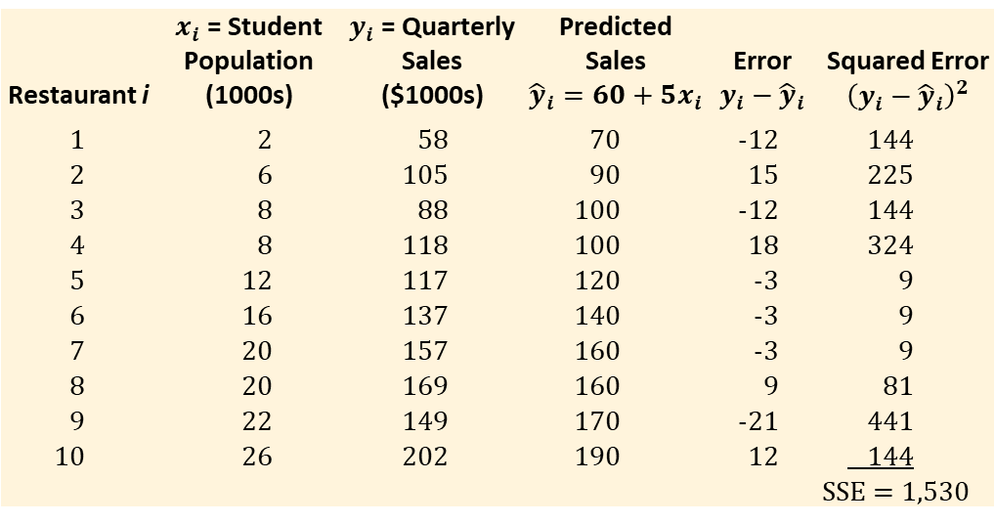
14.3 Sum of Squares Due to Error (SSE)
$y_{i}−{\hat{y}}_{i}$ is the residual for the 𝑖th observation; that is, the difference between the observed value of the dependent variable, $y_{i}$, and the predicted value of the dependent variable, ${\hat{y}}_{i}$.
The sum of squares of the residuals, also known as the sum of squares due to error (SSE), is the quantity minimized by the least squares method.
$$SSE=\sum{{\left(y_{i}−{\hat{y}}_{i}\right)}^{2}}$$
The table to the right shows the calculations required to compute SSE for the Armand’s Pizza Parlors example.
Thus, $SSE=1,530$ measures the error in using the estimated regression equation $\hat{y}=60+5x$ to predict sales.
Restaurant i | $x_{i}$ = Student Population (1000s) | $y_{i}$ = Quarterly Sales ($1000s) | Predicted Sales $${\hat{y}}_{i}=60+5x_{i}$$ | Error $y_{i}−{\hat{y}}_{i}$ | Squared Error ${\left(y_{i}−{\hat{y}}_{i}\right)}^{2}$
1 | 2 | 58 | 70 | -12 | 144
2 | 6 | 105 | 90 | 15 | 225
3 | 8 | 88 | 100 | -12 | 144
4 | 8 | 118 | 100 | 18 | 324
5 | 12 | 117 | 120 | -3 | 9
6 | 16 | 137 | 140 | -3 | 9
7 | 20 | 157 | 160 | -3 | 9
8 | 20 | 169 | 160 | 9 | 81
9 | 22 | 149 | 170 | -21 | 441
10 | 26 | 202 | 190 | 12 | 144
 |  |  |  |  | SSE = 1,530

Slide 17
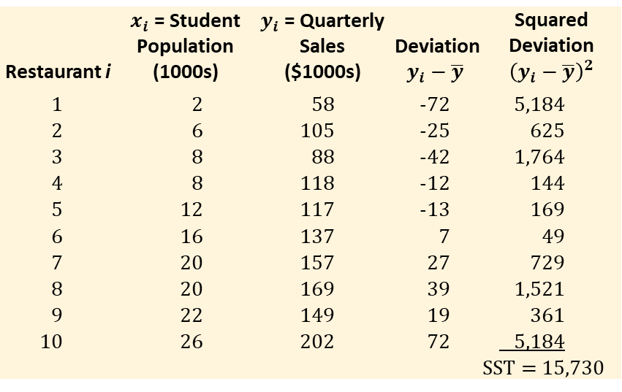
14.3 Total Sum of Squares (SST)
For the 𝑖th restaurant in the sample, the difference $y_{i}−\overline{y}$ provides a measure of the error when using $\overline{y}$ to predict sales. The corresponding sum of squares, called the total sum of squares, is denoted by SST.
$$SST=\sum{{\left(y_{i}−\overline{y}\right)}^{2}}$$
Restaurant i | $x_{i}$ = Student Population (1000s) | $y_{i}$ = Quarterly Sales ($1000s) | Deviation $y_{i}−\overline{y}$ | Squared Deviation ${\left(y_{i}−\overline{y}\right)}^{2}$
1 | 2 | 58 | -72 | 5,184
2 | 6 | 105 | -25 | 625
3 | 8 | 88 | -42 | 1,764
4 | 8 | 118 | -12 | 144
5 | 12 | 117 | -13 | 169
6 | 16 | 137 | 7 | 49
7 | 20 | 157 | 27 | 729
8 | 20 | 169 | 39 | 1,521
9 | 22 | 149 | 19 | 361
10 | 26 | 202 | 72 | 5,184
 |  |  |  | SST = 15,730
The table to the right shows the calculations required to compute SST for the Armand’s Pizza Parlors example.
Thus, $SST=15,730$ measures the error in using $\overline{y}=130$ to predict sales.
Note how much larger the squared deviations for SST are when compared to the squared error values for SSE.

Slide 18
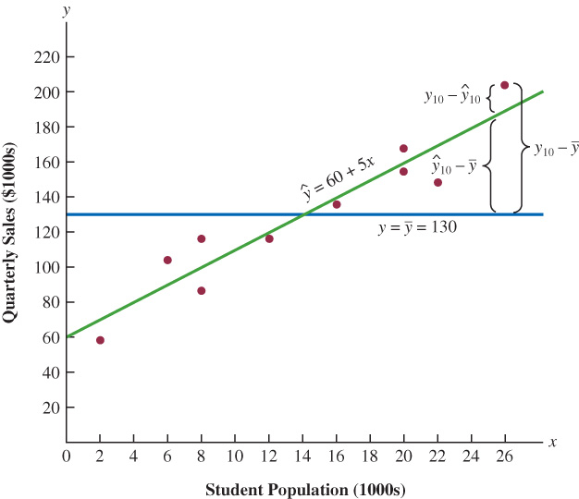
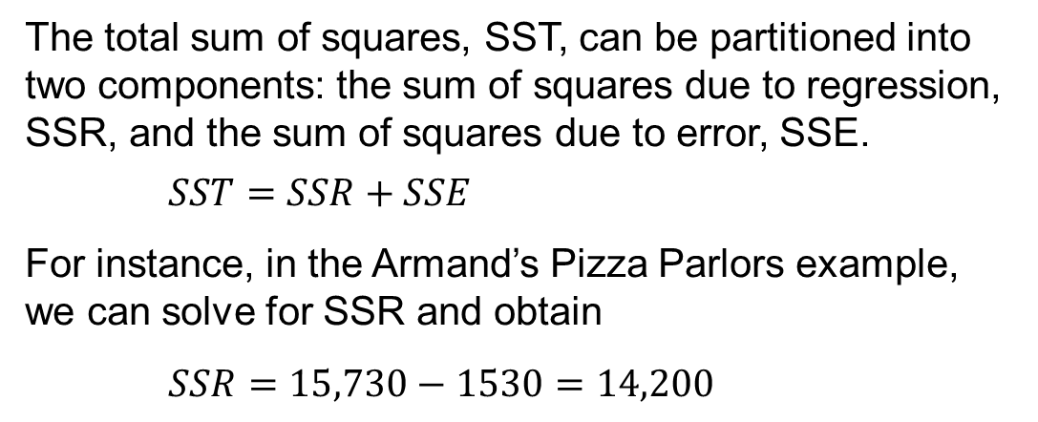
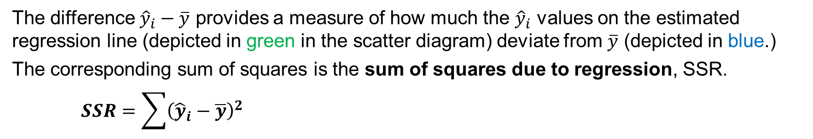
14.3 Sum of Squares Due to Regression (SSR)
The difference ${\hat{y}}_{i}−\overline{y}$ provides a measure of how much the ${\hat{y}}_{i}$ values on the estimated regression line (depicted in green in the scatter diagram) deviate from $\overline{y}$ (depicted in blue.)
The corresponding sum of squares is the sum of squares due to regression, SSR.
$$SSR=\sum{{\left({\hat{y}}_{i}−\overline{y}\right)}^{2}}$$
The total sum of squares, SST, can be partitioned into two components: the sum of squares due to regression, SSR, and the sum of squares due to error, SSE.
$$SST=SSR+SSE$$
For instance, in the Armand’s Pizza Parlors example, we can solve for SSR and obtain
$SSR=15,730−1530=14,200$

Slide 19
14.3 Compute the Coefficient of Determination
The estimated regression equation provides a perfect fit when every value of the dependent variable $y_{i}$ lies on the estimated regression line, so that all residuals $y_{i}−{\hat{y}}_{i}=0$ and $SSE=0$.
Because $SST=SSR+SSE$, for a perfect fit, $SSR=SST$ and the ratio ${SSR}/{SST}=1$ (*see notes.)
The ratio $SSR /SST$ is called the coefficient of determination, denoted by $r^{2}$.
$$r^{2}=\frac{SSR}{SST}$$
The coefficient of determination can only assume values between zero and one, and it is used to evaluate the goodness of fit for the estimated regression equation.
$${\text{For} \text{the} \text{Armand}\text{’}\text{s} \text{Pizza} \text{Parlor} \text{example}\text{, }\text{we} \text{have}\text{: }r}^{2}=\frac{SSR}{SST}=\frac{14,200}{15,730}=0.9027$$
Thus, about 90.3% of the variability in the quarterly sales at Armand’s Pizza Parlor can be explained by the linear relationship between the population of students and quarterly sales.
Notes:
*Note: poorer fits result in larger values for SSE, with the poorest fit at $SSR=0$ and $SSE=SST$.

Slide 20
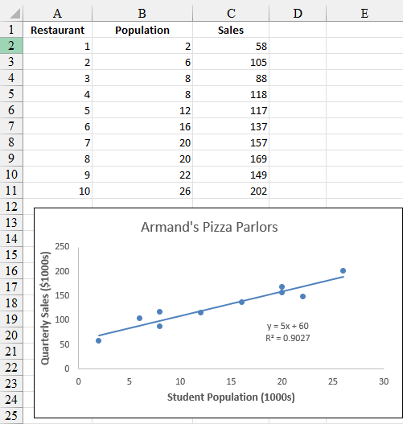
14.3 Excel: Compute the Coefficient of Determination
In Section 14.2, we showed how Excel can be used to construct a scatter diagram, display the estimated regression line, and compute the estimated regression equation for the Armand’s Pizza Parlors data.
Editing Options: We will now describe how to compute the coefficient of determination using the scatter diagram.
Step 1. Right-click on the trendline and select the Format Trendline option
Step 2. When the Format Trendline dialog box appears:
Scroll down and select Display R-squared value on chart
Close the Format Trendline dialog box

Slide 21
14.3 Correlation Coefficient
We previously introduced the correlation coefficient as a descriptive measure of the strength of the linear association between two variables, 𝑥 and y, and having the following properties:
Values of the correlation coefficient are always between −1 and +1.
A value of +1 indicates that x and y are aligned on a straight line with a positive slope.
A value of −1 indicates that x and y are aligned on a straight line with a negative slope.
Values of the correlation coefficient near zero indicate that 𝑥 and y are not linearly related.
The sample correlation coefficient for regression equation $\hat{y}=b_{0}+b_{1}x$ is computed as follows.
$$r_{xy}=\left(\text{sign} \text{of} b_{1}\right)\sqrt{r^{2}}$$
For the Armand’s Pizza Parlor example, we had $\hat{y}=60+5x$ and $r^{2}=0.9027$. Thus, we have
$$r_{xy}=+\sqrt{0.9027}=+0.9501$$
The positive value near +1 indicates a strong positive linear association between 𝑥 and 𝑦.

Slide 22
14.4 Model Assumptions
The tests of significance in regression analysis are based on the following assumptions about the error term, $ε$. In the regression model $y=β_{0}+β_{1}x+ε$, we have:
The error term $ε$ is a random variable with an expected value of zero; that is, $E\left(ε\right)=0$
Implication: because $β_{0}$ and $β_{1}$ are constant, $E\left(β_{0}\right)=β_{0}$ and $E\left(β_{1}\right)=β_{1}$. Thus, for a given value of 𝑥, we obtain the simple linear regression equation, $E\left(y\right)=β_{0}+β_{1}x$.
The variance of $ε$, denoted by $σ^{2}$, is the same for all values of 𝑥.
Implication: The variance of 𝑦 about the regression line equals $σ^{2}$ for all 𝑥 values.
The values of $ε$ are independent.
Implication: Because the values of $ε$ for any two values of 𝑥 are not related, it follows that the values of 𝑦 for any two values of 𝑥 are also not related.
The error term $ε$ is a normally distributed random variable for all values of 𝑥.
Implication: Because 𝑦 is a linear function of $ε$, 𝑦 is also a normally distributed random variable for all values of 𝑥.

Slide 23
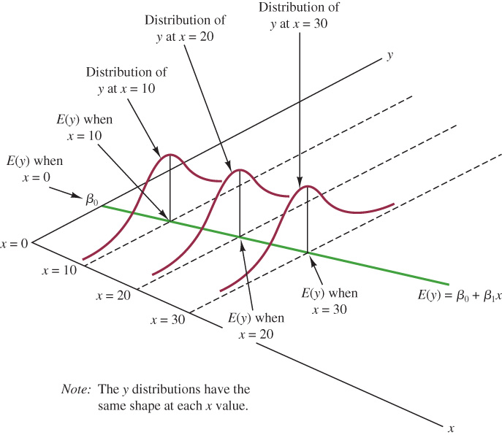
14.4 Graphical Representation of the Assumptions for the Regression Model
Note that the value of $E\left(y\right)$ changes according to the specific value of 𝑥.
However, the probability distribution of $ε$ and the probability distribution of 𝑦 are normally distributed, each with the same variance.
The value of the error $ε$ at a particular value of 𝑥 depends on whether the actual value of 𝑦 is greater than or less than $E\left(y\right)$.
Keep in mind that when we choose a linear model, we are just making an assumption about the form of the relationship between 𝑥 and 𝑦.
However, other non-linear models may very well provide a better fit for the underlying relationship.

Slide 24
14.5 Testing for Significance
The simple linear regression equation, $E\left(y\right)=β_{0}+β_{1}x$, tell us that if $β_{1}=0$,
$E\left(y\right)=β_{0}+\left(0\right)x=β_{0}$.
If $β_{1}=0$, $E\left(y\right)$does not depend on the value of 𝑥, and 𝑥 and 𝑦 are not linearly related
If $β_{1}≠0$, we conclude that the two variables are related
Thus, to test for a significant regression relationship, we must conduct a hypothesis test to determine whether $β_{1}=0$.
Two tests are commonly used:
the t test
the F test.
Both t and F tests require an estimate of $σ^{2}$, the variance of $ε$, in the regression model.

Slide 25
14.5 Estimate of $σ^{2}$
From the assumptions on the error term, we concluded that $σ^{2}$, the variance of $ε$, also represents the variance of the residuals; that is, the deviations of the 𝑦 values about the regression line.
Because SSE, the sum of squared residuals, is a measure of the variability of the 𝑦 values about the estimated regression line, it follows that the mean square error (MSE), SSE divided by its degrees of freedom (*see notes), provides $s^{2}$, the estimate of $σ^{2}$.
$$s^{2}=MSE=SSE/(n−2)$$
To estimate the standard deviation of $ε$, we take the square root of $s^{2}$. The resulting value, s, is referred to as the standard error of the estimate.
$$s=\sqrt{MSE}=\sqrt{SSE/(n−2)}$$
For the Armand’s Pizza Parlor example, we found $SSE=1,530$, and $n=10$. Thus, we have
$MSE={SSE}/{\left(n−2\right)=1,530/(10−2)}=191.25$, and $s=\sqrt{MSE}=\sqrt{191.25}=13.829$.
Notes:
*Note: every sum of squares has associated with it a number called its degrees of freedom. Statisticians have shown that SSE has $n−2$ degrees of freedom because two parameters ($β_{0}$ and $β_{1}$) must be estimated to compute SSE. Thus, the mean square error is computed by dividing SSE by $n−2$.

Slide 26
14.5 t Test for Significance in Simple Linear Regression
The purpose of the t test is to see whether we can conclude that $β_{1}≠0$. The hypotheses are
$$H_{0}: β_{1}=0$$
$$H_{a}: β_{1}≠0$$
$b_{1}$, the least squares estimator of $β_{1}$, follows a sampling distribution with these properties:
Expected value: $E\left(b_{1}\right)=β_{1}$
Standard deviation: $σ_{b_{1}}=σ/{\sqrt{{\left(x_{i}−\overline{x}\right)}^{2}}}$
Distribution form: Normal
The test statistic follows a t distribution with $n−2$ degrees of freedom.
$$t=\frac{b_{1}}{s_{b_{1}}}$$
Where $s_{b_{1}}$ is the estimated standard deviation of $b_{1}$: $s_{b_{1}}=s/{\sqrt{{\left(x_{i}−\overline{x}\right)}^{2}}}$

Slide 27
14.5 t Test for the Armand’s Pizza Parlor Example
To test for a significant relationship between student population (𝑥) and Armand’s Pizza Parlor quarterly sales (𝑦), we use a significance level, $α=0.01$.
Recollect that, for the Armand’s Pizza Parlor case, we found:
$\hat{y}=60+5x$
$s=13.829$
$\sum{{\left(x_{i}−\overline{x}\right)}^{2}}=568$
Hence, the estimated standard error of $b_{1}$ is
$s_{b_{1}}=s/{\sqrt{{\left(x_{i}−\overline{x}\right)}^{2}}}={13.829}/{\sqrt{568}}=0.5803$
And the test statistic is
$$t=\frac{b_{1}}{s_{b_{1}}}=\frac{5}{0.5803}=8.62$$

Slide 28
14.5 Rejection rule for the t Test
Because we have a two-tailed test, the p-value is two times the area under the curve of the t distribution for $t≥8.62$, and with $n−2=8$ degrees of freedom.
Using Table 2 in Appendix B, the t distribution table for 8 degrees of freedom provides
Area in upper tail | 0.20 | 0.10 | 0.05 | 0.025 | 0.01 | 0.005
t Value ($df=8$) | 0.889 | 1.397 | 1.860 | 2.306 | 2.896 | 3.355
With a symmetric t distribution, the upper tail at $t=8.62$ is the same as the lower tail at $t=−8.62$. Thus, the p-value range is twice $p\text{−}\text{value}≤ 0.005$, or $p\text{−}\text{value}≤ 0.01$ (*see notes.)
Because $p\text{−}\text{value}≤ 0.01=α$, we reject $H_{0}$ and conclude that $β_{1}≠0$.
If we use a critical value approach instead, the critical values $±t_{α/2}$for a two-tailed test are
${−t}_{.005}=−3.355$ and $t_{.005}=3.355$
Because $t=8.62≥3.355=t_{.005}$, we also reject $H_{0}$ and still conclude that $β_{1}≠0$.
Notes:
*Note: using Excel, the exact p-value is $2P\left(t≥8.62\right)=\text{2∗}\text{T}\text{.}\text{DIST}\text{.}\text{RT}\text{(}8.62\text{,}\text{8}\text{)}=0.00003$

Slide 29
14.5 Interval Estimate of $β_{1}$
The form of a confidence interval for $β_{1}$ is as follows.
$$b_{1}±t_{α/2}s_{b_{1}}$$
Where $b_{1}$ is the point estimator of $β_{1}$, $t_{α/2}s_{b_{1}}$ is the margin of error, $1−α$ is the confidence coefficient, and $t_{α/2}$ is the t value providing an area of $α/2$ in the upper tail of a t distribution with $n−2$ degrees of freedom.
For the Armand’s Pizza Parlor example, we found $b_{1}=5$ and $s_{b_{1}}=0.5803$.
If we want to develop a 99% confidence interval estimate of $β_{1}$, then from the previous slide we have $t_{α/2}=t_{.005}=3.355$.
Thus, the confidence interval is
$b_{1}±t_{.005}s_{b_{1}}=5±3.355\left(0.5803\right)=5±1.95$
We are 99% confident that $β_{1}$ is between $5−1.95=3.05$ and $5+1.95=6.95$.

Slide 30
14.5 F Test for Significance in Simple Linear Regression
With only one independent variable, the F test is set up just like the t test and it will provide the same conclusion.
$$H_{0}: β_{1}=0$$
$$H_{a}: β_{1}≠0$$
However, with more than one independent variable, only the F test can be used to test for an overall significant relationship of the regression.
The test statistic follows an F distribution with one degree of freedom at the numerator, and $n−2$ degrees of freedom at the denominator.
$$F=\frac{MSR}{MSE}$$
Where, $MSR=SSR/(number of independent variables)$. Because in simple linear regression we have only one independent variable, it follows that, in this case, $MSR=SSR$.

Slide 31
14.5 F Test for the Armand’s Pizza Parlor Example
Recollect that, for the Armand’s Pizza Parlor case, we found $SSR=14,200$ and $MSE=191.25$.
To test for a significant relationship in the linear regression example, we use $α=0.01$.
Hence, $MSR=SSR=14,200$, and the test statistic is
$$F=\frac{MSR}{MSE}=\frac{14,200}{191.25}=74.25$$
In simple linear regression, the p-value is the upper tail of an 𝐹 distribution with one degree of freedom at the numerator and $n−2=8$ degrees of freedom at the denominator.
Area in upper tail | 0.10 | 0.05 | 0.025 | 0.01
$F$ Value (${df}_{1}=1,{df}_{2}=8$) | 3.46 | 5.32 | 7.57 | 11.26
Because $F=74.25$ is greater than $F_{.01}=11.26$, the values in the “Area in Upper Tail” row show that $p\text{−}\text{value}≤ 0.01$. Thus, we reject $H_{0}$ and conclude that $β_{1}≠0$.
The same conclusion is reached using the critical value because $F=74.25≥{11.26=F}_{0.01}$.

Slide 32
14.5 ANOVA Table for Simple Linear Regression
The ANOVA table for simple linear regression conveniently displays the following results.
Source of Variation | Sum of Squares | Degrees of Freedom | Mean Squares | F | p-value
Regression | SSR | 1 | MSR = SSR / 1 | MSR / MSE | P(F ≥ MSR / MSE)
Error | SSE | n – 2 | MSE = SSE / (n – 2)
Total | SST | n − 1
Regression, Error, and Total are the labels for the three sources of variation, with SSR, SSE, and SST appearing as the corresponding sum of squares in the second column.
The ANOVA table with the F test computations performed for Armand’s Pizza Parlors follow.
Source of Variation | Sum of Squares | Degrees of Freedom | Mean Squares | F | p-value
Regression | 14,200 | 1 | 14,200/1 = 14,200 | 74.25 | 0.0000
Error | 1,530 | 8 | 1,530/8 = 191.25
Total | 17,530 | 9

Slide 33
14.5 Some Cautions About the Interpretation of Significance Tests
Rejecting $H_{0}: β_{1}=0$ and concluding that the relationship between 𝑥 and 𝑦 is significant does not enable us to conclude that a cause-and-effect relationship is present between 𝑥 and 𝑦.
Concluding a cause-and-effect relationship is warranted only if the analyst can provide some type of theoretical justification that the relationship is, in fact, causal.
For Armand’s Pizza Parlors, we cannot necessarily conclude that changes in student population cause changes in quarterly sales.
Just because we are able to reject $H_{0}: β_{1}=0$ and demonstrate statistical significance does not enable us to conclude that there is a linear relationship between 𝑥 and 𝑦.
Given a significant relationship, we can use with confidence the estimated regression equation only for predictions within the range of the 𝑥 values observed in the sample.
For Armand’s Pizza Parlors, we should use the regression equation only to predict sales for restaurants where the associated student population is between 2,000 and 26,000.

Slide 34
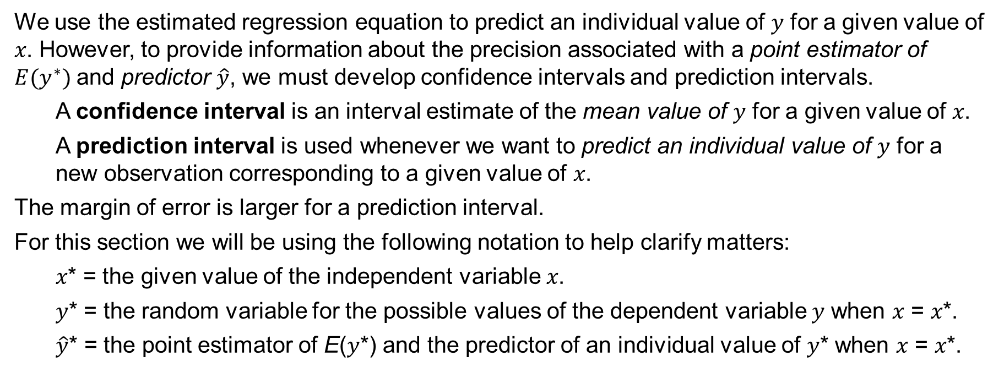
14.6 Using the Estimated Regression Equation for Estimation and Prediction
We use the estimated regression equation to predict an individual value of 𝑦 for a given value of 𝑥. However, to provide information about the precision associated with a point estimator of $E(y^{∗})$and predictor $\hat{y}$, we must develop confidence intervals and prediction intervals.
A confidence interval is an interval estimate of the mean value of 𝑦 for a given value of 𝑥.
A prediction interval is used whenever we want to predict an individual value of 𝑦 for a new observation corresponding to a given value of 𝑥.
The margin of error is larger for a prediction interval.
For this section we will be using the following notation to help clarify matters:
𝑥* = the given value of the independent variable 𝑥.
𝑦* = the random variable for the possible values of the dependent variable 𝑦 when 𝑥 = 𝑥*.
$\hat{y}$* = the point estimator of E(𝑦*) and the predictor of an individual value of 𝑦* when 𝑥 = 𝑥*.

Slide 35
14.6 Confidence Interval for the Mean Value of y
The form of a confidence interval for $E(y^{∗})$ is as follows.
$${\hat{y}}^{∗}±t_{α/2}s_{{\hat{y}}^{∗}}$$
Where $1−α$ is the confidence coefficient, and $t_{α/2}$ is based on a t distribution with $n−2$ degrees of freedom.
$s_{{\hat{y}}^{∗}}$ is the estimate of the standard deviation of ${\hat{y}}^{∗}$ and it is calculated as follows.
$$s_{{\hat{y}}^{∗}}=s\sqrt{\frac{1}{n}+\frac{{\left(x^{∗}−\overline{x}\right)}^{2}}{\sum{{\left(x_{i}−\overline{x}\right)}^{2}}}}$$
Note that the estimated standard deviation of ${\hat{y}}^{∗}$ is smallest when $x^{∗}=\overline{x}$. In such case, we have
$$s_{{\hat{y}}^{∗}}=s\sqrt{\frac{1}{n}+\frac{{\left(\overline{x}−\overline{x}\right)}^{2}}{\sum{{\left(x_{i}−\overline{x}\right)}^{2}}}}=s\sqrt{\frac{1}{n}}$$

Slide 36
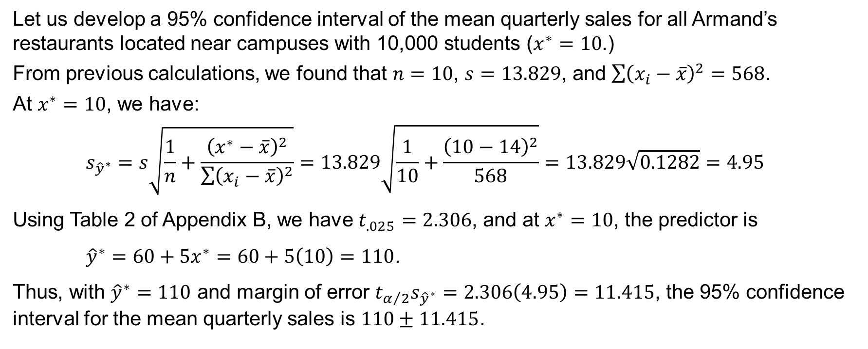
14.6 Confidence Interval for the Mean Quarterly Sales at a Given Value of Student Population
Let us develop a 95% confidence interval of the mean quarterly sales for all Armand’s restaurants located near campuses with 10,000 students ($x^{∗}=10$.)
From previous calculations, we found that $n=10$, $s=13.829$, and $\sum{{\left(x_{i}−\overline{x}\right)}^{2}}=568$.
At $x^{∗}=10$, we have:
$$s_{{\hat{y}}^{∗}}=s\sqrt{\frac{1}{n}+\frac{{\left(x^{∗}−\overline{x}\right)}^{2}}{\sum{{\left(x_{i}−\overline{x}\right)}^{2}}}}=13.829\sqrt{\frac{1}{10}+\frac{{\left(10−14\right)}^{2}}{568}}=13.829\sqrt{0.1282}=4.95$$
Using Table 2 of Appendix B, we have $t_{.025}=2.306$, and at $x^{∗}=10$, the predictor is
${\hat{y}}^{∗}=60+5x^{∗}=60+5\left(10\right)=110$.
Thus, with ${\hat{y}}^{∗}=110$ and margin of error $t_{α/2}s_{{\hat{y}}^{∗}}=2.306\left(4.95\right)=11.415$, the 95% confidence interval for the mean quarterly sales is $110±11.415$.

Slide 37
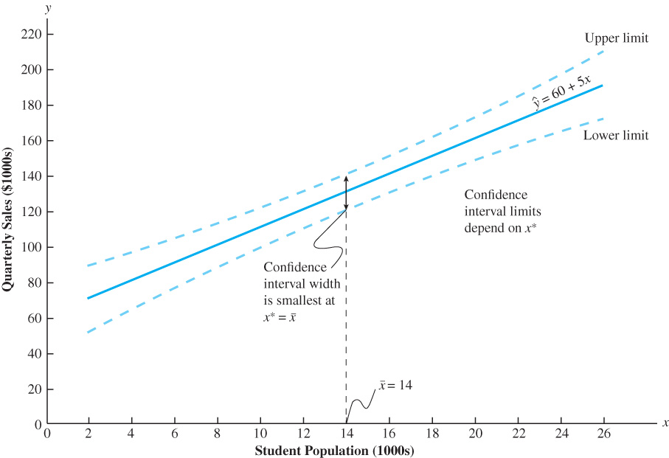
14.6 Confidence Intervals for the Mean Value of y at Given Values of x (Armand’s Pizza Example)

Slide 38
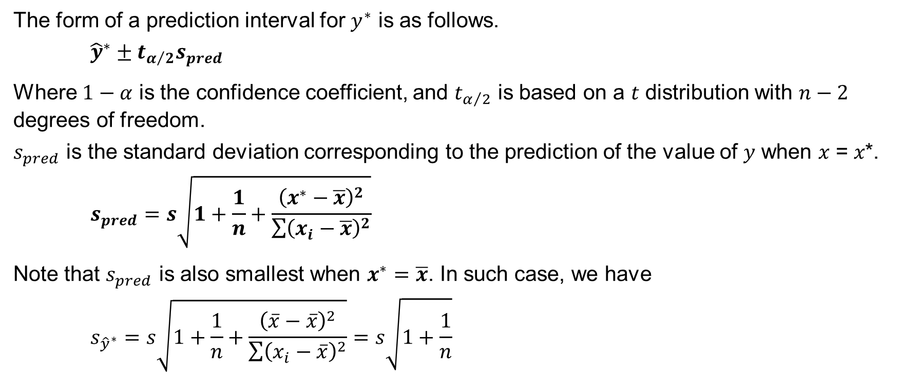
14.6 Prediction Interval for an Individual Value of y
The form of a prediction interval for $y^{∗}$ is as follows.
$${\hat{y}}^{∗}±t_{α/2}s_{pred}$$
Where $1−α$ is the confidence coefficient, and $t_{α/2}$ is based on a $t$ distribution with $n−2$ degrees of freedom.
$s_{pred}$ is the standard deviation corresponding to the prediction of the value of 𝑦 when 𝑥 = 𝑥*.
$$s_{pred}=s\sqrt{1+\frac{1}{n}+\frac{{\left(x^{∗}−\overline{x}\right)}^{2}}{\sum{{\left(x_{i}−\overline{x}\right)}^{2}}}}$$
Note that $s_{pred}$ is also smallest when $x^{∗}=\overline{x}$. In such case, we have
$$s_{{\hat{y}}^{∗}}=s\sqrt{1+\frac{1}{n}+\frac{{\left(\overline{x}−\overline{x}\right)}^{2}}{\sum{{\left(x_{i}−\overline{x}\right)}^{2}}}}=s\sqrt{1+\frac{1}{n}}$$

Slide 39
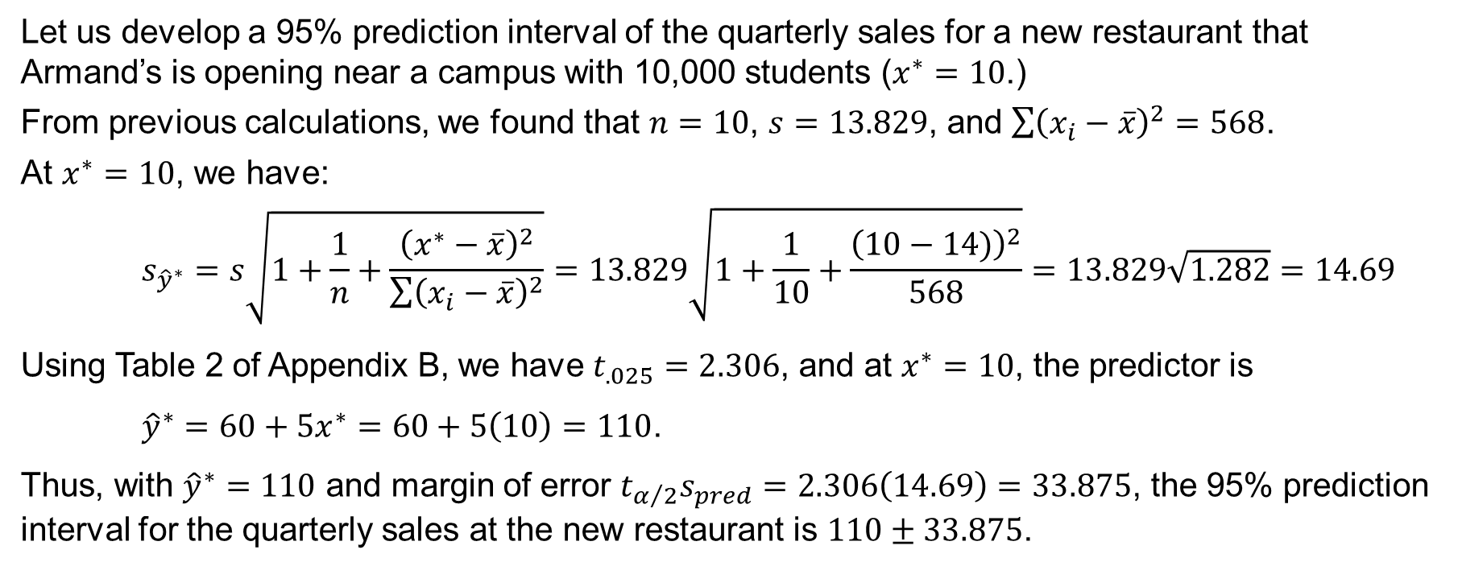
14.6 Prediction Interval for the Quarterly Sales at an Individual Restaurant
Let us develop a 95% prediction interval of the quarterly sales for a new restaurant that Armand’s is opening near a campus with 10,000 students ($x^{∗}=10$.)
From previous calculations, we found that $n=10$, $s=13.829$, and $\sum{{\left(x_{i}−\overline{x}\right)}^{2}}=568$.
At $x^{∗}=10$, we have:
$$s_{{\hat{y}}^{∗}}=s\sqrt{1+\frac{1}{n}+\frac{{\left(x^{∗}−\overline{x}\right)}^{2}}{\sum{{\left(x_{i}−\overline{x}\right)}^{2}}}}=13.829\sqrt{1+\frac{1}{10}+\frac{{\left(10−14)\right)}^{2}}{568}}=13.829\sqrt{1.282}=14.69$$
Using Table 2 of Appendix B, we have $t_{.025}=2.306$, and at $x^{∗}=10$, the predictor is
${\hat{y}}^{∗}=60+5x^{∗}=60+5\left(10\right)=110$.
Thus, with ${\hat{y}}^{∗}=110$ and margin of error $t_{α/2}s_{pred}=2.306\left(14.69\right)=33.875$, the 95% prediction interval for the quarterly sales at the new restaurant is $110±33.875$.

Slide 40
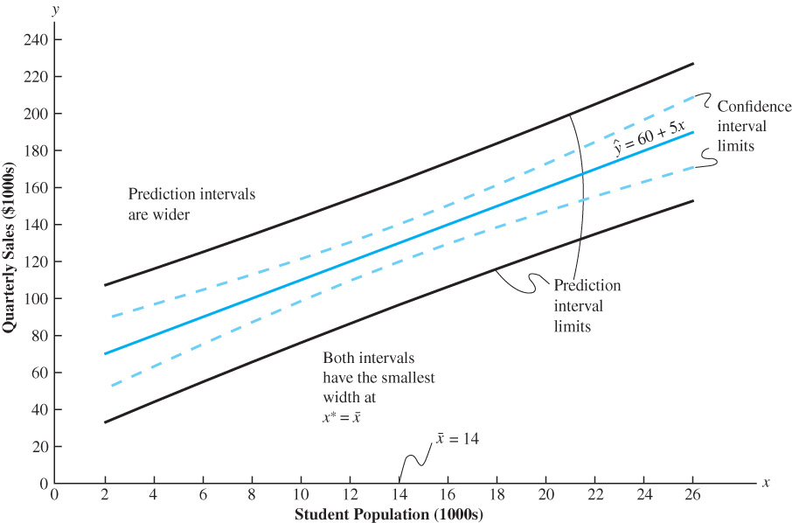
14.6 Confidence and Prediction Intervals for y at Given Values of x (Armand’s Pizza Example)

Slide 41
14.7 Excel’s Regression Tool
In previous sections of this chapter, we have shown how Excel’s chart tools can be used for various tasks in a regression analysis.
Excel also has a more comprehensive Regression tool.
In this section, we will illustrate how Excel’s Regression tool can be used to perform a complete regression analysis, including statistical tests of significance for the Armand’s Pizza Parlors data.

Slide 42
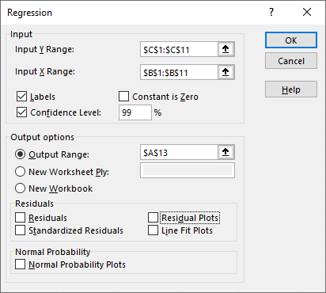
14.7 Excel: Regression Tool Dialog Box
Enter/Access Data: Open the file armands. The data and labels are in cells B1:C11.
Apply Tools: The following steps describe how to use Excel’s Regression tool to perform the regression analysis computations performed in Sections 14.2–14.5.
Step 1. Click the Data tab on the Ribbon
Step 2. In the Analyze group, click Data Analysis
Step 3. Choose Regression from the list of tools
Step 4. In the Regression dialog box:
Enter C1:C11 in the Input Y Range: box
Enter B1:B11 in the Input X Range: box
Select the check box for Labels
Select the check box for Confidence Level: and enter 99
Select Output Range: in the Output options area and enter A13
Click OK.

Slide 43
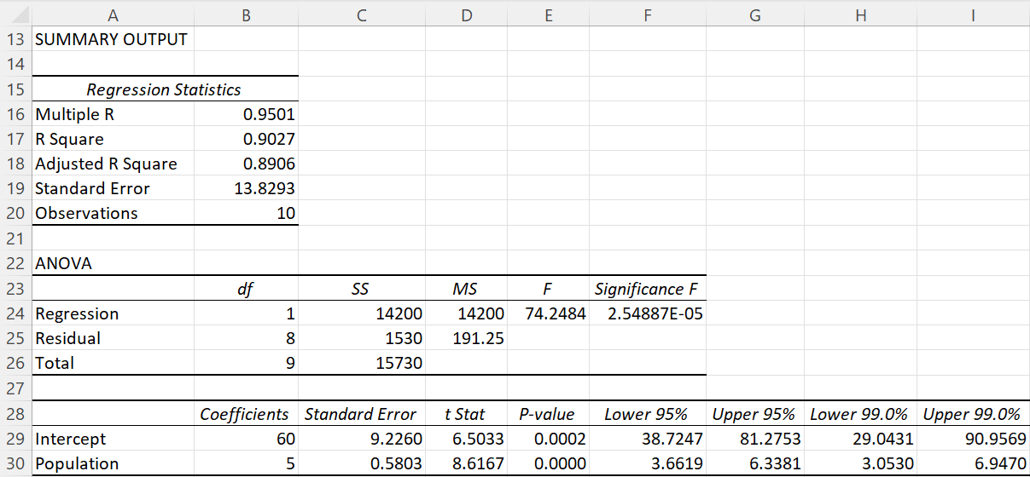
14.7 Excel: Regression Tool Output for Armand’s Data

Slide 44
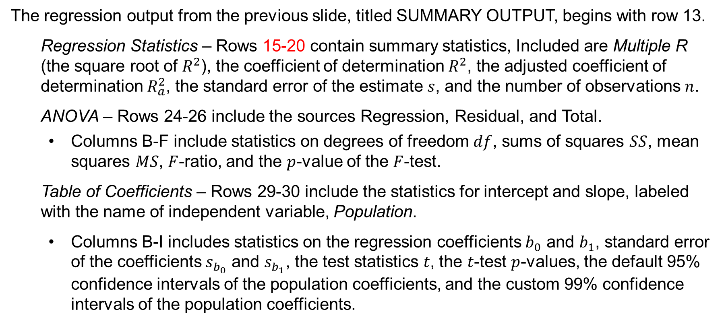
14.7 Excel: Interpretation of Regression Output
The regression output from the previous slide, titled SUMMARY OUTPUT, begins with row 13.
Regression Statistics – Rows 15-20 contain summary statistics, Included are Multiple R (the square root of $R^{2}$), the coefficient of determination $R^{2}$, the adjusted coefficient of determination $R_{a}^{2}$, the standard error of the estimate $s$, and the number of observations $n$.
ANOVA – Rows 24-26 include the sources Regression, Residual, and Total.
Columns B-F include statistics on degrees of freedom $df$, sums of squares $SS$, mean squares $MS$, $F$-ratio, and the $p$-value of the $F$-test.
Table of Coefficients – Rows 29-30 include the statistics for intercept and slope, labeled with the name of independent variable, Population.
Columns B-I includes statistics on the regression coefficients $b_{0}$ and $b_{1}$, standard error of the coefficients $s_{b_{0}}$ and $s_{b_{1}}$, the test statistics $t$, the $t$-test $p$-values, the default 95% confidence intervals of the population coefficients, and the custom 99% confidence intervals of the population coefficients.

Slide 45
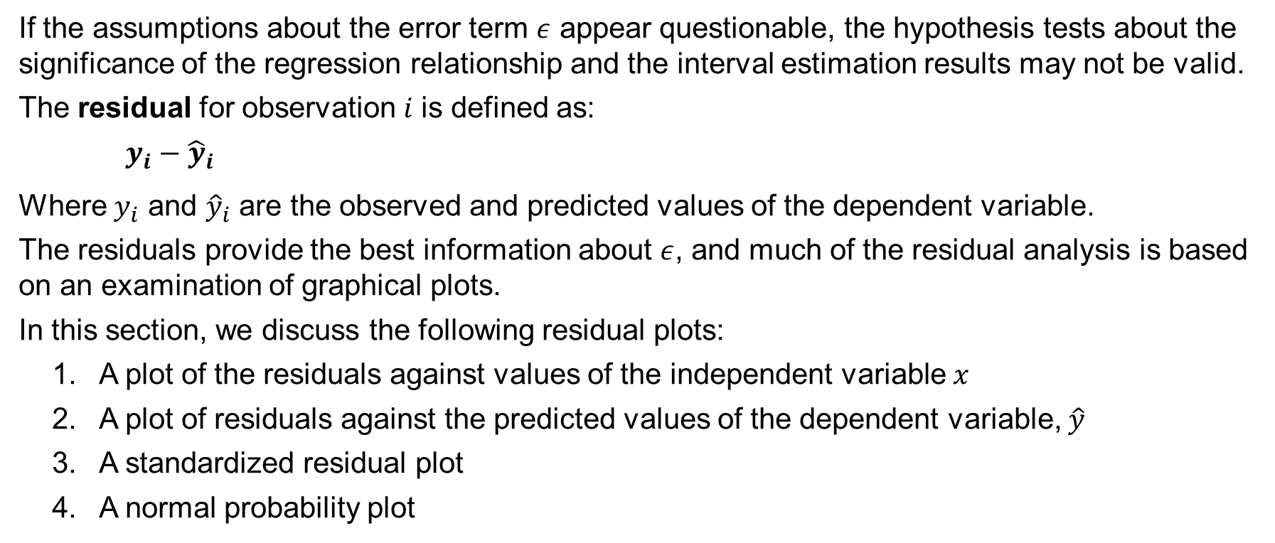
14.8 Residual Analysis: Validating Model Assumptions
If the assumptions about the error term $ε$ appear questionable, the hypothesis tests about the significance of the regression relationship and the interval estimation results may not be valid.
The residual for observation 𝑖 is defined as:
$y_{i}−{\hat{y}}_{i}$
Where $y_{i}$ and ${\hat{y}}_{i}$ are the observed and predicted values of the dependent variable.
The residuals provide the best information about $ε$, and much of the residual analysis is based on an examination of graphical plots.
In this section, we discuss the following residual plots:
A plot of the residuals against values of the independent variable 𝑥
A plot of residuals against the predicted values of the dependent variable, $\hat{y}$
A standardized residual plot
A normal probability plot

Slide 46
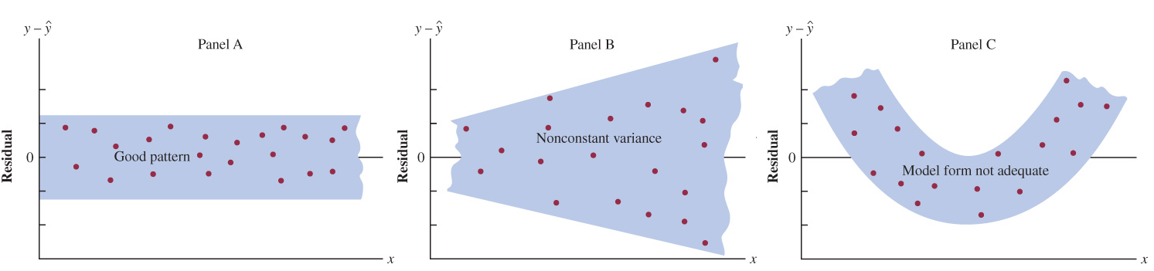
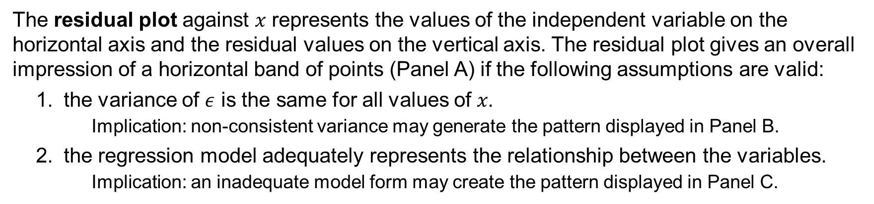
14.8 Residual Plot Against x
The residual plot against 𝑥 represents the values of the independent variable on the horizontal axis and the residual values on the vertical axis. The residual plot gives an overall impression of a horizontal band of points (Panel A) if the following assumptions are valid:
the variance of $ε$ is the same for all values of 𝑥.
Implication: non-consistent variance may generate the pattern displayed in Panel B.
the regression model adequately represents the relationship between the variables.
Implication: an inadequate model form may create the pattern displayed in Panel C.

Slide 47
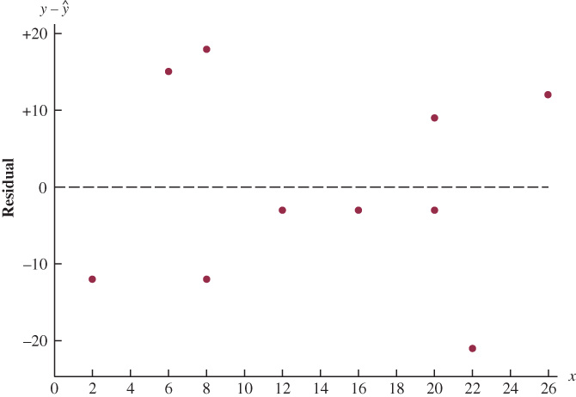
14.8 Residual Plot Against x for Armand’s Pizza Parlors
The residuals for the Armand’s Pizza Parlor sample data appear to approximate the horizontal pattern in Panel A from the previous slide.
Hence, we conclude that the residual plot does not provide evidence that the assumptions made for Armand’s regression model should be challenged.
At this point, we are confident in the conclusion that Armand’s simple linear regression model is valid.

Slide 48
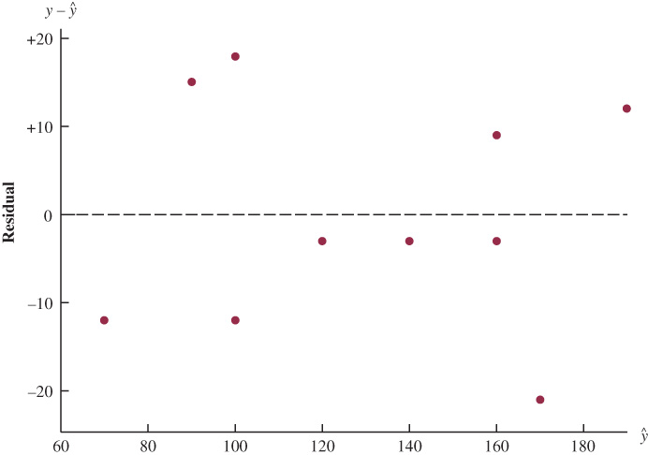
14.8 Residual Plot Against $\hat{y}$ for Armand’s Pizza Parlors
Another residual plot represents the predicted value of the dependent variable $\hat{y}$ on the horizontal axis in place of the independent variable 𝑥.
The residual plot against $\hat{y}$ is used for multiple regression analysis in the presence of more than one independent variable.
The pattern of the residual plot against $\hat{y}$ is the same as the pattern of the residual plot against 𝑥. Thus, it is not a pattern that would lead us to question the model assumptions.

Slide 49
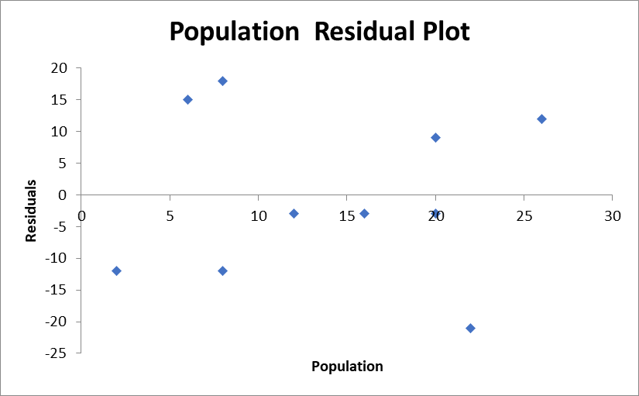
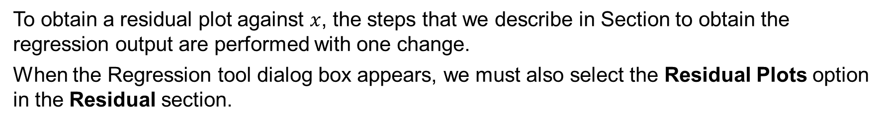
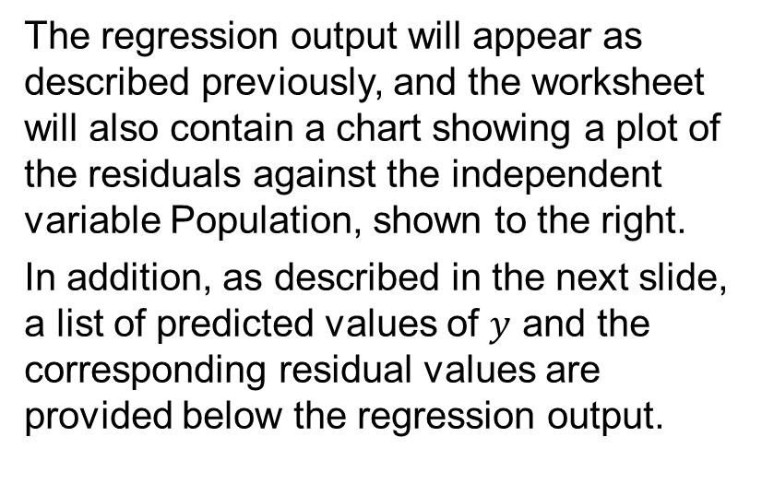
14.8 Excel: Residual Plot Against x
To obtain a residual plot against $x$, the steps that we describe in Section to obtain the regression output are performed with one change.
When the Regression tool dialog box appears, we must also select the Residual Plots option in the Residual section.
The regression output will appear as described previously, and the worksheet will also contain a chart showing a plot of the residuals against the independent variable Population, shown to the right.
In addition, as described in the next slide, a list of predicted values of $y$ and the corresponding residual values are provided below the regression output.

Slide 50
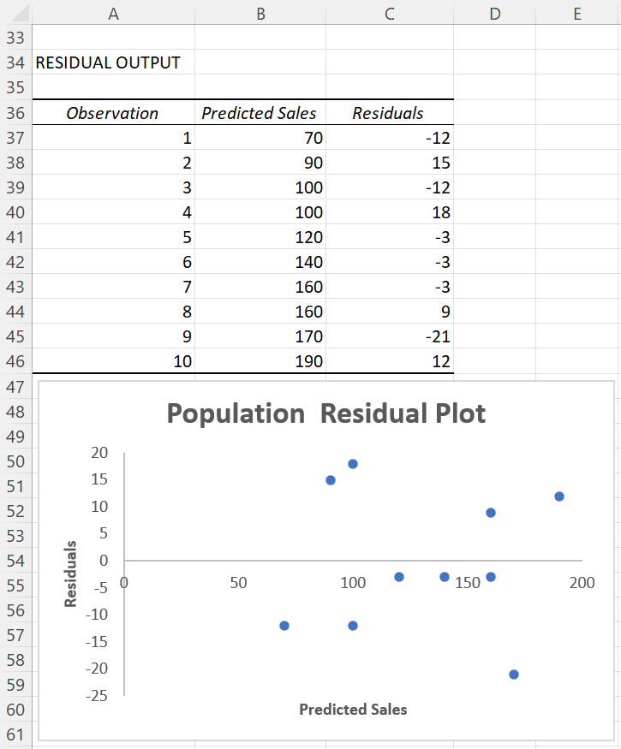
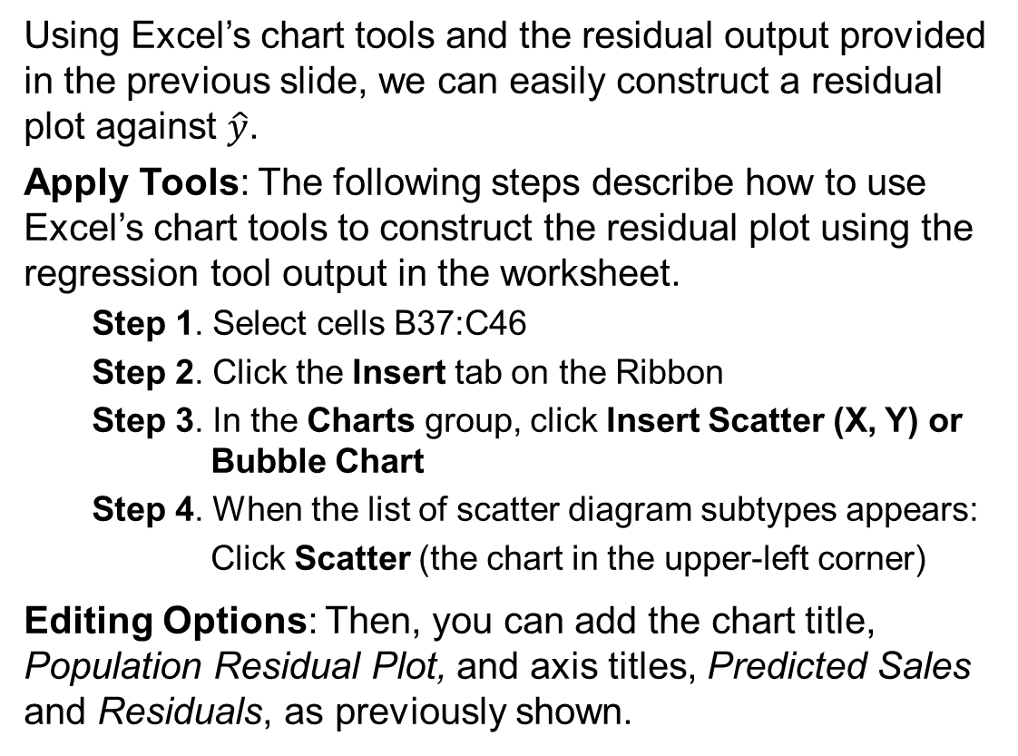
14.8 Excel: Residual Plot Against $\hat{y}$
Using Excel’s chart tools and the residual output provided in the previous slide, we can easily construct a residual plot against $\hat{y}$.
Apply Tools: The following steps describe how to use Excel’s chart tools to construct the residual plot using the regression tool output in the worksheet.
Step 1. Select cells B37:C46
Step 2. Click the Insert tab on the Ribbon
Step 3. In the Charts group, click Insert Scatter (X, Y) or Bubble Chart
Step 4. When the list of scatter diagram subtypes appears:
Click Scatter (the chart in the upper-left corner)
Editing Options: Then, you can add the chart title, Population Residual Plot, and axis titles, Predicted Sales and Residuals, as previously shown.

Slide 51
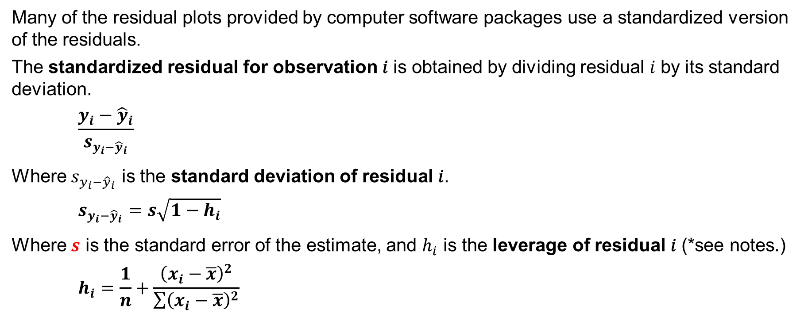
14.8 Standardized Residuals
Many of the residual plots provided by computer software packages use a standardized version of the residuals.
The standardized residual for observation 𝑖 is obtained by dividing residual 𝑖 by its standard deviation.
$$\frac{y_{i}−{\hat{y}}_{i}}{s_{y_{i}−{\hat{y}}_{i}}}$$
Where $s_{y_{i}−{\hat{y}}_{i}}$ is the standard deviation of residual 𝑖.
$$s_{y_{i}−{\hat{y}}_{i}}=s\sqrt{1−h_{i}}$$
Where $s$ is the standard error of the estimate, and $h_{i}$ is the leverage of residual 𝑖 (*see notes.)
$$h_{i}=\frac{1}{n}+\frac{{\left(x_{i}−\overline{x}\right)}^{2}}{\sum{{\left(x_{i}−\overline{x}\right)}^{2}}}$$
Notes:
*Note: Leverage will be discussed further when we consider influential observations in Section 14.9.

Slide 52
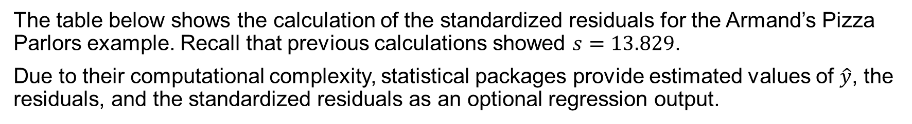
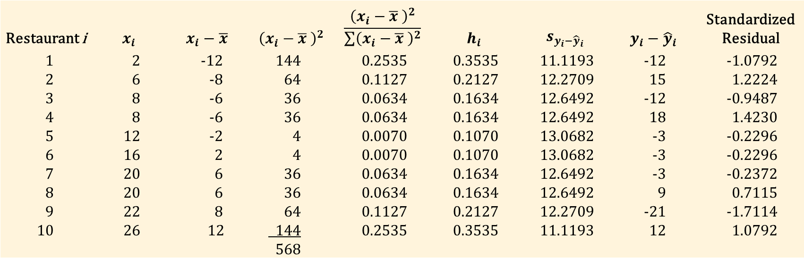
14.8 Standardized Residuals for Armand’s Pizza Parlors
The table below shows the calculation of the standardized residuals for the Armand’s Pizza Parlors example. Recall that previous calculations showed $s=13.829$.
Due to their computational complexity, statistical packages provide estimated values of $\hat{y}$, the residuals, and the standardized residuals as an optional regression output.
Restaurant i | $$x_{i}$$ | $$x_{i}−\overline{x}$$ | $${\left(x_{i}−\overline{x} \right)}^{2}$$ | $$\frac{{\left(x_{i}−\overline{x} \right)}^{2}}{\sum{{\left(x_{i}−\overline{x} \right)}^{2}}}$$ | $$h_{i}$$ | $$s_{y_{i}−{\hat{y}}_{i}}$$ | $$y_{i}−{\hat{y}}_{i}$$ | Standardized Residual
1 | 2 | -12 | 144 | 0.2535 | 0.3535 | 11.1193 | -12 | -1.0792
2 | 6 | -8 | 64 | 0.1127 | 0.2127 | 12.2709 | 15 | 1.2224
3 | 8 | -6 | 36 | 0.0634 | 0.1634 | 12.6492 | -12 | -0.9487
4 | 8 | -6 | 36 | 0.0634 | 0.1634 | 12.6492 | 18 | 1.4230
5 | 12 | -2 | 4 | 0.0070 | 0.1070 | 13.0682 | -3 | -0.2296
6 | 16 | 2 | 4 | 0.0070 | 0.1070 | 13.0682 | -3 | -0.2296
7 | 20 | 6 | 36 | 0.0634 | 0.1634 | 12.6492 | -3 | -0.2372
8 | 20 | 6 | 36 | 0.0634 | 0.1634 | 12.6492 | 9 | 0.7115
9 | 22 | 8 | 64 | 0.1127 | 0.2127 | 12.2709 | -21 | -1.7114
10 | 26 | 12 | 144 | 0.2535 | 0.3535 | 11.1193 | 12 | 1.0792
 |  |  | 568

Slide 53
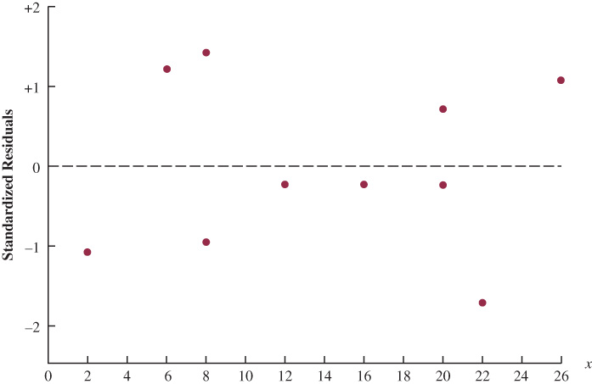
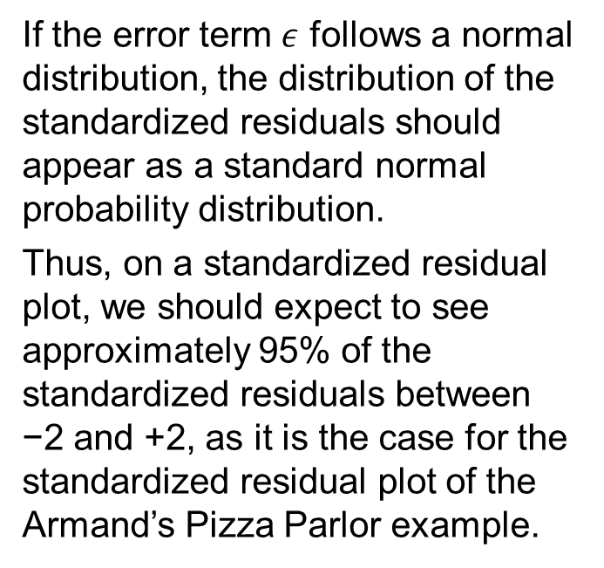
14.8 Standardized Residual Plot Against x for Armand’s Pizza Parlors
If the error term $ε$ follows a normal distribution, the distribution of the standardized residuals should appear as a standard normal probability distribution.
Thus, on a standardized residual plot, we should expect to see approximately 95% of the standardized residuals between −2 and +2, as it is the case for the standardized residual plot of the Armand’s Pizza Parlor example.

Slide 54
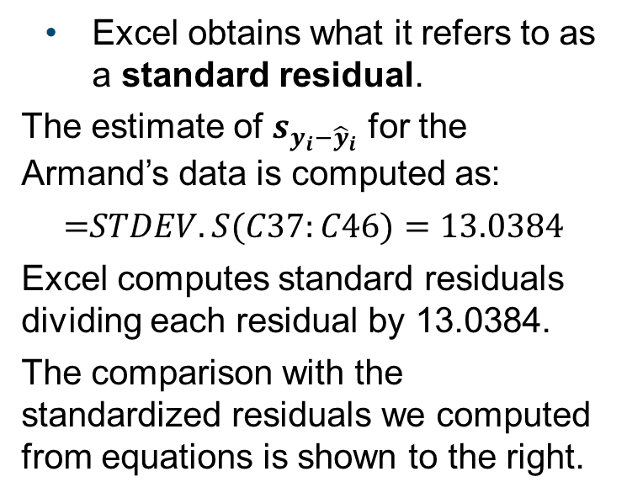
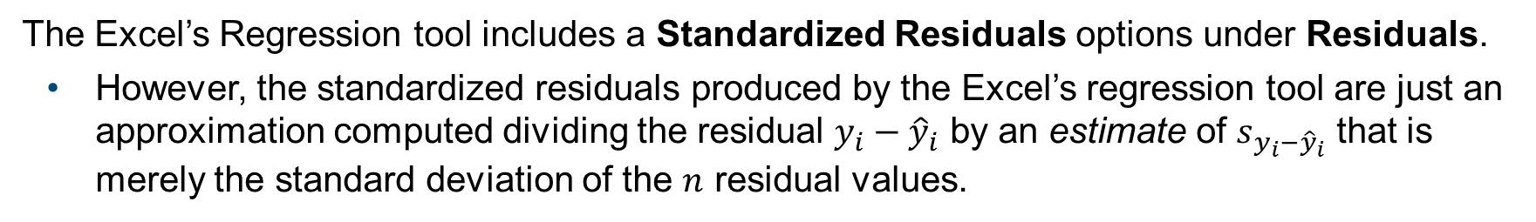
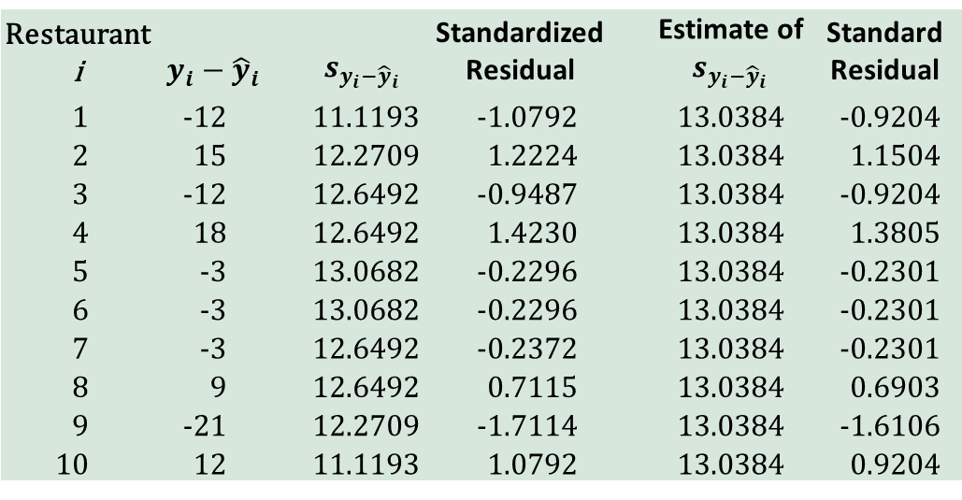
14.8 Excel: Standardized vs. Standard Residuals
The Excel’s Regression tool includes a Standardized Residuals options under Residuals.
However, the standardized residuals produced by the Excel’s regression tool are just an approximation computed dividing the residual $y_{i}−{\hat{y}}_{i}$ by an estimate of $s_{y_{i}−{\hat{y}}_{i}}$ that is merely the standard deviation of the $n$ residual values.
Excel obtains what it refers to as a standard residual.
The estimate of $s_{y_{i}−{\hat{y}}_{i}}$ for the Armand’s data is computed as:
$$\text{=}STDEV.S(C37:C46)=13.0384$$
Excel computes standard residuals dividing each residual by 13.0384.
The comparison with the standardized residuals we computed from equations is shown to the right.
 |  |  | Values from Equations |  | Values from Excel
Restaurant i | $$y_{i}−{\hat{y}}_{i}$$ |  | $$s_{y_{i}−{\hat{y}}_{i}}$$ | Standardized Residual |  | Estimate of $s_{y_{i}−{\hat{y}}_{i}}$ | Standard Residual
1 | -12 |  | 11.1193 | -1.0792 |  | 13.0384 | -0.9204
2 | 15 |  | 12.2709 | 1.2224 |  | 13.0384 | 1.1504
3 | -12 |  | 12.6492 | -0.9487 |  | 13.0384 | -0.9204
4 | 18 |  | 12.6492 | 1.4230 |  | 13.0384 | 1.3805
5 | -3 |  | 13.0682 | -0.2296 |  | 13.0384 | -0.2301
6 | -3 |  | 13.0682 | -0.2296 |  | 13.0384 | -0.2301
7 | -3 |  | 12.6492 | -0.2372 |  | 13.0384 | -0.2301
8 | 9 |  | 12.6492 | 0.7115 |  | 13.0384 | 0.6903
9 | -21 |  | 12.2709 | -1.7114 |  | 13.0384 | -1.6106
10 | 12 |  | 11.1193 | 1.0792 |  | 13.0384 | 0.9204

Slide 55
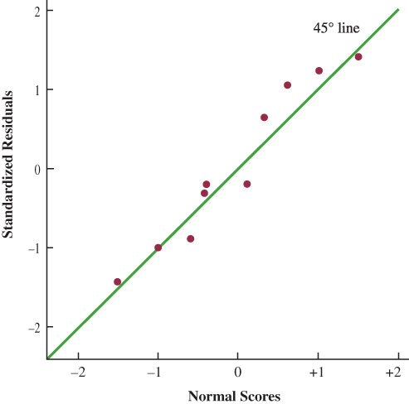
14.8 Normal Probability Plot
A normal probability plot displays the ordered standardized residuals against the values of the normal scores (*see notes for details about normal scores.)
With a linear pattern close to the 45º line, we can assume that the error term has a normal probability distribution.
Below are the 10 observations for the Armand’s Pizza Parlor normal probability plot that is shown to the right.
Order Statistic | Normal Scores | Ordered Standardized Residuals
1 | -1.55 | -1.7114
2 | -1.00 | -1.0792
3 | -0.65 | -0.9487
4 | -0.37 | -0.2372
5 | -0.12 | -0.2296
6 | 0.12 | 0.2296
7 | 0.37 | 0.7115
8 | 0.65 | 1.0792
9 | 1.00 | 1.2224
10 | 1.55 | 1.4230
Notes:
*Note: the first normal score is the expected value of the first-order statistic for a standard normal probability distribution.
The first-order statistic is a random variable representing the smallest value obtained in the repeated sampling of a given size from a normal probability distribution.
Statisticians proved that for $n=10$, as it is in the Armand’s Pizza Parlors case, the first-order statistic, and first normal score, is -1.55.
Once the first and last normal scores of -1.55 and +1.55 are identified, then the other $n−2=8$ normal scores are computed by dividing the range between -1.55 and +1.55 into $8+1=9$ intervals of equal probability.

Slide 56
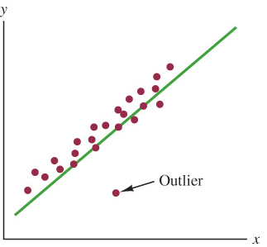
14.9 Outliers and Influential Observations
An outlier is a data point (observation) that does not fit the trend shown by the remaining data.
Outliers represent observations that are suspect and warrant careful examination.
The presence of an outlier may be due to one of the following reasons:
Erroneous data.
Action: the data should be corrected.
Signal of a violation in the model assumptions
Action: another model should be considered.
Unusual values that occurred by chance
Action: the data should be retained.
Standardized residuals can also be used to identify outliers. If an observation deviates greatly from the pattern of the remaining data, the corresponding standardized residual will be large in absolute value.

Slide 57
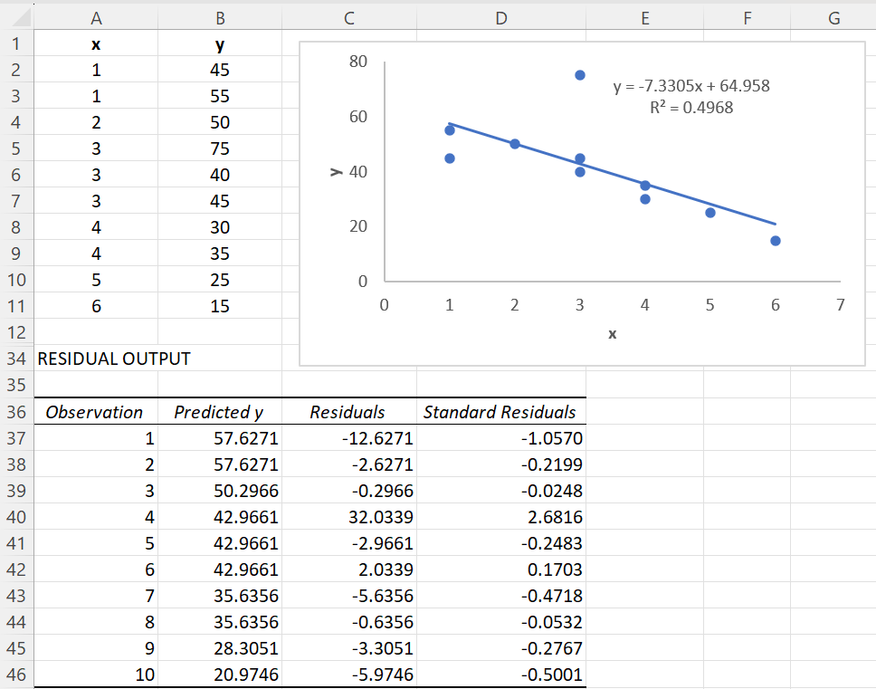
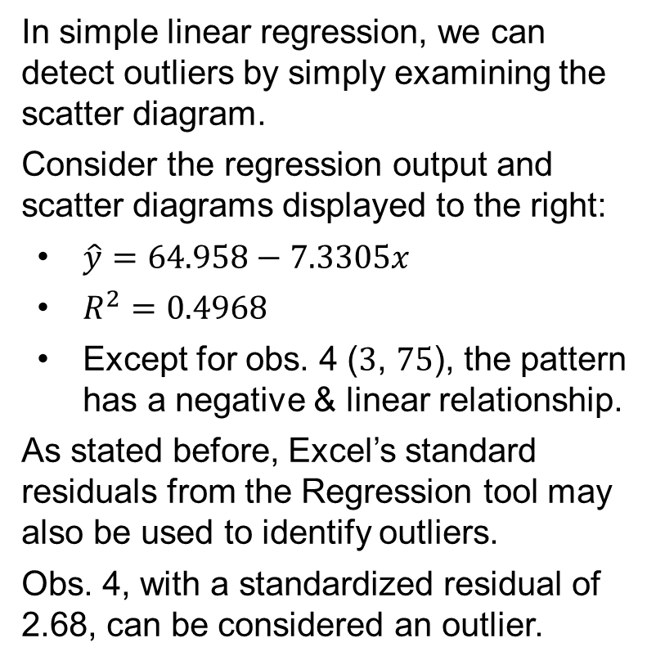
14.9 Excel: Data Set with an Outlier
In simple linear regression, we can detect outliers by simply examining the scatter diagram.
Consider the regression output and scatter diagrams displayed to the right:
$\hat{y}=64.958−7.3305x$
$R^{2}=0.4968$
Except for obs. 4 ($3$, $75$), the pattern has a negative & linear relationship.
As stated before, Excel’s standard residuals from the Regression tool may also be used to identify outliers.
Obs. 4, with a standardized residual of 2.68, can be considered an outlier.

Slide 58
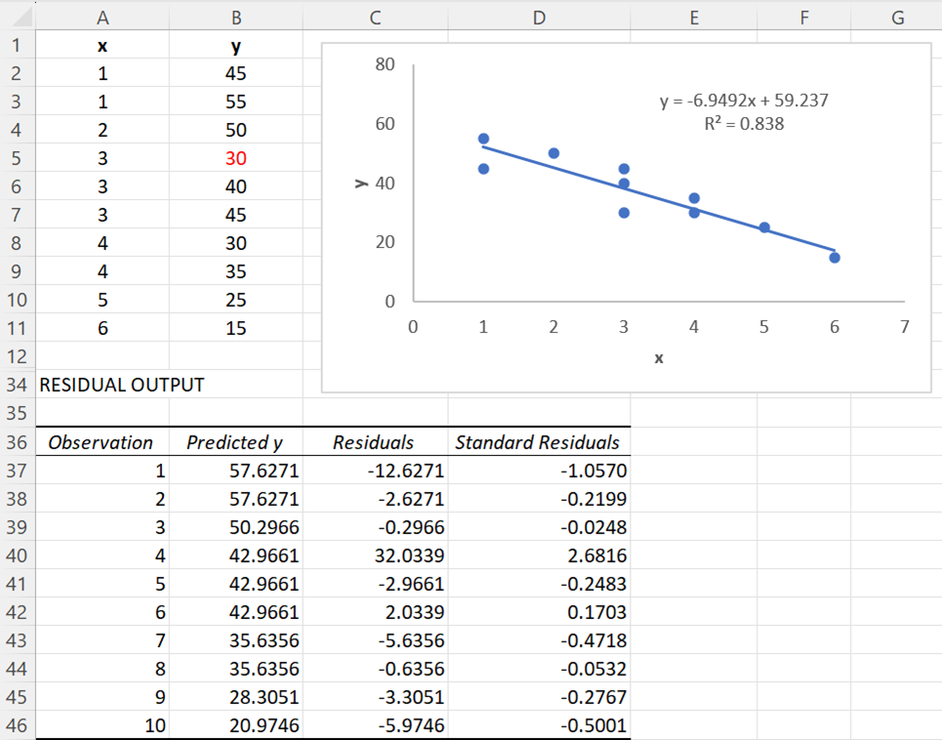
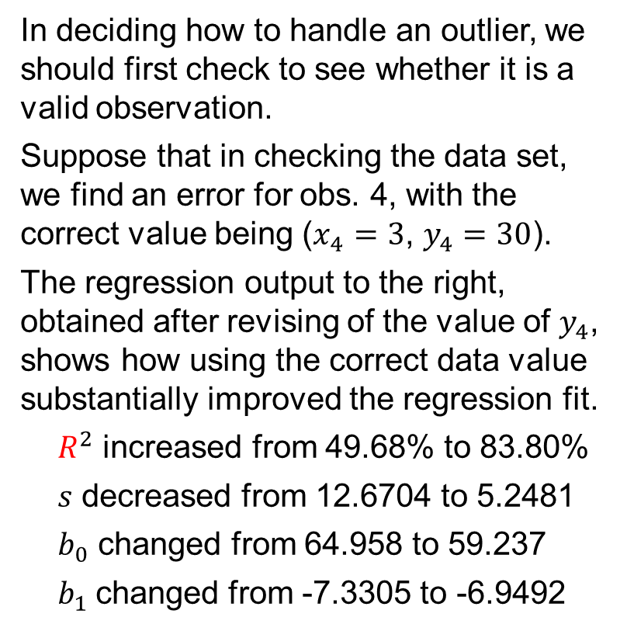
14.9 Excel: Revised Data Set without the Outlier
In deciding how to handle an outlier, we should first check to see whether it is a valid observation.
Suppose that in checking the data set, we find an error for obs. 4, with the correct value being ($x_{4}=3$, $y_{4}=30$).
The regression output to the right, obtained after revising of the value of $y_{4}$, shows how using the correct data value substantially improved the regression fit.
$R^{2}$ increased from 49.68% to 83.80%
$s$ decreased from 12.6704 to 5.2481
$b_{0}$ changed from 64.958 to 59.237
$b_{1}$changed from -7.3305 to -6.9492

Slide 59
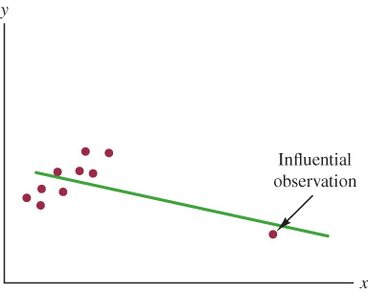
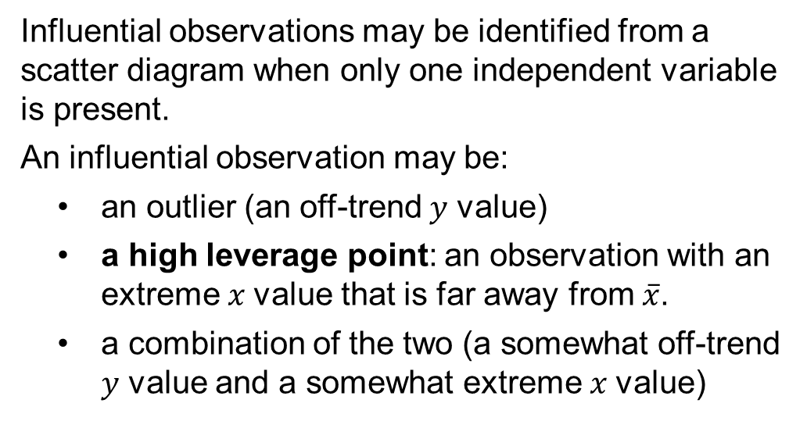
14.9 Detecting Influential Observations
An influential observation exerts a strong influence on the results of linear regression.
The estimated regression line shown in the diagram has a negative slope. However, if the influential observation were dropped from the data set, the slope of the estimated regression line would change from negative to positive and the 𝑦-intercept would be smaller.
Influential observations may be identified from a scatter diagram when only one independent variable is present.
An influential observation may be:
an outlier (an off-trend 𝑦 value)
a high leverage point: an observation with an extreme 𝑥 value that is far away from $\overline{x}$.
a combination of the two (a somewhat off-trend 𝑦 value and a somewhat extreme 𝑥 value)

Slide 60
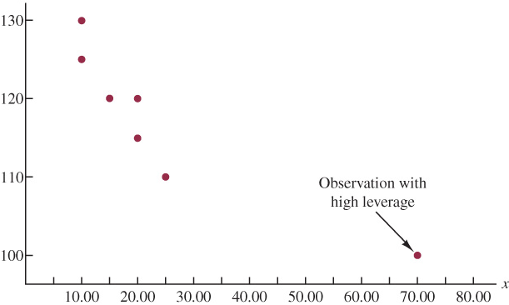

14.9 Data Set with a High Leverage Observation
For the single independent variable case, the leverage of observation 𝑖, denoted $h_{i}$, can be computed by using the following equation.
$$h_{i}=\frac{1}{n}+\frac{{\left(x_{i}−\overline{x}\right)}^{2}}{\sum{{\left(x_{i}−\overline{x}\right)}^{2}}}$$
From the formula, it is clear that the farther $x_{i}$ is from its mean $\overline{x}$, the higher the leverage of observation 𝑖.
Many statistical packages automatically identify observations with high leverage as part of the standard regression output.
As an illustration of points with high leverage, let us consider observation 7 at coordinates ($x_{7}=70$, $y_{7}=100$).

Slide 61

14.9 Calculation of $h_{i}$ in the High Leverage Data Set
The leverage for observation ($x_{7}=70$, $y_{7}=100$) of the high leverage data set is computed as follows.
$$h_{7}=\frac{1}{n}+\frac{{\left(x_{7}−\overline{x}\right)}^{2}}{\sum{{\left(x_{i}−\overline{x}\right)}^{2}}}=\frac{1}{7}+\frac{{\left(70−24.286\right)}^{2}}{2,621.43}=0.94$$
For the case of simple linear regression, observation 𝑖 has high leverage if $h_{i}>6/n$ or 0.99, whichever is smaller.
For the high leverage data set, $6/n=6/7=0.86$. Because $h_{7}=0.94>0.86$, we will identify observation 7 as a highly influential observation due to an extreme value of 𝑥.
Influential observations that are caused by an interaction of large residuals and high leverage can be difficult to detect.
Diagnostic procedures are available that take into account when an observation is influential. One such measure, called Cook’s D statistic, is discussed in more advanced statistics books.

Slide 62

14.10 Practical Advice: Big Data and Hypothesis Testing in Simple Linear Regression
In simple linear regression, as the sample size increases,
the p-value for the t test, used to determine whether a significant relationship exists between the dependent and the independent variables, decreases.
the confidence interval for the slope parameter associated with the independent variable narrows.
the confidence interval for the mean value of 𝑦 narrows.
the prediction interval for an individual value of 𝑦 narrows.
The fact that with larger sample sizes it becomes more likely to reject $H_{0}$, and the precision of estimates and prediction increases, does not necessarily make these results more reliable.
No matter how large is the sample used to estimate the simple linear regression equation, we must be concerned about the potential presence of nonsampling error in the data and carefully consider whether a random sample of the population of interest has been taken.

Slide 63
Summary
In this chapter, we showed how regression analysis can be used to determine how a dependent variable 𝑦 is related to an independent variable 𝑥.
The simple linear regression equation describes how the expected value of 𝑦 is related to 𝑥.
We used the least squares method to develop the estimated regression equation from sample data and estimate the unknown model parameters $b_{0}$ and $b_{1}$ from the sample statistics $β_{0}$ and $β_{1}$.
The coefficient of determination can be interpreted as the proportion of the variation in the dependent variable 𝑦 that is explained by the estimated regression equation.
Based on a set of assumptions about the error term of the regression, we presented two tests to determine whether the relationship between two variables is statistically significant.
The chapter concluded with considerations about computer output, and two sections on the use of residual analysis to validate the model assumptions and to identify outliers and influential observations.

