Slide 1
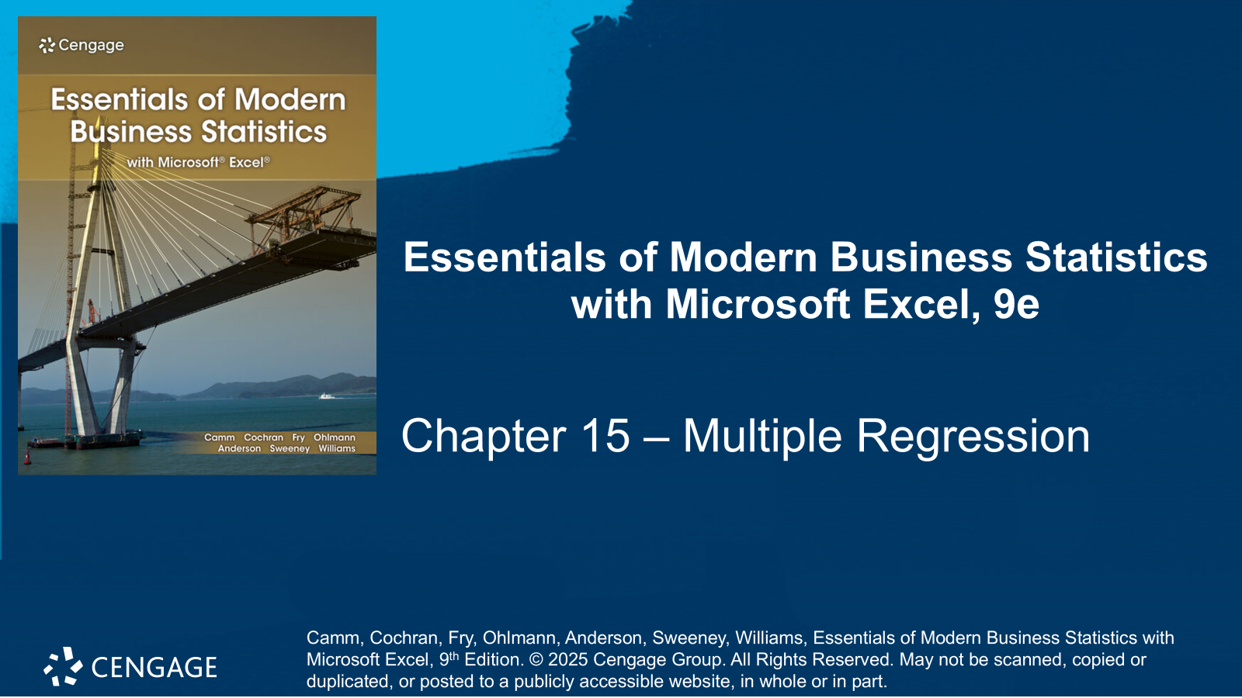

Slide 2
Chapter Contents
15.1 Multiple Regression Model
15.2 Least Squares Method
15.3 Multiple Coefficient of Determination
15.4 Model Assumptions
15.5 Testing for Significance
15.6 Using the Estimated Regression Equation for Estimation and Prediction
15.7 Categorical Independent Variables
15.8 Residual Analysis
15.9 Practical Advice: Big Data and Hypothesis Testing in Multiple Regression
Summary

Slide 3
Chapter Objectives (1 of 2)
After completing this chapter, you will be able to:
LO 15-1 Develop a multiple linear regression equation that estimates how a dependent variable is related to multiple independent variables.
LO 15-2 Interpret the coefficients in a multiple linear regression analysis.
LO 15-3 Use a multiple linear regression model to predict the value of the dependent variable given values of the independent variables.
LO 15-4 Calculate and interpret the multiple coefficient of determination and adjusted multiple coefficient of determination as goodness-of-fit measures in a multiple regression analysis.
LO 15-5 Use the t test to assess the significance of individual coefficients in a multiple linear regression analysis.
LO 15-6 Use the F test to assess the overall significance of a multiple linear regression model.

Slide 4
Chapter Objectives (2 of 2)
LO 15-7 Determine if multicollinearity is present in a multiple linear regression analysis using the correlation between independent variables.
LO 15-8 Develop a confidence interval for the mean value of the dependent variable given values of the independent variables.
LO 15-9 Develop a prediction interval for a particular value of the dependent variable given values of the independent variables.
LO 15-10 Develop a multiple linear regression equation that estimates how a dependent variable is related to categorical independent variables.
LO 15-11 Validate the assumptions of a multiple linear regression model using residual analysis.
LO 15-12 Identify outliers and influential observations for multiple linear regression analysis.

Slide 5
Introduction
In the previous chapter, we presented simple linear regression and demonstrated its use in developing an estimated regression equation that describes the relationship between two variables:
the dependent variable: the variable being predicted or explained.
the independent variable: the variable used to predict or explain the dependent variable.
In this chapter, we continue our study of regression analysis by considering situations involving two or more independent variables.
This subject area, called multiple regression analysis, enables us to consider more factors and thus obtain better predictions than are possible with simple linear regression.

Slide 6
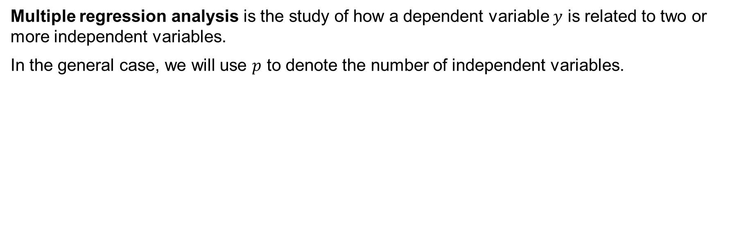
15.1 Multiple Regression Model
Multiple regression analysis is the study of how a dependent variable $y$ is related to two or more independent variables.
In the general case, we will use $p$ to denote the number of independent variables.

Slide 7
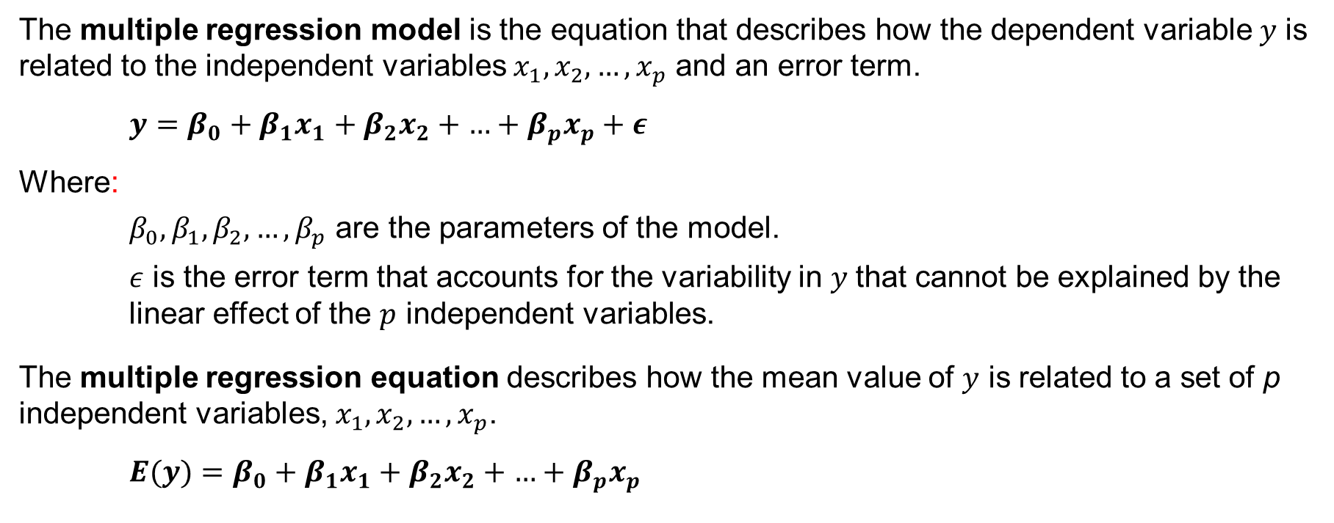
15.1 Regression Model and Regression Equation
The multiple regression model is the equation that describes how the dependent variable 𝑦 is related to the independent variables $x_{1}, x_{2}, …, x_{p}$ and an error term.
$y=β_{0}+β_{1}x_{1}+β_{2}x_{2}+\text{…}+β_{p}x_{p}+ε$
Where:
$β_{0},β_{1},β_{2},…,β_{p}$ are the parameters of the model.
$ε$ is the error term that accounts for the variability in 𝑦 that cannot be explained by the linear effect of the $p$ independent variables.
The multiple regression equation describes how the mean value of $y$ is related to a set of p independent variables, $x_{1},x_{2},…,x_{p}$.
$E(y)=β_{0}+β_{1}x_{1}+β_{2}x_{2}+\text{…}+β_{p}x_{p}$

Slide 8
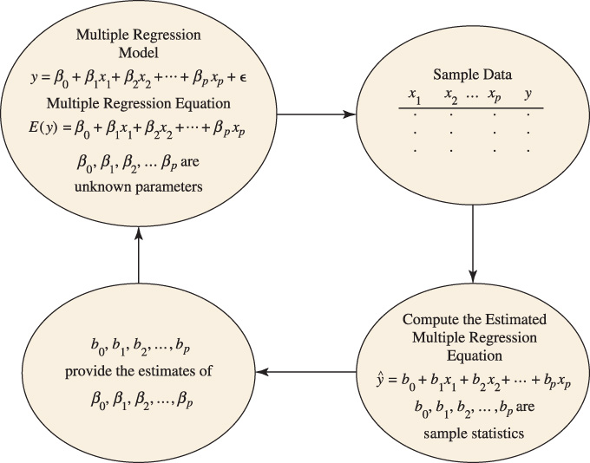
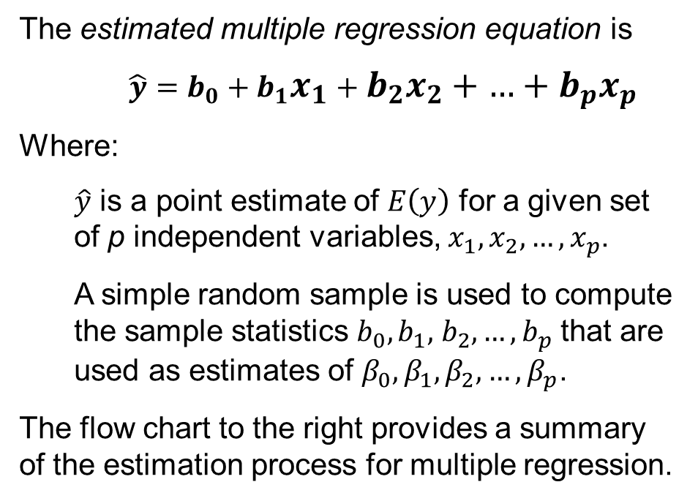
15.1 The Estimation Process in Multiple Regression
The estimated multiple regression equation is
$$\hat{y}=b_{0}+b_{1}x_{1}+b_{2}x_{2}+\text{…}+b_{p}x_{p}$$
Where:
$\hat{y}$ is a point estimate of $E\left(y\right)$ for a given set of p independent variables, $x_{1},x_{2},…,x_{p}$.
A simple random sample is used to compute the sample statistics $b_{0},b_{1},$ $b_{2},…,b_{p}$ that are used as estimates of $β_{0},β_{1},β_{2},…,β_{p}$.
The flow chart to the right provides a summary of the estimation process for multiple regression.

Slide 9
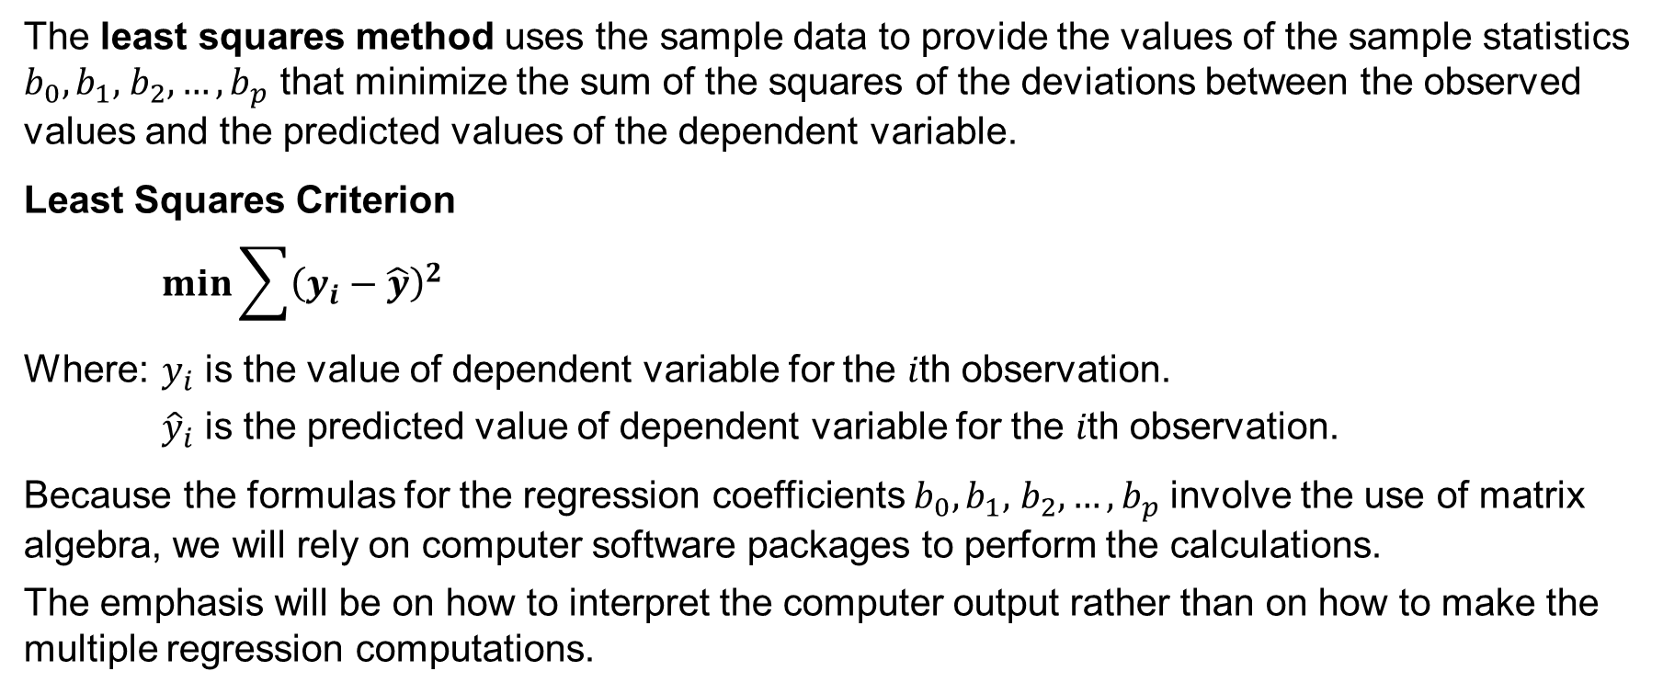
15.2 Least Squares Method
The least squares method uses the sample data to provide the values of the sample statistics $b_{0},b_{1},$ $b_{2},…,b_{p}$ that minimize the sum of the squares of the deviations between the observed values and the predicted values of the dependent variable.
Least Squares Criterion
$$\min{\sum{{\left(y_{i}−\hat{y}\right)}^{2}}}$$
Where: $y_{i}$ is the value of dependent variable for the 𝑖th observation.
${\hat{y}}_{i}$ is the predicted value of dependent variable for the 𝑖th observation.
Because the formulas for the regression coefficients $b_{0},b_{1},$ $b_{2},…,b_{p}$ involve the use of matrix algebra, we will rely on computer software packages to perform the calculations.
The emphasis will be on how to interpret the computer output rather than on how to make the multiple regression computations.

Slide 10
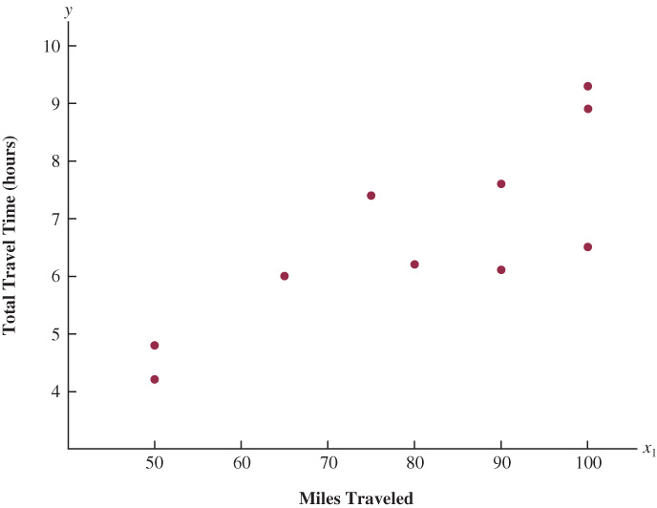
15.2 The Butler Trucking Company Example
To develop better work schedules, the managers at the Butler Trucking Company, want to predict the total daily travel time for their drivers.
Initially, the managers believed that the total daily travel time (𝑦) would be closely related to the number of miles traveled in making the daily deliveries, 𝑥.
DATAfile: butler
The managers used a simple random sample of 10 driving assignments to build a scatter diagram depicting the relationship between the variables.
Because the scatter diagram shows a positive linear relationship, the managers chose the simple linear regression model to represent the relationship between total daily delivery time (𝑦) and the number of miles driven in making daily deliveries (𝑥.)

Slide 11
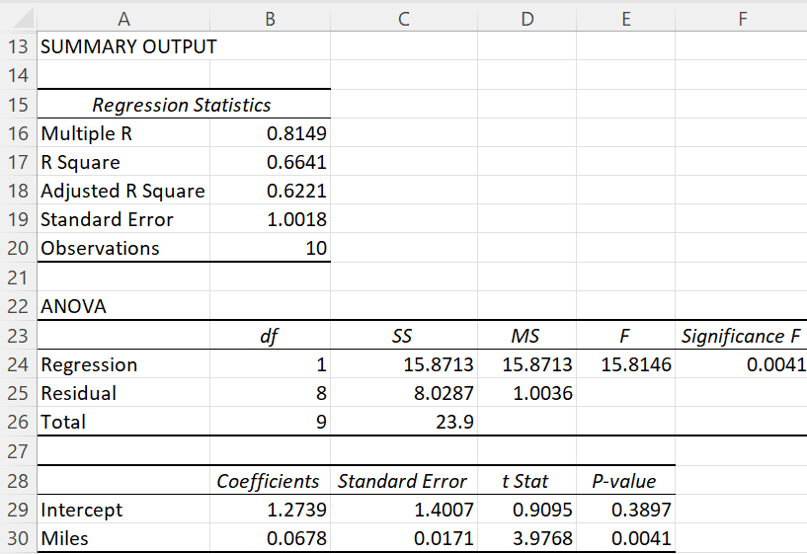

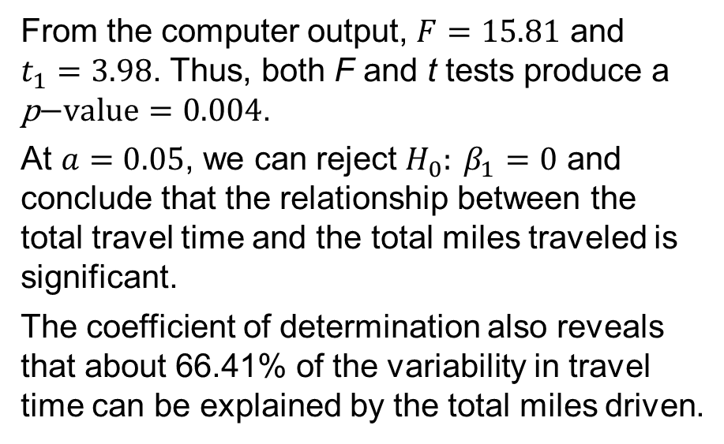
15.2 Excel: Simple Linear Regression Output with One Independent Variable
The computer output to the right shows the results of the simple linear regression with the total miles traveled as the independent variable 𝑥.
$$\hat{y}=1.27+0.0678 x$$
From the computer output, $F=15.81$ and $t_{1}=3.98$. Thus, both F and t tests produce a $\text{p}\text{−}\text{value}=0.004$.
At $a=0.05$, we can reject $H_{0}: β_{1}=0$ and conclude that the relationship between the total travel time and the total miles traveled is significant.
The coefficient of determination also reveals that about 66.41% of the variability in travel time can be explained by the total miles driven.

Slide 12
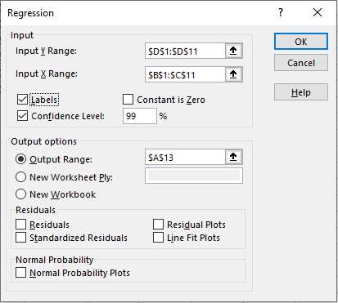
15.2 Excel: Regression Tool Dialog Box
The managers felt that the number of deliveries (column D) could also contribute to the total travel time. Thus, we must compute a multiple regression with two independent variables.
Enter/Access Data: Open the file butler. The data and labels are in cells B1:D11.
Apply Tools: The following steps describe how to use Excel’s Regression tool to perform multiple regression analysis computations. See notes.
Step 1. Click the Data tab on the Ribbon
Step 2. In the Analyze group, click Data Analysis
Step 3. Choose Regression from the list of tools
Step 4. In the Regression dialog box:
Enter D1:D11 in the Input Y Range: box
Enter B1:C11 in the Input X Range: box
Select the check box for Labels
Select Output Range: in the Output options area and enter A13
Click OK.
Notes:
The procedure is the same as the one shown for simple linear regression in Section 14.7, with the only additional requirement that the independent variables must be located in contiguous columns.

Slide 13
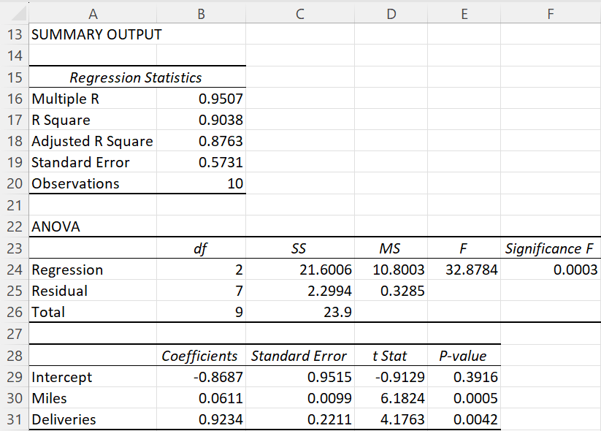
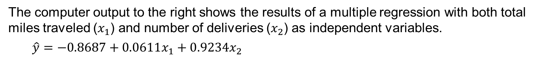
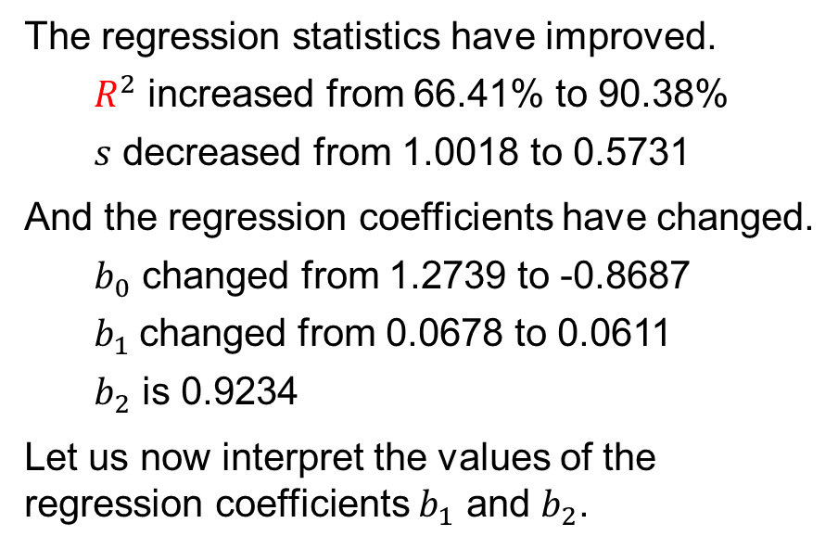
15.2 Excel: Multiple Regression Output with Two Independent Variables
The computer output to the right shows the results of a multiple regression with both total miles traveled ($x_{1}$) and number of deliveries ($x_{2}$) as independent variables.
$$\hat{y}=−0.8687+0.0611x_{1}+0.9234x_{2}$$
The regression statistics have improved.
$R^{2}$ increased from 66.41% to 90.38%
$s$ decreased from 1.0018 to 0.5731
And the regression coefficients have changed.
$b_{0}$ changed from 1.2739 to -0.8687
$b_{1}$changed from 0.0678 to 0.0611
$b_{2}$ is 0.9234
Let us now interpret the values of the regression coefficients $b_{1}$ and $b_{2}$.

Slide 14
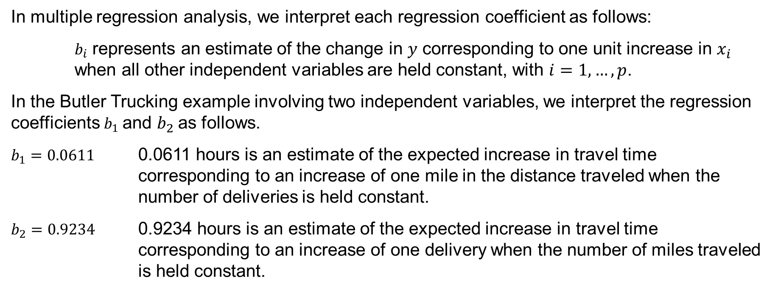
15.2 Interpreting Multiple Regression Coefficients
In multiple regression analysis, we interpret each regression coefficient as follows:
$b_{i}$ represents an estimate of the change in 𝑦 corresponding to one unit increase in $x_{i}$ when all other independent variables are held constant, with $i=1,…,p$.
In the Butler Trucking example involving two independent variables, we interpret the regression coefficients $b_{1}$and $b_{2}$as follows.
$b_{1}=0.0611$ 0.0611 hours is an estimate of the expected increase in travel time corresponding to an increase of one mile in the distance traveled when the number of deliveries is held constant.
$b_{2}=0.9234$ 0.9234 hours is an estimate of the expected increase in travel time corresponding to an increase of one delivery when the number of miles traveled is held constant.

Slide 15
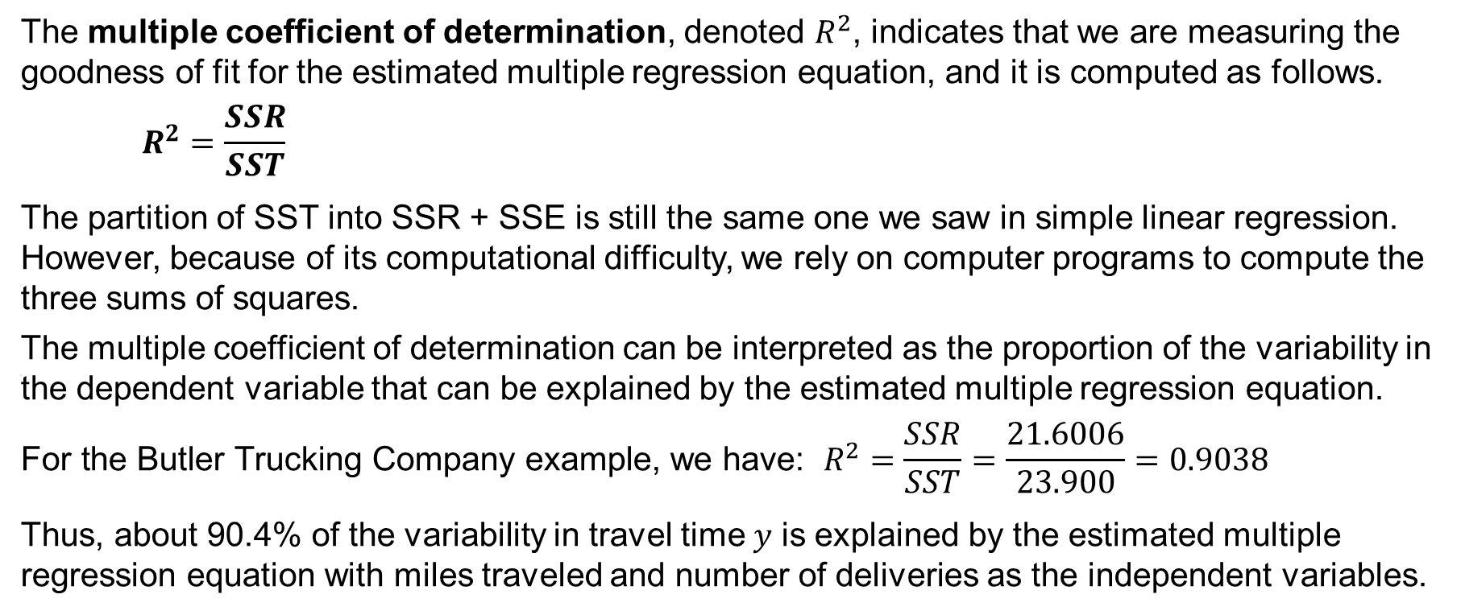
15.3 Multiple Coefficient of Determination
The multiple coefficient of determination, denoted $R^{2}$, indicates that we are measuring the goodness of fit for the estimated multiple regression equation, and it is computed as follows.
$$R^{2}=\frac{SSR}{SST}$$
The partition of SST into SSR + SSE is still the same one we saw in simple linear regression. However, because of its computational difficulty, we rely on computer programs to compute the three sums of squares.
The multiple coefficient of determination can be interpreted as the proportion of the variability in the dependent variable that can be explained by the estimated multiple regression equation.
$${\text{For} \text{the} \text{Butler} \text{Trucking} \text{Company} \text{example}\text{, }\text{we} \text{have}\text{: }R}^{2}=\frac{SSR}{SST}=\frac{21.6006}{23.900}=0.9038$$
Thus, about 90.4% of the variability in travel time 𝑦 is explained by the estimated multiple regression equation with miles traveled and number of deliveries as the independent variables.

Slide 16
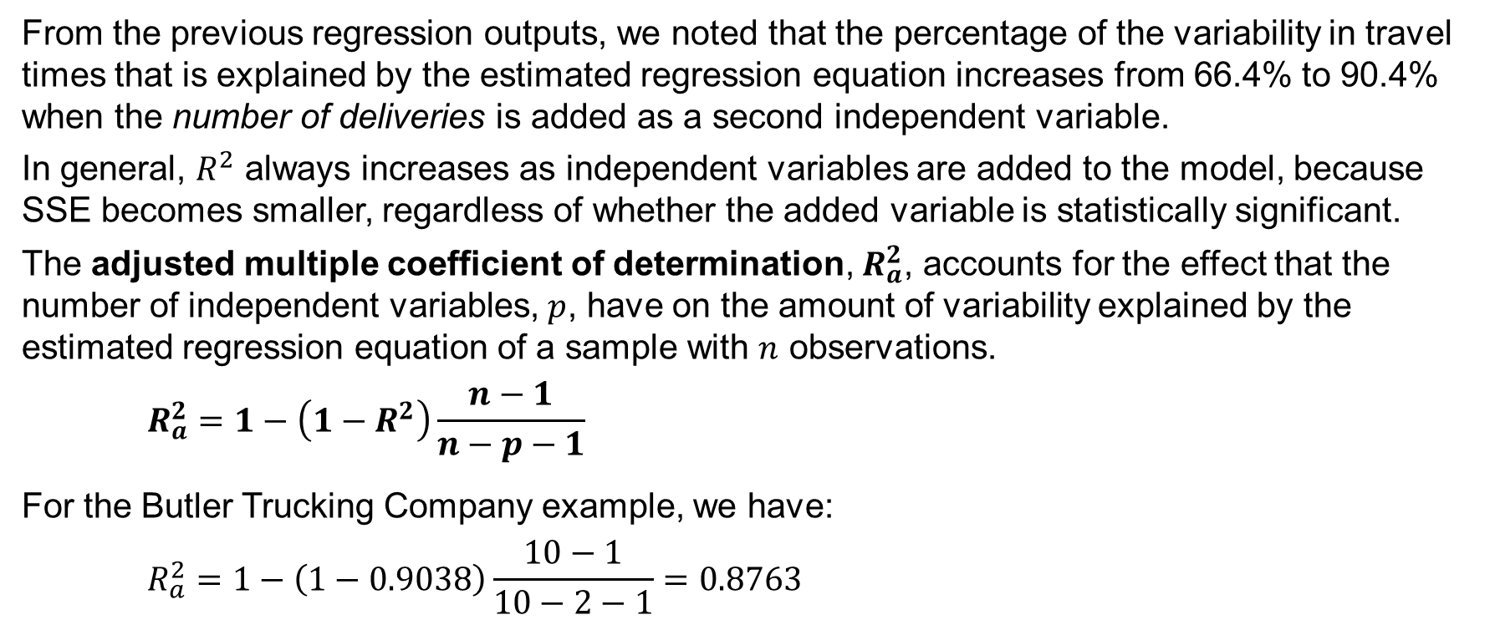
15.3 Adjusted Multiple Coefficient of Determination
From the previous regression outputs, we noted that the percentage of the variability in travel times that is explained by the estimated regression equation increases from 66.4% to 90.4% when the number of deliveries is added as a second independent variable.
In general, $R^{2}$ always increases as independent variables are added to the model, because SSE becomes smaller, regardless of whether the added variable is statistically significant.
The adjusted multiple coefficient of determination, $R_{a}^{2}$, accounts for the effect that the number of independent variables, $p$, have on the amount of variability explained by the estimated regression equation of a sample with $n$ observations.
$$R_{a}^{2}=1−\left(1−R^{2}\right)\frac{n−1}{n−p−1}$$
For the Butler Trucking Company example, we have:
$$R_{a}^{2}=1−\left(1−0.9038\right)\frac{10−1}{10−2−1}=0.8763$$

Slide 17
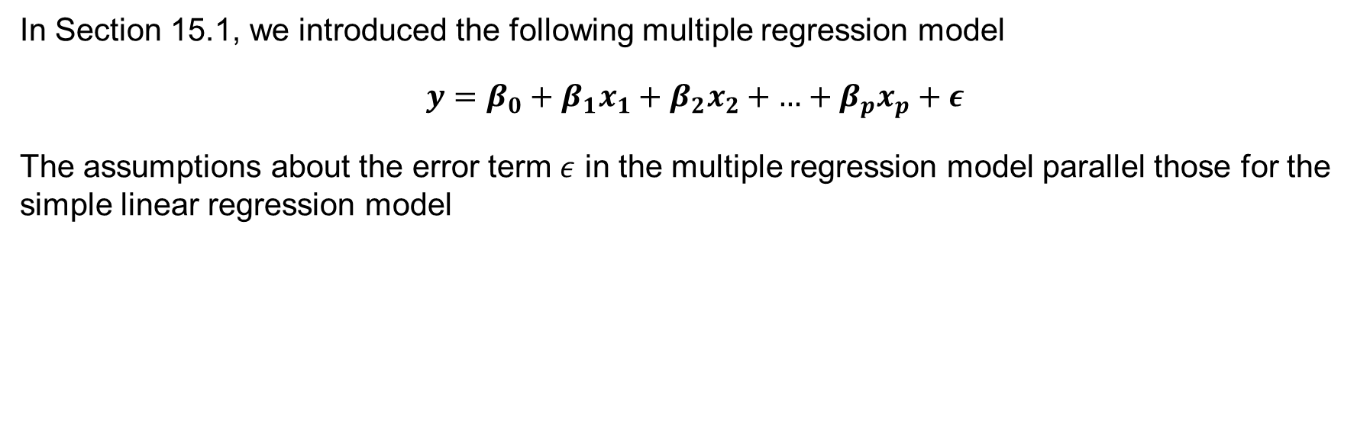
15.4 Model Assumptions
In Section 15.1, we introduced the following multiple regression model
$$y=β_{0}+β_{1}x_{1}+β_{2}x_{2}+\text{…}+β_{p}x_{p}+ε$$
The assumptions about the error term $ε$ in the multiple regression model parallel those for the simple linear regression model

Slide 18
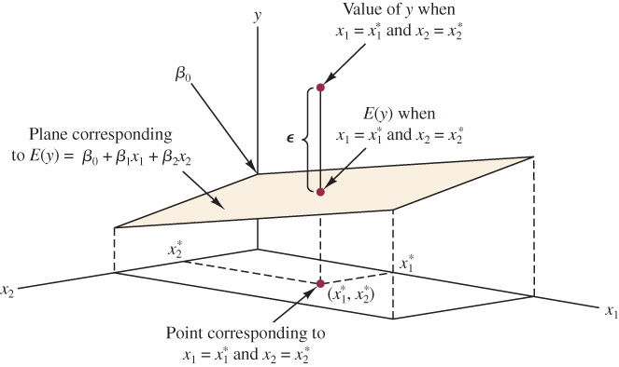
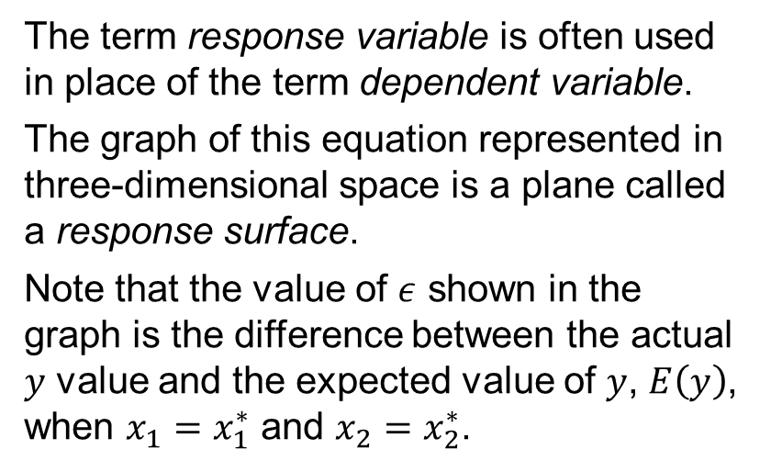
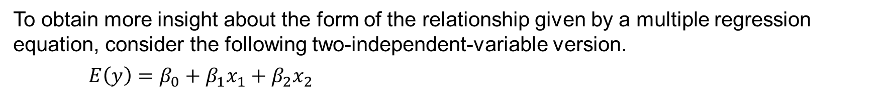
15.4 Graphical Representation of a Multiple Regression Equation with Two Independent Variables
To obtain more insight about the form of the relationship given by a multiple regression equation, consider the following two-independent-variable version.
$E\left(y\right)=β_{0}+β_{1}x_{1}+β_{2}x_{2}$
The term response variable is often used in place of the term dependent variable.
The graph of this equation represented in three-dimensional space is a plane called a response surface.
Note that the value of $ε$ shown in the graph is the difference between the actual 𝑦 value and the expected value of 𝑦, $E\left(y\right)$, when $x_{1}=x_{1}^{∗}$ and $x_{2}=x_{2}^{∗}$.

Slide 19
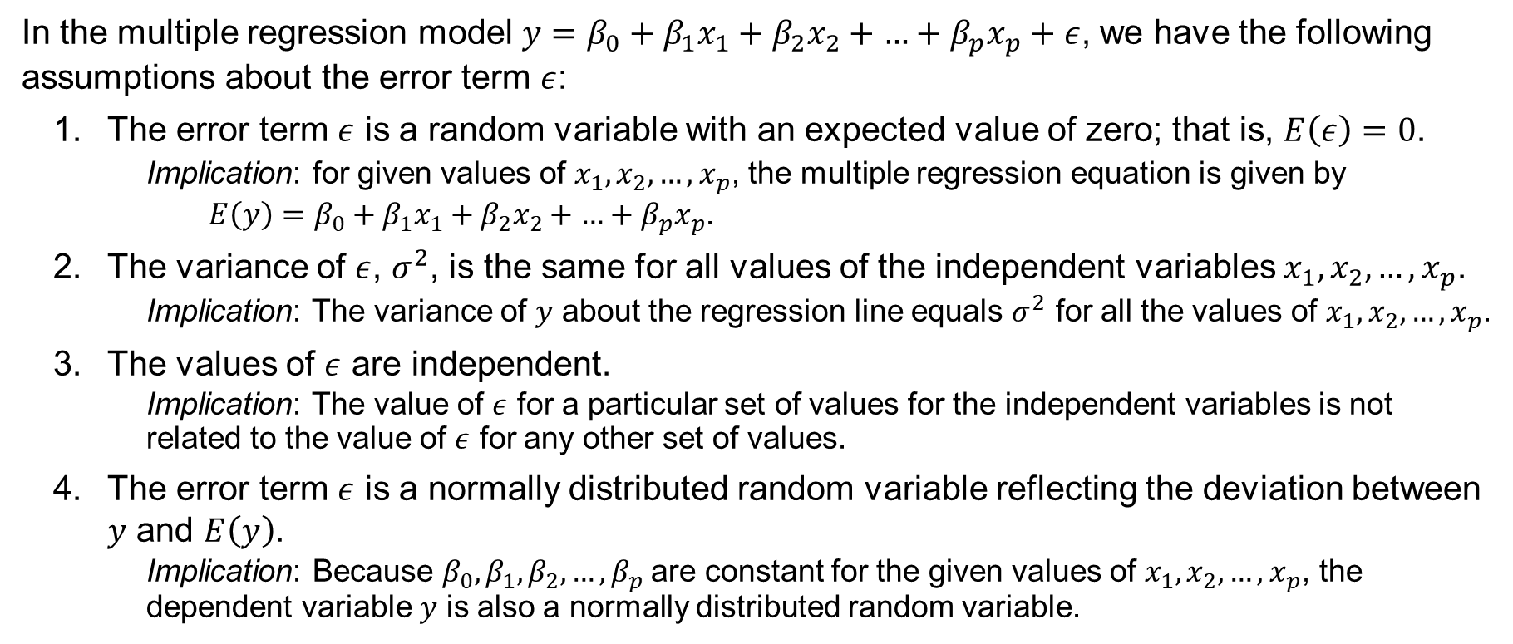
15.4 Assumptions About the Error Term $ε$
In the multiple regression model $y=β_{0}+β_{1}x_{1}+β_{2}x_{2}+\text{…}+β_{p}x_{p}+ε$, we have the following assumptions about the error term $ε$:
The error term $ε$ is a random variable with an expected value of zero; that is, $E\left(ε\right)=0$.
Implication: for given values of $x_{1},x_{2},…,x_{p}$, the multiple regression equation is given by
$E\left(y\right)=β_{0}+β_{1}x_{1}+β_{2}x_{2}+\text{…}+β_{p}x_{p}$.
The variance of $ε$, $σ^{2}$, is the same for all values of the independent variables $x_{1},x_{2},…,x_{p}$.
Implication: The variance of 𝑦 about the regression line equals $σ^{2}$ for all the values of $x_{1},x_{2},…,x_{p}$.
The values of $ε$ are independent.
Implication: The value of $ε$ for a particular set of values for the independent variables is not related to the value of $ε$ for any other set of values.
The error term $ε$ is a normally distributed random variable reflecting the deviation between 𝑦 and $E\left(y\right)$.
Implication: Because $β_{0},β_{1},β_{2},…,β_{p}$are constant for the given values of $x_{1},x_{2},…,x_{p}$, the dependent variable 𝑦 is also a normally distributed random variable.

Slide 20
15.5 Testing for Significance
In simple linear regression, the 𝐹 and 𝑡 test provide the same conclusion.
However, in multiple regression, the 𝐹 and 𝑡 test have different purposes.
The 𝐹 test is used to determine whether a significant relationship exists between the dependent variable and the set of all the independent variables.
We will refer to the 𝐹 test as the test for overall significance.
If the 𝐹 test shows an overall significance, the 𝑡 test is used to determine whether each of the individual independent variables is significant.
A separate 𝑡 test is conducted for each of the independent variables in the model.
We refer to each of these 𝑡 tests as a test for individual significance.
In the material that follows, we will explain the 𝐹 and the 𝑡 test and apply each to the Butler Trucking Company example.

Slide 21
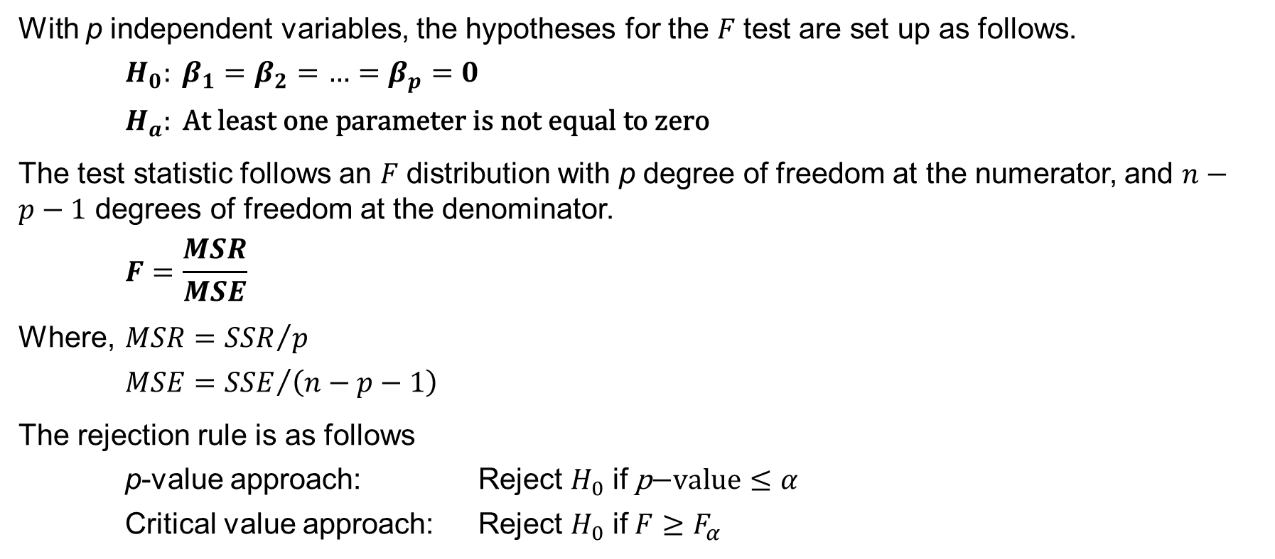
15.5 F Test for Overall Significance
With p independent variables, the hypotheses for the 𝐹 test are set up as follows.
$$H_{0}: β_{1}=β_{2}=\text{…}=β_{p}=0$$
$$H_{a}: \text{At} \text{least} \text{one} \text{parameter} \text{is} \text{not} \text{equal} \text{to} \text{zero}$$
The test statistic follows an 𝐹 distribution with p degree of freedom at the numerator, and $n−p−1$ degrees of freedom at the denominator.
$$F=\frac{MSR}{MSE}$$
Where, $MSR={SSR}/p$
$MSE={SSE}/{\left(n−p−1\right)}$
The rejection rule is as follows
p-value approach: Reject $H_{0}$ if $\text{p}\text{−}\text{value}≤α$
Critical value approach: Reject $H_{0}$ if $F≥F_{α}$

Slide 22
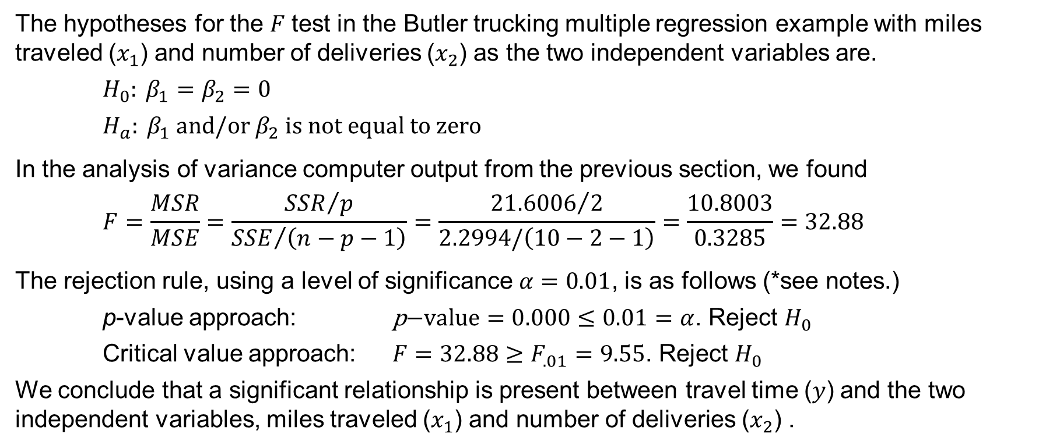
15.5 F Test for the Butler Trucking Example
The hypotheses for the 𝐹 test in the Butler trucking multiple regression example with miles traveled ($x_{1}$) and number of deliveries ($x_{2}$) as the two independent variables are.
$$H_{0}: β_{1}=β_{2}=0$$
$$H_{a}:{ β}_{1} \text{and}\text{/}\text{or} β_{2} \text{is} \text{not} \text{equal} \text{to} \text{zero}$$
In the analysis of variance computer output from the previous section, we found
$$F=\frac{MSR}{MSE}=\frac{{SSR}/p}{{SSE}/{\left(n−p−1\right)}}=\frac{{21.6006}/2}{2.2994/\left(10−2−1\right)}=\frac{10.8003}{0.3285}=32.88$$
The rejection rule, using a level of significance $α=0.01$, is as follows (*see notes.)
p-value approach: $\text{p}\text{−}\text{value}=0.000≤0.01=α$. Reject $H_{0}$
Critical value approach: $F=32.88≥F_{.01}=9.55$. Reject $H_{0}$
We conclude that a significant relationship is present between travel time (𝑦) and the two independent variables, miles traveled ($x_{1}$) and number of deliveries ($x_{2}$) .
Notes:
*Note: the p-value in the analysis of variance computer output is 0.000. Table 4 in Appendix B provides $F_{.01}=9.55$ with two degrees of freedom in the numerator and seven degrees of freedom in the denominator.

Slide 23
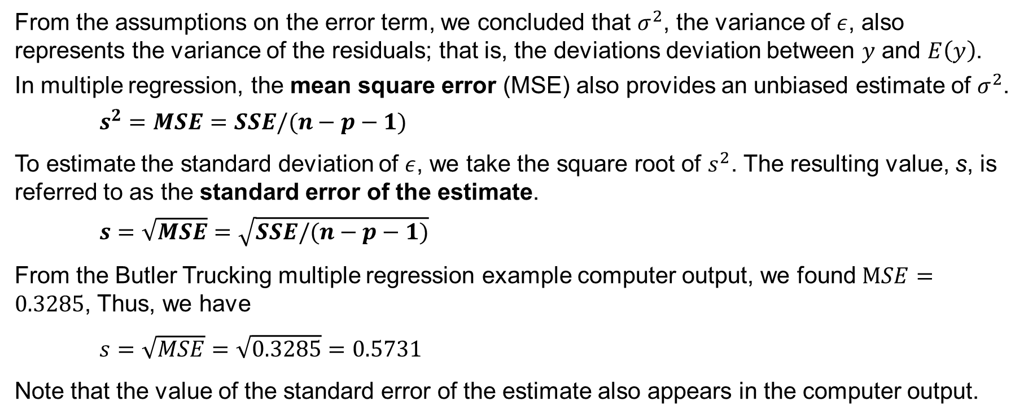
15.5 Estimate of $σ^{2}$ in Multiple Regression
From the assumptions on the error term, we concluded that $σ^{2}$, the variance of $ε$, also represents the variance of the residuals; that is, the deviations deviation between 𝑦 and $E\left(y\right)$.
In multiple regression, the mean square error (MSE) also provides an unbiased estimate of $σ^{2}$.
$$s^{2}=MSE=SSE/(n−p−1)$$
To estimate the standard deviation of $ε$, we take the square root of $s^{2}$. The resulting value, s, is referred to as the standard error of the estimate.
$$s=\sqrt{MSE}=\sqrt{SSE/(n−p−1)}$$
From the Butler Trucking multiple regression example computer output, we found $MSE=0.3285$, Thus, we have
$s=\sqrt{MSE}=\sqrt{0.3285}=0.5731$
Note that the value of the standard error of the estimate also appears in the computer output.

Slide 24
15.5 ANOVA Table for Multiple Regression
The ANOVA table for multiple regression displays the results of the 𝐹 test.
Source of Variation | Sum of Squares | Deg. of Freedom | Mean Squares | F | p-value
Regression | SSR | p | MSR = SSR / p | MSR / MSE | P(F ≥ MSR / MSE)
Error | SSE | n – p – 1 | MSE = SSE / (n – p – 1)
Total | SST | n − 1
Regression, Error, and Total are the labels for the three sources of variation, with SSR, SSE, and SST appearing as the corresponding sum of squares in the second column.
The ANOVA table with the 𝐹 test computations for the Butler Trucking example follows.
Source of Variation | Sum of Squares | Deg. of Freedom | Mean Squares | F | p-value
Regression | 21.6006 | 2 | 10.8003 | 32.88 | 0.0003
Error | 2.2994 | 7 | 0.3285
Total | 23,9000 | 9

Slide 25
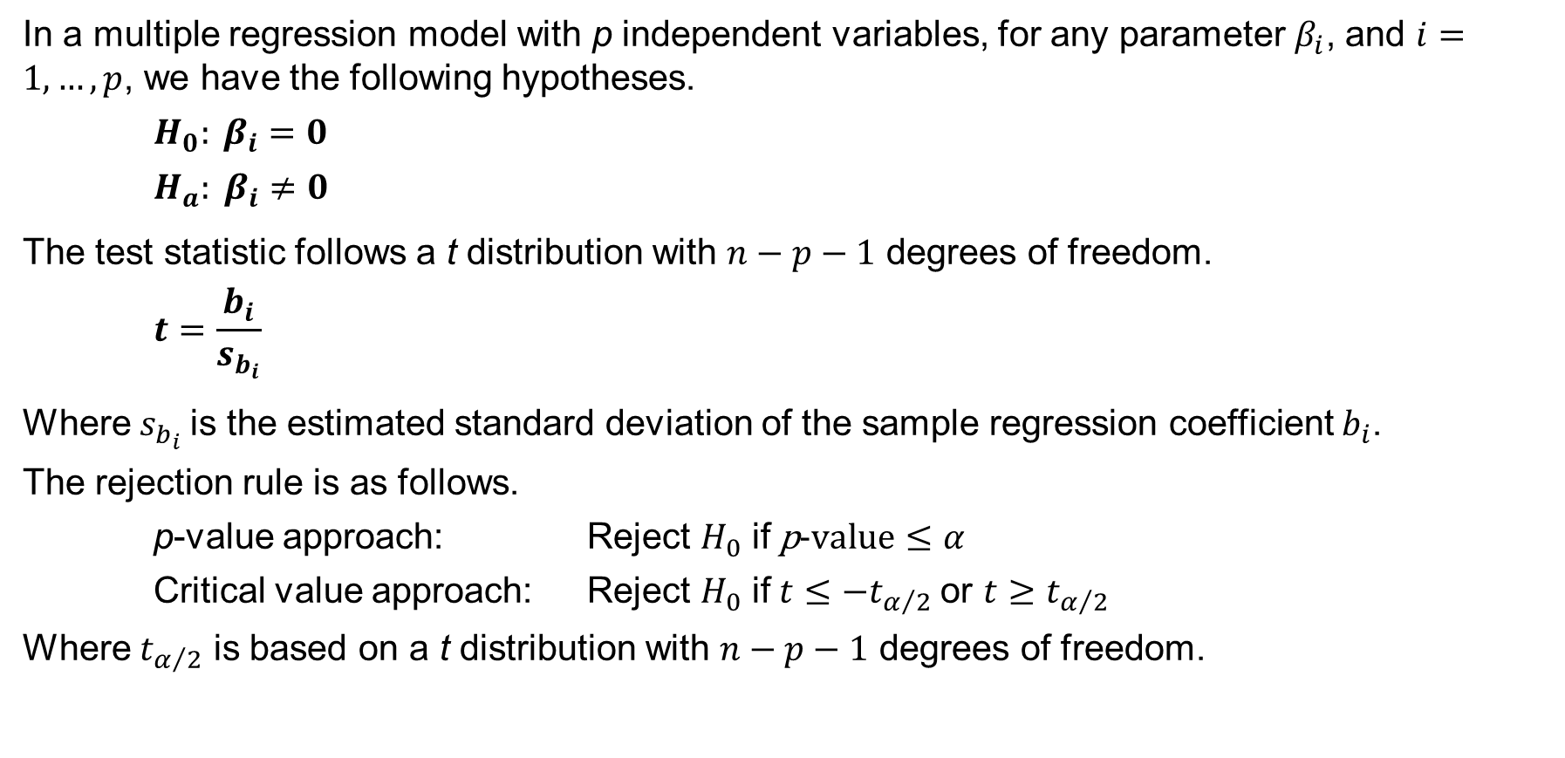
15.5 t Test for Individual Significance
In a multiple regression model with p independent variables, for any parameter $β_{i}$, and $i=1,…,p$, we have the following hypotheses.
$$H_{0}: β_{i}=0$$
$$H_{a}: β_{i}≠0$$
The test statistic follows a t distribution with $n−p−1$ degrees of freedom.
$$t=\frac{b_{i}}{s_{b_{i}}}$$
Where $s_{b_{i}}$is the estimated standard deviation of the sample regression coefficient $b_{i}$.
The rejection rule is as follows.
p-value approach: Reject $H_{0}$ if $\text{p}\text{−}\text{value}≤α$
Critical value approach: Reject $H_{0}$ if $t≤−t_{α/2}$or $t≥t_{α/2}$
Where $t_{α/2}$ is based on a t distribution with $n−p−1$ degrees of freedom.

Slide 26
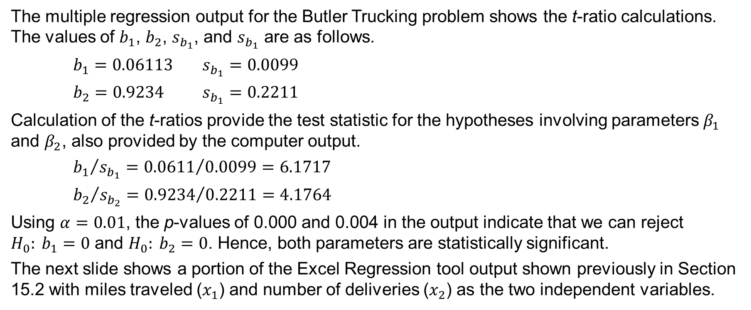
15.5 Individual t Tests for the Butler Trucking Example
The multiple regression output for the Butler Trucking problem shows the t-ratio calculations. The values of $b_{1}$, $b_{2}$, $s_{b_{1}}$, and $s_{b_{1}}$ are as follows.
$b_{1}=0.06113$ $s_{b_{1}}=0.0099$
$b_{2}=0.9234$ $s_{b_{1}}=0.2211$
Calculation of the t-ratios provide the test statistic for the hypotheses involving parameters $β_{1}$ and $β_{2}$, also provided by the computer output.
${b_{1}}/{s_{b_{1}}}={0.0611}/{0.0099}=6.1717$
${b_{2}}/{s_{b_{2}}}={0.9234}/{0.2211}=4.1764$
Using $α=0.01$, the p-values of 0.000 and 0.004 in the output indicate that we can reject $H_{0}: b_{1}=0$ and $H_{0}: b_{2}=0$. Hence, both parameters are statistically significant.
The next slide shows a portion of the Excel Regression tool output shown previously in Section 15.2 with miles traveled ($x_{1}$) and number of deliveries ($x_{2}$) as the two independent variables.

Slide 27
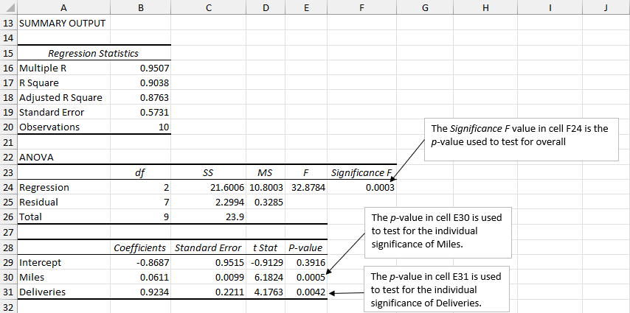
15.5 Excel: Testing for Significance on Regression Output

Slide 28
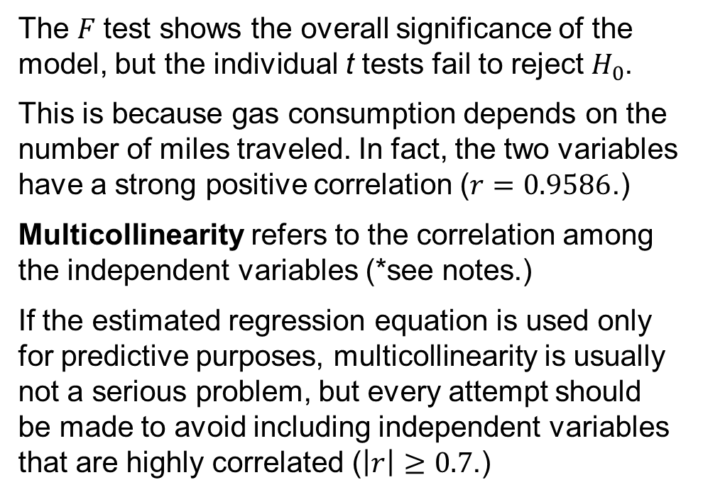
15.5 Multicollinearity
Consider a modification of the Butler Trucking example in which the independent variables are total miles driven ($x_{1}$) and gas consumption ($x_{2}$.)
Regression Statistics
Multiple R | 84.03%
R Square | 70.61%
Adj. R Square | 62.21%
Standard Error | 1.0017
Observations | 10
ANOVA
 | df | SS | MS | F | P-value
Regression | 2 | 16.876 | 8.438 | 8.41 | 0.014
Residual | 7 | 7.024 | 1.003
Total | 9 | 23.900
 | Coefficients | Std. Err. | t Stat | P-value
Intercept | 1.681 | 1.458 | 1.152 | 0.287
Miles | 0.1253 | 0.0599 | 2.091 | 0.075
Consumption | -0.615 | 0.615 | -1.001 | 0.350
The 𝐹 test shows the overall significance of the model, but the individual t tests fail to reject $H_{0}$.
This is because gas consumption depends on the number of miles traveled. In fact, the two variables have a strong positive correlation ($r=0.9586$.)
Multicollinearity refers to the correlation among the independent variables (*see notes.)
If the estimated regression equation is used only for predictive purposes, multicollinearity is usually not a serious problem, but every attempt should be made to avoid including independent variables that are highly correlated ($\left|r\right|≥0.7$.)
Notes:
*Note: in this case, the interpretation of coefficient $b_{2}$ is: 0.615 hours is an estimate of the expected decrease in travel time corresponding to an increase of one gallon of gasoline consumption when the number of miles traveled is held constant. In other words, consuming more gasoline, usually by traveling faster, decreases the time needed to travel to the destination.

Slide 29
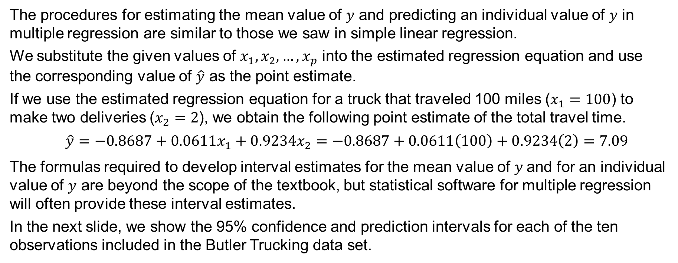
15.6 Using the Estimated Regression Equation for Estimation and Prediction
The procedures for estimating the mean value of 𝑦 and predicting an individual value of 𝑦 in multiple regression are similar to those we saw in simple linear regression.
We substitute the given values of $x_{1},x_{2},…,x_{p}$ into the estimated regression equation and use the corresponding value of $\hat{y}$ as the point estimate.
If we use the estimated regression equation for a truck that traveled 100 miles ($x_{1}=100$) to make two deliveries ($x_{2}=2$), we obtain the following point estimate of the total travel time.
$$\hat{y}=−0.8687+0.0611x_{1}+0.9234x_{2}=−0.8687+0.0611\left(100\right)+0.9234\left(2\right)=7.09$$
The formulas required to develop interval estimates for the mean value of$y$ and for an individual value of $y$ are beyond the scope of the textbook, but statistical software for multiple regression will often provide these interval estimates.
In the next slide, we show the 95% confidence and prediction intervals for each of the ten observations included in the Butler Trucking data set.

Slide 30
15.6 The 95% Confidence and Prediction Intervals for the Butler Trucking Example
Note that the interval estimate for an individual value of 𝑦 is wider than the interval estimate for the expected value of 𝑦 because we can always estimate the mean travel time for all trucks with more precision than we can predict the travel time for one specific truck.
Value of | Value of |  | 95% Confidence Interval |  | 95% Prediction Interval
x₁ | x₂ | Lower Limit | Upper Limit | Lower Limit | Upper Limit
100 | 4 | 8.135 | 9.742 | 7.363 | 10.514
50 | 3 | 4.127 | 5.789 | 3.369 | 6.548
100 | 4 | 8.135 | 9.742 | 7.363 | 10.514
100 | 2 | 6.258 | 7.925 | 5.500 | 8.683
50 | 2 | 3.146 | 4.924 | 2.414 | 5.656
80 | 2 | 5.232 | 6.505 | 4.372 | 7.366
75 | 3 | 6.037 | 6.936 | 5.059 | 7.915
65 | 4 | 5.960 | 7.637 | 5.205 | 8.392
90 | 3 | 6.917 | 7.891 | 5.964 | 8.844
90 | 2 | 5.776 | 7.184 | 4.953 | 8.007
75 | 4 | 6.669 | 8.152 | 5.865 | 8.955

Slide 31
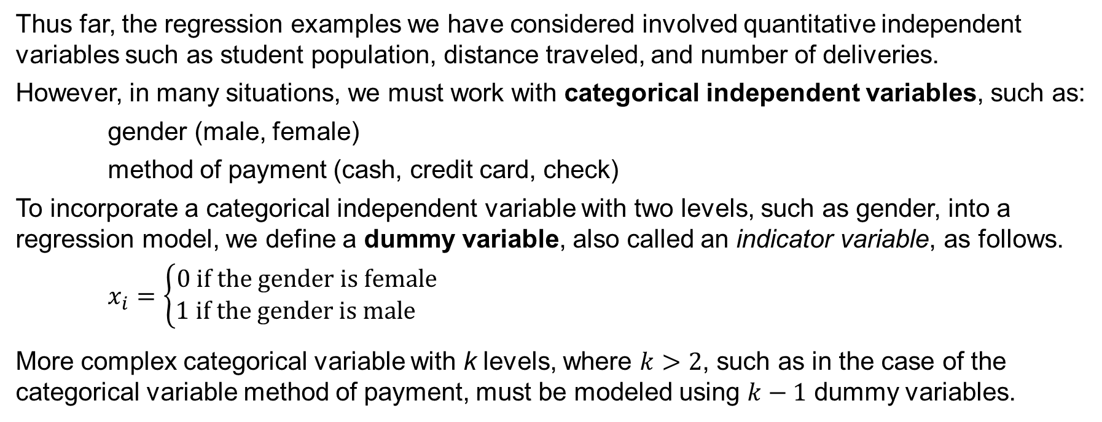
15.7 Categorical Independent Variables
Thus far, the regression examples we have considered involved quantitative independent variables such as student population, distance traveled, and number of deliveries.
However, in many situations, we must work with categorical independent variables, such as:
gender (male, female)
method of payment (cash, credit card, check)
To incorporate a categorical independent variable with two levels, such as gender, into a regression model, we define a dummy variable, also called an indicator variable, as follows.
$$x_{i}=\left\{\begin{aligned}0 \text{if} \text{the} \text{gender} \text{is} \text{female} \\ 1 \text{if} \text{the} \text{gender} \text{is} \text{male} \end{aligned}\right.$$
More complex categorical variable with k levels, where $k>2$, such as in the case of the categorical variable method of payment, must be modeled using $k−1$ dummy variables.

Slide 32
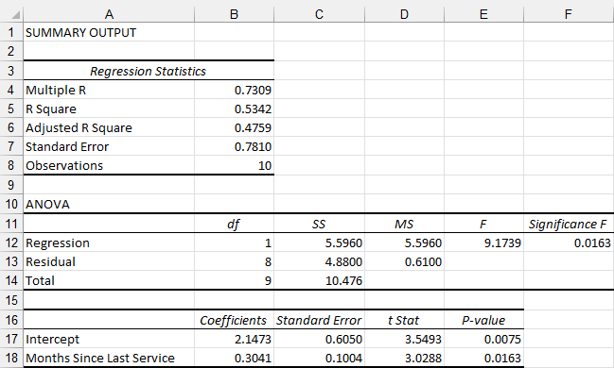
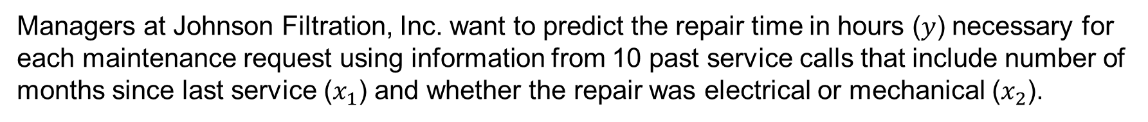
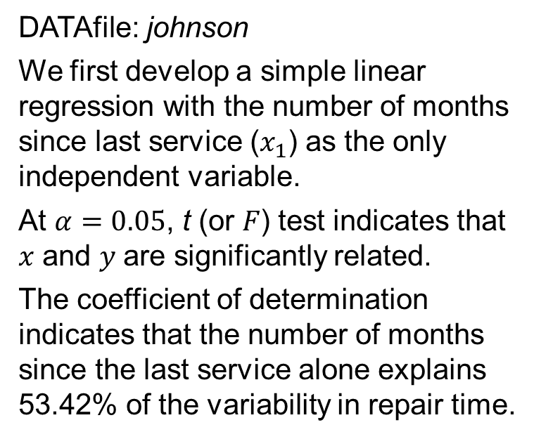
15.7 An Example: Johnson Filtration, Inc.
Managers at Johnson Filtration, Inc. want to predict the repair time in hours (𝑦) necessary for each maintenance request using information from 10 past service calls that include number of months since last service ($x_{1}$) and whether the repair was electrical or mechanical ($x_{2}$).
DATAfile: johnson
We first develop a simple linear regression with the number of months since last service ($x_{1}$) as the only independent variable.
At $α=0.05$, t (or 𝐹) test indicates that 𝑥 and 𝑦 are significantly related.
The coefficient of determination indicates that the number of months since the last service alone explains 53.42% of the variability in repair time.

Slide 33
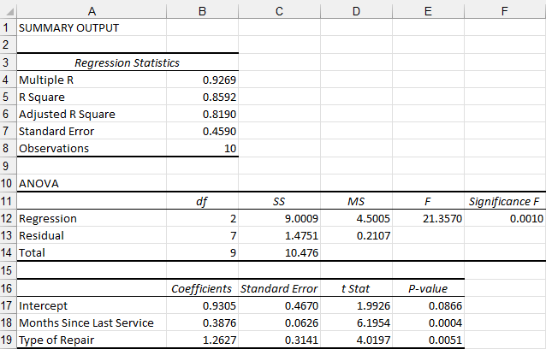
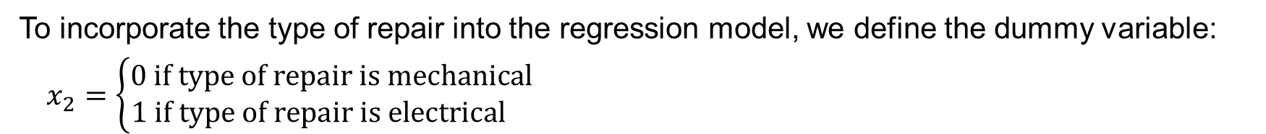
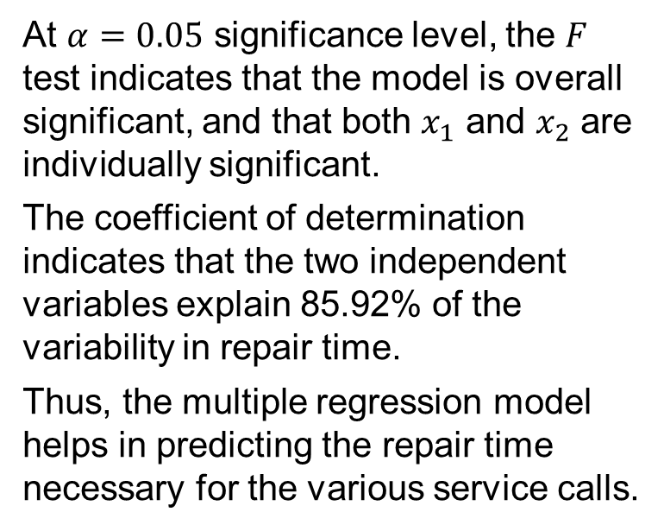
15.7 Adding a Dummy Variable
To incorporate the type of repair into the regression model, we define the dummy variable:
$$x_{2}=\left\{\begin{aligned}0 \text{if} \text{type} \text{of} \text{repair} \text{is} \text{mechanical} \\ 1 \text{if} \text{type} \text{of} \text{repair} \text{is} \text{electrical} \end{aligned}\right.$$
At $α=0.05$ significance level, the 𝐹 test indicates that the model is overall significant, and that both $x_{1}$ and $x_{2}$ are individually significant.
The coefficient of determination indicates that the two independent variables explain 85.92% of the variability in repair time.
Thus, the multiple regression model helps in predicting the repair time necessary for the various service calls.

Slide 34
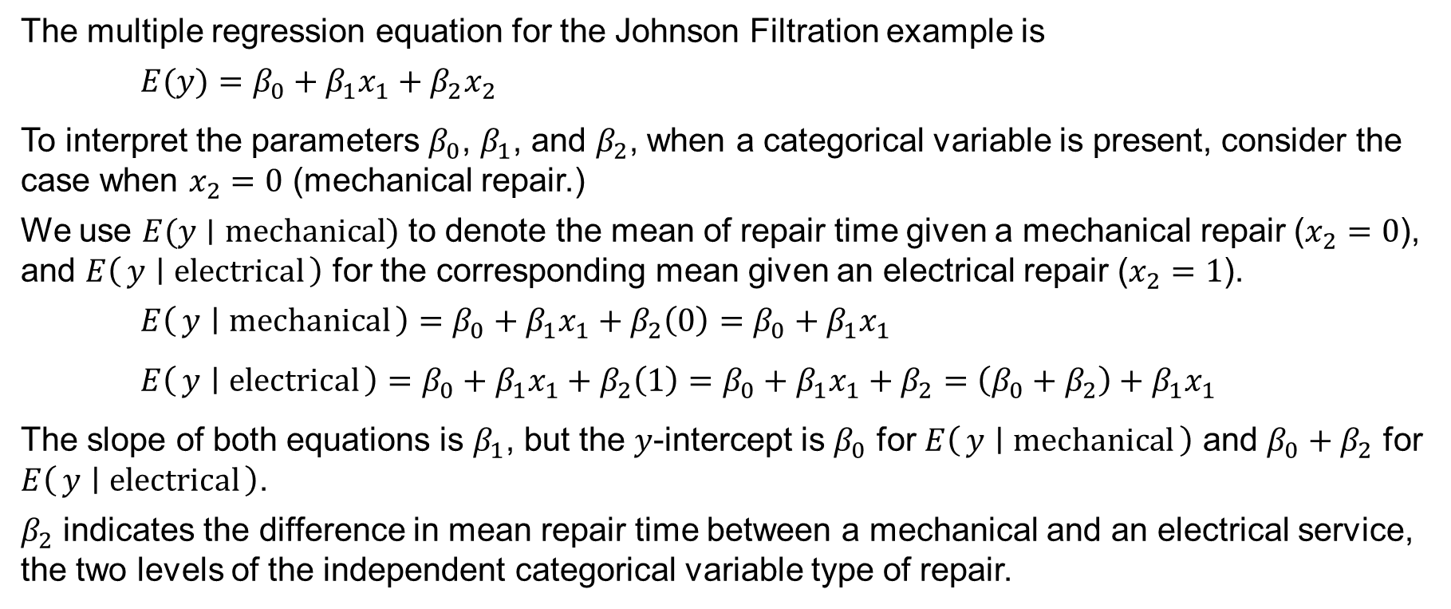
15.7 Interpreting the Parameter of a Dummy Variable
The multiple regression equation for the Johnson Filtration example is
$E(y)=β_{0}+β_{1}x_{1}+β_{2}x_{2}$
To interpret the parameters $β_{0}$, $β_{1}$, and $β_{2}$, when a categorical variable is present, consider the case when $x_{2}=0$ (mechanical repair.)
We use $E(y∣\text{mechanical})$ to denote the mean of repair time given a mechanical repair ($x_{2}=0$), and $E\left(y ∣ \text{electrical}\right)$ for the corresponding mean given an electrical repair ($x_{2}=1$).
$E\left(y ∣ \text{mechanical}\right)=β_{0}+β_{1}x_{1}+β_{2}\left(0\right)=β_{0}+β_{1}x_{1}$
$E\left(y ∣ \text{electrical}\right)=β_{0}+β_{1}x_{1}+β_{2}\left(1\right)=β_{0}+β_{1}x_{1}+β_{2}=\left(β_{0}+β_{2}\right)+β_{1}x_{1}$
The slope of both equations is $β_{1}$, but the 𝑦-intercept is $β_{0}$ for $E\left(y ∣ \text{mechanical}\right)$ and $β_{0}+β_{2}$ for $E\left(y ∣ \text{electrical}\right)$.
$β_{2}$ indicates the difference in mean repair time between a mechanical and an electrical service, the two levels of the independent categorical variable type of repair.

Slide 35
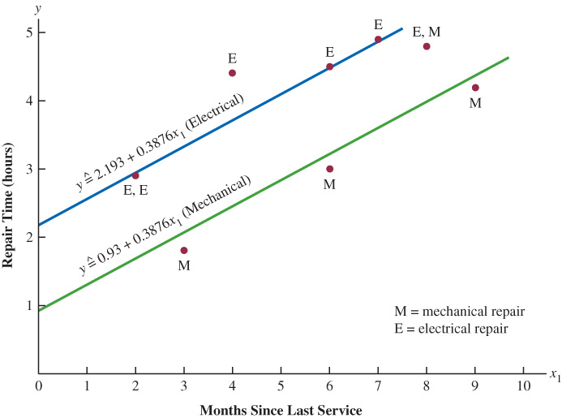
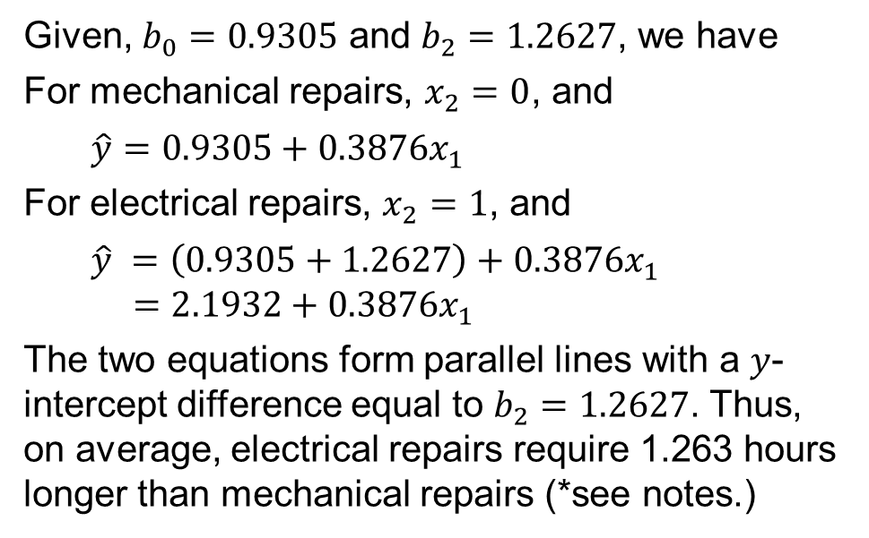
15.7 Interpreting the Parameters in the Johnson Filtration Example
If $β_{2}$ is positive, the mean repair time for an electrical repair will be greater than that for a mechanical repair; the opposite will be true if $β_{2}$ is negative. If $β_{2}=0$, there is no difference.
Given, $b_{0}=0.9305$ and $b_{2}=1.2627$, we have
For mechanical repairs, $x_{2}=0$, and
$\hat{y}=0.9305+0.3876x_{1}$
For electrical repairs, $x_{2}=1$, and
$$\hat{y} =\left(0.9305+1.2627\right)+0.3876x_{1}$$
$=2.1932+0.3876x_{1}$
The two equations form parallel lines with a 𝑦-intercept difference equal to $b_{2}=1.2627$. Thus, on average, electrical repairs require 1.263 hours longer than mechanical repairs (*see notes.)
Notes:
*Note: in the scatter diagram, repair time in hours (𝑦) is represented by the vertical axis, and months since last service ($x_{1}$) is represented by the horizontal axis. A data point for a mechanical repair is indicated by an M and a data point for an electrical repair is indicated by an E.

Slide 36
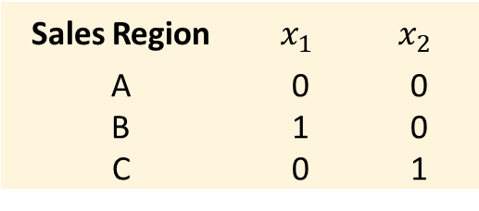
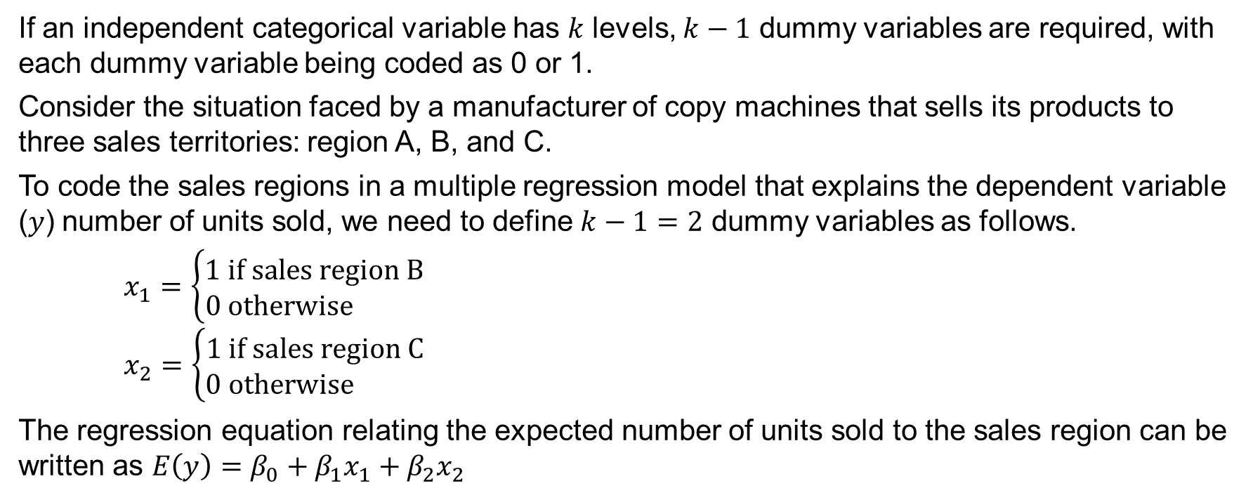
15.7 More Complex Categorical Variables
If an independent categorical variable has 𝑘 levels, $k−1$ dummy variables are required, with each dummy variable being coded as 0 or 1.
Consider the situation faced by a manufacturer of copy machines that sells its products to three sales territories: region A, B, and C.
To code the sales regions in a multiple regression model that explains the dependent variable (𝑦) number of units sold, we need to define $k−1=2$ dummy variables as follows.
$x_{1}=\left\{\begin{aligned}1 \text{if} \text{sales} \text{region} \text{B} \\ 0 \text{otherwise} \end{aligned}\right.$
$x_{2}=\left\{\begin{aligned}1 \text{if} \text{sales} \text{region} \text{C} \\ 0 \text{otherwise} \end{aligned}\right.$
The regression equation relating the expected number of units sold to the sales region can be written as $E\left(y\right)=β_{0}+β_{1}x_{1}+β_{2}x_{2}$
Sales Region | $$x_{1}$$ | $$x_{2}$$
A | 0 | 0
B | 1 | 0
C | 0 | 1

Slide 37
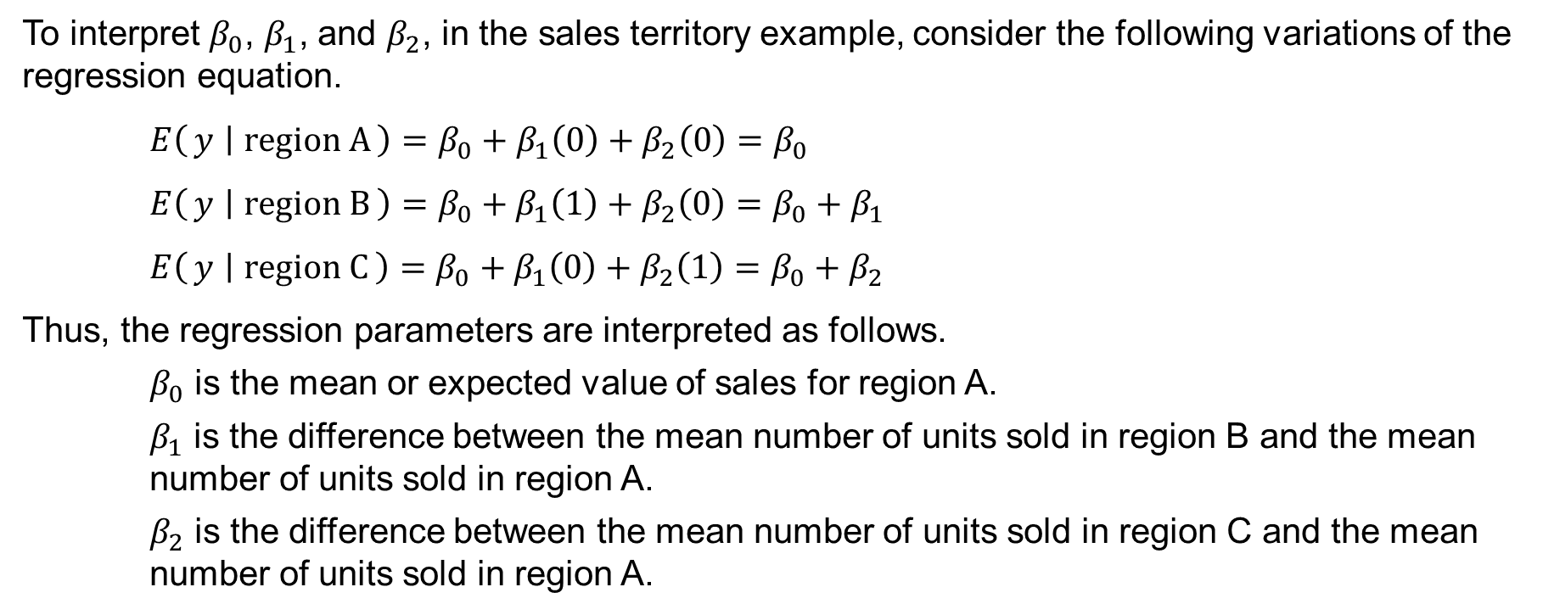
15.7 Interpretation of the Parameters for a Categorical Variable with Three Levels
To interpret $β_{0}$, $β_{1}$, and $β_{2}$, in the sales territory example, consider the following variations of the regression equation.
$E\left(y ∣ \text{region} \text{A}\right)=β_{0}+β_{1}\left(0\right)+β_{2}\left(0\right)=β_{0}$
$E\left(y ∣ \text{region} \text{B}\right)=β_{0}+β_{1}\left(1\right)+β_{2}\left(0\right)=β_{0}+β_{1}$
$E\left(y ∣ \text{region} \text{C}\right)=β_{0}+β_{1}\left(0\right)+β_{2}\left(1\right)=β_{0}+β_{2}$
Thus, the regression parameters are interpreted as follows.
$β_{0}$ is the mean or expected value of sales for region A.
$β_{1}$ is the difference between the mean number of units sold in region B and the mean number of units sold in region A.
$β_{2}$ is the difference between the mean number of units sold in region C and the mean number of units sold in region A.

Slide 38
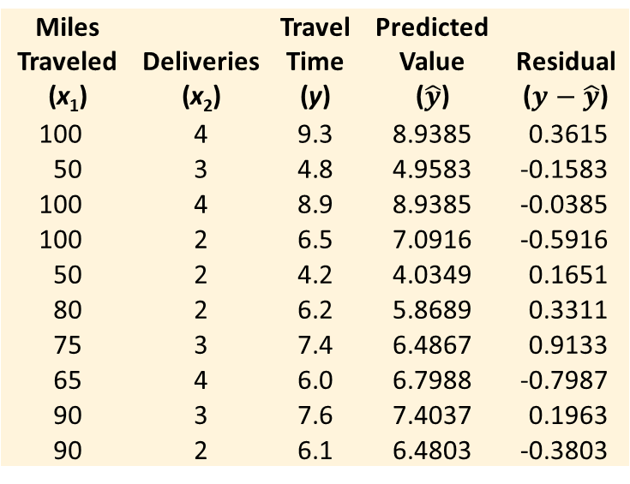
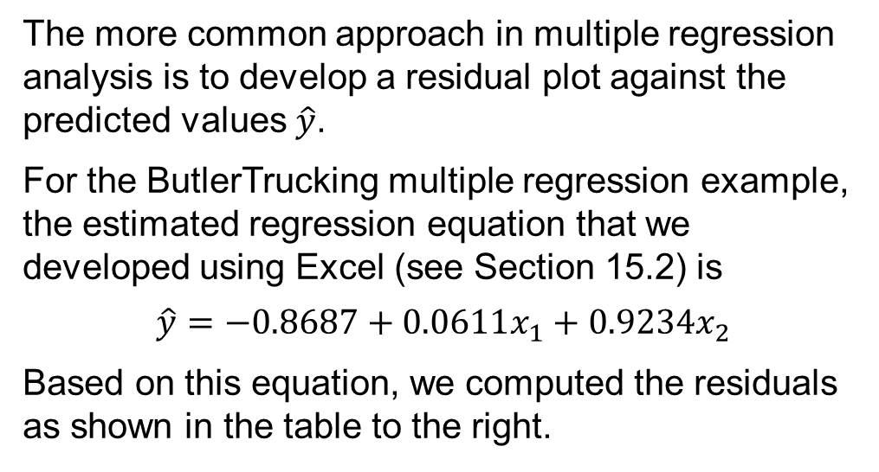
15.8 Residual Analysis
In Chapter 14, we showed how a residual plot against the independent variable 𝑥 can be used to validate the assumptions for a simple linear regression model.
Because multiple regression deals with two or more independent variables, we would have to examine a residual plot against each independent variable to use this approach.
The more common approach in multiple regression analysis is to develop a residual plot against the predicted values $\hat{y}$.
For the ButlerTrucking multiple regression example, the estimated regression equation that we developed using Excel (see Section 15.2) is
$$\hat{y}=−0.8687+0.0611x_{1}+0.9234x_{2}$$
Based on this equation, we computed the residuals as shown in the table to the right.
Miles |  | Travel | Predicted
Traveled | Deliveries | Time | Value | Residual
(x₁) | (x₂) | (y) | ($\hat{y}$) | ($y−\hat{y}$)
100 | 4 | 9.3 | 8.9385 | 0.3615
50 | 3 | 4.8 | 4.9583 | -0.1583
100 | 4 | 8.9 | 8.9385 | -0.0385
100 | 2 | 6.5 | 7.0916 | -0.5916
50 | 2 | 4.2 | 4.0349 | 0.1651
80 | 2 | 6.2 | 5.8689 | 0.3311
75 | 3 | 7.4 | 6.4867 | 0.9133
65 | 4 | 6.0 | 6.7988 | -0.7987
90 | 3 | 7.6 | 7.4037 | 0.1963
90 | 2 | 6.1 | 6.4803 | -0.3803

Slide 39
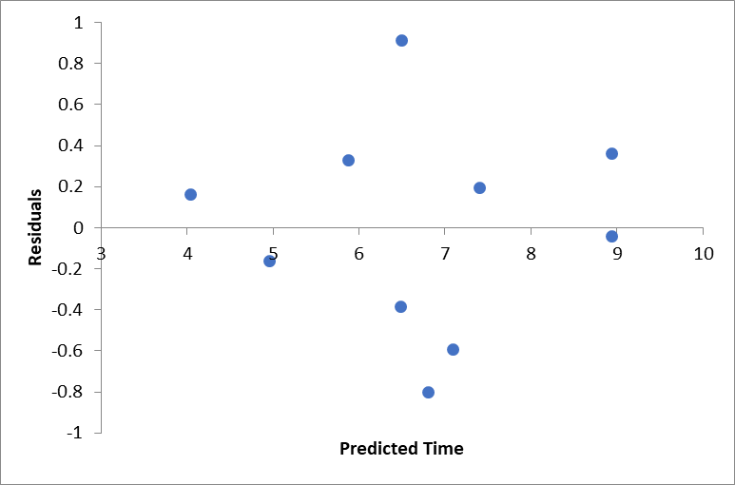
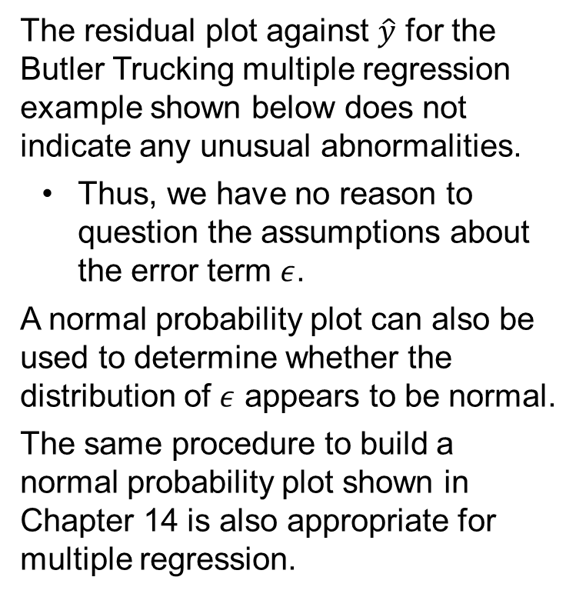
15.8 Residual Plot Against $\hat{y}$ for Butler Trucking
The residual plot against $\hat{y}$ for the Butler Trucking multiple regression example shown below does not indicate any unusual abnormalities.
Thus, we have no reason to question the assumptions about the error term $ε$.
A normal probability plot can also be used to determine whether the distribution of $ε$ appears to be normal.
The same procedure to build a normal probability plot shown in Chapter 14 is also appropriate for multiple regression.

Slide 40
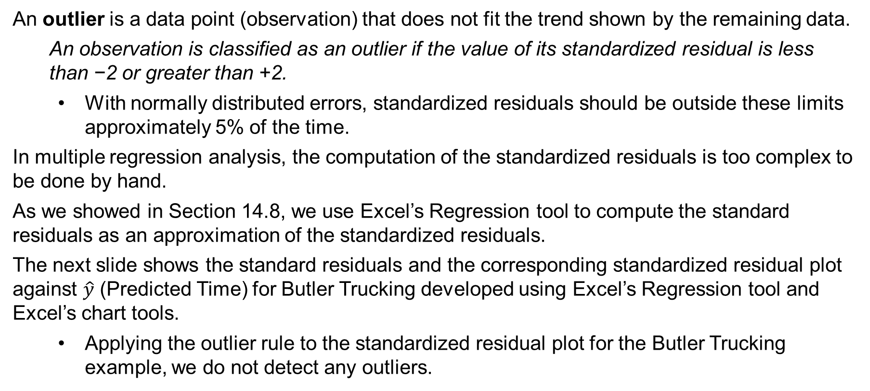
15.8 Detecting Outliers in Multiple Regression
An outlier is a data point (observation) that does not fit the trend shown by the remaining data.
An observation is classified as an outlier if the value of its standardized residual is less
than −2 or greater than +2.
With normally distributed errors, standardized residuals should be outside these limits approximately 5% of the time.
In multiple regression analysis, the computation of the standardized residuals is too complex to be done by hand.
As we showed in Section 14.8, we use Excel’s Regression tool to compute the standard residuals as an approximation of the standardized residuals.
The next slide shows the standard residuals and the corresponding standardized residual plot against $\hat{y}$ (Predicted Time) for Butler Trucking developed using Excel’s Regression tool and Excel’s chart tools.
Applying the outlier rule to the standardized residual plot for the Butler Trucking example, we do not detect any outliers.

Slide 41
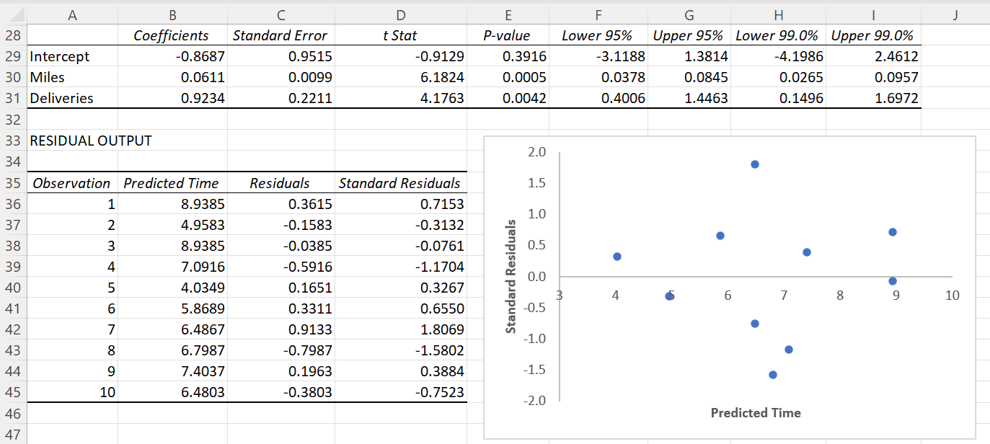
15.8 Standardized Residual Plot Against $\hat{y}$

Slide 42
15.9 Practical Advice: Big Data and Hypothesis Testing in Multiple Regression
In multiple regression, as the sample size increases,
the p-value for the 𝐹 test, used to determine whether a significant relationship exists between the dependent variable and the set of all independent variables, decreases.
the p-value for each of t test used to determine whether a significant relationship exists between the dependent variable and an individual independent variable, decreases.
the confidence interval for the slope parameter associated with each individual independent variable narrows.
the confidence interval for the mean value of 𝑦 narrows.
the prediction interval for an individual value of 𝑦 narrows.
Besides the effects due to sample size and nonsampling error already introduced for simple linear regression, multicollinearity may also cause the estimated slope coefficients in multiple regression to be misleading.

Slide 43
Summary
Multiple regression analysis enables us to understand how a dependent variable is related to two or more independent variables.
We introduced the multiple coefficient of determination as a measure of goodness of fit for multiple regression, and the adjusted multiple coefficient of determination that accounts for the impact of adding more independent variables to the model.
The 𝐹 test is used to determine the overall significance of the model, and the t test is used to determine whether an individual independent variable is significant.
Correlation among the independent variables, known as multicollinearity, was discussed.
We use dummy variables to incorporate categorical data into multiple regression analysis.
In residual analysis, standardized residuals, leverage, studentized deleted residuals, and Cook’s distance measure can be used to detect outliers and influential observations.

