Slide 1
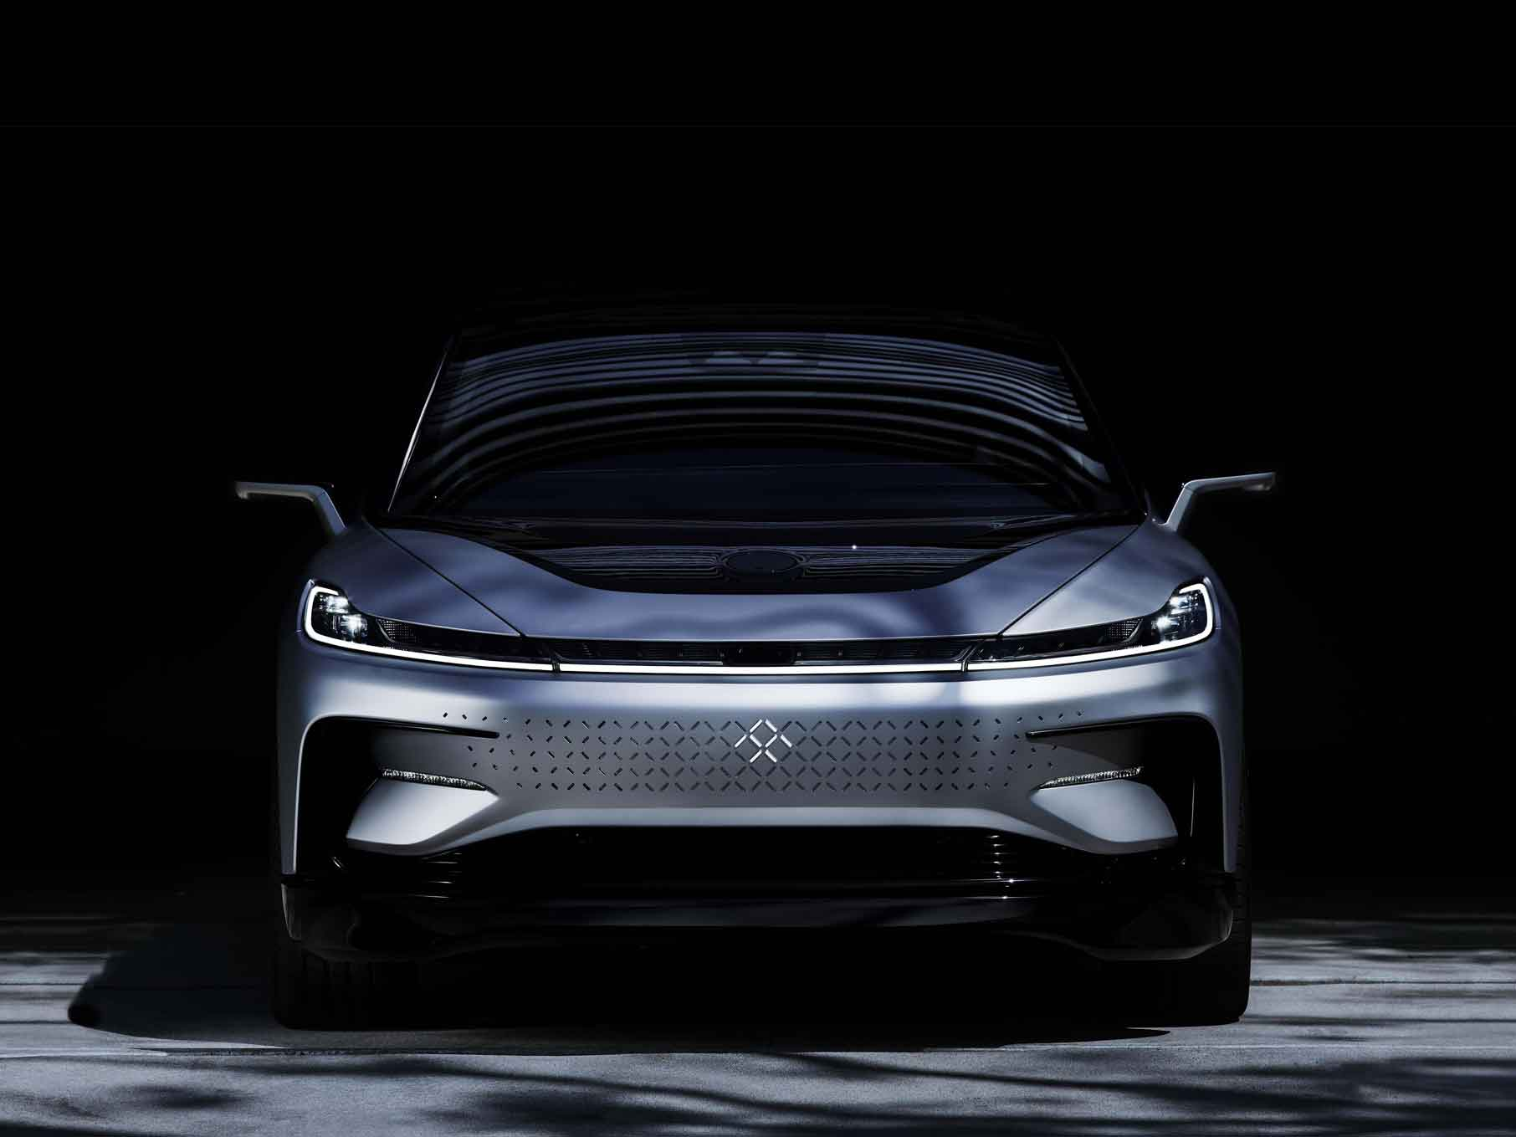
Faraday future 91
By Xiang Yifan 5B(31)
Venture forward

Slide 2
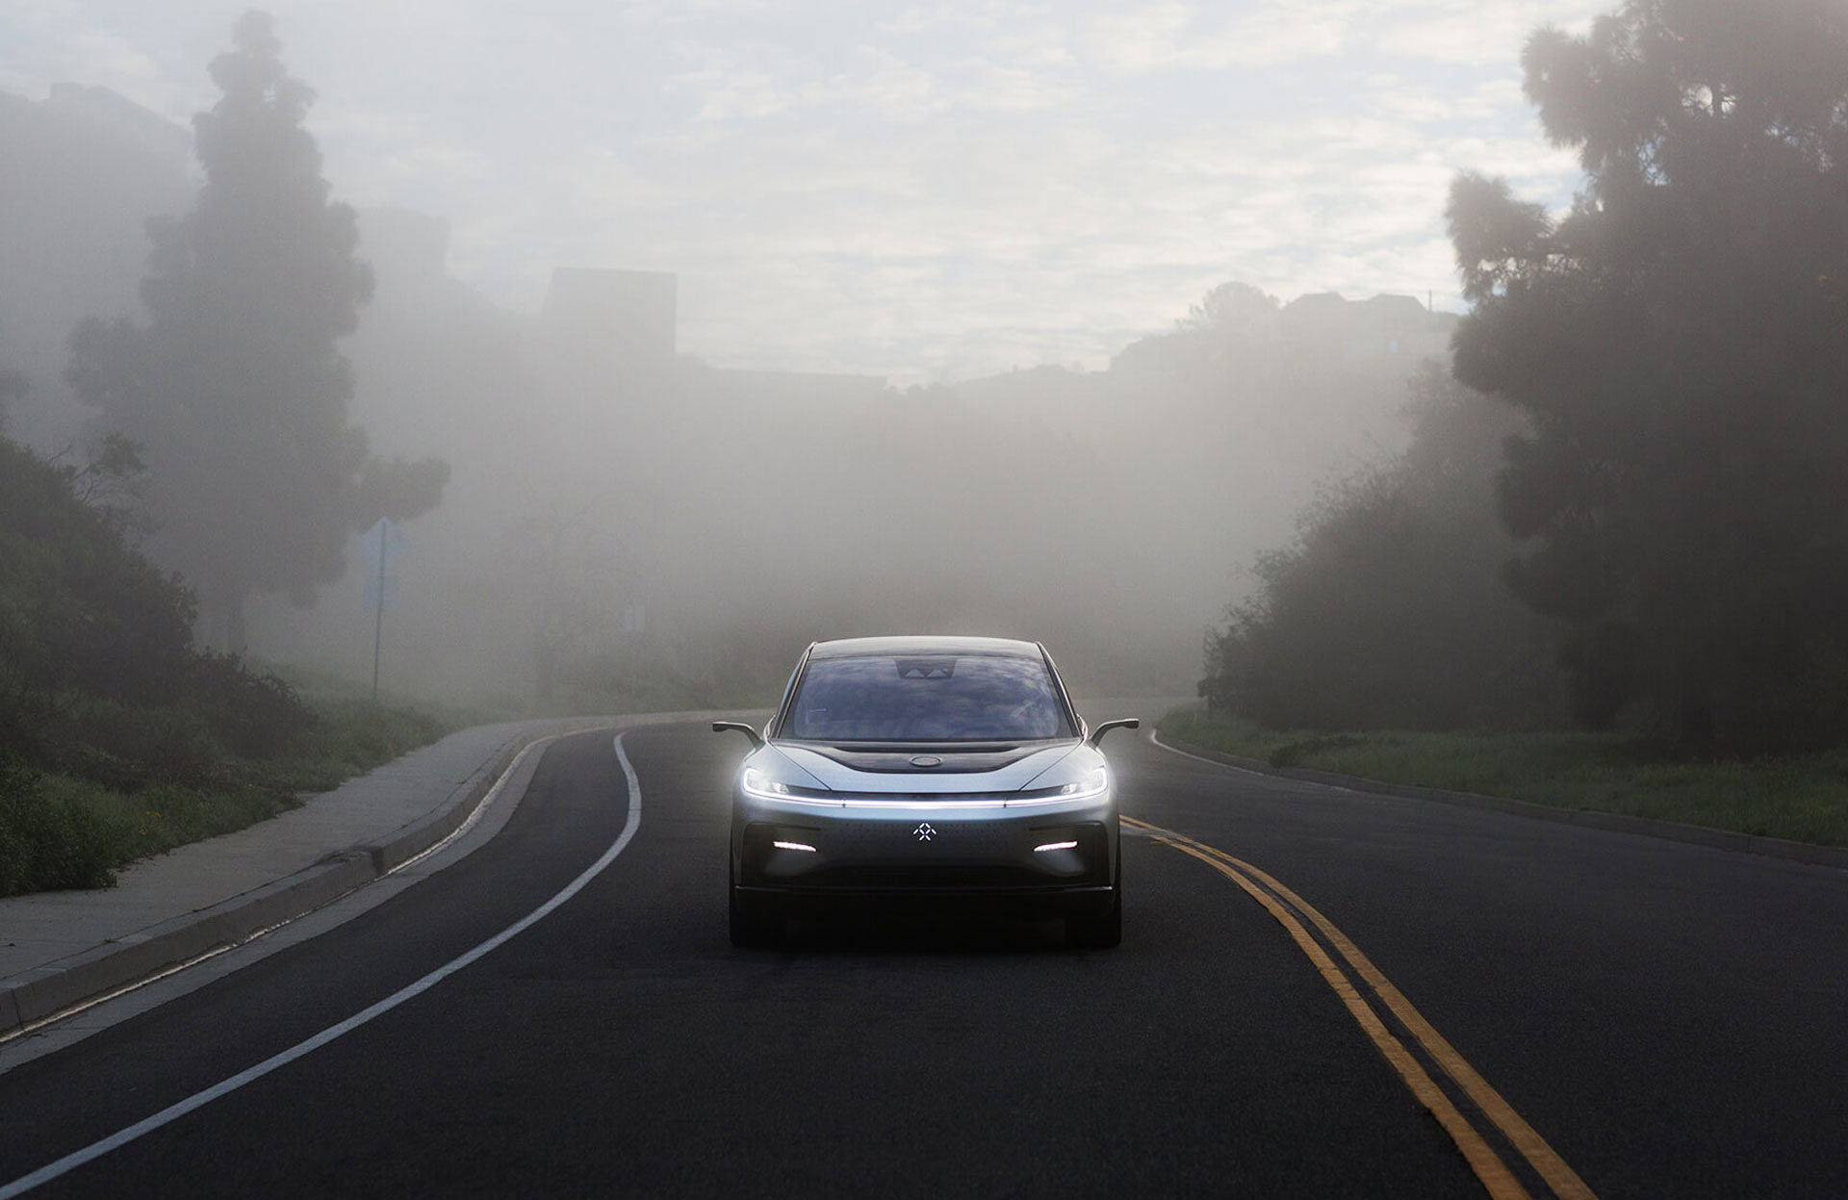
A Beautiful Future
FF 91 is our first production vehicle and flagship model. All-electric, autonomous-ready and seamlessly connected, it embodies our latest mobility advancements in performance, intelligence, and user experience. This is the reason why we gave FF 91 a future-forward design that visually sets it apart from anything else on the road.

Slide 3
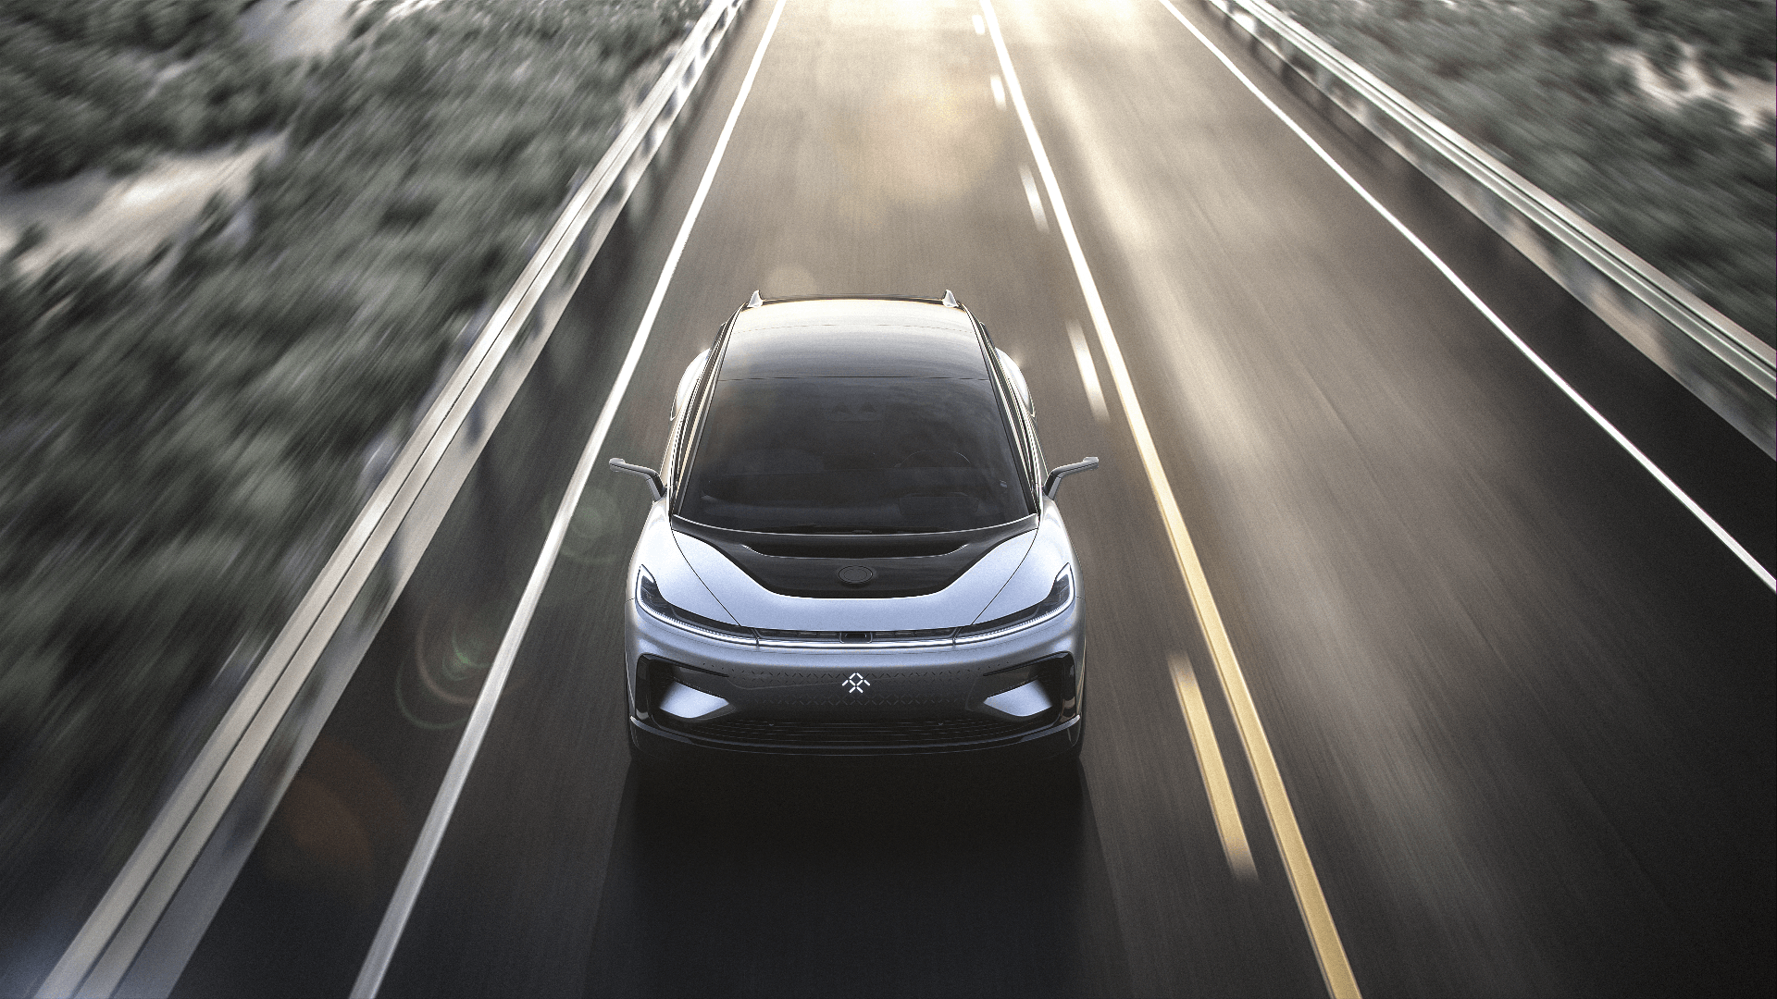
A Cleaner, More Electrifying Future
Committed to breathtaking power that also allows us to breathe more freely, our engineers are pushing the limits of electric performance and range. Designed to be highly modular, our Variable Platform Architecture (VPA) securely houses the battery, powertrain and the FF Echelon Inverter; our first patent.

Slide 4

Technology
Everything about our cutting-edge technology was created to make your life more connected, more engaging, more effortless. We designed our A.I. and user interaction to be as intuitive and convenient as possible, giving you back more of your invaluable time.

Slide 5
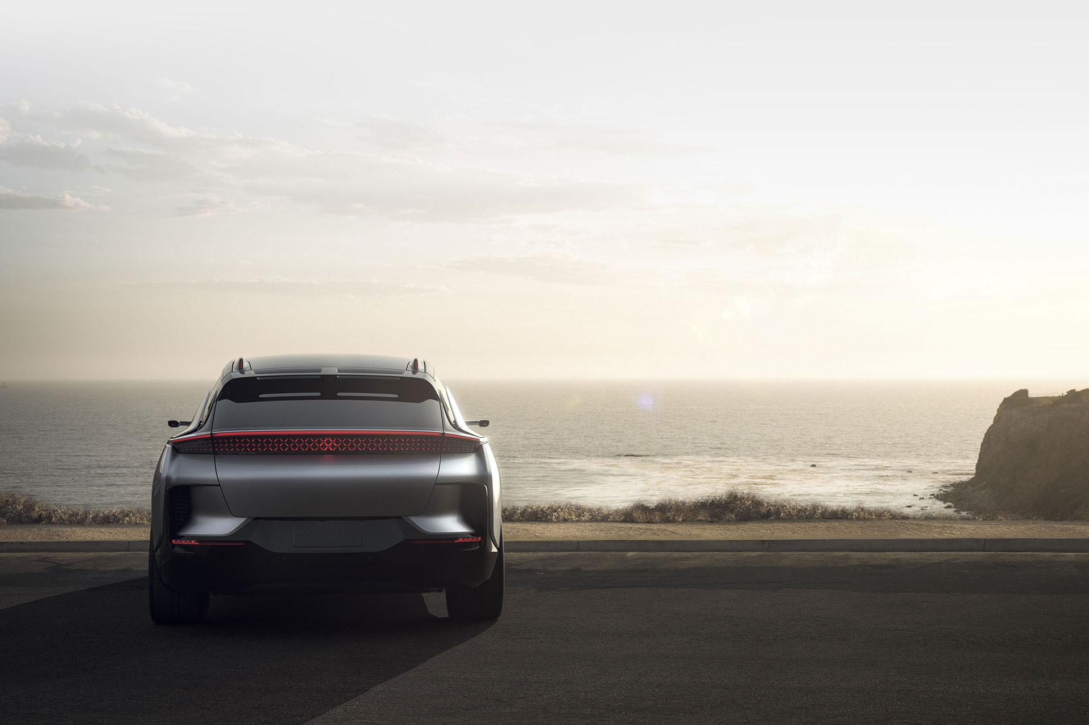
Specs
3 Electric Motors
0-60 in 2.39 secs
1050 Horsepower
Dynamic Vehicle Control
300+ Miles per Charge
Intelligent
Facial Recognition

