Slide 1


WELCOME TO MY PRESENTATION

Slide 2
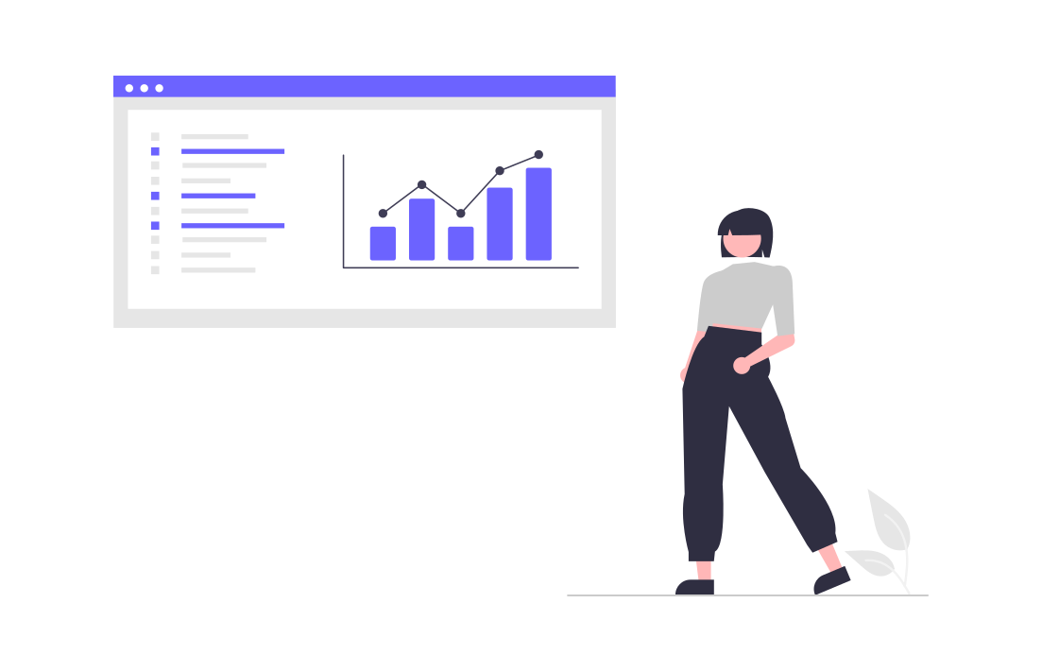
SELF INTRODUCTION
Assalamualaikum
Im Saim Al Ifran. I am a dedicated and motivated student currently pursuing a BSc in Computer Science and Engineering at International Standard Univercity. Apart from that I am also a Web Application Developer .

Slide 3
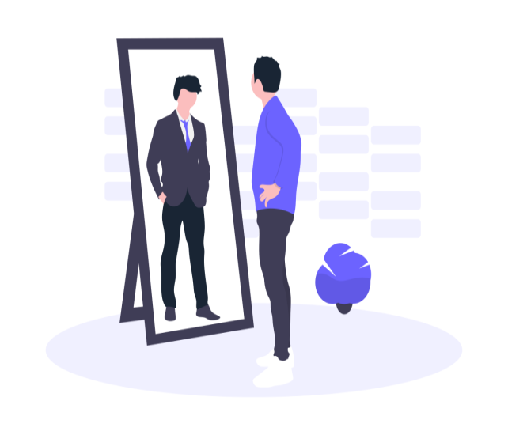
ABOUT FUTURE PLAN
So I told you earlier that I am a web application developer and As a developer my future plan is to create an app like facebook with brand new features and benefits. Also I want to contribute to new technologies like green computing and blockchain.

Slide 4

Strength and Weakness
Now I am going to tell my strength and weakness. There is nothing special about it .My strength is my mother's smile and weakness is my lack of confidence in some areas.

Slide 5
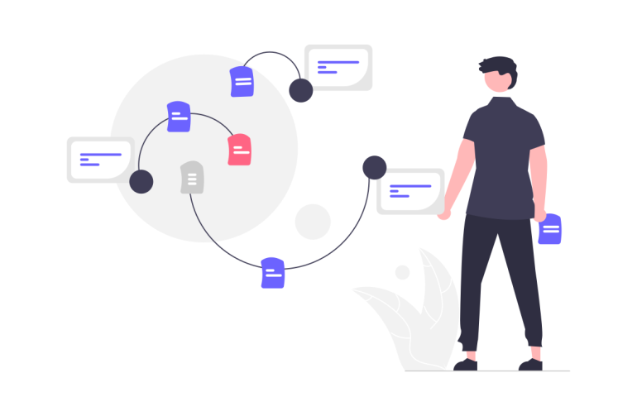
HOW DO I ADD VALUE TO THIS PROFESSION ?
Well As a web application developer, I have the opportunity to add significant value to the profession in various ways. Here are a few ways I can contribute:
Technical Expertise
Problem Solving
User Experience (UX )
Collaboration and Communication
Continuous Learning and Adaptation,
Attention to Security

Slide 6


