Slide 1
American Sign Language (ASL) Hand Gesture Recognition
Deep Learning-Based Image Classification Project

Slide 2
Introduction
This project aims to develop a deep learning model to classify ASL hand gestures, covering both alphabets and numbers. The workflow includes custom image preprocessing, CNN-based training, and evaluation.

Slide 3
Dataset Information
- ASL Alphabet Dataset (Kaggle)
- Synthetic ASL Numbers Dataset (Kaggle)
- Combined and Preprocessed Dataset
All images were resized and normalized for consistency.

Slide 4
Image Preprocessing Pipeline
- Converted grayscale images to RGB format
- Applied Gaussian blur to smooth input
- Sharpened edges to enhance gesture shape
- Detected skin regions using YCrCb segmentation
- Removed small noise components
- Applied mask on a black background for clarity

Slide 5
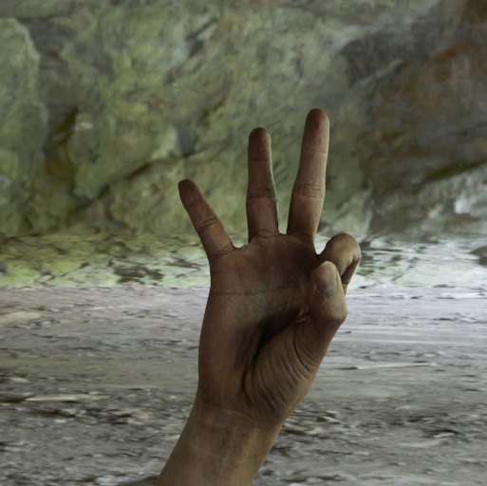
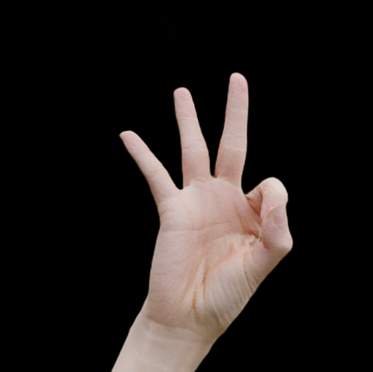
Original vs preprocessed
Original
processed

Slide 6
CNN Model Overview
- 3 Convolutional layers with ReLU, BatchNorm, MaxPooling
- Flatten layer followed by Dense layers
- Final Dense layer with 39 output classes
- Optimized with Adam, CrossEntropy Loss
- Trained over 10 epochs

Slide 7
Training Results
Accuracy and Loss tracked for train/test sets
Final test accuracy achieved after training
Confusion matrix plotted for 39 classes
final test accuracy around ~92 percent
All 30 classes well represented

Slide 8
Conclusion
Successfully built ASL hand gesture classifier
End-to-end pipeline: Preprocessing → Classification
Ready for real-time extension with minor improvements
Conclusion: A foundational ASL recognition system with high accuracy

Slide 9
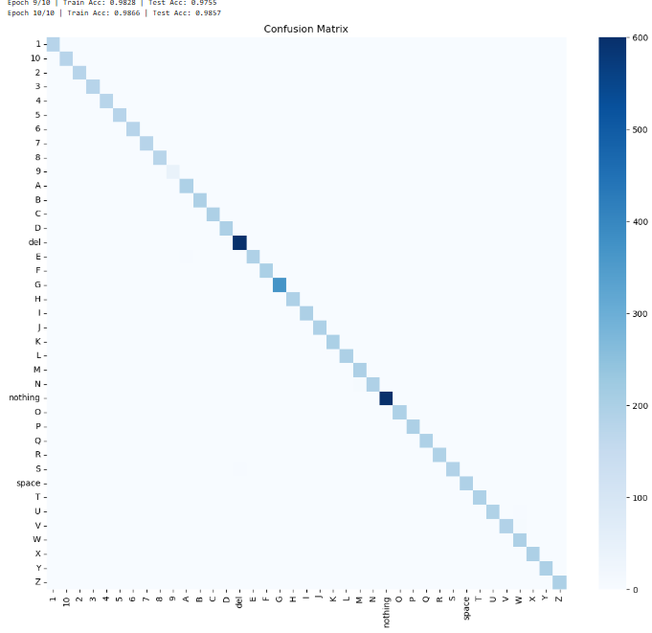
Confusion Matrix

Slide 10
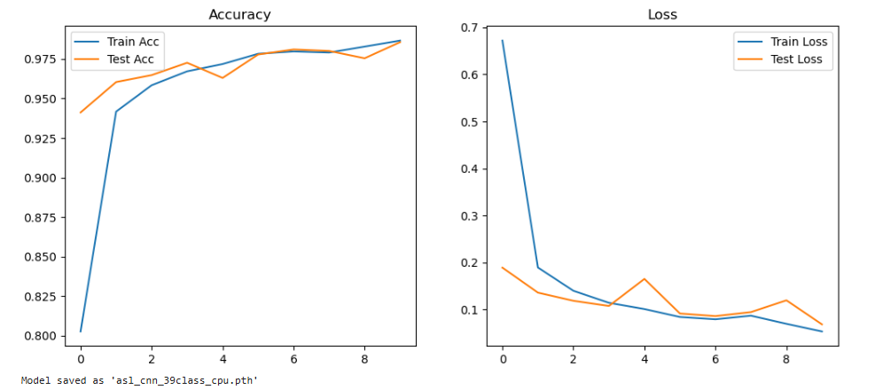
Training Metrics

