Slide 1

CI/CD and Environment Configuration
(Automating ML Training with Docker and Ansible)
A DevOps project focused on streamlining machine learning workflows through containerization and automation. Presented by Ishan Mangal, Muheet Alam, Paras Chandra, Keshu Shukla, and Ujjawal Tomar under the supervision of Dr. Ankit Deswal from the Department of Information Technology, Delhi Technological University.

Slide 2

Project Objectives
Primary Goal
Key Deliverables
Automate machine learning model setup and training processes using Ansible and Docker to ensure consistency and reproducibility.
Fully Dockerized ML environment that packages all dependencies and workflows into a portable container.
Automation Tools
Distribution
Ansible playbooks for both local and remote environment setup, eliminating manual configuration steps.
Published DockerHub image enabling global access and portability across different systems.

Slide 3
Problem Statement & Solution
Challenges
Our Approach
Inconsistent ML environments across different systems
Package the entire ML environment in a Docker image
Error-prone manual setup processes
Automate setup and deployment using Ansible
Difficulties in collaboration and reproducibility
Publish image to DockerHub for global accessibility

Slide 4
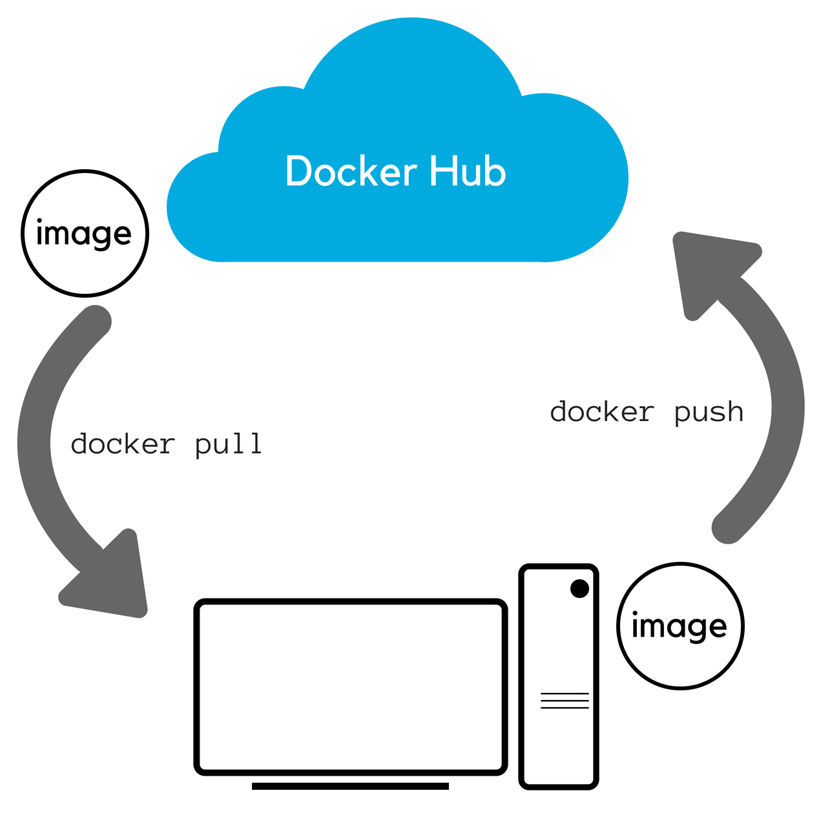




Technology Stack
Docker
Ansible
DockerHub
Containerizes the entire ML workflow, ensuring consistent environments across all systems and eliminating "it works on my machine" problems.
Automates environment provisioning through playbooks, reducing manual steps and potential for human error in setup processes.
Enables sharing of the containerized application globally, allowing anyone to pull and run the exact same environment.
Python
Powers the core ML training script with libraries like scikit-learn, pandas, and NLTK for the fake news detection model.

Slide 5






ML Use Case: Fake News Detection
Evaluation
Accuracy metrics and confusion matrix
Model
TF-IDF + PassiveAggressiveClassifier
Dataset
train.csv and test.csv files
Our machine learning example focuses on a fake news detection system that processes news articles and classifies them as real or fake. The system generates model.pkl and vectorizer.pkl files as outputs, which can be used for future predictions.

Slide 6
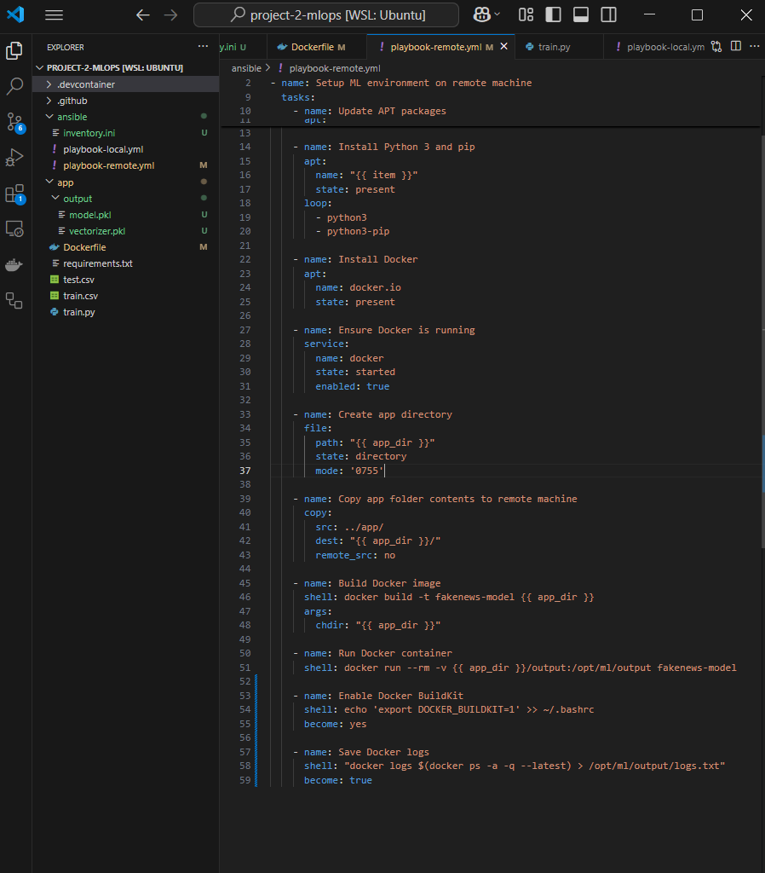



Project Structure & Implementation
Project Organization
Structured with app/ containing ML code and Dockerfile, and ansible/ containing automation playbooks
2
Dockerfile
Based on python:3.9, installs pandas, sklearn, nltk, numpy, and copies training files
Ansible Playbooks
playbook-local.yml for local setup and playbook-remote.yml for SSH-based remote deployment
DockerHub Integration
Published as alamsaim/fakenews-model for global access and easy deployment

Slide 7





Execution Workflow
Run Ansible Playbook
Initiates the automation process with ansible-playbook command
File Preparation
Copies ML code and data files to /opt/ml directory
Docker Build
Constructs container image with all dependencies
Training Execution
Container runs the ML training script automatically
Output Generation
Produces model.pkl and vectorizer.pkl files

Slide 8
🗂️ File Roles and Project Integration
Train.py
Initiates the automation process with ansible-playbook command
Dockerfile
Defines container environment and auto-runs train.py
requirements.txt
Lists Python dependencies (scikit-learn, nltk, etc.)
playbook-local.yml
Automates setup and Docker tasks on local machine
playbook-remote.yml
Same automation for remote machine (via SSH)
inventory.ini: Stores remote machine IP and credentials

Slide 9
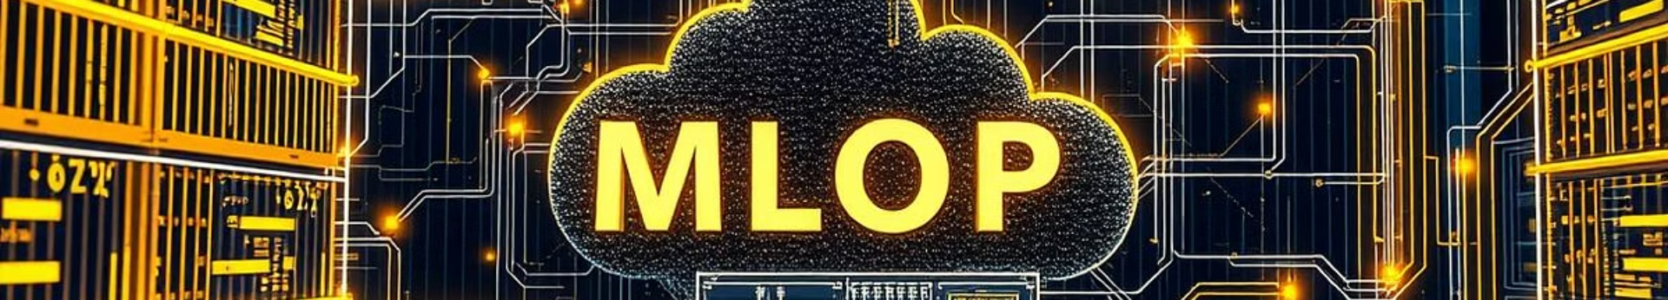
Benefits & Future Directions
100%
75%
3
Reproducibility
Time Saved
Platforms
Ensures identical environments across all systems
Reduces debugging and setup time
Works seamlessly on Linux, Windows, and macOS
This project successfully automated ML environment setup and training using Docker and Ansible, solving reproducibility issues and aligning with real-world MLOps practices. Future enhancements include adding a REST API with Flask/FastAPI, automating CI/CD via GitHub Actions, and scaling the solution using Kubernetes.

