Slide 1
KDDM Ice Hockey Talent Scouting — Phase I
Data preprocessing, cleaning and exploratory analysis
Group 174
Muhammad Saim Akram · Matriculation 12344542
Zamarak Sufyan
Knowledge Discovery and Data Mining · Summer 2026
Files we submit: Phase1_DataCleaning.ipynb · data/newdata/master_merged.csv

Slide 2
Approach — turning 7 messy files into 1 clean table
Phase I · Group 174 · Muhammad Saim Akram (12344542), Zamarak Sufyan
• We have 10,000 ice hockey players spread across 7 files in 5 different formats. The goal of Phase 1 is just to clean the data — we don't have the answer column yet.
• Our plan:
  – 1. Load each of the 7 files using the right pandas function for its format.
  – 2. Look at each file (shape, head, missing values) before changing anything.
  – 3. Clean each file on its own (rename, fix types, fix units).
  – 4. Combine all the files into one big master table using IDs and names.
  – 5. Fill in the missing values where it makes sense.
  – 6. Make some plots to understand the data.
• Tools we used: pandas, numpy, matplotlib. Plus a small function we wrote to convert Roman numerals to normal numbers.
• Final result: data/newdata/master_merged.csv with 10,000 rows × 55 columns, and 6 plots saved in docs/figures/.
1 / 8 — Approach

Slide 3
Preprocessing 1 — Fixing the weird files
• identity_card_0 had three problems we had to fix one by one:
  – The column names were in Latin (praenomen, cognomen, ...). We made a small dictionary to rename them.
  – The international_id was in Roman numerals (like CCLXXV = 275). We wrote a small function that walks through each letter.
  – Some names ended with -ius or -us (Keithus, Alleeius). We removed those endings so the names match the other files.
• medical_information.xlsx had a broken header:
  – The first row was metadata, the real column names were in another row, and 'medical_id' was alone in a different cell.
  – We re-read the file with header=None and built the column names by hand.
• The height column was a mix of cm and m ("1.79m" vs "180.1135cm"). We wrote a small function that checks the ending and converts everything to cm.
• weight had a 'kg' suffix sometimes; body_fat_percentage had '%' sometimes. We stripped them off and converted to numbers.
• return_date came in 3 different formats. pd.to_datetime with errors='coerce' handles all of them.
• There was a typo in performance.tsv: 'penality_minutes' instead of 'penalty_minutes'. We renamed the column.
2 / 8 — Preprocessing

Slide 4
Preprocessing 2 — Making things consistent and joining everything
• Making values consistent:
  – gender had values like 'm', 'male', 'M'. We mapped them all to 'male', 'female', or 'other'.
  – nationality was written like 'austria', 'Austria', 'AUSTRIA'. We just lowercased everything.
  – fitness_level had the literal string 'Nan' instead of a real missing value. We replaced it with np.nan, then lowercased.
  – captain and won_championship were stored as object with mixed True/False/strings. We mapped them to real booleans.
  – Some ages were over 400 years old. We set anything above 60 to NaN. Draft years before 1960 were also fixed (NHL drafts started in 1963).
• Joining the tables (we used left joins so we keep all 10,000 players):
  – identity = identity_0 stacked on top of identity_1 = 10,000 rows
  – Then we joined performance, contracts and scouting using international_id.
  – Then we joined medical using medical_id.
  – moms_notes has NO id column, so we built a name_key from lowercase first_name + last_name. 9,815 of our 9,818 keys matched.
• Columns we dropped because they have no hockey meaning: eye_color, stuffed_animal_name, favourite_board_game, favourite_child_info, favourite_tv_show, favourite_food, physician_signature, first_name, last_name, medical_id, jersey_number, shoe_size.
• Final shape: 10,000 rows × 55 columns.
3 / 8 — Preprocessing

Slide 5
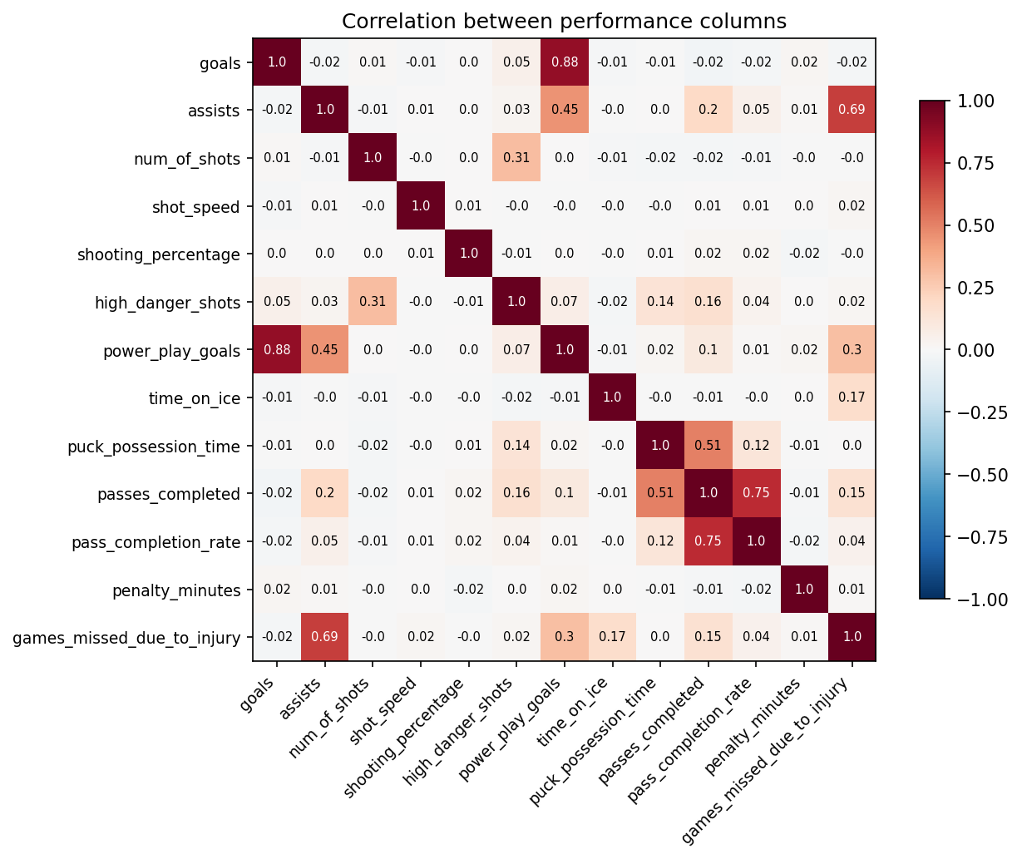
Relationships 1 — Which columns move together?
• A correlation tells us how two columns move together. +1 = they go up together, -1 = one goes up when the other goes down, 0 = no relation.
• The strongest pairs we found:
  – +0.88 power_play_goals and goals — makes sense, most goals happen on power plays.
  – +0.75 pass_completion_rate and passes_completed — also makes sense, they measure related things.
  – +0.69 games_missed_due_to_injury and assists — this is unexpected and worth looking at in Phase 2.
  – +0.51 passes_completed and puck_possession_time — the more you have the puck, the more you can pass.
• There is a small block of weak correlations between penalty time, injuries and time on ice — could be interesting.
4 / 8 — Relationships

Slide 6
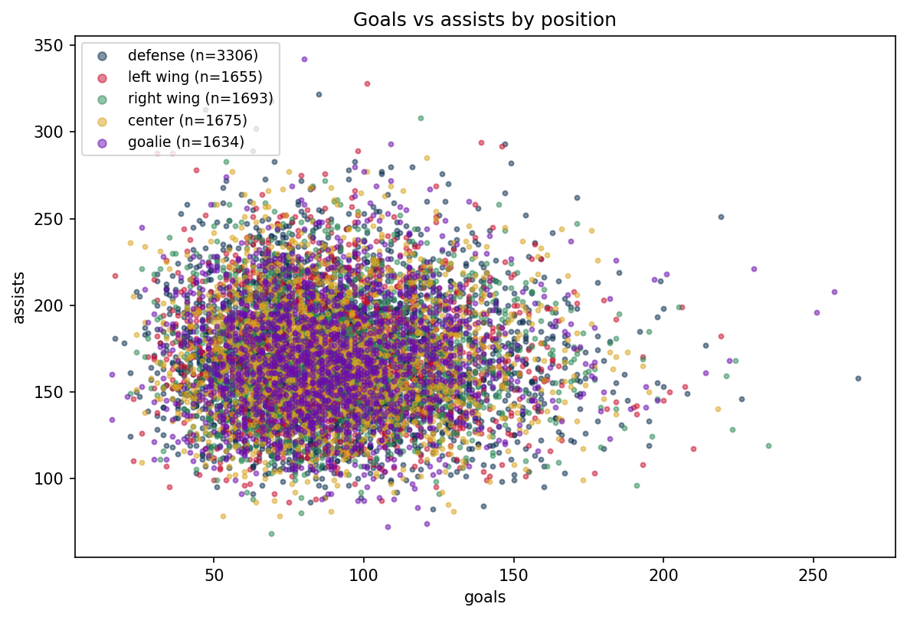
Relationships 2 — Position separates the players cleanly
• Each dot is one player. The colors show their position. Goalies are clearly different from everyone else — they sit near (0, 0) because they don't score goals.
• Forwards (centre, left wing, right wing) spread out to the upper-right (more goals and assists). Defenders sit between forwards and goalies.
• This is why we used position-aware imputation later — filling a goalie's missing height with the overall median would be wrong.
• We also checked the derived columns:
  – pass_completion_rate matches goals/passes_attempted on every row. Good.
  – shooting_percentage disagrees with goals/num_of_shots in 9,511 of 9,963 rows. Worst case is about 87 percent off.
  – So pass_completion_rate is trustworthy, but shooting_percentage is broken. We'll re-derive it in Phase 2 if we need it.
5 / 8 — Relationships

Slide 7
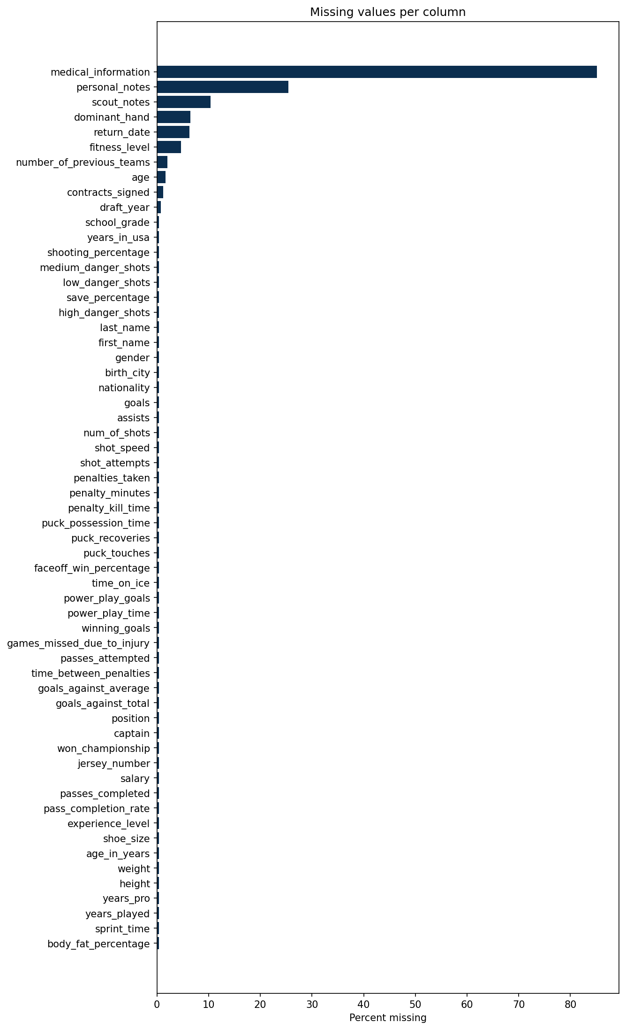
Cleaning 1 — Dealing with missing values
• Interesting finding: the SAME 37 players are missing in every file. This is not random — they just have no data anywhere. We kept those rows but did not invent data for them.
• Three groups of missing columns:
  – About 8,518 rows missing medical_information — only injured players have one. We leave it as NaN.
  – About 1,000 - 2,500 rows missing free-text columns like scout_notes and personal_notes — we leave them for Phase 2.
  – Exactly 37 rows missing across all feature columns — the structural cohort from above.
• How we filled in the missing values:
  – Body-related columns (height, weight, body fat, sprint time): we used the MEDIAN of the same position. Defenders and goalies have different body shapes.
  – Other numeric columns (age, draft_year, salary, etc.): we used the column median.
  – Categorical columns (dominant_hand, fitness_level): we used the most common value (mode) for the same position.
  – Free text (scout_notes, medical_information, personal_notes): we left as NaN — we can deal with text in Phase 2 if we want.
6 / 8 — Cleaning

Slide 8
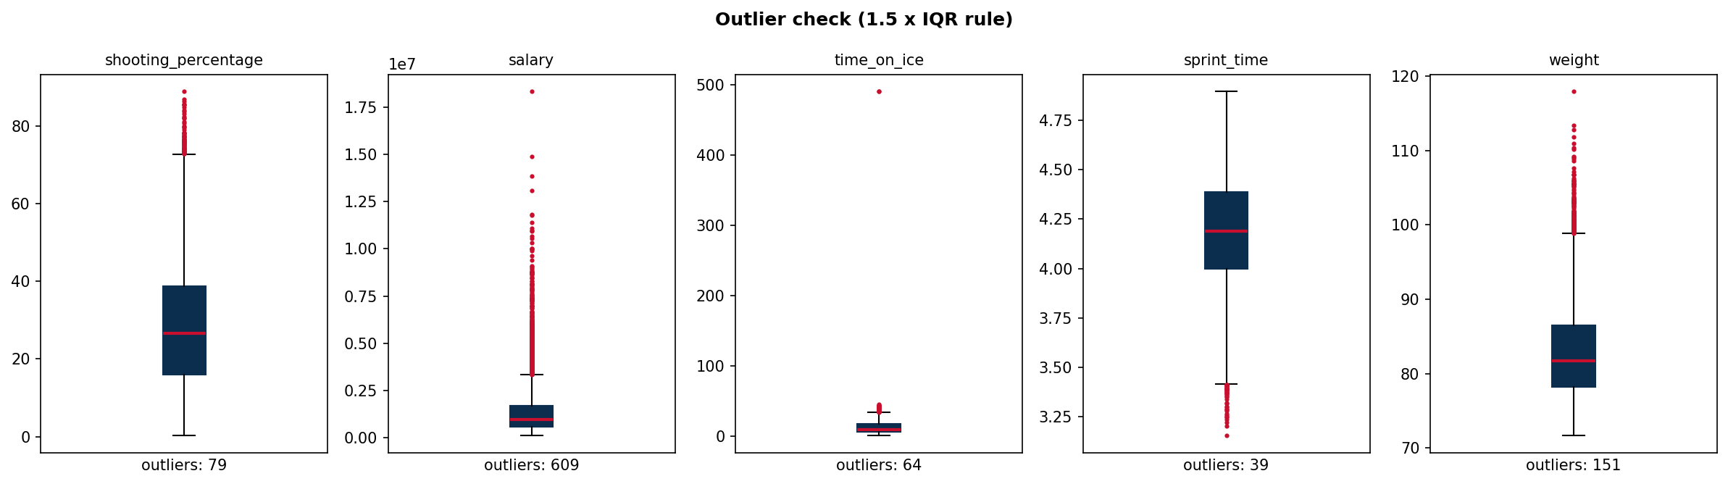
Cleaning 2 — Outliers and impossible values
• Impossible values we fixed BEFORE filling in missing values (so the medians don't get poisoned):
  – age > 60 → NaN. The raw max was around 455 years old.
  – draft_year < 1960 → NaN. NHL drafts started in 1963. We found 40 rows like this.
  – age_in_years column dropped — it disagreed with age by up to 430 years in some rows.
• Outlier check using the IQR rule (anything more than 1.5 × IQR from the box is an outlier):
  – We checked shooting_percentage, salary, time_on_ice, sprint_time, weight.
  – We just flagged the outliers — we did NOT drop them, because the brief says some are intentional.
• Height after cleaning goes from 131.6 to 309 cm. The 309 cm record is clearly a unit-confusion mistake — we should flag this for Phase 2.
• Joke / distractor columns we removed: 3 columns in moms_notes were 100% empty (favourite_child_info, favourite_tv_show, favourite_food). physician_signature had values like 'Dr. House' and 'Doctor Strange'.
7 / 8 — Cleaning

Slide 9
What we found in Phase 1
• The same 37 players are missing in every file. This is not random — they have no data anywhere. We kept these rows in the master table instead of dropping them.
• identity_card_0 needed three independent fixes for one 888-row file: Latin column names, Roman numeral IDs, and Latin name endings. Each one needed its own small function.
• medical_information.xlsx had a broken header — the first row was junk, the real column names were in another row. We had to re-read the file and build the column names by hand.
• pass_completion_rate is consistent (matches passes_completed / passes_attempted), but shooting_percentage is NOT — 9,511 of 9,963 rows disagree by more than 1 percent.
• Goalies form a clear cluster near (0, 0) on goals vs assists — one scatter plot separates the positions. This is why we used position-aware imputation.
• Salary is very right-skewed (most are small, a few are huge). On a log scale it looks normal. We will log-transform it before modeling in Phase 2.
• Distractor / joke columns confirmed: 3 moms_notes columns are 100% empty, physician_signature has joke values. We dropped them and 9 other useless columns.
• Final master: 10,000 rows × 55 columns. All 6 figures were made by the same notebook, so the work is reproducible.
8 / 8 — Findings

