Slide 1

An innovative and unique platform to
engage your TG is here…

Slide 2




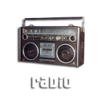

Café Coffee Day
An all new ‘Media’ to connect with your TG
Read on to find out how…

Slide 3
?
What is Coffee Day?

Slide 4

India's largest coffee conglomerate,
Amalgamated Bean Coffee Trading
Company Ltd
Pioneer of the café culture and the first
to launch the ‘coffee bar’ concept in
India
Network strength: Over 1530 cafés in 200 cities/towns across India and growing
Average Footfalls: 200 per café per day

Slide 5
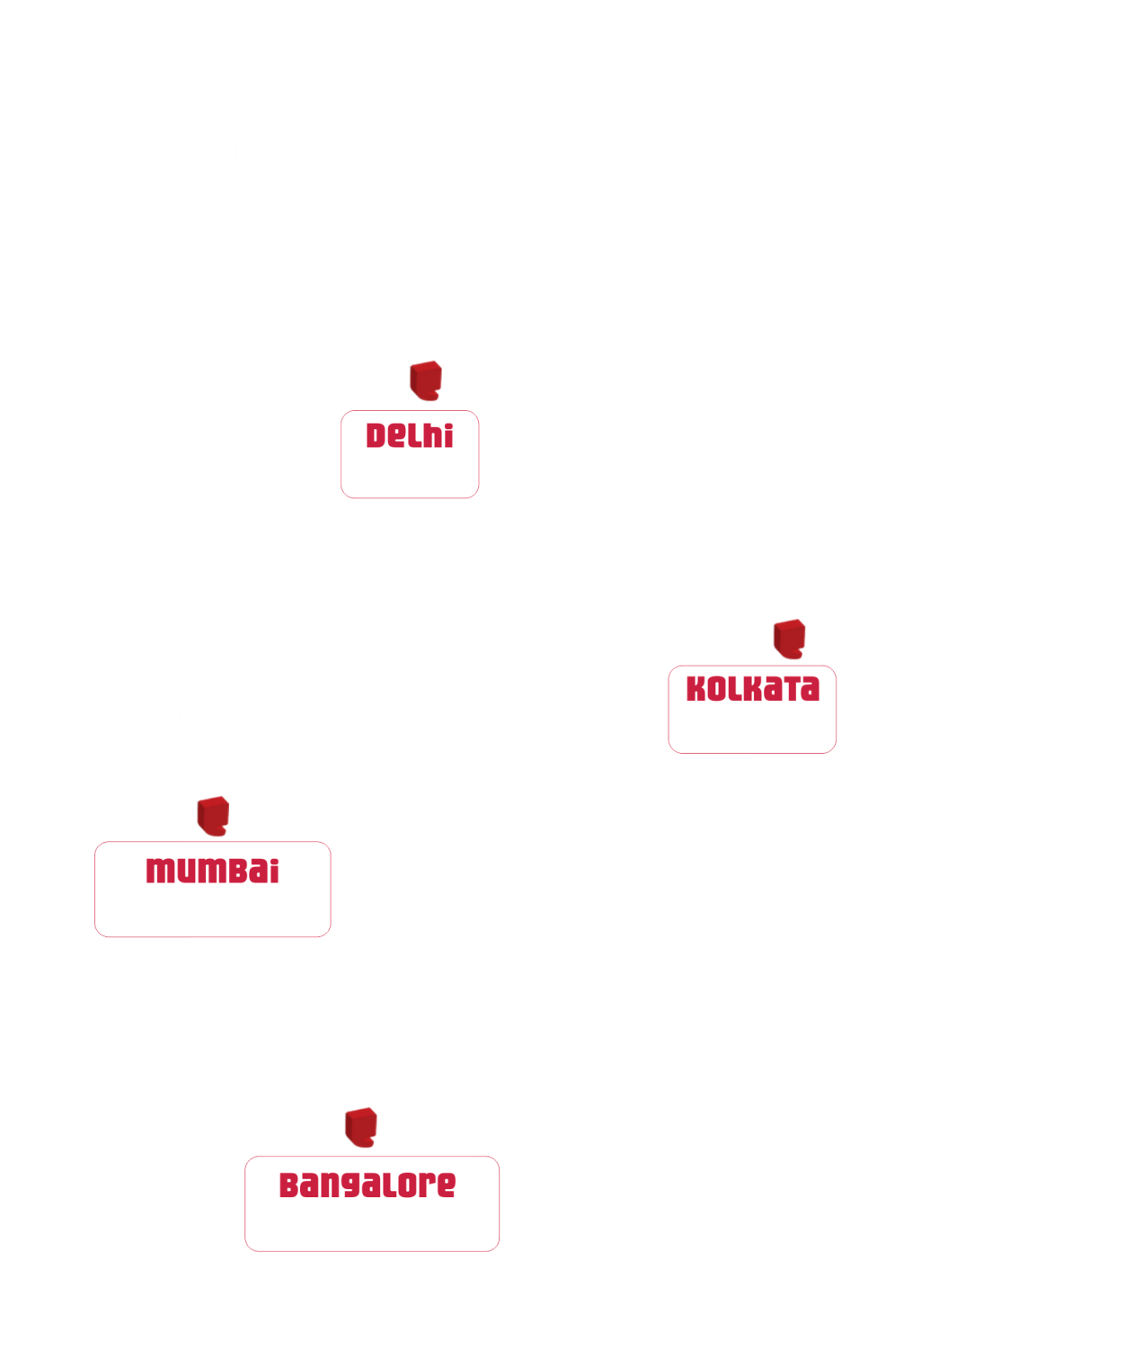
Café Coffee Day Network
of 1530 cafes across India
185 cafes
64 cafes
172 cafes
191 cafes

Slide 6

Average dwell time at café: 45 minutes
Meeting place for 15-35 year olds
The place they frequent most after “home and workplace/college”
A place where they meet friends and colleagues, in groups of 3 or more
A place where they rejuvenate and are free to be themselves rather than a place to be “seen at”

Slide 7

Who
hangs out at Coffee Day?
Research shows that while a part of our customers come to us for our products, a substantial amount of our customers come to “hang out” with friends.
The café is also the venue for
“business meetings” (23%),
“celebrating special occasions” (20%) or
just plain “hang out” (57%).

Slide 8

Profiling the CCD’ian
Hangs out at cafes/malls
Looking for a good lifestyle
Likes to be seen at the right place
Socially Active
Seeks 'feel-good factor' and expression of identity through choice of brands consumed. But is also value conscious
Looking for a multiplicity of experiences
Consumption areas: Personal clothing & accessories, food, entertainment, consumer durables
Strong voice in household purchases
Tech Savvy
Make consumption related decisions in company of friends
Influencers: Peer group, workmates

Slide 9
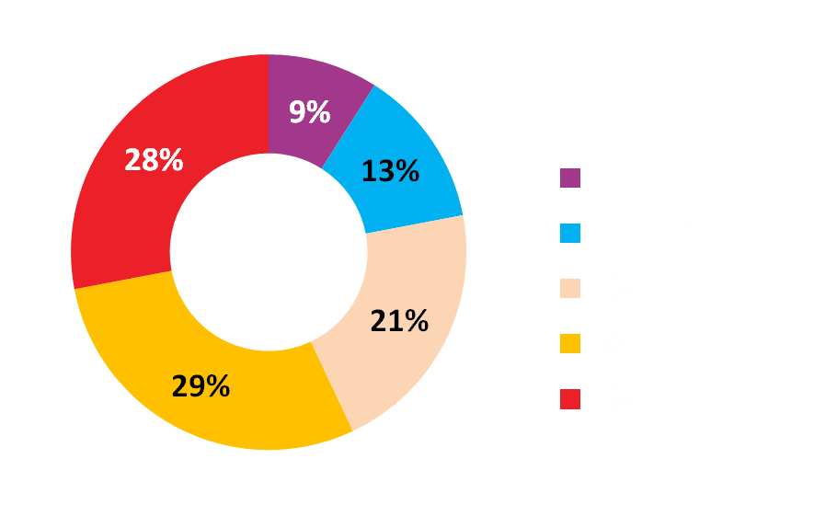
Key Target Audience
Major chunk of CCD customers falls within the age group of 20 to 30 which accounts for 57% of the overall percentage.
The group comprises of mainly college going students and young working professionals

Slide 10
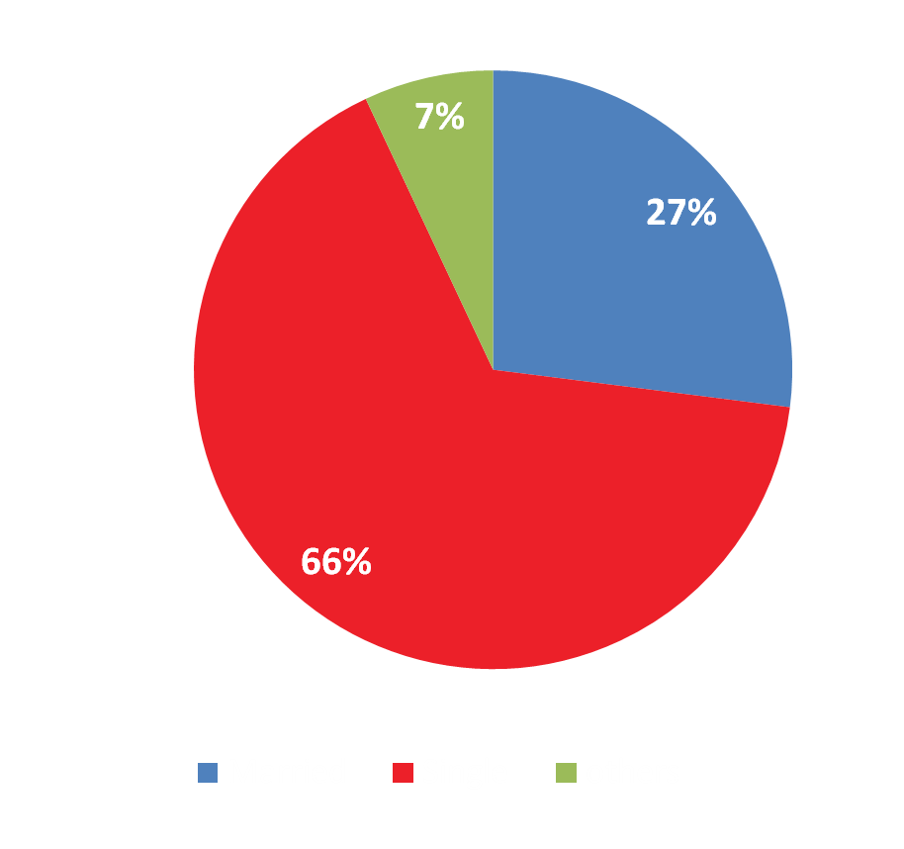
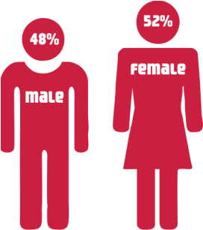
Sex Ratio & Marital Status
There is a definite skew towards singles: 66% singles, 27% married & 7% others.

Slide 11



Traditional Media Vehicles
An interactive alternative media
Targets the ‘young at heart’ high on engagement
Low cost per contact for a filtered TG
Infinite possibilities of innovation and first point contact
Brand communication through traditional modes only: visual & audio modes
Heavy spillovers
High clutter levels
High cost per contact

Slide 12





8.4 million consumers per month
80% of these in 15 – 30yrs age group
Cumulative monthly disposable spend of Rs 2106 Crores
Relevant Reach
Uninterrupted OTS
Least opportunity of consumers to
switch communication
No attention diverters
Relaxed frame of mind
Open to engaging with the communication
45 minutes of uninterrupted dwell time
Captive Audience
Network
Unbeatable 1500+ cafes, 200 cities
Covering Tier 2 & 3 towns as well
Unique creative concept

Slide 13
What Café Coffee Day offers the marketer?
An opportunity to convert a typical mass media campaign to a 360 degree communication endeavor
Uncluttered and consistent presence in a highly innovative manner

Slide 14
Customized
Brand Connectors
@
Café Coffee Day

Slide 15
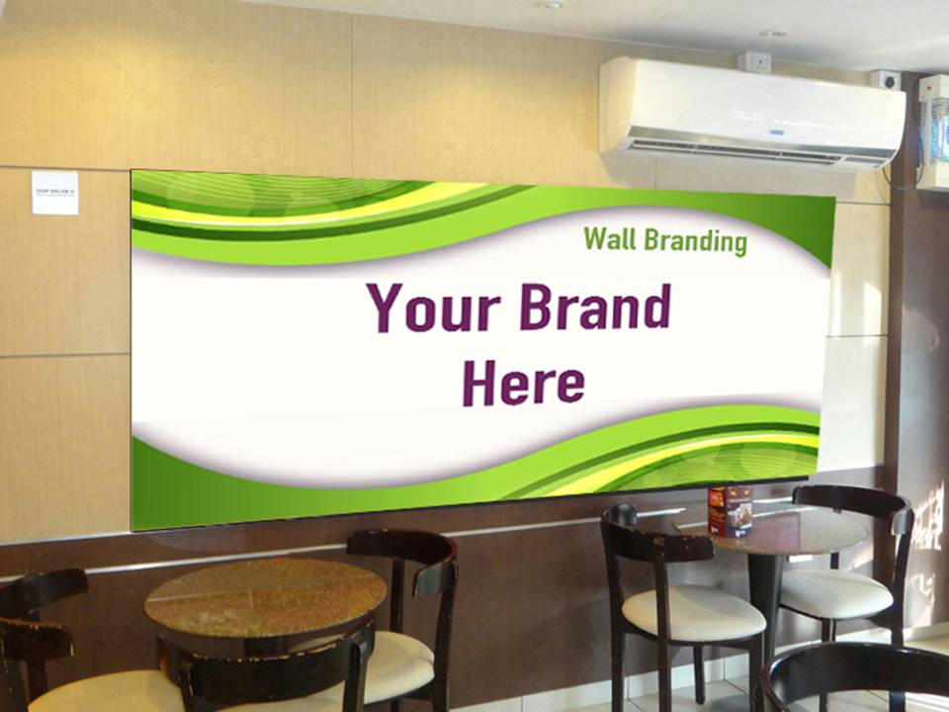
Wall Branding

Slide 16
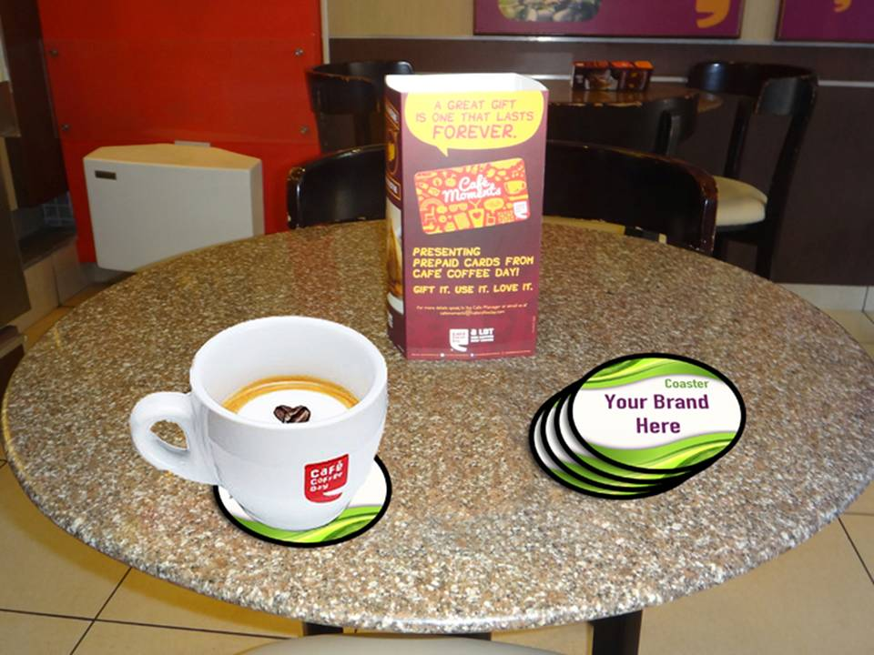
Coasters

Slide 17
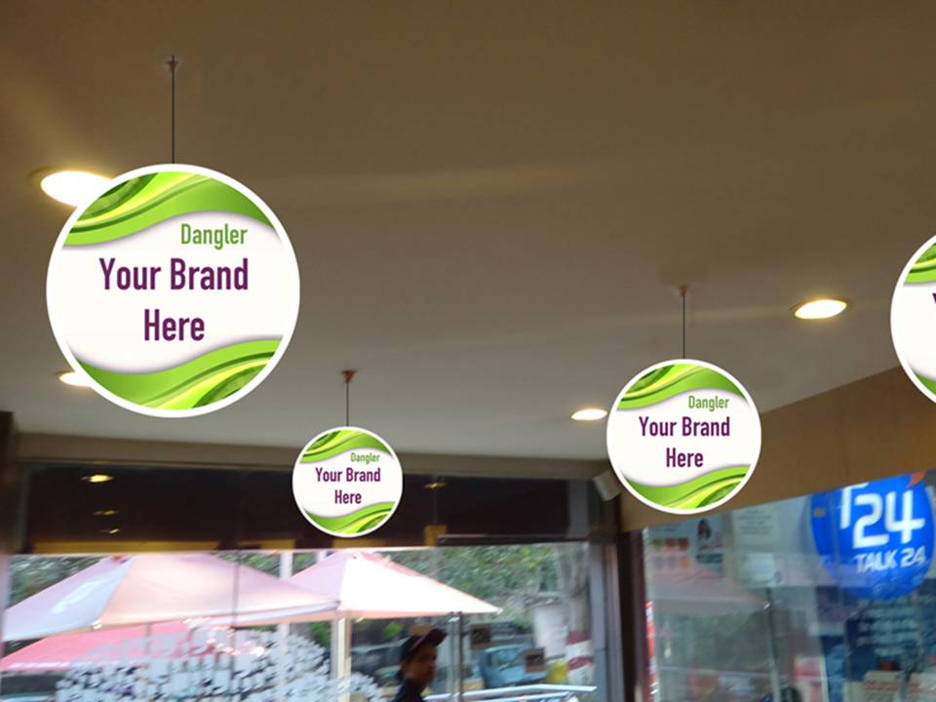
Danglers

Slide 18
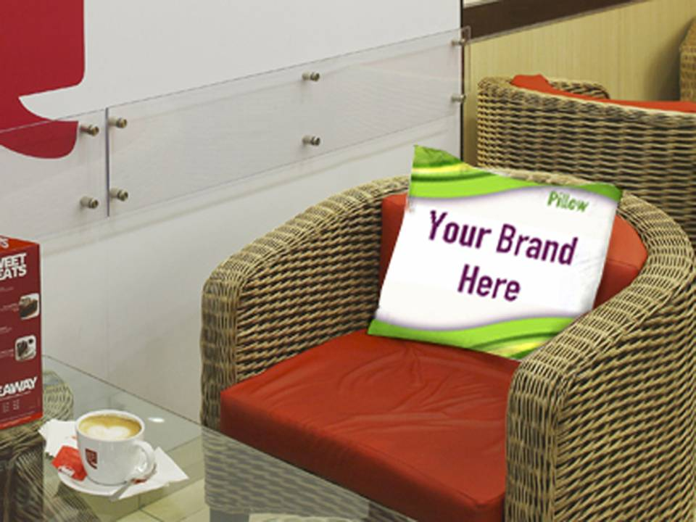
Pillow Branding

Slide 19
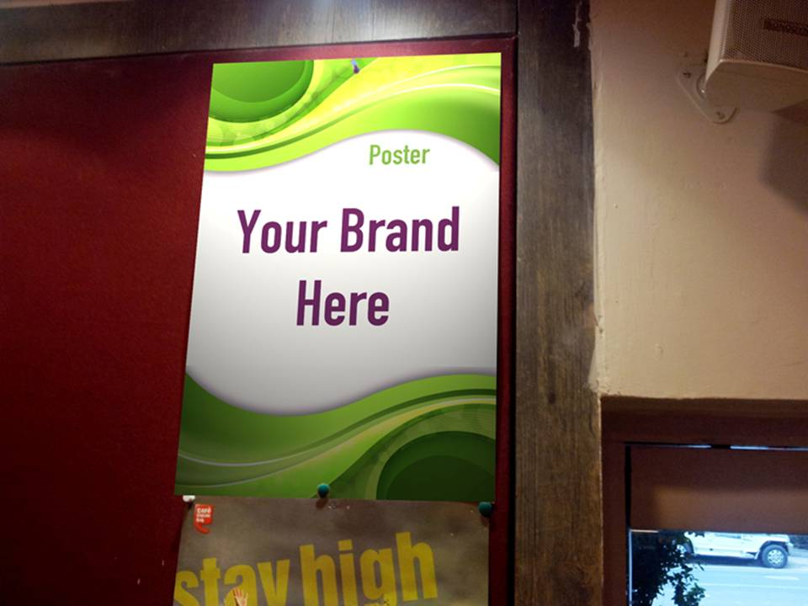
Posters

Slide 20

Saucer Tag

Slide 21
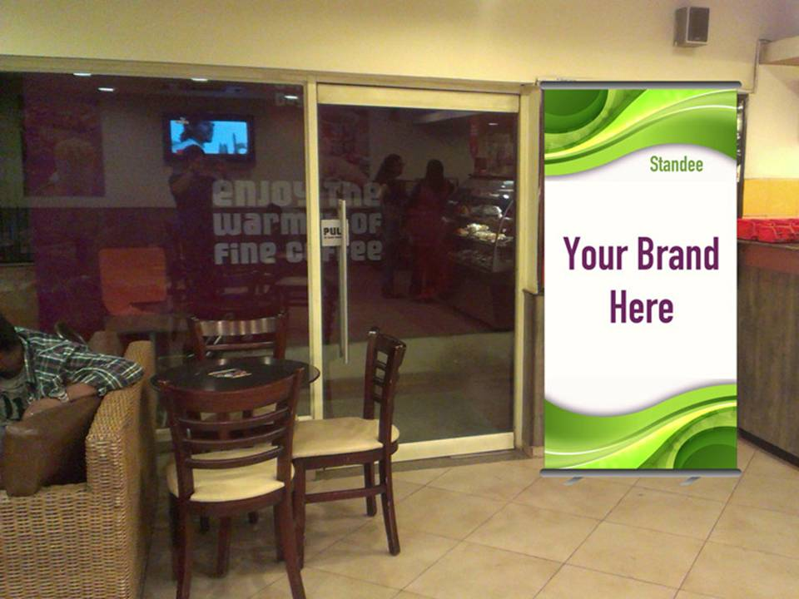
Standee

Slide 22
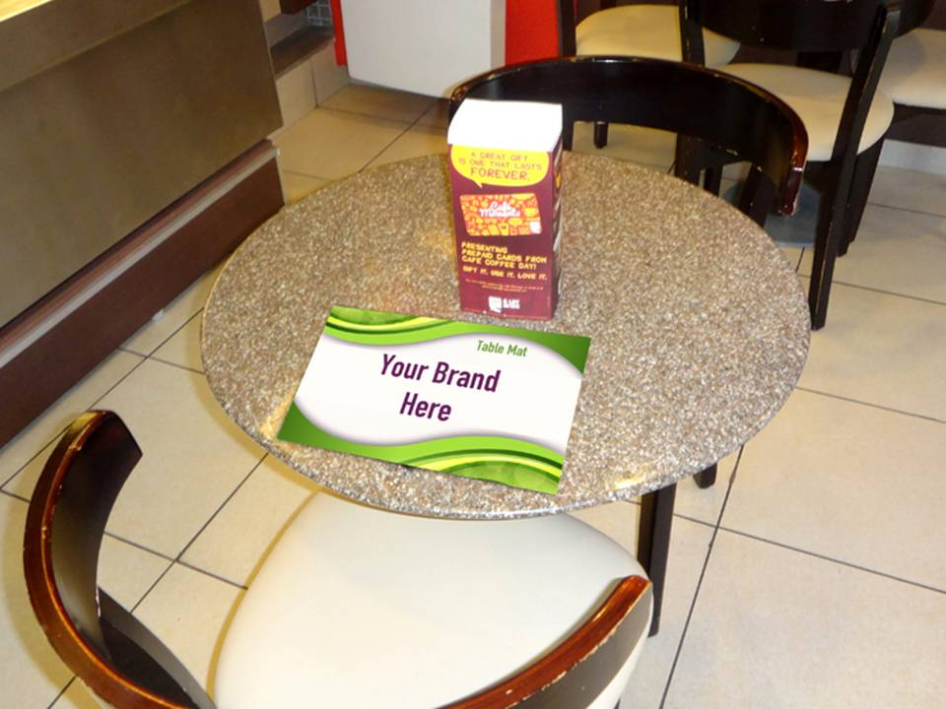
Table Mat

Slide 23
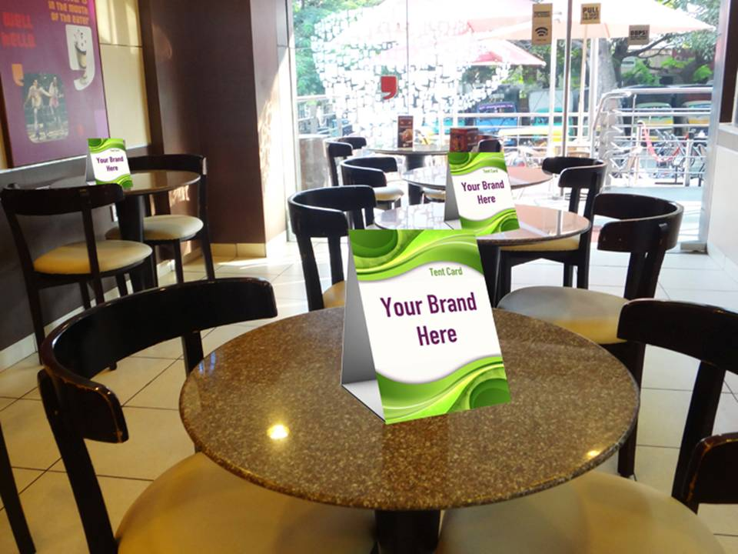
Tent Card

Slide 24
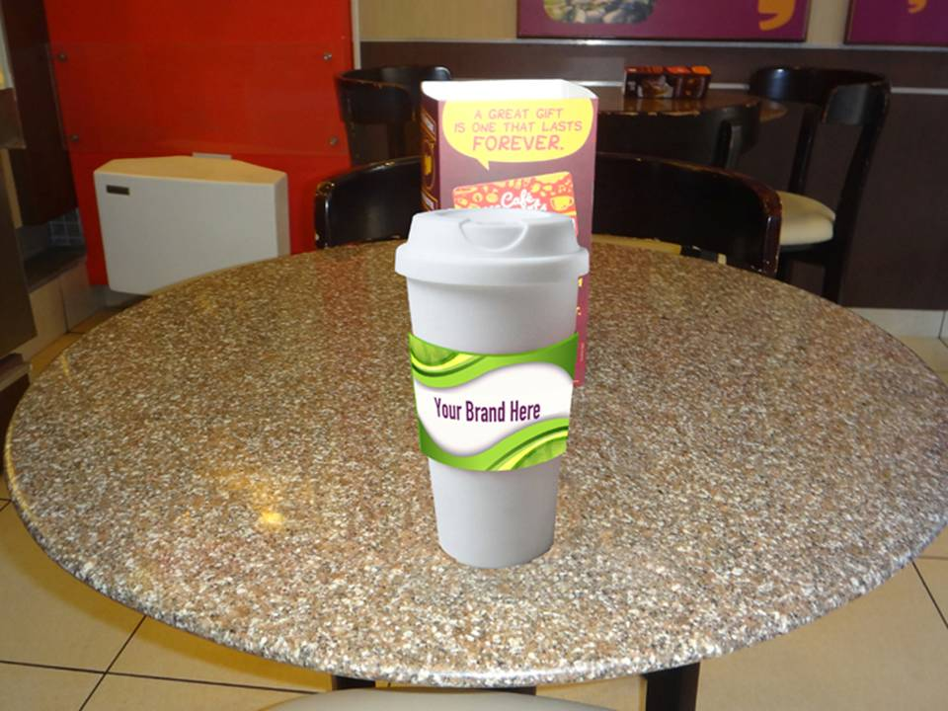
Cup Sleeves

Slide 25
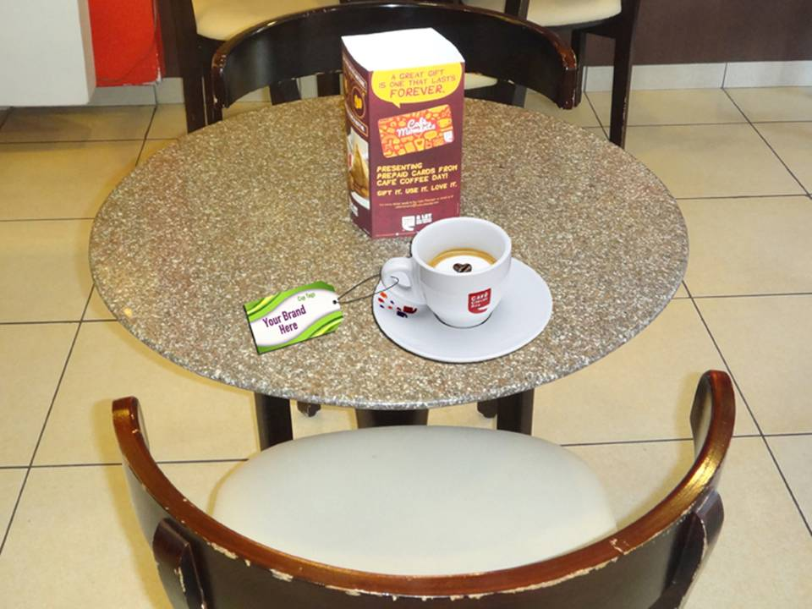
Cup Tags

Slide 26
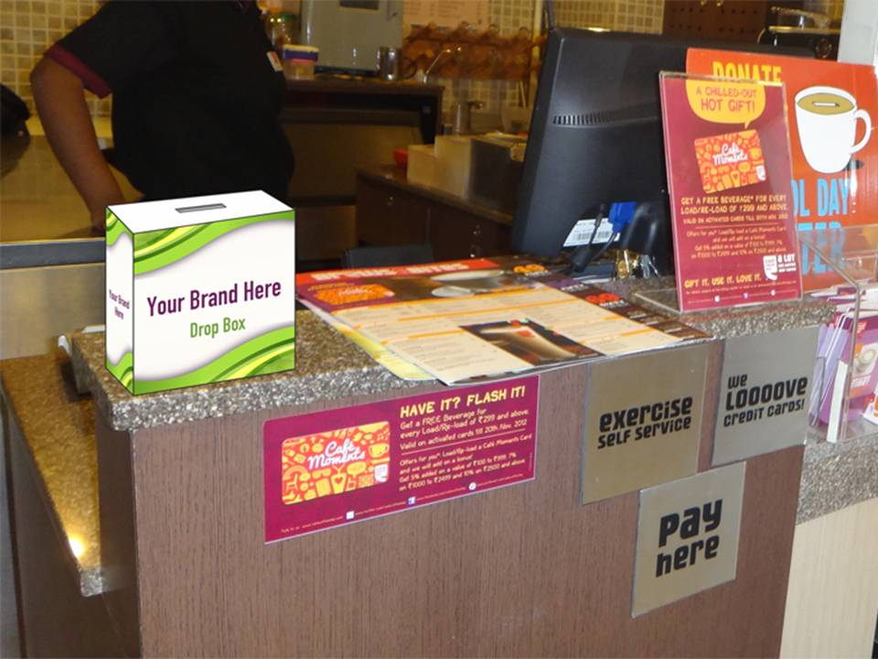
Drop Box

Slide 27
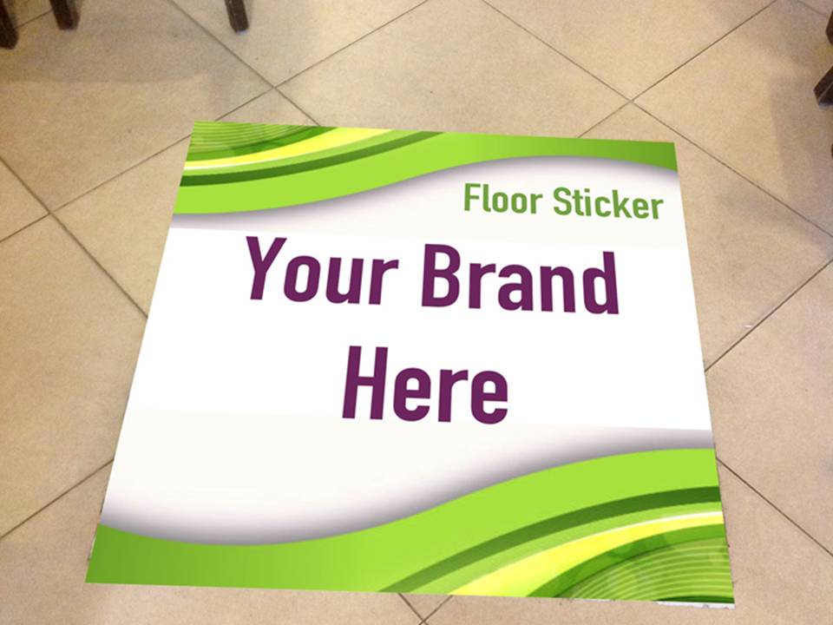
Floor Sticker

Slide 28
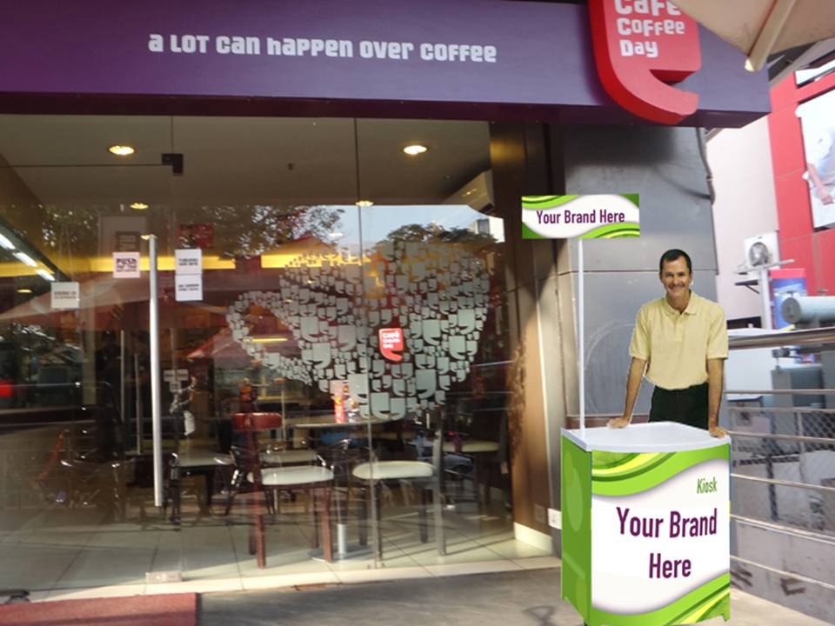
Kiosk with Promoter

Slide 29
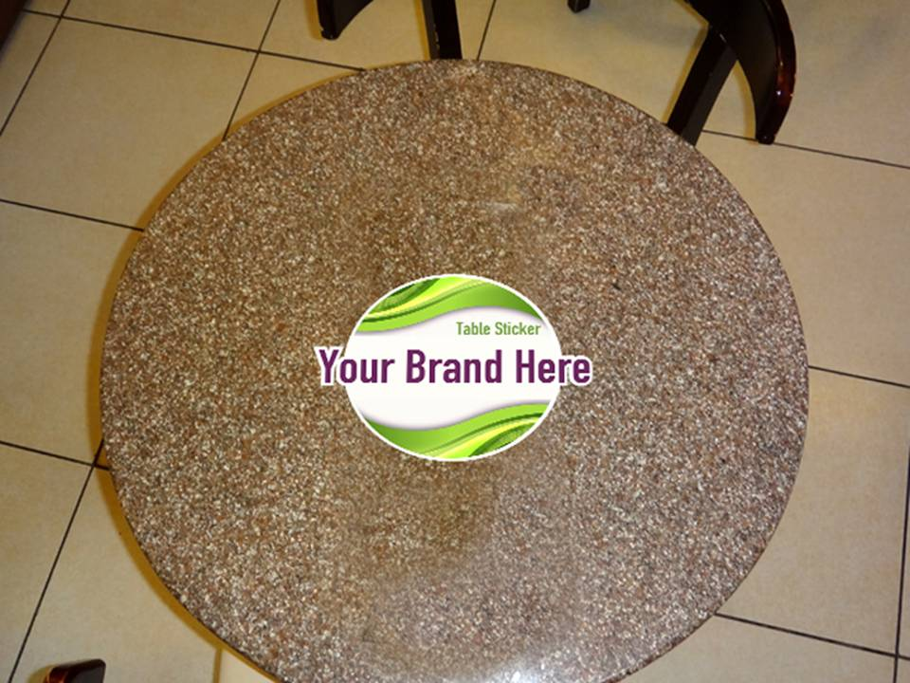
Table Sticker

Slide 30
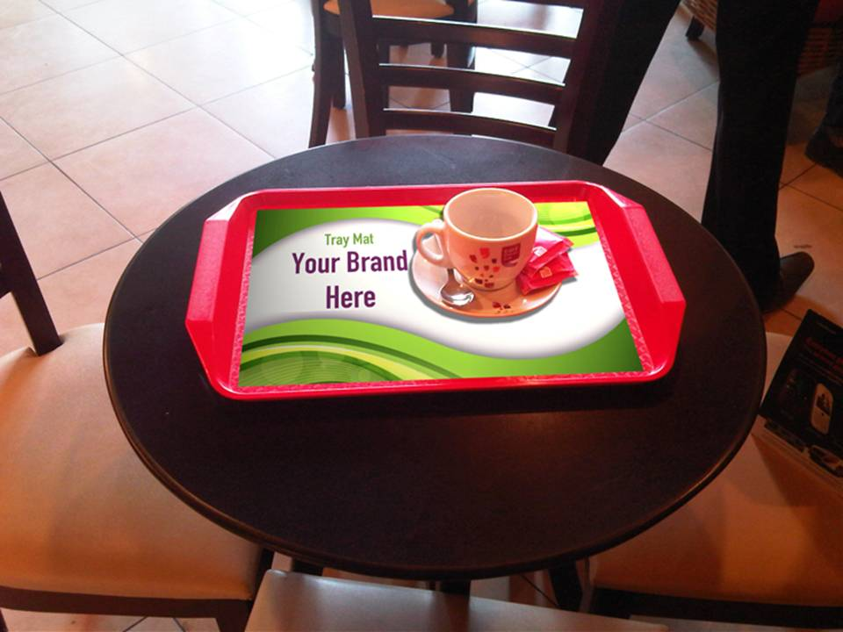
Tray Mat

Slide 31
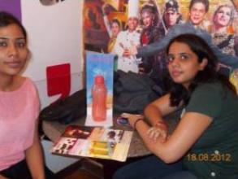
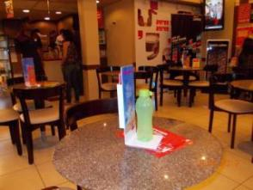
Tupperware
Campaign Objectives
To promote their water bottles and to create a platform for their distributors to talk about Tupperware products
Elements
A creative Tupperware branded stand with a water bottle holder and leaflets for communication were kept on the tables & counters
Previous Successful Brand Associations

Slide 32
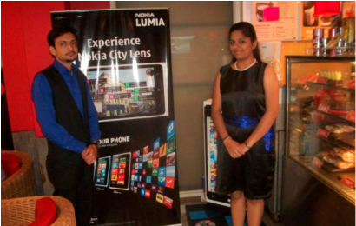
Nokia
Campaign Objective
To demonstrate the newly launched Nokia 800 series.
Elements
Creating a demo zone inside the cafe. Promoter access in the cafe to interact with customers-giving demo-collecting leads.
Previous Successful Brand Associations

Slide 33
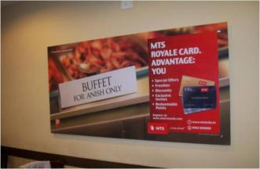
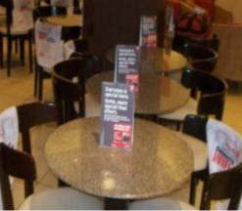
MTS
Campaign Objective
MTS had launched its Royale Card for their elite customer base.
Elements
Innovative way of branding ‘MTS – Royale Card’ with branding touch points like tent card and wall branding.
Previous Successful Brand Associations

Slide 34
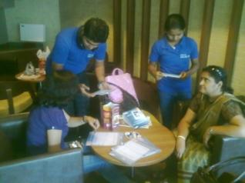
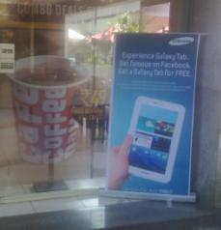
Samsung
Campaign Objective
To create an experience oriented campaign for Samsung Tab-II.
Elements
Creating a demo zone inside the cafe. Promoter access in the cafe to interact with customers- giving demo-collecting leads.
Previous Successful Brand Associations

Slide 35
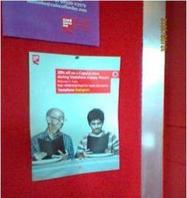
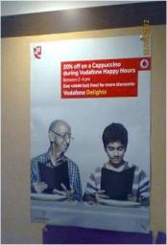
Vodafone
Campaign Objective
To promote Vodafone Happy Hours & give 20% discount to all the Vodafone customers visiting the café between 2pm to 4pm.
Elements
Poster, Tent Card and Bill Counter Display
Previous Successful Brand Associations

Slide 36
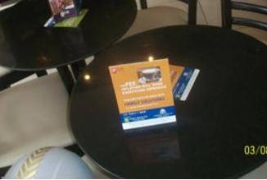
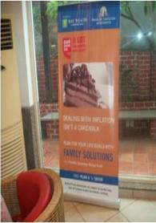
Franklin Templeton Investment
Campaign Objective
Awareness of new investment policy to the customers
Elements
Standee, Tent Card, Leaflet & Table Sticker
Previous Successful Brand Associations

Slide 37
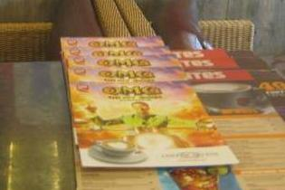
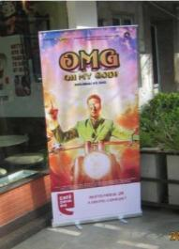
Oh My God
Campaign Objective
Promotion of OMG Movie across cafes in India
Elements
Standee, Side Menu Card & Poster on the notice board
Previous Successful Brand Associations

Slide 38

The Café Coffee Day out-of-box ideas advantage
Infinite possibilities of inside-the-café, innovative
activation and customer engagement ideas
Extension possibilities of a brand campaign only limited by your imagination
Gives partnering brands a creative advantage unlike
other media vehicles

Slide 39
The successful
Britannia Bourbon Cappuccino branding story
@
Café Coffee Day

Slide 40
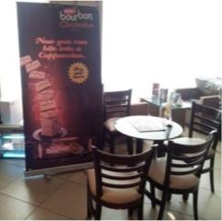
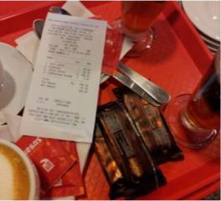
Britannia Cappuccino
Approach & activity:
Britannia had launched their new Bourbon – Cappuccino flavor and wanted to reach people to try out their new product. Dispensers were displayed across 250 cafes and billing POS were updated with one liner branding of Britannia. Highly impactful wall branding visual was displayed inside the café and with every order customers were served a Bourbon - Cappuccino.
Previous Successful Brand Associations

Slide 41
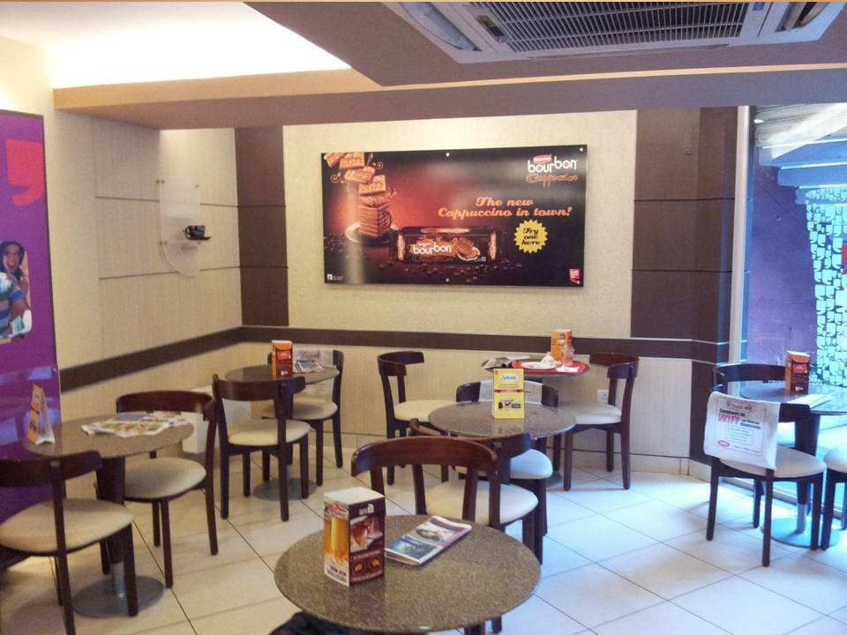

Slide 42
Previous Successful Brand Associations
Britannia Bourbon Cappuccino
Result so far:
The objective of the brand was to maximize its reach to the captive audience across cafes where the customer could taste the new Cappuccino Bourbon. Customers noticed the campaign as they got free sample pack of biscuits with every order they placed.

Slide 43
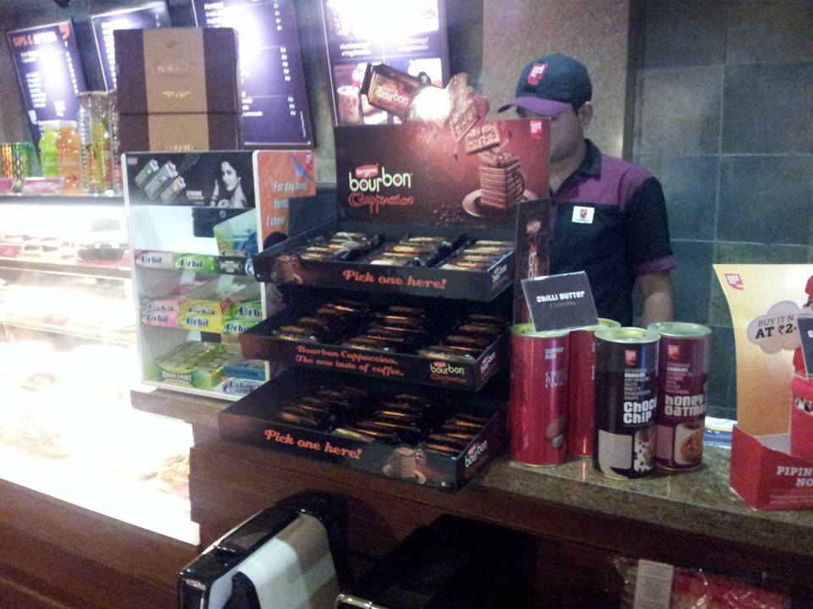

Slide 44






Other media partners…
Media Partner
Advertising Medium
Pan India presence
Teli Brahma
Café Chronicle
DSN screens
Radiowalla
Wi-Fi / Bluetooth downloads
Café Newspaper
Television screens
Café Radio
405
721
168
334

Slide 45

































Our Brand Campaign Partners

Slide 46
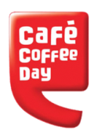
A lot more can happen over coffee…
Thank You..!!

