Slide 1
Smart Textile Waste Collection System -Dynamic Route Optimization With IoT

Slide 2
Abstract
The management of textile waste presents a significant challenge in today's society due to the increasing volume of discarded textiles and the environmental impact associated with improper disposal. To address this issue, we propose a Smart Textile Waste Collection System integrated with Dynamic Route Optimization using Internet of Things (IoT) technology. This system aims to optimize the collection and recycling process of textile waste by dynamically optimizing collection routes based on real-time data from IoT sensors. By leveraging IoT sensors installed in textile waste bins and collection vehicles, the system continuously monitors fill levels, traffic conditions, and other relevant factors to dynamically adjust collection routes in response to changing conditions. This approach not only improves the efficiency of waste collection operations but also reduces fuel consumption, emissions, and operational costs. Moreover, by promoting the proper disposal and recycling of textile waste, the system contributes to environmental sustainability and the circular economy.

Slide 3
Introduction
This project introduces a pioneering waste management system that harnesses the capabilities of the ESP32 microcontroller, aiming to revolutionize garbage disposal processes. By integrating multiple sensors and actuators with the ESP32, the system offers a comprehensive solution for monitoring and managing waste disposal in diverse settings. Key components include ultrasonic sensors for precise garbage level measurements, facilitating optimized waste collection scheduling. Additionally, a soil moisture sensor ensures efficient waste separation by assessing moisture conditions. The system's servo motor mechanism enables accurate waste separation, directing dry and wet waste into their respective bins with precision. Furthermore, an IR sensor serves as a trigger mechanism, initiating waste management processes upon detecting objects in the disposal area. Through its innovative design and automation features, this waste management system represents a significant step forward in promoting environmental sustainability and resource conservation.

Slide 4
Literature Survey
TITTLE: WASTE MANAGEMENT INITIATIVES IN INDIA FOR HUMAN WELL BEING
Authors: Dr. Raveesh Agarwal, Mona Chaudhary, Jayveer Singh
The objectives of writing this paper is to study the current practicesrelated to the various waste management initiatives taken in India for humanwellbeing. The other purpose is to provide some suggestions andrecommendations to improve the waste management practices in Indiantowns. This paper is based on secondary research. Existing reports related towaste management and recommendations ofplanners/NGOs/consultants/government accountability agencies/key industryexperts/ for improving the system are studied. It offers deep knowledgeabout the various waste management

Slide 5
Literature Survey
TITTLE: Improving the solid waste management
Authors: Veasna Kum, Alice Sharp, Napat Harnpornchai
Though the solid waste management (SWM) system in Phnom Penh city in general has been upgraded since the waste collection service was franchised out to the private sector, the performance of the existing SWM system is still low. Unreliable and irregular collection service still exists. This means that there are shortcomings in the existing SWM system that need correction. This paper is an attempt to identify those shortcomings in order to find ways to improve the existing system. First, the present SWM system is reviewed. Then the system is evaluated to find constraints and shortfalls and finally some appropriate strategies are proposed that may help make SWM in the city more effective and efficient to meet environmentally sound objectives.

Slide 6
Literature Survey
TITTLE : Improving municipal solid waste management in third world countries
Author: Cad R. Bartone and Janis D. Bernstein .
Cities are the main catalysts of economic growth in developing countries. Productive activities tend to concentrate in urban centers, where 60% of gross domestic product (GDP) is generated. In some of the largely urban countries, the urban share of GDP is projected to be as high as 80% by the year 2000. At the same time, however, there are substantial constraints to urban productivity, one of the most important of which are deficiencies in urban infrastructure and weak institutional frameworks for urban waste management. Because of its critical role in protecting the environment and improving productivity, accomplishing effective municipal solid waste management (MSWM) should be a priority for Third World cities.

Slide 7
Existing Method
The conventional waste management methods have several drawbacks that hinder their effectiveness in addressing the growing challenges of urban waste disposal. In the traditional approach, waste collection and separation are often carried out on a fixed schedule, regardless of the actual garbage levels, leading to inefficient resource allocation and increased operational costs. Additionally, these methods lack real-time monitoring, making it challenging to respond promptly to overflowing bins or environmental hazards. Moreover, the absence of any gas sensing mechanism can pose health risks to workers during waste processing. Overall, the conventional methods lack the adaptability, efficiency, and safety required to address modern waste management needs

Slide 8
Draw backs of the system
There is no monitoring is presented.
Time consuming and less effective
it purely depends upon only weight
high costs
bad smell spreads and may cause illness to human beings

Slide 9
Proposed Method
The proposed Smart Textile Waste Collection System with Dynamic Route Optimization utilizes IoT technology to optimize the collection process of textile waste. IoT sensors are installed in textile waste bins to monitor fill levels continuously. These sensors transmit real-time data to a central server or cloud-based platform, where it is processed and analyzed to determine the optimal collection routes.
Furthermore, the system integrates with GPS tracking and navigation systems installed in collection vehicles to provide real-time tracking and monitoring of vehicle locations, route progress, and adherence to optimized routes.
Through dynamic route optimization, the proposed system enhances the efficiency of textile waste collection operations, reduces fuel consumption and emissions, minimizes vehicle wear and tear, and improves overall resource utilization

Slide 10
Block Diagram
Power Supply
Web Server
Ultrasonic Sensor - 1
Microcontroller
GSM module
GPS module
1W red
LCD

Slide 11
Hardware Requirements
ESP-32
Ultrasonic sensor
GPS
GSM
Power Supply
I2c-lcd

Slide 12
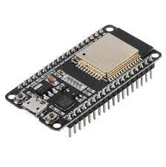
ESP-32
The ESP32 is a powerful and versatile microcontroller that has gained popularity for its wide range of features and capabilities. Developed by Espressif Systems, the ESP32 offers dual-core processing power, built-in Wi-Fi and Bluetooth connectivity, as well as a rich set of peripheral interfaces, making it suitable for a variety of IoT (Internet of Things) applications. Its low power consumption, high performance, and support for multiple communication protocols make it ideal for projects ranging from home automation and sensor networks to industrial automation and wearable devices.
.

Slide 13
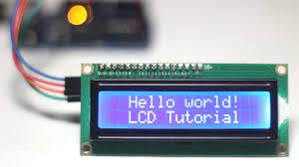
i2c-lcd
I2C, or Inter-Integrated Circuit, is a serial communication protocol commonly used to connect microcontrollers, sensors, and other integrated circuits within electronic devices. Developed by Philips Semiconductor (now NXP Semiconductors), I2C allows multiple devices to communicate with each other using only two wires: a data line (SDA) for transmitting data and a clock line (SCL) for synchronizing communication between devices. I2C supports multi-master and multi-slave configurations, enabling complex communication networks with various devices sharing the same bus. It is widely used due to its simplicity, flexibility, and efficiency in connecting peripherals over short distances, making it suitable for applications in embedded systems, consumer electronics, and industrial automation.

Slide 14
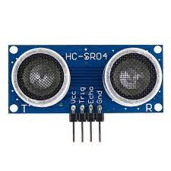
Ultrasonic sensor
Ultrasonic sensors are devices that use sound waves with frequencies higher than the human audible range to measure distance or detect objects. They work on the principle of sending out a sound pulse and measuring the time it takes for the pulse to bounce back after hitting an object. This time measurement is then used to calculate the distance to the object. Ultrasonic sensors are commonly used in applications such as robotics, industrial automation, automotive parking assistance systems, and even in medical devices like ultrasound imaging machines. They are valued for their accuracy, reliability, and ability to work in various environmental conditions, making them versatile tools in many fields of technology.

Slide 15
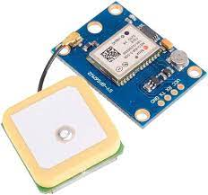
GPS
GPS, or Global Positioning System, is a satellite-based navigation system that provides location and time information anywhere on Earth where there is an unobstructed line of sight to four or more GPS satellites. Developed and maintained by the United States government, GPS works by using a network of orbiting satellites to transmit precise timing signals. GPS receivers use these signals to calculate their precise location, speed, and elevation. GPS technology has become an integral part of various applications, including navigation for vehicles, aircraft, ships, and outdoor activities like hiking and geocaching. It is also used in precision agriculture, surveying, disaster management, and location-based services on smartphones and other devices. Overall, GPS has revolutionized navigation and positioning, enabling accurate and reliable location information worldwide.

Slide 16
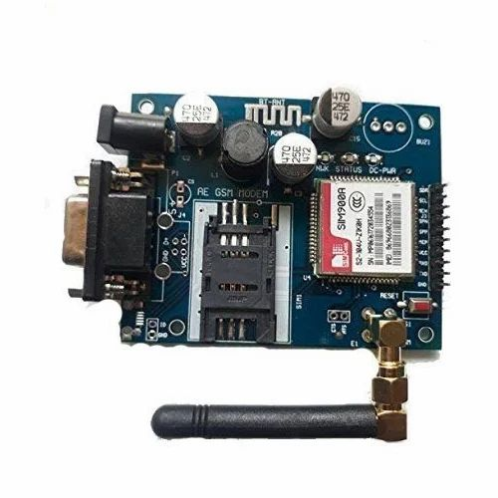
GSM
GSM is a mobile communication modem; it is stands for global system for mobile communication (GSM). The idea of GSM was developed at Bell Laboratories in 1970. It is widely used mobile communication system in the world. GSM is an open and digital cellular technology used for transmitting mobile voice and data services operates at the 850MHz, 900MHz, 1800MHz and 1900MHz frequency bands.

Slide 17
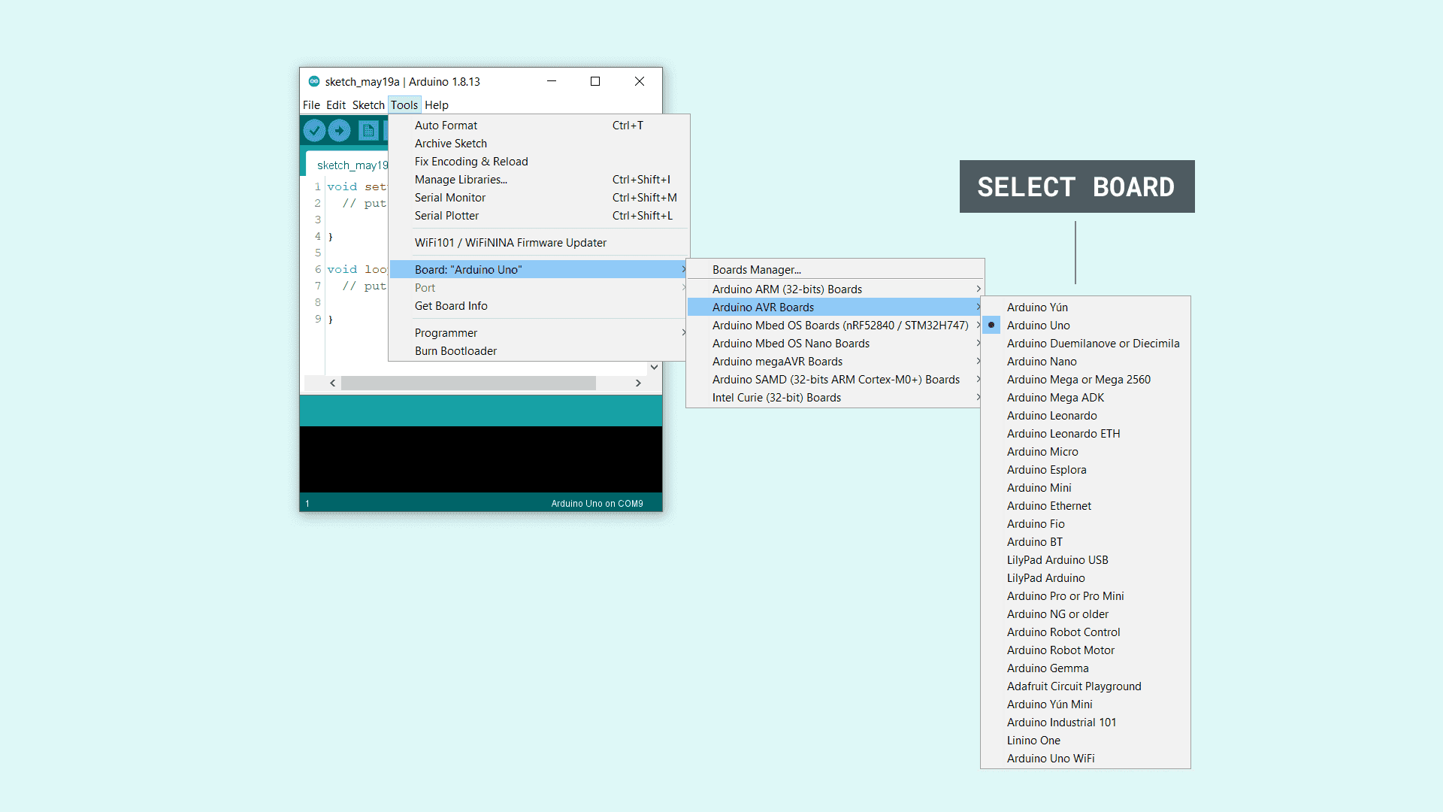
Arduino IDE
The Arduino Integrated Development Environment (IDE) is an open-source software platform used for programming Arduino microcontrollers. It provides a user-friendly interface and a simplified programming environment, making it easy for beginners and experienced users to write, compile, and upload code to Arduino boards.

Slide 18
Advantages
Reduces human effort.
Saves time and fuel consumption

Slide 19
Application
Garbage bins
Urban waste management systems
Commercial waste disposal in offices or shopping malls
Residential waste segregation in communities or apartments
Industrial waste management in manufacturing facilities
Waste disposal systems in educational institutions
Managing waste at public events and gatherings

Slide 20
Conclusion
In conclusion, the presented waste management system offers a comprehensive solution for efficiently handling and monitoring garbage disposal. By integrating multiple sensors and actuators with the ESP32 microcontroller, the system enables precise measurement of garbage levels, optimization of waste separation based on moisture conditions, and automated waste management processes triggered by object detection. This approach promises to enhance waste management efficiency, promote environmental sustainability, and contribute to cleaner and healthier living environments. Overall, the system represents a significant advancement in waste management technology with versatile applications across various sectors, from urban areas to industrial facilities and educational institutions.

Slide 21
References…
[1] Prof. R.M.Sahu, Akshay Godase, Pramod Shinde, Reshma Shinde, “Garbage and Street Light Monitoring System Using Internet of Things” INTERNATIONAL JOURNAL OF INNOVATIVE RESEARCH IN ELECTRICAL, ELECTRONICS, INSTRUMENTATION AND CONTROL ENGINEERING, ISSN (Online) 2321 – 2004, Vol. 4, Issue 4, April 2016.
[2] Kanchan Mahajan, Prof.J.S.Chitode, “Waste Bin Monitoring System Using Integrated Technologies”, International Journal of Innovative Research in Science, Engineering and Technology (An ISO 3297: 2007 Certified Organization) Vol. 3, Issue 7, July 2014.
[3] Md. Shafiqul Islam, M.A. Hannan, Maher Arebey , Hasan Basri , “An Overview For Solid Waste Bin Monitoring System”, Journal of Applied Sciences Research, ISSN 181-544X, vol.5,lssue4, February 2012.
[4] Twinkle sinha, k.mugesh Kumar, p.saisharan, “SMART DUSTBIN”, International Journal of Industrial Electronics and Electrical Engineering, ISSN: 2347-6982 Volume-3, Issue-5, May2015.
[5] Richu Sam Alex, R Narciss Starbell, “Energy Efficient Intelligent Street Lighting System Using ZIGBEE and Sensors”, International Journal of Engineering and Advanced Technology (IJEAT) ISSN: 2249 – 8958, Volume-3, Issue-4, April 2014.

