Slide 1

Rolle's Theorem and Lagrange Mean Value Theorem
Aditya Maharjan
Saimon Ghimire
Lisah Manandhar
Ujjwal Bista

Slide 2
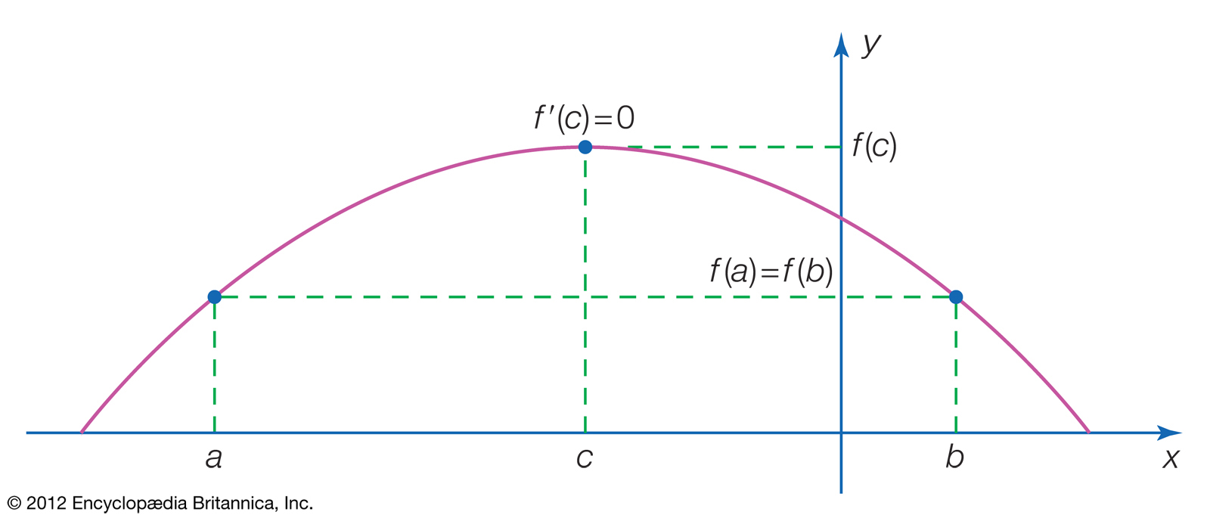
ROLLE’S THEOREM
Introduction
Rolle’s theorem states that if a function f(x) is continuous in the closed interval [a, b] and differentiable in the open interval (a, b) such that f(a) = f(b), then f′(c) = 0 for some c with a ≤ c ≤ b.
In other words, if a continuous curve passes through the same y-value (such as the x-axis) twice and has a unique tangent line (derivative) at every point of the interval, then somewhere between the endpoints it has a tangent parallel to the x-axis.

Slide 3
Rolle’s theorem proof
Let's actually prove the theorem itself. Rolle's Theorem says that if a function f(x) satisfies all three conditions, then there must be a number c such at a < c < b and f'(c) = 0. We can show that this is always true if we prove that it is true for each of these cases:
A function with only a constant at [a,b]
A function with a maximum at [a,b]
A function with a minimum at [a,b]

Slide 4
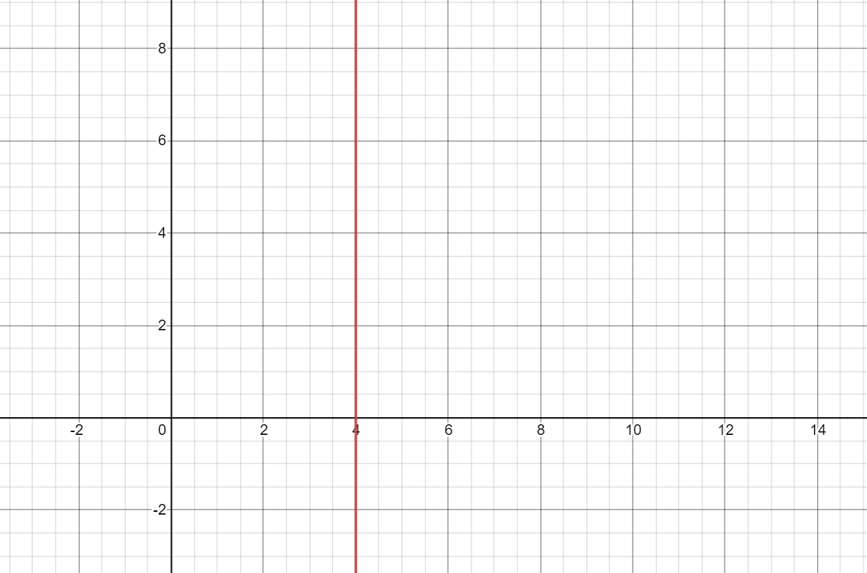
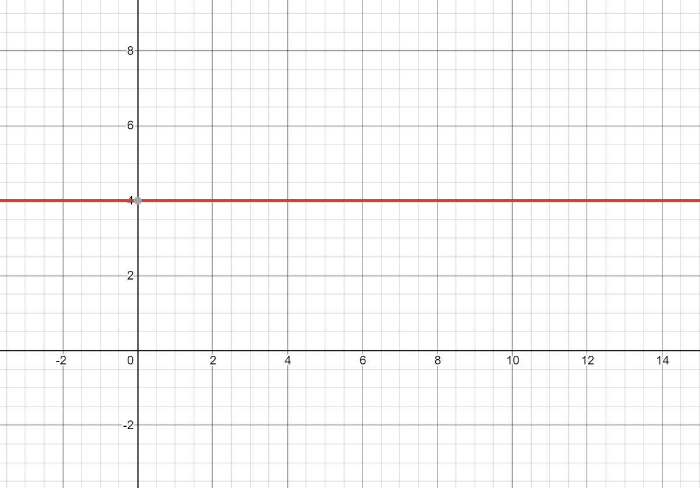
A Function with Only a Constant
Consider the function f(x) = k within the interval [a,b], where k is a constant. Differentiating the function, it gives:
f'(x)=0
Here, the derivative is always 0 since f'(x) = 0 for all x, then we can pick any number within the interval [a,b] as c. Thus, we found a number c such that a < c < b and f'(c) = 0.

Slide 5
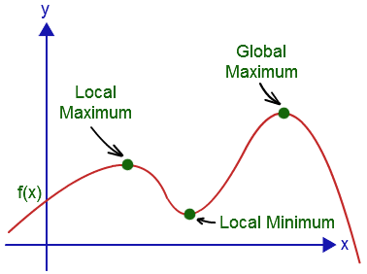
A Function with a Maximum
Consider some number k in the interval [a,b] such that
f (k) > (f(a) = f(b). If f(x) is continuous, then that means there exists
a maximum at point c. Since we know f(x) is differentiable (from the 2nd
condition), then we know that f'(x) exists. Since f'(x) exists and there is
a maximum within the interval [a,b], then we know that f'(c) = 0 within
[a,b]. Hence, there exists a number c such that a< c < b and f'(c) = 0.
A Function with a Minimum
Consider some number k in the interval [a,b] such that f (k) < f(a) = f(b). If f(x) is continuous, then that means
there exists a minimum at point c. Since we know f(x) is differentiable, f'(x) exists. Since f'(x) exists and there is
a minimum within the interval [a,b], then we know that f'(c) = 0 within
[a,b]. In other words, there exists a number c such that a < c < b and f'(c) = 0.
Since all cases are true, then Rolle's Theorem is proved. Now let's look at some examples of Rolle's Theorem.

Slide 6
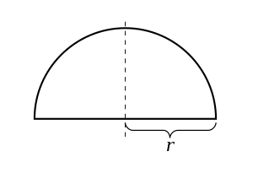

EXAMPLES OF ROLLE’S THEOREM
FIRST EXAMPLE.
Consider a function
f(x)$=\sqrt{r^{2}−x^{2} , }x∈\left[−r,r\right]$
Here, r is the radius of the formed semi-circle with center at the origin. Clearly, this function is continuous in the closed interval [−r, r] and differentiable in the open interval (−r, r). However, it is not differentiable at the endpoints −r and r. But since f (−r) = f (r), Rolle's theorem applies and there is a point where the derivative of f is zero. The theorem applies even when the function cannot be differentiated at the endpoints because it only requires the function to be differentiable in the open interval.

Slide 7
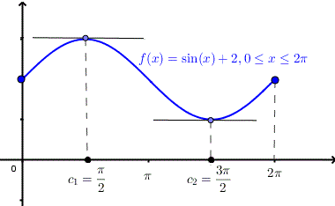
EXAMPLE 2:
The graph of f(x) = sin (x) + 2 for 0 ≤ x ≤ 2π is shown
alongside.
Here, clearly the function exists for all x in [0, 2π].
So f is continuous in the interval [0,2π]
And, the function is differentiable in the closed interval (0, 2π), since f’(x)=cos (x).
Finally, f(0) = f(2π) = 2
Hence, according to Rolle’s theorem, there exists at least one point x=c such that f’(c) = 0
f’(c) = 0
cos(c) = 0
The above equation has two solutions in the interval [0,2π]
c1= π/r and c2 =3π/2
At points c1 and c2, the tangents are parallel to x-axis (i.e, slope is zero) as shown in the figure.

Slide 8
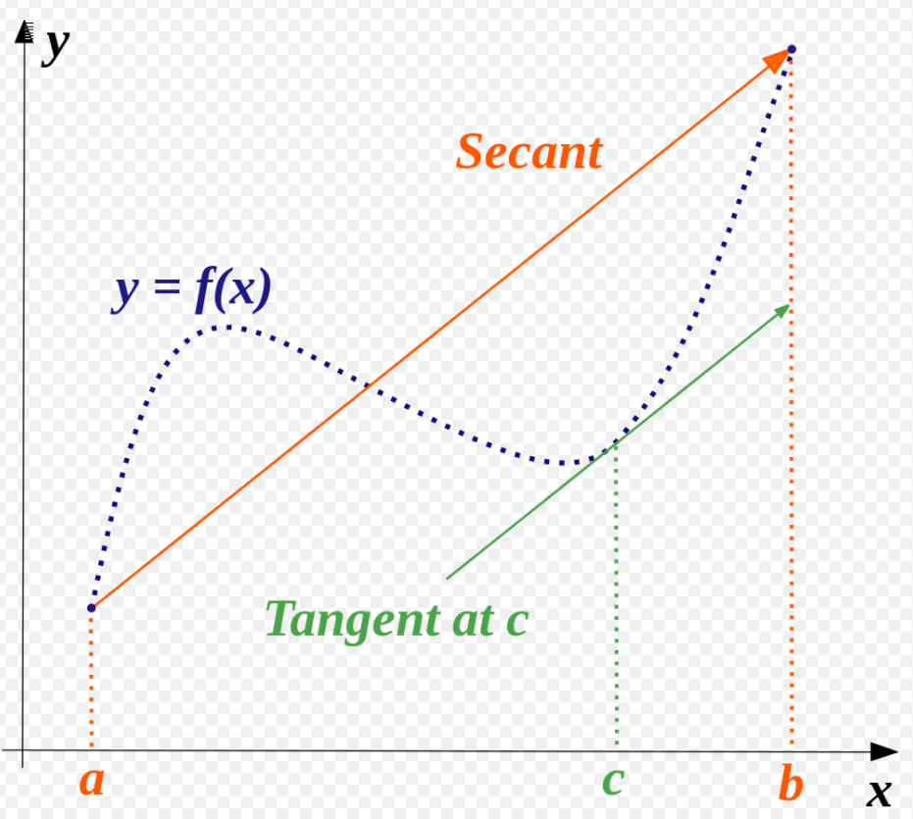

LAGRANGE MEAN VALUE THEOREM
The mean value theorem states that the slope
of a line connecting any two points of a curve is the
same as the slope of the tangent to the curve at some
Point between the two points. In symbols, if the
function f(x) represents the curve, a and b the two
endpoints, and c is point in between, then
$f^{′}\left(c\right)=\frac{f\left(b\right)−f\left(a\right)}{b−a}$ in which f’(c) represents the slope of
the tangent line at c, given by it’s derivative.
Conditions to be satisfied:
f(x) is continuous in the interval [a,b]
f(x) is differentiable in the interval (a,b)
If the curve satisfies the condition, there exists at least one point ‘c’ such that $f^{′}\left(c\right)=\frac{f\left(b\right)−f\left(a\right)}{b−a}$
The conditions are same as that of Rolle’s theorem except here the value of f(a) and f(b) need
not be equal. In fact, Rolle’s theorem is a special case of Mean Value Theorem.

Slide 9
History:
A special case of this theorem was first described by Parameshvara (1370–1460), from the Kerela School of Astronomy and Mathematics in India, in his commentaries on Govindaswami and Bhaskara II.^{[1]} A restricted form of the theorem was proved by Michel Rolle in 1691; the result was what is now known as Rolle's theorem, and was proved only for polynomials, without the techniques of calculus. The mean value theorem in its modern form was stated and proved by Augustin Louis Cauchy in 1823.^{[2]} Many variations of this theorem have been proved since then.

Slide 10
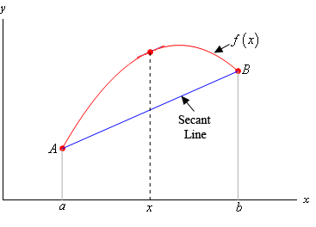

PROOF OF MEAN VALUE THEOREM
Let f(x) be a curve between the points (a,b). Let g(x) be the function representing the secant joining f(a) and f(b).
For g(x):
$g\left(x\right)−f\left(a\right)=\frac{f\left(b\right)−f\left(a\right)}{b−a}\left(x−a\right)$
Now, let h(x) = f(x) – g(x)
So, h(x) = f(x) - $\left[ \frac{f\left(b\right)−f\left(a\right)}{b−a}\left(x−a\right)+f\left(a\right) \right]$
Which is a continuous function
Then, calculating it’s derivative,
h’(x) = f’(x) - $\frac{f\left(b\right)−f\left(a\right)}{b−a}$
this proves that h(x) is differentiable in (a,b).
Clearly at points f(a) and f(b), the value of h(x) is zero. Hence h(x) satisfies all conditions of Rolle’s theorem.

Slide 11

Hence, we can say there exists a point c such that h’(c) = 0
So,
h’(c) = f’(c) - $\frac{f\left(b\right)−f\left(a\right)}{b−a}$
0 = f’(c) - $\frac{f\left(b\right)−f\left(a\right)}{b−a}$
Therefore, f’(c) = $\frac{f\left(b\right)−f\left(a\right)}{b−a}$
Hence, the theorem is proved

Slide 12
Corollaries of Mean Value Theorem
Corollary 1: If f'(x) = 0 at each point of x of an open interval (a, b), then f(x) = C for all x in (a, b) where C is a constant.
Corollary 2: If f'(x) = g'(x) at each point x in an open interval (a, b), then there exists a constant C such that f(x) = g(x) + C.
The first corollary confirms that if the derivative of a function is zero then the function is a constant function. The second corollary says that the graphs of functions with identical derivatives differ only by a vertical shift. This property is used in solving initial value problems in integral calculus.

Slide 13
M.V.T AND NATURE OF FUNCTION
Mean value theorem is the relationship between the derivative of a function and increasing or decreasing nature of function. It basically defines the derivative of a differential and continuous function. Below are few important results used in mean value theorem.
1. Let the function be f such that it is, continuous in interval [a,b] and differentiable on interval (a,b), then
f'(x) = 0, x ∈ (a,b), then f(x) is constant in [a,b].
2. Strictly Increasing Function
Let the function be f such that, continuous in interval [a, b] and differentiable in interval (a,b)
f'(x) > 0, x ∈ (a,b), then f(x) is strictly increasing function in [a,b]
3. Strictly Decreasing Function
Let the function be f such that, continuous in interval [a,b] and differentiable in interval (a, b)
f'(x) < 0, x ∈ (a,b), then f(x) is strictly decreasing function in [a,b].

Slide 15
Application of Rolle’s theorem and Mean Value Theorem
Rolle’s Theorem and Mean Value Theorem are important theorems in the field of differential and integral calculus and calculus, without doubt can be applied in practical life as well. Some of it’s applications are: 1) Rolle’s theorem helps a lot in finding the maximum height of the projectile trajectory. 2) Rolle’s theorem also applies in the construction of domes that amplify the strength of sound and light.
3) The Mean Value Theorem is the basis for several other important theorems in . mathematics (e.g Taylor’s theorem, Broyden’s method etc)
4) Mean Value Theorem is also an important theorem in the field of real analysis. It . . can be used to practically analyze various kinds of data as well.

Slide 16
THANK YOU

