Slide 1
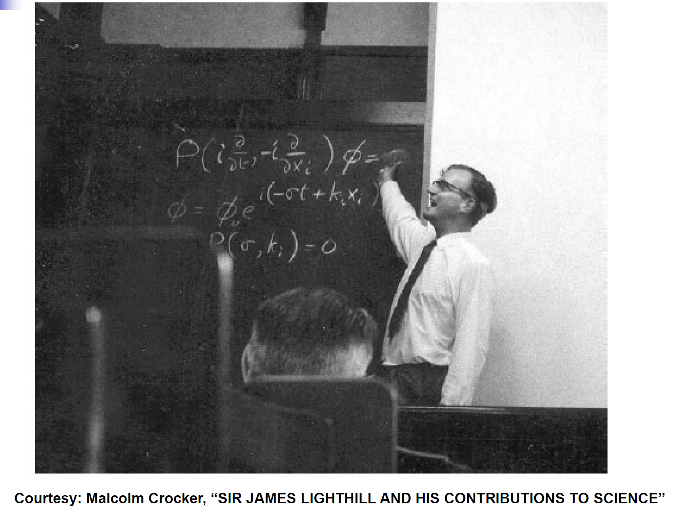
Sir. James Lighthill (1924-98)

