Slide 1
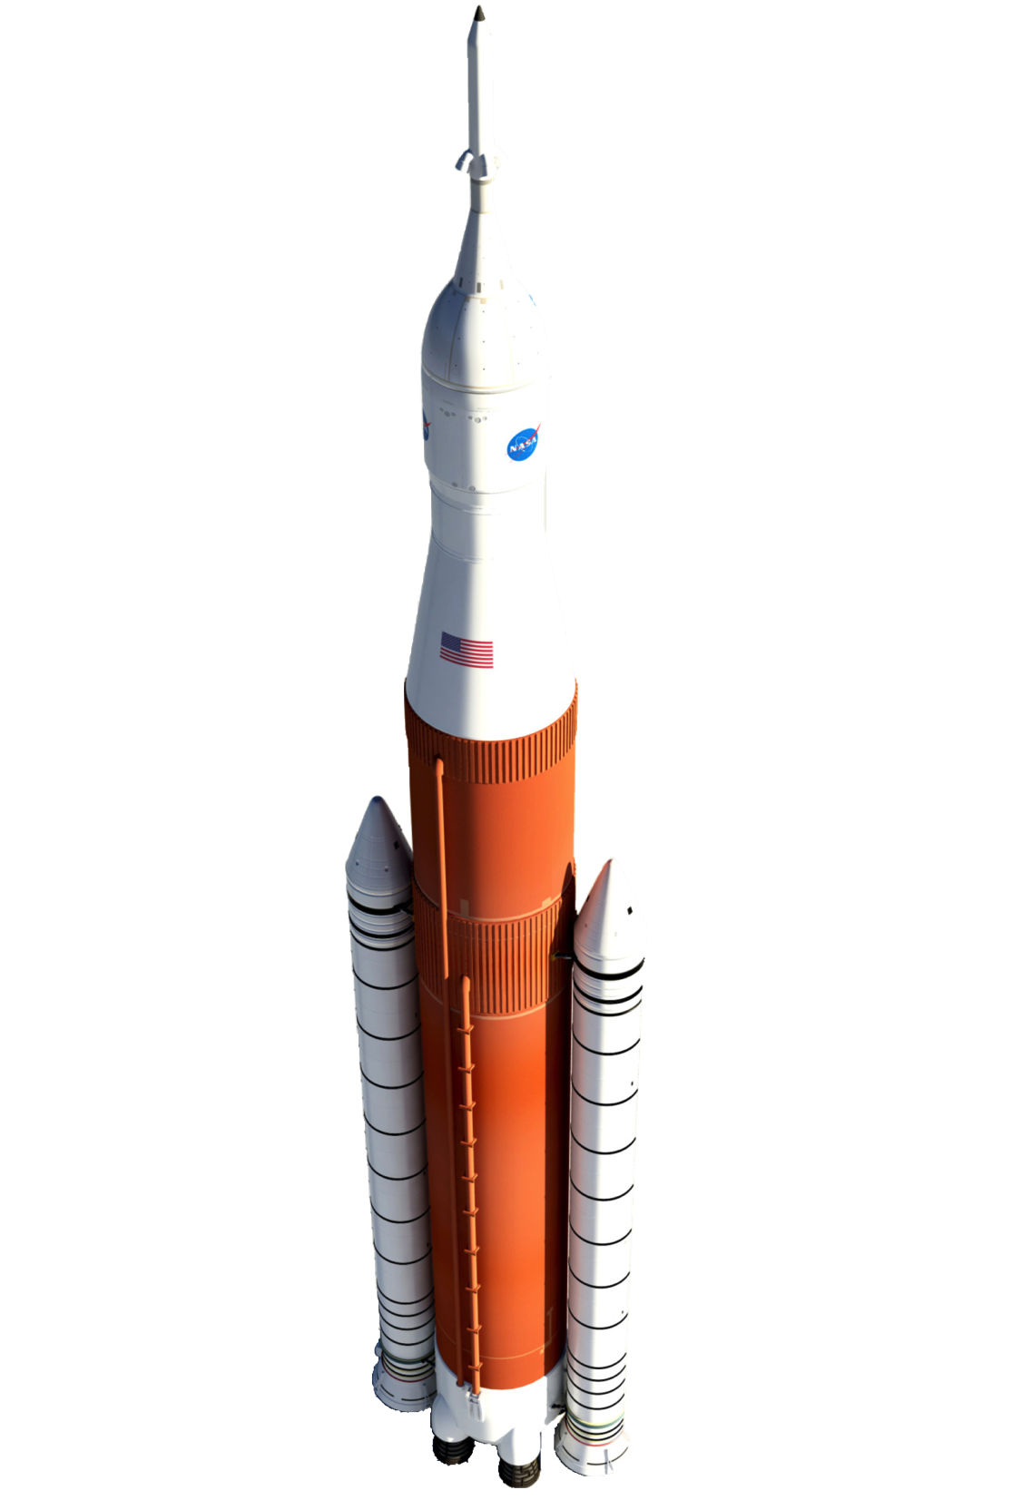
Review of Aeroacoustic Prediction Techniques for Launch Vehicles
Logan Halstrom
12/1/16

Slide 2
Motivation
Launch vehicles experience severe acoustic environments
Launch: engine plumes reflected by pad
Ascent: Transonic flight, unsteady shocks, engine plume noise
Abort: Direct abort motor plumb impingement/flow interaction
Potential hazards due to structural vibration
Failure of electrical or mechanical component
Fatigue failure of internal or exterior structural component
Fatigue of payload
Goal: design to minimize acoustics
Need methods of modeling aeroacoustics

Slide 3
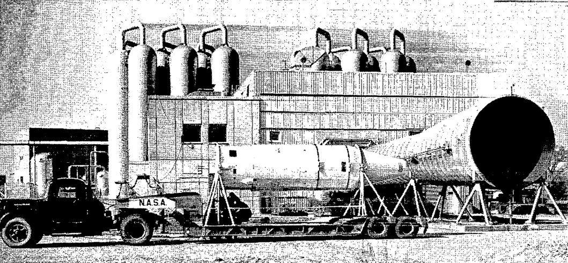
Free-Field Acoustic Testing
Subject test article to unconstrained acoustic source
Need acoustic source similar to flight
Blowdown wind tunnel exhaust
Rocket engine static test

