Slide 1

Parking System Scale Model
PCF8574 LCD / Effector
HC-SR04 Distance Sensor

Slide 2

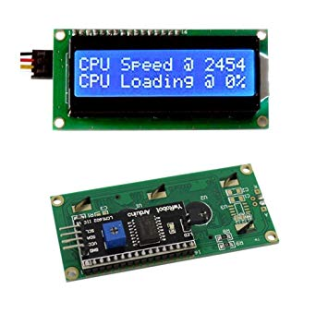
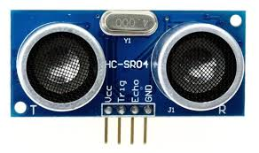
Proposal
HC-SR04 ultrasonic sensor will measure the distance of the car and the readings will be shown on the PCF8574 LCD.
However, for the next semester LCD will be connected with the infrared sensor to display the availability of the parking lots on the screen.

Slide 3
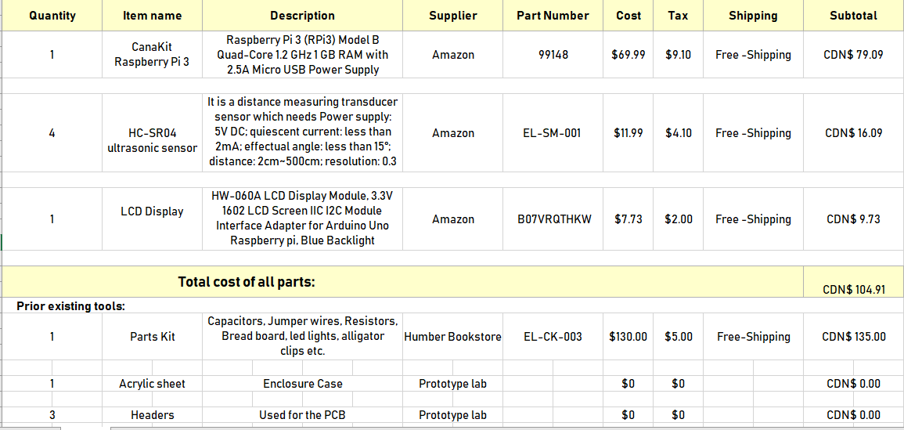
Budget
Total CDN$ 104.91

Slide 4
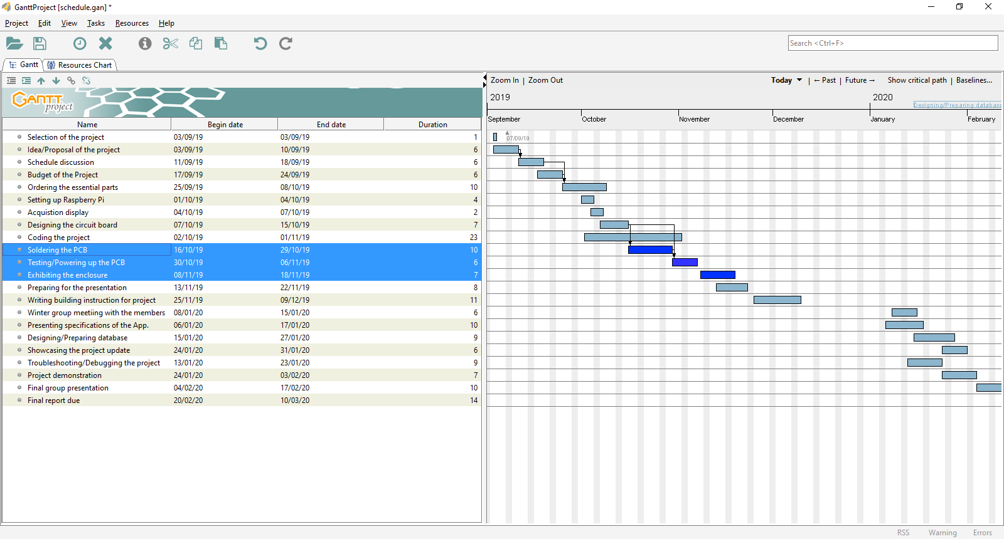
Schedule
Delayed task were: PCB connection problems, testing PCB.

Slide 5
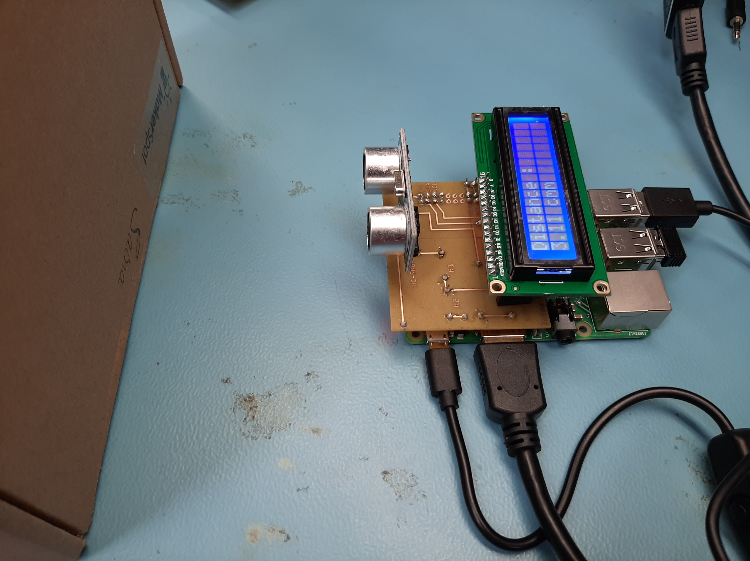
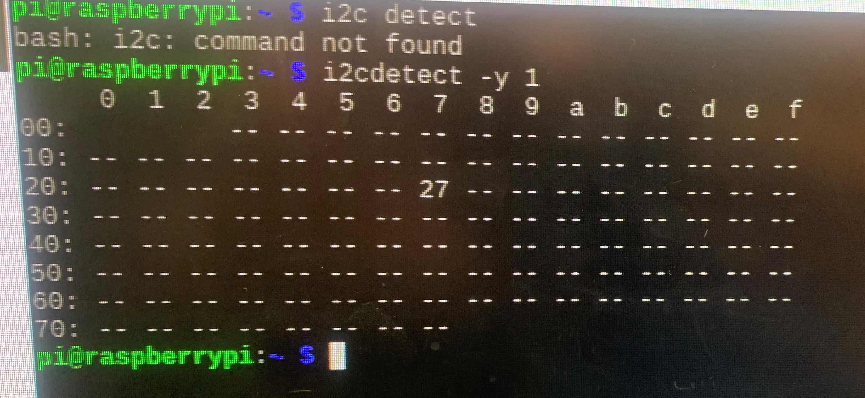
Distance displayed on the LCD
I2C Interface

Slide 6
Knowledge from previous courses
Electric Circuits – Understanding the breadboard and the connections.
Technical C – Understanding the Raspberry pi.
Embedded Systems – More usage and functionalities of the Raspberry pi and its environment.
Software Engineering – Developing the Gantt chart, working on schedule and usage in the software development platform.
Unix Scripting- Commands used on the terminal to navigate through the code written.

Slide 7
Thank you!
- Saina Kapoor

