Slide 1
Network Flow and Circulation with Demands Problem
Presented By:
Sainadh Chilukamari & Venkata Samudrala

Slide 2
Overview
Create adjacency list from input graph file Lists.
Implement Breadth First Search & Shortest path.
Determine maximum flow of a graph using Ford-Fulkerson algorithm.
Verify circulation of a graph.
Test using Random graph generator, with multiple graphs
Discuss test results.

Slide 3
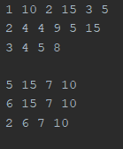
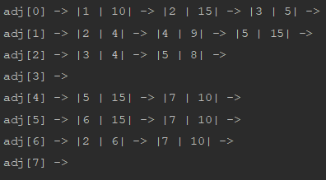
Creating Graph from data file
An array of Linked Lists is used to create an adjacency list.
Data file consists of edge to which node and their corresponding weights for all nodes.
For each line in the data file, edge is created to i^{th} value with (i+1)^{th} value as weight between the nodes.

Slide 4
Breadth First Search
BFS is a traversing algorithm which starts traversing from a selected node and traverse the graph, exploring the neighbor nodes.
Continue the same until all nodes are traversed.
Assign parent for each node traversed to detect which path reached the destination.
Used a visited flag for each node to avoid traversing the same node again, thus finding the order of nodes in which traversal is done.
Time Complexity for this algorithm is O(E+V).

Slide 5
BFS Implementation
BFS (G) //Where G is the graph - adjacency list
let Q be queue.
let visited be boolean array //To avoid processing more than once
let parent be integer array //To store parent of particular vertex
Q.add( source ) //Inserting source in queue
//mark source as visited.
while ( Q is not empty)
//Removing that vertex from Q, whose neighbours will be visited now
v = Q.poll( )
for all neighbours w of v in Graph G //processing all the neighbours of v
if w is not visited
Q.add( w ) //Stores w in Q to further visit its neighbour
mark w as visited. //Put true in visited
store v as w’s parent.
return (visited[sink])

Slide 6
1
9
4
10
4
15
10
15
0
15
2
8
5
10
7
5
6
15
10
4
3
6
BFS Traversal:
0
1
2
3
4
5
7
6

Slide 7
Edmonds–Karp algorithm
Edmonds–Karp algorithm computes the maximum flow in a flow network.
Maximum flow - maximum amount of flow from source to sink.
The original graph is stored as a residual graph.
A residual graph indicates how much more flow is allowed in each edge in the network graph.
The residual graph is obtained by augmenting paths from source to sink.
If there are no augmenting paths possible from source to sink, then the flow is maximum.
Time Complexity - O(V(E*2))

Slide 8
Edmonds–Karp Implementation
FordFulkerson(Graph G): //Where G is the original graph
residualGraph = G //store original graph as residual graph
maxFlow = 0 //initialize maxFlow to zero
while (BFS(residualGraph)): //check for augmenting path from S to T
maxFlow += pathFlow //store minimum capacity path flow
Update residual network graph
return maxFlow

Slide 9
Updating Residual graph
Updating residual graph includes following steps:
For every edge in the augmenting path, a value of minimum capacity in the path is subtracted from all the edges of that path.
An edge of equal amount is added to edges in reverse direction for every successive nodes in the augmenting path.

Slide 10
9
1
9
4
10
9
9
1
10
4
15
10
1
14
15
1
8
1
9
0
15
2
8
5
10
7
7
1
9
5
6
15
10
4
3
6
Max Flow =
9 +
1 +
8 = 18

Slide 11
Circulation Problem
For this Max-flow problem is considered again, but this time there will be no source and sink.
Each vertex has a demand or supply, i.e., the flow a vertex can take or give respectively.
Demand if d(v) > 0
Supply if d(v) < 0
A common source and a common sink are added to the graph where all supplies are connected to the source and all demands to sink.
Supplies and demands are assigned to respective edges from source and to sink.

Slide 12
Circulation Problem Implementation
Add source & sink
Add edges (S, v) for all supply vertices (d(v)<0) with edge capacity |-d(v)|
Add edges (v, T) for demand vertices (d(v)>0)) with capacity d(v)
Find Max flow with Ford-Fulkerson algorithm
Circulation problem is only possible when:
The sum of demands is equal to the sum of supply in a graph.
It is feasible if and only if it is equal the max-flow value f.
If any of the above condition fails, then there is no circulation in the graph.

Slide 13
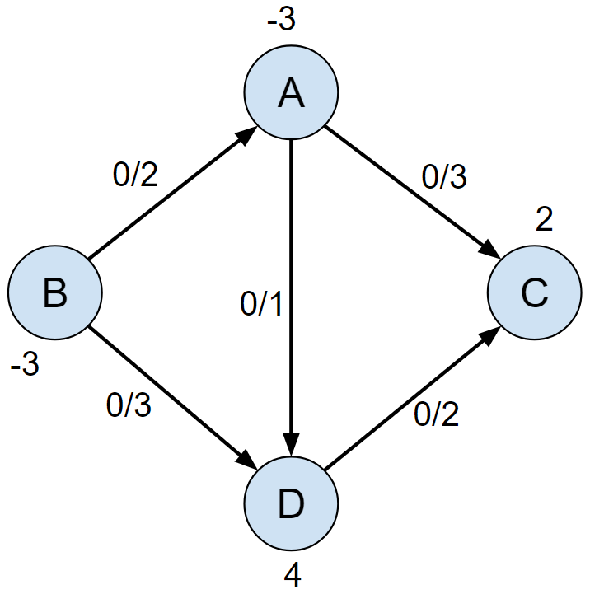
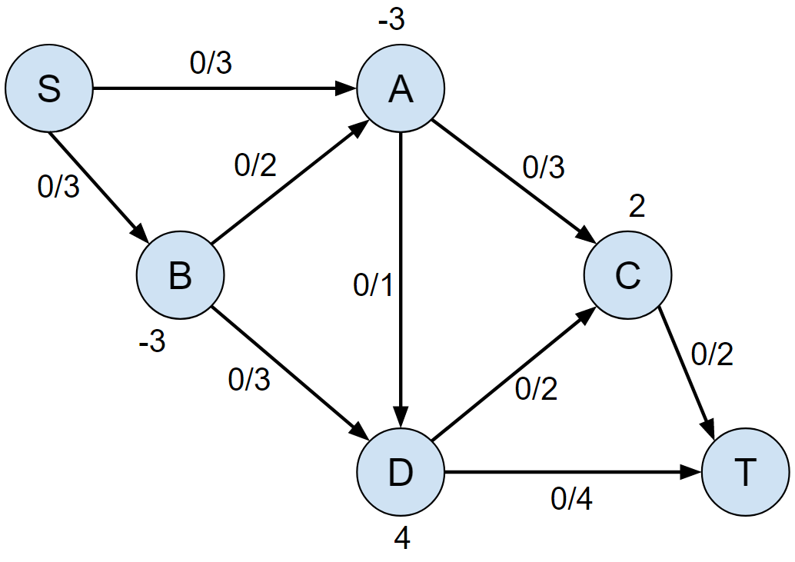
Example

Slide 14
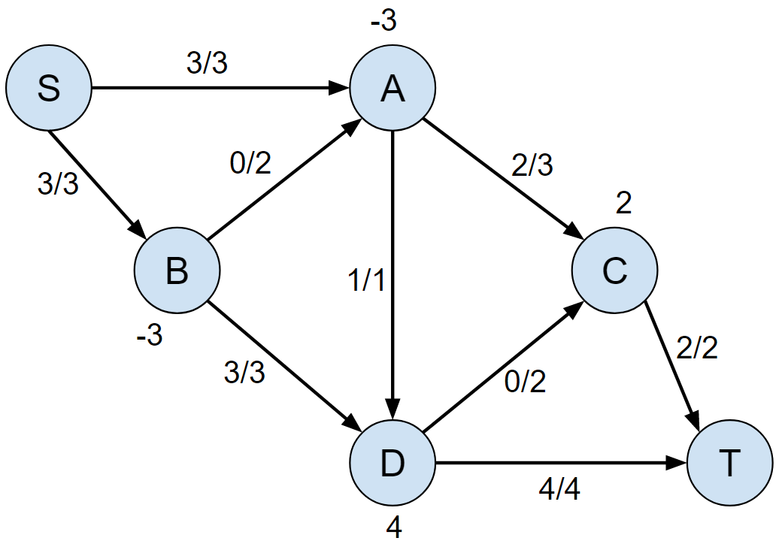
Apply Ford Fulkerson
Graph has circulation
Sum of supplies = 6
Sum of Demands = 6
Max Flow = 6

Slide 15
Experimental Run Results
1000 test cases are considered for BFS and FFA.
Graphs with 10, 100, 1000, 5000, 10000 and 20000 vertices are generated (0.6*maxEdges).
Run time is measured for each graph file.
Nodes | Edges | BFS Time(ms) | FFA Time(s)
10 | 23 | 1.52 | 0.013
100 | 2859 | 8.12 | 0.74
1000 | 267447 | 58.4 | 30.39
5000 | 5527030 | 270.3 | 782
10000 | 22115957 | 653.9 | 4720
20000 | 64204450 | 3501.2 | 16727

Slide 16
Test Cases & Discussion
BFS and FFA are run on randomly generated graphs.
Graphs with 5 to 1000 vertices respectively (0.6*maxEdges).
Run time is measured for each graph file.
Plotted time complexities with run times.

Slide 17
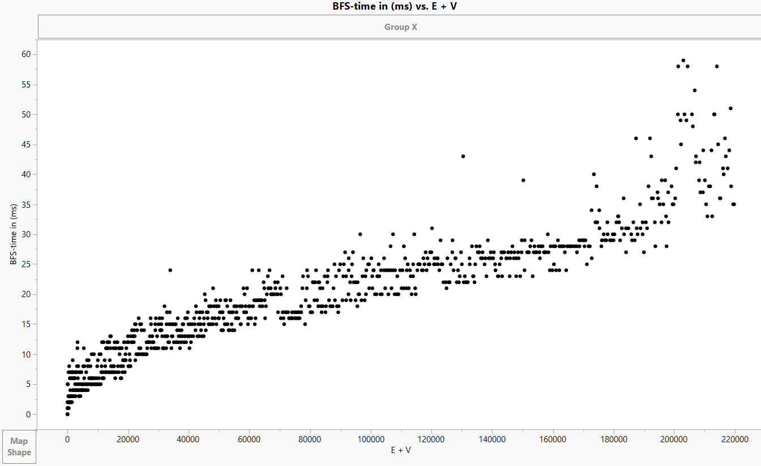
Results & Discussion
BFS graph – (Run time in milli-seconds vs E+V)

Slide 18
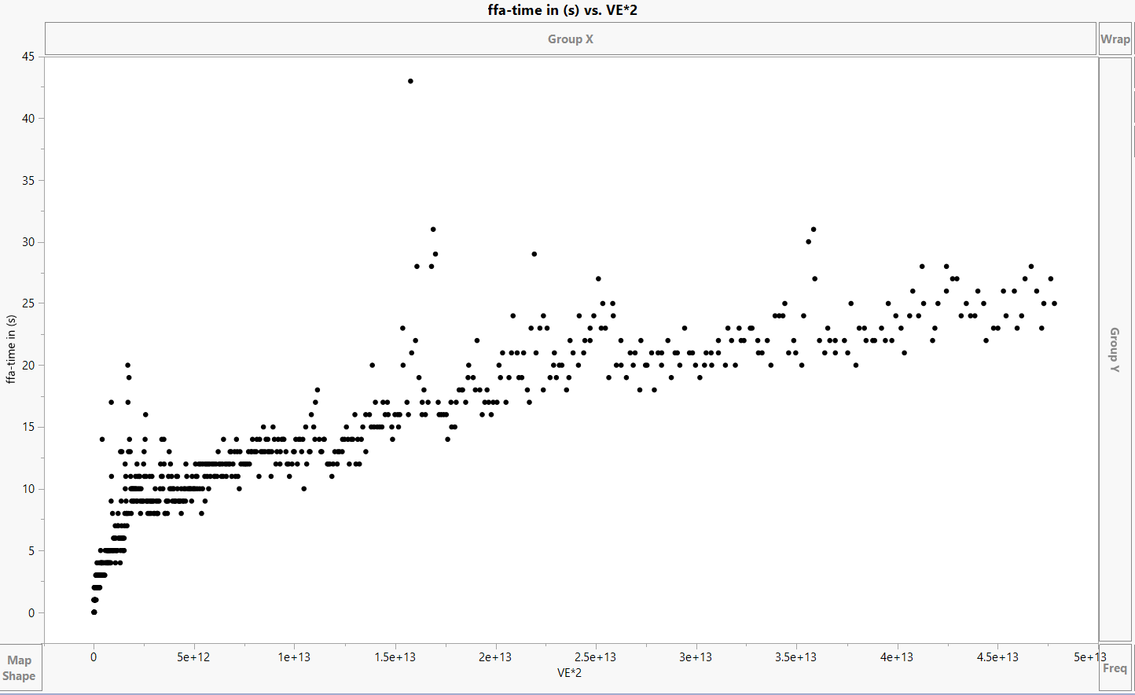
Results & Discussion
FFA graph – (Run time in seconds vs V(E^2))

Slide 19
Demo

Slide 20
Questions?

