Slide 1
NOTE/ 2 COMIC
let your notes tell a story!

Slide 2
INTRODUCTION
Notes 2 Comic is an AI-based website designed to make learning easier, faster, & more engaging.
It not only converts lengthy notes into simple comic-style stories but also creates quizzes based on the content.
Students can read, revise, & test themselves in one place.
The platform supports visual learning nd helps students track their performance over time.

Slide 3

PROBLEM
Notes 2 Comic was developed to directly tackle the frustrations students face with traditional study methods.
Difficulty understanding lengthy, dense notes.
Struggling to retain information from passive reading.
Lack of engaging and interactive study material.

Slide 4
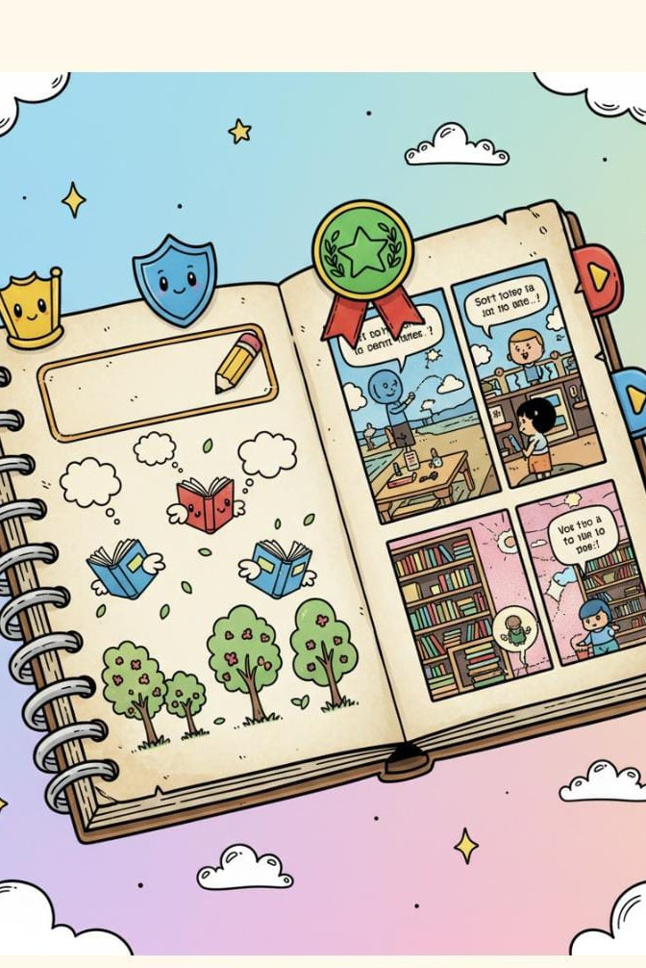



How Notes 2 Comic Works
Our platform streamlines the learning process through three intuitive steps:
Upload & AI Processing
Students upload notes (images, docs, PDFs). Our AI reads and extracts key concepts.
Comic Creation
AI converts extracted concepts into engaging, comic-style stories.
Quiz & Track Progress
AI generates quizzes, and students attempt them to check understanding. Performance, comics, and assessments are saved.

Slide 5






ROLE OF AI IN NOTE/ 2 COMIC
Notes 2 Comic harnesses advanced AI to deliver personalized and effective learning experiences.
Content /implification
AI simplifies lengthy notes into short, meaningful explanations.
Visual /torytelling
Creates visual comics to represent complex concepts.
Automated Quizzing
Generates quizzes and questions from extracted information.
Performance Tracking
Tracks user performance and updates progress in their profile.

Slide 6
BENEFIT/
Engaging & /tress-Free
/tudy
Makes studying more fun and less stressful through interactive comics.
Enhanced Memory Retention
Comic-style visuals significantly improve long-term memory.
Instant /elf- Assessment
Quizzes help students test their understanding instantly.
Trackable Progress Monitors learning journey through saved assessments and activity.
Efficient Revision
Great for last-minute revision and clarifying tough concepts.

Slide 7
PROTOTYPE

Slide 8


RESULT OF IT
Notes 2 Comic successfully addresses study challenges such as difficulty understanding lengthy notes
Lack of engaging study material
No easy way to self-test after studying
This platform makes concepts visual, provides quizzes automatically, and stores all progress in one place.
Students understand faster, remember better, and can measure their improvements easily.

Slide 9


CONCLU/ION!
NOTes 2 COMIC TRANsFORMs TRAdITIONAL sTUdYING INTO A FUN, VIsUAL, ANd INTeRACTIVe eXpeRIeNCe.
BY COMbINING COMICs, qUIZZes, ANd pROGRess TRACKING, IT sUppORTs COMpLeTe LeARNING IN ONe pLATFORM.
THIs pROJeCT pROVes THAT AI CAN MAKe edUCATION eAsIeR, sMARTeR, ANd MORe
peRsONALIZed FOR eVeRY sTUdeNT.

Slide 10
Meet Our Team
The minds behind Notes 2 Comic
D. Meghana
K. Sai Nandana
L. Jaya Shree
T. Preethi Ann
Thank you!

