Slide 1
RL-MOTS-XAI v2
Explainable Reinforcement Learning for Energy-Efficient Cloud Resource Scheduling
Dueling Double-DQN + Safety Action Mask · 4 XAI Methods · 6 Audited Trust Metrics
Trained on real Google Borg traces (328 MB · 405k events) and validated on KTH SP2 HPC traces
100% pure NumPy — every backprop step, Shapley value and trust metric hand-built
Implementation Review — Integrated Cloud Computing

Slide 2
Implementation Flow — Six-Phase Pipeline
Every phase is a standalone module; the whole pipeline reproduces with one command
1 · Data Ingestion (borg_loader.py / swf_loader.py)
2 · Environment (env.py)
3 · Decision Engine (qnetwork.py / dqn_agent.py)
Parse 328 MB Google Borg CSV (405k events) + KTH SP2 SWF log; filter completed jobs; cache 5,000-task pools (.npz) for <0.1 s reloads
8 heterogeneous VMs (2 edge + 6 cloud) with parallel time-shared execution; 45-dim state (5 task + 5×8 VM features); QoS-dominated reward with potential-based shaping
Dueling Double-DQN in pure NumPy: shared backbone 45→128→64, value stream →32→1, advantage stream →32→8; safety mask blocks VMs >90% util before argmax
4 · Training (train.py)
5 · Explainability (explainability.py)
6 · Trust Audit + UI (fidelity.py / dashboard)
300 episodes · curriculum batching 150–500 tasks · SumTree PER (50k, α=0.6, β→1) · soft target sync τ=0.005 · Adam with grad clipping
KernelSHAP (250 coalitions + WLS), Gradient×Input (exact analytic), Occlusion, Integrated Gradients — all explain the same masked policy that acts
6 metrics (del/ins AOPC, top-k fidelity, consistency, infidelity, stability) + operator console, publication Figure 1, animated walkthrough

Slide 3
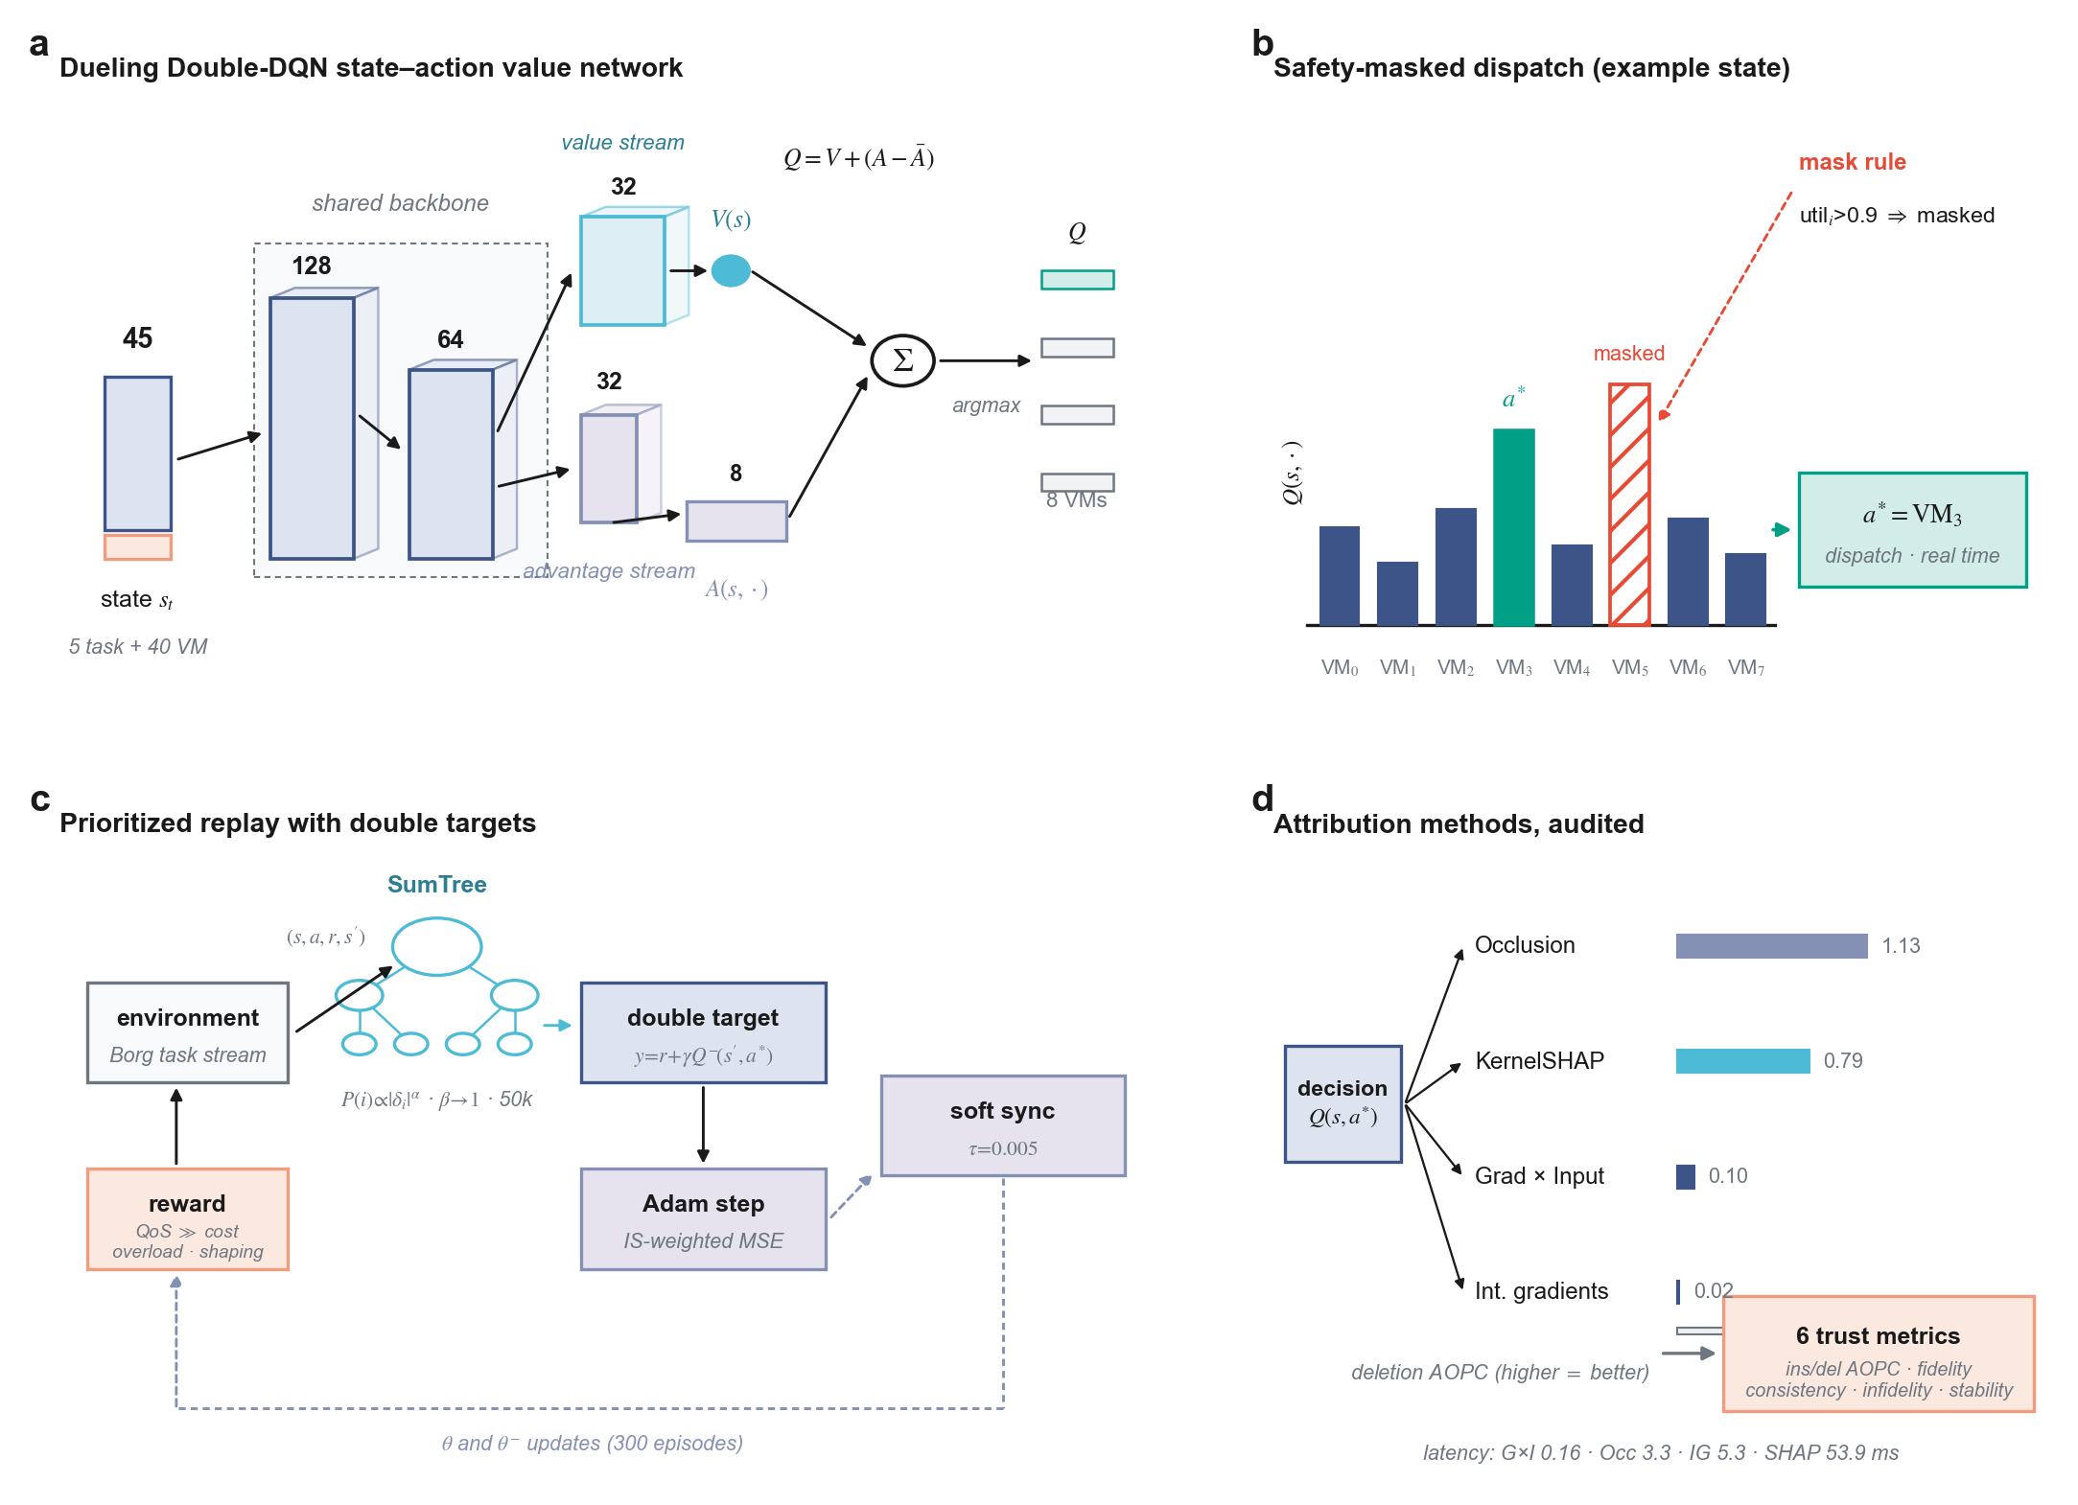
Model Architecture — Figure 1 (publication format)
Nature-style figure: 183 mm double-column, vector PDF/SVG, zero collisions machine-verified
a network · b masked dispatch · c prioritized-replay training · d audited attributions (real deletion-AOPC values)

Slide 4
Key Implementation Details
What makes this build work
▪ Dueling decomposition Q(s,a) = V(s) + (A − Ā): value stream learns pool health, advantage stream learns per-VM preference — ablation: removing it costs +34% cost
▪ Safety action mask pure function of the observed state: util > 0.9 ⇒ Q ← −∞ before argmax AND during exploration — ablation: +37% cost without it
▪ Double DQN + PER online net selects, target net evaluates (kills overestimation); SumTree samples high-|TD| transitions 50k× faster than a list scan
▪ Potential-based shaping F = γΦ(s′) − Φ(s) with Φ = −(imbalance + queue): dense signal, provably policy-invariant (Ng et al. 1999)
▪ Parallel VM model each VM tracks its live task set; finish time stretched by oversubscription ratio → schedulers produce genuinely distinct makespans/miss rates
▪ Corrected AOPC deletion/insertion normalized by Q-spread (decision margin) instead of |Q| — fixes sign-flip on large Q, clamped to [−5, 5]
▪ Explain the deployed policy XAI scores Q + mask — the exact function that acts — so fidelity measures what operators actually see
▪ One-command reproducibility config.yaml drives everything; mtime-keyed caches; manifest logs seed, platform, dataset stats, runtime

Slide 5
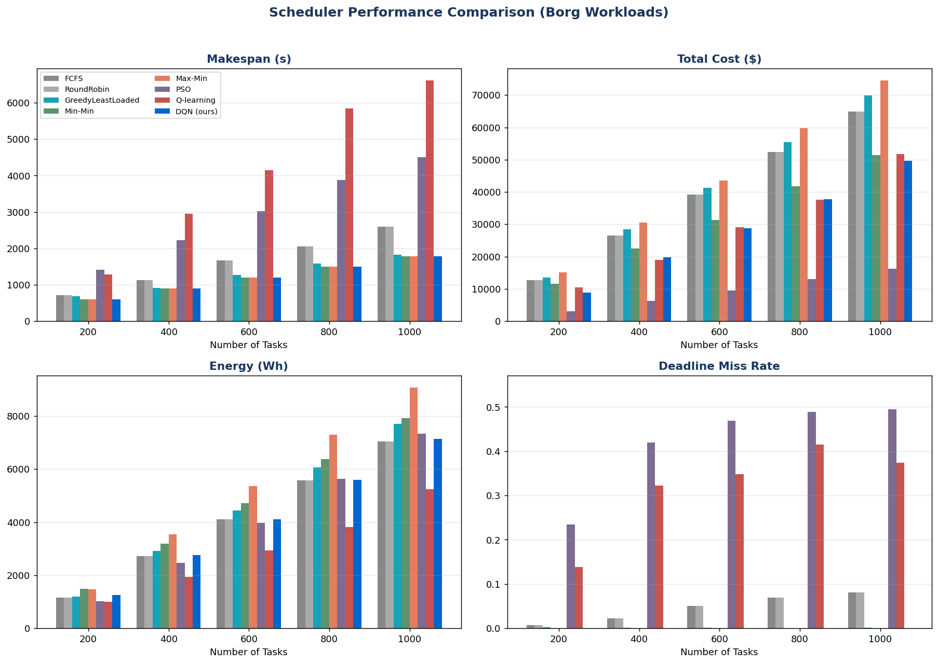
Evaluation & Results — Real Borg Workloads
8 schedulers × 5 loads (200–1000 tasks) × 5 seeds; identical VM pool (seed 42) for fairness
Scheduler | Makespan (s) | Cost ($) | Miss | DI
Min-Min (best heuristic) | 1194 ± 18 | 32,036 | 0.0% | 4.29
DQN (ours) | 1194 ± 18 | 29,141 | 0.0% | 1.04
▪ Ties the best makespan & miss rate across every load
▪ Significantly cheaper than Min-Min (Wilcoxon p = 0.0004, n = 75)
▪ #1 load balance of all 8 schedulers (DI 1.04 ± 0.03)
▪ Cross-dataset: Borg's champion Min-Min collapses 14× on KTH; our DQN stays within 1.44× of best

Slide 6
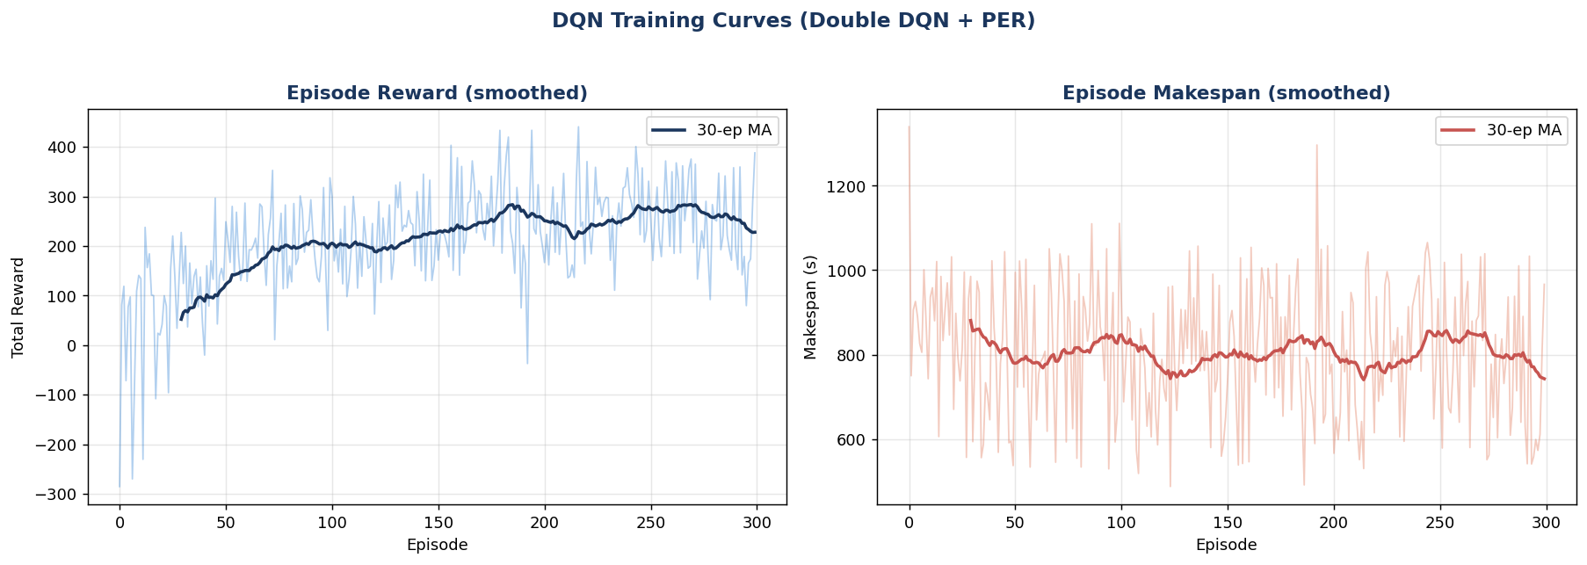
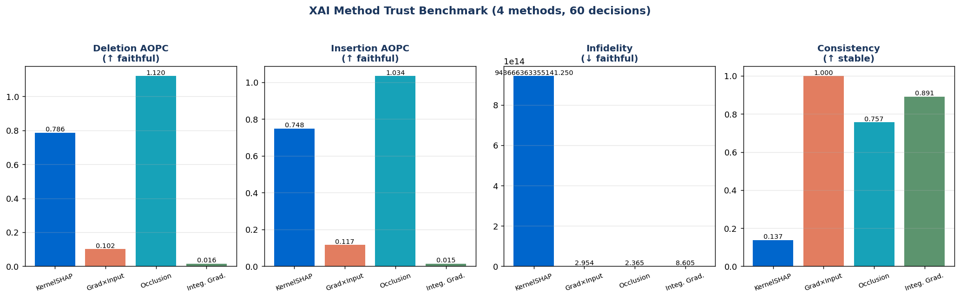
Explainability Layer & Trust Audit — The Contribution
Explanations are mathematically audited, not just displayed
▪ 4 attribution methods KernelSHAP · Gradient×Input · Occlusion · Integrated Gradients explain the same 60 live dispatch decisions
▪ 6 trust metrics deletion/insertion AOPC · top-k fidelity · consistency · infidelity · stability — every method verified faithful (positive AOPC)
▪ Audited trade-off Occlusion most faithful (1.13) vs Gradient×Input 340× faster (0.16 ms) — no single method dominates
Dueling DQN learning curve — stable convergence, no divergence

Slide 7
Publication Rigor & How to Reproduce
Statistically validated; one command regenerates everything
▪ 5-seed evaluation mean ± std across seeds 0–4 — DQN tops the table with tight variance (cost 29,141 ± 3,097)
▪ Wilcoxon signed-rank significantly better than FCFS/RR/Greedy on all metrics (p < 0.0002, n = 75 pairs)
▪ 4-way ablation Dueling (+34% if removed) and mask (+37%) are the load-bearing ideas; PER ≈ neutral at this scale — reported honestly
▪ Dual datasets Google Borg (cloud, light) + KTH SP2 (HPC, heavy) — robustness where heuristic rankings invert
> reproduce everything
cd cloud_rl_xai_project_v2
python run_experiment.py
# train + evaluate + explain (~14 min)
python plots.py
python build_dashboard.py
python rigor.py --job aggregate
Outputs: dashboard.html · Figure 1 (PDF/SVG)
decision_log.json (60 explained decisions)
significance.json · ablation.json · manifest
Live demo: dashboard Decision-Log tab — pick any row: the AI chose VM1 because vm1_util pushed its Q-value up (+2.59), verified faithful.

