Slide 1
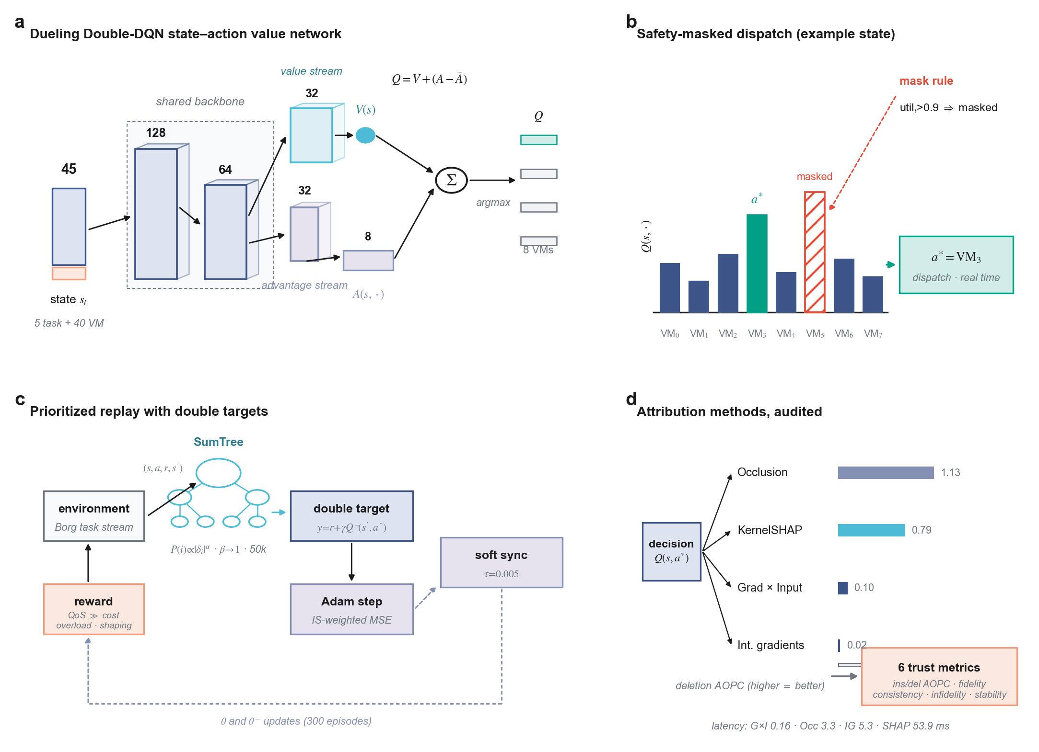
Implementation — RL-MOTS-XAI v2: Explainable Dueling DQN Cloud Scheduler
Pure NumPy · Real Google Borg + KTH SP2 traces · 4 XAI methods · 6 audited trust metrics · 8-scheduler benchmark
PIPELINE (one command: python run_experiment.py)
RESULTS (Borg, 5 seeds, mean ± std)
Borg/SWF loaders
328 MB, 405k events → cached 5k-task pools
Scheduler | Makespan | Cost | Miss | DI
Min-Min (best heur.) | 1194±18 | 32,036 | 0.0% | 4.29
DQN (ours) | 1194±18 | 29,141 | 0.0% | 1.04
PSO | 3054 | 9,615 | 44.1% | 25.2
Environment
8 VMs, parallel time-sharing, 45-dim state, shaped reward
Dueling Double-DQN
45→128→64 → value(32→1)+advantage(32→8); mask util>0.9
Training
300 eps · curriculum · SumTree PER · τ=0.005 soft sync
HEADLINE FINDINGS
XAI + Trust
SHAP·Grad×Input·Occlusion·IG → 6 faithfulness metrics
▪ Ties best makespan & 0.0% miss; cheaper than Min-Min (Wilcoxon p=0.0004)
▪ #1 load balance of 8 schedulers (DI 1.04 ± 0.03)
▪ Cross-dataset: Min-Min collapses 14× on KTH — DQN within 1.44× of best
▪ Occlusion most faithful (AOPC 1.13) vs Grad×Input 340× faster (0.16 ms)
KEY IMPLEMENTATION IDEAS (ablation-validated)
▪ Dueling Q = V+(A−Ā) — removing it costs +34% cost
▪ Safety mask on saturated VMs — removing it costs +37%
▪ Corrected AOPC: normalize by Q-spread, not |Q|
▪ XAI explains the deployed masked policy (what operators see)
reproduce: python run_experiment.py → plots.py → build_dashboard.py
outputs: dashboard · Figure 1 (PDF/SVG) · decision_log (60 explained) · significance · ablation
Figure 1 — network · masked dispatch · training · audited XAI (publication format)

