Slide 1
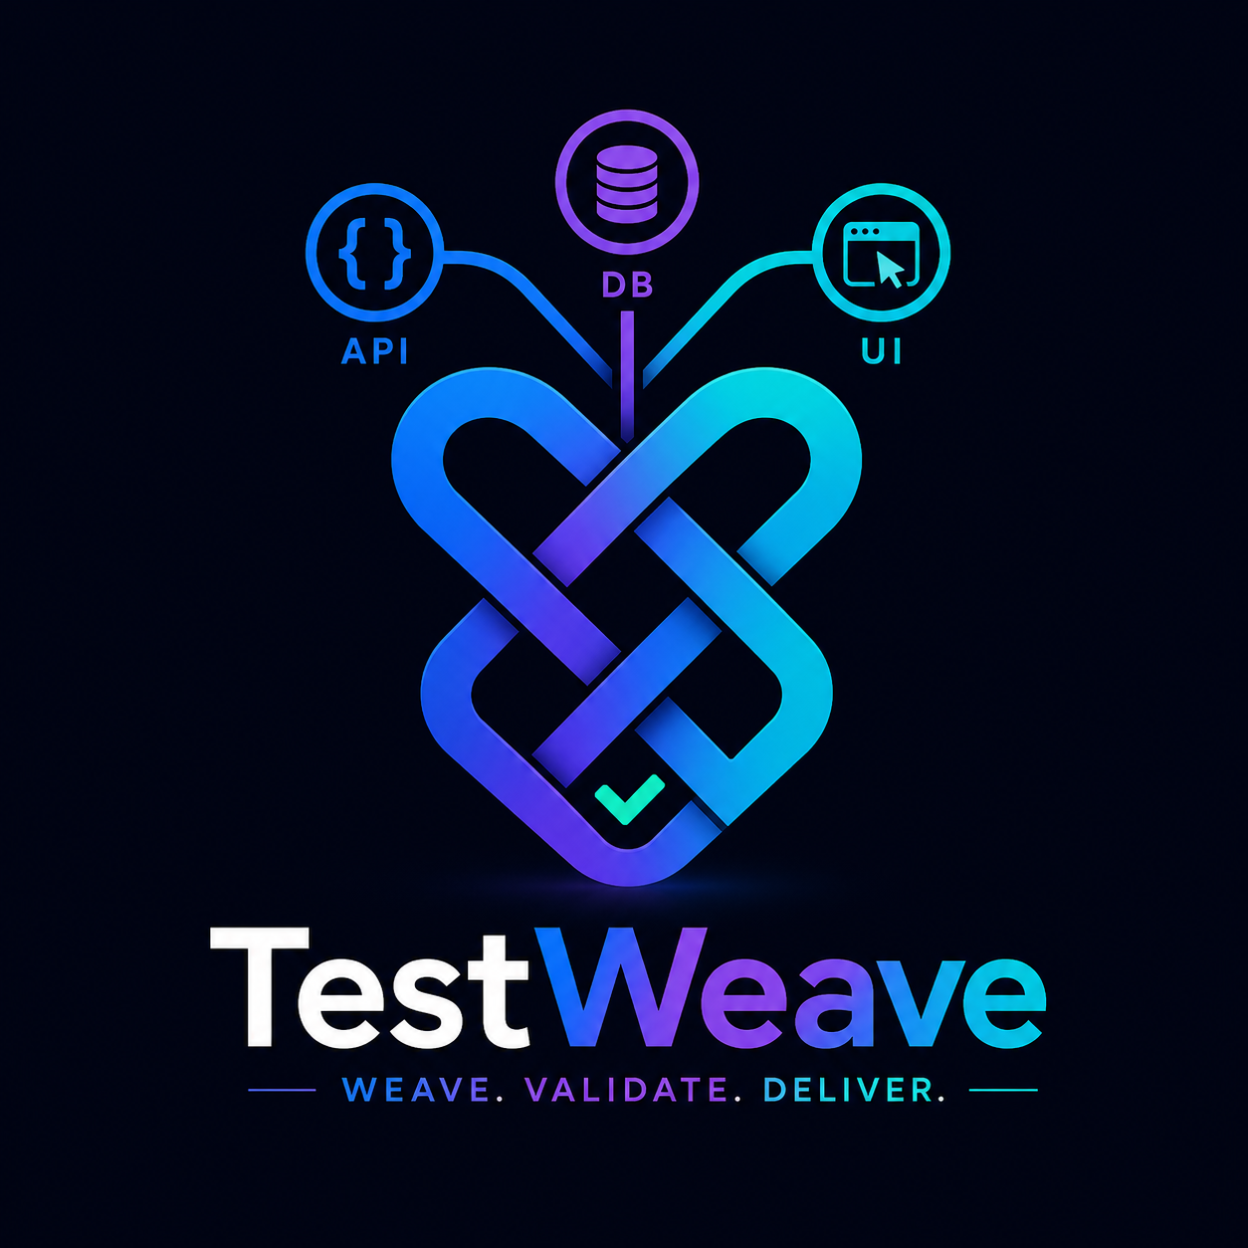
TestWeave
Weave. Validate. Deliver.
A unified desktop validation workbench for API, JSON, DB, performance, and web test flows.
Product Feature Overview & Future Roadmap
TestWeave | 01

Slide 2
The Problem TestWeave Solves
Validation work is scattered across tools, logs, scripts, and browser sessions.
Today’s Friction
TestWeave Response
Outcome
API checks live separately from DB checks
One workbench for API, DB, UI, JSON, and load tests
Less tool switching
UI flows are hard to record after login or MFA
Capture variables once and reuse everywhere
Faster root-cause isolation
Performance evidence is not tied to functional validation
Record web flows from fresh or active browsers
Repeatable regression packs
Reusable values are copied manually across tools
Store validation evidence for release decisions
Stronger confidence before delivery
TestWeave | 02

Slide 3
Current Feature Landscape
A single workspace for the validations teams already perform every day.
API & JSON
DB & Performance
Web Testing
REST calls with headers, token auth, and payload editing
JDBC connection profiles
Browser-side step recorder
Pretty/raw response inspection
Parameterized SQL with saved variables
Attach to debug Chrome for complex flows
Strict or lenient JSON comparisons
Resultset preview and DB-to-API validation
Replay captured actions and assertions
Response variable capture from JSON paths
Load-test metrics and report access
Screenshot and validation steps
TestWeave | 03

Slide 4
API Validation & Variable Capture
Turn one successful API call into reusable test data.
Request Builder
Variables That Travel
Configure method, endpoint, auth, headers, and body in one compact panel. Send the request and inspect status, latency, size, headers, cookies, and formatted response payload.
Capture JSON fields as named variables and reuse them in API URLs, request bodies, DB SQL, web steps, and performance tests. This creates a living chain across validations.
TestWeave | 04
TestWeave | 04

Slide 5
DB Validator: From Query to Evidence
Validate API truth against database state without leaving the tool.
Connection & Query
Validation Rules
Variable Export
Save and load JDBC connection profiles
Compare API fields to DB columns
Select any resultset cell
Insert variables directly into SQL templates
Support equality, contains, and ordered comparisons
Save row/column values as variables
Preview query resultsets in a table
Handle multi-row results and row-specific columns
Reuse DB values in later test stages
Load DB columns into validation rules
Display pass/fail details per rule
TestWeave | 05

Slide 6
Web Testing: Complex Flow Capture
Record browser behavior from fresh sessions or already-open debug Chrome windows.
Fresh Browser
Attach Browser
Smart Replay
Launch a Playwright-controlled browser and record clicks, typing, navigation, assertions, and screenshots for clean reproducible tests.
Connect to debug Chrome on port 9222 to capture flows after manual login, SSO, MFA, deep navigation, or hard-to-script setup.
Replay native dropdowns with selectOption, resolve variables in steps, and surface pass/fail evidence for each browser action.
TestWeave | 06
TestWeave | 06

Slide 7
Test Suite Runner Vision
The canvas where individual validations become orchestrated quality journeys.
Drag, connect, run, and review
Future Test Suite Runner will let users arrange API, DB, web, performance, and comparison test cases on a canvas. Variables can flow from one node to another, creating clear end-to-end test stories.
API response -> DB validation -> UI flow -> Performance check -> Release evidence
TestWeave | 07
TestWeave | 07

Slide 8
Unified Dashboard: One Quality Command Center
A consolidated dashboard makes validation status visible, comparable, and actionable.
Why It Helps
What It Shows
Business Value
Single pass/fail view across all validation types
API, DB, UI, JSON, and performance health
Shared QA and dev understanding
Faster release readiness decisions
Flaky tests and failing components
Clear audit trail for releases
Trend visibility across builds and environments
Latest evidence, screenshots, and reports
Earlier defect discovery
Less manual status consolidation
Environment-wise validation history
Better prioritization of fixes
TestWeave | 08

Slide 9
n8n + Jira Integration
Automation can turn failed validations into trackable engineering work.
How the workflow can operate
1. TestWeave completes a validation run and exports structured results.
2. n8n watches the output, webhook, or scheduled report location.
3. Failed critical validations create or update Jira issues with logs, payloads, screenshots, SQL evidence, and environment tags.
4. Jira status can flow back into a dashboard so teams see whether failures are accepted, in progress, or fixed.
Result: fewer missed defects, cleaner handoff, and a tighter validation-to-remediation loop.
TestWeave | 09
TestWeave | 09

Slide 10
Swing to JavaFX: UI Evolution
JavaFX can help TestWeave feel more modern, visual, and workflow-oriented.
Why Move
Migration Approach
UX Gains
Cleaner layouts and responsive controls
Keep services and models reusable
Drag/drop suite canvas
Modern styling with CSS
Move screen-by-screen instead of rewriting all logic
Richer tables and filters
Better charts, dashboards, and canvas interactions
Start with dashboard and Test Suite Runner
Interactive charts and timelines
Smoother future UX for suite orchestration
Retain existing Swing features during transition
More polished product identity
TestWeave | 10

Slide 11
Future Roadmap
A practical path from tool to validation platform.
Now
Next
Later
Stabilize web recording and replay
Test Suite Runner drag/drop canvas
JavaFX migration
Polish DB resultset variable capture
Unified dashboard MVP
CI/CD execution mode
Package repeatable demo workflows
n8n webhook/report integration
Team-shared test repositories
Improve reporting exports
Jira issue automation for failures
AI-assisted test generation and healing
TestWeave | 11

Slide 12
TestWeave
From scattered validation tasks to one connected quality fabric.
The roadmap moves TestWeave beyond a desktop helper into a release-confidence platform: orchestrated suites, unified dashboards, automated Jira follow-up, and a modern JavaFX user experience.
TestWeave | 12

