Slide 1



BALLARI INSTITUTE OF TECHNOLOGY AND MANAGEMENT
BALLARI
DEPARTMENT OF COMPUTER SCIENCE AND ENGINEERING
An Industry Internship
on
Retail Sales Data Analysis and Visualization
TEAM MEMBERS:
V Pavan Kumar G Vinay Raghavendra hK Sainath N Diwakar
Vishnu Kumar V
Under the guidance
MR. VIRUPAKSHA GOWDA DR. P PANI RAMA PRASAD
MS.MANJULA K
MS.MANJULA K
MRS.VARADA ALEKHYA
Internship Co-ordinator
Mr. HARI KRISHNA
Assistant Professor

Slide 2
Table of Contents
Company Profile
About Domain / Specialization
Tasks/ Activities Performed during Internship
Project Details
Screen shots
Conclusion
Reference

Slide 3

Company Profile
HERO VIRED
Name: Hero Vired Pvt. Ltd. Founded: 2021 Headquarters: New Delhi, India Parent Company: Hero Group Website: www.herovired.com
Founder: Akshay Munjal, CEO: Prakhar Kasar
Overview: Hero Vired is a premium EdTech company launched by the Hero Group, India’s most respected corporate entities. The company aims to transform education in India by offering industry-relevant, career-focused programs designed to bridge the skill gap between academia and industry demands.
Datanyze: reports around 280 employees.

Slide 4
About Domain/Specialization
The Data Analytics internship provided hands-on experience with essential analytical tools and techniques. It covered data cleaning, visualization, statistical analysis, and predictive modeling
Basics of data analytics
Using Sql and Excel for analysing the raw data.
Using python for basic data visualization
Using power bi for data visualization.

Slide 5
Tasks/Activities Performed During Internship
Data Collection and Cleaning
Exploratory Data Analysis (EDA)
Data Visualization and Reporting
SQL and Database Management
Business Insights and Decision Support

Slide 6
Abstract
This project focuses on the analysis and visualization of retail sales data to uncover key business insights and trends. By leveraging data analytics techniques, the project processes historical sales records to identify patterns in customer behavior, product performance, and seasonal trends. Visualization tools such as dashboards and interactive charts are used to present the data in an intuitive and accessible manner. The insights gained support data-driven decision-making for inventory management, marketing strategies, and sales forecasting. Overall, the project aims to enhance operational efficiency and strategic planning through comprehensive retail data analysis and visualization.

Slide 7
Introduction
In today's competitive market, retail businesses generate vast amounts of sales data daily. Effectively analyzing this data is crucial for understanding customer preferences, optimizing inventory, and improving overall business performance. This project, Retail Sales Data Analysis and Visualization, aims to transform raw sales data into meaningful insights through data processing, statistical analysis, and visual representation. By utilizing tools such as Python, Excel, and data visualization libraries, the project identifies trends, seasonal patterns, and key performance indicators.

Slide 8
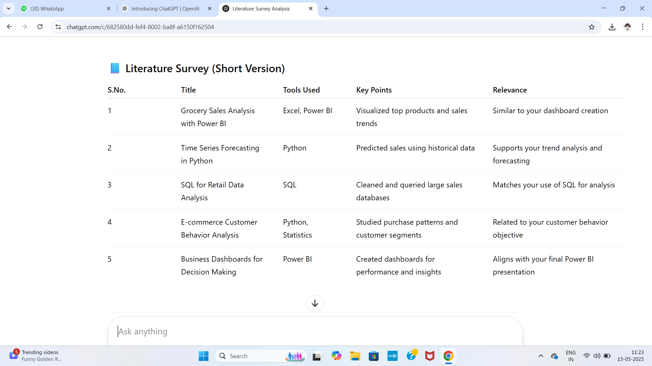
Literature survey

Slide 9
Objectives
To analyze historical retail sales data for identifying trends, patterns, and customer purchasing behavior.
To develop interactive visualizations that simplify the interpretation of complex data.
To provide actionable insights for improving inventory management and sales forecasting.
To support data-driven decision-making for marketing and operational strategies.
To enhance business performance by leveraging analytical tools for better understanding of sales dynamics.

Slide 10
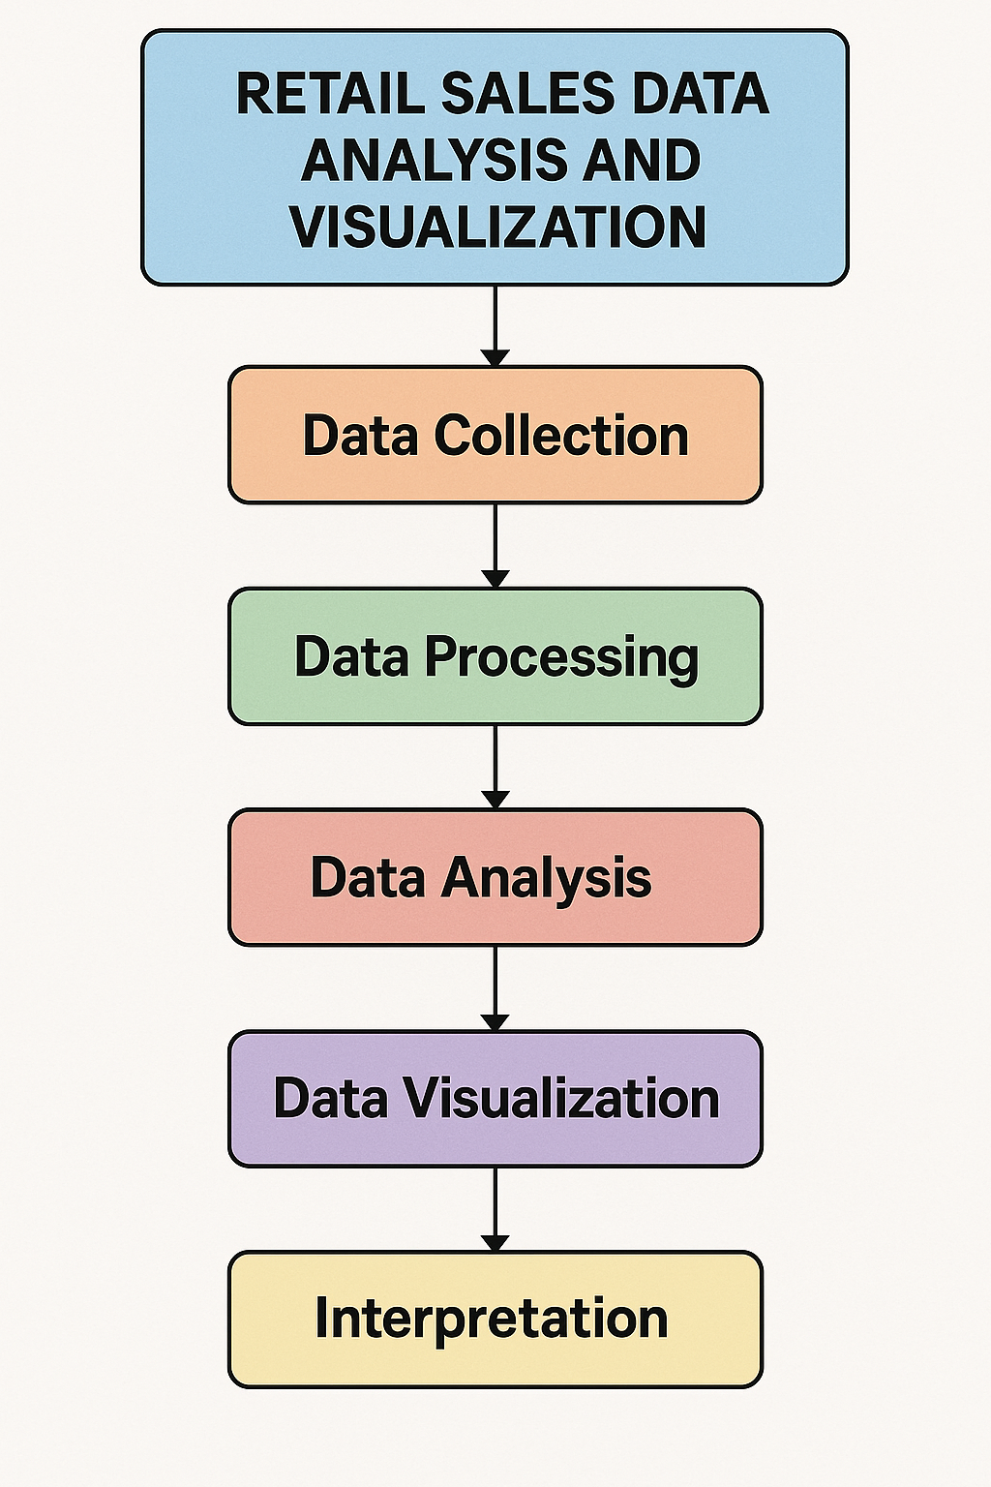
Implementation

Slide 11
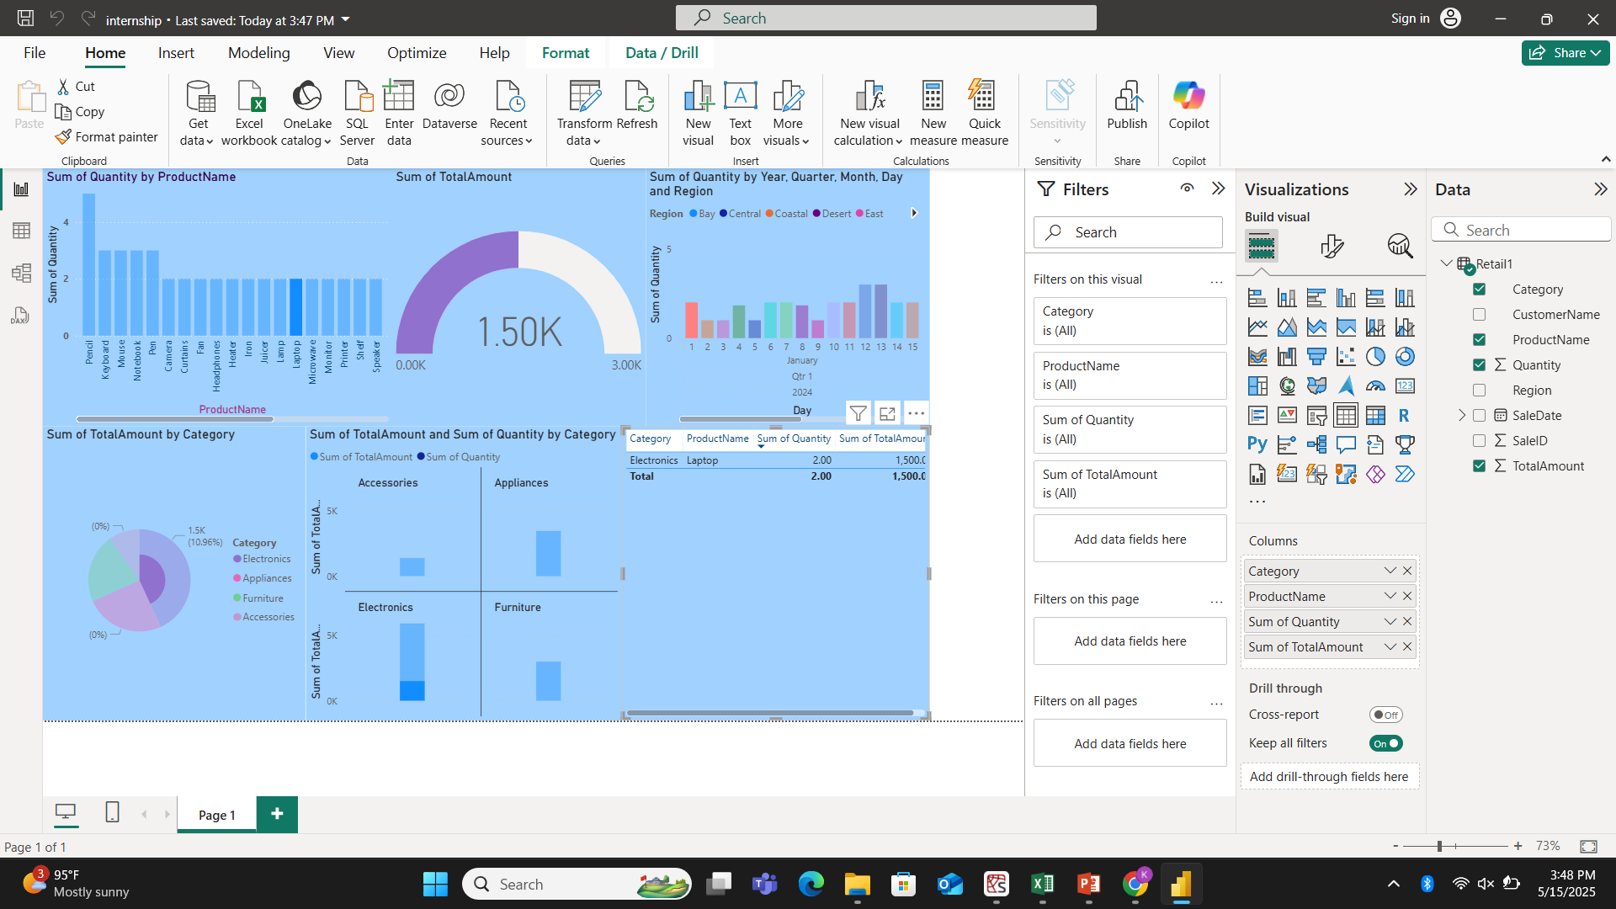
Screenshot
Fig: Power BI , Visualized data

Slide 12
Conclusion
The Retail Sales Data Analysis and Visualization project successfully demonstrates how data analytics can transform raw sales information into valuable business insights. Through systematic data collection, processing, and visualization, the project uncovers trends, customer behaviors, and sales patterns that are critical for strategic planning. The use of interactive charts and dashboards makes the data more accessible and actionable for decision-makers. Overall, the project highlights the importance of data-driven strategies in the retail sector, enabling businesses to enhance efficiency, improve customer satisfaction, and boost profitability through informed and timely decisions.

Slide 13
References
1.Han, J., Kamber, M., & Pei, J. (2012). Data Mining: Concepts and Techniques (3rd ed.). Morgan Kaufmann.
McKinney, W. (2017). Python for Data Analysis: Data Wrangling with Pandas, NumPy, and Python (2nd ed.). O’Reilly Media.
Few, S. (2009). Now You See It: Simple Visualization Techniques for Quantitative Analysis. Analytics Press.
Tableau Software. (n.d.). Data Visualization Best Practices. Retrieved from https://www.tableau.com/learn
Kaggle. (n.d.). Retail Sales Datasets for Data Analysis Projects. Retrieved from https://www.kaggle.com

