Slide 1
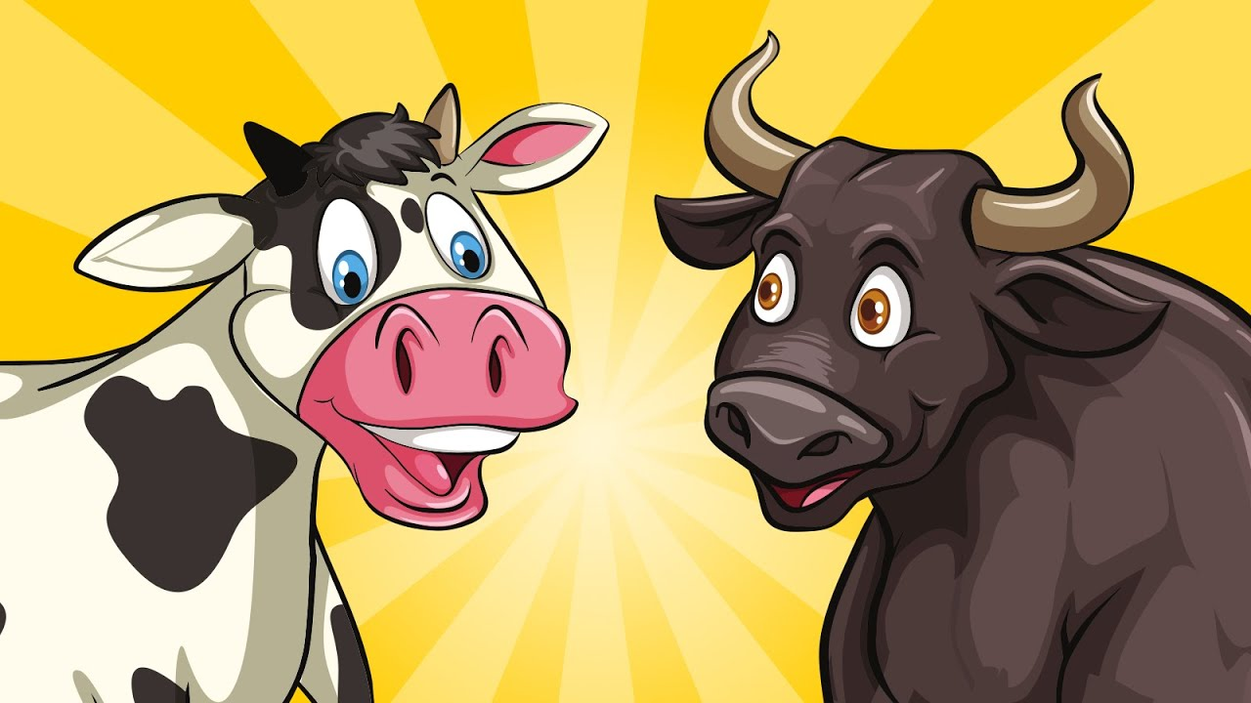
Bulls and Cows game with Entropy
SAINATH CHETTUPALLY Department of Applied Data Science, College of Engineering, University of Florida, FL

Slide 2
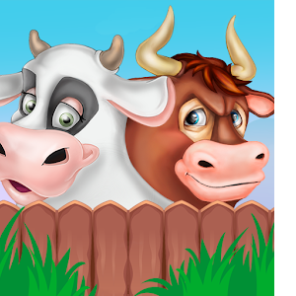
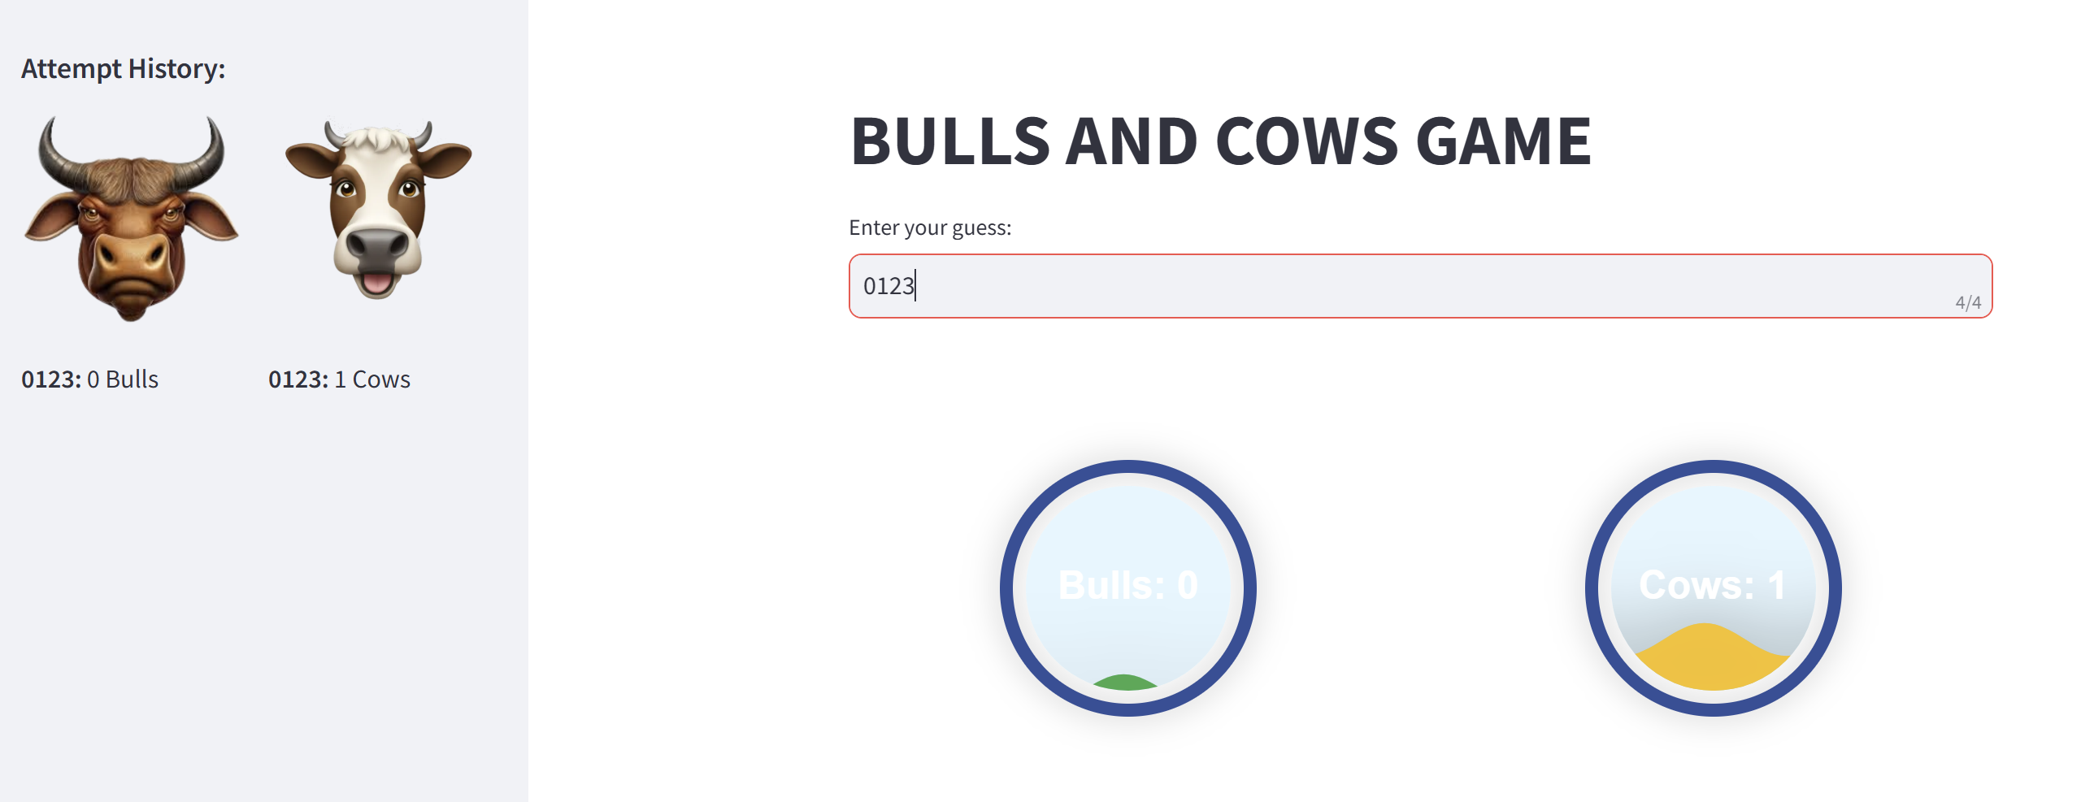
Introduction
Bulls and Cows is a classic number-guessing game where the player must guess a secret 4-digit number.
The twist?
After each guess, the game tells you how many digits are in the correct position (bulls) and how many digits are in the wrong position but still part of the secret number (cows).

Slide 3

WHAT IS ENTROPY AND INFORMATION GAIN?

Slide 4
Calculating Entropy and Information Gain in the Code
Initialization(start_game()): The game starts with the secret number being randomly generated, and all possible 4-digit combinations are stored in a list (possibilities).Initially, the entropy is high because there are 5040 possible combinations.
Calculating Bulls and Cows(calculate_bulls_and_cows()): The function calculate_bulls_and_cows(secret, guess) compares the player’s guess with the secret number and returns the number of bulls (correct digit in the correct position) and cows (correct digit but in the wrong position).
Filtering Possibilities(filter_possibilities(): After each guess, we filter the possibilities to eliminate numbers that couldn’t have produced the same number of bulls and cows. This helps reduce the search space.
Step-by-Step Explanation of Functions

Slide 5
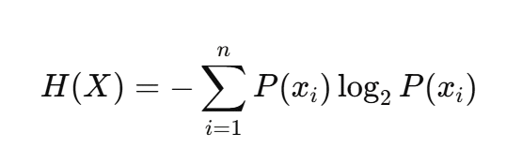

Step-by-Step Explanation
Entropy Calculation(calculate_entropy()):For each guess, we compute the entropy of the remaining possibilities. As guesses are made and possibilities are filtered, entropy decreases.
The formula used in the code calculates the entropy of the remaining valid possibilities based on their probability of occurrence.
We compare the initial entropy (before the guess) with the new entropy (after the guess).
The information gain is the difference between the two, showing how much uncertainty was reduced by making the guess. IG(X,Y)=H(X)−H(X∣Y)
The entropy and information gain are displayed on a line graph for real-time feedback, showing how the uncertainty decreases with each guess.
Players also see the probability of finding the secret number after each guess, which is calculated as
Calculating Information Gain:
Displaying Results:

Slide 6
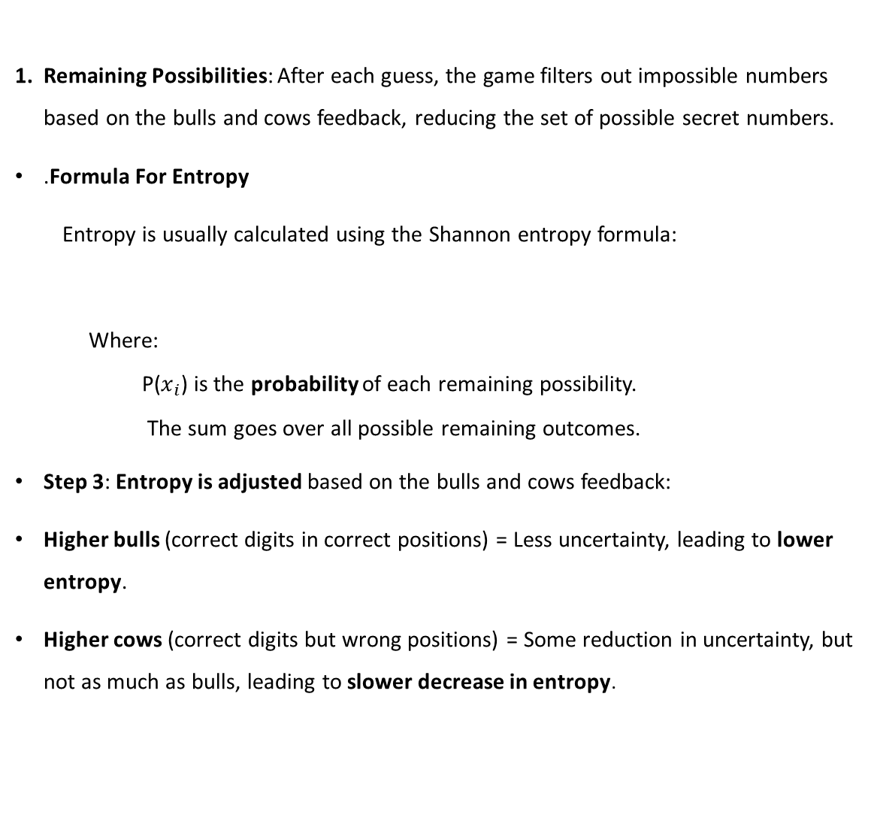
Entropy Calculation
Remaining Possibilities: After each guess, the game filters out impossible numbers based on the bulls and cows feedback, reducing the set of possible secret numbers.
.Formula For Entropy
Entropy is usually calculated using the Shannon entropy formula:
Where:
P($x_{i}$) is the probability of each remaining possibility.
The sum goes over all possible remaining outcomes.
Step 3: Entropy is adjusted based on the bulls and cows feedback:
Higher bulls (correct digits in correct positions) = Less uncertainty, leading to lower entropy.
Higher cows (correct digits but wrong positions) = Some reduction in uncertainty, but not as much as bulls, leading to slower decrease in entropy.

Slide 7
Information Gain Calculation
Information Gain measures the reduction in uncertainty or entropy that results from knowing the outcome of an event (in this case, the player’s guess).
It’s a key concept in decision-making and is used to evaluate how much information we gain by making a particular decision.
Formula for Information Gain
IG(X,Y)=H(X)−H(X∣Y)
Where:
H(X) is the entropy before the guess and H(X|Y) is the entropy after the guess How It's Calculated in the Code:
Initial Entropy: Before the guess, we calculate the entropy based on all possible numbers.
Remaining Entropy: After each guess, we calculate entropy again based on the filtered possibilities (remaining valid numbers).
Information Gain: The difference between the initial entropy and remaining entropy.

Slide 8
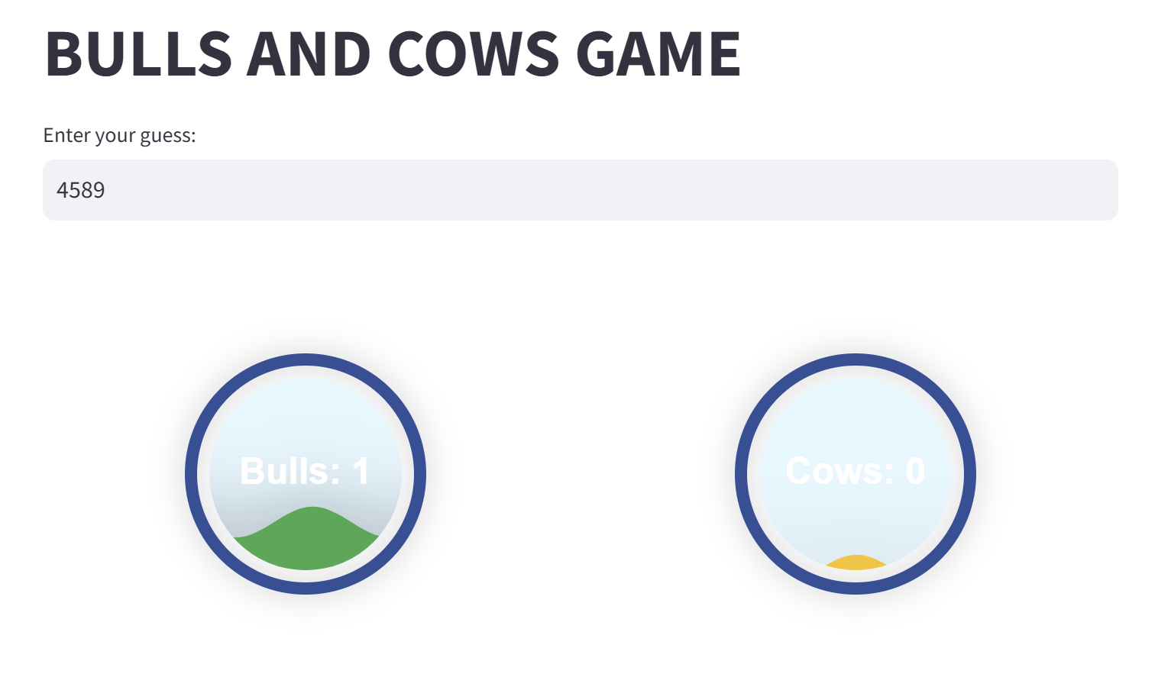
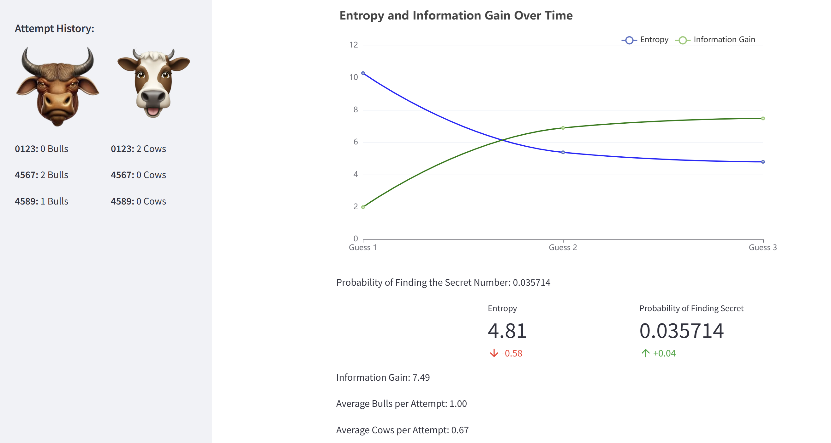
User Interface and Visualization

Slide 9

Practical Application and Insights
Why Should Players Care About Entropy?
Players can use entropy and information gain to adjust their guessing strategy:
High entropy means there’s a lot of uncertainty and many possibilities. Players need to make a guess that maximizes information gain (e.g., guess a number that will eliminate a large portion of possibilities).
Low entropy means fewer possibilities are left, and the player is closer to guessing the secret number.
Optimizing Guesses Using Entropy
A more optimal guessing strategy involves selecting guesses that minimize entropy. This is akin to maximizing information gain by choosing numbers that will split the remaining possibilities in a way that reduces uncertainty the most.

Slide 10
Real-World Applications of Entropy and Information Gain
Machine Learning: Information gain is used in decision tree algorithms (like ID3 and C4.5). It helps select the best feature to split the data, reducing uncertainty.
Data Science: Entropy is used to measure the diversity of datasets. For example, in clustering, entropy can help evaluate the "mixedness" of a cluster of data points.
Cryptography: Entropy is used to measure the randomness in cryptographic keys and ensure they are unpredictable.

Slide 11
Code, Documentation, and Demo Video Links
1. Code
GitHub Repository: Link to Code on GitHub
This link will take you to the GitHub repository where the Bulls and Cows game code is hosted. You can view, clone, and contribute to the code.
2. Code Documentation
Documentation PDF: Link to Code Documentation
This is a detailed PDF containing comments, explanations, and documentation on how the code works, including functions, entropy calculation, and information gain.
3. Demo Video
Demo Video: Link to Demo Video
This link will lead to the 8 min demo video where I demonstrate how the Bulls and Cows game works, how entropy and information gain are calculated, and how the game reduces uncertainty over time.

Slide 12
