Slide 1


SponsorForge
The AI-Powered Brand & Creator Matching Platform

Slide 2


The Influencer Marketing Bottleneck
Wasted Hours
Brands manually search for the right influencers — slow, imprecise, and expensive
Invisible Creators
Talented micro and macro creators struggle with discoverability in a crowded market
Broken Payments
Messy deliverable tracking leads to trust issues, disputes, and delayed payouts

Slide 3


Enter SponsorForge
Semantic AI Matching
Replaces manual searching with intelligent, precision-driven creator discovery
Escrow Points System
Built-in secure payments eliminate disputes and guarantee on-time payouts
End-to-End Campaign Management
Full campaign lifecycle dashboard from launch to completion, all in one place

Slide 4


Who is SponsorForge For?
Brands & Startups
Content Creators
Maximize marketing ROI through targeted influencer campaigns — no expensive agency fees, no wasted budget
YouTubers, Streamers & Influencers find a legitimate, scam-free marketplace for sponsorships that match their exact audience

Slide 5

Precision Matching via AI Embeddings
1
NLP Analysis
2
Vector Similarity Search
3
Higher Conversions
Advanced Sentence Transformers analyze creator bios and brand campaign descriptions
pgvector instantly connects brands with the most relevant creators by niche, platform, and content style
Authentic brand integrations — no more guesswork

Slide 6

Trustless & Automated Payouts
01
02
Brand Pool
Escrow Lock
Funds allocated for creatives
Secure, trustless hold of payment
03
04
Submit & Approve
Instant Transfer
Creator delivers; brand verifies
Automated payout on approval
Every transaction is guaranteed — brands receive deliverables, creators get paid on time, every time.

Slide 7





Seamless Campaign Management
Brands target YouTube, TikTok, Instagram, and Twitch with precise subscriber requirements. An intuitive Kanban workflow keeps every campaign on track from launch to close.
Pending Review
In Progress
Ready for Payout
Completed

Slide 8
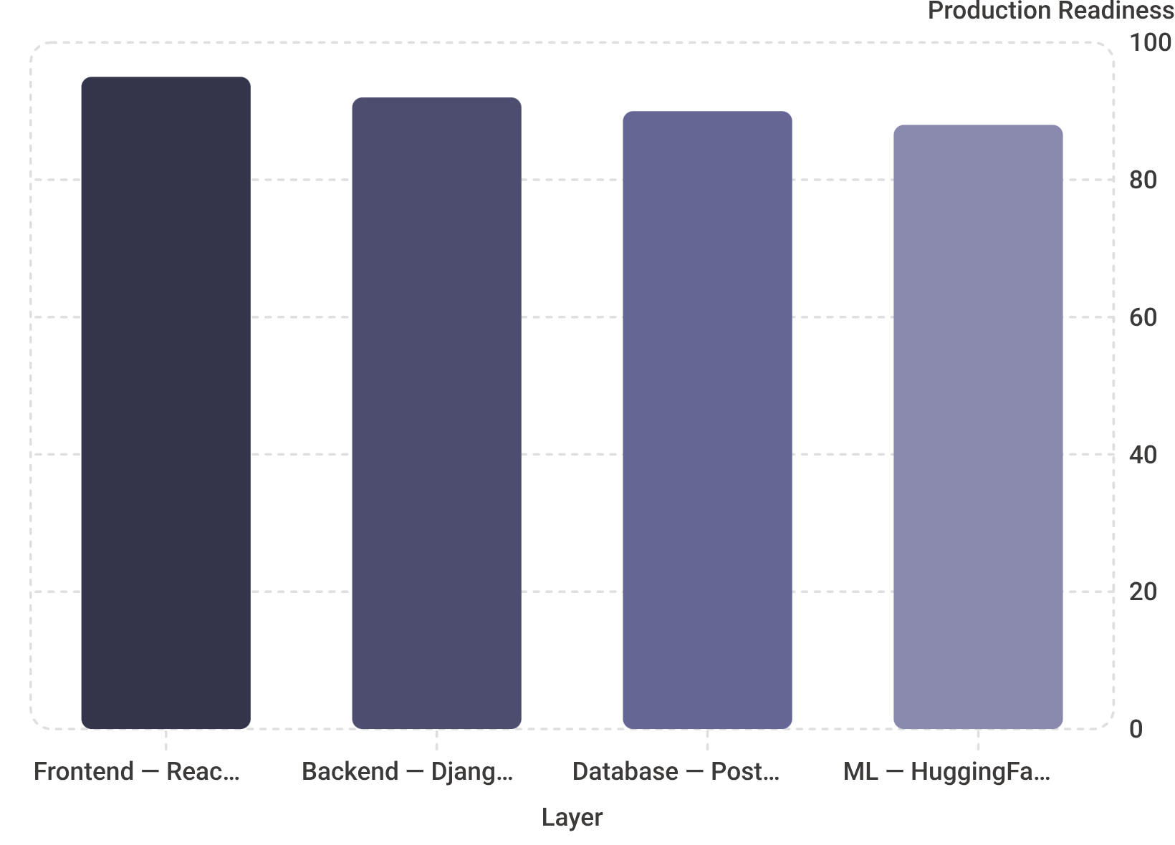
Built for Scale and Performance
⚡ Frontend
🔧 Backend
React.js
Lightning-fast, highly responsive user interface
Django REST Framework
Robust, scalable Python API handling
🗄️ Database
🤖 ML
PostgreSQL + pgvector
Blazingly fast cosine-similarity AI matching
HuggingFace MiniLM
High-quality text embeddings at scale

Slide 9



Future Scope
SponsorForge is evolving into an enterprise-grade sponsorship infrastructure — AI-native, financially connected, and built for scale.
Advanced AI & ML Enhancements
Financial & Monetization Ecosystem
Real-Time Communication & Analytics
Multi-Modal AI Analysis
Automated Deliverable Verification
Audience Quality Scoring
Dynamic Pricing
Fiat-to-Crypto Gateway
Smart Contracts & On-Chain Escrow
Multi-Tier Subscriptions
WebSockets & Instant Messaging
Campaign Performance Dashboard
ROI Tracking
Enterprise Governance & Security
Mobile & Extension Ecosystem
Contract Auto-Generation & e-Signatures
Dispute & Mediation Portal
Team & Agency Workspaces
Native Mobile App (React Native/Flutter)
Browser Extension for Brands

