Slide 1
RAIoT LAB · INNOVATION DAY 2026
GhostPrint
Every device betrays itself.
Identifying IoT devices from how they talk — packet sizes, timing, rhythm —
not what they say. No payload inspection. Works through encryption.
Notes:
Open with the one-liner: we fingerprint behaviour, not content. 30 seconds max, then move.

Slide 2
THE PROBLEM
Encryption hides the payload — not the behaviour
You can't inspect what you can't read
IoT traffic is overwhelmingly encrypted; content scanning is blind by design.
18.8B
Device inventories don't match reality
New, cloned or compromised devices appear on networks with no registry entry.
connected IoT devices worldwide in 2024 — every one of them a device someone has to account for.
Behaviour still leaks identity
A camera, a sensor and a smart plug move in fundamentally different rhythms — and that rhythm survives encryption.
Source: IoT Analytics, State of IoT 2024
GhostPrint · RAIoT Lab — Innovation Day 2026
Notes:
Punchline: security tools read content; devices are identified by behaviour. That gap is GhostPrint.

Slide 3
HOW IT WORKS
From raw packets to a named device in seconds
1
2
3
4
5
Simulate
Capture
Fingerprint
Classify
Detect
3 device profiles + rogue & spoofer, on real ESP8266s or in software
Packet metadata only — size, timing, source IP. Never the payload
12 s rolling window -> 4 behavioural features per device
Random Forest names the device with a confidence score
Rogue devices flagged; impersonation caught by z-score baseline
Metadata-only by design: the capture filter never reads payload bytes — identification works identically on encrypted and plaintext traffic.
GhostPrint · RAIoT Lab — Innovation Day 2026
Notes:
Walk left to right. Emphasise stage 2: metadata only, so encryption is irrelevant to us.

Slide 4
THE FINGERPRINT
Three devices, three unmistakable rhythms
Avg packet size (bytes)
Packets per minute
A 12-second window yields 4 features per device: avg packet size, inter-packet interval, packet rate, burstiness.
Source: GhostPrint device profiles (config.py) and training corpus, 1,500 windows
GhostPrint · RAIoT Lab — Innovation Day 2026
Notes:
A camera pushes 1200-byte frames in bursts; a sensor trickles 72-byte readings; a switch fires tiny event packets. The classifier separates them at 100% in cross-validation.

Slide 5
DETECTION ENGINE
Two attacks, two alarms — seconds apart
ROGUE DEVICE
SPOOFING ATTACK
An unknown device joins the network
An impostor takes over a known device's identity
Feature vector sits far from every known device profile
Classifier confidence below threshold also triggers
Amber warning with the device's source IP
Clone matches the victim's profile — but not perfectly
Gated z-score baseline spots the timing drift; attack traffic never reshapes the reference
Red critical alert names the impersonated device
≤ 5 s to alert
~10 s to alert
Both detectors run on packet metadata alone; every alert carries the source IP, a timestamp and a one-click review state.
GhostPrint · RAIoT Lab — Innovation Day 2026
Notes:
This is the demo slide: rogue = stranger at the door, spoofing = impostor wearing a resident's clothes.

Slide 6
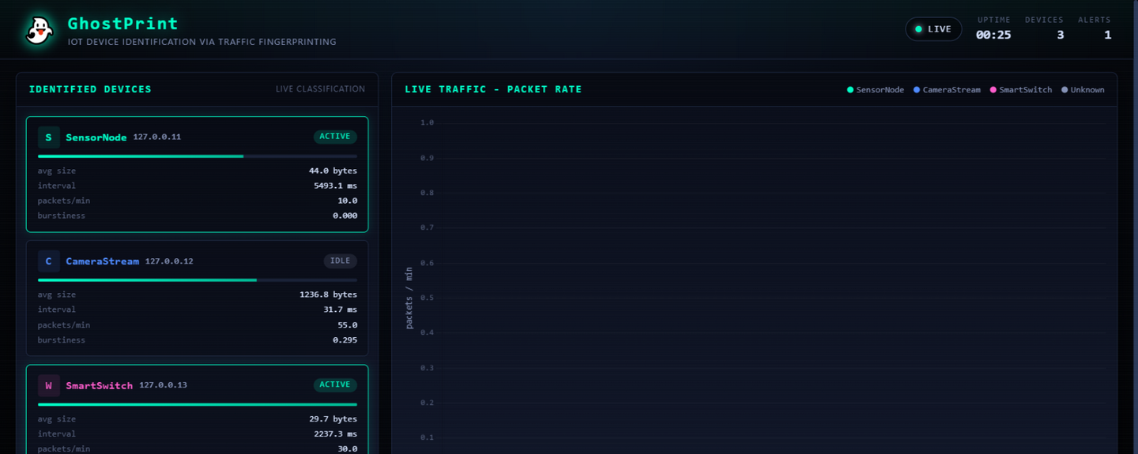
LIVE DEMO
One laptop, the whole attack-defence story
Real product UI: devices identified live, 60-second traffic graph, colour-coded alert feed with one-click review.
GhostPrint · RAIoT Lab — Innovation Day 2026
Notes:
Everything on screen is the shipped software: three devices classified, live packet-rate graph, demo controls to launch a rogue or spoofing attack on demand.

Slide 7
VERIFIED RESULTS
Measured on the shipped build, not promised
100%
25
22
≤ 5 s
~10 s
5-fold cross-validation accuracy
automated tests passing
SRS requirements traced
rogue device alert
spoofing alert
Random Forest, 1,500 windows, 3 classes
features, classifier, detectors, simulator
IEEE-aligned spec, REQ-1 to REQ-22
unknown device, with source IP
critical, names the victim device
Pre-demo health check: python scripts/smoke_test.py — replays the full attack scenario headlessly and fails loudly if anything regresses.
Accuracy measured as 5-fold cross-validation over the generated training corpus; alert timings from scripted end-to-end runs.
GhostPrint · RAIoT Lab — Innovation Day 2026
Notes:
If asked about 100%: it is cross-validation on the simulator corpus — profiles are well separated by design; the interesting numbers are the detection latencies.

Slide 8
UNDER THE HOOD
A pipeline a single laptop can run
Devices
Capture
Features
Classifier
Detectors
3 × ESP8266 boards
+ spoofer board
(or software twin)
→
scapy / in-process
UDP metadata
BPF-filtered
→
12 s rolling window
4 behavioural
features
→
Random Forest
scikit-learn
200 trees
→
rogue: z-distance
spoofing: gated
z-score baseline
Flask + Socket.IO → live dashboard — device cards, 60-second Chart.js traffic graph, alert feed with review workflow; every pipeline event pushed in real time.
Python 3.10 · scikit-learn · Flask · Flask-SocketIO · Chart.js · scapy · Arduino/ESP8266 firmware — all thresholds in one config file.
GhostPrint · RAIoT Lab — Innovation Day 2026
Notes:
Same code path for simulated and real ESP8266 traffic: the simulator feeds packets through the identical capture interface.

Slide 9
WHY IT MATTERS
Where GhostPrint goes next
Where it fits today
Roadmap
Smart homes — spot the cloned camera or hijacked plug
Enterprise & campus IoT — audit what is really on the LAN
Procurement — verify a device class behaves like its datasheet
Teaching — a complete, inspectable attack-vs-defence lab
Live ESP8266 capture demo on real Wi-Fi (scapy path is built)
More device classes: speakers, bulbs, vacuums, wearables
Richer features: DNS/TLS handshake metadata, session shapes
Per-vendor fingerprint library + model retrain CLI
The core idea scales: any device that talks, leaks a rhythm.
GhostPrint · RAIoT Lab — Innovation Day 2026
Notes:
Close the argument: fingerprints generalise to any device class; hardware demo is the next milestone.

Slide 10
See it catch an attack — live.
Demo: python scripts/run_demo.py → http://localhost:5000
Rogue device in 5 seconds. Spoofed sensor in 10. All on one laptop.
GhostPrint · RAIoT Lab — Amity University Rajasthan · Innovation Day 2026
Notes:
Invite the judges to launch the attacks themselves from the dashboard controls.

