Slide 1

INTELLIAGRO
K. SAI SHRUJAN Sri Indu College Of Engineering & Technology
K. SAI NITHIN Osmania University College of Engineering
CH. SURARCHITHA Nalla Malla Reddy Engineering College

Slide 2
INTELLIAGRO

Slide 3
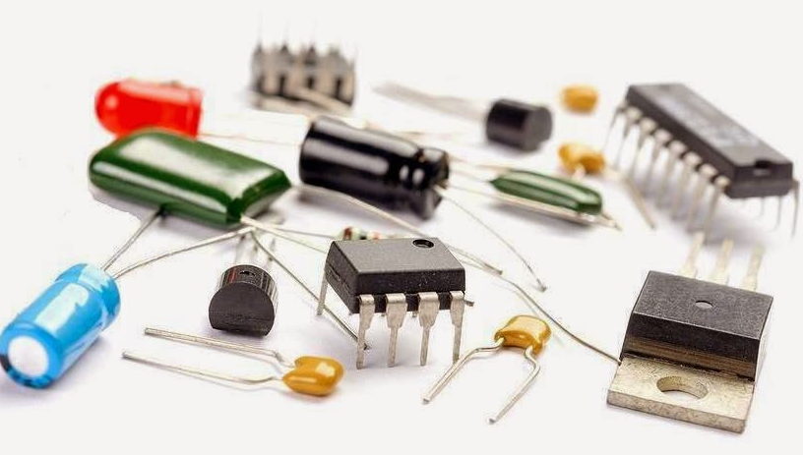
COMPONENTS USED
ESP32
ESP8266
Soil Moisture Sensor
Water Flow Sensor
DHT11

Slide 4

FLOWCHART

Slide 6


CIRCUIT DIAGRAM

Slide 8
SCOPE OF THE PROJECT

Slide 9
SCOPE OF THE PROJECT
LoRa

