Slide 1
Reading and Writing

Slide 2
knowledge, experience, and thinking in getting the meaning from the print.
Text as Connected Discourse
“Reading comprehension is the active process of constructing meaning from text.” - Vaughn and Linan
connectedness among - the Author and reader and text.

Slide 3
Reading as a Skill
read effectively
decoding process
comprehension process
involving the readers into an interaction with the text
enable to use reading strategies
it can be learned

Slide 4
Reading Process
3 stages of Reading
pre-reading
during reading
post-reading

Slide 5
Techniques in Reading
Skimming - get only the main ideas of a written text in order to know what the material is all about.
Previewing - general look in order to know what the material contains.
Overviewing - taking a look at the title, chapter, or heading.
Surveying - involves giving the text a rundown from first section to the last section

Slide 6
Techniques in Reading
Scanning - search only for specific information needed.
Comprehensive - requires processing if the text for full understanding of the material.
Critical - involves an analysis of the claims.

Slide 7
01
Using Contextual Clues
Context clues – are words, phrases and sentences that would help you to deciher the meaning of difficult words in the selection.

Slide 8
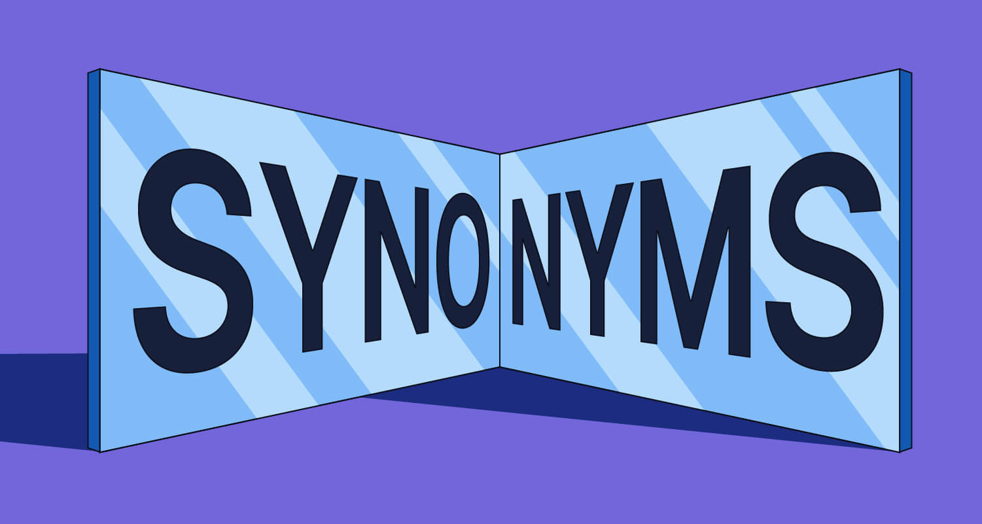
Use of Synonyms as Context Clues
Synonyms appear in a sentence in the following ways:
By dashes
Example: She finds solace-comfort-in the country-side.
By commas to separate the appositive.
Example: The advocates, supporters, of anti-mining formed a picket outside the building.

Slide 9
Use of Synonyms as Context Clues
By parentheses
Example: The local residents are among the hordes (a large group of people) who lined up to take their chance in the contest.
By reinstatement or expression of the word in a more familiar term
Example: The smiles these little children are guileless. They show innocence and no deception

Slide 10
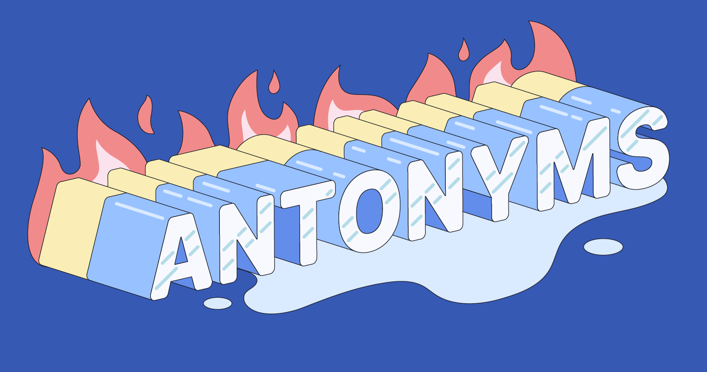
Use of Antonyms as Context Clues
Example: His siblings are generous and giving but she is so stingy.
Note: antonyms are recognized in a sentence through any word which presents opposite meanings like but, although, despite, instead, in contrast, unlike, however, even though, on the contrary, conversely, etc.

Slide 11

Use of Examples as Context Clues
Examples are list of illustrations which make the unfamiliar word clearer. In order to derive the meaning of the word, you have to analyze the examples given and find a common trait or characteristic.
Example: Lyn is on a diet. However, she still ate a portion of everything served like a small piece of meat, a small piece of bread, and a small piece of cake.

Slide 12

Use of Comparison as Context Clues
Identifying the similarities and differences of two or more things, places, or events.
Examples: Laura gets easily perplexed by the brain teasers but Kim figures them out easily.

Slide 13
Comprehensive reading
understanding
answering questions about the selection and it also includes predicting, summarizing, and critical thinking.
Inferring the Main Idea
involves the use of information presented in the text and connecting it to your own knowledge.
interconnection of the author’s text and prior knowledge.

Slide 14
Levels of Comprehension
Literal comprehension
understanding of the message directly stated in the text.
Inferential Comprehension
able to make inferences, draw conclusions and predict outcomes from information implicitly stated in the text.
Applied Comprehension
able to use your experiences and prior knowledge into the written text in making an evaluation.

Slide 15
Techniques in Selecting and Organizing Information

Slide 16
Techniques in Selecting and Organizing Information
Outlining
Brainstorming
Graphic Organizer

Slide 17
What do we get by reading?

Slide 18

Outlining
It is a process of organizing information gathered from reading.

Slide 19
There are two (2) kinds of numbering system:
Traditional Outline
Modern Outline
I.
A.
B.
C.
1.
2.
3.
a.
b.
c.
1.
1.1
1.2
1.3
1.3.1
1.3.2
1.3.3
1.3.3.3.1
1.3.3.3.2
1.3.3.3.3

Slide 20
Two types of Outlining
Topic Outline
Sentence Outline
I. When family conflicts arise as a result of divorce, adolescents suffer. A. During the first year, these young people may be depressed due to conflicts between the custodial and non-custodial parents. B. Grandparents, aunts, and uncles are often restricted by visitation provisions. C. Almost without exception, adolescents find divorce very painful, but they react in differing degrees depending on their age. II. Some of the most negative effects on adolescents may be associated with economic problems. A. The family will most probably experience a lower standard of living due to the cost of maintaining two households. B. Some female custodial parents have poor job skills and must train before entering the job market. C. The lower standard of living may result in misunderstanding and conflicts within the family. D. The decreased standard of living, particularly for an untrained female custodial parent, often causes relocation. 1. The family may have to move to a poorer neighborhood in order to cut costs. 2. As a result, the adolescent may have to attend a different school. III. Adolescents from divorced families often experience peer problems. A. Due to relocation and prejudice, adolescents may lose friends. B. The lack of a solid relationship with both parents affects an adolescent's attitude toward the opposite sex.
I. Family Problems
a. Custodial: Non-custodial conflicts
b. Extended Family
c. Adolescent’s Age
II. Economic Problems
a. Child Support
b. Women’s Job Training
c. Lower Standard of Living
d. Possible Relocation
1. Poorer Neighbourhood
2. New School
III. Peer Problems
a. Loss of Friends
b. Relationships with Dates
Source: https://www.oakton.edu/studentservices/learning_center/tutoring/research_paper_tips/sentence_outline.php

Slide 21

Brainstorming List
Is a process of writing down specific topics gathered from different sources.
Is composed of major points with sub-details for each.

Slide 22
Graphic Organizer
Knowledge
Concepts
Thoughts/Ideas
Relationship
Technique in organizing information involves the use of visual symbols.

Slide 23
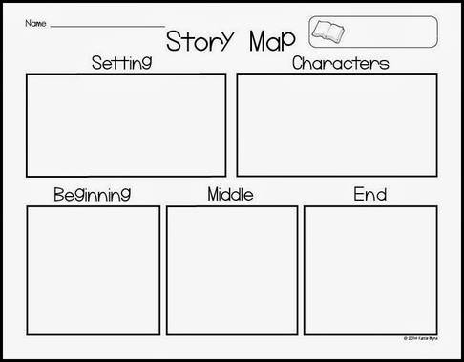
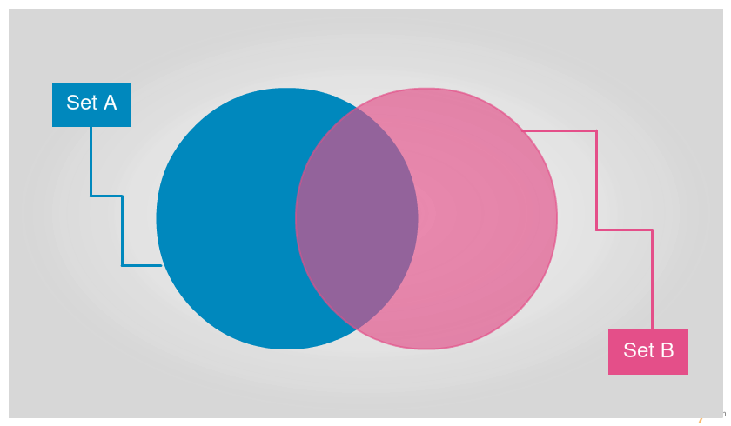
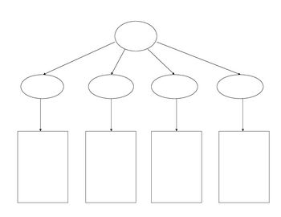
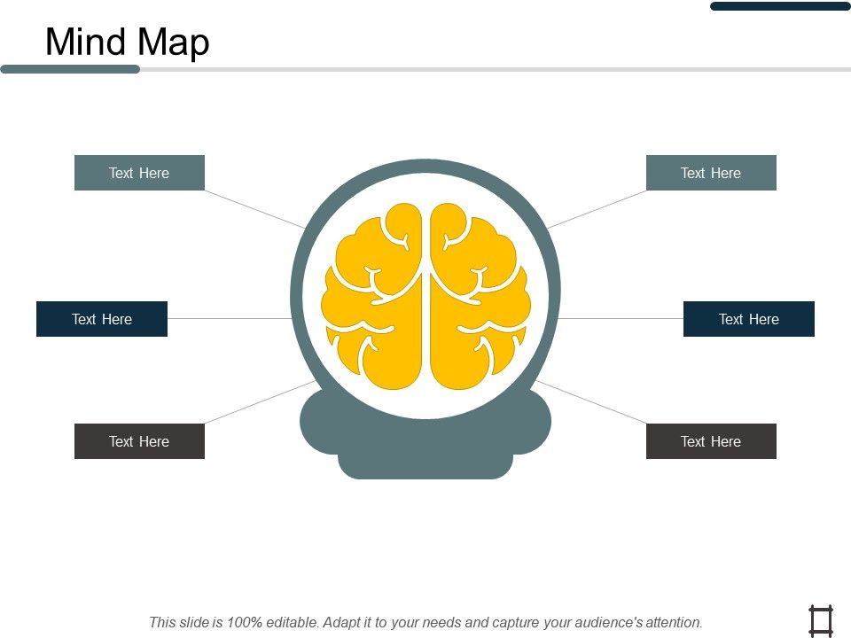
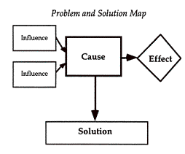
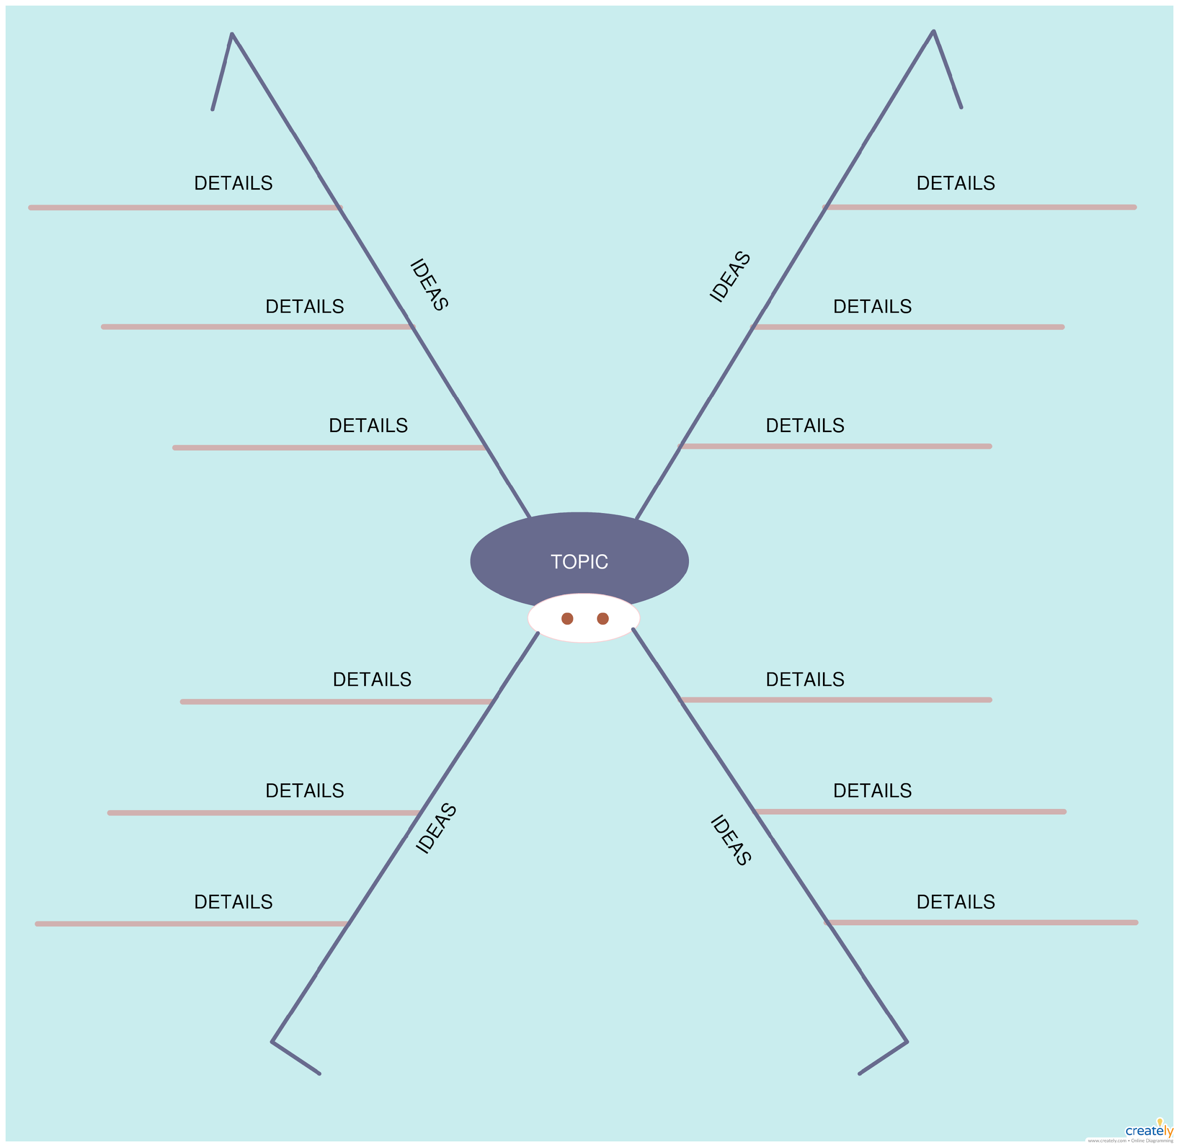
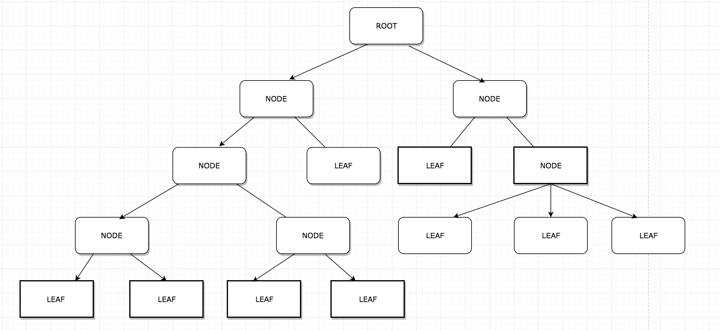
Types of graphic organizer
Knowledge map/ Concept map
Is a form of visualization through images or shapes that displays connections between data that represents ideas and arrows denoting relations between them
Story Map
It helps the reader understand a work of literature by tracking the setting, characters, problem, events, solution, and conclusion.
Venn Diagram
Used to compare and contrast ideas and events.
Network Tree Map
Used to show relationships of scientific categories, lineages, and categories. It represents classification, branching, and hierarchy.
Spider Map
Used to investigate and enumerate different aspects of a central idea such as a topic, a concept, or a theme.
Problem Solution Map
Used to shows the nature of the problem’s causes and effects, description, and logical solutions.

Slide 24
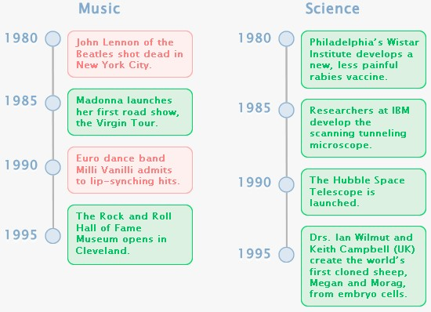
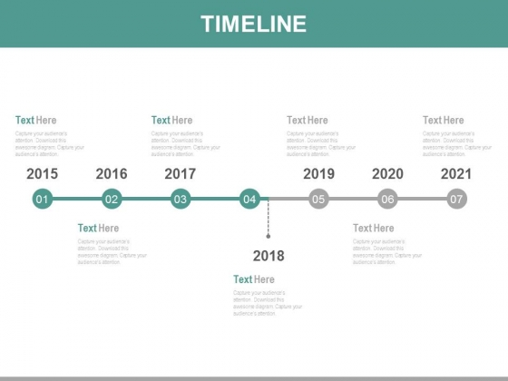
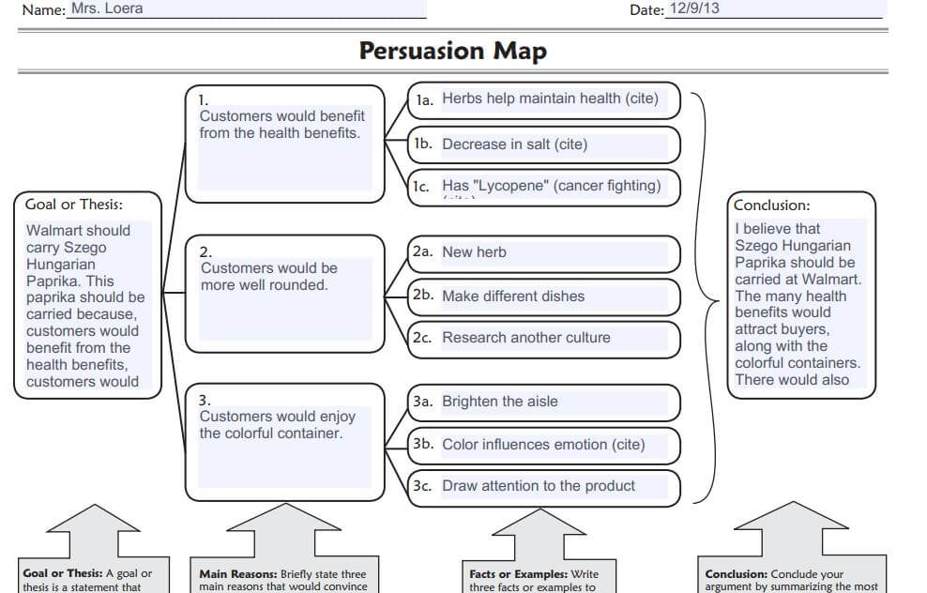
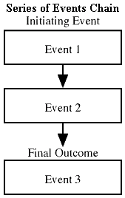
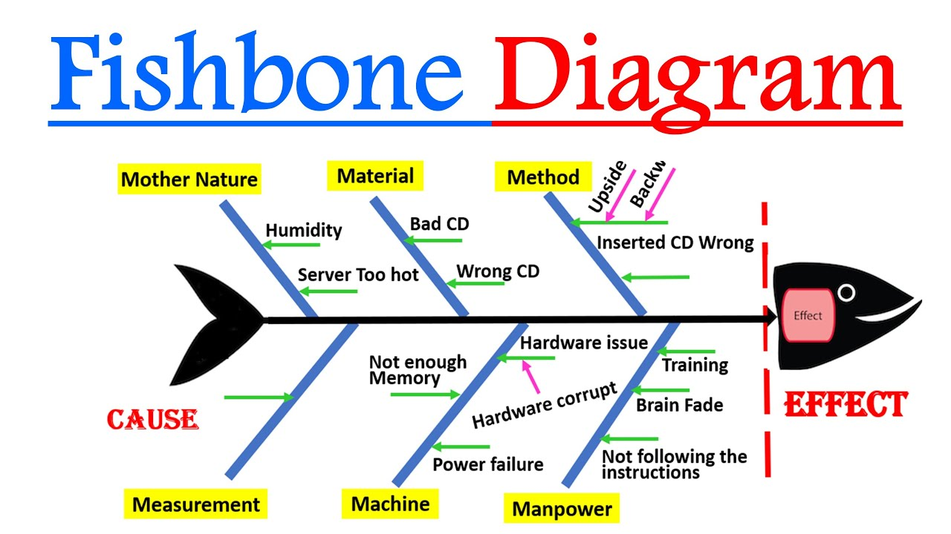
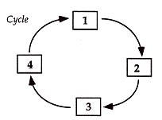
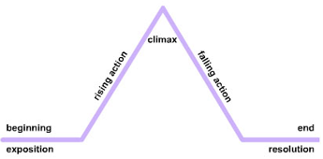
Types of graphic organizer
Persuasion Map
Used to map out arguments and evidences and how these pieces of informaation result to coherent conclusion.
Timeline
Used to show how events occurred chronologically through a long bar labeled with specific dates and events.
Series of Events Chain
Used to demonstrate how a linear sequence leads to a specific outcome.
Fishbone Map
Is a visualization tool for categorizing the potential cause a specific problem and details of each cause.
Cycle Map
Used to describe how a series of events interact to generate a set of results repeatedly.
Plot Diagram
Used to map events in a story which aims to analyze each part of the plot.

Slide 25
Review:
1. Outlining
2. Brainstorming
3. Graphic Organizer
1. knowledge/concept map 2. Story Map
3. Venn Diagram
4. Network Tree
5. Spider Map
6. Problem-Solution Map
7. Persuasion Map
8. Timeline
9. Series of Events Chain
10. Fishbone Map
11. Cycle Map
12. Plot Diagram

Slide 26
thanks!
Any questions?

