Slide 1
Reading and Writing

Slide 2
1.
Properties of a Well-Written Text

Slide 3
When can we say text is a well written?

Slide 4

Organization

Slide 5
Many students have a problems comprehending expository text because they can’t see a basic structure of text. (Dymoch 2005)

Slide 6
Organization
structural framework for writing
logical progression and completeness of ideas in a text.

Slide 7
Text Organization
Physical Presentation
Text Structure
Textual Cues
Headings
Sub-headings
- locating main ideas
- topic sentence
- signal words
- chunk of text
1. Expository
Scientific articles
Cause and Effect
Speeches
2. Narrative
- Grammar Free

Slide 8
Important features of an organized Text
1. Focus
I was glad when the COVID restrictions ended and the shopping mall was open. Then we all shopped and bought lots of new outfits and the most fashionable color this year is blue. When I got home I immediately went on Facebook to show off my clothes haul to my social media followers.

Slide 9
Important features of an organized Text
2. Development
Touch is our most intimate and powerful means of communication. A doctor makes the mother feel her baby to give her satisfaction after her birth labor. The mother caresses the newborn and gives the baby a feeling of love and security that will be the foundation of the self. A father taps the shoulder of his son holds his father’s hand in a final goodbye. A friend embraces another friend to drive away the latter’s loneliness. These are tactile stimulations oftentimes spell a difference.
Topic sentence: beginning of the paragraph
Controlling idea: touch intimate, powerful communication
Supporting details: sentences 2-5
Clinching sentence: last sentence

Slide 10
Important features of an organized Text
3. Unity
I was glad when the COVID restrictions ended and the shopping mall was open. At last I could meet with my friends and hang out at the food court. I immediately called them and they agreed to go out with me. Then we all shopped and bought lots of new outfits and the most fashionable color this year is blue. When I got home I immediately went on Facebook to show off my clothes haul to my social media followers.

Slide 11
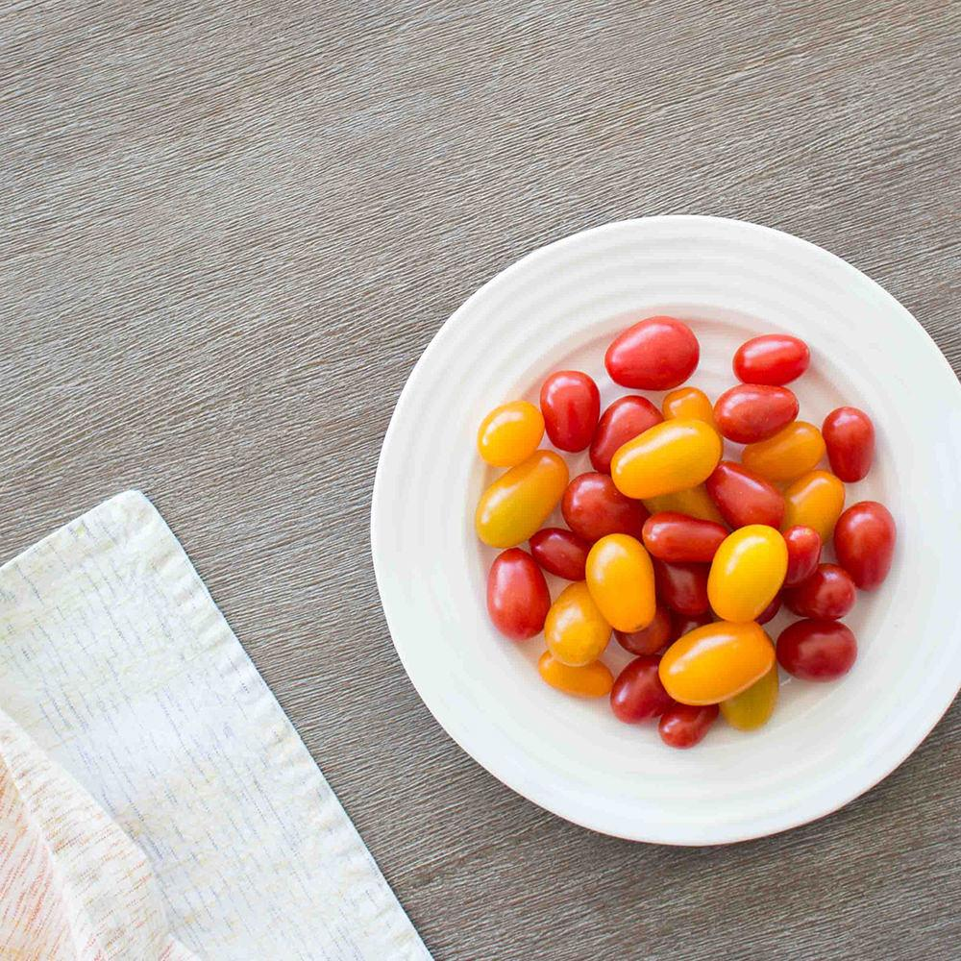
Formula of an organize text/essay
STTC
Single Idea
Topic Sentence
(appropriate) Techniques
Connectives

Slide 12
Cohesion and Coherence

Slide 13
Cohesion
Is defined as the set of resources for constructing relations in discourse which transcend grammatical structure. (Haliday 1994)

Slide 14
6 main ways that cohesion is created in a text (Halliday and Hasan 1976)
Reference
Substitution
Ellipsis
Lexical Chains
Cohesive Nouns
Conjunction

Slide 15
Reference
Personal Pronouns
e.g. I, me, she, he, you, mine
Demonstratives
e.g. Near – this, these, here
Far – that, those, there
Comparatives e.g. another, other, similar, better, many, identical
The definite article
e.g.The
Death penalty is a serious issue that has not been resolved for quite a long time. Arguments for and against it have been discussed fully. Those who favor the death penalty argue that only way to stop crime is to eliminate the criminal. Those opposing it say that putting a criminal to death denies the chance to repent and mend his ways. But are criminals especially the deep-eyed ones, capable of repentance?
E.G.
I have collected BTS photo cards and I love it.
them

Slide 16
Substitution
Death penalty is a serious issue that has not been resolved for quite a long time. Arguments for and against it have been discussed fully. Those who favor the death penalty argue that only way to stop crime is to eliminate the criminal. Those opposing it say that putting a criminal to death denies the chance to repent and mend his ways. But are criminals especially the deep-eyed ones, capable of repentance?
uses a word or phrase to replace a word or phrase used earlier.
Ones is substitute to criminals

Slide 17
Ellipsis
Omitting words because it is already understood in the context.
E.g I can play ukulele and he can too.

Slide 18
Lexical Chains
Death penalty is a serious issue that has not been resolved for quite a long time. Arguments for and against it have been discussed fully. Those who favor the death penalty argue that only way to stop crime is to eliminate the criminal. Those opposing it say that putting a criminal to death denies the chance to repent and mend his ways. But are criminals especially the deep-eyed ones, capable of repentance?
One word is related to another.
Sequence of related words in writing.

Slide 19
Cohesive Nouns
A kind of lexical reference
Can summarize words can be used to signal what is to come can refer back.
E.g
Two cars collided on the flyover. However, nobody was hurt in the accident.

Slide 20
Conjunction
Death penalty is a serious issue that has not been resolved for quite a long time. Arguments for and against it have been discussed fully. Those who favor the death penalty argue that only way to stop crime is to eliminate the criminal. Those opposing it say that putting a criminal to death denies the chance to repent and mend his ways. But are criminals especially the deep-eyed ones, capable of repentance?
Firstly, next, moreover, however, but and more…

Slide 21
Coherence
Comes from making logical connections between ideas in each part of the text and the context.

Slide 22
How can you achieve coherent text?
Clarify the meaning
Indicate a change of topic
Headings and sub-headings
Layout
Formatting

Slide 23
Coherence could be achieve having:
Logical ordering of ideas
Formatting/ clear communicative stages
Eliminating ambiguity
Maintaining consistency in texts and syntax (do not forget the cohesive devices)

Slide 24
Cohesion vs. Coherence
Cohesion
- as the act of forming a whole unit.
- a subject of coherence
- Focused on the grammatical aspect of writing
- Degree to which sentences are connected
- Is where you can see connections
Coherence
- quality of being logical, consistent and be able to be understood.
- rhetorical aspects of writing which include developing and supporting your argument, synthesizing and integrating, reading, organizing and clarifying ideas.
- Is where you infer connections

Slide 25
Language Use

Slide 26
Appropriate language use
Acceptable style of language for a particular form of text.
Determined when it is appropriate to use formal language or when informal language is acceptable.

Slide 27
Characteristics of an Effective Language
1. Use concrete words
- Short and simple
- Avoid redundancy
Examples:
X We collaborated together on the project.
We collaborated on the project.
X The other alternative is to eat healthy foods.
The alternative is to eat healthy foods.

Slide 28
Characteristics of an Effective Language
1. Use concrete words
- Short and simple
- Avoid redundancy
2. Use familiar words
- Use words that are almost everyone’s vocabulary
3. Use precise and clear words
- Exact or accurate

Slide 29
Characteristics of an Effective Language
4. Avoid sexist language
- Not gender bias
Examples:
X Reading makes a full man. (Francis Bacon)
Reading makes a full person.
X Each students must have notebook with him in class.
All students must have notebooks with them in class.

Slide 30
Characteristics of an Effective Language
5. Use of constructive language
- Can boost someone’s confidence.
6. Use of formal and informal language
- A register is a variety of language related to particular subject matter or area of activity.
Examples:
This is to tell you.
We have bought books.
informed
purchased

Slide 31
Characteristics of an Effective Language
6. Use of formal and informal language:
- A register is a variety of language related to particular subject matter or area of activity.
Active and Passive Voice – passive voice is more formal.
Phrasal verbs and Latinate verbs – Latinate is formal.
Formal uses nominator not personal pronouns.
Example:
The researcher or we used qualitative method in the research.
Active
Qualitative method was used in the research.
Passive
Example:
The building failed down.
Phrasal Verb
The building collapsed.
Latinate Verbs
Example:
If you lose it, Pls. contact the customer service as soon as possible.
If you lose it; pls. contact us.
Personal Pronouns
Nominator
Any loss of this document should be reported immediately.

Slide 32
Mechanics

Slide 33
Mechanics of Writing
Punctuations
Capitalizations
Spelling
Abbreviation

Slide 34
1. Punctuations
a. Comma
Example:
Practical Research 1, EAPP, and Empowerment are specialized subjects in the Senior High School.
- separate items in a series. A series is made up of 3 or more nouns, verbs, modifiers, or phrases.
- separate coordinate adjectives; two or more adjectives that equally modify the same noun.
Example:
The asymptomatic, COVID positive patient was rushed to the hospital.
- separate long clauses joined by conjunctions such as by, and, but, or, for, yet, and s: although it is omitted if the clauses are short.
Example:
Last week was my sister’s wedding, so I prepared to go to the salon for my haircut.

Slide 35
1. Punctuations
a. Comma
Example:
While I was waiting for the rain to subside, suddenly there was a bolt of lightning split the sky.
- Use commas after introductory clauses, phrases, or words that come before the main clause.
Example:
Being on time, I have received an incentive from my book.
- Set off introductory elements (words that introduce a sentence with a comma)
Participial Phrase
Infinitive Phrase
To travel outside the region, you need to secure necessary documents.
Ms. Alarcon, who passionately taught English Educators, was one of my favorite teachers.
Appositive Phrase

Slide 36
1. Punctuations
a. Comma
Use commas set off dates (except the month and day)
Geographical names, items in a date. (except the month and day)
Addresses (except street number and name)
Titles in names.
Examples:
On March 31, 2011, Panabo became a city.
Trisha Q. Posadas, LPT.

Slide 37
1. Punctuations
b. Semicolon
Example:
I am excited to go home; I wanted to stay there for good.
- When you link two independent clauses with no connecting words.
- Joining two independent clauses with one of the following conjunctive adverbs.
Example:
I am excited to go home; moreover, I wanted to stay there for good.
Conjunctive adverbs: however, moreover, therefore, consequently, otherwise, nevertheless, thus, etc.

Slide 38
1. Punctuations
c. Colon
Examples:
My favorite verse is Philippians 4:13.
Majority of the references that I cited were taken from the Academic Journal 11:23 (volume 11, page 23)
- Separating chapter from verse in Bible reference, separating volume from page in bibliography reference, writing a salutatory greeting in professional writing and giving the time.
Example:
Three things I have accomplished today: answered modules, e-mailed documents, and researched enrichment activities.
- Introduce a formal list

Slide 39
2. Capitalization
Davao region is located on the southeastern portion of Mindanao.
Always capitalized the first word in a sentence.
Proper nouns and adjectives
Capitalize the pronoun I and the interjection O.
The Davao Crocodile Park is a must-see destination in Davao City.
O God, I thank you.

Slide 40
2. Capitalization
D. Capitalize professional titles when used before a personal name and academic titles and their abbreviations when they follow a personal name.
E. Brand names
F. First word in a letter’s greeting or close.
G. The days of the week, months of the year, and holidays.
Dr. Callie Torres
Addison Adrianne Forbes Montgomery, M.D.
My dream car is Toyota Fortuner.
Sincerely yours,
The opening of the classes is in October.
I always set a vacation to meditate for Holy Week.

Slide 41
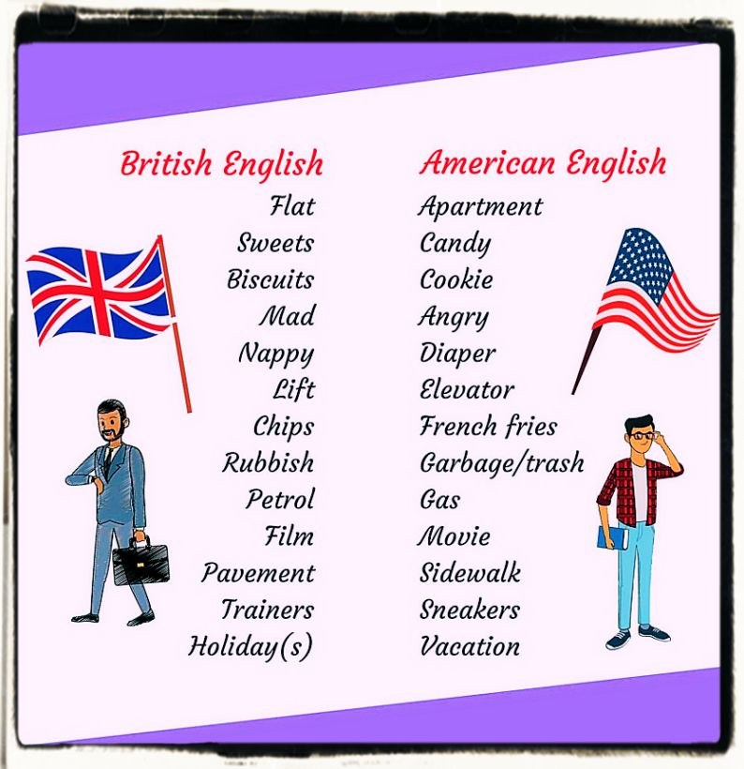
3. Spelling
Reference: https://google.com/images

Slide 42
4. Abbreviation
a. Only abbreviate well-known terms.
b. Abbreviations that use capital letters are called initialisms it is required to put a period after each letter.

Slide 43
Any questions?
Thank you for listening!

