Slide 1
Reading and Writing
ijm

Slide 2
SHARING

Slide 3
Reading as a Skill
One has to read effectively in order to tackle requirements and pass the subject.

Slide 4

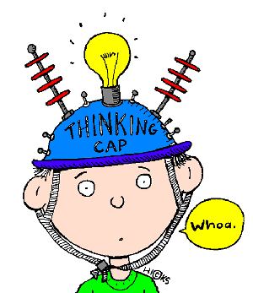
Reading…
Decoding process
Comprehension process

Slide 5
Text as Connected Discoursed
Use of knowledge, experience, and thinking in getting the meaning from the print.
Author
Reader
And Text

Slide 6
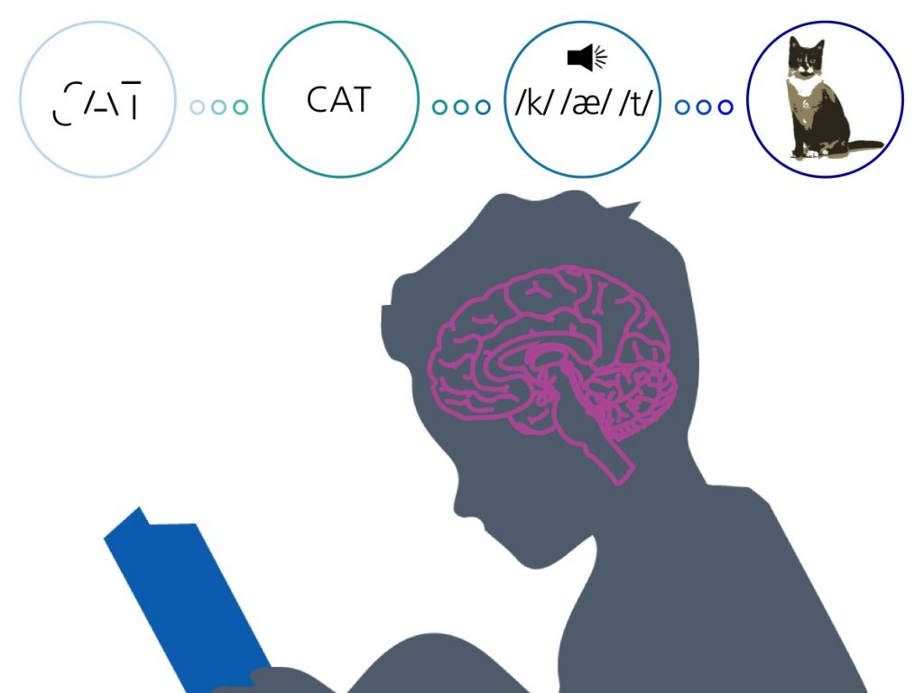
Reading as a Process
Reading is an activity which takes on stages or levels.
According to Woods (2006), it has 3 stages:
Pre-reading,
During reading, and
Post reading

Slide 7
Techniques in Reading
Previewing
Overviewing
Surveying
Used to get only the main ideas of a written text in order to know what the material is all about.
Skimming
Scanning
Used to search only for specific information needed.
This requires pro-cessing of the text for full understanding of the material
Comprehensive
Critical
This involves an analysis of the claims presented in the text.

Slide 8
01
Using Contextual Clues
Context clues – are words, phrases and sentences that would help you to deciher the meaning of difficult words in the selection.

Slide 9

Use of Synonyms as Context Clues
Synonyms appear in a sentence in the following ways:
By dashes
Example: She finds solace-comfort-in the country-side.
By commas to separate the appositive.
Example: The advocates, supporters, of anti-mining formed a picket outside the building.

Slide 10
Use of Synonyms as Context Clues
By parentheses
Example: The local residents are among the hordes (a large group of people) who lined up to take their chance in the contest.
By reinstatement or expression of the word in a more familiar term
Example: The smiles these little children are guileless. They show innocence and no deception

Slide 11
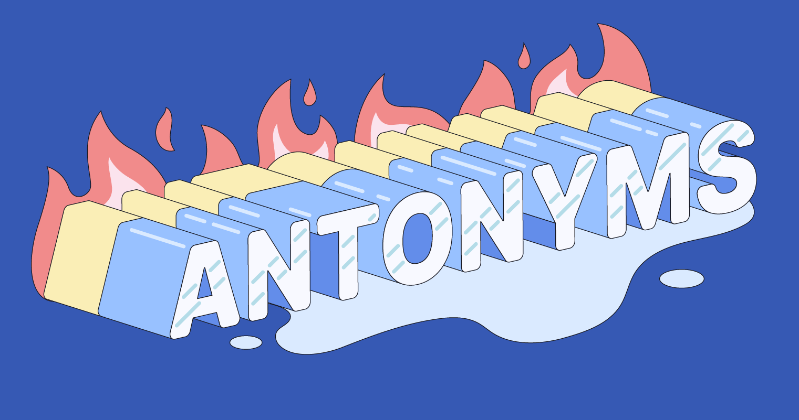
Use of Antonyms as Context Clues
Example: His siblings are generous and giving but she is so stingy.
Note: antonyms are recognized in a sentence through any word which presents opposite meanings like but, although, despite, instead, in contrast, unlike, however, even though, on the contrary, conversely, etc.

Slide 12

Use of Examples as Context Clues
Examples are list of illustrations which make the unfamiliar word clearer. In order to derive the meaning of the word, you have to analyze the examples given and find a common trait or characteristic.
Example: Lyn is on a diet. However, she still ate a portion of everything served like a small piece of meat, a small piece of bread, and a small piece of cake.

Slide 13
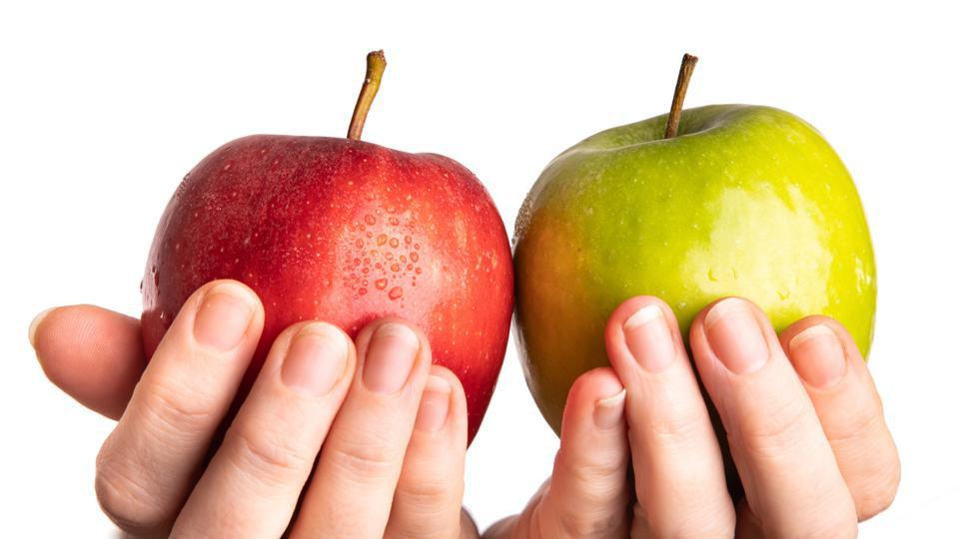
Use of Comparison as Context Clues
Identifying the similarities and differences of two or more things, places, or events.
Examples: Laura gets easily perplexed by the brain teasers but Kim figures them out easily.

Slide 14

Use of Sense of Sentence as Context Clues
Consider the meaning, nature, or significance of the while sentence.
Example: It is important to clean the colon by eating fruits and vegetables to rid the body of toxins.

Slide 15
Comprehensive Reading
02
Understanding of what you read.

Slide 16
Inferring the Main
03
Involves the use of information presented in the text and connecting it to your own knowledge.

Slide 17

Levels of Comprehesion
Literal Comprehension
Inferential
Applied Comprehension

Slide 18
Distinguishing Facts from Opinion
04

Slide 19
“

