Slide 1



ARELLANO UNIVERSITY
Jose Abad Santos Campus
Basic Education Department – Senior High School
3058 Taft Avenue, Pasay City
STATISTICS AND PROBABILITY

Slide 2
Objectives:
Define Sampling Distribution of sample means;
Illustrates the steps in constructing the sampling distributions of the sample mean.
Illustrate the formula in calculating Population Mean, Variance and Standard Deviation;
Compute the Mean , Variance and Standard Deviation of the Sampling Distribution of the Sample Means.

Slide 3
SAMPLING DISTRIBUTION
OF THE
SAMPLE MEANS

Slide 4
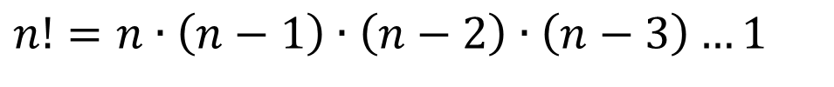
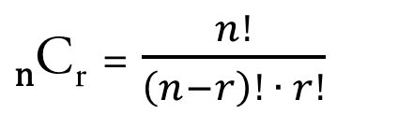
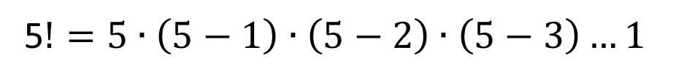
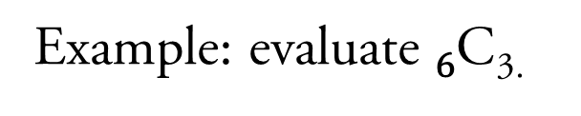
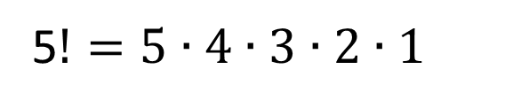
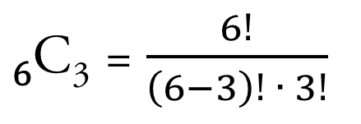
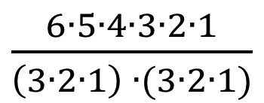
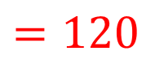
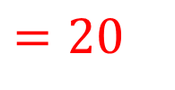
REVIEW
FACTORIAL NOTATION
COMBINATION
- Regardless of order.
Example: evaluate 5!

Slide 5
SAMPLING DISTRIBUTION
The probability distribution of a sample statistic.

Slide 6
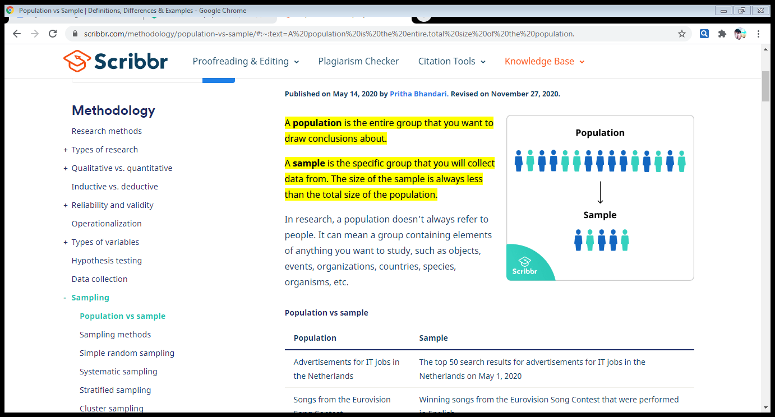
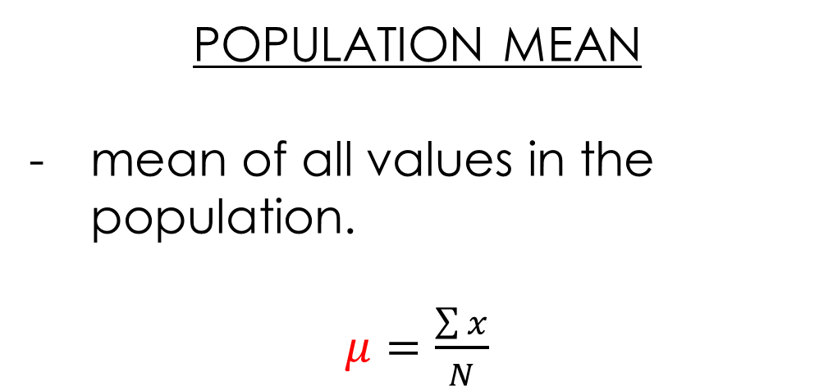
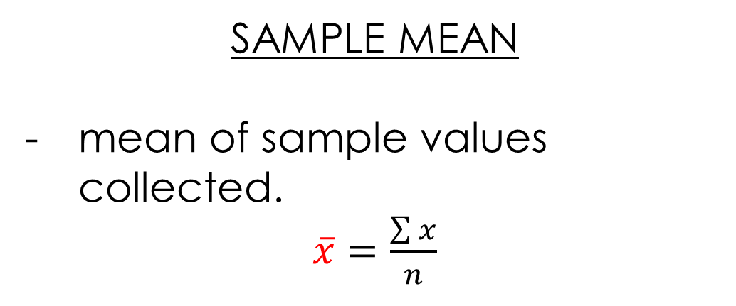

Slide 7
SAMPLING DISTRIBUTION OF THE
SAMPLE MEAN
A frequency distribution using means computed from all possible random samples of a specific size taken from a population.

Slide 8
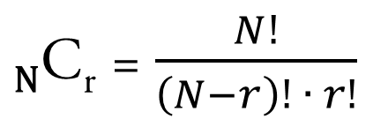
STEPS IN CONSTRUCTING THE SAMPLING DISTRIBUTION OF THE SAMPLE MEAN
Determine the number of possible samples that can be drawn from the population using the formula of combination “ _{N}C_{r} ” where N is the size of the population and r is the size of the sample.
List all the possible samples and compute the mean of each
sample.
3. Construct a frequency distribution of the sample means obtained
in step 2.

Slide 9
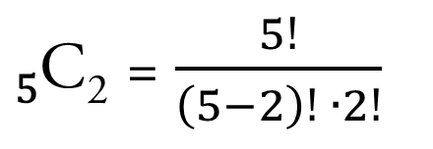
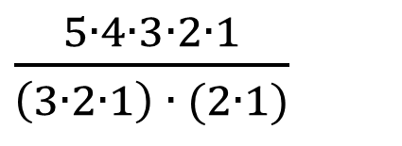
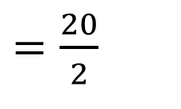

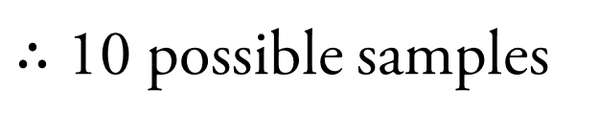
Example 1: Five small pouches are known to contain 5,8,10,6, and 4 marbles in each pouch. These pouches are placed in a box and two pouches are drawn at random from the box. Construct a sampling distribution of the average number of marbles in a pouch.
Given: N = 5; r = 2
Step 1: Determine the number of possible samples that can be drawn from the population.

Slide 10



Step 2: List all the possible samples and compute the mean of each sample.
(4, 5)
(4, 6)
(4, 8)
(4, 10)
(5, 6)
(5, 10)
(5,8)
(6, 8)
(6,10)
(8,10)
4
5
10
6
8
Random Possible Sample | (4, 5) | (4, 6) | (4, 8) | (4, 10) | (5, 6) | (5, 8) | (5, 10) | (6, 8) | (6, 10) | (8, 10)
Sample Mean
4.5
5
6
7
5.5
6.5
7.5
7
8
9

Slide 11
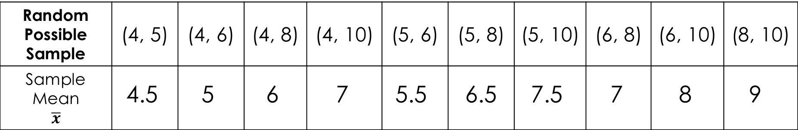
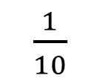
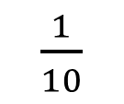
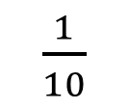
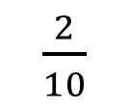
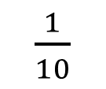
Step 3: Construct a frequency distribution of the sample means obtained in step 2.
Sample Mean | 4.5 | 5 | 5.5 | 6 | 6.5 | 7 | 7.5 | 8 | 9
Frequency

