Slide 1
Differential gene expression analysis in HCC
Tumor vs adjacent non-tumor liver tissues • GSE22058
Aim: identify differentially expressed genes and interpret their biological and miRNA-target regulation patterns.
15-minute presentation
Paired design
Functional enrichment
Notes:
Good morning. Today I will present my gene expression data analysis project on hepatocellular carcinoma. The aim was to compare tumor and adjacent non-tumor liver samples, identify differentially expressed genes, and then interpret those genes using functional enrichment and miRNA-target enrichment. I will not focus on the code line by line; instead, I will focus on the analytical choices, the quality controls, and the biological meaning of the results.

Slide 2
Dataset
Study design and biological question
Question
96
192
2
Which genes and biological processes distinguish HCC tumor tissue from adjacent non-tumor liver tissue?
paired patients
samples analyzed
conditions
Paired comparison
Tumor and adjacent non-tumor tissue come from the same individuals.
This controls part of the inter-patient variability.
Therefore, a paired t-test is appropriate downstream.
Tumor
Adjacent non-tumor
Gene expression data analysis • HCC tumor vs adjacent non-tumor liver
02
Notes:
The dataset contains paired samples, meaning that each patient contributes one tumor sample and one adjacent non-tumor liver sample. In the final imported metadata, I retained 96 patients with both tissue types, for 192 samples total. This paired design is important because tumor and control are matched within the same individual. As a result, the statistical analysis can compare tumor and normal expression within patients rather than treating the samples as completely independent.

Slide 3
Pipeline
Analysis workflow
1
2
3
4
5
Import
Preprocess
Test
Visualize
Interpret
GEO matrix + metadata
log2(data + 1) + IQR filter
paired t-test + FDR
volcano, boxplots, heatmap, PCA
EnrichR + MIENTURNET
Output of the pipeline
1667 differentially expressed genes
Directional pathway enrichment
Candidate miRNA-target regulatory modules
Gene expression data analysis • HCC tumor vs adjacent non-tumor liver
03
Notes:
The analysis was organized as a sequential pipeline. First, I imported the GEO expression matrix and phenotype metadata. Second, I performed preprocessing by applying a log2 transformation and IQR-based filtering. Third, I calculated log fold change and performed a paired t-test for each gene, followed by FDR correction. Fourth, I generated diagnostic and interpretive plots: volcano plots, boxplots, heatmap, and PCA. Finally, I used EnrichR and MIENTURNET to interpret the DEG list functionally and from a miRNA-target perspective.

Slide 4
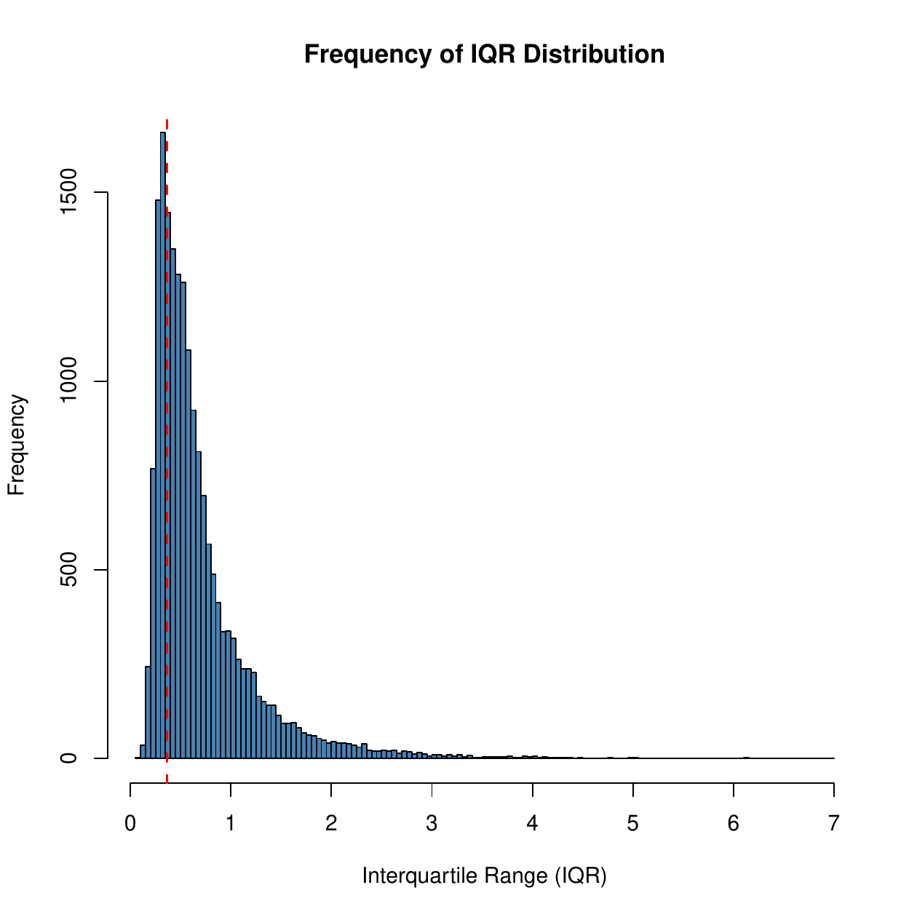
Filtering
Preprocessing: remove low-information genes
IQR filtering
Expression values were transformed as log2(data + 1).
IQR was computed for each gene across all samples.
Genes below the 25th percentile of IQR were removed.
This keeps genes with enough variability to be informative.
18,503
13,877
25%
genes before filtering
genes retained
low-IQR genes removed
Interpretation
The histogram is highly concentrated near low IQR values, so filtering removes genes with little variation while preserving most of the transcriptomic signal.
Gene expression data analysis • HCC tumor vs adjacent non-tumor liver
04
Notes:
Before testing for differential expression, I transformed the expression matrix with log2 of data plus one, as required by the project. Then I calculated the interquartile range for every gene. The histogram shows that many genes have low variability across samples. I used the 25th percentile of the IQR distribution as the filtering threshold. This reduced the dataset from 18,503 genes to 13,877 genes. The reason is that genes with very low variability are unlikely to be informative for differential expression analysis and may add unnecessary noise.

Slide 5
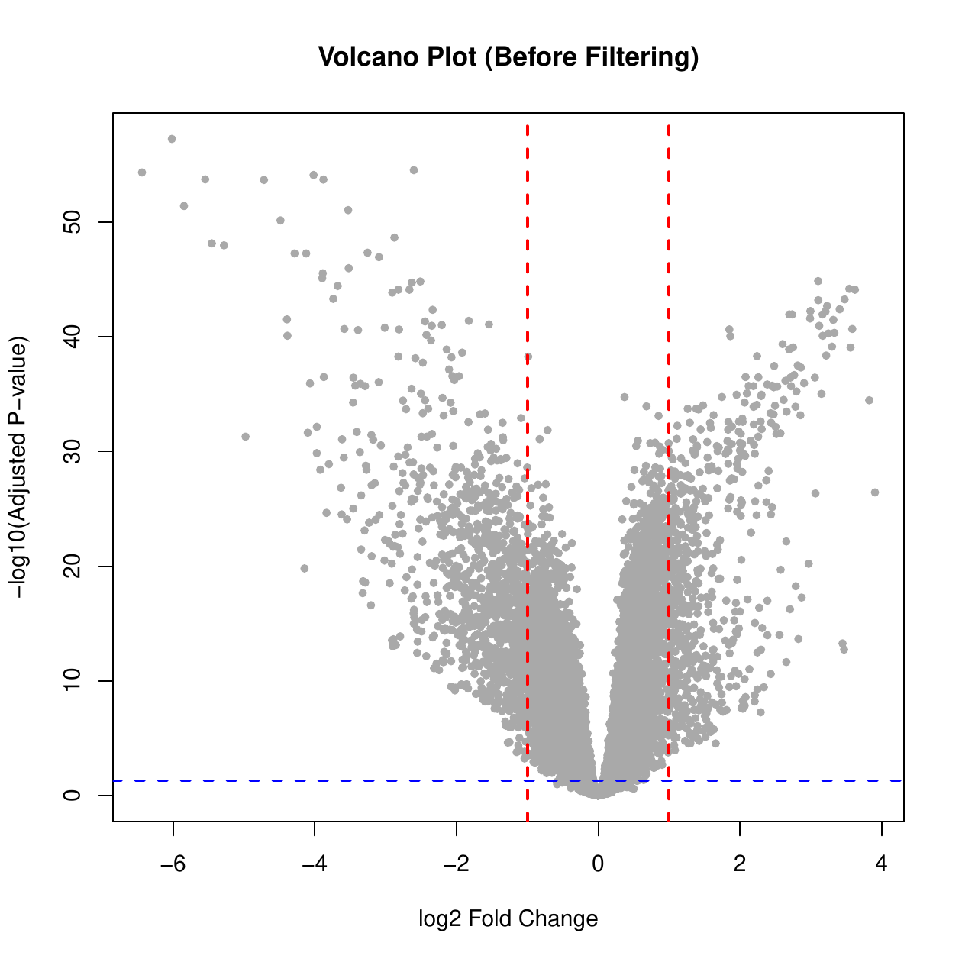
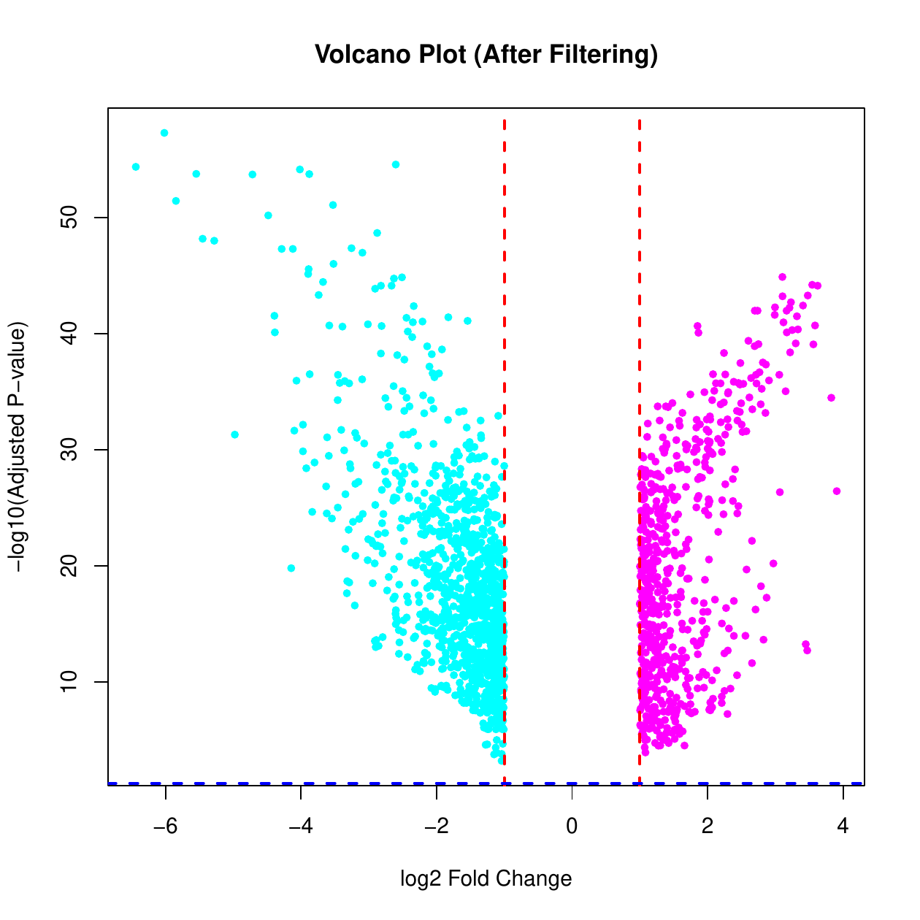
DEG results
Differential expression: 1667 genes pass FC and FDR thresholds
Thresholds
Fold-change ≥ 2
|log2FC| ≥ 1
Adjusted p-value < 0.05
Paired Student’s t-test
1667
602
1065
DEGs
UP-regulated
DOWN-regulated
Before filtering
After filtering
Positive logFC = higher expression in tumor. Negative logFC = lower expression in tumor.
Gene expression data analysis • HCC tumor vs adjacent non-tumor liver
05
Notes:
Differential expression was performed on the filtered log-transformed matrix. Because the samples are paired, I used a paired Student's t-test for each gene. Then I corrected p-values using FDR. I selected genes with adjusted p-value below 0.05 and absolute log2 fold change of at least one, corresponding to a fold change of at least two. With these thresholds I obtained 1667 differentially expressed genes: 602 were up-regulated in tumor and 1065 were down-regulated. The pre-filter volcano shows the full distribution of genes, while the post-filter volcano shows only genes that pass both the fold-change and adjusted p-value thresholds.

Slide 6
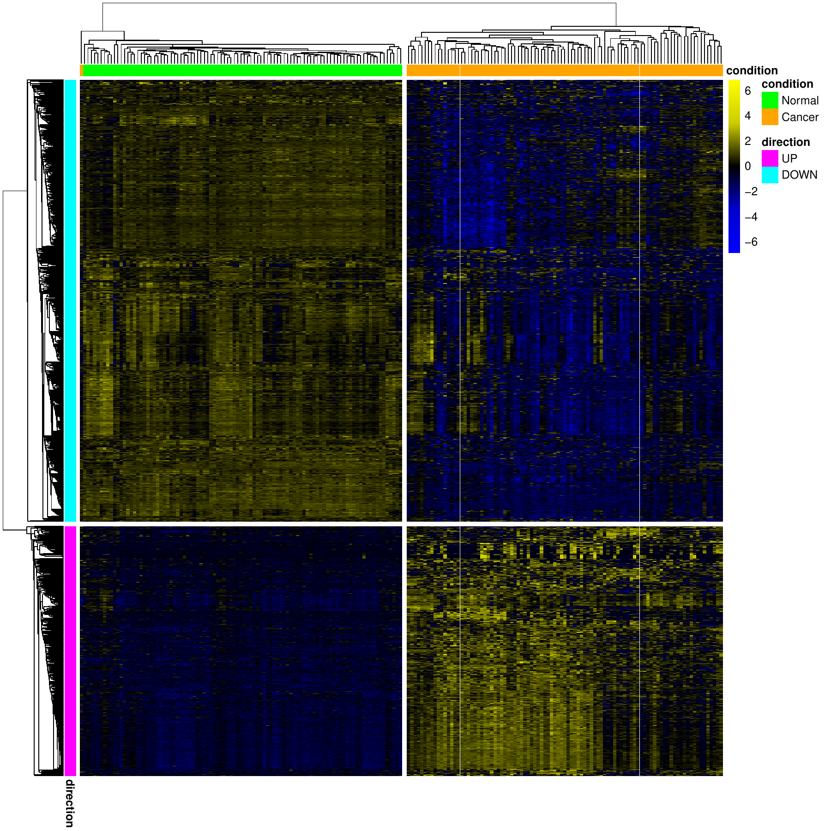
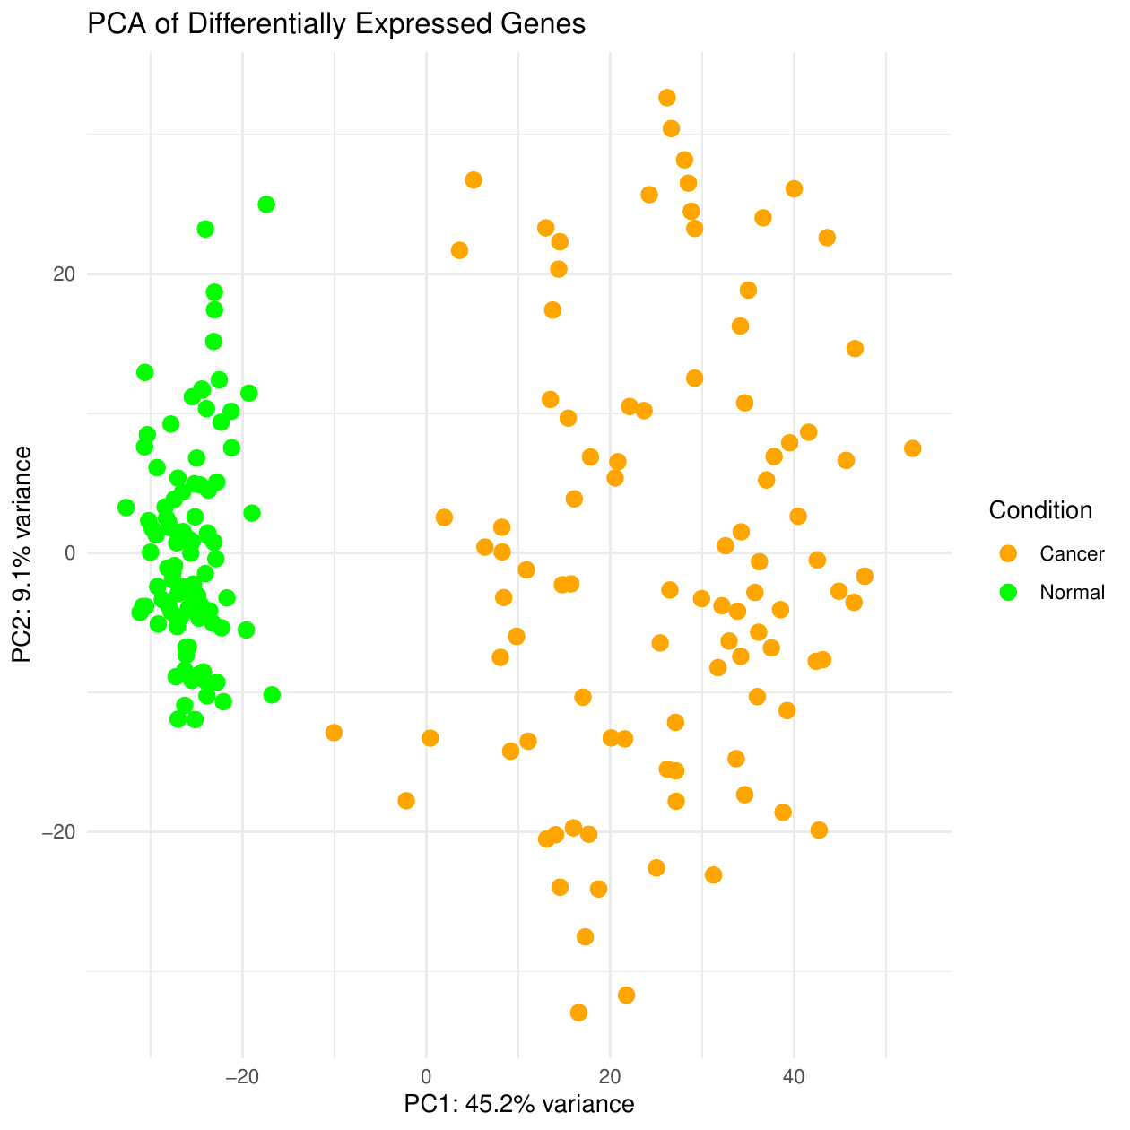
Quality check
DEG profiles separate tumor from adjacent normal samples
Key readout
PC1 explains 45.2% of variance and clearly separates normal and tumor samples.
The heatmap shows opposite expression blocks for UP and DOWN genes.
PCA
Heatmap
Gene expression data analysis • HCC tumor vs adjacent non-tumor liver
06
Notes:
After identifying the DEG list, I checked whether these genes really separate the two biological conditions. The heatmap is very clear: tumor samples and normal samples form distinct expression patterns, and the UP and DOWN regulated genes show opposite blocks. The PCA gives the same message. PC1 explains 45.2 percent of the variance and separates normal samples from tumor samples. This supports the idea that the DEG list captures a real biological difference between the two tissues.

Slide 7
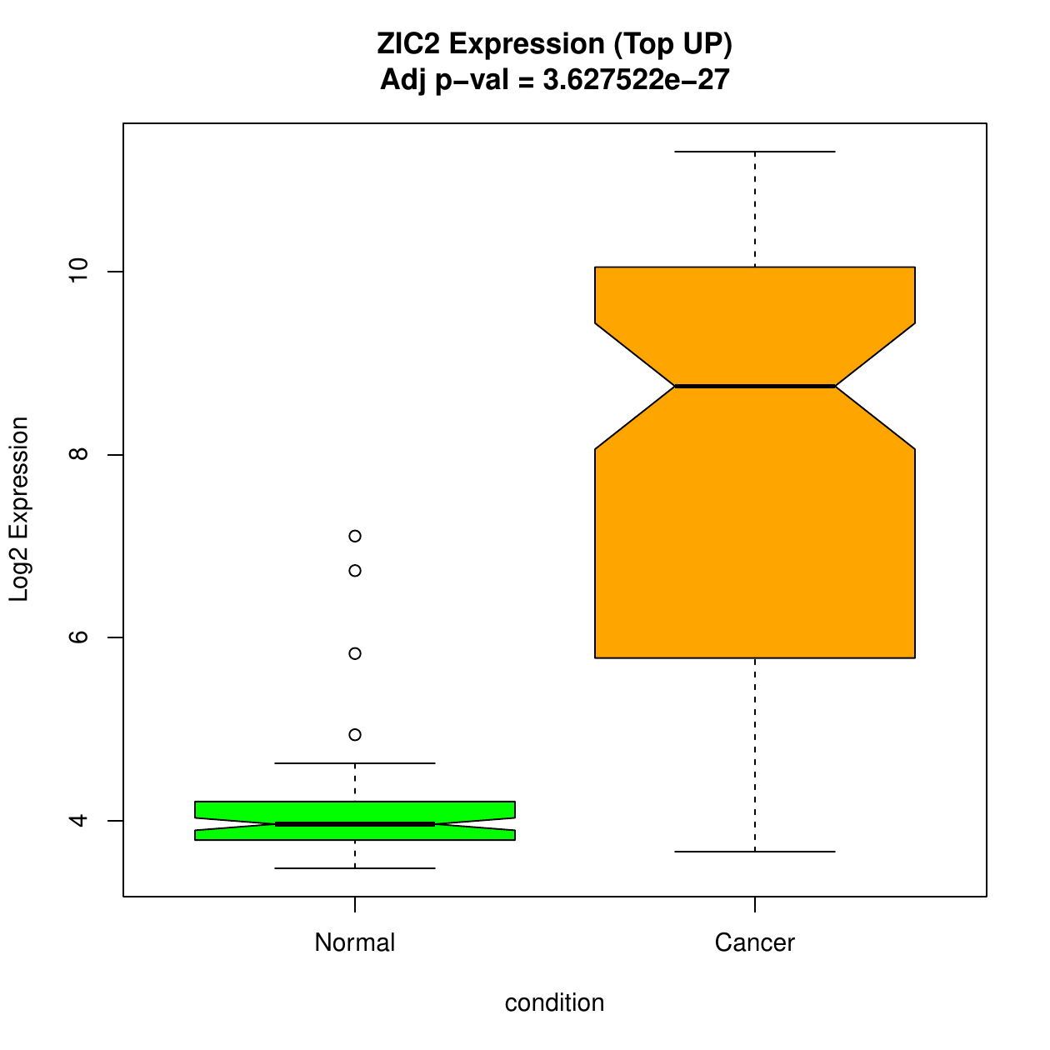
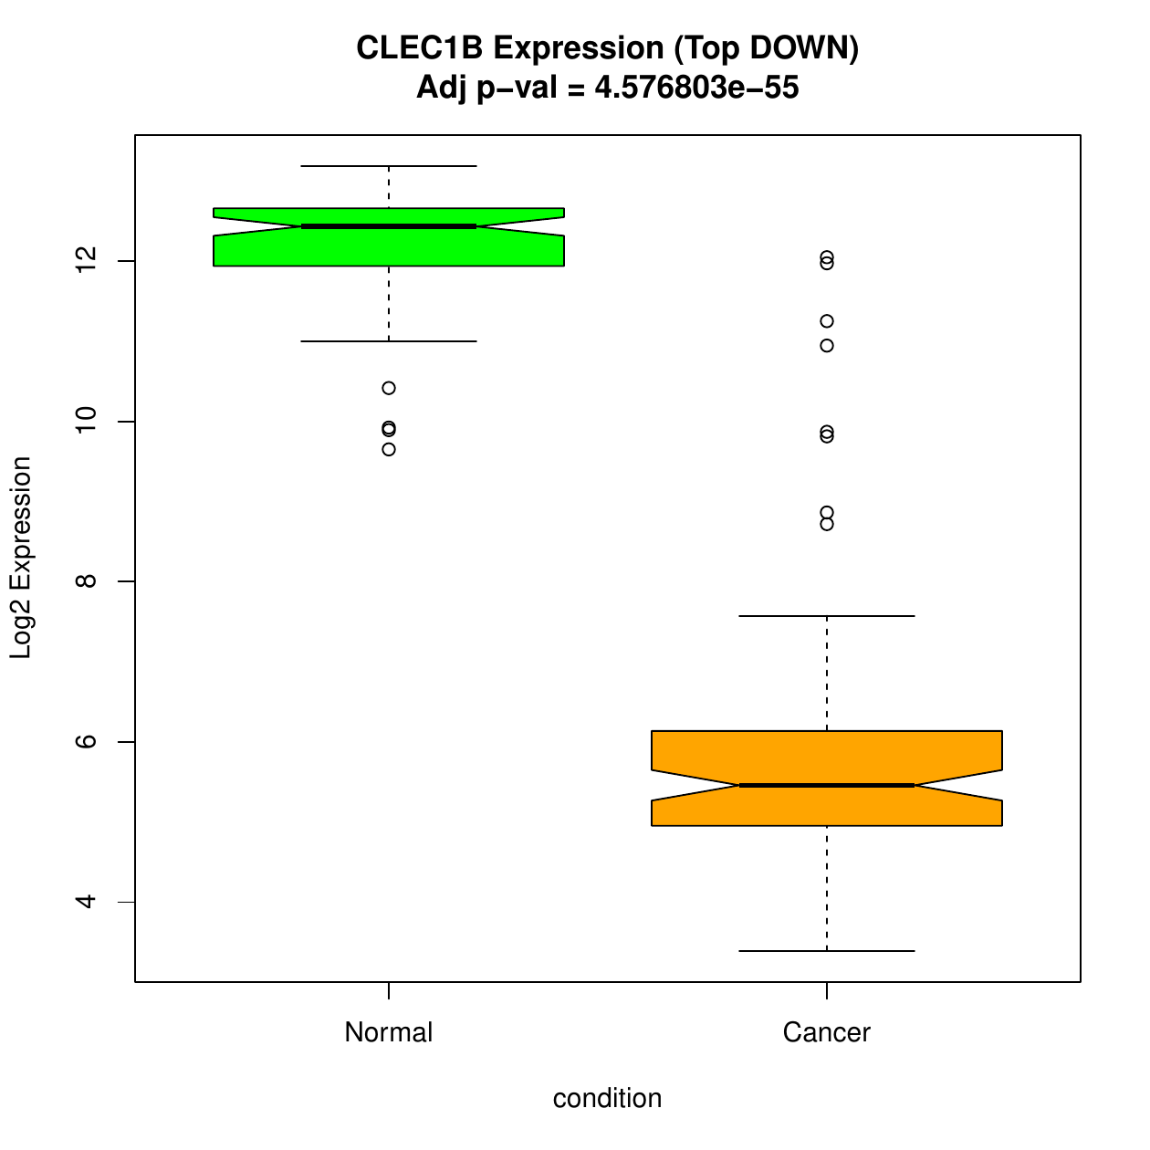
Top genes by logFC
Representative genes validate the direction of change
ZIC2: top UP-regulated gene
CLEC1B: top DOWN-regulated gene
Gene expression data analysis • HCC tumor vs adjacent non-tumor liver
07
Notes:
To make the differential expression result more concrete, I selected one representative UP-regulated gene and one representative DOWN-regulated gene based on log fold change. ZIC2 is strongly higher in cancer samples than in adjacent normal samples, with a very significant adjusted p-value. CLEC1B shows the opposite pattern: it is highly expressed in normal tissue and strongly reduced in tumor tissue. These two boxplots are useful in the presentation because they show, in a simple way, how the DEG calls translate into actual expression differences across samples.

Slide 8
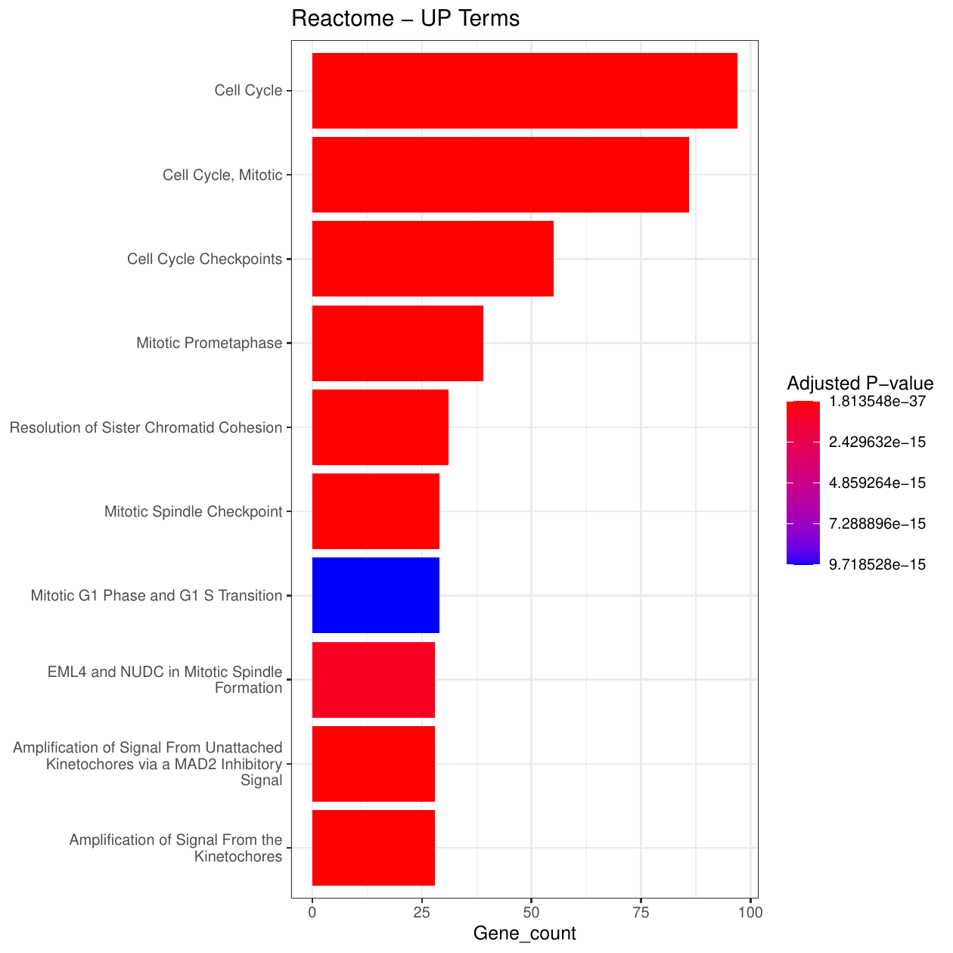
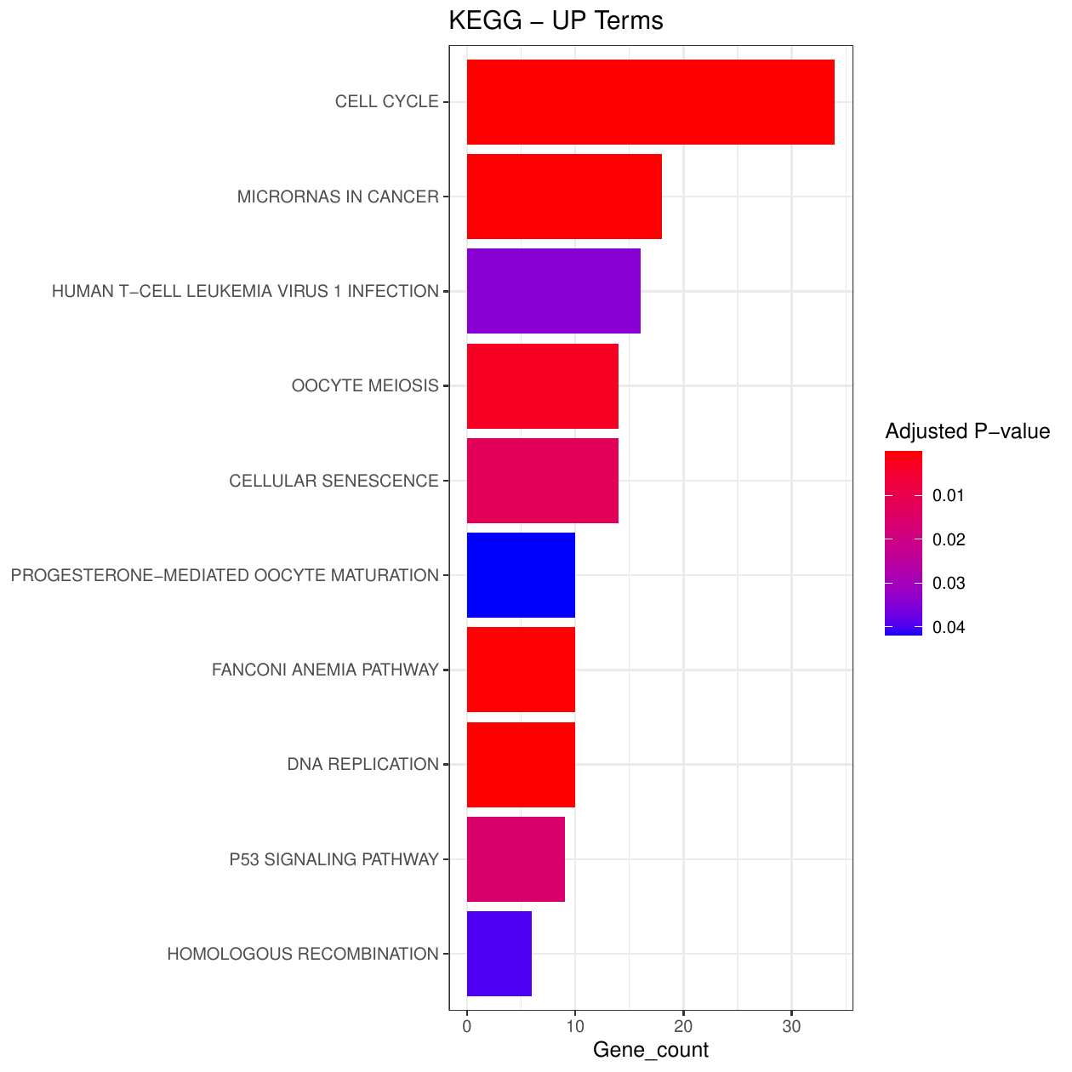
Functional enrichment
UP-regulated genes: cell cycle and mitotic proliferation
Biological message
Cell cycle
DNA replication
Mitotic checkpoints
Chromosome segregation
p53 signaling
MicroRNAs in cancer
Tumor samples activate proliferative programs.
Reactome
KEGG
Gene expression data analysis • HCC tumor vs adjacent non-tumor liver
08
Notes:
The enrichment analysis was performed separately for UP and DOWN regulated genes. For the UP-regulated genes, the result is very coherent. Reactome highlights cell cycle, mitotic cell cycle, cell cycle checkpoints, mitotic prometaphase, and spindle checkpoint terms. KEGG confirms the same picture, with cell cycle as the dominant pathway, followed by DNA replication, microRNAs in cancer, p53 signaling, and homologous recombination. Biologically, this means that tumor samples activate a proliferation-related program involving DNA replication, mitosis, and checkpoint regulation.

Slide 9
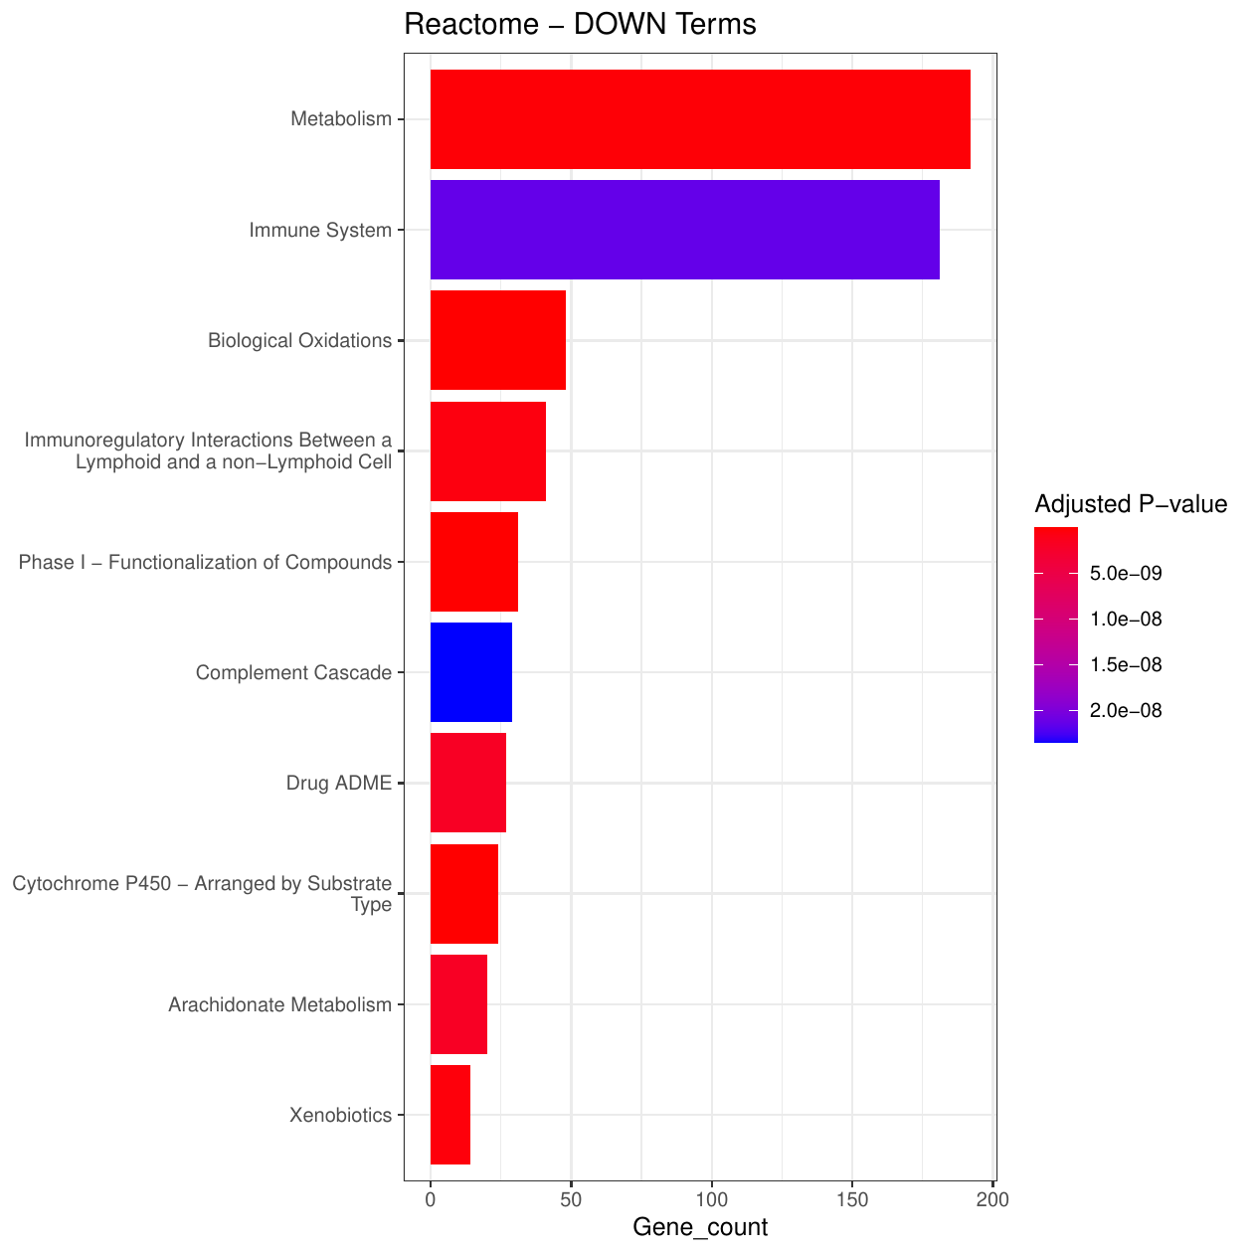
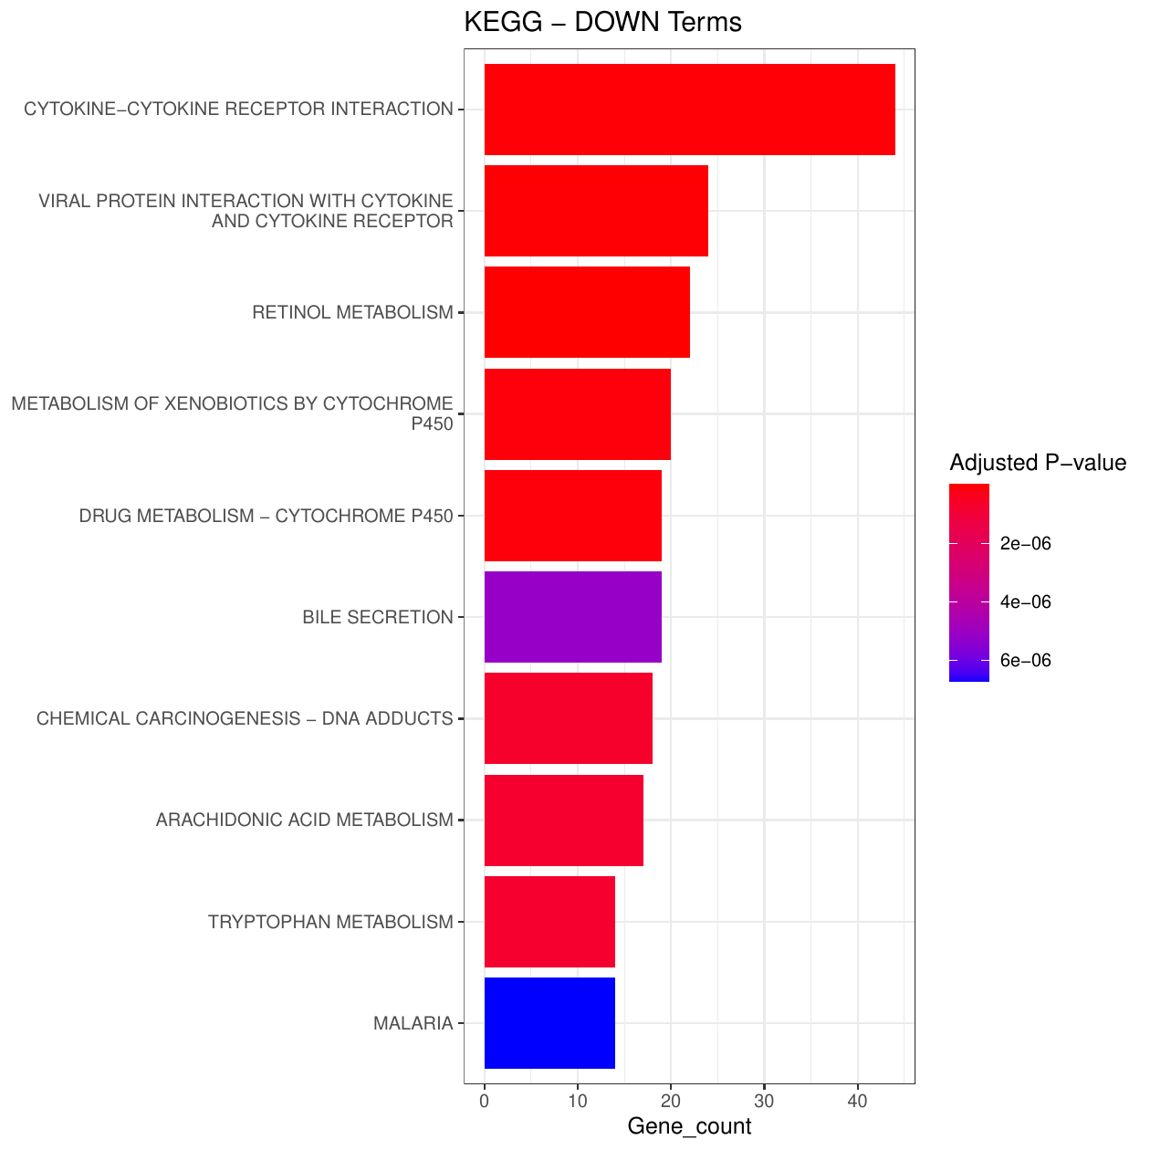
Functional enrichment
DOWN-regulated genes: loss of liver metabolism and immune remodeling
Biological message
Cytochrome P450 metabolism
Xenobiotic and drug metabolism
Retinol metabolism
Bile secretion
Biological oxidations
Cytokine/chemokine signaling
Tumor samples lose normal hepatocyte metabolic functions.
Reactome
KEGG
Gene expression data analysis • HCC tumor vs adjacent non-tumor liver
09
Notes:
The DOWN-regulated genes show a different biology. Reactome highlights metabolism, immune system, biological oxidations, phase I functionalization, drug ADME, and cytochrome P450-related pathways. KEGG highlights retinol metabolism, cytokine-cytokine receptor interaction, xenobiotic metabolism by cytochrome P450, drug metabolism, and bile secretion. This suggests that the tumor tissue has reduced expression of normal liver metabolic and detoxification functions. At the same time, there is also an immune and inflammatory component, visible through cytokine and immune-related pathway terms.

Slide 10
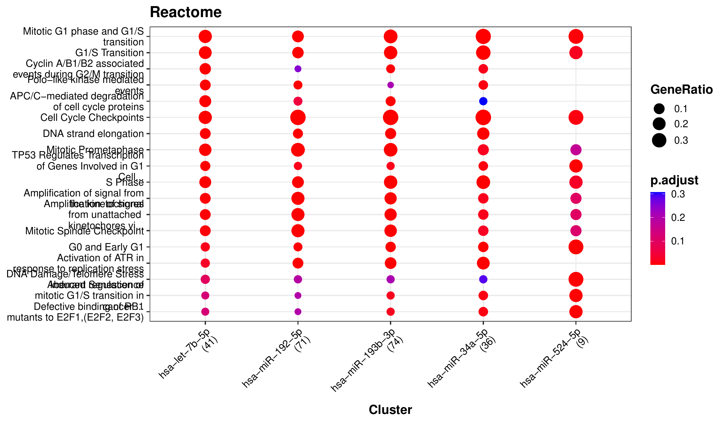
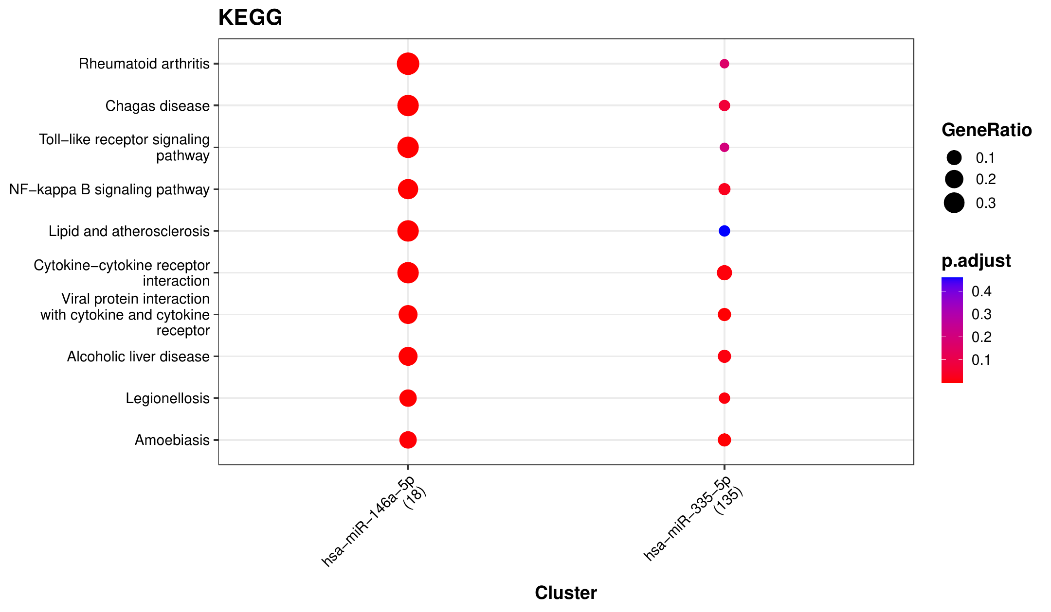
miRNA-target enrichment
MIENTURNET: candidate miRNA regulators of DEG modules
UP genes: cell-cycle/DNA replication miRNA-target modules
DOWN genes: immune/inflammatory miRNA-target modules
hsa-let-7b-5p
hsa-miR-192-5p
hsa-miR-193b-3p
hsa-miR-34a-5p
hsa-miR-146a-5p
hsa-miR-335-5p
Interpret with caution: these are enriched candidate regulators, not measured miRNA expression changes.
Gene expression data analysis • HCC tumor vs adjacent non-tumor liver
10
Notes:
To investigate possible post-transcriptional regulation, I used MIENTURNET. I ran UP and DOWN gene lists separately. For the UP-regulated genes, the enriched miRNA-target modules were associated with cell cycle, G1/S transition, DNA replication, p53 signaling, and DNA damage response. Candidate miRNAs included hsa-let-7b-5p, hsa-miR-192-5p, hsa-miR-193b-3p, and hsa-miR-34a-5p. For the DOWN-regulated genes, the strongest result was hsa-miR-146a-5p, with pathway terms related to Toll-like receptor signaling, NF-kB signaling, cytokine signaling, interleukins, and chemokines. It is important to be precise: these miRNAs were not measured as differentially expressed; they are candidate regulators based on enrichment of their known targets.

Slide 11
Additional analysis
Literature-based validation of selected findings
Purpose: check whether the main computational findings are biologically plausible according to previous HCC/cancer literature.
ZIC2: top UP-regulated gene by logFC
CLEC1B: top DOWN-regulated gene by logFC
Reported as a prognostic and immune-response marker in liver cancer/HCC.
Supports the relevance of the strong tumor-up signal.
Reported as a prognostic biomarker in HCC and associated with immune infiltration.
Consistent with its strong reduction in tumor samples.
CYP450 / drug metabolism loss
miRNA-target findings
HCC literature reports down-regulation/deregulation of xenobiotic-metabolizing CYP genes.
Supports loss of normal hepatocyte detoxification function.
miR-146a: immune/inflammatory and TLR/NF-kB-related signaling.
miR-34a: p53-related miRNA linked to cell-cycle arrest, DNA-damage response, and apoptosis.
Conclusion: findings are consistent with published HCC/cancer biology, but remain hypothesis-generating.
Selected examples: Sun et al. 2021; Liang et al. 2022; Nekvindova et al. 2020; Fu et al. 2023.
Gene expression data analysis • HCC tumor vs adjacent non-tumor liver
11

Slide 12
Synthesis
Integrated biological interpretation
UP in tumor
DOWN in tumor
Regulatory layer
Cell cycle
DNA replication
Mitosis
Checkpoint control
P450 metabolism
Drug/xenobiotic metabolism
Retinol and bile pathways
miRNA-target modules
Cancer and immune signaling
Candidate post-transcriptional control
Overall conclusion
HCC tumor tissue is characterized by activation of proliferative cell-cycle programs and reduced expression of normal liver metabolic/detoxification functions, with additional immune and miRNA-target regulatory signals.
Gene expression data analysis • HCC tumor vs adjacent non-tumor liver
12
Notes:
Putting all results together, the project gives a coherent biological story. The genes up-regulated in tumor tissue are strongly connected to proliferation: cell cycle, DNA replication, mitosis, and checkpoint control. The genes down-regulated in tumor tissue are connected to normal liver metabolic functions, including cytochrome P450 metabolism, xenobiotic metabolism, drug metabolism, retinol metabolism, and bile secretion. The miRNA-target enrichment adds a regulatory layer, suggesting candidate miRNAs associated with the proliferative and inflammatory components of the DEG signature. Overall, the analysis suggests that hepatocellular carcinoma tissue activates tumor growth programs while losing differentiated hepatocyte functions.

Slide 13
Final takeaways
Conclusions and limits
Main conclusions
Limitations
1667 DEGs distinguish tumor from adjacent non-tumor liver samples.
UP-regulated genes point to proliferation, DNA replication, and mitotic checkpoint activity.
DOWN-regulated genes point to loss of hepatocyte metabolism and detoxification.
MIENTURNET suggests candidate miRNA regulators of proliferative and immune/inflammatory modules.
miRNAs are inferred from target enrichment, not directly tested for expression.
Functional enrichment is hypothesis-generating.
Further validation would require independent cohorts or experimental follow-up.
Take-home message
The pipeline produced a biologically coherent HCC signature: proliferative activation in tumors, loss of normal liver function, and plausible miRNA-target regulatory modules.
Gene expression data analysis • HCC tumor vs adjacent non-tumor liver
13
Notes:
To conclude, the coding and data generation produced a complete and consistent result. With the selected thresholds, the analysis identified 1667 differentially expressed genes. The visualizations show strong separation between normal and tumor samples. Functional enrichment shows that UP-regulated genes are related to proliferation and cell cycle, while DOWN-regulated genes are related to liver metabolism and detoxification. MIENTURNET adds candidate miRNA-target regulatory modules. The main limitation is that the miRNAs are inferred from target enrichment and not directly measured as differentially expressed. Therefore, they should be interpreted as candidate regulators. Overall, the take-home message is that the analysis produced a biologically coherent HCC expression signature.

