Slide 1




API Compare and Contrast
January 11, 2017

Slide 2
WELCOME!
About Us:
Meetup Calendar:
http://www.meetup.com/
Slack Group:
http://www.slack.com
Facebook:
Twitter:

Slide 3
FULL STACK
High-level points about a “Full Stack” and its components…

Slide 4
API BASICS
API’s are a nice way to decouple development of the Full Stack components from the previous slide…
Some basic shit about API’s…. CONTRACT
JSON or XML
REST vs. SOAP

Slide 5
REST
Representational State Transfer (or something like this)
Some basic shit about REST….
Resources
Routes
GET
POST
DELETE
PUT or PATCH

Slide 6
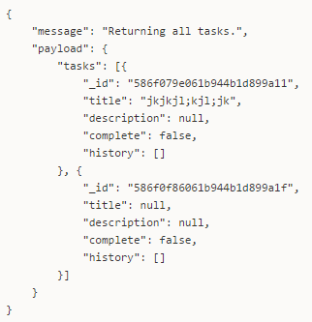
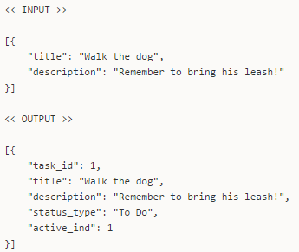
API CONTRACT
1. GET /tasks
2. POST /tasks
3. PATCH /tasks/{id}
4. PATCH /tasks/{id}

Slide 7

TODO APP
We implemented basic REST API concepts in a ToDo app
Features of the app…
How it works…
Multiple Full Stacks (identical Front-End’s)
Can we talk about Vue on this slide? Or does it need its own?

Slide 8



MULTIPLE FULL STACKS
#1
#2
#3
#4
Front-End
API Layer
Database

Slide 9
SLIM PHP + POSTGRESQL
#1
#2
#3
#4
Front-End
API Layer
Database

Slide 10
NODE.JS + MONGODB
#1
#2
#3
#4
Front-End
API Layer
Database

Slide 11
FLASK + SQLITE
#1
#2
#3
#4
Front-End
API Layer
Database

Slide 12
DJANGO + ???
#1
#2
#3
#4
Front-End
API Layer
Database

Slide 13
SLIM PHP + POSTGRESQL
Lightweight RESTful framework
Written in PHP
Super Fast
Relational Database System
Feature-Rich
Free and Open Source

Slide 14

NODE.JS + MONGODB
Server-side JavaScript Framework
Web Server and more
Asynchronous
NoSQL Document Database
Replication
Sharding

Slide 15
FLASK + SQLITE
Lightweight RESTful framework (like Slim!)
Written in Python
Super Fast
Small Relational Database (like a mini-PostgreSQL!)
Used in Mobile
xxxx

Slide 16

DJANGO + ???
Full-Fledge Web Framework
Written in Python
Not as fast as Flask… but Feature-Rich!
????
????
????

Slide 17
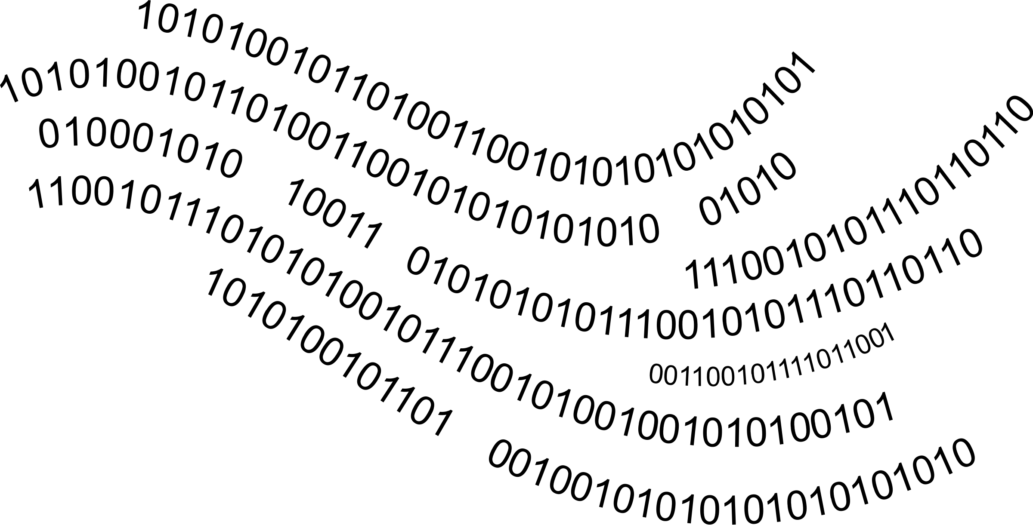

DEMOS!!!

Slide 18
NEXT STEPS
ADDITIONAL FEATURES:
Due Dates
Logins / Permissions
Recurring Tasks
Task Dependencies
Error Handling and Reporting
Better Development Practices

