Slide 1

A Night With:
October 10, 2018

Slide 2

<< Empty Bullets >>
xxxxx
xxxxxx
xxxxx
xxxxxx
xxxxx
xxxxxx

Slide 3
<< Empty Slide >>

Slide 4

To The Terminal!
xxxx

Slide 5

Next Steps
Docker Volumes
Dockerfile
Docker Compose and Swarm
Docker in a CI/CD Pipeline

Slide 6

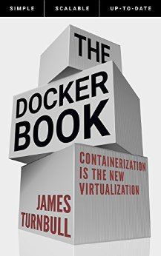
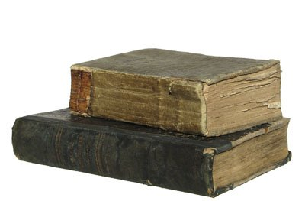
Docker Resources
https://app.pluralsight.com/library/courses/containers-images-big-picture/table-of-contents
https://app.pluralsight.com/library/courses/docker-deep-dive/table-of-contents
https://www.xenonstack.com/blog/docker-overview-a-complete-guide
https://docs.docker.com/get-started

Slide 7

Thanks!

