Slide 1




What Others Are Doing….
“R as a Data Transformation Pipeline”
Oct 11 (Thu) • 6 pm
CIC@CET • 20 S. Sarah St
“Kubernetes for Java Developers”
Oct 11 (Thu) • 6:30 pm
World Wide Technology – WHQ • 701 Fee Fee Rd
“An Insurance Industry Look at Distributed Ledger Tech”
Oct 23 (Tue) • 5:30 pm
12140 Woodcrest Executive Dr Ste 310
Creating a Centralized Store that Fits Your App
Oct 24 (Wed) • 7:00 pm
CIC@CET • 20 S. Sarah St

Slide 2
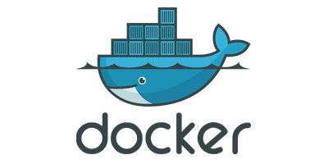
A Night With:
October 10, 2018

Slide 3
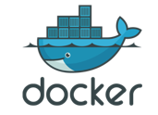

Next Steps
Docker Volumes
Dockerfile
Docker Compose and Swarm
Docker in a CI/CD Pipeline

Slide 4
Next Steps
Docker Volumes
Dockerfile
Docker Compose and Swarm
Docker in a CI/CD Pipeline

Slide 5
Next Steps
Docker Volumes
Dockerfile
Docker Compose and Swarm
Docker in a CI/CD Pipeline
Docker Networking

Slide 6
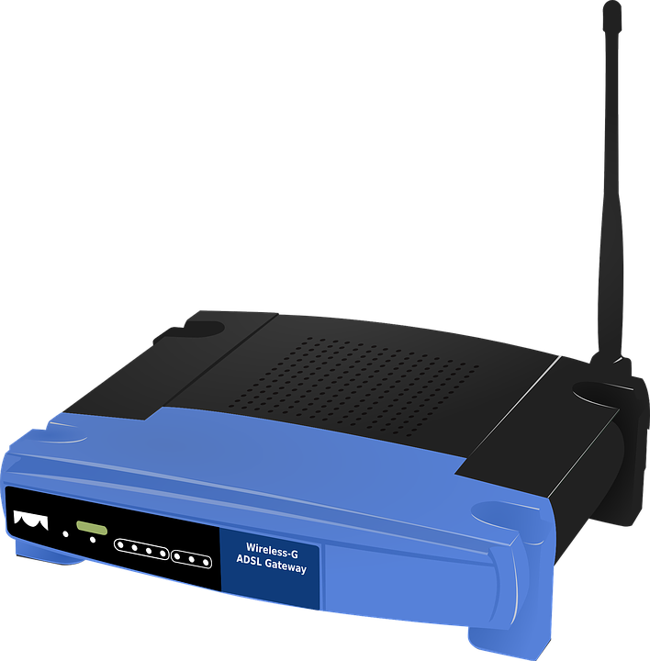



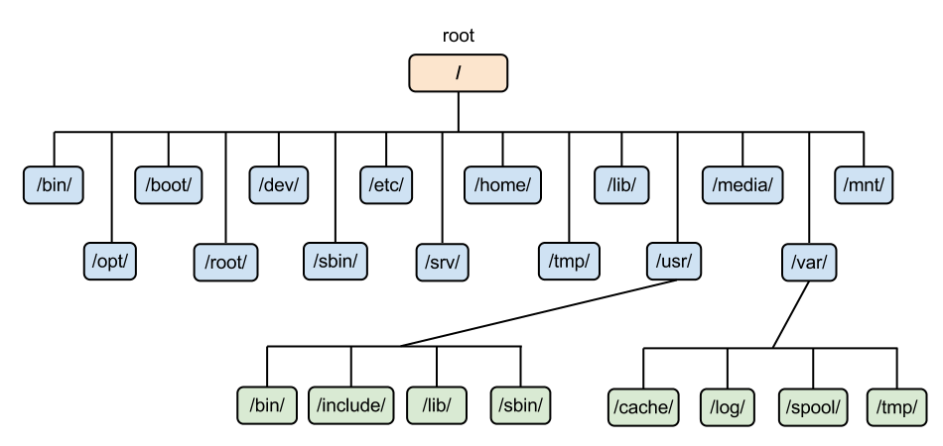

Refresh 101 – Containers!
CONTAINERS ARE:
Isolated Processing Environments
Can include their own network, storage, etc.
Host system houses containers
Purpose: To Run an Application or Service
Includes EVERYTHING – (Small) OS…. Files…. Dependencies
Lightweight
Minimum requirements to run
FAST!!!

Slide 7
Refresh 101 – Why Use
Predictable DEPLOYMENT Environments
DEV → QA → UAT → PROD
Deployment Types: (1) Blue/Green (2) Rolling (3) Phoenix
Efficient PRODUCTION Environments
Run More Applications on a Machine
Manage Highly-Elastic Applications
Effective DEVELOPMENT Environments
Easy Software Install and Admin / Configuration
Speedy Sandboxes

Slide 8

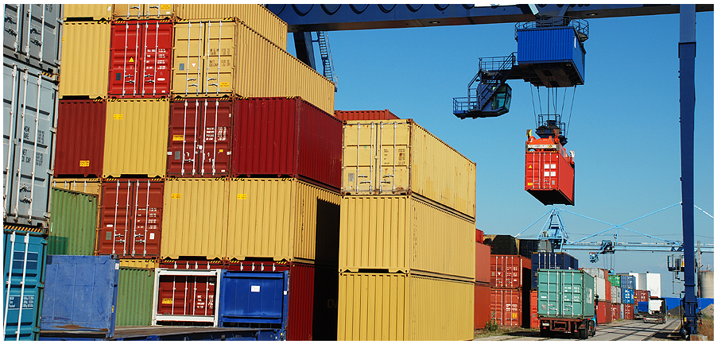
Refresh 101 – What Is Docker?
Creates, Manages and Orchestrates Containers
Separate Applications from Infrastructure
Better… Faster Software Deployment
Packages an Application → Shippable (and Runnable) Image
“Build, ship, and run any app, anywhere”
Applications work the same on everyone’s machines
Docker:
“Dock Worker” moves goods into/out of ships

Slide 9
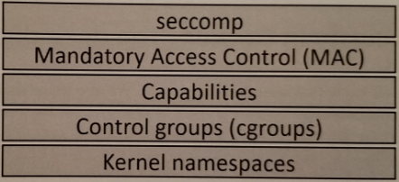
Refresh 101 – Enabling Technologies
Kernel Namespaces
Slice up an OS to look like multiple isolated environments (Process, Network, File System)
Control Groups
Limit Resource Usage (CPU, RAM, Disk I/O)
Capabilities
Choose which ROOT powers a container needs

Slide 10
Refresh 101 – Docker Concepts
Engine | Coordinates all of the Docker components
Images | Core artifact of Docker…. Binaries (“Build”)
Containers | Launched from images …. Running applications (“Deploy”)
Dockerfiles | Readable code for image creation (“Source Code”)
Registries | Collection of repositories (which store images)

Slide 11
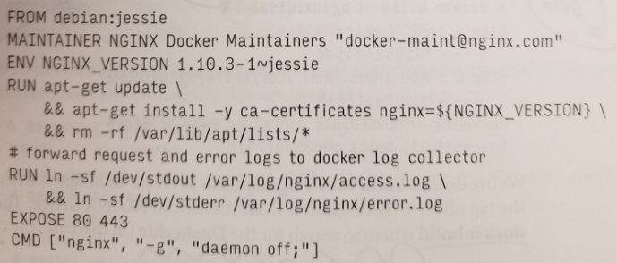
Dockerfiles
Recipes for Building Images
Instructions and Shell Commands
First Instruction Specifies a Base Image
Each Command Creates a New Layer
Source Code Artifact
Store in Version Control!!

Slide 12
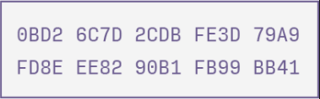
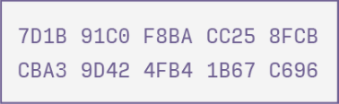
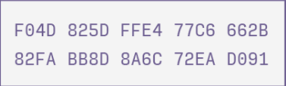
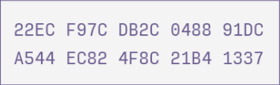
Dockerfiles
Recipes for Building Images
Instructions and Shell Commands
First Instruction Specifies a Base Image
Each Command Creates a New Layer
Source Code Artifact
Store in Version Control!!
New
Image Layers

Slide 13
Dockerfiles – Build Context
Set of Files – Path or URL
Supporting files for a Docker build
Transfers contents to Docker daemon
Context Location is Important!
Root (/) directory will transfer all contents to Docker daemon
.dockerignore File
Similar to .gitignore
Define exempt files

Slide 14

To The Terminal!
1. Simple Dockerfile Examples

Slide 15
Dockerfiles – Command Keywords
FROM
Base image to use
RUN
Execute commands in a new layer
WORKDIR
RUN, CMD, ENTRYPOINT, COPY, ADD
ENV
Environment variables for image
COPY
Copying files to container
ADD
Tarball Extraction…. Remote URL
ENTRYPOINT
Command to start a container
CMD
Default parms to start a container

Slide 16
To The Terminal!
2. Dockerfile Example – WORKDIR…. ENV…. COPY…. CMD

Slide 17
Dockerfiles – Command Keywords
ARG
Variable to be passed at build-time
EXPOSE
States which port container listens on
LABEL
Metadata for an image
VOLUME
Creates a mount point
USER
Name or group for image/commands
ONBUILD
Trigger for child images to execute
STOPSIGNAL
Sets system signal to exit container
HEALTHCHECK
Test if container is ok

Slide 18
Dockerfiles – Command Keywords
ARG
Variable to be passed at build-time
EXPOSE
States which port container listens on
LABEL
Metadata for an image
VOLUME
Creates a mount point
USER
Name or group for image/commands
ONBUILD
Trigger for child images to execute
STOPSIGNAL
Sets system signal to exit container
HEALTHCHECK
Test if container is ok
SHELL

Slide 19
To The Terminal!
3. Dockerfile Example – ARG…. LABEL…. HEALTHCHECK

Slide 20
Dockerfiles – COPY vs. ADD
COPY
xxxxx
xxxxx
Xxxxx
ADD
xxxxx
xxxxx
xxxxx

Slide 21
Dockerfiles – ENTRYPOINT vs. CMD
ENTRYPOINT
xxxxx
xxxxx
Xxxxx
CMD
xxxxx
xxxxx
xxxxx

Slide 22
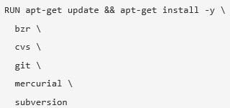
Dockerfiles – Recommended Practices
Order Commands for Caching
Build Cache
ADD/COPY → File contents checked
Minimize Layers
Keep Images Small
.dockerignore
Avoid unnecessary packages
Multi-Stage Builds
One Concern per Container
Web app…. DB…. In-Memory Cache
Speedy Boot-Up Times
Containers are (mostly) ephemeral
Sort Multi-Line Arguments

Slide 23
To The Terminal!
4. Dockerfile Examples – Image Impact…. Multi-Step Builds…. Image Flattening…. Volume (for segue way)

Slide 24
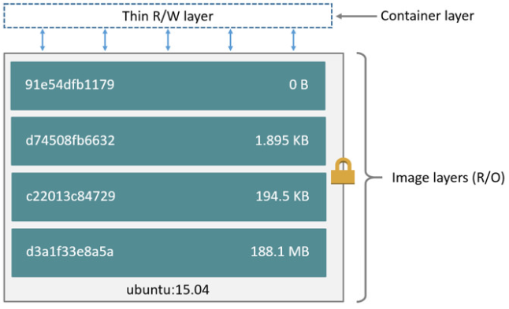
Container Statelessness
Containers are Short-Lived

Slide 25
Container Statelessness
Containers are Short-Lived

Slide 26
Container Statelessness
Containers are Short-Lived
Data Does Not Persist
Data Increases Container Size
Difficult to Share Data
Storage Driver Performance

Slide 27
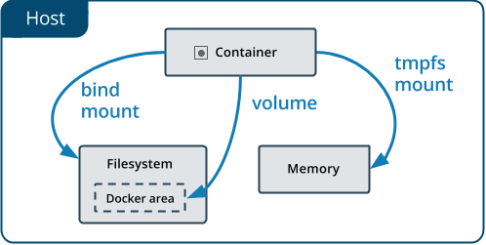
Storage Options
Docker Options for Storing Data on Host
tmpfs Mounts
Host’s Memory
Bind Mounts
Anywhere on the Host
Non-Docker procs can modify
Volumes
On the Host…. Managed by Docker
Recommended to Persist Data

Slide 28
Volumes – Use Cases
Sharing Data Between Containers
Storing Data on Remote Hosts
Backups… Restores… Migrations

Slide 29
Volumes – Commands
docker volume create
docker volume inspect
docker volume ls
docker volume prune
docker volume rm

Slide 30
Volumes – Tips
Use Volumes Where Possible
Mount Location Matters!
Read-Only Volumes to Avoid Race Conditions
Prune at Regular Intervals

Slide 31
To The Terminal!
5. Volume Stuff

Slide 32
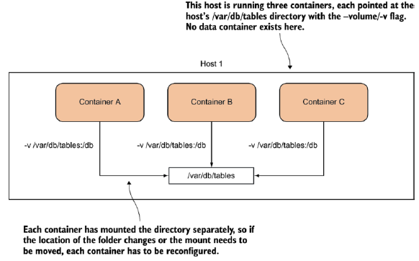
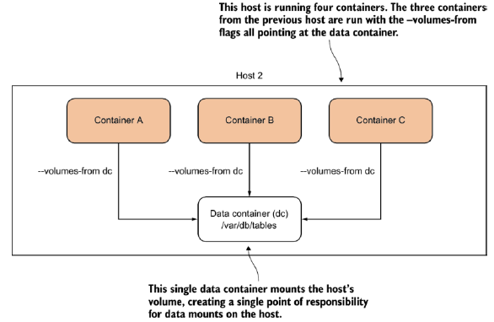
Volumes – Data-Only Container
sudo docker run -it --mount source=empty-volume,target=/var --name volume-test-empty ubuntu bash
sudo docker run -it --volumes-from volume-test-data --name volume-test-data-user ubuntu bash

Slide 33
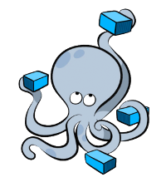
Docker Compose
Easily Define multi-container applications
Single .yml file
Creates isolated docker environment
Automates *some* docker processes
Only recrates/rebuilds necessary containers
Python Command
Some environments – `pip install docker-compose`
Installed w/Docker on OSX

Slide 34
Docker Compose Commands
UP
Brings up all services in .yml definition file
Down
Kills and cleans up all running services
Kill
Kill running service(s)
Build
Rebuild service(s) images
Logs
Attach to running service(s) logs

Slide 35
To The Terminal!

Slide 36
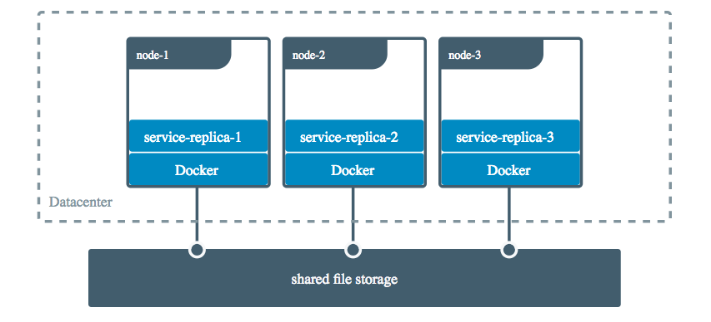
Volumes
Allows containers to share data
Persistent
Decouple bound data from run-time environment
Linux, Windows, etc...
Does not increase container size
Synonymous with mount
Mount is more verbose

Slide 37
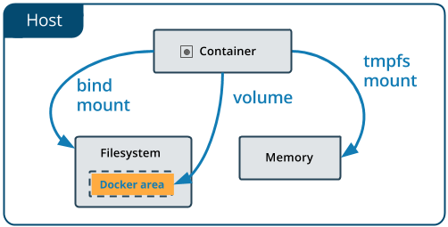
Volumes
Created in shared location within docker directory
Named or anonymous
Able to be backed up
Command: Docker volume

Slide 38
Volume Commands
create
Creates a volume
ls
Lists the volumes
inspect
Retrieve detailed information about a volume
prune
Remove unused volumes
rm
Remove a volume

Slide 39
To The Terminal!

Slide 40
Networking
Docker creates two default networks
Bridge – default container network
Host – same network stack as host *only linux
Intra-network communication
All ports exposed to network neighbors
Intra-network automatic dns resolution
Neighbors can find each other via hostname
Containers can join/leave network on the fly *except bridge
Networking Prevents unnecessary port exposure

Slide 41
Networking Commands
Connect – connect to a network
Create – create a network
Disconnect – disconnect from a network
Inspect – get detailed network information
Ls – list networks
Prune – remove unused networks
Rm – remove a network
Don't remove `host` or `bridge`

Slide 42
To The Terminal!

Slide 43
Next Steps
Orchestration
CI/CD Pipeline
Monitoring and Logging
Troubleshooting
Security

Slide 44
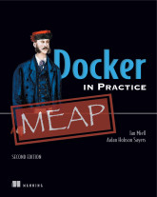
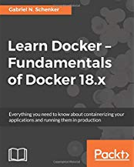
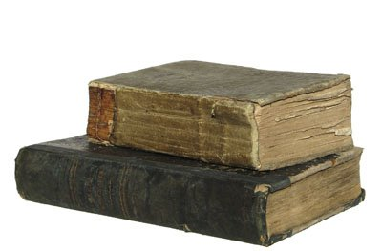
Resources – Dockerfiles and Volumes
https://docs.docker.com/storage/volume
https://docs.docker.com/engine/reference/builder/
https://rock-it.pl/how-to-write-excellent-dockerfiles/
https://www.udemy.com/docker-mastery/

Slide 45
Resources – Compose and Networking
Check the docs – they're really good now 😀😁😆
Volumes - https://docs.docker.com/storage/
Compose - https://docs.docker.com/compose/overview/
Networking - https://docs.docker.com/network/

Slide 46

Thanks!

