Slide 1
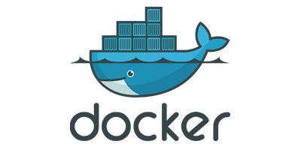
A Night With:
October 10, 2018

Slide 2
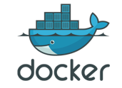
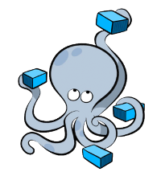
Docker Compose
Easily Define multi-container applications
Single .yml file
Creates isolated docker environment
Automates *some* docker processes
Only recrates/rebuilds necessary containers
Python Command
Some environments – `pip install docker-compose`
Installed w/Docker on OSX

Slide 3
Docker Compose Commands
UP
Brings up all services in .yml definition file
Down
Kills and cleans up all running services
Kill
Kill running service(s)
Build
Rebuild service(s) images
Logs
Attach to running service(s) logs

Slide 4

To The Terminal!

Slide 5
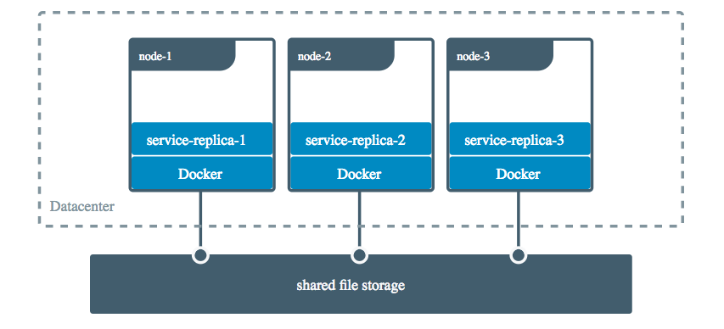
Volumes
Allows containers to share data
Persistent
Decouple bound data from run-time environment
Linux, Windows, etc...
Does not increase container size
Synonymous with mount
Mount is more verbose

Slide 6
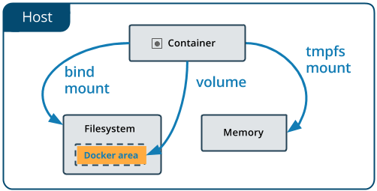
Volumes
Created in shared location within docker directory
Named or anonymous
Able to be backed up
Command: Docker volume

Slide 7
Volume Commands
create
Creates a volume
ls
Lists the volumes
inspect
Retrieve detailed information about a volume
prune
Remove unused volumes
rm
Remove a volume

Slide 8
To The Terminal!

Slide 9
Networking
Docker creates two default networks
Bridge – default container network
Host – same network stack as host *only linux
Intra-network communication
All ports exposed to network neighbors
Intra-network automatic dns resolution
Neighbors can find each other via hostname
Containers can join/leave network on the fly *except bridge
Networking Prevents unnecessary port exposure

Slide 10
Networking Commands
Connect – connect to a network
Create – create a network
Disconnect – disconnect from a network
Inspect – get detailed network information
Ls – list networks
Prune – remove unused networks
Rm – remove a network
Don't remove `host` or `bridge`

Slide 11
To The Terminal!

Slide 12
Docker Resources
Check the docs – they're really good now 😀😁😆
Volumes - https://docs.docker.com/storage/
Compose - https://docs.docker.com/compose/overview/
Networking - https://docs.docker.com/network/

Slide 13
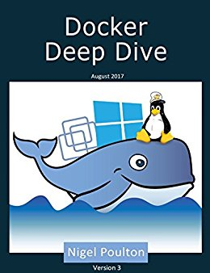
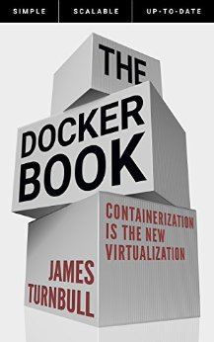

Docker Resources
https://app.pluralsight.com/library/courses/containers-images-big-picture/table-of-contents
https://app.pluralsight.com/library/courses/docker-deep-dive/table-of-contents
https://www.xenonstack.com/blog/docker-overview-a-complete-guide
https://docs.docker.com/get-started

Slide 14

Next Steps
Docker Volumes
Dockerfile
Docker Compose and Swarm
Docker in a CI/CD Pipeline

Slide 15

Thanks!

