Slide 1
Saint Louis Full Stack Web Development
TOPIC:
Amazon Web Services
Meeting No. 2
February 11, 2015

Slide 2

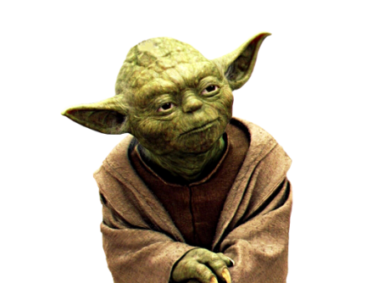
Introduction
Bryan Jones
Application DBA
Involved in IT since 2008 (2009?) … NOT an expert!
Adam Bowen
- Head of Software Engineering
Has ALL of the Answers
to ALL of your Questions!

Slide 3
Welcome!
PREVIOUS POINTS:
Tentative Mission Statement:
Build End-to-End Internet Applications
3 Key Question Types:
1. What?… 2. How? … 3. HOW?!!!!
Discussed Ways to Approach “Full Stack”
One Piece/Month… Various Ecosystems… Build an App
WE NEED A COMMON INFRASTRUCTURE !!!
Amazon Web Services (AWS)

Slide 4
Today’s Agenda
“IAAS” Importance
Infrastructure As A Service
Amazon Web Services (AWS):
EC2… EBS… S3… Route 53
Adam’s Experience With AWS
Deployment Pipeline
Open Group Discussion

Slide 5


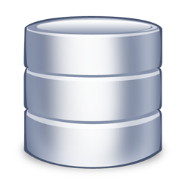
Changes in the Tech Stack (THEN)
1. CLIENT SIDE
2. SERVER SIDE
1
2
4
3

Slide 6
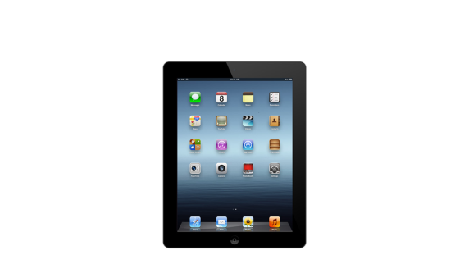

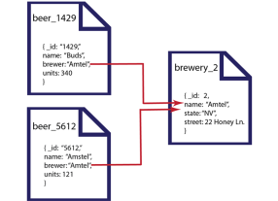

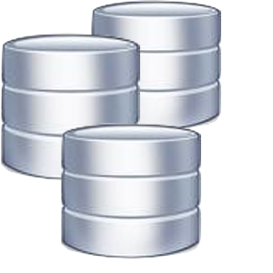


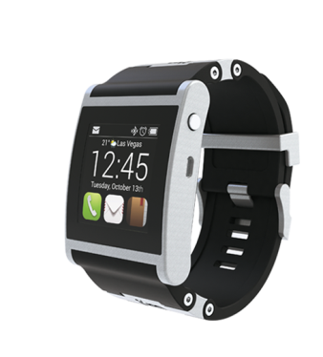
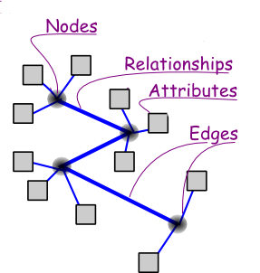
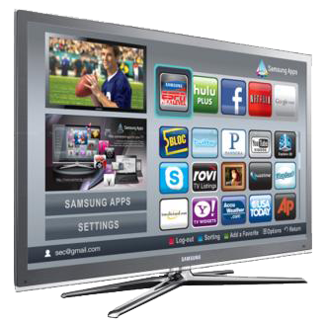


Changes in the Tech Stack (NOW)
1. CLIENT SIDE
2. SERVER SIDE
3. DATA

Slide 7



Why Is IAAS Important?
IAAS
A way to RENT components
For Large-scale Applications
PAAS
Abstracts some of the IAAS Complexity
SAAS
Specific Application Built On
a PAAS or an IAAS

Slide 8



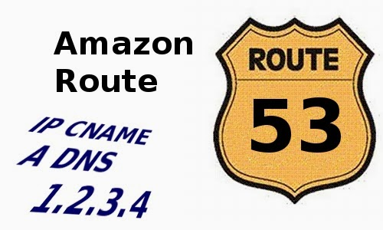
Amazon Web Services Components
TEMPORARY Storage & Compute Capacity
(COMPLETE Control of Computing Resources)
PERSISTENT Storage
(Good for Databases, File Systems)
Store any amount of data
(Good for Static Files and Images)
Domain Name System (DNS)
(Converts meetup.com to 190.93.246.104)

Slide 9

Thank You!
Let’s Talk!
Contact us at…
bjones1831@gmail.com
OR
SaintLouis-FullStack-WebDevelopment-list@meetup.com

Slide 10
Today’s Recap
IAAS Importance
Amazon Web Services (AWS):
EC2… EBS… S3… Route 53
Adam’s Experience With AWS
Deployment Pipeline
Open Group Discussion

Slide 11
3 Key Question Types…
1. What? {{ Context }}
“What is Node.js?”
2. How? {{ Functionality }}
“How does Node.js work?”
Syntax, etc.
3. HOW?! {{ Implementation }}
“How do I USE Node.js in my application?”

Slide 12
Ways to Contribute
Meeting Attendance
Presenting Information
Resource Sharing / Answering Questions
Asking Questions

Slide 13
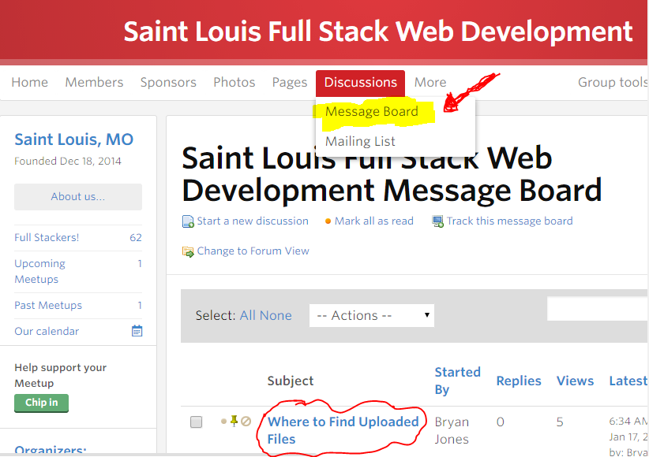
Resources (#1): Discussion Boards

Slide 14
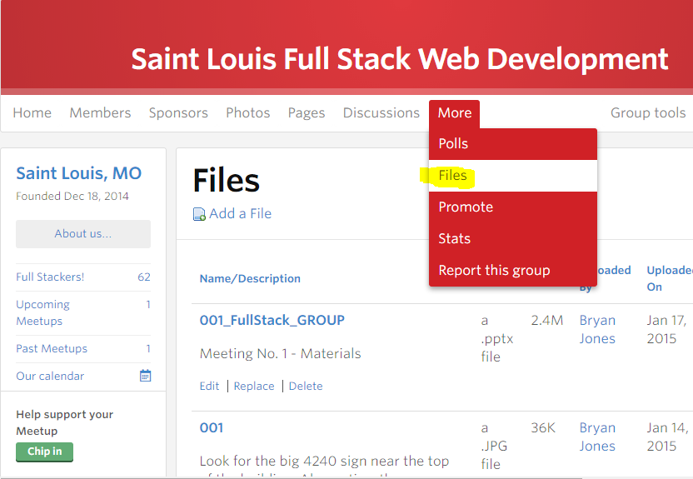
Resources (#2): “More >> Files”

Slide 15



How Will YOU Benefit?
Novice
Appreciation for Full-Stack Apps
Better Position to Assess IT Talent
Intermediate
Teaching Your Components Focuses Your Thoughts
Learn How to DIY a Full-Stack Application
Jedi Master
“To Teach is to Learn Twice…”
Outsiders’ Perspectives

Slide 16
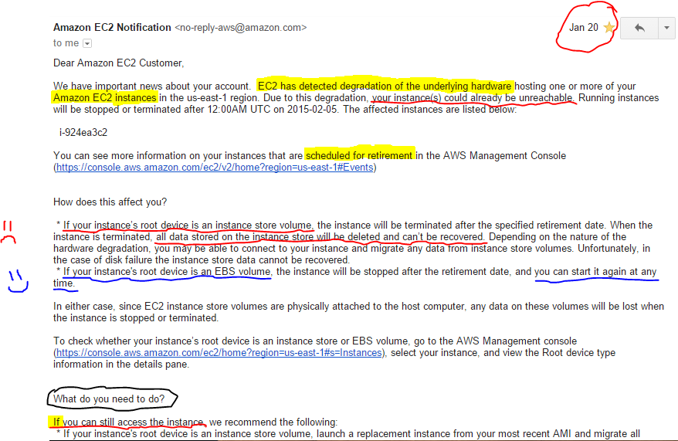
Next Meeting Theme? “The Dark Side of AWS…”

