Slide 1
Saint Louis Full Stack Web Development
TOPIC:
PHP Framework – Laravel
Meeting No. 5
October 14, 2015

Slide 2
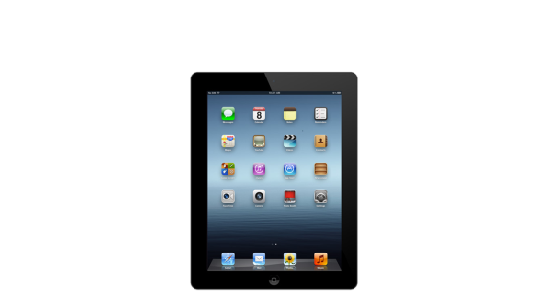


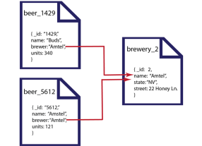





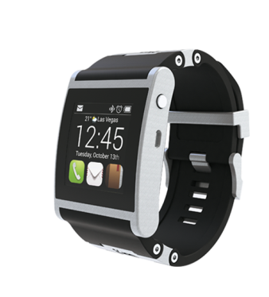
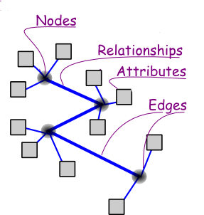
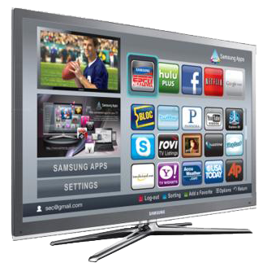


The Tech Stack
1. CLIENT SIDE
2. SERVER SIDE
3. DATA

