Slide 1


Apache Spark & Hadoop
Nov 9, 2016
Tameem Syed and Bryan Jones

Slide 2
Why Spark? Why Hadoop?
“Big Data and How We Got Here”
Volume, Velocity, Variety is Increasing
Falling Cost of Data Generation and Storage
Need to convert : (1) Data → (2) Information → (3) Knowledge
Vertical Scaling vs. Horizontal Scaling

Slide 3

Big Data Platforms
MapReduce Framework
Spark Framework (In-Memory)

Slide 4
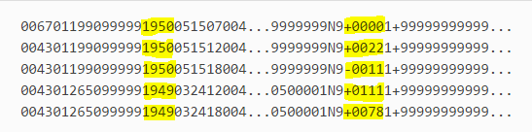
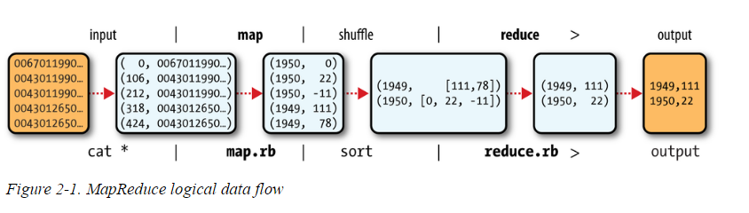
MapReduce Framework
Map
Shuffle
Sort
Reduce

Slide 5
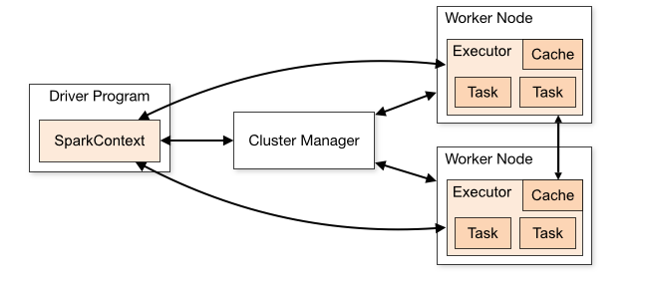
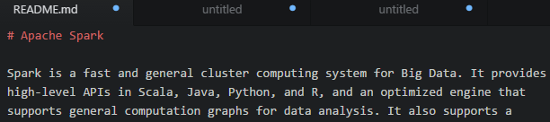
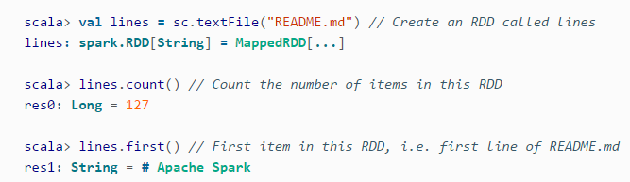
Spark Framework
3
1
2
3
1
Driver
Spark Context
Cluster Manager
Worker Node(s)
Executor(s)
Task(s)
Cache
2
3

Slide 6
Spark – Key Concepts
DAG – Execution Plan of Processing Steps
Lazy Evaluation
Transformation – Data Manipulation Operations
Action – Request for Output or a Prompt to Execute Program
RDD – Immutable, In-Memory Data Structure
Data Frame – Distributed Collection with a Defined Schema (Like a SQL Table)

Slide 7
Spark – API
TRANSFORMATIONS
Map
Filter
GroupBy
SortBy
Union
Intersection
Subtract
Sample
ACTIONS
Reduce
Count
Collect
First
Foreach
GroupByKey
ReduceByKey
Join
Min …. Max …. Mean …. Stdev

Slide 8
Spark vs. Hadoop
Similarities
Batch Processing
Distributed Datasets
Free and Open Source
Differences
Spark
In-Memory Computing
Broad API for Processing
No Storage Layer
Cluster Managers Beyond YARN
Hadoop
Disk-Based Computing
MapReduce for Processing
HDFS as Main Storage Layer
YARN as Cluster Manager

Slide 9
Demo Time – Running Spark
2 Ways of Running Spark Applications:
(1) SPARK SHELL
Open Up Terminal
Type in Code
Execute!
(2) JOB SUBMISSION
IDE
Build Tools
Jar File
Submit Jar File to Spark Driver

Slide 10

Any Questions

