Slide 1
Saint Louis Full Stack Web Development
TOPIC:
Introductions and General Discussion
Meeting No. 1
January 14, 2015

Slide 2
Welcome!
PREVIOUS POINTS:
Created Our Group
“Saint Louis Full Stack Web Development”
Tentative Mission Statement:
Build End-to-End Internet Applications
Discussion and Learning!
Scheduled Our Initial Meeting
Welcome Full Stackers!

Slide 3
Today’s Agenda
Changes in the Technology Stack:
Then vs. Now
The Group’s Goal
3 Key Question Types
1. What? …. 2. How? …. 3. HOW?!
Our Group’s Approach
Group Expectations
The Benefits to YOU

Slide 4
Introduction
Bryan Jones
Application DBA
MBA, MSIS from UMSL
Joined Meetup.com in 2013-2014
Involved in IT since 2008 (2009?) … NOT an expert!

Slide 5



Changes in the Tech Stack (THEN)
1. CLIENT SIDE
2. SERVER SIDE
1
2
4
3

Slide 6


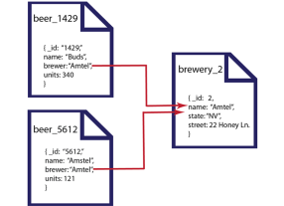





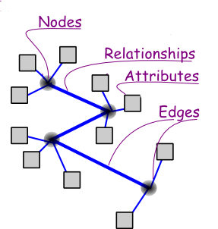



Changes in the Tech Stack (NOW)
1. CLIENT SIDE
2. SERVER SIDE
3. DATA

Slide 7
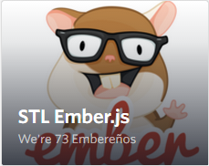
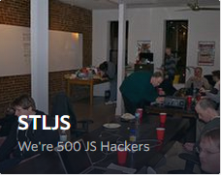
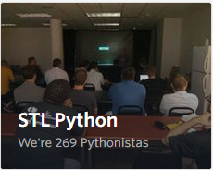
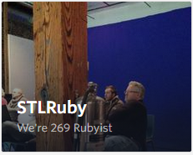
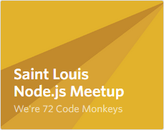
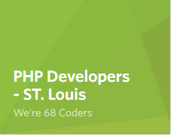
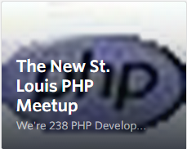

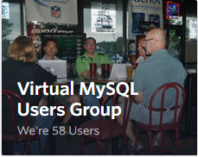
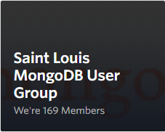
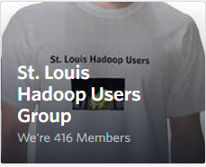

Many Meetup Groups
1. CLIENT SIDE
2. SERVER SIDE
3. DATA

Slide 8
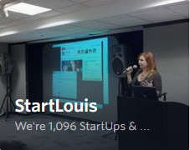
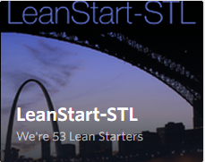
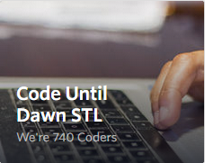
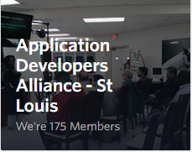
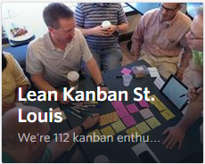
More Meetup Groups
4. BUSINESS
5. ???
What UNITES These Groups ?
Create End-to-End Internet Applications
Pursue and Validate Viable Business Models

Slide 9
The Goal…. JOIN FORCES!
Learn How To Stack Together “End-to-End” Internet Applications
Data Source => App Layer => End-User Client Device(s)
IAAS Offers a Way to Build Large Sites
Internet Landscape Much More Complex
Lots of Silo Groups… But Little Integration
Verbal Communication = That LAST MILE of understanding
COLLABORATION and CONTEXT are the keys!

Slide 10
3 Key Question Types…
1. What? {{ Context }}
“What is Node.js?”
2. How? {{ Functionality }}
“How does Node.js work?”
Syntax, etc.
3. HOW?! {{ Implementation }}
“How do I USE Node.js in my application?”

Slide 11







Attacking the 3 Key Question Types
1. Google… Blogs… Books
2. Webcasts and Podcasts
3. Discussion Boards and Chat Rooms
4. FACE-to-FACE!
For the LAST MILE of understanding!

Slide 12
How Do We Want to Approach?
Format Ideas:
Monthly presentations on individual pieces or a full-stack
One full-stack application – Group Effort
Four Month Sprints – Focused on a particular stack
BEST: “Collaboration AND Context”
Resource sharing/communication between meetings

Slide 13



How Do We Want to Approach?
Initial Base-Lining of our Group
Technologies we know
Technologies we want to learn
Use the same tools? (e.g. AWS, Ubuntu, GitHub group?)

Slide 14
Ways to Contribute
Meeting Attendance
Presenting Information
Resource Sharing / Answering Questions
Asking Questions

Slide 15



How Will YOU Benefit?
Novice
Appreciation for Full-Stack Apps
Better Position to Assess IT Talent
Intermediate
Teaching Your Components Focuses Your Thoughts
Learn How to DIY a Full-Stack Application
Jedi Master
“To Teach is to Learn Twice…”
Outsiders’ Perspectives

Slide 16

Thank You!
Let’s Talk!
Contact me at…
bjones1831@gmail.com
Or our group on Meetup.com

Slide 17
Today’s Recap
Changes in the Technology Stack:
Then vs. Now
The Group’s Goal
3 Key Question Types
1. What? …. 2. How? …. 3. HOW?!
Our Group’s Approach
Group Expectations
The Benefits to YOU

Slide 18
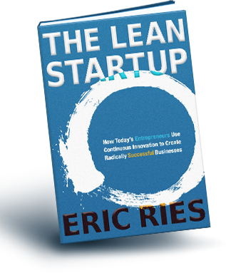
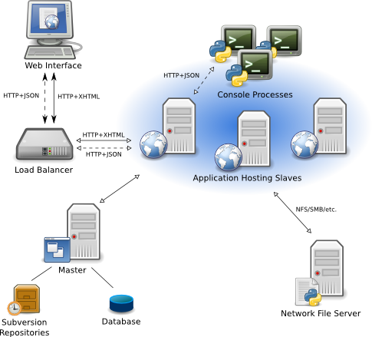




Full-Stack + LEAN = Opportunities
+
+
=
1
2
3
Or…
Or…

Slide 19
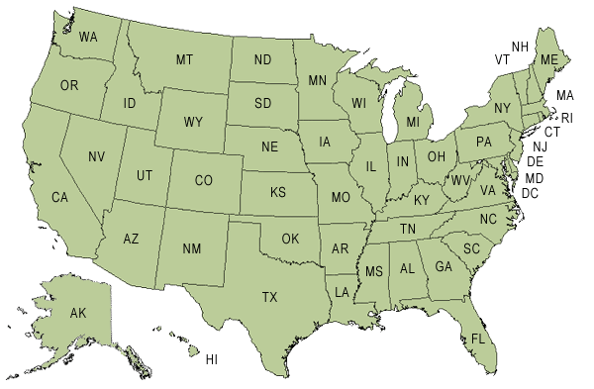
Top 20 US Cities for Tech Startup Funding (2014)
http://www.inc.com/associated-press/top-20-cities-for-tech-startup-funding.html

