Slide 1
Relational Databases
June 8, 2016
Chris Schmitz and Bryan Jones

Slide 2
Intro
What is a RDBMS? → Relational Algebra and Set Theory
Memory vs. Disk
Why RDBMS? ...Update! Storage! ACID! (RDBMS vs. Flat Files vs. In-Memory, etc.)
Database Objects (Tables, Columns, Rows, Indexes, Constraints, Users, Groups, etc.)
DML and DDL ……. and CRUD!!!
Different Data Types for Column Values

Slide 3
Data Types
Numbers
Characters
Dates and Times
Binary Large Objects (BLOBs)
NULL

Slide 4
SELECT Statement - CRUD
SELECT
WHERE
Operators (IN, LIKE, etc.)
DISTINCT …. LIMIT
GROUP BY .... SUM, MIN, MAX, AVG
HAVING
ORDER BY
Aliases Fields and Tables
Order of Operations (e.g. Why aliases allowed in ORDER BY)

Slide 5
Write Statements - CRUD
CREATE → Table, Primary Key, Index
UPDATE → Table
DELETE → Table …. vs. TRUNCATE → Table …. vs. DROP → Table
ALTER → Column
RENAME → Column

Slide 6
Indexes, Constraints, and 3NF
Indexes (Primary Key, Filtered Index, etc.)
Why Use Indexes?
Primary Keys and Third Normal Form (3NF)
Why Use PKs and 3NF?
Constraints (Foreign Key, Unique, etc.)
Why Use Constraints?

Slide 7
Chris
The types of relationships
How you'd relate tables
Break tables out and create relationships between them
How and why you'd structure supporting tables
How you should pick your fields and why
Leveraging join tables

Slide 8
Multiple Tables Basics
JOIN(s)
Cardinality ( 1 to 1 ... 1 to Many ... Many to Many )
FKs

Slide 9




NoSQL…
RDBMS not great for everything
Key Value …. Documents …. Columns …. Graphs
Schema vs. Schema-less
ACID vs. BASE
However, NoSQL and RDBMS are converging (Mongo Row Locks …. PostgreSQL JSONB, etc.)

Slide 10
Summary
???

Slide 11
Possible Future Topics
Advanced Objects (Triggers, Functions, Procedures, Views, CTEs)
Performance (Indexing … Caching … Optimizer and Query Plan)
Security (Verify All Input … SQL Injection, Prepared Statements, etc.)
Architecture (Replication… Sharding (Horizontal ?) … Vertical Partitioning)
Administration (Users, Groups, Permissions, Backups and Restores)
Syntax (Vendor Differences and the ANSI Standard)
……. and NoSQL !!!

Slide 12
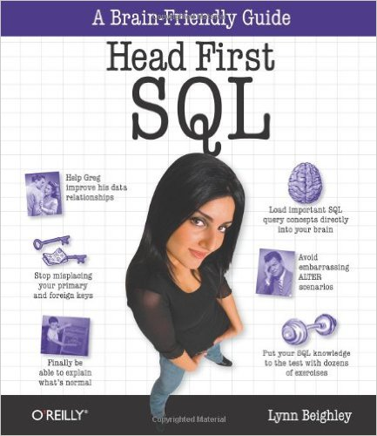
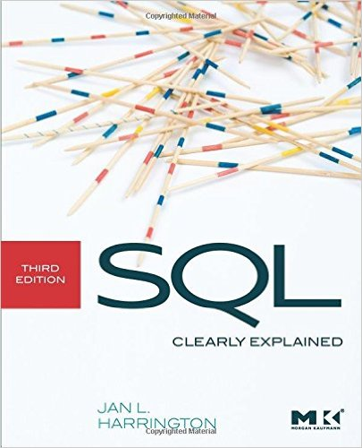
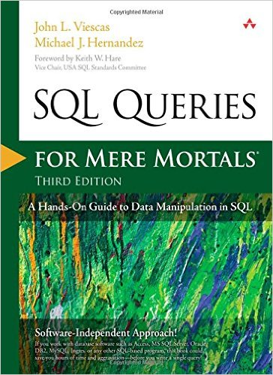
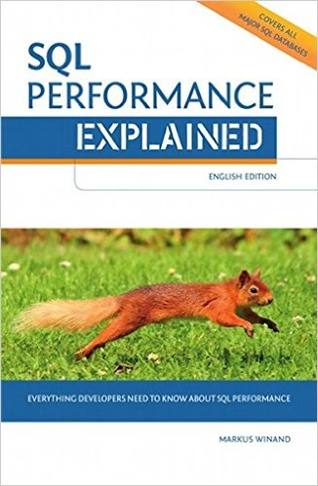
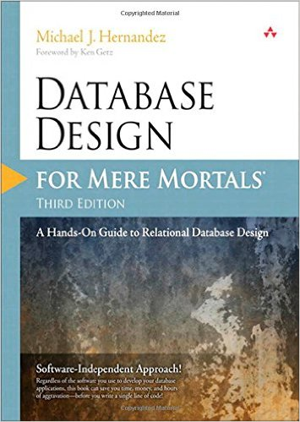
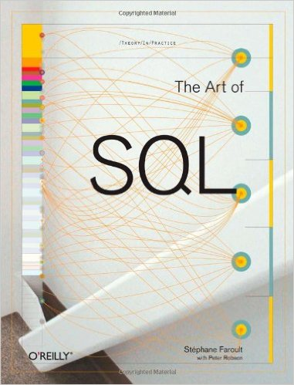
Resources
“Head First SQL”
“SQL Queries For Mere Mortals” (3rd)
“Database Design For Mere Mortals” (3rd)
“SQL Clearly Explained” (3rd)
“SQL Performance Explained”
“The Art of SQL”

Slide 13
Items RDBMS … Ignore
Why RDBMs? ...Update! Storage! ACID!
Memory vs. Disk
3NF
Cardinality ( 1 to 1 ... 1 to Many ... Many to Many )
SELECT
WHERE
Operators (IN, LIKE, etc.)
JOIN(s)
Aliases Fields and Tables
GROUP BY .... SUM, MIN, MAX, AVG
HAVING
ORDER BY
Order of Ops Aliases in ORDER BY
PKs ... Reiterate 3NF
FKs
Indexing
Data Types
NULL ... ISNULL()
The Game = Reduce load

Slide 14
Items Other … Ignore
Triggers, Functions, Procedures
Caching
Syntax Diffs and ANSI
DML, DDL, and CRUD
Users and Groups
Optimizer and Query Plan
Prepared Statements
SQL Injection Basic Example (?)
Verify All Input!!!
Replication
Sharding
Chris :
The types of relationships
How you'd relate tables
Break tables out and create relationships bw them
How and why you'd structure supporting tables
How you should pick your fields and why
Leveraging join tables

