Slide 1
Dimensionality Reduction
Concepts are ensembled from various online sources with a great acknowledgement to all those made them available online.

Slide 2
Data Dimensionality
From a theoretical point of view, increasing the number of features should lead to better performance.
In practice, the inclusion of more features leads to worse performance (i.e., curse of dimensionality).
The number of training examples required increases exponentially with dimensionality.

Slide 3
The curse of dimensionality
Real data usually have thousands, or millions of dimensions
E.g., web documents, where the dimensionality is the vocabulary of words
Facebook graph, where the dimensionality is the number of users
Huge number of dimensions causes problems
Data becomes very sparse, some algorithms become meaningless
The complexity of several algorithms depends on the dimensionality and they become infeasible.

Slide 4
Dimensionality Reduction
Usually the data can be described with fewer dimensions, without losing much of the meaning of the data.
The data reside in a space of lower dimensionality
Essentially, we assume that some of the data is noise, and we can approximate the useful part with a lower dimensionality space.
Dimensionality reduction does not just reduce the amount of data, it often brings out the useful part of the data

Slide 5
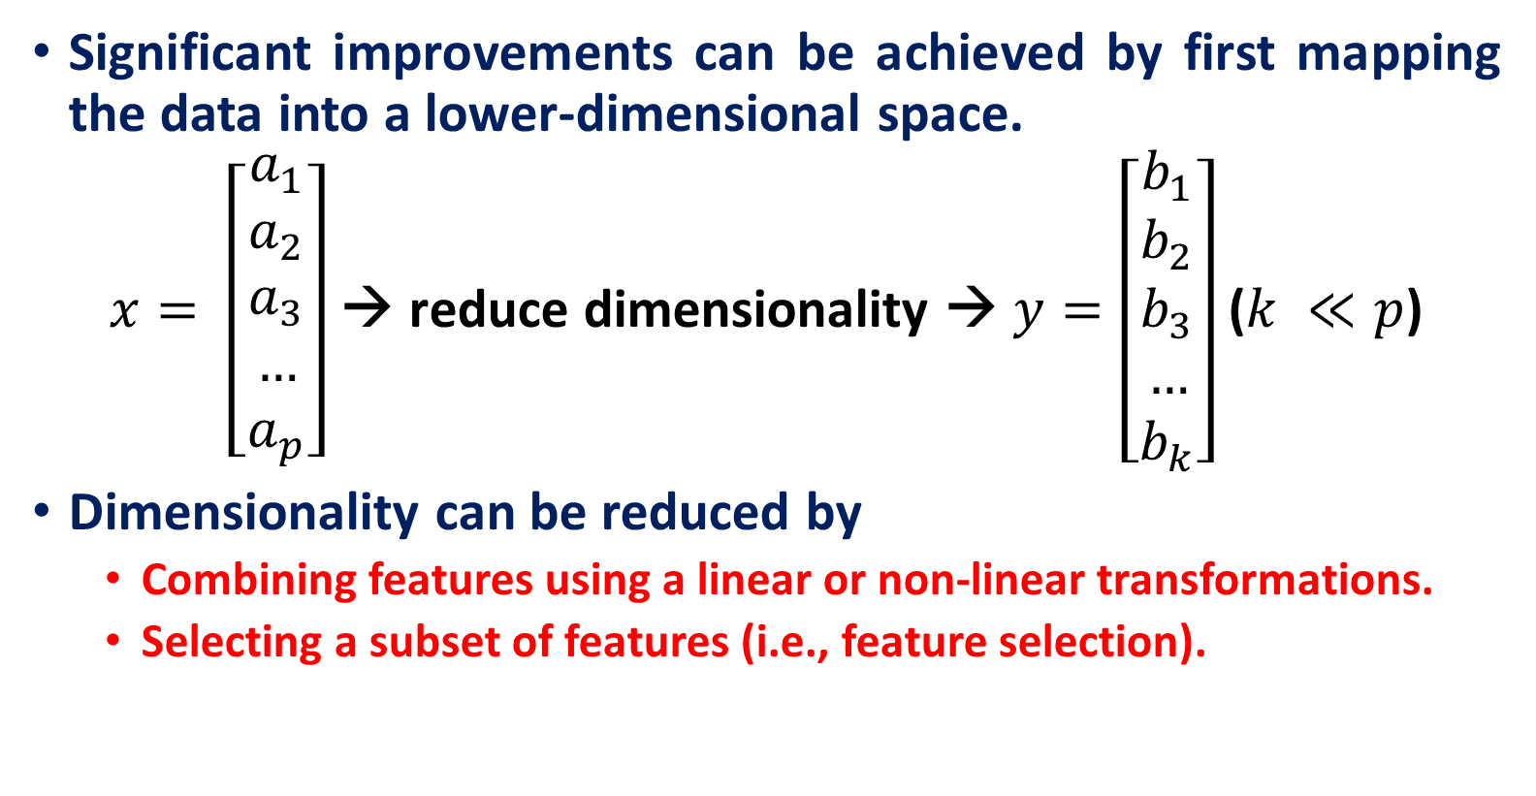
Dimensionality Reduction
Significant improvements can be achieved by first mapping the data into a lower-dimensional space.
$x= \left[\begin{aligned}a_{1} \\ a_{2} \\ a_{3} \\ … \\ a_{p}\end{aligned}\right]$ → reduce dimensionality → $y=\left[\begin{aligned}b_{1} \\ b_{2} \\ b_{3} \\ … \\ b_{k}\end{aligned}\right]$ ($k ≪p$)
Dimensionality can be reduced by
Combining features using a linear or non-linear transformations.
Selecting a subset of features (i.e., feature selection).

Slide 6
Dimensionality Reduction
Linear combinations are particularly attractive because they are simple to compute and analytically tractable.
Given $x ε ℝp$, the goal is to find an $p×k$matrix U such that:
$y = U^{T}x ε ℝ^{k}$ where $k≪p$
$x= \left[\begin{aligned}a_{1} \\ a_{2} \\ a_{3} \\ … \\ a_{p}\end{aligned}\right]$ → reduce dimensionality → $y=\left[\begin{aligned}b_{1} \\ b_{2} \\ b_{3} \\ … \\ b_{k}\end{aligned}\right]$ ($k <<p$)

Slide 7
Example of a problem
We collected p parameters about 100 students:
Height
Weight
Hair color
Average grade
…
We want to find the most important parameters that best describe a student.

Slide 8
Example of a problem
Each student is described using a vector length p:
(180, 70,’ purple’, 84,…)
We have n = 100 such vectors. Let’s put them in one matrix, where each column is one student vector.
So we have a$p×n$matrix. This will be the input of our problem.

Slide 9
Which parameters can we ignore?
Constant parameter (number of heads)
1,1,…,1.
Constant parameter with some noise -(thickness of hair)
0.003, 0.005,0.002,….,0.0008 → low variance
Parameter that is linearly dependent on other parameters (head size and height)
$Z=aX +bY$

Slide 10
Which parameters do we want to keep?
Parameter that doesn’t depend on others (e.g. eye color), i.e. uncorrelated.
• Parameter that changes a lot (grades)
The opposite of noise
High variance
Questions:
How we describe ‘most important’ features using math?
Variance
How do we represent our data so that the most important features can be extracted easily?
Change of basis

Slide 11
Principal Component Analysis Maximum Variance Projection Method

Slide 12
Principal component analysis
Principal component analysis (PCA) is a way to reduce data dimensionality by finding a new set of variables, smaller than the original set of variables, that nonetheless retains most of the sample's information.
The new variables, called principal components (PCs), are uncorrelated, and are ordered by the fraction of the total information each retains.
PCA projects the data in the least square sense– it captures big (principal) variability in the data and ignores small variability.

Slide 13
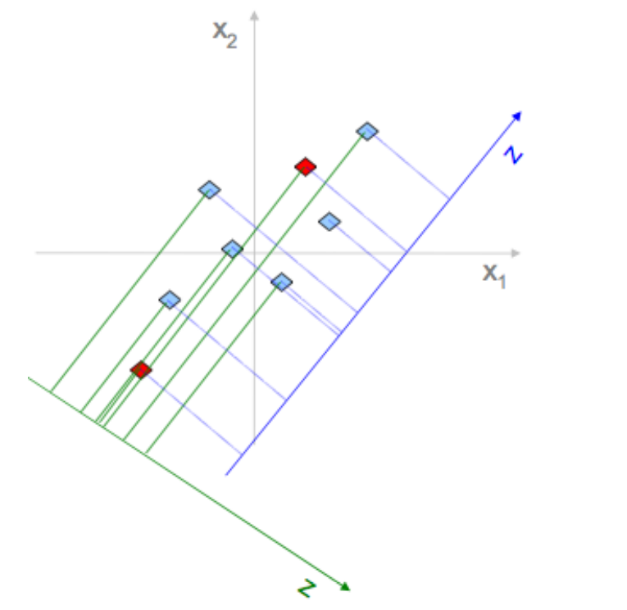
Why Variance
Example: reduce 2-dimensional data to 1d
$\left\{x_{1},x_{2}\right\} ⟶e$(along new axis)
Pick E to maximize variability
Reduces cases when two points are close in e-space but very far in ($x,y$)-space
Minimizes distances between original points and their projectons

Slide 14
Geometric picture of principal components (PCs)
Here is a small dataset of opponents we have to fight.
Each data object is represented by its X-Y location in 2D space.
A randomly chosen object is show in orange.
weight
height

Slide 15
Geometric picture of principal components (PCs)
Let us z-normalize the data…
Each data object is still represented by its X-Y location in 2D space

Slide 16
Geometric picture of principal components (PCs)
Let us rotate the axis to find the highest variance
PC1

Slide 17
Geometric picture of principal components (PCs)
The idea is to rotate the axes so that the new axes (also called the principal components, i.e., PCs for short) are such that the variance of the data on each axis goes down from axis to axis.
The first new axis is called the first principal component (PC1) and it is in the direction of the greatest variance in the data.
Each new axis is constructed orthogonal to the previous ones and along the direction with the largest remaining variance.
PC1
PC2

Slide 18
Geometric picture of principal components (PCs)
Each data object is still represented by its location in 2D space.
However, instead of X-Y space, we are now in PC1-PC2 space.
Note that for our orange example, the value in PCI is large, and in PC2 is small.
This is true on average for all data points. Moreover, it is true by definition, this is what PCA does!
PC1
PC2

Slide 19
Geometric picture of principal components (PCs)
We can project the data onto just the PC1 axis
PC1
PC2

Slide 20
Geometric picture of principal components (PCs)
PC1
We can project the data onto just the PC1 axis. This means that PC2 no longer exist
This is a general trick.
Starting with any N dimensions, we can do PCA, and keep just n dimensions, n <=N, as use the n dimensions for clustering, classifying, indexing, plotting etc.

Slide 21
Using backpropagation to implement PCA inefficiently
Try to make the output be the same as the input in a network with a central bottleneck.
The activities of the hidden units in the bottleneck form an efficient code.
If the hidden and output layers are linear, it will learn hidden units that are a linear function of the data and minimize the squared reconstruction error.
This is exactly what PCA does.
The M hidden units will span the same space as the first M components found by PCA
Their weight vectors may not be orthogonal.
They will tend to have equal variances.
output vector
code
input vector

Slide 22
Using backpropagation to generalize PCA
With non-linear layers before and after the code, it should be possible to efficiently represent data that lies on or near a non-linear manifold.
The encoder converts coordinates in the input space to coordinates on the manifold.
The decoder does the inverse mapping.
output vector
decoding weights
code
encoding weights
input vector

Slide 23
Autoencoders
Concepts are ensembled from various online sources with a great acknowledgement to all those made them available online.

Slide 24



Autoencoders
Autoencoders are an unsupervised learning technique that uses neural networks for representation learning.
A bottleneck layer is introduced in the neural network design, forcing the model to generate a compressed representation of the original input data.
$$…$$
Hidden Layer
$$…$$
$$…$$

Slide 25



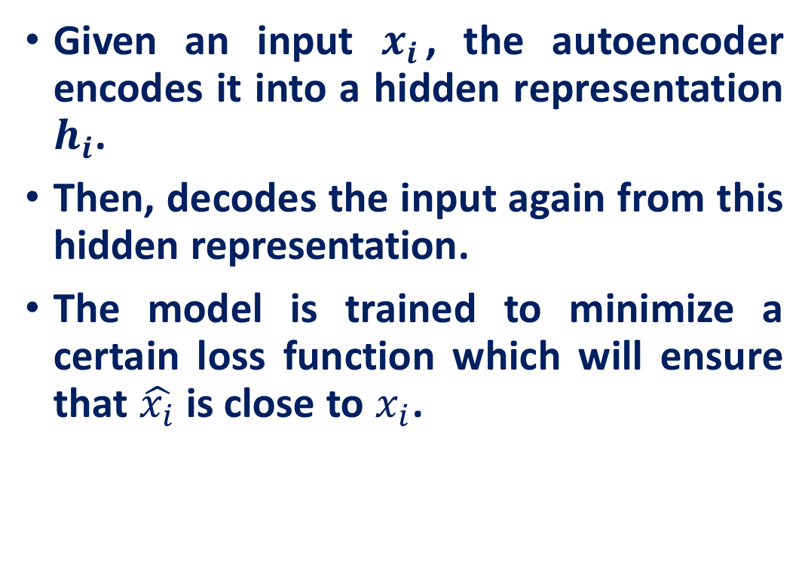




Autoencoders
Given an input $x_{i}$​, the autoencoder encodes it into a hidden representation $h_{i}$.
Then, decodes the input again from this hidden representation.
The model is trained to minimize a certain loss function which will ensure that $\hat{x_{i}}$is close to $x_{i}$.
$$\hat{x_{i}}$$
$$…$$
$$W^{∗}$$
Hidden Layer
$$h_{i}$$
$$…$$
$$W$$
$$x_{i}$$
$$…$$
$$h_{i}=g\left(Wx_{i}+b\right)$$
$$\hat{x_{i}}=f\left(W^{∗}h_{i}+c\right)$$

Slide 26
Autoencoders
General types of autoencoders based on size of hidden layer
Undercomplete autoencoders
Overcomplete autoencoders
$$\hat{x_{i}}$$
$$…$$
$$W^{∗}$$
Hidden Layer
$$h_{i}$$
$$…$$
$$W$$
$$x_{i}$$
$$…$$
$$h_{i}=g\left(Wx_{i}+b\right)$$
$$\hat{x_{i}}=f\left(W^{∗}h_{i}+c\right)$$

Slide 27
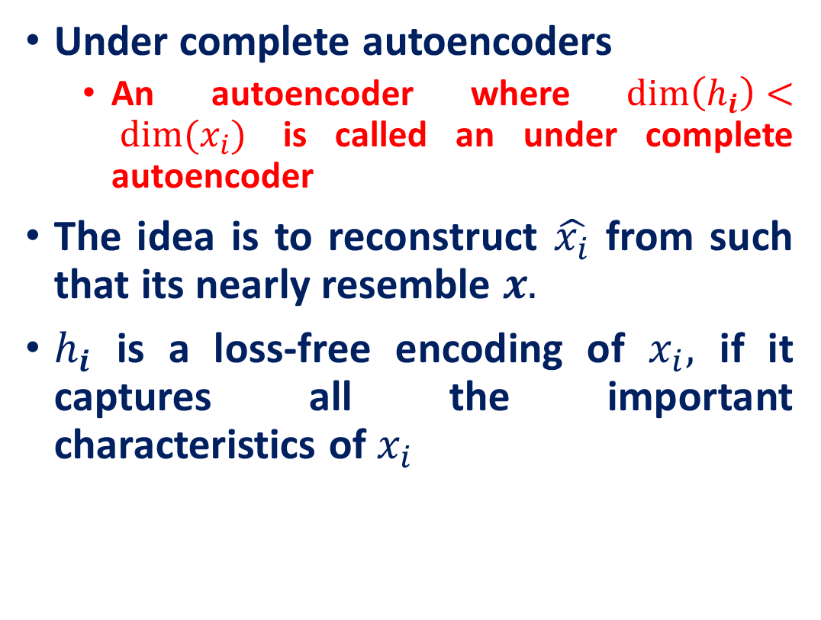
Autoencoders
Under complete autoencoders
An autoencoder where $\dim\left(h_{i}\right)< dim⁡(x_{i})$ is called an under complete autoencoder
The idea is to reconstruct $\hat{x_{i}}$ from such that its nearly resemble $x.$
$h_{i}$ is a loss-free encoding of $x_{i},$ if it captures all the important characteristics of $x_{i}$
$$\hat{x_{i}}$$
$$…$$
$$W^{∗}$$
Hidden Layer
$$h_{i}$$
$$…$$
$$W$$
$$x_{i}$$
$$…$$
$$h_{i}=g\left(Wx_{i}+b\right)$$
$$\hat{x_{i}}=f\left(W^{∗}h_{i}+c\right)$$

Slide 28

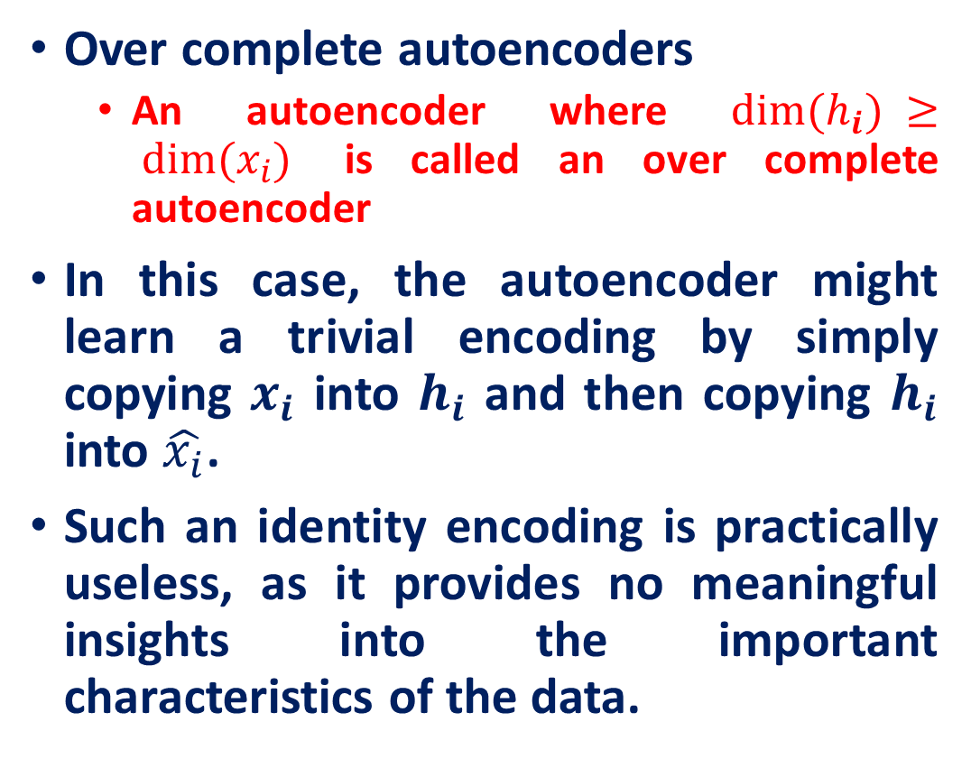


Autoencoders
Over complete autoencoders
An autoencoder where $dim⁡(h_{i}) ≥ dim⁡(x_{i})$ is called an over complete autoencoder
In this case, the autoencoder might learn a trivial encoding by simply copying $x_{i}$ into $h_{i}$ and then copying $h_{i}$ into $\hat{x_{i}}$.
Such an identity encoding is practically useless, as it provides no meaningful insights into the important characteristics of the data.
$$…$$
$$…$$
$$…$$
$$h_{i}=g\left(Wx_{i}+b\right)$$
$$\hat{x_{i}}=f\left(W^{∗}h_{i}+c\right)$$

Slide 29

Autoencoders
Two important consideration
Choice of $f(h_{i})$ and $g(x_{i})$
Choice of loss function
$$…$$
$$W^{∗}$$
Hidden Layer
$$…$$
$$W$$
$$…$$
$$h_{i}=g\left(Wx_{i}+b\right)$$
$$\hat{x_{i}}=f\left(W^{∗}h_{i}+c\right)$$

Slide 30
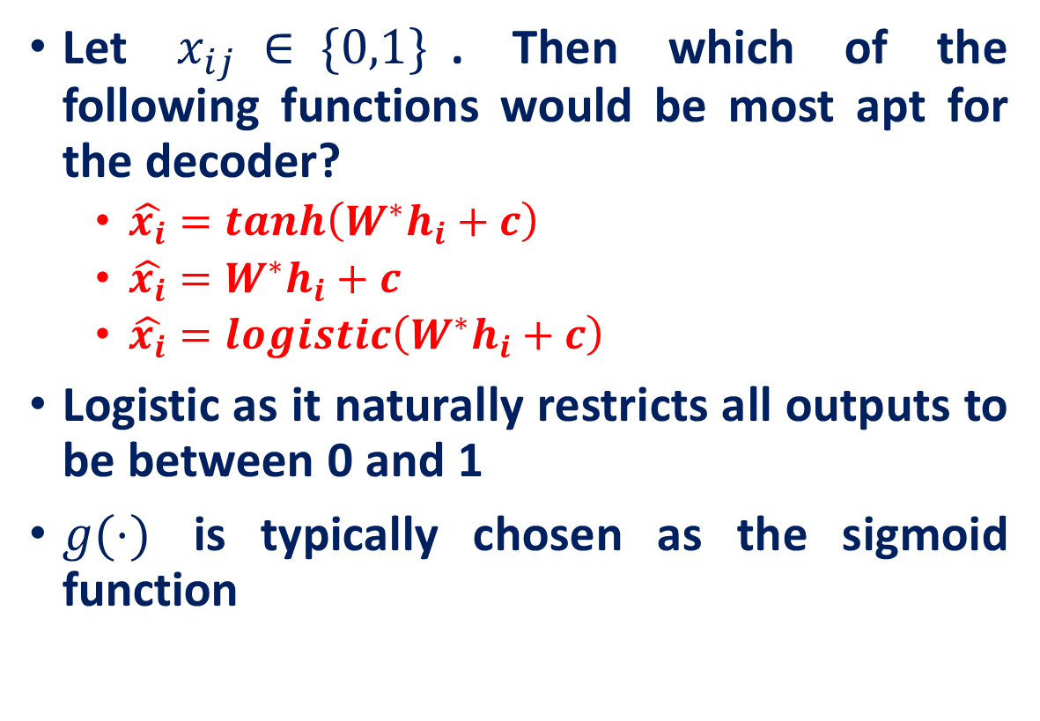
Autoencoders: Mapping Function
Let $x_{ij} ∈ \{0,1\}$. Then which of the following functions would be most apt for the decoder?
$\hat{x_{i}}=tanh\left(W^{∗}h_{i}+c\right)$
$\hat{x_{i}}=W^{∗}h_{i}+c$
$\hat{x_{i}}=logistic\left(W^{∗}h_{i}+c\right)$
Logistic as it naturally restricts all outputs to be between 0 and 1
$g(⋅)$ is typically chosen as the sigmoid function
$$…$$
$$W^{∗}$$
Hidden Layer
$$…$$
$$W$$
$$…$$
$$h_{i}=g\left(Wx_{i}+b\right)$$
$$\hat{x_{i}}=f\left(W^{∗}h_{i}+c\right)$$

Slide 31
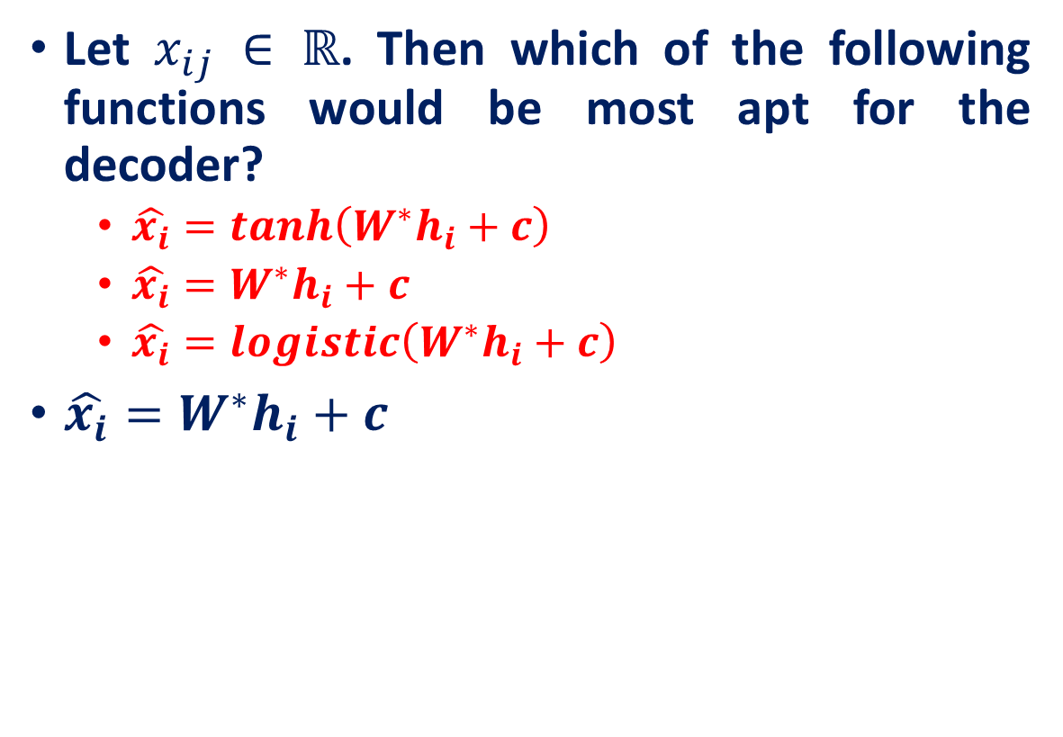
Autoencoders: Mapping Function
Let $x_{ij} ∈ ℝ$. Then which of the following functions would be most apt for the decoder?
$\hat{x_{i}}=tanh\left(W^{∗}h_{i}+c\right)$
$\hat{x_{i}}=W^{∗}h_{i}+c$
$\hat{x_{i}}=logistic\left(W^{∗}h_{i}+c\right)$
$\hat{x_{i}}=W^{∗}h_{i}+c$
$$…$$
$$W^{∗}$$
Hidden Layer
$$…$$
$$W$$
$$…$$
$$h_{i}=g\left(Wx_{i}+b\right)$$
$$\hat{x_{i}}=f\left(W^{∗}h_{i}+c\right)$$

Slide 32
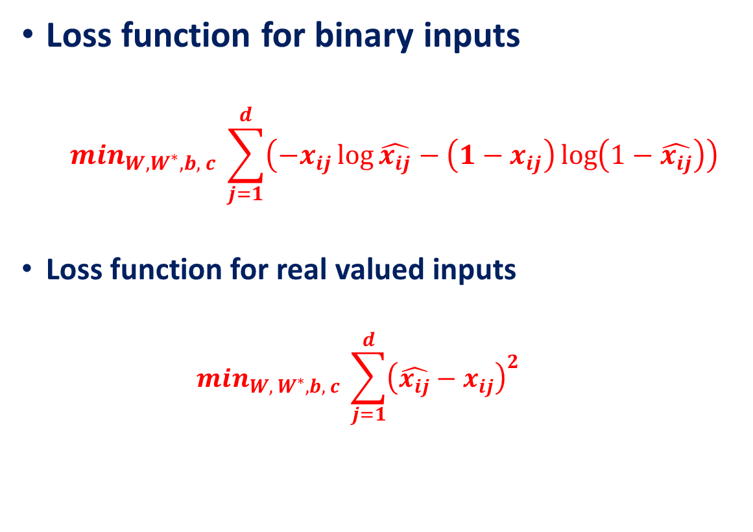
Autoencoders: Loss Function
Loss function for binary inputs
$$\min_{W, W^{∗}, b, c} \sum_{j=1}^{d}{\left(−x_{ij}\log{\hat{x_{ij}}}−\left(1−x_{ij}\right)\log\left(1−\hat{x_{ij}}\right)\right)}$$
Loss function for real valued inputs
$$m{in}_{W, W^{∗}, b, c} \sum_{j=1}^{d}{{\left(\hat{x_{ij}}−x_{ij}\right)}^{2}}$$
$$…$$
$$W^{∗}$$
Hidden Layer
$$…$$
$$W$$
$$…$$
$$h_{i}=g\left(Wx_{i}+b\right)$$
$$\hat{x_{i}}=f\left(W^{∗}h_{i}+c\right)$$

Slide 33
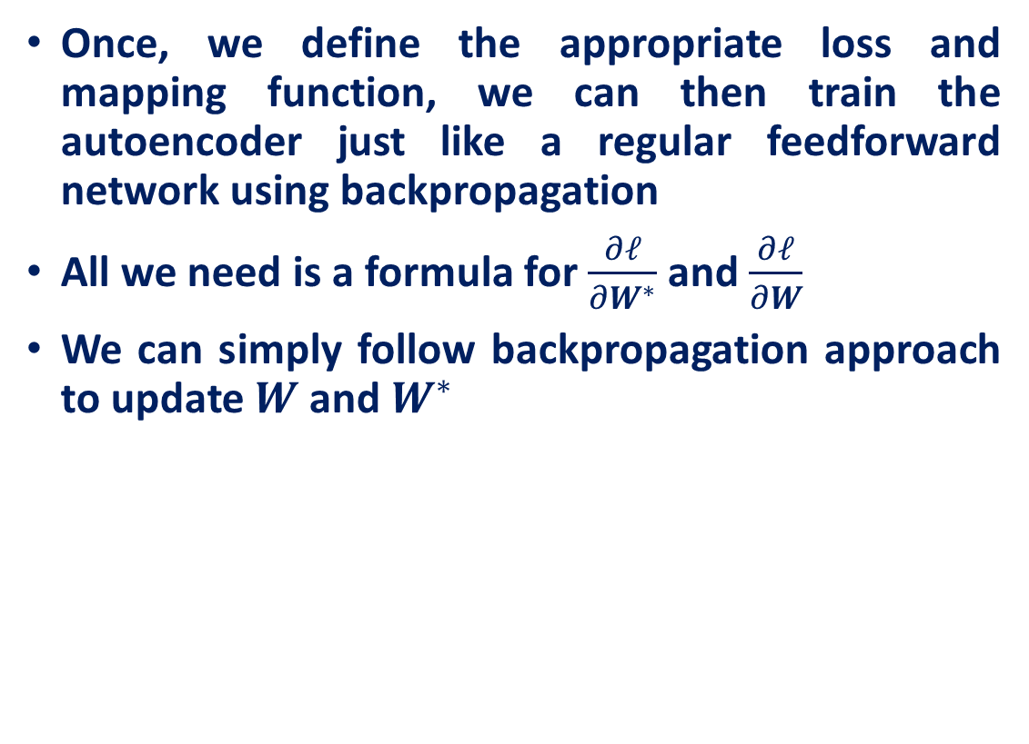
Autoencoders: Loss Function
Once, we define the appropriate loss and mapping function, we can then train the autoencoder just like a regular feedforward network using backpropagation
All we need is a formula for $\frac{∂ℓ}{∂W^{∗}}$ and $\frac{∂ℓ}{∂W}$
We can simply follow backpropagation approach to update $W$ and $W^{∗}$
$$…$$
$$W^{∗}$$
Hidden Layer
$$…$$
$$W$$
$$…$$
$$h_{i}=g\left(Wx_{i}+b\right)$$
$$\hat{x_{i}}=f\left(W^{∗}h_{i}+c\right)$$

Slide 34
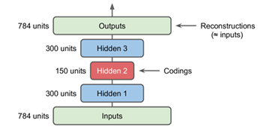
Autoencoders
Stacked Autoencoders: A stacked autoencoder has multiple hidden layers

Slide 35
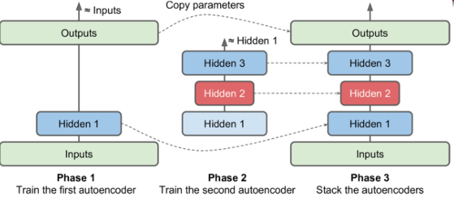
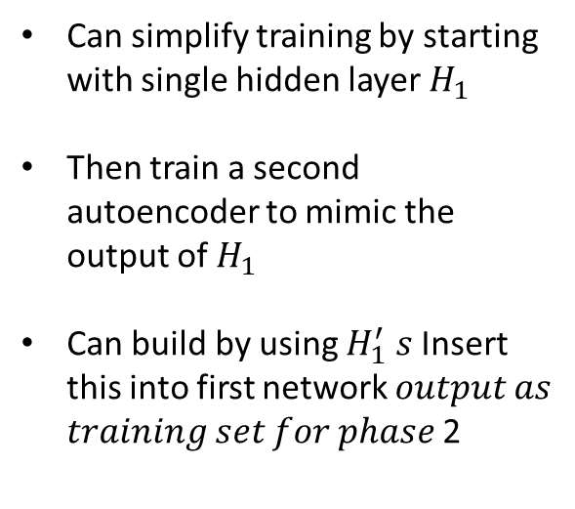
Autoencoders
Stacked Autoencoders: Incremental Training
Can simplify training by starting with single hidden layer $H_{1}$
Then train a second autoencoder to mimic the output of $H_{1}$
Can build by using $H_{1}^{′}$ $s$ Insert this into first network 𝑜𝑢𝑡𝑝𝑢𝑡 𝑎𝑠 𝑡𝑟𝑎𝑖𝑛𝑖𝑛𝑔 𝑠𝑒𝑡 𝑓𝑜𝑟 𝑝ℎ𝑎𝑠𝑒 2

Slide 36
Regularized Autoencoders
Regularized autoencoders: add regularization term that encourages the model to have other properties
Sparsity of the representation (sparse autoencoder)
Robustness to noise or to missing inputs (denoising autoencoder)

Slide 37
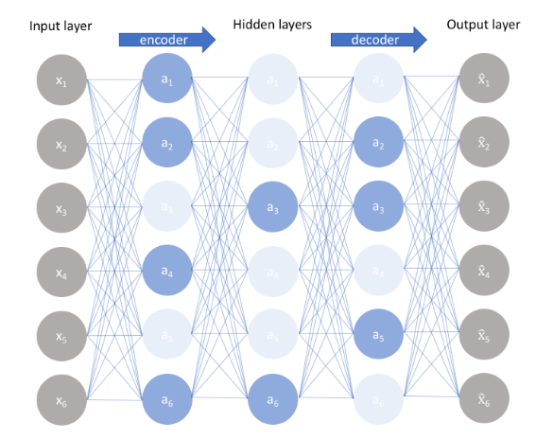
Autoencoders
Sparse Autoencoders
An overcomplete architecture
An alternative method for introducing an information bottleneck without requiring a reduction in the number of nodes at our hidden layers.
Construct our loss function such that we penalize activations within a layer.
For any given observation, the network learn an encoding and decoding which only relies on activating a small number of neurons.

Slide 38
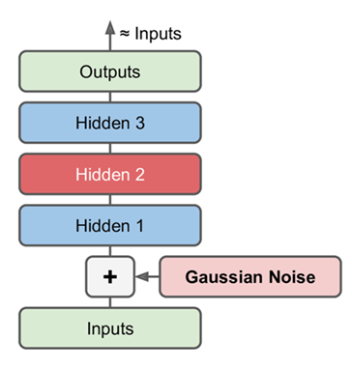
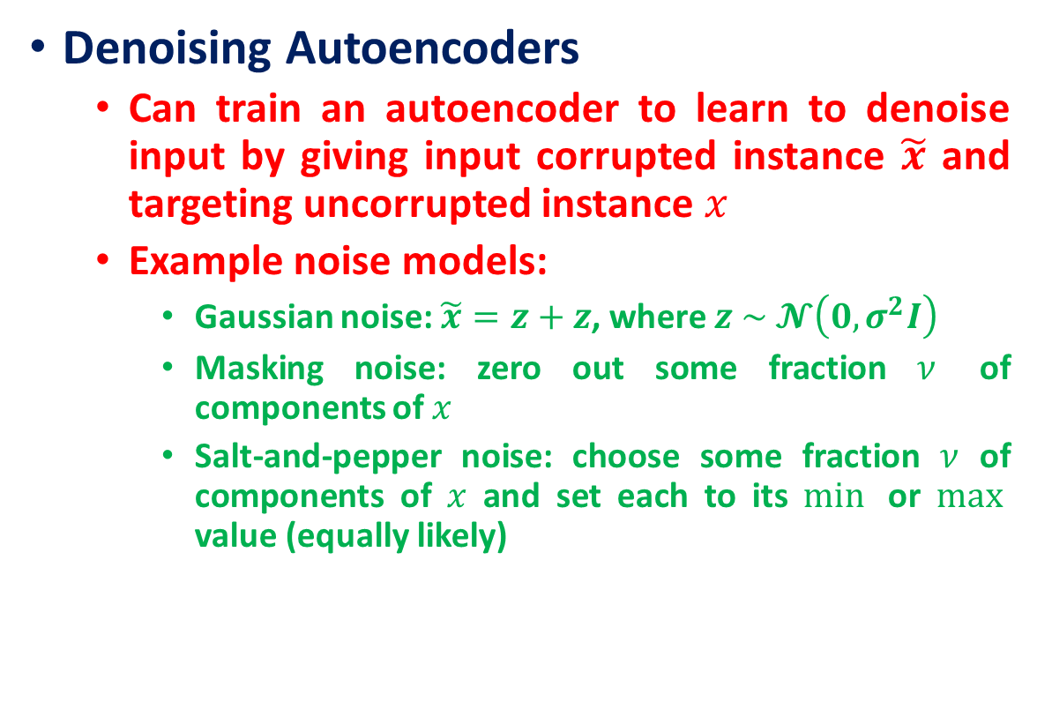
Autoencoders
Denoising Autoencoders
Can train an autoencoder to learn to denoise input by giving input corrupted instance $\tilde{x}$ and targeting uncorrupted instance $x$
Example noise models:
Gaussian noise: $\tilde{x}=z+z$, where $z \sim 𝓝\left(0, σ^{2}I\right)$
Masking noise: zero out some fraction $ν$ of components of $x$
Salt-and-pepper noise: choose some fraction $ν$ of components of $x$ and set each to its $min⁡$ or $max⁡$ value (equally likely)

Slide 39
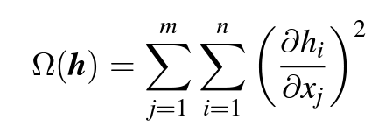
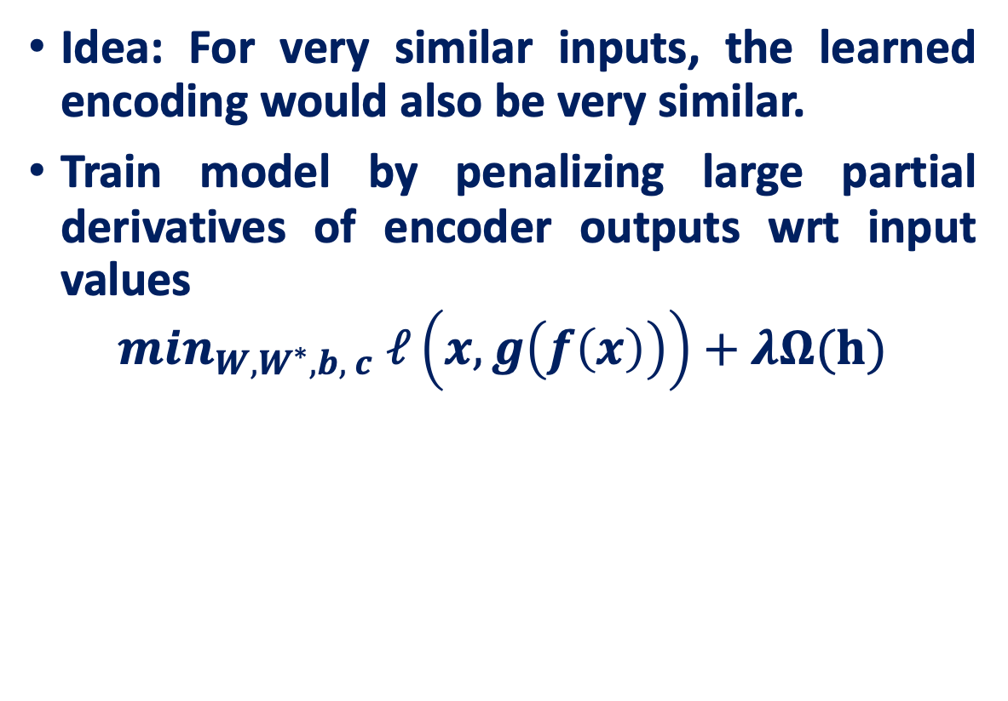
Contractive autoencoders
Idea: For very similar inputs, the learned encoding would also be very similar.
Train model by penalizing large partial derivatives of encoder outputs wrt input values
$$m{in}_{W, W^{∗}, b, c} ℓ\left(x,g\left(f\left(x\right)\right)\right)+λΩ(h)$$

Slide 40
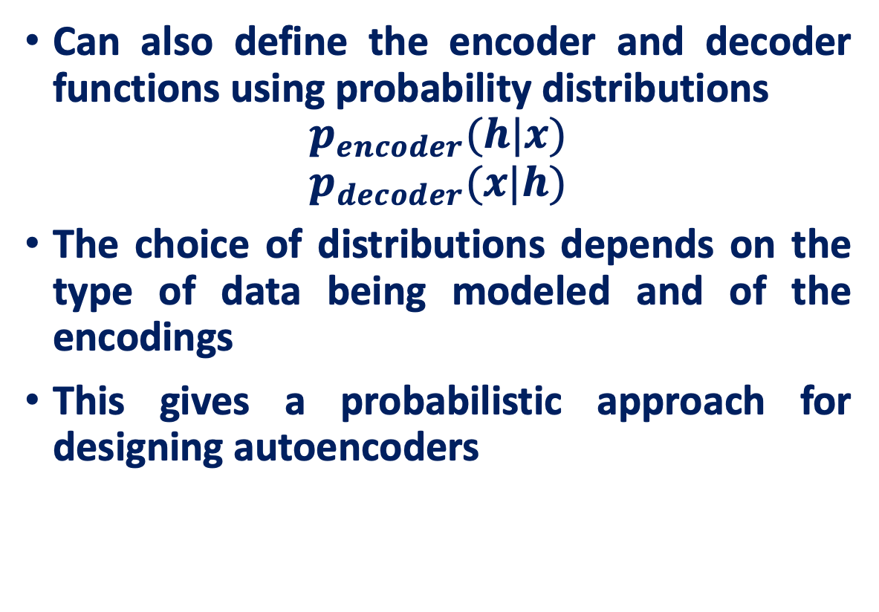
Stochastic Autoencoders
Can also define the encoder and decoder functions using probability distributions
$$p_{encoder}(h|x)$$
$$p_{decoder}(x|h)$$
The choice of distributions depends on the type of data being modeled and of the encodings
This gives a probabilistic approach for designing autoencoders

Slide 41
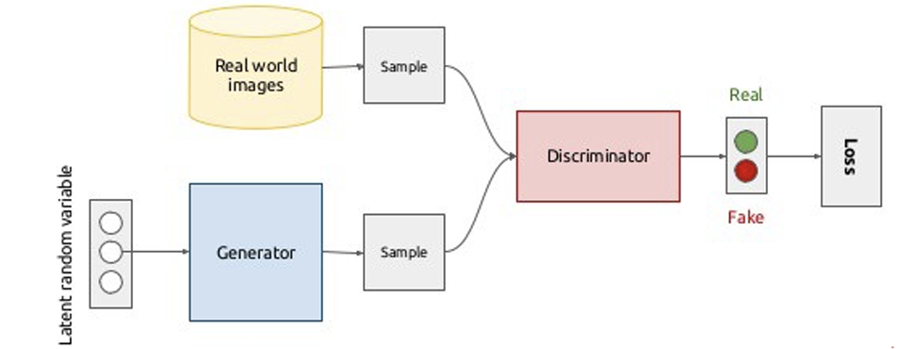
Generative Adversarial Network
GANs are also generative models, like VAEs
Models a game between two players
Generator creates samples intended to come from training distribution
Discriminator attempts to discern the “real” (original training) samples from the “fake” (generated) ones
Discriminator trains as a binary classifier, generator trains to fool the discriminator

Slide 42
References
CS7015 (Deep Learning) : Lecture 7 Autoencoders and relation to PCA, Regularization in autoencoders, Denoising autoencoders, Sparse autoencoders, Contractive autoencoders by Mitesh M. Khapra
https://www.jeremyjordan.me/autoencoders/
https://cse.unl.edu/~sscott/teach/Classes/cse496S18/slides/5-Autoencoders.pdf

