Slide 1
Sequence Modeling
Concepts are ensembled from various online sources with a great acknowledgement to all those made them available online.

Slide 2
Sequence Data
Sequences consist of data points that can be meaningfully ordered such that observations at one location in the sequence provide useful information about observations at other location(s).

Slide 3
Two common tasks with sequential data
The input is a sequence while the target output is a single data point
Examples include video activity recognition, sentiment classification, stock price prediction, etc.
Both the input and the target output are sequences
Examples: natural language translation, DNA sequence analysis, name entity recognition, etc.

Slide 4
A Sequence Modeling Problem: Predict the Next Word
“This morning I took my cat for a walk.”
“This morning I took my cat for a walk.”
given these words
predict the next word

Slide 5
A Sequence Modeling Problem: Predict the Next Word
“This morning I took my cat for a walk.”
“This morning I took my cat for a walk.”
given these words
predict the next word
Idea: use a fixed window
Problem: can’t model long-term dependencies
“France is where I grew up, but I now live in Boston. I speak fluent ___.”
We need information from the distant past to accurately predict the correct word.

Slide 6
A Sequence Modeling Problem: Predict the Next Word
“This morning I took my cat for a walk.”
“This morning I took my cat for a walk.”
given these words
predict the next word
Idea: use entire sequence as set of counts
bag of words
Problem: counts don’t preserve order
The food was good, not bad at all.
vs.
The food was bad, not good at all.

Slide 7
A Sequence Modeling Problem: Predict the Next Word
“This morning I took my cat for a walk.”
“This morning I took my cat for a walk.”
given these words
predict the next word
Idea: use a really big fixed window
Problem: Things we learn about the sequence won’t transfer if they appear elsewhere in the sequence.
no parameter sharing

Slide 8
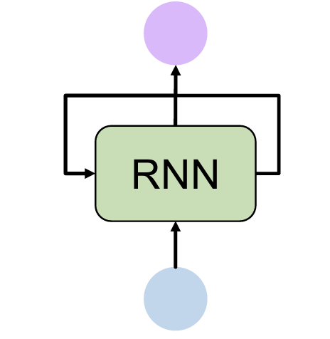
Sequence modeling: design criteria
To model sequences, we need to:
Handle variable-length sequences
Track long-term dependencies
Maintain information about order
Share parameters across the sequence

Slide 9
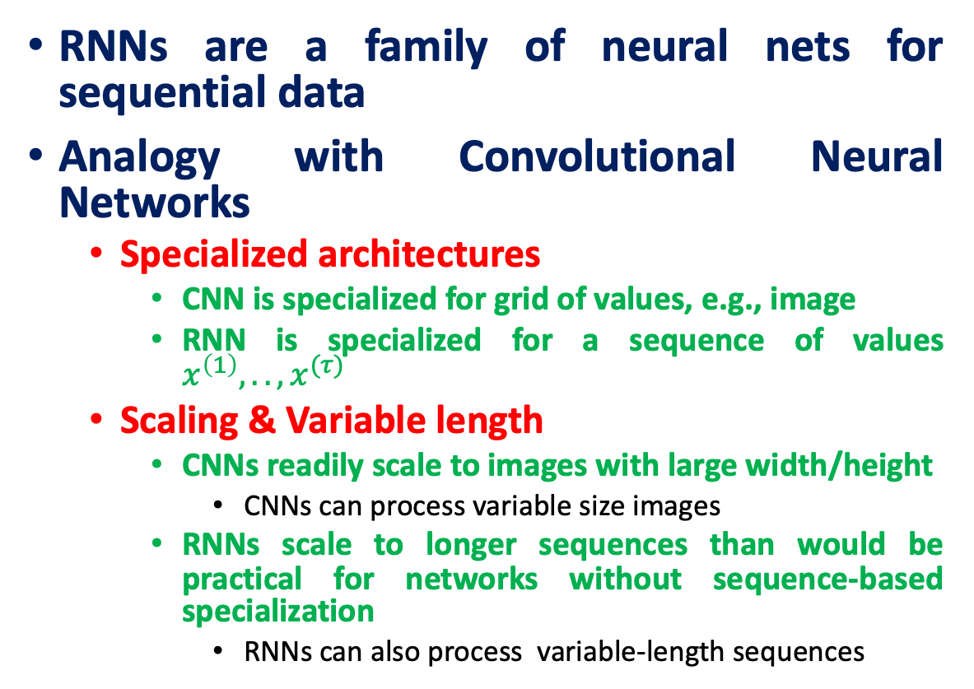
Convolutional vs Recurrent Neural Networks
RNNs are a family of neural nets for sequential data
Analogy with Convolutional Neural Networks
Specialized architectures
CNN is specialized for grid of values, e.g., image
RNN is specialized for a sequence of values $x^{\left(1\right)},..,x^{(τ)}$
Scaling & Variable length
CNNs readily scale to images with large width/height
CNNs can process variable size images
RNNs scale to longer sequences than would be practical for networks without sequence-based specialization
RNNs can also process variable-length sequences

Slide 10
RNNs share same weights across Time Steps
From Multi-Layer Networks to RNNs:
Share parameters across time steps instead of using separate ones for each input as in MLP.
Generalization:
Separate parameters for each time step can't generalize to unseen sequence lengths.
Importance of Sharing: Crucial when key information appears at multiple positions in the sequence.
Example: RNNs can extract "1999" in both "I went to Nepal in 1999" and "In 1999, I went to Nepal.

Slide 11
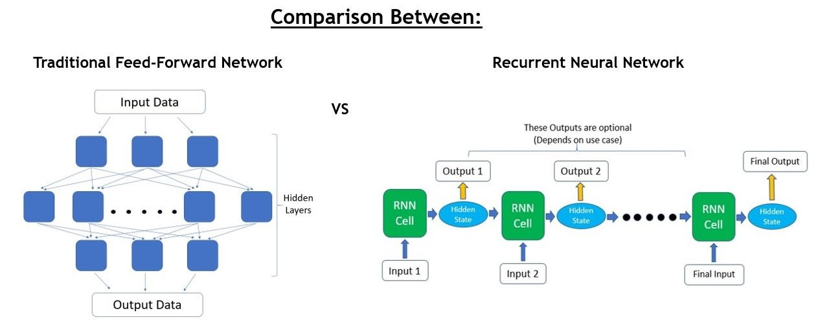
Feed-Forward Vs Recurrent

Slide 12
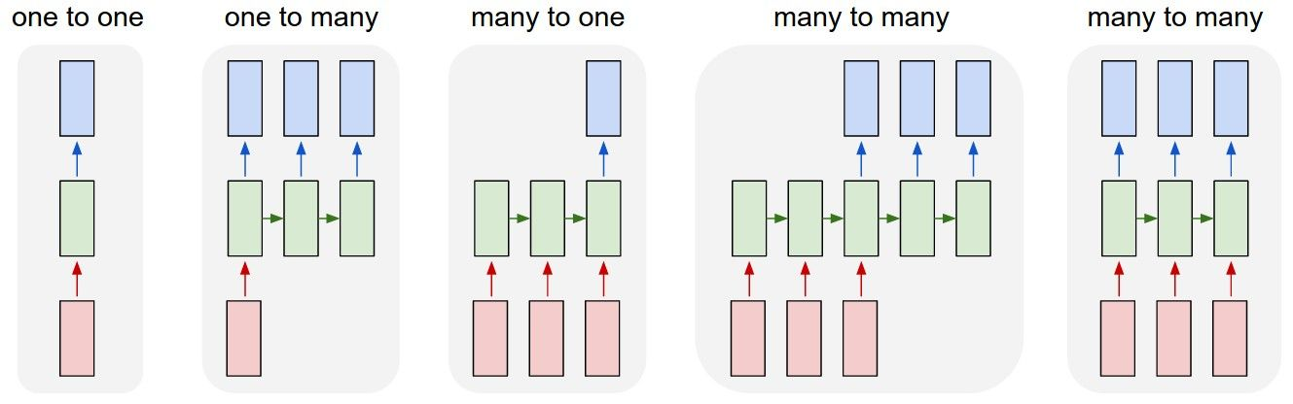
Where to extract output from RNN
RNNs are really flexible and can adapt to your needs
Binary Classification
Image Captioning
Sentiment Classification
Music Generation
This image is taken from Andrej Karpathy’s blog post

Slide 13
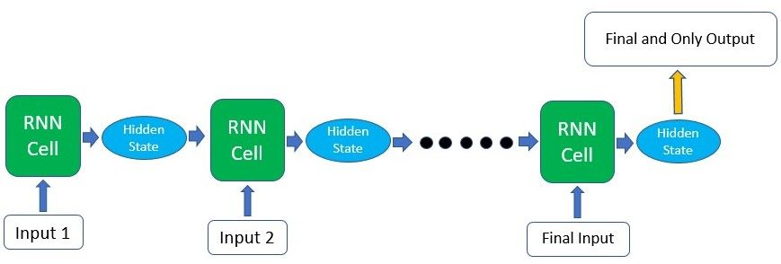
Many inputs – one output
The final result is indeed dependent on all the previous computations and inputs.

Slide 14
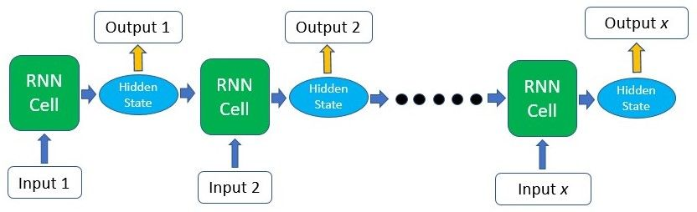
Many inputs – Many outputs

Slide 15
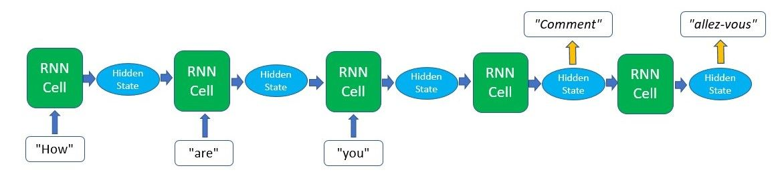
Sequence-to-sequence models

Slide 16
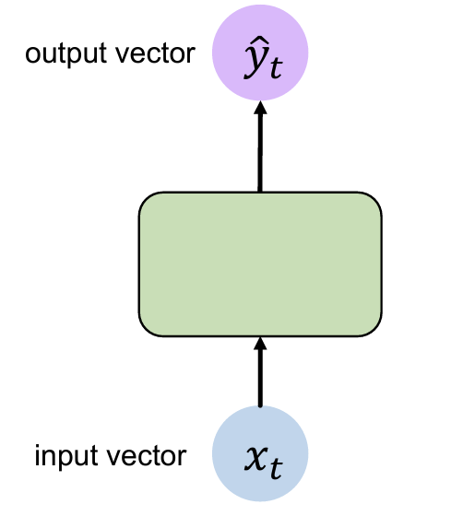
A standard “vanilla” neural network

Slide 17
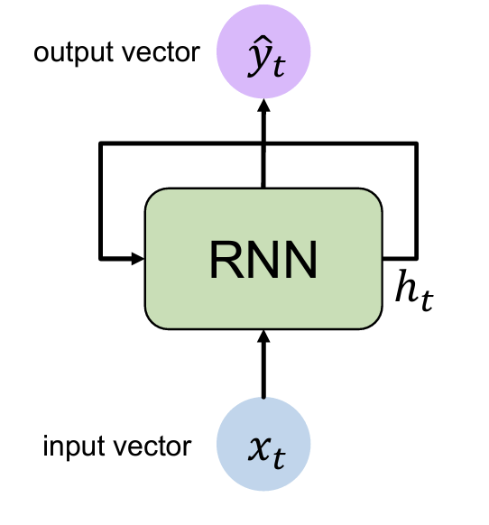
A recurrent neural network (RNN)

Slide 18
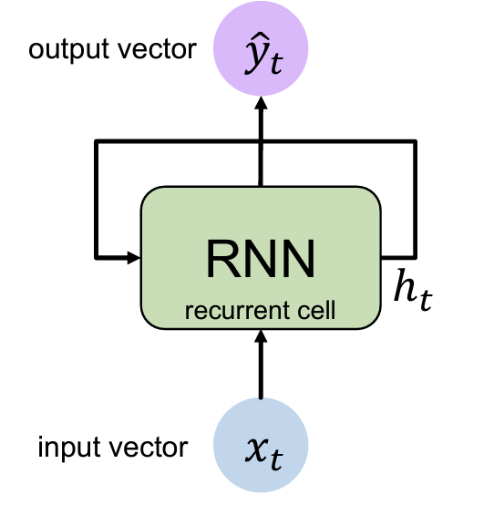
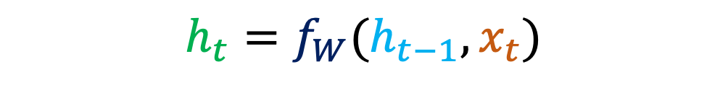
A recurrent neural network (RNN)
Apply a recurrence relation at every time step to process a sequence
Old State
Input vector at time step t
$$h_{t}=f_{W}(h_{t−1},x_{t})$$
Cell State
Fun. Parameterized by W

Slide 19
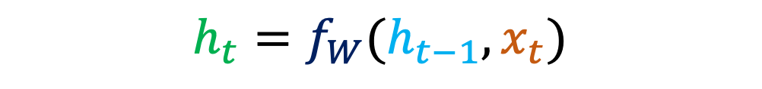
A recurrent neural network (RNN)
Apply a recurrence relation at every time step to process a sequence
$$h_{t}=f_{W}(h_{t−1},x_{t})$$
Note: the same function and set of parameters are used at every time step

Slide 20
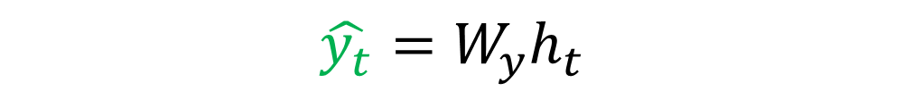

A recurrent neural network (RNN)
Output Vector
$$\hat{y_{t}}=W_{y}h_{t}$$
Update Hidden State
$$h_{t}=tanh(W_{h}h_{t−1}+W_{x}x_{t})$$
Input Vector: $x_{t}$

Slide 21
Unfolding Computational Graphs
A Computational Graph is a way to formalize the structure of a set of computations
Such as mapping inputs and parameters to outputs and loss
We can unfold a recursive or recurrent computation into a computational graph that has a repetitive structure
Corresponding to a chain of events
Unfolding this graph results in sharing of parameters across a deep network structure

Slide 22
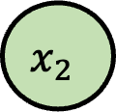
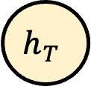
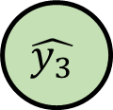

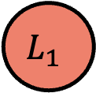
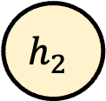

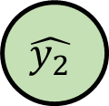

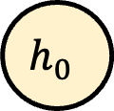
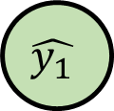


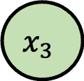

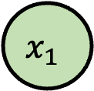
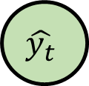
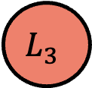
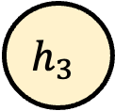

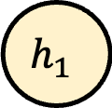

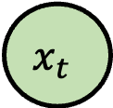
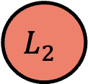
RNN: Computational Graph (Many to Many)
$$\hat{y_{t}}$$
$$L$$
$$L_{1}$$
$$L_{2}$$
$$L_{3}$$
$$L_{T}$$
Unfolding
RNN CELL
$$\hat{y_{1}}$$
$$\hat{y_{2}}$$
$$\hat{y_{3}}$$
$$\hat{y_{T}}$$
$$x_{t}$$
$$h_{0}$$
$$f_{W}$$
$$h_{1}$$
$$f_{W}$$
$$h_{2}$$
$$f_{W}$$
$$h_{3}$$
$$…$$
$$h_{T}$$
$$x_{1}$$
$$x_{2}$$
$$x_{3}$$
Re-use the same weight matrix at every time-step
$$W$$

Slide 23
RNN: Computational Graph (Many to One)
$$L$$
$$\hat{y_{T}}$$
$$h_{0}$$
$$f_{W}$$
$$h_{1}$$
$$f_{W}$$
$$h_{2}$$
$$f_{W}$$
$$h_{3}$$
$$…$$
$$h_{T}$$
$$x_{1}$$
$$x_{2}$$
$$x_{3}$$
Re-use the same weight matrix at every time-step
$$W$$

Slide 24
RNN: Computational Graph (One to Many)
$$L$$
$$L_{1}$$
$$L_{2}$$
$$L_{3}$$
$$L_{T}$$
$$\hat{y_{1}}$$
$$\hat{y_{2}}$$
$$\hat{y_{3}}$$
$$\hat{y_{T}}$$
$$h_{0}$$
$$f_{W}$$
$$h_{1}$$
$$f_{W}$$
$$h_{2}$$
$$f_{W}$$
$$h_{3}$$
$$…$$
$$h_{T}$$
$$x_{1}$$
Re-use the same weight matrix at every time-step
$$W$$

Slide 25

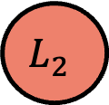
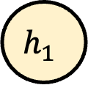
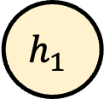
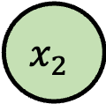
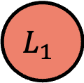


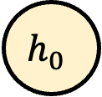


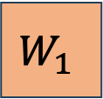
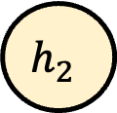

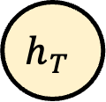
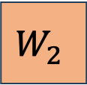
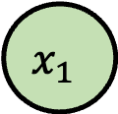

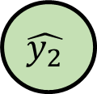

Sequence to Sequence: Many-to-one + one-to-many
$$L$$
$$L_{1}$$
$$L_{2}$$
$$L_{T}$$
$$\hat{y_{1}}$$
$$\hat{y_{2}}$$
$$\hat{y_{T}}$$
$$h_{0}$$
$$f_{W}$$
$$h_{1}$$
$$f_{W}$$
$$…$$
$$h_{T}$$
$$f_{W}$$
$$h_{1}$$
$$f_{W}$$
$$h_{2}$$
$$…$$
$$h_{T}$$
$$x_{1}$$
$$x_{2}$$
$$W_{1}$$
$$W_{2}$$

Slide 26
Training RNN
Principle: unfold the computational graph, and use backpropagation
Called back-propagation through time (BPTT) algorithm
Can then apply any general-purpose gradient-based techniques
Conceptually: first compute the gradients of the internal nodes, then compute the gradients of the parameters

Slide 27
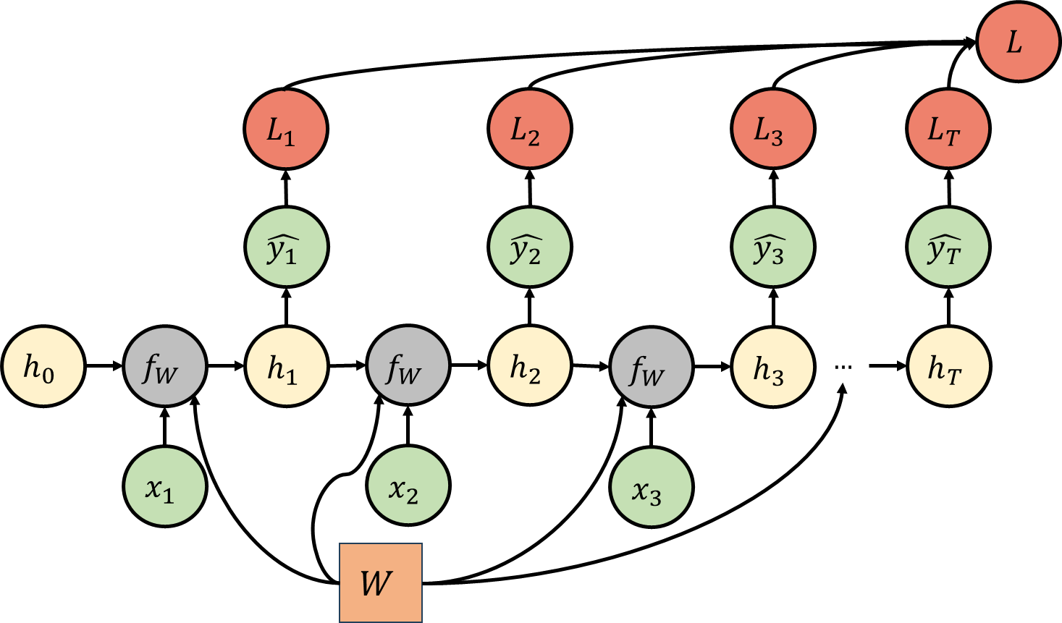
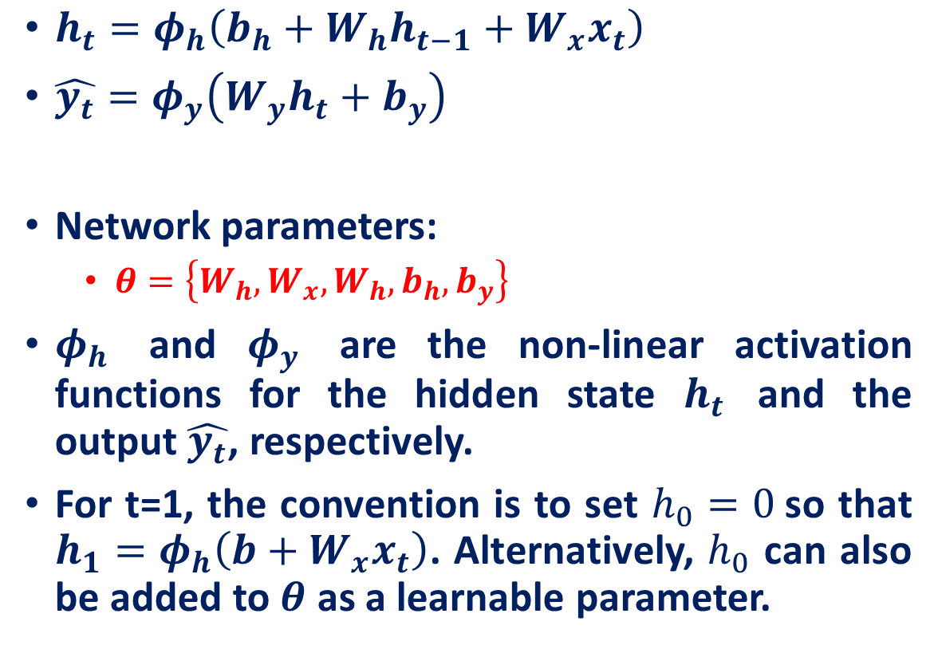
Training RNN: RNN Cell Revisit
$h_{t}=φ_{h}\left(b_{h}+W_{h}h_{t−1}+W_{x}x_{t}\right)$
$\hat{y_{t}}=φ_{y}\left(W_{y}h_{t}+b_{y}\right)$
Network parameters:
$θ=\left\{W_{h}, W_{x}, W_{h}, b_{h}, b_{y}\right\}$
$φ_{h}$ and $φ_{y}$ are the non-linear activation functions for the hidden state $h_{t}$ ﻿and the output $\hat{y_{t}}$, respectively.
For t=1, the convention is to set $h_{0}=0$so that $h_{1}=φ_{h}\left(b+W_{x}x_{t}\right)$. Alternatively, $h_{0}$ can also be added to $θ$ as a learnable parameter.

Slide 28
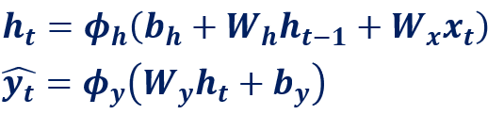
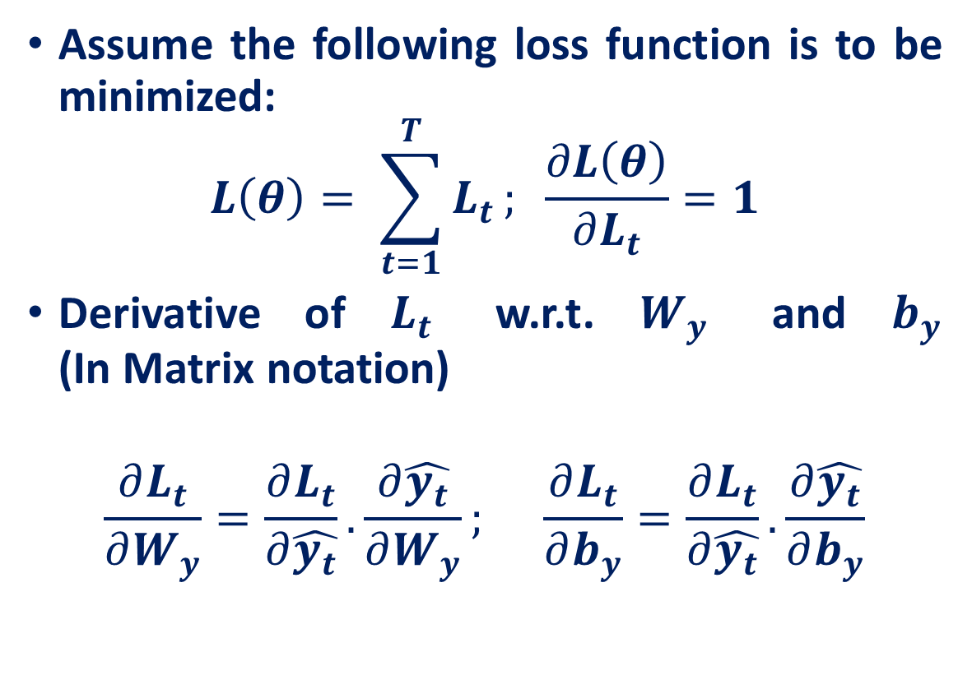
﻿Back-propagation through time (BPTT)
Assume the following loss function is to be minimized:
$$L\left(θ\right)= \sum_{t=1}^{T}{L_{t}}; \frac{∂L\left(θ\right)}{∂L_{t}}=1$$
Derivative of $L_{t}$ w.r.t. $W_{y}$ and $b_{y}$ (In Matrix notation)
$$\frac{∂L_{t}}{∂W_{y}}=\frac{∂L_{t}}{∂\hat{y_{t}}}.\frac{∂\hat{y_{t}}}{∂W_{y}}; \frac{∂L_{t}}{∂b_{y}}=\frac{∂L_{t}}{∂\hat{y_{t}}}.\frac{∂\hat{y_{t}}}{∂b_{y}}$$

Slide 29
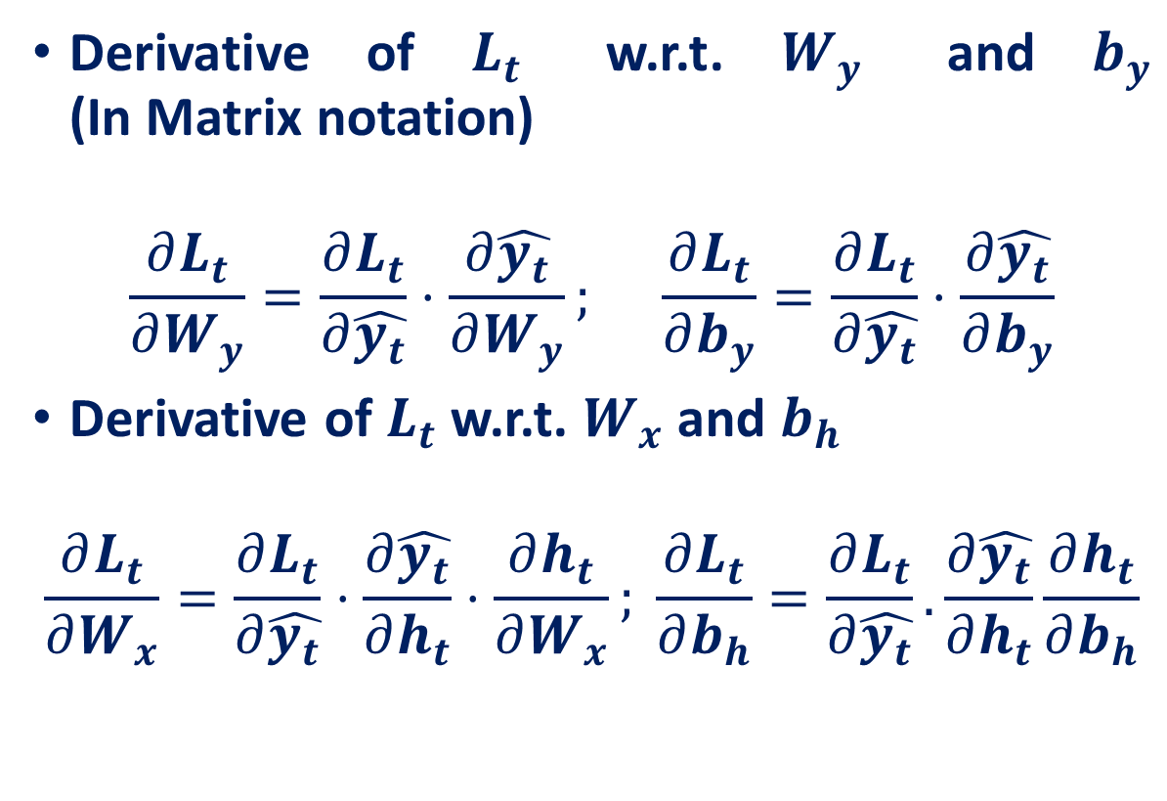
﻿Back-propagation through time (BPTT)
Derivative of $L_{t}$ w.r.t. $W_{y}$ and $b_{y}$ (In Matrix notation)
$$\frac{∂L_{t}}{∂W_{y}}=\frac{∂L_{t}}{∂\hat{y_{t}}}⋅\frac{∂\hat{y_{t}}}{∂W_{y}}; \frac{∂L_{t}}{∂b_{y}}=\frac{∂L_{t}}{∂\hat{y_{t}}}⋅\frac{∂\hat{y_{t}}}{∂b_{y}}$$
Derivative of $L_{t}$ w.r.t. $W_{x}$ and $b_{h}$
$$\frac{∂L_{t}}{∂W_{x}}=\frac{∂L_{t}}{∂\hat{y_{t}}}⋅\frac{∂\hat{y_{t}}}{∂h_{t}}⋅\frac{∂h_{t}}{∂W_{x}}; \frac{∂L_{t}}{∂b_{h}}=\frac{∂L_{t}}{∂\hat{y_{t}}}.\frac{∂\hat{y_{t}}}{∂h_{t}}\frac{∂h_{t}}{∂b_{h}}$$

Slide 30
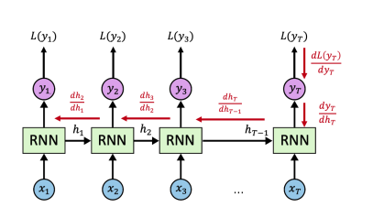
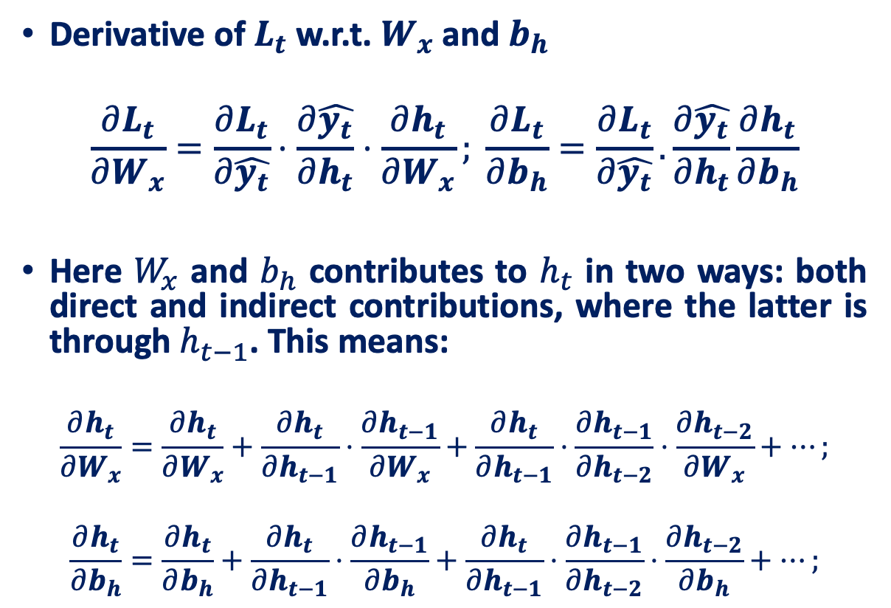
﻿Back-propagation through time (BPTT)
Derivative of $L_{t}$ w.r.t. $W_{x}$ and $b_{h}$
$$\frac{∂L_{t}}{∂W_{x}}=\frac{∂L_{t}}{∂\hat{y_{t}}}⋅\frac{∂\hat{y_{t}}}{∂h_{t}}⋅\frac{∂h_{t}}{∂W_{x}}; \frac{∂L_{t}}{∂b_{h}}=\frac{∂L_{t}}{∂\hat{y_{t}}}.\frac{∂\hat{y_{t}}}{∂h_{t}}\frac{∂h_{t}}{∂b_{h}}$$
Here $W_{x}$ and $b_{h}$ contributes to $h_{t}$ in two ways: both direct and indirect contributions, where the latter is through $h_{t−1}$. This means:
$$\frac{∂h_{t}}{∂W_{x}}=\frac{∂h_{t}}{∂W_{x}}+\frac{∂h_{t}}{∂h_{t−1}}⋅\frac{∂h_{t−1}}{∂W_{x}}+\frac{∂h_{t}}{∂h_{t−1}}⋅\frac{∂h_{t−1}}{∂h_{t−2}}⋅\frac{∂h_{t−2}}{∂W_{x}}+…;$$
$$\frac{∂h_{t}}{∂b_{h}}=\frac{∂h_{t}}{∂b_{h}}+\frac{∂h_{t}}{∂h_{t−1}}⋅\frac{∂h_{t−1}}{∂b_{h}}+\frac{∂h_{t}}{∂h_{t−1}}⋅\frac{∂h_{t−1}}{∂h_{t−2}}⋅\frac{∂h_{t−2}}{∂b_{h}}+…;$$

Slide 31
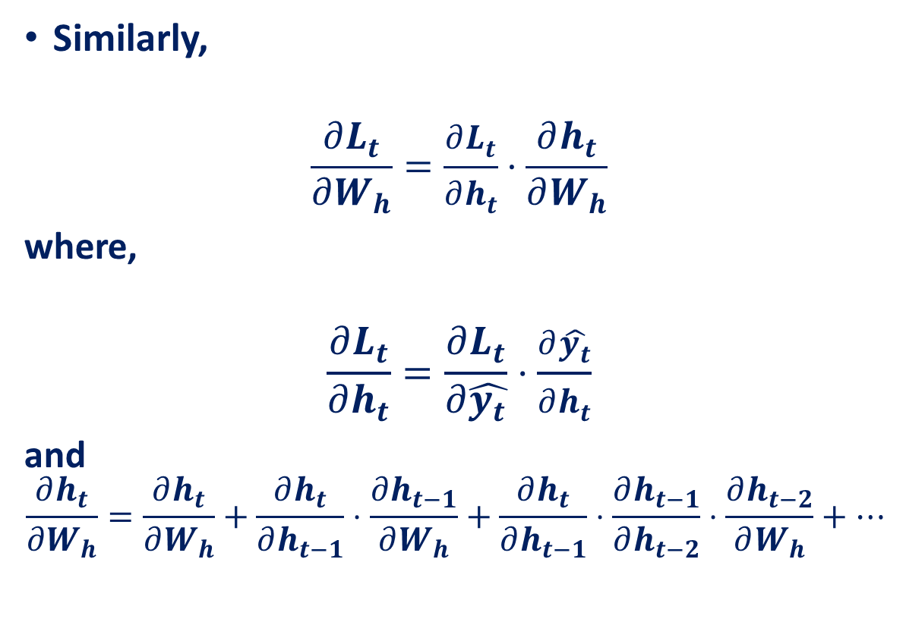
﻿Back-propagation through time (BPTT)
Similarly,
$$\frac{∂L_{t}}{∂W_{h}}=\frac{∂L_{t}}{∂h_{t}}⋅\frac{∂h_{t}}{∂W_{h}}$$
where,
$$\frac{∂L_{t}}{∂h_{t}}=\frac{∂L_{t}}{∂\hat{y_{t}}}⋅\frac{∂\hat{y_{t}}}{∂h_{t}}$$
and
$$\frac{∂h_{t}}{∂W_{h}}=\frac{∂h_{t}}{∂W_{h}}+\frac{∂h_{t}}{∂h_{t−1}}⋅\frac{∂h_{t−1}}{∂W_{h}}+\frac{∂h_{t}}{∂h_{t−1}}⋅\frac{∂h_{t−1}}{∂h_{t−2}}⋅\frac{∂h_{t−2}}{∂W_{h}}+…$$

Slide 32
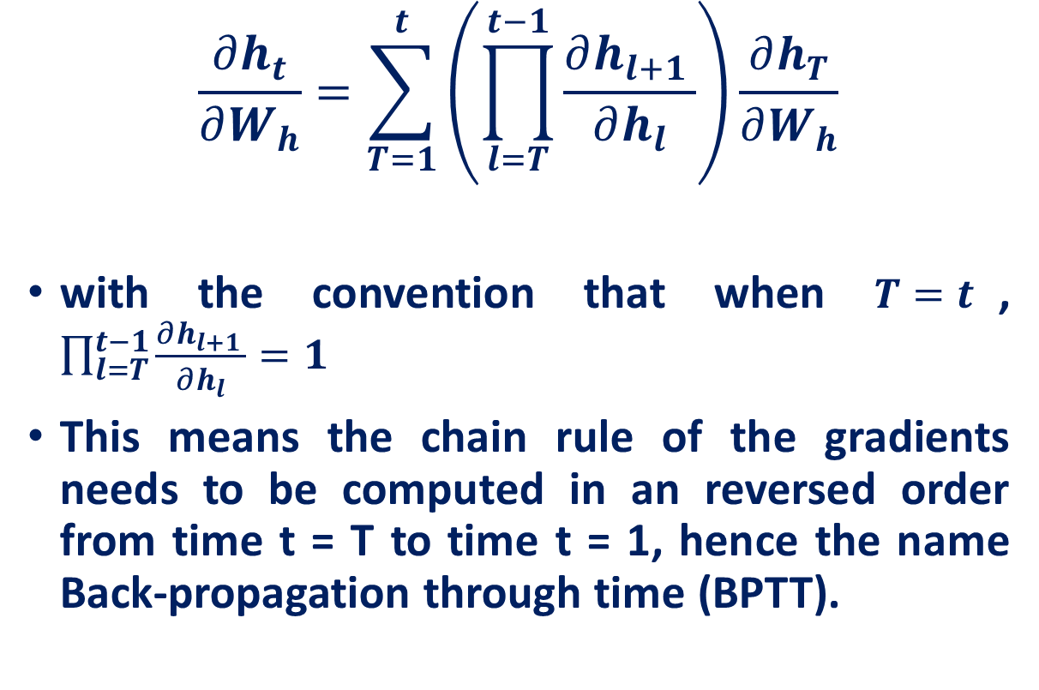
﻿Back-propagation through time (BPTT)
$$\frac{∂h_{t}}{∂W_{h}}=\sum_{T=1}^{t}{\left(\prod_{l=T}^{t−1}{\frac{∂h_{l+1 }}{∂h_{l}}}\right)}\frac{∂h_{T}}{∂W_{h}}$$
with the convention that when $T=t$, $\prod_{l=T}^{t−1}{\frac{∂h_{l+1 }}{∂h_{l}}}=1$
This means the chain rule of the gradients needs to be computed in an reversed order from time t = T to time t = 1, hence the name Back-propagation through time (BPTT).

Slide 33

﻿Back-propagation through time (BPTT)
Truncation with length L might be applied to this back-propagation procedure, and with truncated BPTT the gradient is computed as
$$truncated\left[\frac{∂h_{t}}{∂W_{h}}\right]=\sum_{T=max\left(1, t−L\right)}^{t}{\left(\prod_{l=T}^{t−1}{\frac{∂h_{l+1 }}{∂h_{l}}}\right)}\frac{∂h_{T}}{∂W_{h}}$$

Slide 34
Bidirectional Recurrent Neural Networks
Many applications: output at time 𝑡 may depend on the whole input sequence
Example in speech recognition: correct interpretation of the current sound may depend on the next few phonemes, potentially even the next few words
Bidirectional RNNs are introduced to address this

Slide 35
























RNN: Computational Graph (Many to Many)
$$L$$
$$L_{1}$$
$$L_{2}$$
$$L_{3}$$
$$L_{T}$$
$$\hat{y_{1}}$$
$$\hat{y_{2}}$$
$$\hat{y_{3}}$$
$$\hat{y_{T}}$$
$$h_{t}^{f}=φ_{h}\left(b_{h}^{f}+W_{h}^{f}h_{t−1}^{f}+W_{x}^{f}x_{t}\right)$$
$$h_{t}^{b}=φ_{h}\left(b_{h}^{b}+W_{h}^{b}h_{t+1}^{f}+W_{x}^{b}x_{t}\right)$$
$$h_{t}=\left[h_{t}^{f},h_{t}^{b}\right]$$
$$\hat{y_{t}}=φ_{y}\left(W_{y}h_{t}+b_{y}\right)$$
$$h_{1}^{b}$$
$$h_{2}^{b}$$
$$h_{3}^{b}$$
$$h_{T}^{b}$$
$$…$$
$$h_{1}^{f}$$
$$h_{2}^{f}$$
$$h_{3}^{f}$$
$$h_{T}^{f}$$
$$…$$
$$x_{1}$$
$$x_{2}$$
$$x_{3}$$
$$x_{3}$$

Slide 36

Multilayer RNNs

Slide 37
The problem of exploding/vanishing gradient
What happens to the magnitude of the gradients as we backpropagate through many layers?
If the weights are small, the gradients shrink exponentially.
If the weights are big the gradients grow exponentially.
In an RNN trained on long sequences the gradients can easily explode or vanish.
We can avoid this by initializing the weights very carefully.
Even with good initial weights, its very hard to detect that the current target output depends on an input from many time-steps ago.
So RNNs have difficulty dealing with long-range dependencies.

Slide 38
Long Short Term Memory (LSTM)
Goal of RNNs: remember information from the past
Given the sequence:
“The dog that my family had when I was a child had a fluffy _____.”
We want the prediction to be “tail”
However, RNNs are not very good at remembering things far in the past.
To predict “tail” RNN needs to remember the subject of the sentence - “dog”

Slide 39
Long Short Term Memory (LSTM)
Given the sequence:
“The dog that my family had when I was a child had a fluffy _____.”
We want the prediction to be “tail”
To predict “tail” RNN needs to remember the subject of the sentence - “dog”
“dog” and predicted word are separated by 12 words
On the outer limit of what a vanilla RNN would be able to remember.

Slide 40

RNN Weaknesses

Slide 41

RNN Weaknesses

Slide 42

RNN Weaknesses

Slide 43

RNN Weaknesses
Can imagine that the information about “dog” is stored in some part of the RNN’s hidden state vector

Slide 44

RNN Weaknesses
Through all subsequent RNN steps, we want “dog” to stay the same

Slide 45

RNN Weaknesses
If we think of “dog” as just a few entries in the vector…

Slide 46

RNN Weaknesses
...to preserve “dog” , we need to compute the identity function over the part of the vector that stores it
But will that happen?
No

Slide 47

RNN Weaknesses
...to preserve “dog” , we need to compute the identity function over the part of the vector that stores it
RNN Update Rule:
$h_{t}=φ_{h}\left(W_{h}h_{t−1}+W_{x}x_{t}+b_{h}\right)$
How does this affect the hidden state?

Slide 48


How does this affect the hidden state?
What will happen to our dog after we multiply our weights by our hidden state?
Dog gets lost in all the other information!

Slide 49

How does this affect the hidden state?
RNN forgets about the dog after a certain time

Slide 50

RNN Weaknesses
RNNs cannot learn “long term” dependency
We need new way to update hidden state!

Slide 51

An analogy to human (or computer) memory
RNN hidden state $→$“short term memory/RAM”
Like how you lose contents of RAM if you shut down a computer
or how human short-term memory fades after time
What we want $→$ “long term memory/disk”
Some state representing knowledge that persists
Like how contents of disk persist across shut-downs...
or how sleep consolidates human memory into long-term memory

Slide 52


Long Short Term Memory (LSTM)
Long Short Term Memory (LSTM)
“Short-term memory that persists over time”
i.e. “hidden states that remember information for longer”
Vanilla RNN
LSTM

Slide 53

LSTM cells as filters
Long Short Term Memory (LSTM)
“Short-term memory that persists over time”
i.e. “hidden states that remember information for longer”
Cell State (long short- term memory)
An LSTM consists of 3 major modules:
Forget module
Remember module
Output module
Hidden State (short-term memory)
Word embedding

Slide 54

LSTM cells as filters

Slide 55

Forget Module
Say we just predicted “tail” in “My dog has a fluffy _____.”
Next set of words: “I love my dog”
Model no longer needs to know about “dog”
Ready to delete information about subject
Pointwise multiplication
fully connected layer with sigmoid

Slide 56

Forget Module
Filters out what gets allowed into the LSTM cell from the last state
Example: If it’s remembering gender pronouns, and a new subject is seen, it will forget the old gender pronouns
Either lets parts of $C_{t−1}$ pass through or not

Slide 57





Forget Module
Use pointwise multiplication by a mask vector to forget information
The sigmoid generates values 0 and 1:
0 : completely remove info in the dimension
1 : completely keep info in the dimension
$$C_{t−1}$$
$$f_{t}=σ\left(W_{f}h_{t−1}+U_{f}x_{t}+b_{f}\right)$$
Unforgotten$C_{t−1}=f_{t}⨂C_{t−1}$

Slide 58

Remember Module
We can save information that we want to remember by adding it into “empty” slots in the cell state
pointwise addition
fully connected layer with sigmoid
pointwise multiplication
fully connected layer with tanh

Slide 59


Remember Module
First: use gating to decide what to remember
New candidate cell states $\tilde{C_{t}}$ are created as a function of $h_{t−1}$ and $x_{t}$
Input gates $i_{t}$ decides how much of values of the new candidate cell states $\tilde{C_{t}}$ are combined into the cell states

Slide 60


Remember Module
Then: we add this selective memory into the cell state
Add what we didn’t forget to what we did remember

Slide 61

Why does this solve our problem?
Cell state never goes through a fully connected layer!
Never has to mix up its own information

Slide 62


Output Module
Output will be based on cell state $C_{t}$ with filter from output gate $o_{t}$
The output gate $o_{t}$ decides which part of cell state $C_{t}$ will be in the output
$$o_{t}=σ\left(W_{o}h_{t−1}+U_{o}x_{t}+b_{o}\right)$$
Then the final output is generated from tanh-ed cell states filtered by $o_{t}$
$$h_{t}=o_{t}⨂tanh\left(C_{t}\right)$$

Slide 63
Gated Recurrent Unit
If we never output cell state then why do we have it?
Is it possible to just have one state, the hidden state?

Slide 64
Gated Recurrent Unit
If we never output cell state then why do we have it?
Is it possible to just have one state, the hidden state?

Slide 65


Gated Recurrent Unit
In practice, similar performance and may train faster
Removes cell state, computationally more efficient and less complex
Simplify LSTM by merging forget and input gate into update gate $z_{t}$
$z_{t}$ controls the forgetting factor and the decision to update the state unit
Reset gates $r_{t}$ control which parts of the state get used to compute the next target state

Slide 66

Gated Recurrent Unit
$$z_{t}=σ\left(W_{z}h_{t−1}+U_{z}x_{t}+b_{z}\right)$$
$$r_{t}=σ\left(W_{r}h_{t−1}+U_{r}x_{t}+b_{r}\right)$$
$$\tilde{h_{t}}=tanh\left(W_{h}\left[r_{t}⊗h_{t−1}\right]+U_{h}x_{t}+b\right)$$
$$h_{t}=\left(1−z_{t}\right)⊗h_{t−1}+z_{t}⊗\tilde{h_{t}}$$

Slide 67
Comparison LSTM and GRU
Greff, et al. (2015) compared LSTM, GRU and several variants on thousands of experiments and found that none of the variants can improve upon the standard LSTM architecture significantly, but also the variants do not decrease performance significantly
Greff, Klaus, Rupesh K. Srivastava, Jan Koutník, Bas R. Steunebrink, and Jürgen Schmidhuber. "LSTM: A search space odyssey." IEEE transactions on neural networks and learning systems 28, no. 10 (2016): 2222-2232.

Slide 68
Encoder-Decoder (Seq2Seq) Model

Slide 69
References
Deep Sequence Modeling, MIT 6.S191, Ava Soleimany
Deep Learning, CSCI 1470/2470 Spring 2024, Ritambhara Singh

