Slide 1

BBD Vac week 2021
Team 4 - SPLAT!

Slide 2
Basic Problem Outline:
New Bursary program applicant test
Must be fair to all levels of student applying for the bursary.
Grading should be automatic rather than requiring human grading.
The test should test logical thought processes and attention to detail.

Slide 3

Our Solution: SPLAT
Splat is a combination of a colour based puzzle game and pseudo-code blocks.

Slide 4
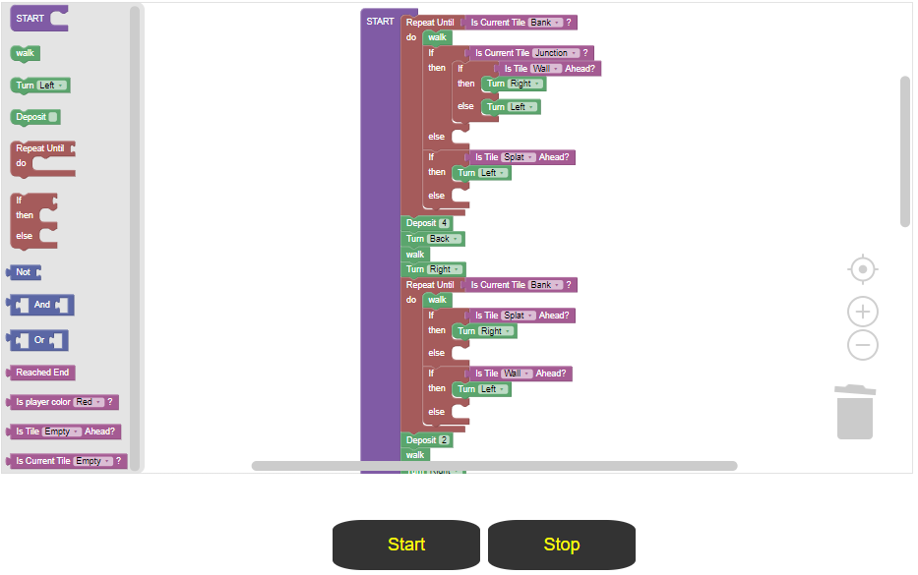
The Pseudo-Code
Implemented using code blocks from Blockly.
Converts code blocks into an array of command objects.
Command objects are interpreted by engine.

Slide 5
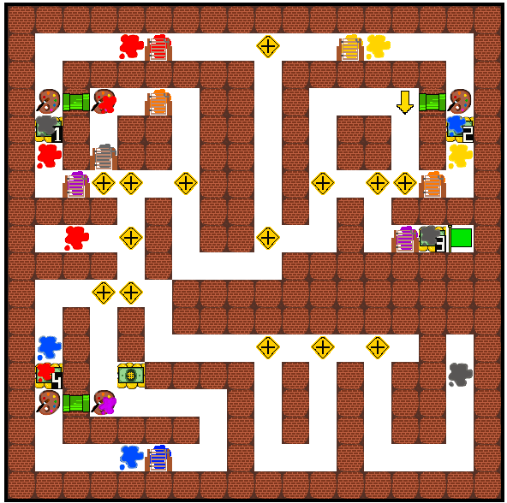
The Puzzle
Comprised of many assets which are only rendered when changed.
Engine translates commands into map state changes which are then rendered.

Slide 6















How to play
Stores your color at
using deposit(1-4)
Bank
Automatically mixes your color with
‘s color
Mixer
Can only pass through this when color matches, i.e.
Gate
A special tile to indicate a crossroads. Aids in navigation
Drag code blocks into the white code staging area within a start code block.
The start button will run your code.
Preview will show the demo solution.
Junction
You can’t walk through them, just like the ones at home.
See also:
Wall
Walk onto this to win. You have to be the same color though.
Goal
It’s literally an empty tile you can move on
Empty
The titular tile, which changes your color. It’s really integral to every solution, so I made it big.
Also splats ->
Splat

Slide 7
Scoring and Fairness: The True Challenge
Points are given per level cleared
Metrics such as number of commands used and time taken for a level are used to scale difficulty according to a predicted level of proficiency.
Predicted proficiency level is made available with the score.
If an Honours student has a predicted proficiency of Grade 9 scratch leaner, you should probably consider ignoring their application.
(Disclaimer)We don’t have a scaling algorithm due to critical lack of test data and data scientists.

Slide 8
Demo Time!

Slide 9
Further Development
Implement the metric collection
Implement difficulty scaling based on metrics
Limit the number of times a code block can be used per level
Level editor
Conversion from JS command objects to Code blocks on the webpage
Pretty interfaces
Optimise rendering
Implement storage and access to scores

Slide 10
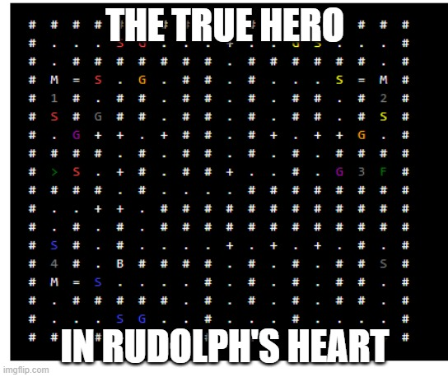
Now for the actually important stuff

Slide 11
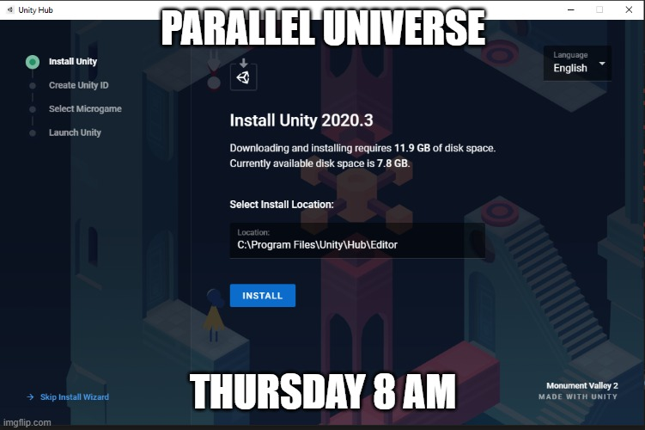
Now for the actually important stuff

Slide 12
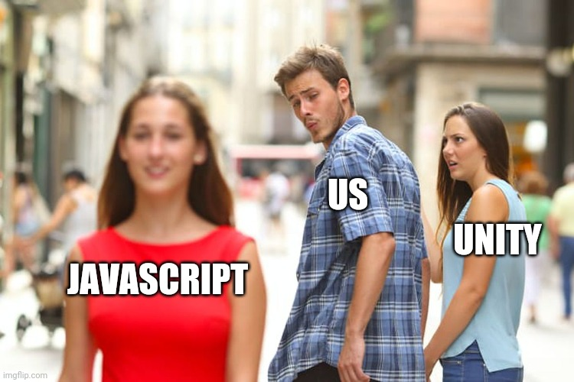
Now for the actually important stuff

Slide 13

Now for the actually important stuff

