Slide 1

Genetic Algorithm (GA)
Sinh viên thực hiện: Đỗ Anh Duy – 20DH111943
Giảng viên hướng dẫn: Ths. Phạm Đức Thành
Research on Genetic Algorithm GA and Application - Graduation Thesis - 2024

Slide 2
Evolutionary Approach in Computer Science
Inspired by:
Nature -> Natural Selection
Darwinian Evolution
Solution -> Individual organism
Population
Ramdomly initiated
Optimal one over generations
Biological operations such as: Crossover, Mutation, etc.
Research on Genetic Algorithm GA and Application - Graduation Thesis - 2024

Slide 3
Genetic Algorithm
Popular and powerful EA
Population-based metaheuristic algorithm [S.Katoch et.al]
Ant Colony Optimization (ACO)
Particle Swarm Optimization (PSP)
Survival of fittest principle
Proposted by J.H.Holland in 1992
Research on Genetic Algorithm GA and Application - Graduation Thesis - 2024

Slide 4




Genetic Algorithm - Introduction
Solution
Parents
Individual
Generation
Research on Genetic Algorithm GA and Application - Graduation Thesis - 2024

Slide 5


Genetic Algorithm - Introduction
Parent 1
Parent 2
Child 1
Child 2
Research on Genetic Algorithm GA and Application - Graduation Thesis - 2024

Slide 6
Genetic Algorithm - Introduction
……
Generation 1
Generation 2
Generation 3
Generation n
Research on Genetic Algorithm GA and Application - Graduation Thesis - 2024

Slide 7
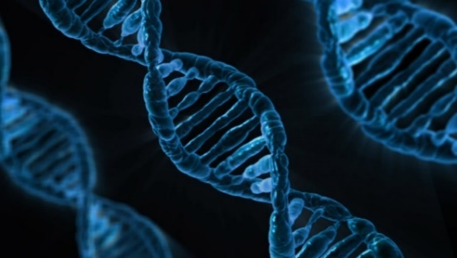
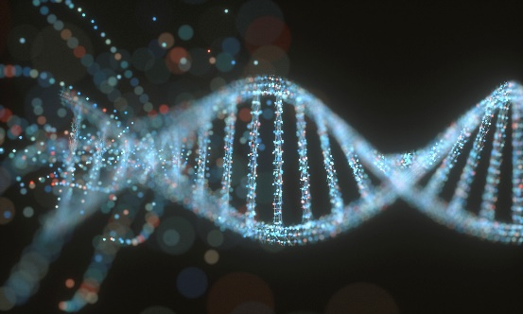
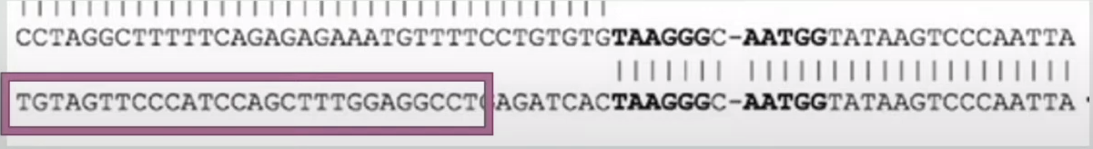
Genetic Algorithm - Fundanmentals
DNA
Chromosome
A - C - F - G - E - B - D
Chromosome sequence = Solution
101001000100001011101
Research on Genetic Algorithm GA and Application - Graduation Thesis - 2024

Slide 8
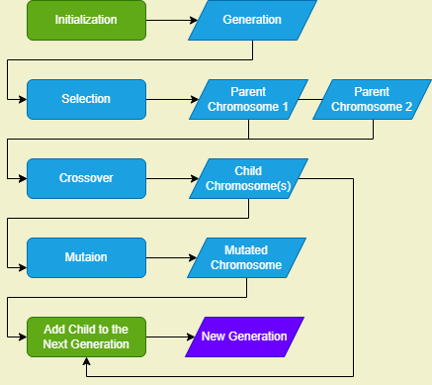
Genetic Algorithm Flow
A - C - F - E - B - D - G
D - A - F - B - G - C - E
D - A - F - B - G - C - E
G - A - F - C - E - B - D
F - C - A - G - E - B - D
D - A - F - B - G - C - E
…
…
P1
P2
A - C - F - E
D - B - G
D - A – F - B
C - E - G
A - C - F - E - D - B - G
A - C - F - D - E - B - G
D - A - F – B - C - E - G
Research on Genetic Algorithm GA and Application - Graduation Thesis - 2024

Slide 9
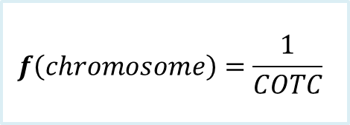
How can we know which chromosome is the fittest
Fitness function & Fitness value
A
B
A
C
B
D
$$f\left(chromosome\right)=\frac{1}{COTC}$$
E
F
E
D
F
C
G
G
H
H
*COTC: Cost of the chromosome
A - D - B - F - C - H - G - E
A - E - D - G - H - F - B - C
Distance / Cost = 12hrs
Distance / Cost = 16hrs
1 / 12 = 0,083(3)
1 / 16 = 0,0625

Slide 10
Notes:
Còn thiếu các loại lai ghép, đột biến, tỷ lệ đột biến, hàm mục tiêu, ví dụ về giải phương trình bậc 2

Slide 11
Apriori Algorithm
Research on Genetic Algorithm GA and Application - Graduation Thesis - 2024

Slide 12
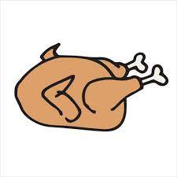


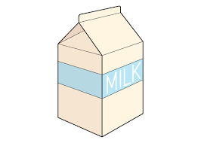
What Is A Transaction Database?
Let be a set of items {a, b, c, d, …} sold in a store.
A transaction is a set of items bought by a customer.
Example:
Transaction | Items
T1 | {Chicken, Milk, Orange, Juice}
T2 | {Bread, Cheese}
T3 | {Milk, Yogurt, Eggs}
Three transactions

Slide 13
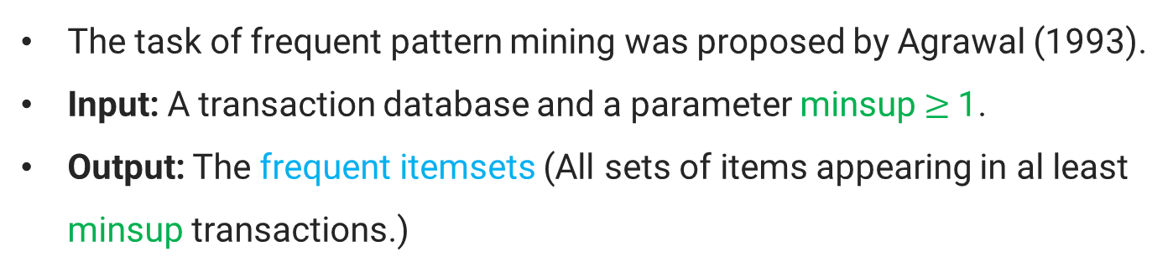
Discovering Frequent Patterns
The task of frequent pattern mining was proposed by Agrawal (1993).
Input: A transaction database and a parameter minsup $≥$1.
Output: The frequent itemsets (All sets of items appearing in al least minsup transactions.)
Transaction database
Frequent itemsets
Transaction | Items
T1 | {Chicken, Milk, Eggs}
T2 | {Bread, Milk}
T3 | {Milk, Bread, Eggs}
Itemset | Support
{Milk} | 3
{Eggs} | 2
{Bread} | 2
minsup = 2

Slide 14
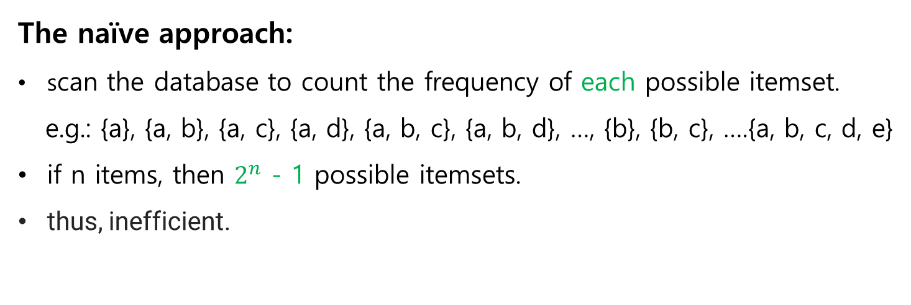
How To Solve The Problem?
The naïve approach:
scan the database to count the frequency of each possible itemset.
e.g.: {a}, {a, b}, {a, c}, {a, d}, {a, b, c}, {a, b, d}, …, {b}, {b, c}, ….{a, b, c, d, e}
if n items, then $2^{n}$ - 1 possible itemsets.
thus, inefficient.
Several efficient algorithms:
Apriori, FPGrowth, H-Mine, LCM, etc,...
Notes:
naive approach" thường được sử dụng để chỉ một cách tiếp cận đơn giản, không tối ưu và thường không hiệu quả nhất đối với một vấn đề cụ thể.

Slide 15
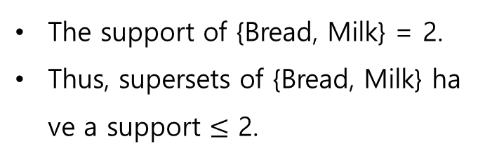
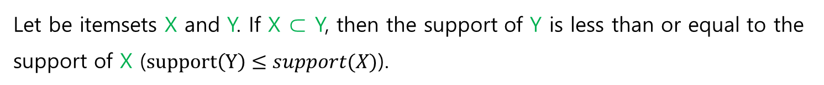
The Apriori Property
Let be itemsets X and Y. If X ⊂ Y, then the support of Y is less than or equal to the support of X ($support\left(Y\right)≤support(X)$).
Example
Transaction | Items
T1 | {Chicken, Milk, Eggs}
T2 | {Bread, Milk}
T3 | {Bread, Milk, Eggs}
The support of {Bread, Milk} = 2.
Thus, supersets of {Bread, Milk} have a support $≤$ 2.

Slide 16
Apriori Algorithm Example
TID | List of items IDS
T100 | i1 | i2 |  |  | i5
T200 |  | i2 |  | i4
T300 |  | i2 | i3
T400 | i1 | i2 |  | i4
T500 | i1 |  | i3 |  |  | i6
T600 |  | i2 | i3
T700 | i1 |  | i3
T800 | i1 | i2 | i3
T900 | i1 | i2 | i3 |  | i5
Consider the following transactions.
Apply the association rule mining to get the association rules with:
Min support: 2
Confidence: 50%
Research on Genetic Algorithm GA and Application - Graduation Thesis - 2024
Notes:
Còn thiếu các loại lai ghép, đột biến, tỷ lệ đột biến, hàm mục tiêu, ví dụ về giải phương trình bậc 2

Slide 17
Apriori algorithm for frequent itemset mining with min support = 2
C1
Itemsets | Frequency
{i1} | 6
{i2} | 7
{i3} | 6
{i4} | 2
{i5} | 2
{i6} | 1
C1
Itemsets | Frequency
{i1} | 6
{i2} | 7
{i3} | 6
{i4} | 2
{i5} | 2
{i6} | 1
L1
Itemsets | Frequency
{i1} | 6
{i2} | 7
{i3} | 6
{i4} | 2
{i5} | 2
Research on Genetic Algorithm GA and Application - Graduation Thesis - 2024

Slide 18
Apriori algorithm for frequent itemset mining with min support = 2
A 2-item set is created by concatenating two 1-item sets.
Examples:
{milk} and {cheese} → {milk, cheese}.
k-itemset (k>2) is created from 2 (k-1)-itemsets with the same prefix.
Example:
{milk, cheese} and {milk, orange} → {milk, cheese, orange}.
Research on Genetic Algorithm GA and Application - Graduation Thesis - 2024

Slide 19
Apriori algorithm
C2
Itemsets | Frequency
{i1, i2} | 4
{i1, i3} | 4
{i1, i4} | 1
{i1, i5} | 2
{i2, i3} | 4
{i2, i4} | 2
{i2, i5} | 2
{i3, i4} | 0
{i3, i5} | 1
{i4, i5} | 0
C2
Itemsets | Frequency
{i1, i2} | 4
{i1, i3} | 4
{i1, i4} | 1
{i1, i5} | 2
{i2, i3} | 4
{i2, i4} | 2
{i2, i5} | 2
{i3, i4} | 0
{i3, i5} | 1
{i4, i5} | 0
L2
Itemsets | Frequency
{i1, i2} | 4
{i1, i3} | 4
{i1, i5} | 2
{i2, i3} | 4
{i2, i4} | 2
{i2, i5} | 2

Slide 20
Apriori algorithm
Apriori property: All subsets of frequent patterns are frequent patterns
C3
Itemsets | Frequency
{i1, i2, i3} | 2
{i1, i2, i5} | 2
Itemsets
{i1, i2, i3}
{i1, i2, i5}
{i1, i3, i5}
{i2, i3, i4}
{i2, i3, i5}
{i2, i4, i5}
Itemsets
{i1, i2, i3}
{i1, i2, i5}
{i1, i3, i5}
{i2, i3, i4}
{i2, i3, i5}
{i2, i4, i5}
L3
Itemsets | Frequency
{i1, i2, i3} | 2
{i1, i2, i5} | 2

Slide 21
Apriori algorithm
C4
Itemsets | Frequency
{i1, i2, i3, i5} | 1
L4
Itemsets | Frequency
No Possible
Research on Genetic Algorithm GA and Application - Graduation Thesis - 2024

Slide 22
Apriori algorithm
Result
L1
Itemsets | Frequency
{i1} | 6
{i2} | 7
{i3} | 6
{i4} | 2
{i5} | 2
L2
Itemsets | Frequency
{i1, i2} | 4
{i1, i3} | 4
{i1, i5} | 2
{i2, i3} | 4
{i2, i4} | 2
{i2, i5} | 2
L3
Itemsets | Frequency
{i1, i2, i3} | 2
{i1, i2, i5} | 2

Slide 23
Apriori algorithm
Frequent 3-itemset(L3) = i => {i1, i2, i3} and {i1, i2, i5}
min support = 2 = 2/9 = 22,22% and confidence = 50%
Non-Empty subset are:
{ {i1}, {i2}, {i3}, {i1, i2}, {i1, i3}, {i2, i3} }
{ {i1}, {i2}, {i5}, {i1, i2}, {i1, i5}, {i2, i5} }
How to form association rule?
For every non-empty subset S of I, the association rule is
S → (i - S) if support(i) / support(S) >= confidence
Research on Genetic Algorithm GA and Application - Graduation Thesis - 2024

Slide 24
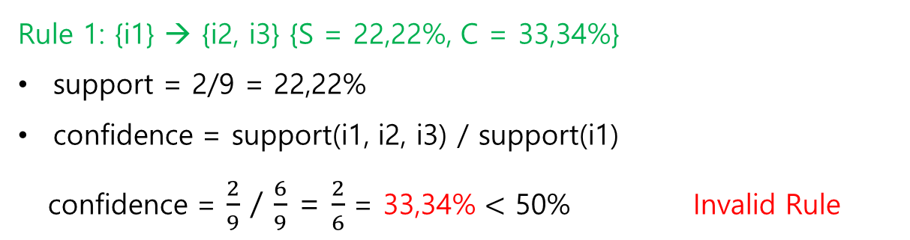
Apriori algorithm
Items | Frequency
{i1} | 6
{i3} | 7
{i2} | 6
{i1, i2} | 4
{i1, i3} | 4
{i2, i3} | 4
{i1, i2, i3} | 2
Frequent 3-itemset(L3) = I => {i1, i2, i3}
Non-Empty subset are:
{ {i1}, {i2}, {i3}, {i1, i2}, {i1, i3}, {i2, i3} }
Rule 1: {i1} → {i2, i3} {S = 22,22%, C = 33,34%}
support = 2/9 = 22,22%
confidence = support(i1, i2, i3) / support(i1)
confidence = $\frac{2}{9}$ / $\frac{6}{9}$ = $\frac{2}{6}$ = 33,34% $<$ 50% Invalid Rule
Research on Genetic Algorithm GA and Application - Graduation Thesis - 2024

Slide 25
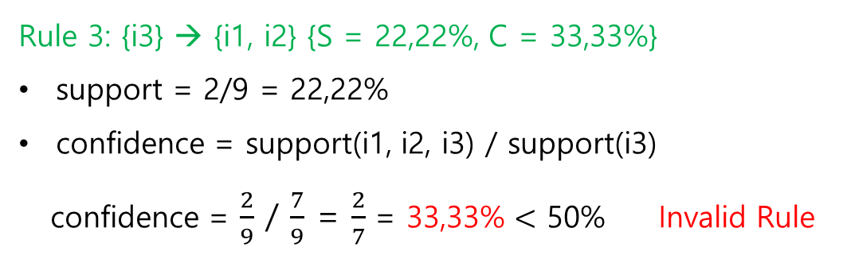

Apriori algorithm
Items | Frequency
{i1} | 6
{i2} | 7
{i3} | 6
{i1, i2} | 4
{i1, i3} | 4
{i2, i3} | 4
{i1, i2, i3} | 2
Rule 2: {i2} → {i1, i3} {S = 22,22%, C = 28,57%}
support = 2/9 = 22,22%
confidence = support(i1, i2, i3) / support(i2)
confidence = $\frac{2}{9}$ / $\frac{7}{9}$ = $\frac{2}{7}$ = 28,57% $<$ 50% Invalid Rule
Rule 3: {i3} → {i1, i2} {S = 22,22%, C = 33,33%}
support = 2/9 = 22,22%
confidence = support(i1, i2, i3) / support(i3)
confidence = $\frac{2}{9}$ / $\frac{7}{9}$ = $\frac{2}{7}$ = 33,33% $<$ 50% Invalid Rule
Research on Genetic Algorithm GA and Application - Graduation Thesis - 2024

Slide 26
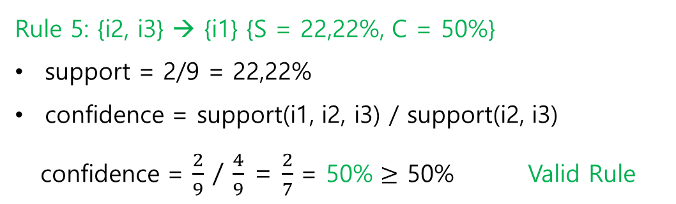

Apriori algorithm
Items | Frequency
{i1} | 6
{i2} | 7
{i3} | 6
{i1, i2} | 4
{i1, i3} | 4
{i2, i3} | 4
{i1, i2, i3} | 2
Rule 4: {i1, i2} → {i3} {S = 22,22%, C = 50%}
support = 2/9 = 22,22%
confidence = support(i1, i2, i3) / support(i1, i2)
confidence = $\frac{2}{9}$ / $\frac{4}{9}$ = $\frac{2}{4}$ = 50% $≥$ 50% Valid Rule
Rule 5: {i2, i3} → {i1} {S = 22,22%, C = 50%}
support = 2/9 = 22,22%
confidence = support(i1, i2, i3) / support(i2, i3)
confidence = $\frac{2}{9}$ / $\frac{4}{9}$ = $\frac{2}{7}$ = 50% $≥$ 50% Valid Rule
Research on Genetic Algorithm GA and Application - Graduation Thesis - 2024

Slide 27
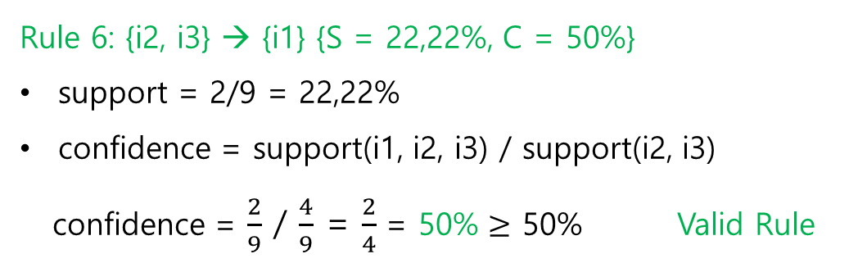
Apriori algorithm
Items | Frequency
{i1} | 6
{i2} | 7
{i3} | 6
{i1, i2} | 4
{i1, i3} | 4
{i2, i3} | 4
{i1, i2, i3} | 2
Rule 6: {i2, i3} → {i1} {S = 22,22%, C = 50%}
support = 2/9 = 22,22%
confidence = support(i1, i2, i3) / support(i2, i3)
confidence = $\frac{2}{9}$ / $\frac{4}{9}$ = $\frac{2}{4}$ = 50% $≥$ 50% Valid Rule
Research on Genetic Algorithm GA and Application - Graduation Thesis - 2024

Slide 28
Apriori algorithm
Items | Frequency
{i1} | 6
{i3} | 7
{i5} | 2
{i1, i2} | 4
{i1, i5} | 2
{i2, i5} | 2
{i1, i2, i5} | 2
Frequent 3-itemset(L3) = I => {i1, i2, i5}
Non-Empty subset are:
{ {i1}, {i2}, {i5}, {i1, i2}, {i1, i5}, {i2, i5} }
Research on Genetic Algorithm GA and Application - Graduation Thesis - 2024

Slide 29
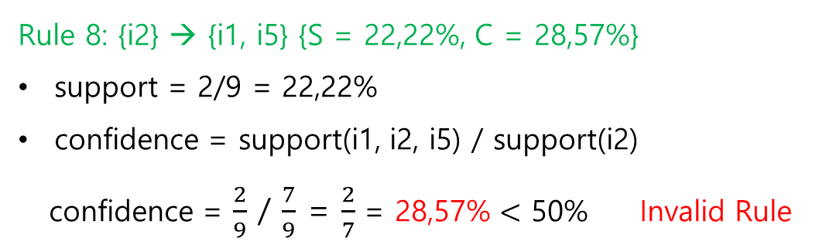
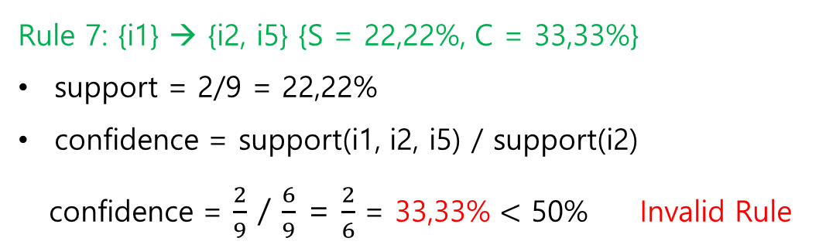
Apriori algorithm
Items | Frequency
{i1} | 6
{i2} | 7
{i5} | 6
{i1, i2} | 4
{i1, i5} | 4
{i2, i5} | 4
{i1, i2, i5} | 2
Rule 7: {i1} → {i2, i5} {S = 22,22%, C = 33,33%}
support = 2/9 = 22,22%
confidence = support(i1, i2, i5) / support(i2)
confidence = $\frac{2}{9}$ / $\frac{6}{9}$ = $\frac{2}{6}$ = 33,33% $<$ 50% Invalid Rule
Rule 8: {i2} → {i1, i5} {S = 22,22%, C = 28,57%}
support = 2/9 = 22,22%
confidence = support(i1, i2, i5) / support(i2)
confidence = $\frac{2}{9}$ / $\frac{7}{9}$ = $\frac{2}{7}$ = 28,57% $<$ 50% Invalid Rule
Research on Genetic Algorithm GA and Application - Graduation Thesis - 2024

Slide 30
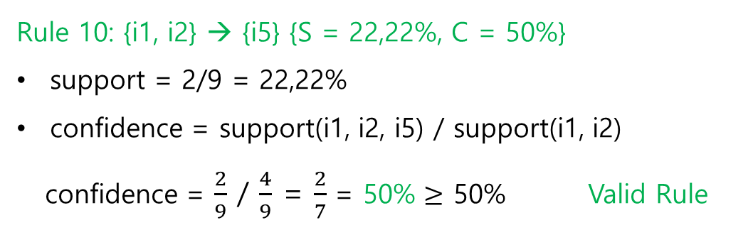
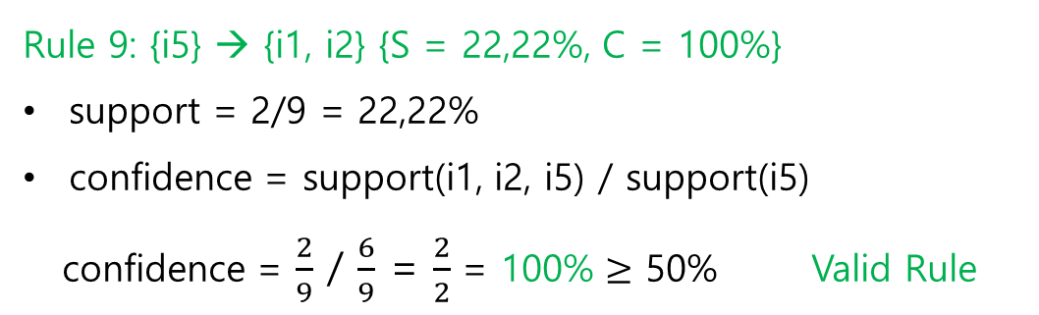
Apriori algorithm
Items | Frequency
{i1} | 6
{i2} | 7
{i5} | 2
{i1, i2} | 4
{i1, i5} | 4
{i2, i5} | 4
{i1, i2, i5} | 2
Rule 9: {i5} → {i1, i2} {S = 22,22%, C = 100%}
support = 2/9 = 22,22%
confidence = support(i1, i2, i5) / support(i5)
confidence = $\frac{2}{9}$ / $\frac{6}{9}$ = $\frac{2}{2}$ = 100% $≥$ 50% Valid Rule
Rule 10: {i1, i2} → {i5} {S = 22,22%, C = 50%}
support = 2/9 = 22,22%
confidence = support(i1, i2, i5) / support(i1, i2)
confidence = $\frac{2}{9}$ / $\frac{4}{9}$ = $\frac{2}{7}$ = 50% $≥$ 50% Valid Rule
Research on Genetic Algorithm GA and Application - Graduation Thesis - 2024

Slide 31


Apriori algorithm
Items | Frequency
{i1} | 6
{i2} | 7
{i5} | 2
{i1, i2} | 4
{i1, i5} | 4
{i2, i5} | 4
{i1, i2, i5} | 2
Rule 11: {i1, i5} → {i2} {S = 22,22%, C = 100%}
support = 2/9 = 22,22%
confidence = support(i1, i2, i5) / support(i2)
confidence = $\frac{2}{9}$ / $\frac{2}{9}$ = $\frac{2}{2}$ = 100% $≥$ 50% Valid Rule
Rule 12: {i2, i5} → {i1} {S = 22,22%, C = 100%}
support = 2/9 = 22,22%
confidence = support(i1, i2, i5) / support(i1)
confidence = $\frac{2}{9}$ / $\frac{2}{9}$ = $\frac{2}{2}$ = 100%$≥$ 50% Valid Rule
Research on Genetic Algorithm GA and Application - Graduation Thesis - 2024

Slide 32
Apriori algorithm
L2
Itemsets | Frequency
{i1, i2} | 4
{i1, i3} | 4
{i1, i5} | 2
{i2, i3} | 4
{i2, i4} | 2
{i2, i5} | 2
Frequent 2-itemset(L2) = i
{i1, i2}
{i1, i3}
{i1, i5}
{i2, i3}
{i2, i4}
{i2, i5}
min support = 2 = 2/9 = 22,22% and confidence = 50%
Research on Genetic Algorithm GA and Application - Graduation Thesis - 2024

Slide 33
Rule 13: {i1} → {i2} <=> support(i1, i2) / support(i1) = 4 / 6 = 66,66%
Rule 14: {i2} → {i1} <=> support(i1, i2) / support(i2) = 4 / 7 = 57%
Rule 15: {i1} → {i3} <=> support(i1, i3) / support(i1) = 4 / 6 = 66,66%
Rule 16: {i3} → {i1} <=> support(i1, i3) / support(i3) = 4 / 6 = 66,66%
Rule 17: {i1} → {i5} <=> support(i1, i5) / support(i1) = 2 / 6 = 33,33%
Rule 18: {i5} → {i1} <=> support(i1, i5) / support(i5) = 2 / 4 = 50%
Rule 19: {i2} → {i3} <=> support(i2, i3) / support(i2) = 4 / 7 = 57%
Rule 20: {i3} → {i2} <=> support(i2, i3) / support(i3) = 4 / 6 = 66,66%
Rule 21: {i2} → {i4} <=> support(i2, i4) / support(i2) = 2 / 7 = 28%
Rule 22: {i4} → {i2} <=> support(i2, i4) / support(i4) = 2 / 4 = 50%
Rule 23: {i2} → {i5} <=> support(i2, i5) / support(i2) = 2 / 7 = 28%
Rule 24: {i5} → {i2} <=> support(i2, i5) / support(i5) = 2 / 4 = 50%
Items | Frequency
{i1} | 6
{i2} | 7
{i3} | 6
{i4} | 4
{i5} | 4
{i1, i2} | 4
{i1, i3} | 4
{i1, i5} | 2
{i2, i3} | 4
{i2, i4} | 2
{i2, i5} | 2
Research on Genetic Algorithm GA and Application - Graduation Thesis - 2024

Slide 34
Apriori algorithm
{i1} → {i2} {C = 57%}
{i2} → {i1} {C = 57%}
{i1} → {i3} {C = 66,66%}
{i3} → {i1} {C = 66,66%}
{i5} → {i1} {C = 50%}
{i2} → {i3} {C = 57%}
{i3} → {i2} {C = 66,66%}
{i4} → {i2} {C = 50%}
{i5} → {i2} {C = 50%}
Result
{i1, i2} → {i3} {C = 50%}
{i2, i3} → {i1} {C = 50%}
{i2, i3} → {i1} {C = 50%}
{i5} → {i1, i2} {C = 100%}
{i1, i2} → {i5} {C = 50%}
{i1, i5} → {i2} {C = 100%}
{i2, i5} → {i1} {C = 100%}
Research on Genetic Algorithm GA and Application - Graduation Thesis - 2024

Slide 35
Limitations Of Frequent Patterns
Frequent pattern mining has many applications.
However, if has important limitations:
Many frequent pattern are not interesting.
Quantities of items in transactions must be 0 or 1.
All items are considered as equally important (having the same weight).

Slide 36
High Utility Itemset Mining (HUI)
Research on Genetic Algorithm GA and Application - Graduation Thesis - 2024

Slide 37
High Utility Itemset Mining
A generalization of frequent pattern mining:
Items can appear more than once in a transaction (e.g. a customer may buy 3 bottles of milk).
Items have a unit profit (e.g. a bottle of milk generates 1$ of profit).
The goal is to find patterns that generate a hight profilt.
Example
{Caviar, Wine} is a pattern that generates a high profilt, although it is rare.

Slide 38
High Utility Itemset Mining
Input: Transaction database with quantities
Unit profit table
Trans. | Items
T1 | a(1), b(5), c(1), d(3), e(1)
T2 | b(4), c(3), d(3), e(1)
T3 | a(1), c(1), d(1)
T4 | a(2), c(6), e(2)
T5 | b(2), c(2), e(1)
Item | Unit Profit
a | 5$
b | 2$
c | 1$
d | 2$
e | 3$
and a threshold minutil
Output: High-utility itemsets

Slide 39
A Full Example
Suppose that minutil = 25$
Transaction database with quantities
Unit profit table
High-utility itemsets
{a, c}: 28$
{a, c, e}: 31$
{b, c}: 28$
{b, c, d, e}: 40$
{b, d}: 30$
{b, e}: 40$
{a, b, c, d, e}: 25$
{b, c, d}: 34$
{b, c, e}: 37$
{b, d, e}: 36$
Trans. | Items
T1 | a(1), b(5), c(1), d(3), e(1)
T2 | b(4), c(3), d(3), e(1)
T3 | a(1), c(1), d(1)
T4 | a(2), c(6), e(2)
T5 | b(2), c(2), e(1)
Item | Unit Profit
a | 5$
b | 2$
c | 1$
d | 2$
e | 3$

Slide 40
How To Calculate Utility
Trans. | Items
T1 | a(1), b(5), c(1), d(3), e(1)
T2 | b(4), c(3), d(3), e(1)
T3 | a(1), c(1), d(1)
T4 | a(2), c(6), e(2)
T5 | b(2), c(2), e(1)
Item | Unit Profit
a | 5$
b | 2$
c | 1$
d | 2$
e | 3$
a(1)
e(1)
a(2)
e(2)
u({a, e})
= (1 * 5$ 1 * 3$)
+ (2 * 5$ 2 * 3$) = 24$

Slide 41
A Difficult Task
Why?
Because utility is not anti-monotonic
(i.e. does not respect the Apriori property)
Example:
u({a}) = 20$
u({a, e}) = 24$
u({a, b, c}) = 16$
Thus, frequent itemset mining algorithems can not be applied to this problem.

Slide 42
How To Solve This Problem
Several algorithems:
Two – Phase (PAKDD 2005).
IHUP (TKDE 2010).
UP – Growth (KDD 2011).
HUI – Miner (CIKM 2012).
FHM (ISMIS 2014).
Key idea: Calculatean upper – bound on the utility of itemsets
(e.g. the TWU) that respects the Apriori property to be able to prune the search space.

Slide 43
Transaction Utility
Transaction utility of a transaction:
the sum of the utility of all items in that transaction
Trans. | Items
T1 | a(1), b(5), c(1), d(3), e(1)
T2 | b(4), c(3), d(3), e(1)
T3 | a(1), c(1), d(1)
T4 | a(2), c(6), e(2)
T5 | b(2), c(2), e(1)
Item | Unit Profit
a | 5$
b | 2$
c | 1$
d | 2$
e | 3$
Example: TU(T1) = (1 * 5) + (5 * 2) + (1 * 1) + (3 * 2) + (1 * 3) = 25$
TU(T4) = (2 * 5) + (6 * 1) + (2 * 3) = 22$

Slide 44
The TWU Upper Bound
TWU of an itemset:
the sum of the transaction utility for transactions containing itemset.
Trans. | Items
T1 | a(1), b(5), c(1), d(3), e(1)
T2 | b(4), c(3), d(3), e(1)
T3 | a(1), c(1), d(1)
T4 | a(2), c(6), e(2)
T5 | b(2), c(2), e(1)
Item | Unit Profit
a | 5$
b | 2$
c | 1$
d | 2$
e | 3$
Example: TWU({a, e}) = TU(T1) + TU(T4) = 25$ + 22$ = 47$
→ TWU({a, e}) = 47$ $≥$ u({a, e}) = 24$ and the utility of any superset of {a, e}
Notes:
Gia su rang ban dang muon tim mot bo vat pham co gia it nhat 50$ thi khong can phai tim bat cu bo vat pham nao trong cac TWU, vi chung khong bao h lon hon 47

Slide 45
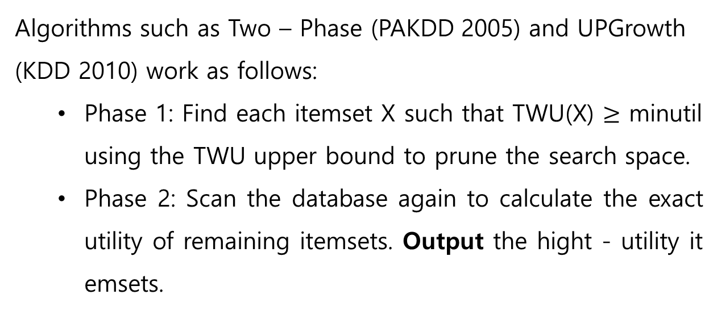
TWU Based Algorithms
Algorithms such as Two – Phase (PAKDD 2005) and UPGrowth
(KDD 2010) work as follows:
Phase 1: Find each itemset X such that TWU(X) $≥$ minutil using the TWU upper bound to prune the search space.
Phase 2: Scan the database again to calculate the exact utility of remaining itemsets. Output the hight - utility itemsets.

Slide 46

But, A Problem
Hight – utility itemset mining is still a very expensive task.
Our solution: A new algorithm name FHM, which extends HUI – Miner (CIKM 2012).
Notes:
Việc khai thác tập mục hữu ích cao vẫn là nhiệm vụ rất tốn kém về mặt thời gian hoặc bộ nhớ

Slide 47

HUI – Miner (CIKM 2012)
HUI – Miner is one of the fastest algorithm for high utility mining.
It performs a depth-first search (DFS) by appending items to itemsets.
$$∅$$
{a}
{b}
{a, b}
{a, c}
{a, d}
{a, e}
{b, c}
{b, d}
{a, b, c}
{a, b, d}
…
…
…
…
…
{a, b, c, d}
{a, b, d, e}
{a, b, c, d, e}

Slide 48
HUI – Miner (2012)
Create a vertical structure named Utility – List for each item.
Trans. | Items
T1 | a(1), b(5), c(1), d(3), e(1)
T2 | b(4), c(3), d(3), e(1)
T3 | a(1), c(1), d(1)
T4 | a(2), c(6), e(2)
T5 | b(2), c(2), e(1)
Item | Unit Profit
a | 5$
b | 2$
c | 1$
d | 2$
e | 3$
T1
T2
T3
e(1)
e(1)
d | 2$
e | 3$
Trans. | Util | Rutil
T1 | 6 | 3
T2 | 6 | 3
T3 | 2 | 0
Property 1: The sum of the second column gives the
utility of the itemset.
u({d}) = 6 + 6 + 2 = 14$
Property 2: The sum of all
number is an upper bound
on the utility of the itemset and its extensions.
6 + 6 + 2 + 3 + 3 + 0 = 20$
The third column is the
remaining utility, that is utility of items appearing after the itemset.
The first column is the list of transactions contraining the itemset.
Example:
The utility – list of {d}:
The second column is the utility of the itemset in these transactions.

Slide 49
HUI – Miner (2012)
Utility list of {a}
Utility list of {d}
Utility list of {a, d}
Trans. | Util | Rutil
T1 | 5 | 20
T3 | 5 | 3
T4 | 10 | 12
Trans. | Util | Rutil
T1 | 6 | 3
T2 | 3 | 5
T3 | 2 | 0
Trans. | Util | Rutil
T1 | 11 | 3
T3 | 7 | 0
T1
T3
5
5
20
3
T1
6
3
T1
T3
11
7
3
0
Join
T3
2
0
u({a}) = 20$
u({d}) = 11$
u({a, d}) = 18$

