Slide 1
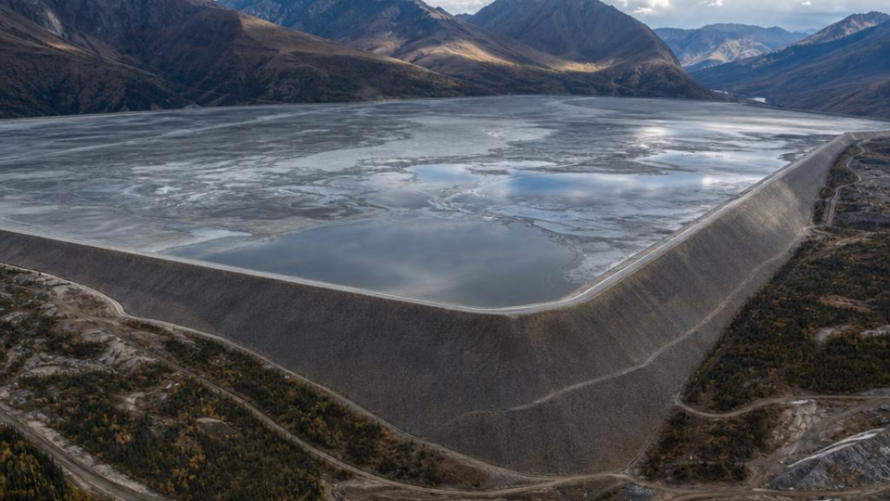

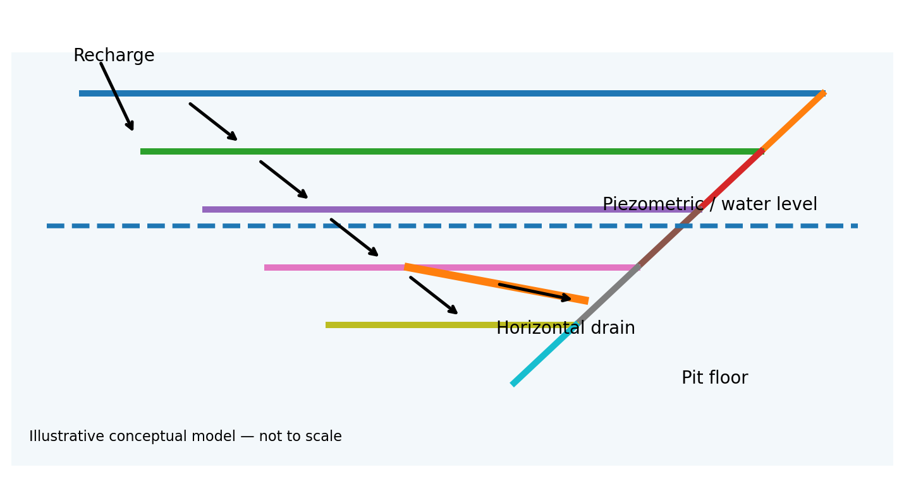
Mine Water Risk & Open-Pit Slope Stability
Graduate Mine Geotechnical / Hydrogeological Field Guide
1

Slide 2

How to Use This Guide
A workflow-oriented reference — not a substitute for site standards or competent-person review
Start with the site-specific Ground Control Management Plan (GCMP), geotechnical design criteria and water-management plan.
Use this deck to understand what data to collect, what questions to ask, how to screen risk and what evidence should support a decision.
Never change slope geometry, exclusion zones, pumping rates or trigger levels from this guide alone; those decisions require the mine's approved design and responsible technical authority.
Keep an auditable chain from observation → interpretation → action → verification.
FIELD RULE: IF THE GROUND OR WATER CONDITIONS DIFFER FROM THE DESIGN BASIS, STOP AND ESCALATE.
2

Slide 3
What a New Graduate Should Be Able to Do
Observe
Measure
Interpret
Escalate
Recognise seepage, wet benches
, tension cracks, ravelling,
erosion and unusual inflows.
Collect reliable piezometer, rainfall
, inflow and deformation data.
Link geology + structures + water +
deformation rather than looking
at one dataset.
Know when a change exceeds your
authority and needs the
geotechnical lead.
COMPETENCE = KNOWING WHAT YOU KNOW, WHAT YOU DO NOT KNOW, AND WHEN TO ESCALATE.
3

Slide 4
1. Build the Water Story
Where is recharge entering the system?
Where are the aquifers and low-permeability units?
Which faults, joints or bedding planes provide preferential flow?
Where does water report to the pit?
How does rainfall or pumping change the response over time?
4

Slide 5
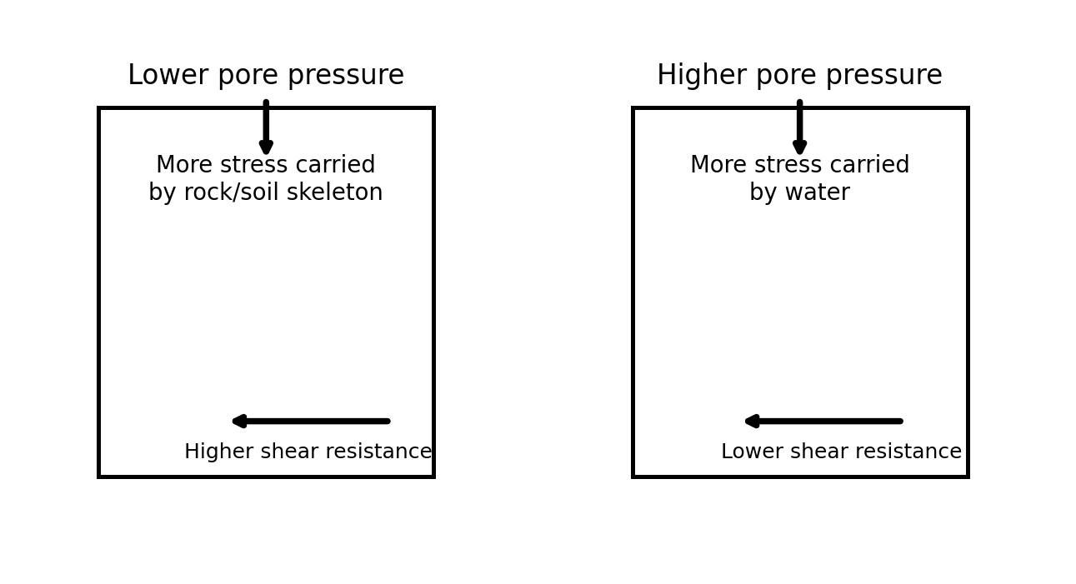
2. Why Water Reduces Stability
Effective stress
σ′ = σ − u. Rising pore pressure u reduces effective stress.
Shear strength
τf = c′ + σ′ tan φ′. Lower σ′ generally means lower available
resistance.
Engineering meaning
A hydraulic change can become a geotechnical stability
change.
5

Slide 6
3. Field Signs: What Should Make You Look Twice?
Seepage
Ponding
Erosion
New wet spots, flowing water or persistent
damp zones.
Water collecting behind berms or on benches.
Rills, gullies or loss of crest/bench material.
Deformation
Changed inflow
Blocked drainage
New cracks, bulging, ravelling or increasing
displacement.
A sudden or sustained change after rainfall,
blasting or pumping.
Sumps, drains or pumps not functioning as
designed.
DOCUMENT LOCATION, TIME, WEATHER, RECENT MINING ACTIVITY AND PHOTOGRAPHS — CONTEXT MATTERS.
6

Slide 7
4. Daily / Shift Water Data Collection
Piezometers
ID, elevation, pressure/head, timestamp, instrument
status
Tracks pore-pressure response
Pit inflow
Location, estimated/flow-meter rate, time
Identifies changing hydraulic conditions
Rainfall
Event total + intensity if available
Provides recharge context
Pumping
Well/pump ID, rate, runtime, downtime
Explains drawdown/recovery
Seepage
Bench/sector, condition, photo, trend
Ground-truths the model
7

Slide 8
5. Piezometer Data: A Graduate's Basic QA/QC
Confirm instrument ID, collar/elevation and installation interval before using a reading.
Check timestamp, units and whether the value is pressure, head or water elevation.
Compare with previous readings: is the change physically plausible?
Flag abrupt jumps, flat-lines, impossible values or readings during known instrument work.
Cross-check against rainfall, pumping and nearby instruments.
Never silently overwrite suspicious values — preserve the raw record and document the correction/flag.
Good habit
Raw data → QA/QC flag → validated dataset → interpretation.
8

Slide 9
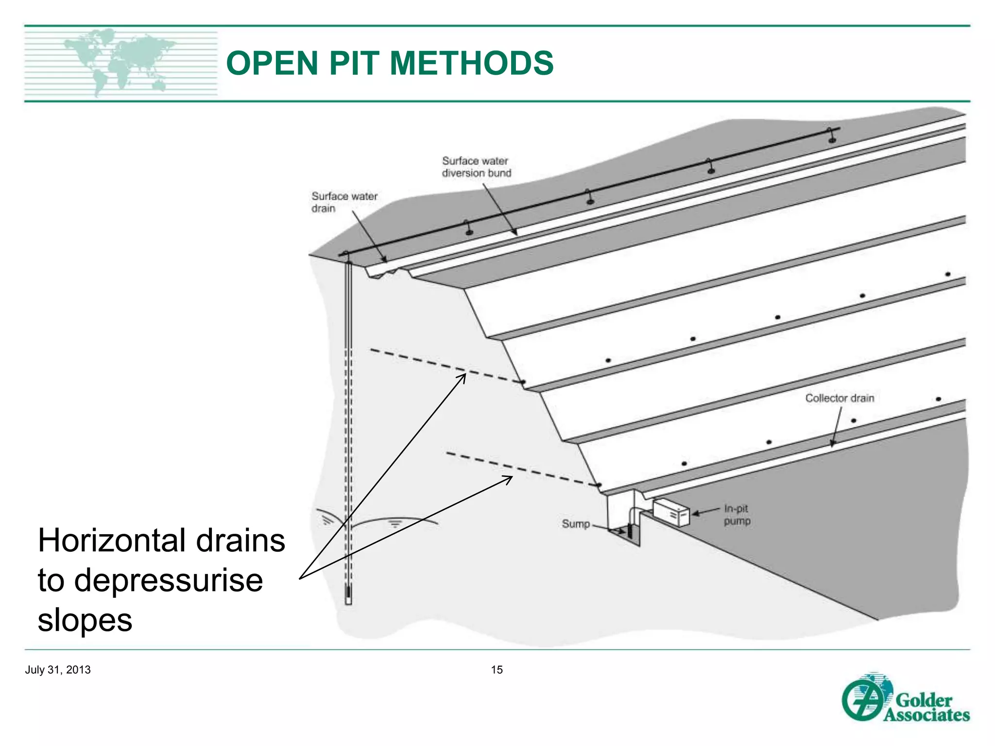
6. Dewatering & Depressurisation
Surface-water diversion keeps runoff away from vulnerable slopes.
Horizontal drains can reduce pore pressure within selected slope sectors.
Sumps and pumping control water reporting to working areas.
Deep wells can lower hydraulic head in suitable aquifers.
Each measure should have a design objective and a way to verify performance.
9

Slide 10
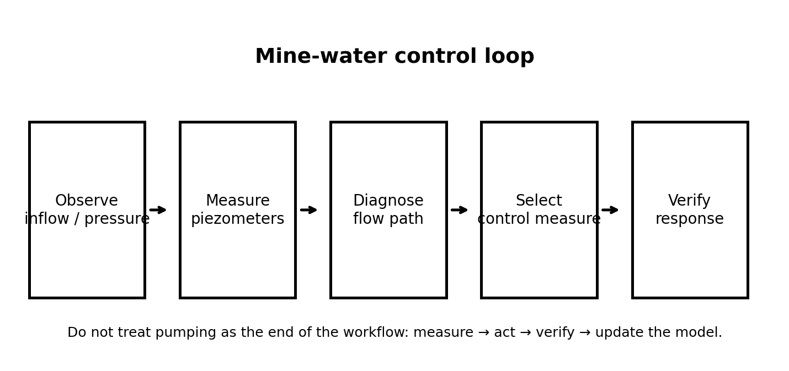
7. The Mine-Water Control Loop
DO NOT ASSUME A PUMP IS WORKING BECAUSE IT IS RUNNING — VERIFY HYDRAULIC RESPONSE.
10

Slide 11
8. Slope-Stability Scenario Workflow
Baseline
Hydraulic cases
Sensitivity
Decision
Use the approved geometry,
geology and strength model.
Test credible piezometric /
pore-pressure conditions.
Identify parameters that most
affect stability.
Compare results with approved
design criteria.
The objective is not to produce a single impressive factor of safety; it is to understand sensitivity and credible adverse conditions.
11

Slide 12
9. Model Inputs: Build an Evidence Chain
Geometry
Geology
Strength
Surveyed pit profile, benches, berms and
planned excavation.
Lithology, alteration, faults, joints, bedding
and weak zones.
Laboratory + field data, rock-mass
characterization and uncertainty.
Hydrology
Loading
Criteria
Piezometric levels, permeability, recharge and
flow pathways.
Water, equipment, blasting effects where
relevant, and external loads.
Approved acceptance criteria, design basis
and consequences.
12

Slide 13
10. Groundwater Model → Slope Model
Conceptual hydrogeological model: define units, boundaries, recharge, structures and discharge.
Calibrate against observed piezometric levels, inflows and pumping response.
Use the resulting hydraulic heads / pore pressures as inputs to the geotechnical stability model.
Reconcile model predictions against monitoring data after mining or dewatering changes.
Update assumptions when observations consistently disagree with the model.
Hydrogeology
Where does water move?
Geotechnics
What does that water do to stability?
Reconciliation
Does monitoring agree?
13

Slide 14
11. Illustrative Dry / Drained / Undrained Comparison
Dry
1.277
Drained
1.246
Undrained
1.230
These values are illustrative case-study values from the source presentation, not universal acceptance criteria.
Use the mine's approved design criteria and responsible engineer's judgement for actual decisions.
14

Slide 15
12. Sensitivity: Ask 'What Controls the Result?'
Hydraulic sensitivity
Strength sensitivity
Geometry sensitivity
How much does FS change if pore pressure
rises?
Which c′, φ′ or rock-mass assumptions
dominate?
Which slope angle, bench or weak layer
matters most?
Run controlled sensitivity cases rather than changing several assumptions at once.
Document the parameter, baseline value, changed value and resulting stability metric.
Use sensitivity to prioritise field investigation and monitoring.
15

Slide 16
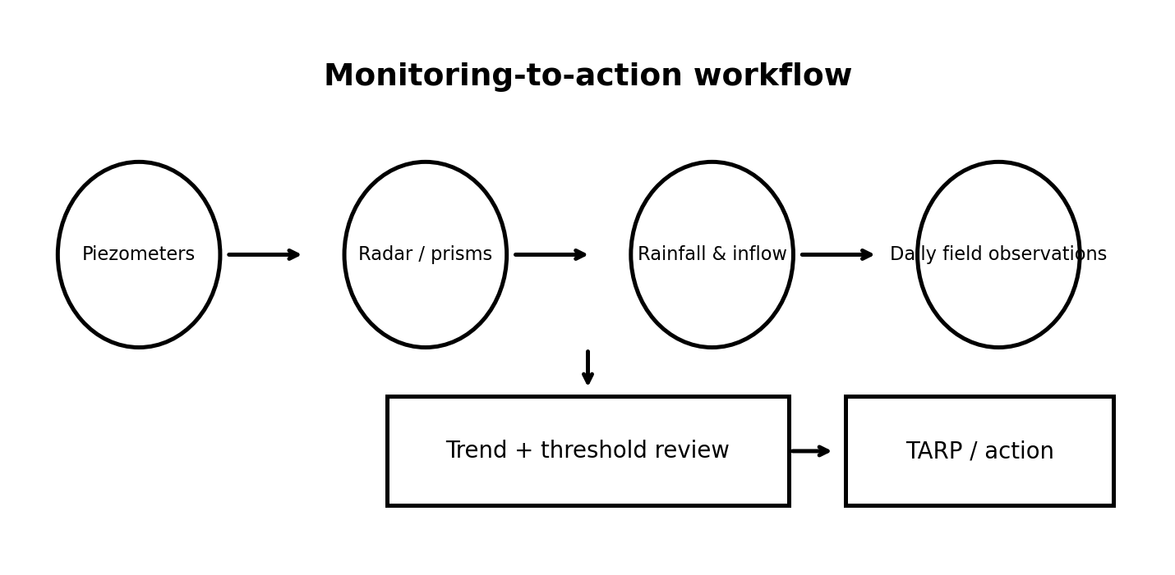
13. Monitoring: From Instruments to Decisions
TREND + RATE + SPATIAL PATTERN + HYDRAULIC CONTEXT IS MORE USEFUL THAN A SINGLE NUMBER.
16

Slide 17
14. TARP / Trigger-Action-Response Thinking
Trigger
Verify
Action
Review
A predefined measurement or
observation crosses an agreed
threshold.
Check instrument health, location,
trend and independent evidence.
Implement the mine-approved
response: inspect, restrict access,
drain, monitor, etc.
Record the event, update
interpretation and confirm
recovery.
Thresholds must be site-specific and approved; this guide does not prescribe universal alarm numbers.
17

Slide 18
15. What to Do After a Sudden Water Event
1. Make the area safe and follow the mine's ground-control / emergency procedure.
2. Record time, location, rainfall, pumping status, inflow and visible deformation.
3. Confirm instrument readings and check for corroborating data.
4. Notify the responsible geotechnical / hydrogeological engineer.
5. Compare observations with the design basis and current model.
6. Track the response after controls are applied and document closure.
SAFETY AND ESCALATION COME BEFORE DATA COLLECTION.
18

Slide 19
16. Daily / Weekly Technical Reporting
What changed?
Where?
So what?
Now what?
Water levels, inflows, rainfall,
deformation, drainage
performance.
Map the affected sectors and
monitoring IDs.
Explain whether the change
affects the current design
assumptions.
State actions, owner, due date
and follow-up measurement.
19

Slide 20
17. New-Graduate Shift Checklist
□ Review previous shift's water and geotechnical observations.
□ Check critical piezometer / radar / prism trends and instrument status.
□ Review rainfall, pumping and drainage performance.
□ Walk designated slope sectors and compare field conditions with the model/design.
□ Photograph and accurately locate new seepage, cracks, ravelling or erosion.
□ Flag anomalies; do not hide or overwrite raw data.
□ Discuss material changes with the responsible engineer before making design interpretations.
□ Record what was observed, what was concluded and what action was taken.
20

Slide 21
18. Common Early-Career Mistakes
Using unverified data
Ignoring structure
Single-factor thinking
Treating every instrument reading as true
without QA/QC.
Looking only at water table elevation and not
flow along faults/joints.
Blaming instability on water alone when
geology/geometry may dominate.
No reconciliation
Overconfidence
Poor records
Running a model but never checking it against
monitoring.
Presenting a calculation as a design decision
without approval.
Losing location, timestamp, units or context.
21

Slide 22
19. Practical Digital Workflow
Field: tablet / GIS / survey → geotagged observations and photographs.
Database: instrument IDs + timestamps + units + QA/QC flags.
Analysis: spreadsheet / Python → trends, correlations, rainfall-response plots and alerts.
3D / geotechnical: Leapfrog / GIS / slope-stability software → geology + geometry + hydraulic conditions.
Reporting: map + trend plot + interpretation + action log.
Archive: preserve raw data, model version, assumptions and approved outputs.
VERSION CONTROL MATTERS: ALWAYS KNOW WHICH GEOMETRY, GROUNDWATER MODEL AND PARAMETER SET PRODUCED A RESULT.
22

Slide 23
20. Ghana Mining Context
Groundwater–surface-water interaction can be especially important where pits intersect streams, catchments or weathered/fractured zones.
Recent research at the Nsuta mine in Ghana highlights the need to consider groundwater and surface-water interaction in pit-slope assessment.
Site-specific geology remains decisive: weathering, structures, lithological contacts and permeability contrasts can control local flow and stability.
Use local mine data and approved Ghanaian regulatory / company requirements rather than importing generic thresholds.
Useful Ghana case study
Kawere catchment / Nsuta mine research: groundwater–surface-water interaction and pit-slope stability.
23

Slide 24
21. Recommended Technical References
Read & Beale — Guidelines for Evaluating Water in Pit Slope Stability: hydrogeological investigation, pressure measurement, conceptual models, numerical modelling, depressurisation and monitoring.
Australian Centre for Geomechanics — open-pit slope stability and groundwater modelling conference papers.
Site Ground Control Management Plan, geotechnical design criteria, hydrogeological model and TARP — these are the primary operational references.
Relevant mine-water and slope-stability procedures from the employer and competent technical authority.
24

Slide 25
Final Takeaway
Think like a geotechnical professional: observe → measure → understand → model → act → verify.
Water management is not separate from slope stability — it is part of the slope-control system.
25

