Slide 1

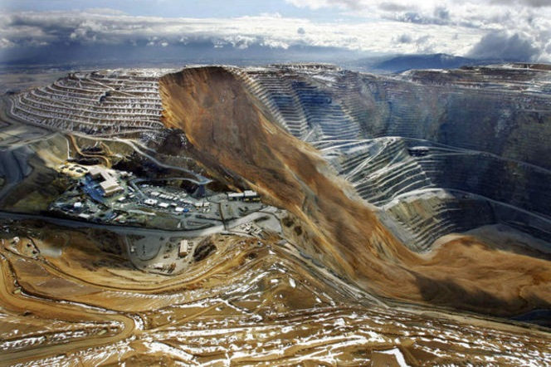
Mechanism Of Slope Failure

Slide 2
TYPES OF FAILURE
PLANE FAILURE
WEDGE FAILURE
CIRCULAR FAILURE
TOPPLING FAILURE

Slide 3
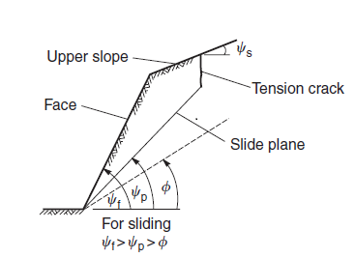
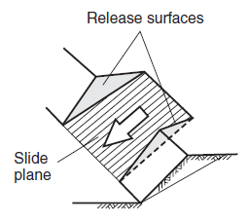
PLANE FAILURE

Slide 4
General conditions for plane failure
The plane on which sliding occurs must strike parallel or nearly parallel (within approximately ±20◦) to the slope face.
The sliding plane must “daylight” in the slope face, which means that the dip of the plane must be less than the dip of the slope face, that is, ψp < ψf
The dip of the sliding plane must be greater than the angle of friction of this plane, that is, ψp > φ.
The upper end of the sliding surface either intersects the upper slope, or terminates in a tension crack.
Release surfaces that provide negligible resistance to sliding must be present in the rock mass to define the lateral boundaries of the slide.

Slide 5
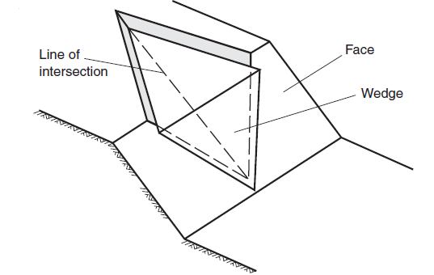
WEDGE FAILURE

Slide 6
General conditions for wedge failure
The dip of the line of intersection must be greater than angle of internal friction.
The dip of the line of intersection is smaller than dip of slope face.
The two sets of discontinuities must intersect each other.
The sliding will take place along the dip of intersection of two discontinuities if the dip of the line of intersection daylights into the slope face and less than dip of the slope face.

Slide 7
CIRCULAR FAILURE
Closely fractured or highly weathered rock.
The slide surface is free to find the line of least resistance through the slope.
when the individual particles in a soil or rock mass are very small compared with the size of the slope.

Slide 8
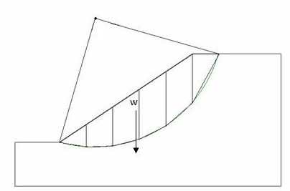

Slide 9
TYPES
Slope failure: In this type of failure, the arc of the rupture surface meets the slope above the toe of the slope. This happens when the slope angle is very high and the soil close to the toe posses the high strength.
Toe failure: In this type of failure, the arc of the rupture surface meets the slope at the toe, at medium slope angle.
Base failure: In this type of failure, the arc of the failure passes below the toe and in to base of the slope. This happens when the slope angle is low and the soil below the base is softer and more plastic than the soil above the base.

Slide 10
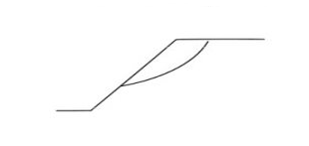
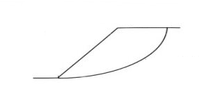
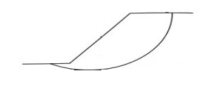
SLOPE FAILURE TOE FAILURE BASE FAILURE

Slide 11
TOPPLING FAILURE
Toppling involves rotation of columns or blocks of rock about a fixed base.

Slide 12
TYPES
BLOCK TOPPLING(a)
when individual columns in a strong rock are formed by a set of discontinuities dipping steeply into the face. A second set of widely spaced orthogonal joints defines the column height.
FLEXURAL TOPPLING(b)
continuous columns of rock, separated by well developed, steeply dipping discontinuities, breaking in flexure as they bend forward. Typical geological conditions in which this type of failure may occur are thinly bedded shale and slate in which orthogonal jointing is not well developed.

Slide 13
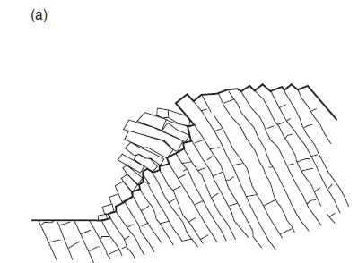
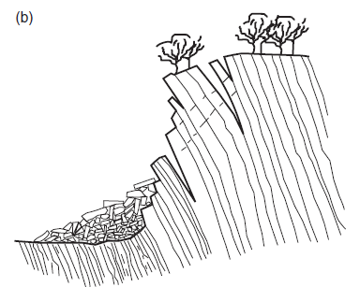
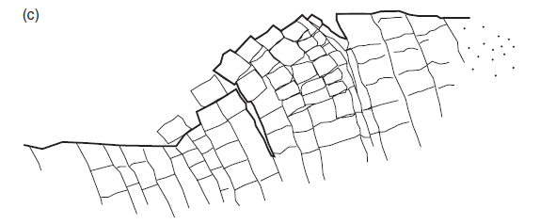

Slide 14
BLOCK-FLEXURAL TOPPLING(c)
It this long columns that are divided by numerous cross joints.
Toppling of columns in this case results from accumulated displacements on the cross-joints. Because of the large number of small movements in this type of topple, there are fewer tension cracks than in flexural toppling, and fewer edge-to-face contacts and voids than in block toppling.

Slide 15
Thank you

