Slide 1
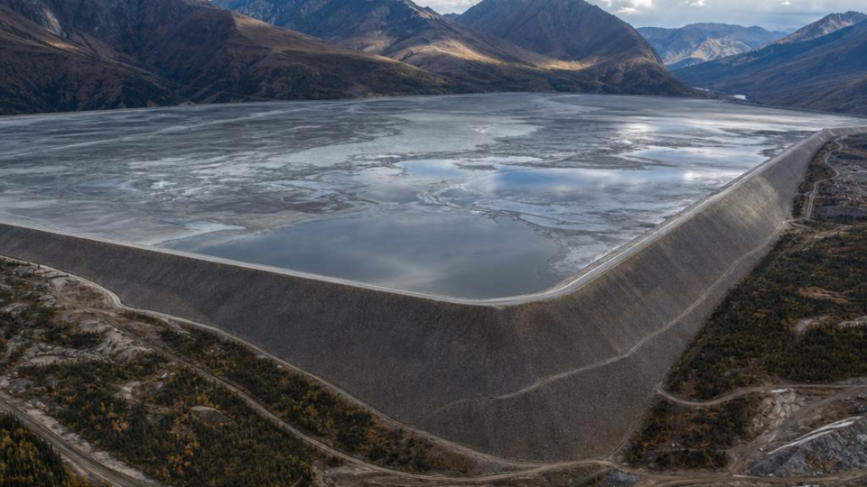

DESIGN OF TAILING STORAGE FACILITY
ADVANCED ENGINEERING GEOLOGY — GED 452

Slide 2

OUTLINE
INTRODUCTION
TYPES OF TAILING STORAGE FACILITY
SITE SELECTION AND GEOLOGICAL CONSIDERATIONS
DESIGN FUNDAMENTALS
ENVIRONMENTAL AND REGULATORY REQUIREMENT
CLOSURE AND REHABILITATION
CASE STUDY
CONCLUSION

Slide 3
INTRODUCTION
Tailings are the fine-grained slurry of ground rock and process water left over after valuable minerals are extracted from ore. A Tailings Storage Facility (TSF) is the engineered structure, usually an embankment and impoundment which is built to store this material safely for the life of a mine and beyond.
5–6
BENEFITS OF USING TSF
serious tailings dam failures occur globally every year
Reclaim and recycle process water
Contain solids that would otherwise pollute rivers and soils
This is why TSFs are treated as “high-consequence” structures: unlike water dams, they are raised in stages over the life of the mine, so design, construction and monitoring must continue together, not just once.
Remain stable through decades of operation and after closure
Protect downstream communities, ecosystems and infrastructure
03

Slide 4
TYPES OF TAILINGS STORAGE FACILITY
Valley / cross-valley impoundment: dam across a natural valley
Ring-dyke (paddock): flat-terrain, fully engineered perimeter embankment
In-pit disposal: tailings placed in a mined-out open pit
Dry-stack (filtered or thickened/paste tailings): no free water pond, stacked and compacted like earthworks

Slide 5
SITE SELECTION & GEOLOGICAL CONSIDERATIONS
Topography
Foundation Geology
3
Seismicity
Natural valleys or depressions reduce embankment volume; flat sites need more engineered fill.
Bearing capacity, weak clay layers, karst, faults and liquefiable soils must be mapped and avoided or treated.
Regional fault activity and design earthquake magnitude drive the dam's dynamic stability analysis.
4
Hydrogeology
Hydrology & Climate
6
Proximity & Buffers
Groundwater levels, aquifer connectivity and seepage pathways determine liner and drainage needs.
Catchment size and extreme rainfall set the water balance and spillway/freeboard requirements.
Distance from settlements, rivers and protected areas, plus haul distance from the plant.

Slide 6
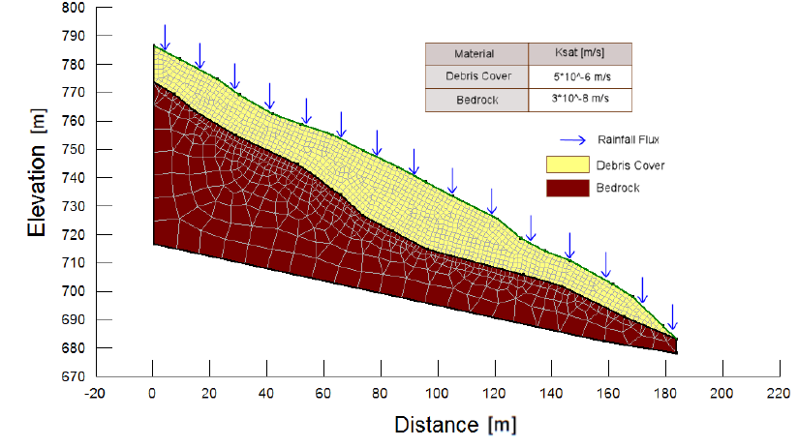

DESIGN FUNDMENTAL
SLOPE STABILITY
Purpose: Ensures structural integrity of the embankment and foundation under both static and dynamic (seismic) conditions.
Key Focus: Maintaining an adequate factor of safety at every single raise stage throughout the facility's lifecycle.

Slide 7
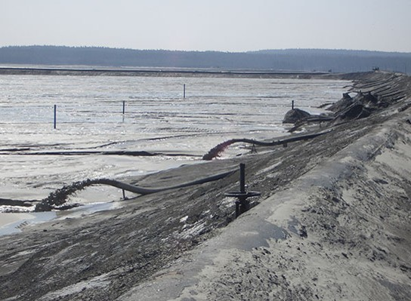
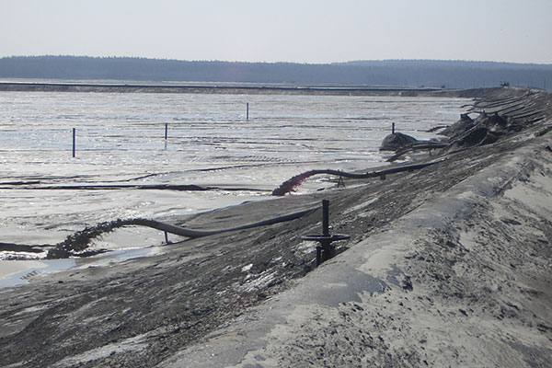
DESIGN FUNDMENTAL
Deposition Method
Purpose: Determines how tailings are placed within the facility based on site-specific climate, topography, and material rheology.
Key Options: Sub-aerial, thickened, paste, or filtered (dry-stack) tailings placement.

Slide 8
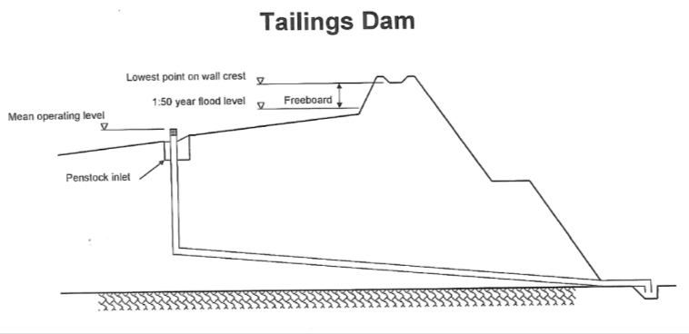

DESIGN FUNDMENTAL
Water Balance & Freeboard
Purpose: Manages incoming water and storage capacity to prevent catastrophic overtopping.
Key Focus: Rigorously sized against extreme weather events like the Probable Maximum Flood (PMF) to ensure the pond never exceeds crest levels.

Slide 9
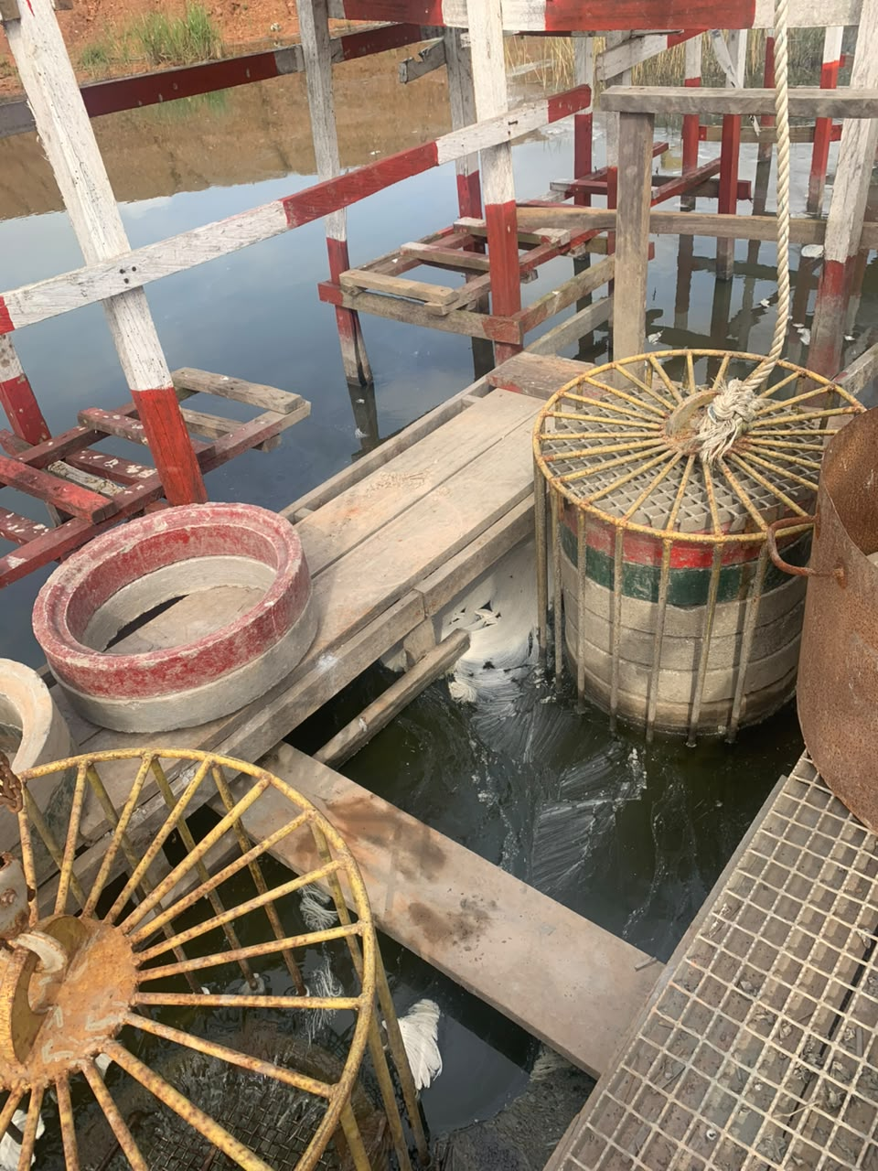

DESIGN FUNDMENTAL
Decant & Return Water
Systems to recover supernatant water from the TSF Dam back to the plant.
Penstock and seepage pond are mostly the systems used for decanting water from TSF to Plant.

Slide 10
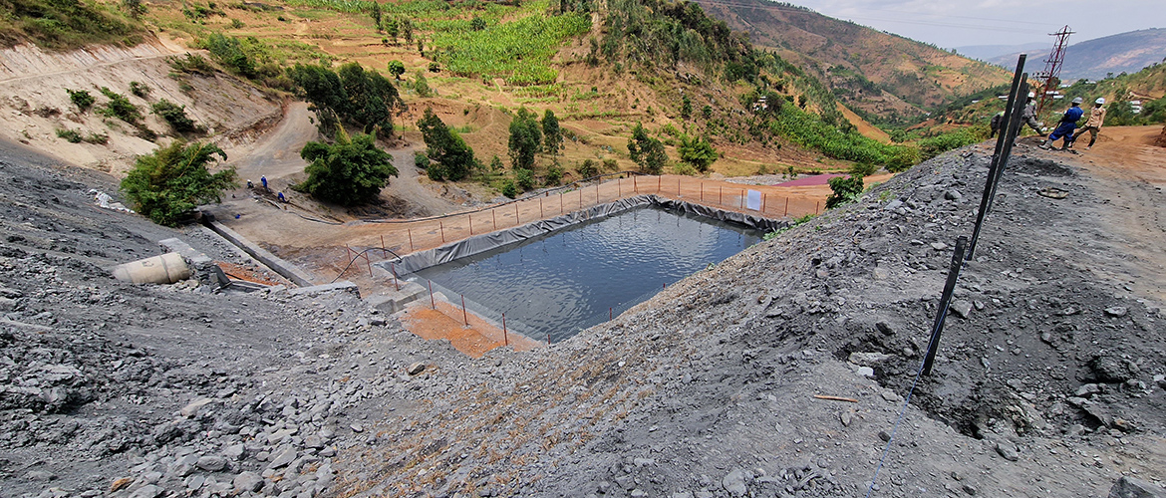

DESIGN FUNDMENTAL
Seepage Control
Purpose: Manages internal phreatic water and prevents internal erosion (piping).
Key Mechanisms: Engineered liners, cut-off walls, and underdrains to capture and redirect migrating water.

Slide 11
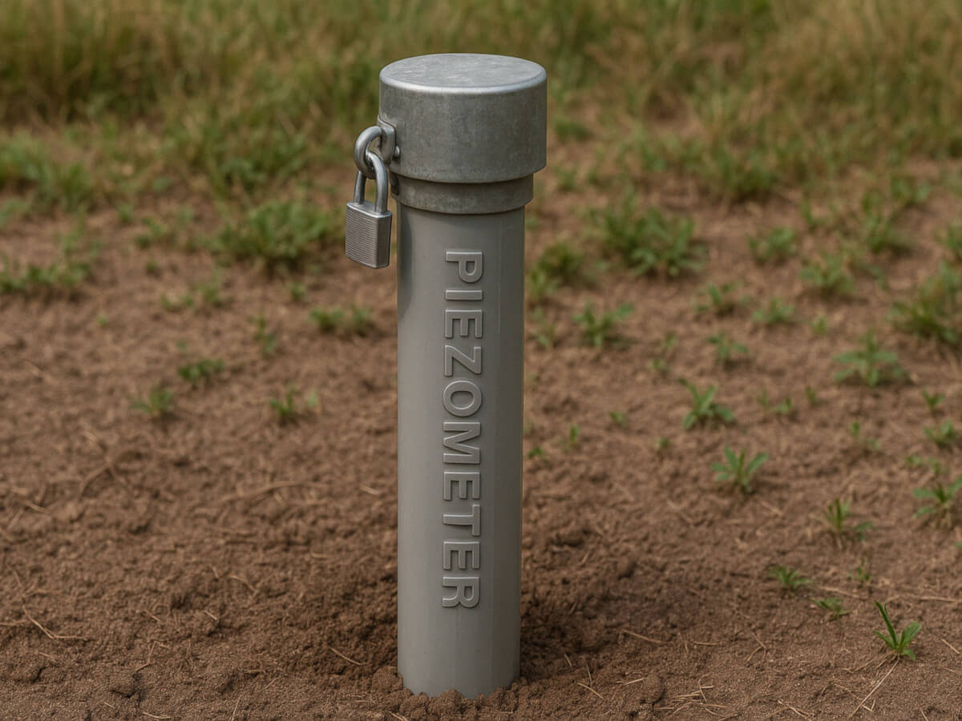

DESIGN FUNDMENTAL
Instrumentation
Installation of Piezometers to check the Phreatic surface.
Installation inclinometers to monitor lateral deformation
Installation of survey monuments to track surface movement, displacement and settlement of TSF in real time.

Slide 12
ENVIRONMENTAL & REGULATORY REQUIREMENTS
Environmental & Social Impact Assessment:
Required before construction; sets baseline conditions and monitoring commitments.
Global Industry Standard on Tailings Management (GISTM)
Consequence-based requirements co-developed by ICMM, UNEP and PRI after Brumadinho.
National permits & water discharge limits
Mining and environmental agencies license construction, operation and closure.
Community consultation
Engagement with, and consent from, communities in the potential inundation footprint.
Independent Tailings Review Board
External experts review design, construction and safety independent of the operator.
07

Slide 13
CLOSURE & REHABILITATION
Progressive Closure: Capping and re-vegetating completed sections while the facility is still operating, rather than waiting until the end.
Cover & Capping Systems: Erosion-resistant covers limit rainfall infiltration, oxidation and acid rock drainage from sulphide tailings.
Re-vegetation & Land Use: Native species and agreed post-mining land use restore ecological and community value.
Long-Term Monitoring: Piezometers and surface monuments continue reading after closure until 'walk-away' stability is demonstrated.
Financial Provision: A closure bond or trust fund guarantees care continues even if the operator exits.
09

Slide 14
CASE STUDY IN BRUMADINHO DAM I, BRAZIL
270
9.7 Mm³
86 m
1976–2019
lives lost
tailings released
dam height
years in service
What happened
Design lessons
Dam was built using the upstream method and raised in stages from 1976. Tailings deposition stopped in 2016, but the dam failed three years later. Researchers attribute the delayed collapse to slow internal creep that grew a slip surface through weak, saturated tailings layers until it reached a critical length and the whole structure gave way suddenly.
Upstream-raised embankments carry the highest inherent risk and are now banned or restricted in several jurisdictions
Internal drainage and monitoring must continue well after deposition ends, not just during active operation
Independent review and transparent hazard classification catch risks an operator alone may under-report
The disaster directly led to the 2020 Global Industry Standard on Tailings Management (GISTM)
10

Slide 15
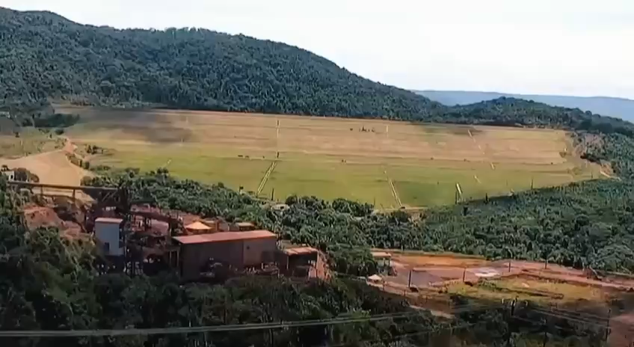
CASE STUDY IN BRUMADINHO DAM I, BRAZIL

Slide 16
CONCLUSION
TSF design is a continuous discipline: siting, engineering, environmental compliance, construction, operation and closure are one integrated life-cycle, not separate stages
Foundation geology, water management and construction method (upstream, downstream, centerline or dry-stack) set the inherent risk of the facility
Instrumentation, independent review and emergency planning turn a design into a safe, operating facility
History from Brumadinho to earlier failures shows that cutting corners in design or oversight has catastrophic, irreversible consequences
Global standards such as GISTM now push the industry toward zero-harm tailings management

