Slide 1
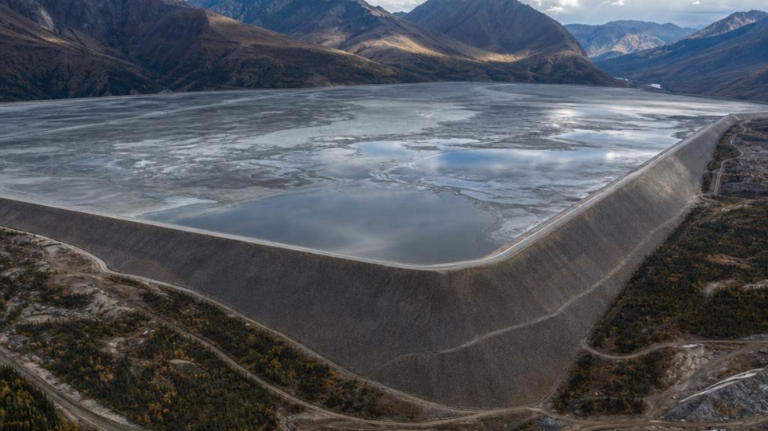


ADVANCED ENGINEERING GEOLOGY — GED 452
Construction of Tailings Dams
Engineering Design Principles, Sequential Embankment Raising Methods, and Geotechnical Risk Management
Advanced Mining Geotechnics
Technical Monograph

Slide 2

Engineering Principles
Fundamental characteristics of mining waste slurries, starter embankment foundations, and hydraulic deposition dynamics.

Slide 3
Tailings & Starter Dam Design
Tailings Slurry Characteristics
Starter Embankment Structure
Tailings consist of fine-grained mineral process residue mixed with water. Unlike water-retention dams, tailings facilities store crushed rock particles ranging from coarse sands to ultra-fine clays with variable hydraulic conductivity and liquefaction susceptibility.
The initial starter dam is constructed on competent bedrock or engineered foundations using compacted rockfill or earth fill. It provides initial containment for decant pond formation and establishes the hydraulic drainage boundary for sequential raises.

Slide 4

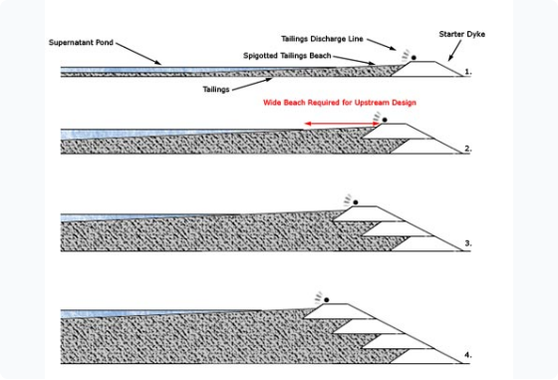
Upstream Construction Method
Sequential Sub-Upstream Raises
The upstream method begins with a starter dike, after which tailings slurry is spigotted along the inner crest to form a beach.
Successive dike raises are constructed directly step-wise over the previously deposited, consolidated tailings beach.
While exceptionally cost-effective and requiring minimal borrow fill, it exhibits high sensitivity to rapid raise rates, high water tables, and seismic liquefaction.

Slide 5
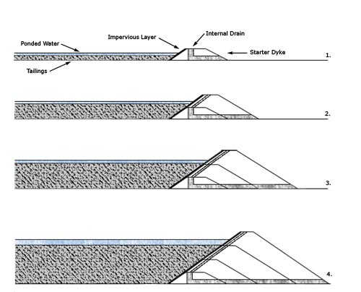
Downstream Construction Method
High Structural Stability
Downstream dams are sequentially raised away from the impoundment, with each new raise founded entirely on compacted structural fill or coarse tailings sand downstream of the starter crest.
This design allows the inclusion of internal sand-gravel filters, low-permeability cores, and toe drain systems, rendering it resilient against extreme seismic shaking and storm events.

Slide 6








Centerline Construction Method
Vertical Wall Raising
Cyclone Sand Separation
Moderate Seismic Resistance
The dam axis remains constant as sequential raises are placed directly above the starter dam centerline, balancing material usage and stability.
Coarse sand fractions separated via hydrocyclones are placed on the downstream slope, while fine slime tailings flow into the upstream pond.
Offers significantly greater resistance to static and dynamic liquefaction than upstream designs with smaller physical footprint than downstream dams.

Slide 7


Phreatic Surface & Seepage
Piezometric Level Control
1.50
Internal seepage management is the single most critical factor in slope stability. The phreatic line must be kept deep within the embankment shell.
High pore-water pressures reduce effective normal stress along potential slip surfaces, leading to slope failure or piping erosion. Basal blanket drains and chimney drains are installed to safely discharge seepage water.
Minimum Factor of Safety (FoS)

Slide 8
Instrumentation & Monitoring
Vibrating Wire Piezometers: Installed at multiple vertical and horizontal grid points to provide real-time monitoring of internal pore water pressures and water table elevations.
Inclinometers & Extensometers: Measure lateral subsurface deformation and settlement within the embankment zones to detect early creep or shearing signs.
InSAR & GNSS Automated Surveys: Millimeter-accurate satellite radar interferometry and continuous GPS station arrays track surface movement across the entire impoundment.
Seepage Flow Weirs: V-notch flumes measure turbidity and volumetric flow rate of drained water to verify filter integrity and catch piping piping early.

Slide 9

Comparison of Raise Methods
Design Criterion | Upstream Method | Centerline Method | Downstream Method
Fill Volume Needed | Very Low (Most Economical) | Moderate | High (Largest Footprint)
Seismic Liquefaction Risk | High / Vulnerable | Moderate Resistance | Very Low / High Resistance
Water Storage Capacity | Poor (Requires wide beach) | Fair | Excellent (Can retain pond)
Rate of Raise Constraint | Slow (Requires drying time) | Moderate | Flexible / Fast
Regulatory Acceptance | Banned in many jurisdictions | Conditional Approval | Widely Accepted Globally

Slide 10






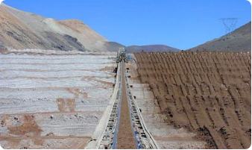
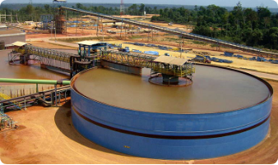
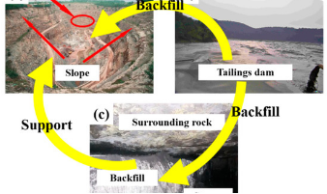
Alternative Tailings Storage
Filtered / Dry Stack
Thickened / Paste Tailings
In-Pit Backfilling
Mechanical vacuum or pressure filtration reduces moisture content below 20%, allowing non-slurry dry stacking without retaining dams.
High-rate thickeners dewater slurries to a non-segregating paste consistency, reducing free water and footprint area.
Deposition directly into exhausted open pit voids or underground stopes, eliminating surface dam structures entirely.

Slide 11

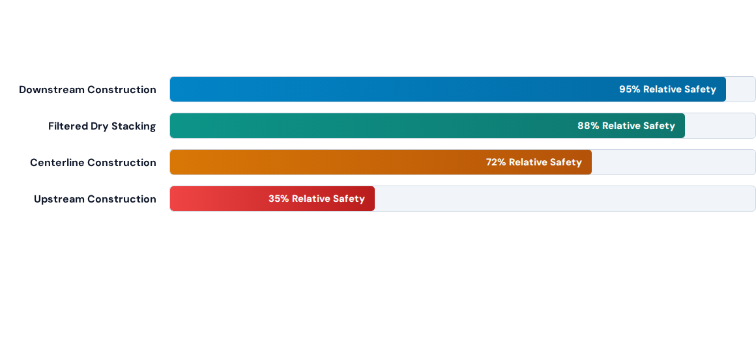
Stability & Seismic Safety

Slide 12

Questions & Discussion
Global Industry Standard on Tailings Management (GTRM) Compliance & Best Practices

Slide 13





Image Sources
https://www.tailings.info/images/assets/content/upstream.jpg
Source: www.tailings.info
https://live.staticflickr.com/4538/24553044818_4fd925ee56_o.jpg
Source: www.grida.no
https://www.tailings.info/images/assets/content/bigdrystack.jpg
Source: www.tailings.info
https://www.westechwater.com/hs-fs/hubfs/image/page/case-study/hidensity-paste-thickener-paragominas-brazil/hidensity-paste-thickener-at-paragominas-brazil-768w.jpg?noresize&width=768&height=480&name=hidensity-paste-thickener-at-paragominas-brazil-768w.jpg
Source: www.westechwater.com
https://www.mdpi.com/minerals/minerals-11-00818/article_deploy/html/images/minerals-11-00818-g001-550.jpg
Source: www.mdpi.com

