Slide 1
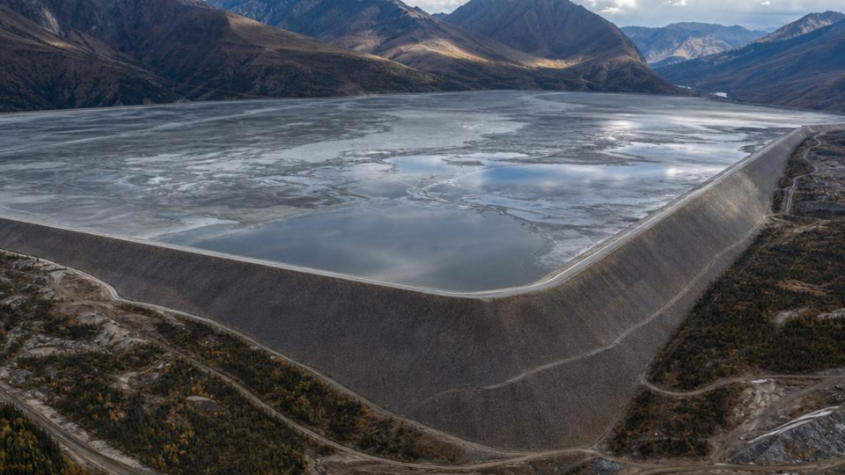

Tailings Dam Monitoring
ADVANCED ENGINEERING GEOLOGY — GED 452
Ensuring Structural Stability and Environmental Safety

Slide 2

Presentation Outline
Introduction to Tailing Dams
Standard Monitoring Methods
Monitoring Instrumentation
Advantages & Disadvantages
Why Monitoring Matters
Core Monitoring Objectives
Failure Modes Guarded Against
Conclusion

Slide 3
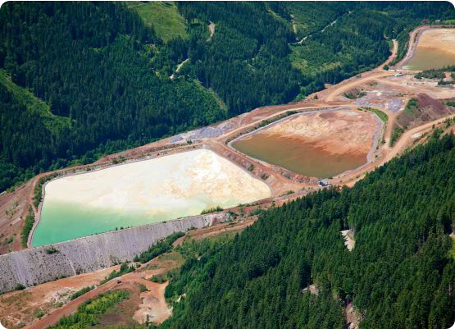
Introduction to Tailings Dams
A specialized earth-fill embankment dam built to store the
leftover materials (tailings) and water from mining operation.
The primary purpose of monitoring is to ensure structural stability and prevent catastrophic breaches.
Constant oversight ensures that contaminated water and heavy metals do not escape into the surrounding ecosystem.

Slide 4








Standard Monitoring Methods
Visual Inspections
Engineers physically walk the site looking for early warning signs like cracks, bulging walls or unexpected wet spots on the dam embankment.
Groundwater Logging
Utilizing boreholes around the site to perform regular water sampling, checking if contaminated seepage is reaching local groundwater networks.
Physical Surveying
Using piezometers to check internal water pressure, and survey monuments to measure if the dam structure is physically shifting over time.

Slide 5








Key Monitoring Instrumentation
Piezometers
Installed deep within the earth-fill embankment to continuously measure internal pore water pressure and soil saturation levels.
Survey Monuments
Fixed, physical markers anchored into the dam surface used by surveyors to detect millimeter-level structural shifting or slumping.
Monitoring Boreholes
Drilled around the facility perimeter to take regular water quality samples and monitor the local water table for chemical leaks.

Slide 6



Standard Monitoring Assessment
Advantages
Proven and well-established industry standard.
High point specific accuracy for key structural areas.
Direct physical measurement confirms theoretical models.
Establishes fundamental baseline data for long-term study.
Relatively low initial equipment cost compared to sensors.
Disadvantages
Highly labor intensive process requiring field teams.
Provides point specific data, which may miss broader issues.
Susceptible to human error during manual readings.
Can result in a delayed warning signal during sudden events.

Slide 7

Why Monitoring Matters
Tailings storage facilities rank among the highest
consequence structures in mining operations.
Unlike water dams, they are raised in stages over decades, often while operating, meaning risk conditions evolve continuously and monitoring must keep pace.
A failure releases stored tailings and process water downstream, impacting communities, waterways and ecosystems often irreversibly.

Slide 8






Core Monitoring Objectives
Verify Design Assumptions
Detect Early Warnings
Identify active trends, not just single readings, that indicate a developing failure mechanism before it becomes visible at surface.
Regulatory Compliance
Provide the structured, auditable data trail routinely required by regulators, insurers and independent review boards.
Confirm that pore pressures, seepage rates and deformation remain strictly within the ranges the design originally anticipated.

Slide 9







Failure Modes Guarded Against
OVERTOPPING
Pond level rises above freeboard during extreme storms or blocked spillways, allowing water to flow over the crest.
SEEPAGE AND PIPING
Uncontrolled internal seepage erodes fines from within the embankment, forming channels that can progress to internal collapse.
SLOPE INSTABILITY
Shear strength is exceeded along a slip surface, causing slumping or a rotational slope failure of the embankment.
STATIC/SEISMIC LIQUEFACTION
Loose, saturated tailings lose strength under static loading or earthquake shaking and flow as a fluid.

Slide 10

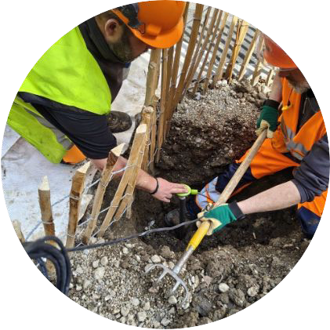
Conclusion
Even with the rise of modern remote sensing
technology, standard monitoring techniques like piezometers, physical surveying and groundwater logging remain the structural backbone of tailings dam safety.
Checking these reliable instruments regularly is what prevents small leaks from developing into catastrophic failure.

Slide 11
Questions?
Thank you for your time and attention.

Slide 12


Image Sources
https://image.kkday.com/v2/image/get/c_fill%2Cq_55%2Ct_webp%2Cw_960/s1.kkday.com/product_261463/20250327080921_btb8y/jpg
Source: www.kkday.com
https://images.squarespace-cdn.com/content/v1/5c80d350ab1a62362b81c9d1/1782130453075-HXDD3FHUZUSMC439V49Y/1775128257337.jpg?format=1000w
Source: www.decentlab.com

