Slide 1
INDUSTRIAL TRAINING PRESENTATION HYDROHOPE DRILLING AND CONSTRUCTION SERVICES

Slide 2
OUTLINE
INTRODUCTION
SITE ASSESSMENT AND HAZARD CLEARANCE.
STEPS INVOLVED IN GROUNDWATER EXPLOITATION
GEOPHYSICAL SURVEY
HOW WE USED THE ADMT FOR SURVEYING
BOREHOLE DRILLING
GRAVEL PACKING AND GROUTING
BOREHOLE DEVELOPMENT
PUMP INSTALLATION
CONCLUSIONS

Slide 3
INTRODUCTION
Groundwater is the water present beneath Earth's surface in rock and soil pore spaces and in the fractures of rock formations. About 30 percent of all readily available fresh water in the world is groundwater.
The exploration for water requires several important steps to get adequate and portable water for consumption and other domestic uses.

Slide 4
SITE ASSESSMENT AND HAZARD CLEARANCE.
Contamination Control
Identified potential sources of contamination
Maintained minimum 30 m distance from septic tanks and soakaways
Prevented leachate infiltration into groundwater (aquifer protection)
Hazard Identification
Checked for high-tension power lines (pylons)
Located underground utilities (pipes, cables, etc.)

Slide 5
STEPS INVOLVED IN GROUNDWATER EXPLOITATION
Geophysical Survey
Borehole Drilling
Construction
Gravel Packing
Development
Pump installation

Slide 6
GEOPHYSICAL SURVEY
Geophysical techniques are non-invasive technologies that measure the variations in the physical characteristics of the surface and subsurface geology, either NATURAL OR ARTIFICIAL, generated within the Earth’s crust.
METHODOLOGY
There are various methods used in conducting a geophysical survey. These include the Electrical Resistivity method, the Magnetic/Electromagnetic method, and the Seismic Method.
Out of the afore-mentioned methods, the Electrical Resistivity method using ADMT is mostly employed by this company.

Slide 7
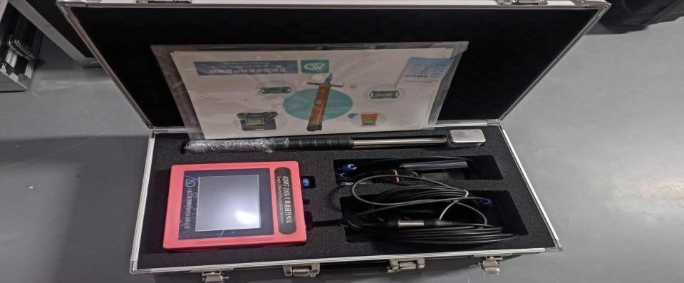
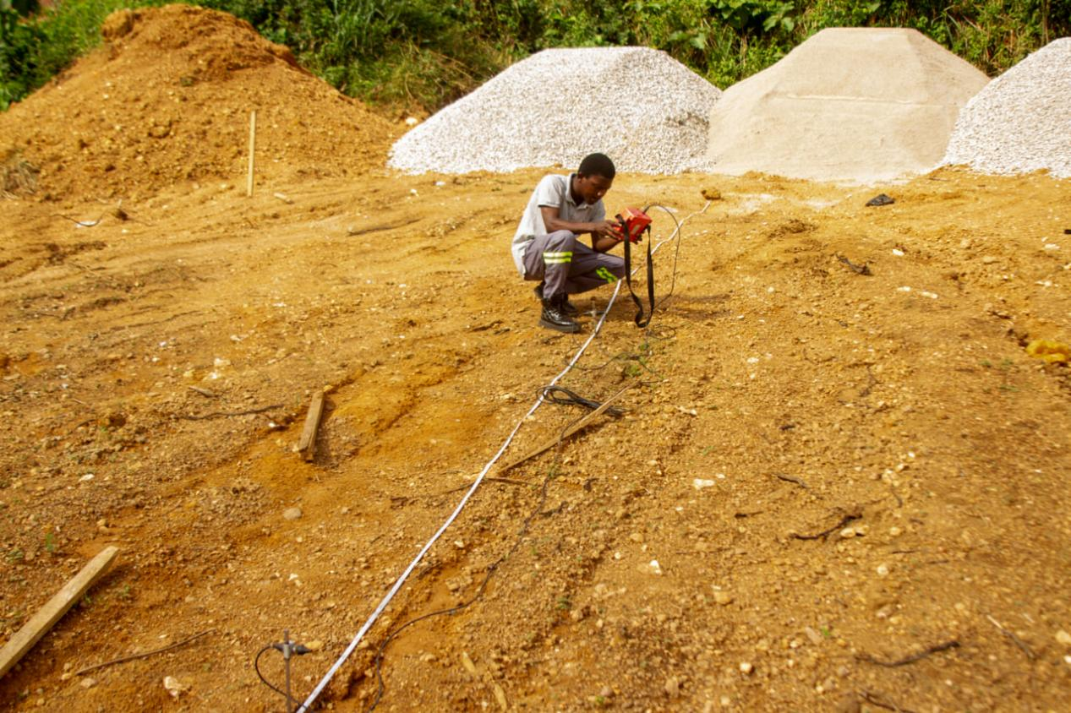
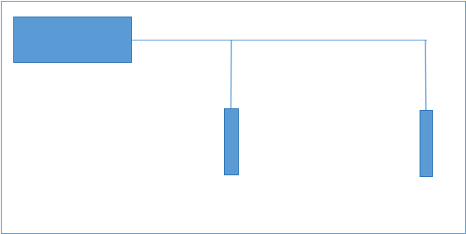

HOW WE USED THE ADMT FOR SURVEYING
The ADMT-200S-Y water detector was used for the Groundwater prospecting.
The midpoint between the two electrodes was measured.
After each reading, the electrodes were moved equidistantly in the same direction until the entire profile measurement was completed
MAINFRAM
M

Slide 8
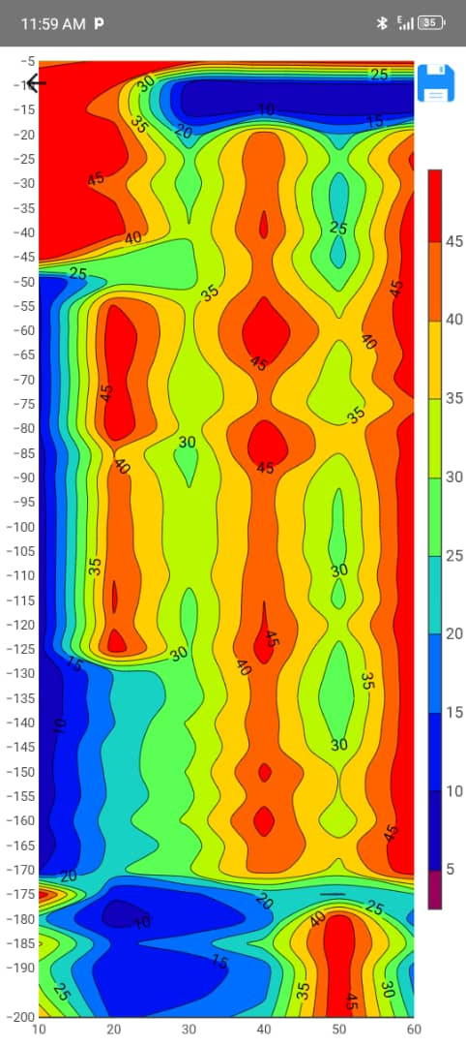
Interpretation of Data From the ADMT water detector
The data collected by the instrument is processed by Aidu Intelligent Data Processing Software and presented in a contour map form where inference can be made of the position, width and judgement depth of geological anomalies.
The results, which are presented in the contour map, are shown in the appendix, where the abscissa indicates the measuring point number, the ordinate indicates the depth, the green area is the aquifer zones, and the blue area is the low resistivity area.

Slide 9
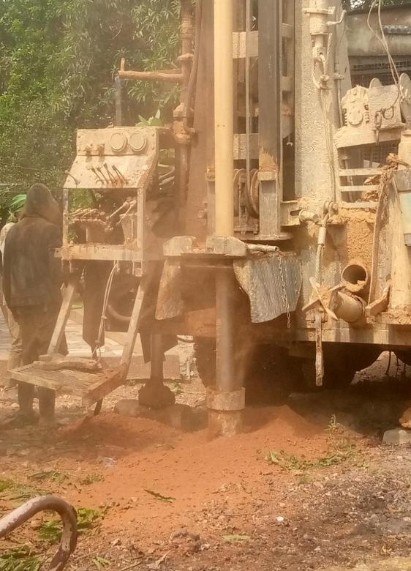
BOREHOLE DRILLING
A JCR DTH water well rig was used for the drilling works.
For 125 mm casing, a 300 mm hole was drilled using an insert bit with air or mud flush to the partially weathered rock.
A 250 mm steel temporary surface casing was installed to hold back the overburden.
A nominal 175 mm (7-inch) hole Through underlying rock to the final depth using an air down-the-hole hammer button bit, sometimes with water injected into the air circulation during drilling.

Slide 10
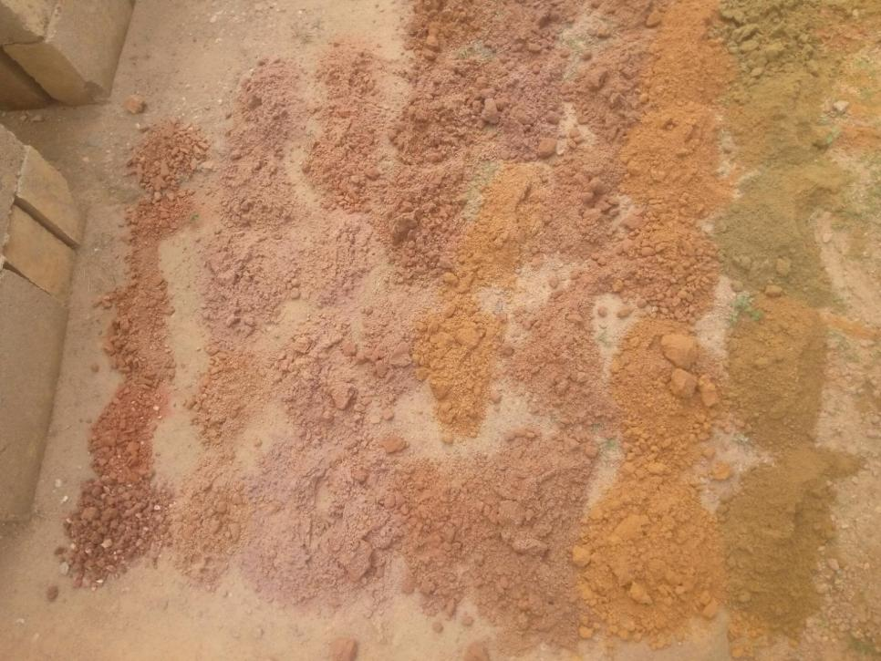
LOGGING AND SAMPLE COLLECTION
LOGGED SAMPLES ON FIELD
Well logging also known as borehole logging, is the practice of making a detailed record of the geology formation penetrated by a borehole.
Drilling was stopped when sufficient water.

Slide 11
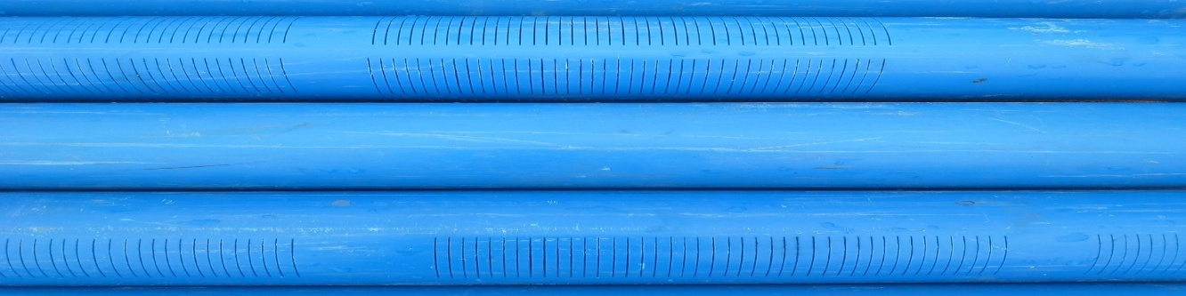
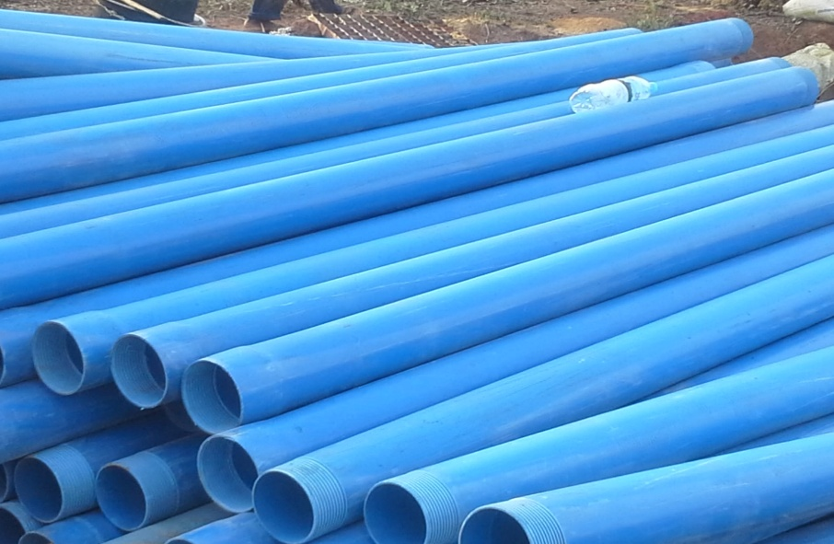
BOREHOLE CONSTRUCTION
Screens
Borehole construction was carried out after the successful completion of drilling and casing operations to convert the drilled hole into a stable and functional groundwater abstraction structure
The construction process involved the installation of casing and screens, placement of gravel pack, and well head completion to ensure structural integrity, efficient water inflow, and protection against contamination
Plains

Slide 12
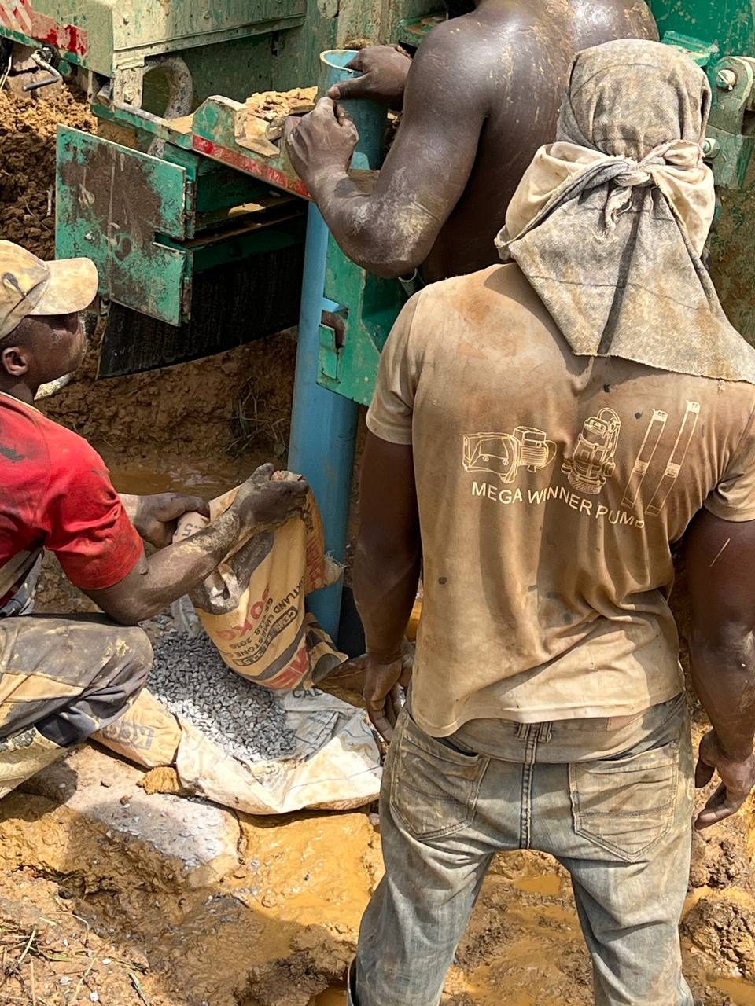
GRAVEL PACKING AND GROUTING
A well-graded gravel pack was placed in the annular space between the borehole wall and the screened sections of the casing.
The gravel pack served as a filter to prevent fine formation materials from entering the borehole while improving groundwater flow into the screens.
After the gravel packing, the borehole head was completed with the construction of a concrete apron sloped away from the borehole to allow proper drainage of surface water.

Slide 13
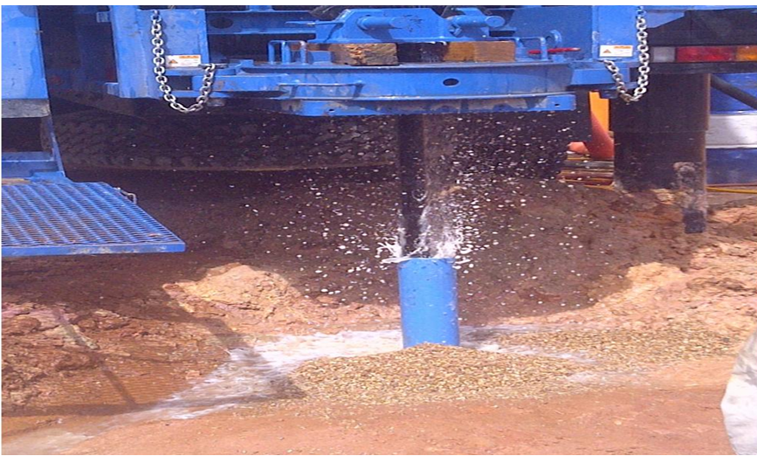
BOREHOLE DEVELOPMENT
Air Lifting (or Pumping)
Use compressed air or a pump to blow/lift dirty water out.
Continue until the water becomes clear.
Flush out drilling mud, cuttings, and fine particles from the borehole.
This helps open the aquifer around the screen.
Move water up and down in the borehole using a surge block or plunger.
This loosens fine materials around the screen.

Slide 14
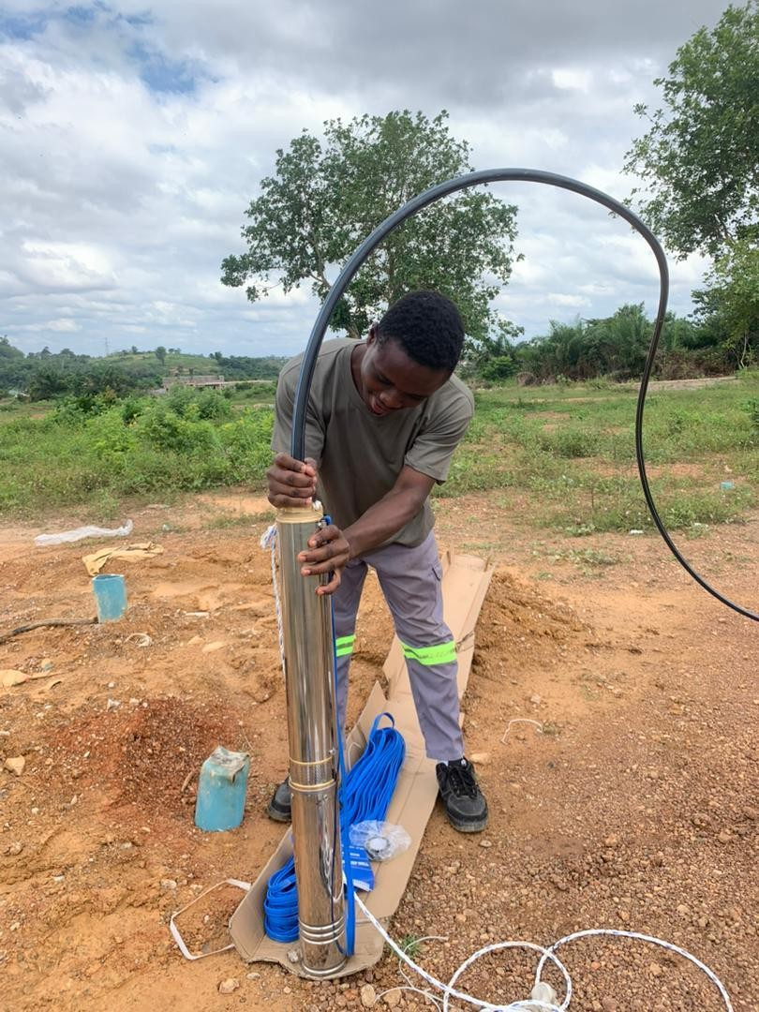
PUMP INSTALLATION
Installed a stainless steel submersible pump based on hydraulic data and recharge rate
Pump was sized according to the sustainable yield of the aquifer to prevent over-pumping and structural damage
Connected with high-pressure pipes and submerged at a calculated depth to ensure continuous operation
Installed wellhead cap to prevent contamination
Integrated control panel to regulate operation and protect against electrical surges

Slide 15
BOREHOLE CAPPING
Install Well Cap
Fix a tight-fitting sanitary well cap on the casing.
Construct Concrete Apron
Build a concrete slab around the borehole.
The slab should slope outward to drain water away.
Provide Drainage Channel
Construct a small channel to carry wastewater away.
Seal the Annular Space
Use cement grout to seal the space between casing and borehole wall.
Install Lock (if needed)
Lock the cap for security.

Slide 16
CONCLUSIONS
Exposure to groundwater exploration and borehole development processes
Significance of health, safety, and environmental practices during field operations.
Improved technical competence in the use of geophysical equipment.

Slide 17
RECOMMENDATIONS
Conduct mandatory geophysical surveys before drilling for better site selection
Maintain detailed and systematic logging records
Ensure continuous Health, Safety, and Environmental (HSE) training
Perform pumping test analysis after borehole completion to:
Evaluate aquifer performance.
Determine sustainable yield.
Support groundwater management.

Slide 18
THANK YOU

